Slide 1
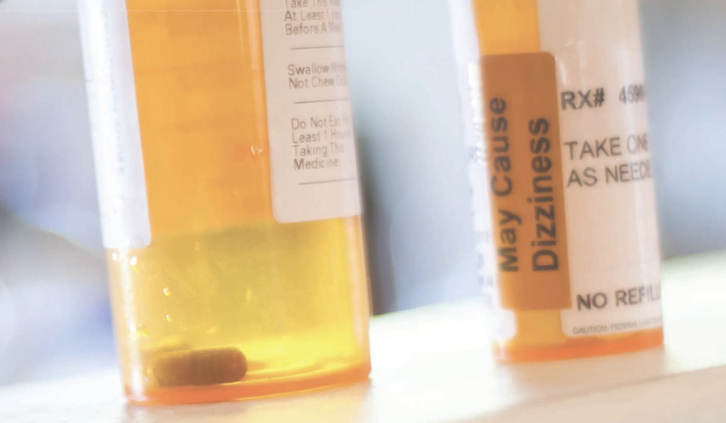
WORKERS COMPENSATION and PRESCRIPTION NARCOTICS
Dr. J. Tobias Musser
Shepherd Center
Shepherd Spine and Pain Institute

Slide 2
GENERAL THOUGHTS & COMMENTS FOR WC PAIN MANAGEMENT
Lack of required:
  Risk stratification measures
  Outcome measures
  WC-specific physcian education
Comparison of “Pain Management and Psychologic Treatment” in WC
  Psychological profiling, screening, and treatment

Slide 3
WORKERS COMPENSATION AND PRESCRIPTION DRUGS:
The major topics that COULD be discussed are:
The estimated annual prescription drug share of WC medical costs
The impact of price and utilization changes on prescription drug costs
Potential prescription drug cost savings from a State-drug formulary
Physician dispensing
Brand name and generic drugs
Compounded pain (topical) medications
Controlled substances
Comorbidities in WC claim

Slide 4
WORKERS COMPENSATION AND PRESCRIPTION DRUGS:
Prescription drug (Rx) costs represent a significant portion of workers compensation (WC) medical costs and is one of the most active subjects of WC‐related legislative activity.
NCCI estimates that for every $100 paid for medical services provided to workers injured in 2014, $17 will be paid for prescription drugs.
Furthermore, the prescription drugs portion of medical costs increases rapidly as claims age.
For every $100 of medical services paid on claims older than 10 years, approximately $45 to $50 will be for prescription drugs.

Slide 5
WORKERS COMPENSATION AND CONTROLLED SUBSTANCES:
The major topics that COULD be discussed are:
  Who should decided the Rx
  Indication for controlled substances
  State drug formularies
  Duration of treatment
  Assessment of benefit
  Complications
  Long term costs
  Legal issues

Slide 6
WORKERS COMPENSATION AND PRESCRIPTION DRUGS:
Prescription drug costs per active claim continue to grow
The prescription drug share of total medical costs for Accident Year 2014 was 17%
The prescription drug share of total medical costs increases rapidly as claims age
In 2014, prescription drug prices increased 11%—substantially greater than the 10‐year average increase of 4%
In 2014, prescription drug utilization declined by 4%, resulting in growth in prescription drug costs per active claim of 6%
In many states, introduction of a drug formulary has the potential to reduce WC prescription drug costs by 10% or More
In 2014, controlled substances’ prices increased 16%, while utilization decreased 7%
Both physician‐dispensed prescription drug prices and utilization increased 4% in 2014
The share of prescription drug costs for generic drugs increased in 2014

Slide 7
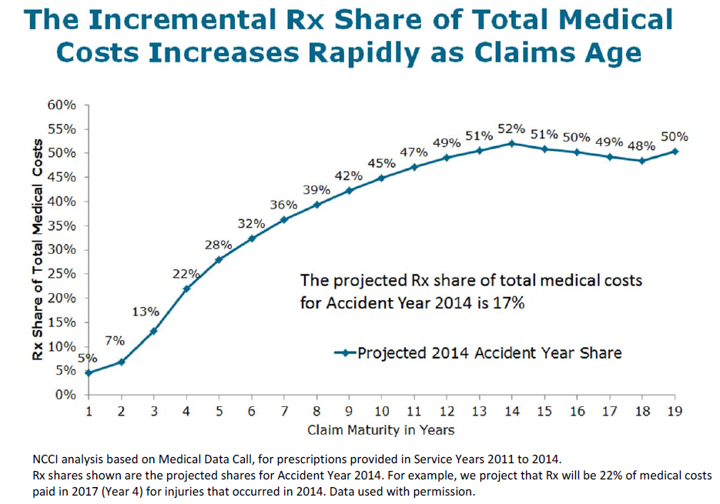
PRESCRIPTION DRUG SHARE OF TOTAL MEDICAL

Slide 8
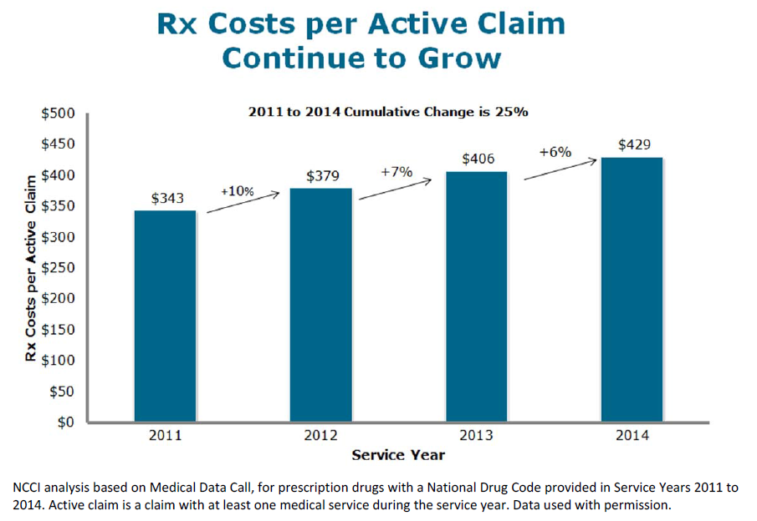
PRESCRIPTION DRUG PRICE, UTILIZATION, AND COSTS:

Slide 9
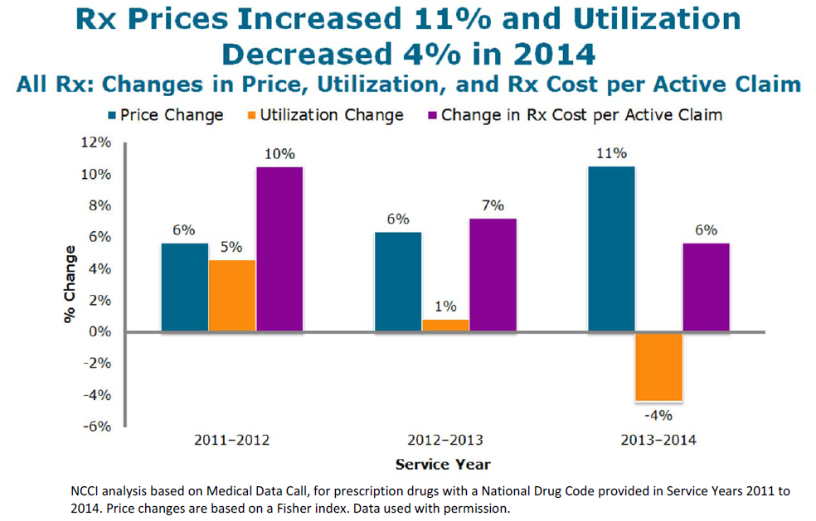

Slide 10
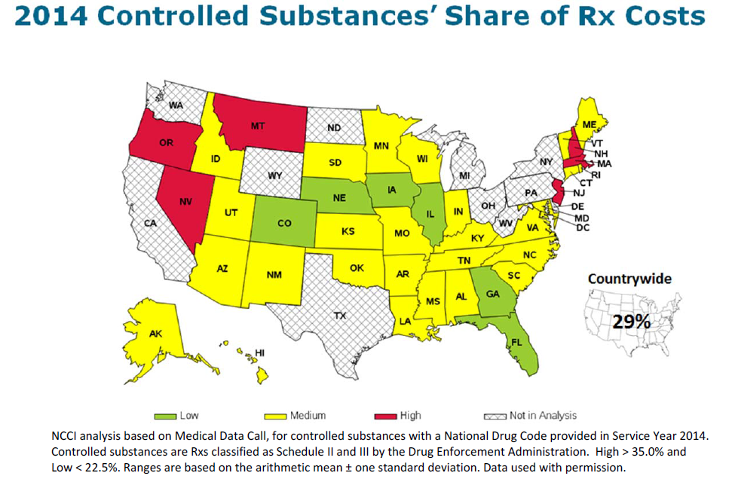

Slide 11
CONTROLLED SUBSTANCES AND WC PRESCRIPTION DRUG COSTS
Controlled substances are a significant share of WC prescription drug costs.
In 2014, the countrywide controlled substances’ share of prescription drug costs was 29%, ranging between 28% and 31%.
The controlled substances’ share of prescription drugs costs has varied substantially by state, ranging from 16% to 41% in 2014.
Controlled substance costs per active claim continue to grow - costs grew 8% in 2014 due to a 16% increase in prices and a 7% decrease in utilization.
Notably, the 2014 decline in utilization marks the second consecutive year of utilization decreases for controlled substances.
The primary drivers of the utilization decreases observed in 2013 and 2014 were declines in both
  (1) the share of active claims receiving a controlled substance
  (2) the number of controlled substances per active claim receiving at least one controlled substance.

Slide 12
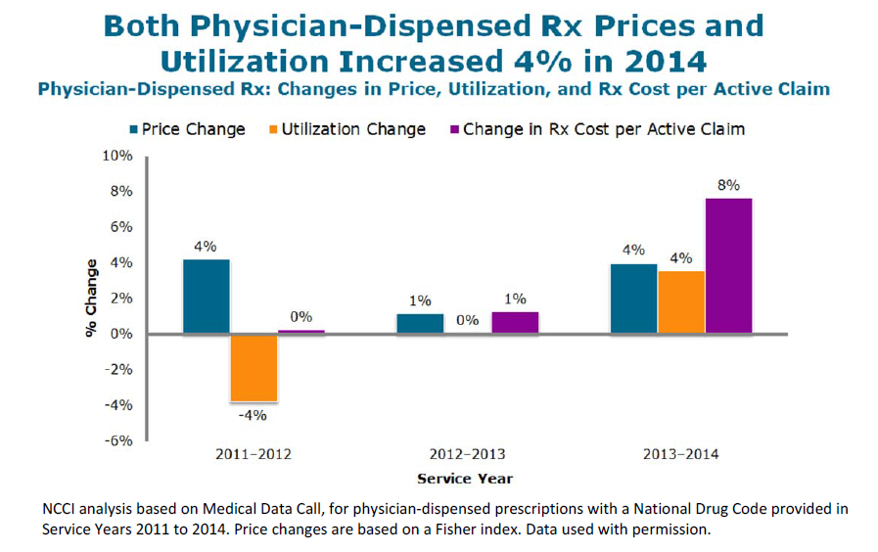

Slide 13
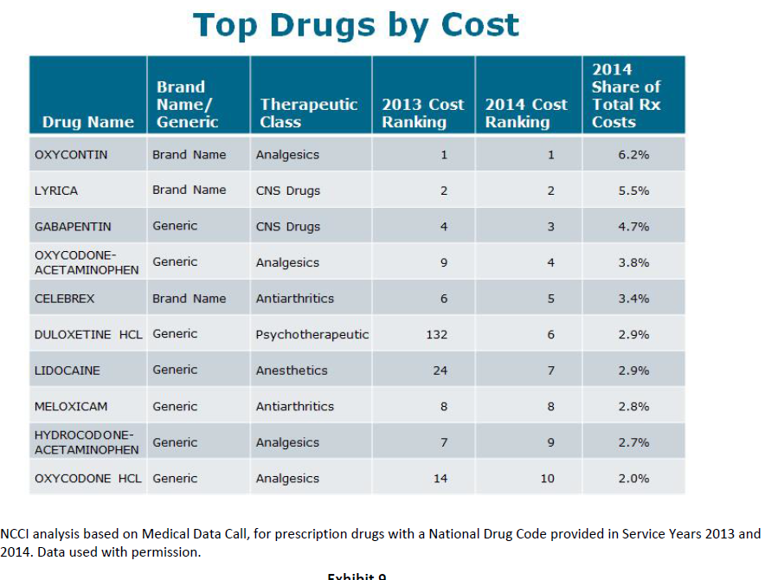

Slide 14
NARCOTICS IN WORKERS COMPENSATION:
Per-claim narcotic costs have increased
There have been changes in which narcotics are most commonly used
Narcotic use is concentrated among a small percentage of claimants
Initial narcotic use is indicative of future use

Slide 15
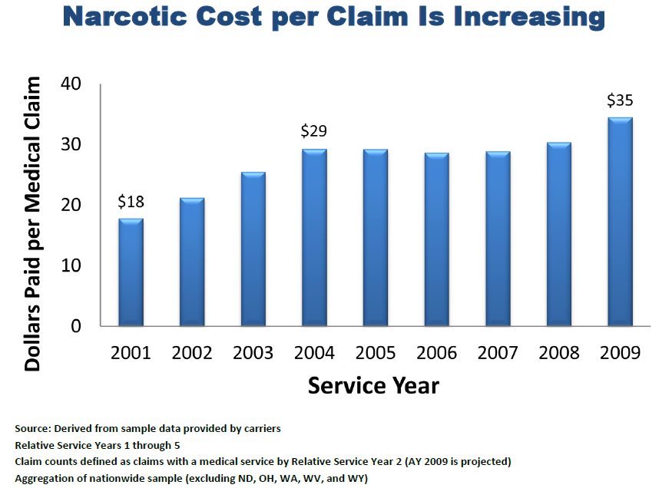

Slide 16
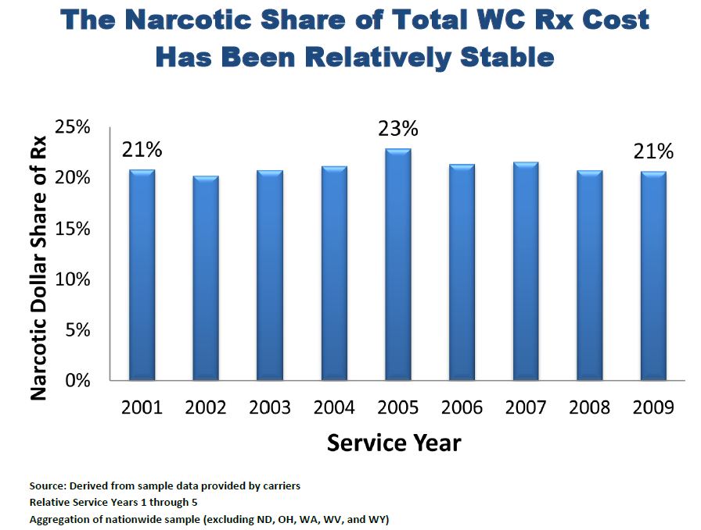

Slide 17
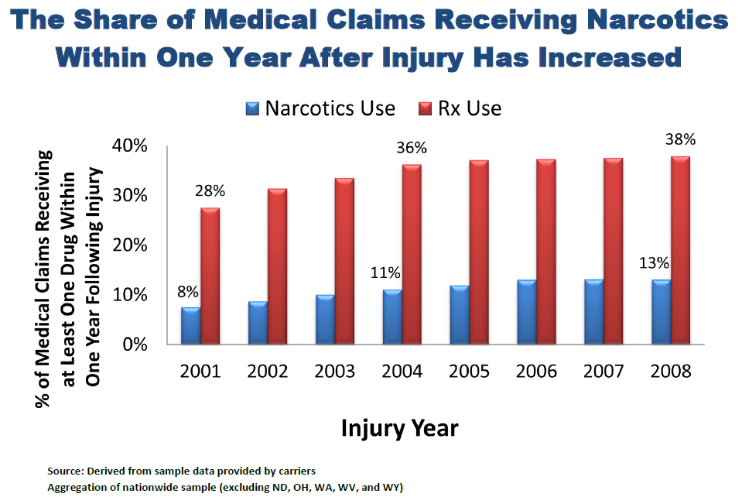

Slide 18
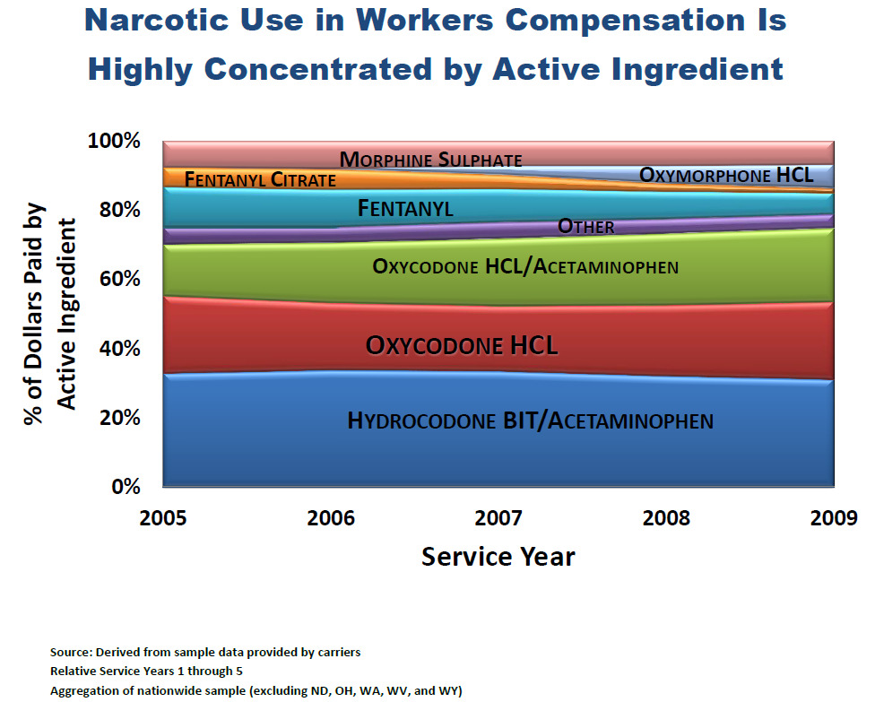

Slide 19
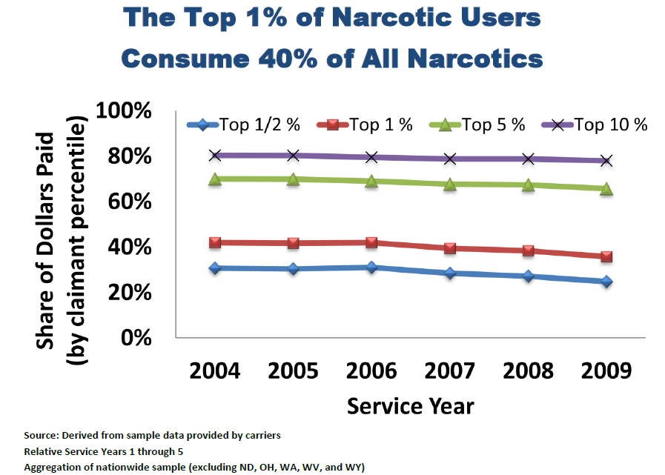

Slide 20
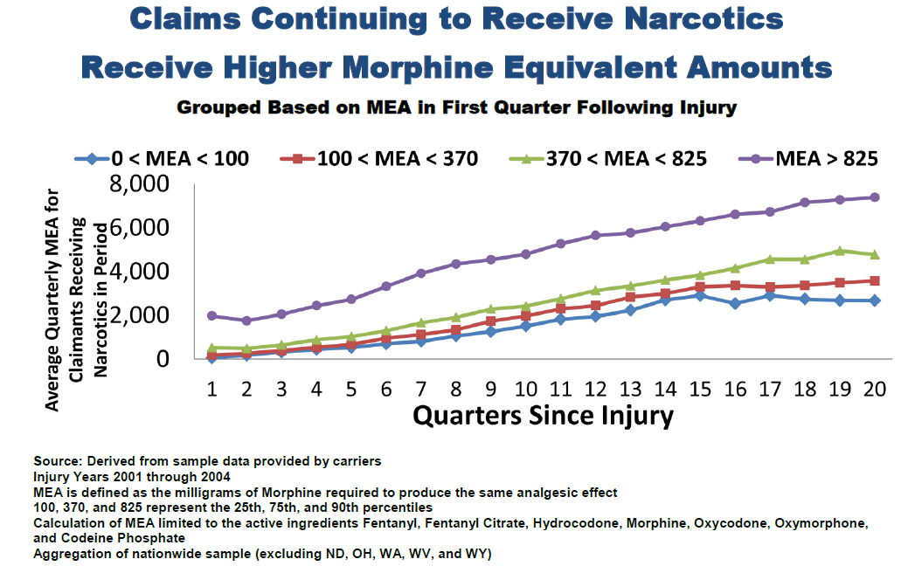

Slide 21
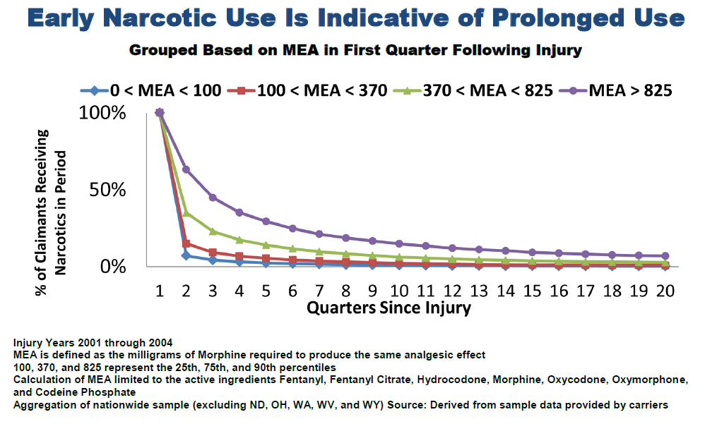

Slide 22
COMORBIDITIES IN WORKERS COMPENSATION:
The share of workers compensation claims with a comorbidity diagnosis nearly tripled from Accident Year1 2000 to Accident Year 2009, growing from a share of 2.4% to 6.6%
Claims with a comorbidity diagnosis have about twice the medical costs of otherwise comparable claims
Comorbidity diagnoses for hypertension are the most prevalent of those investigated
The initial comorbidity diagnosis tends to occur early in the life of a claim
Hospital and physician visits account for a majority of visits resulting in a recorded comorbidity diagnosis
Only a small portion of visits result in the recording of a comorbidity diagnosis

Slide 23
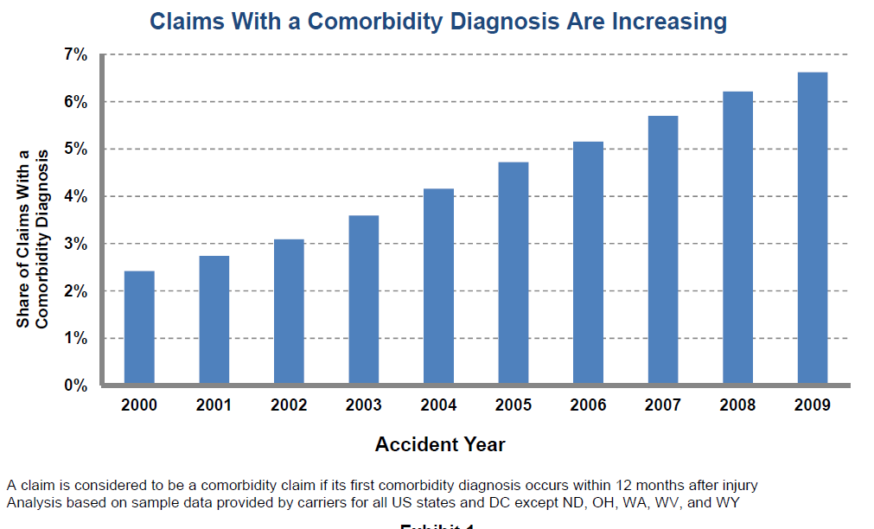

Slide 24
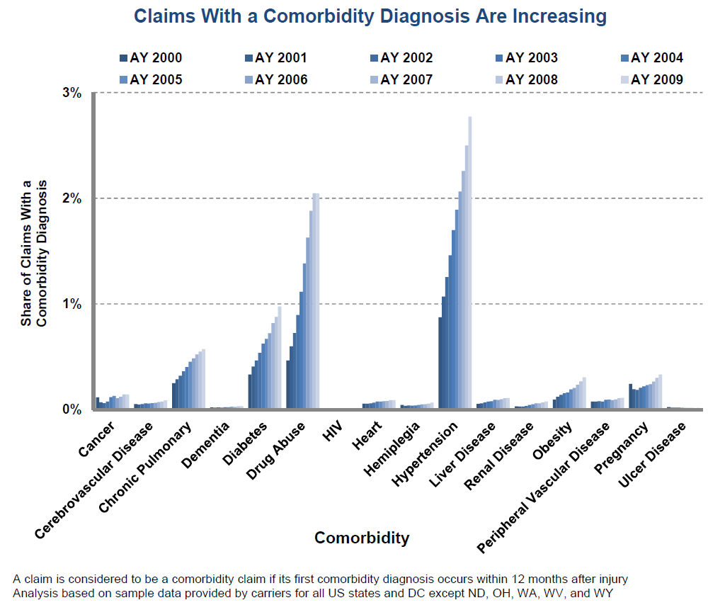

Slide 25
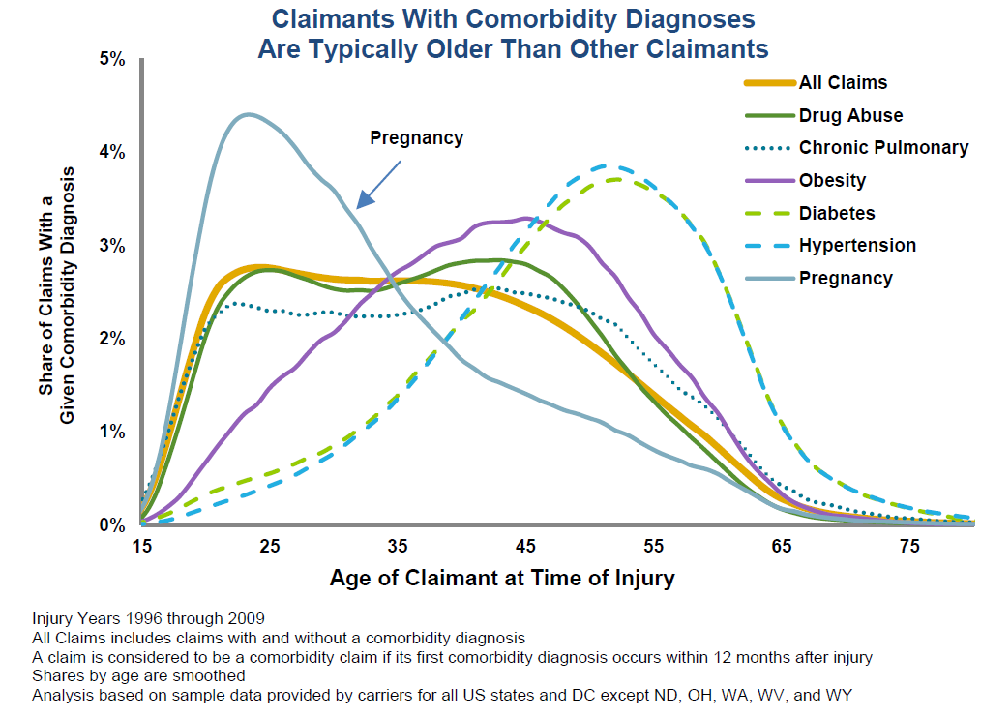

Slide 26
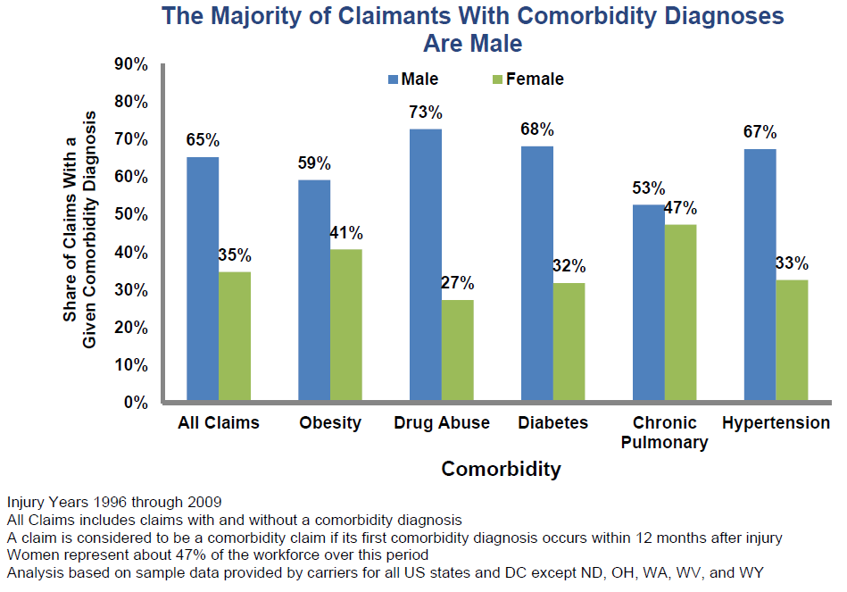

Slide 27
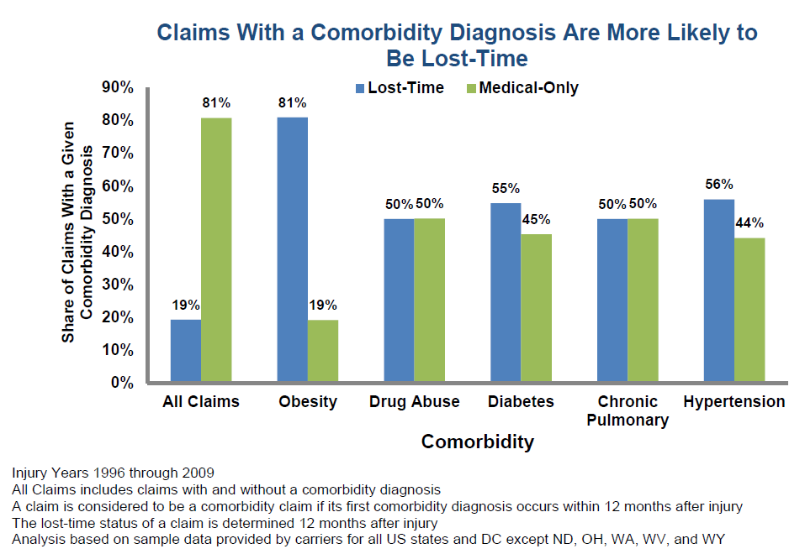

Slide 28
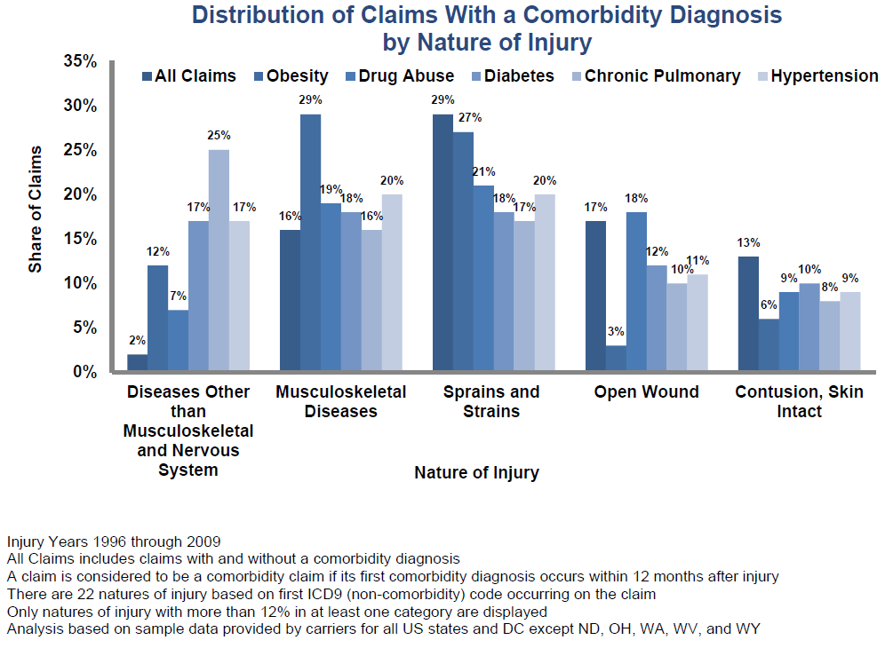

Slide 29
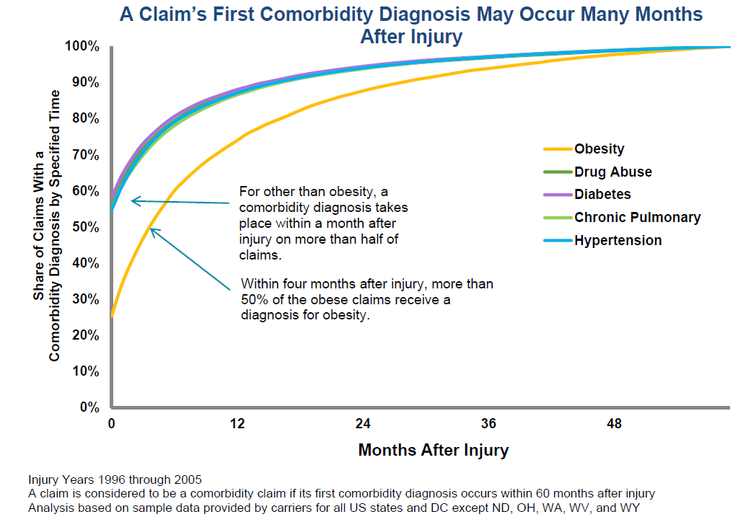

Slide 30
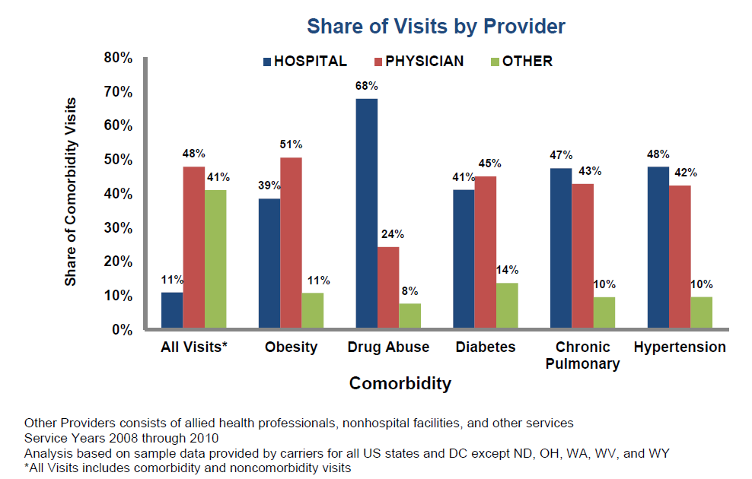

Slide 31
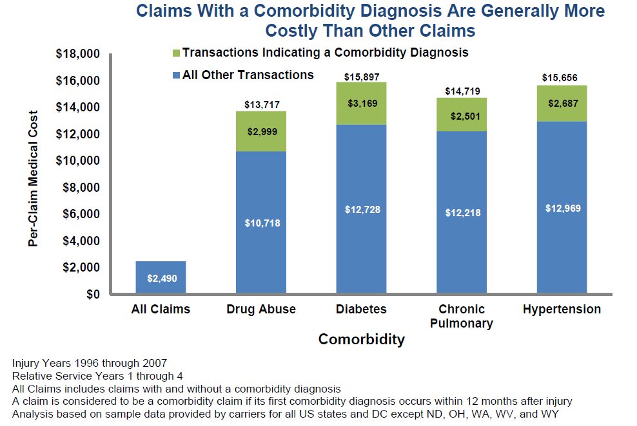

Slide 32
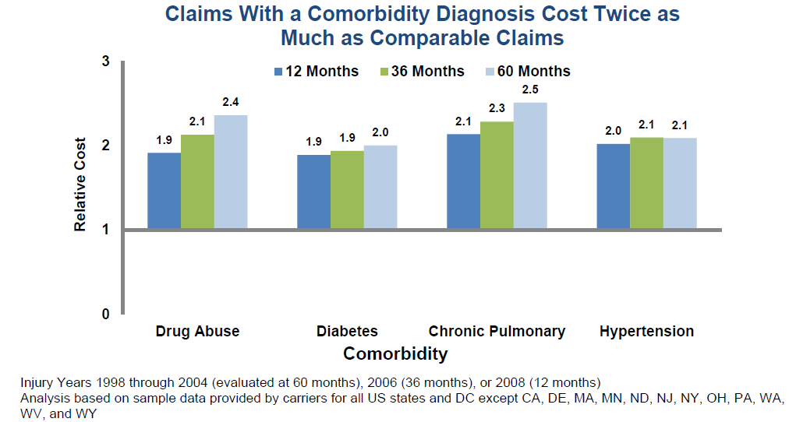

Slide 33
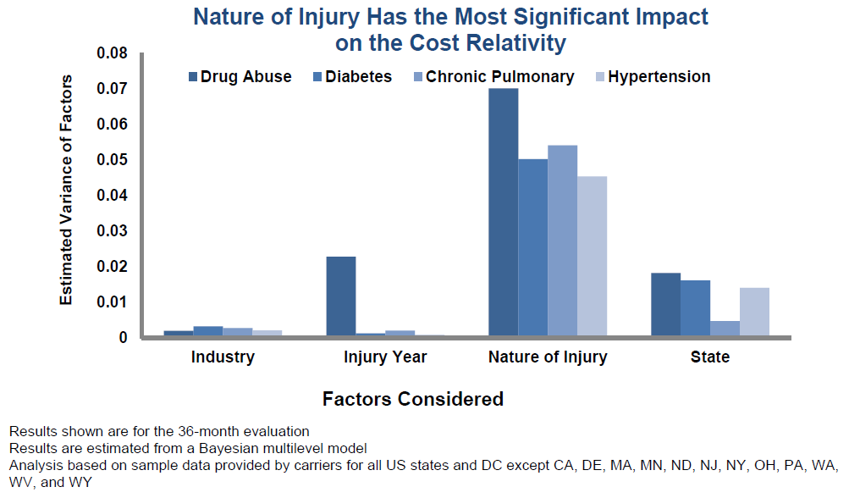

Slide 34
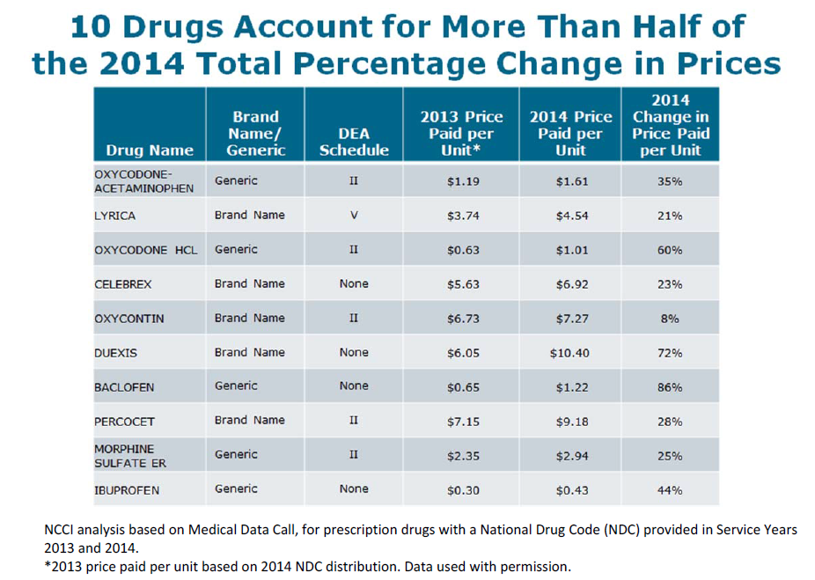

Slide 35
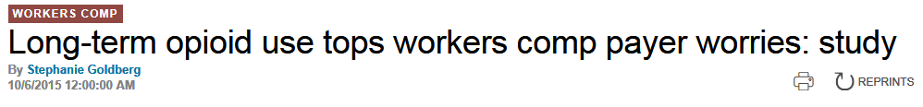
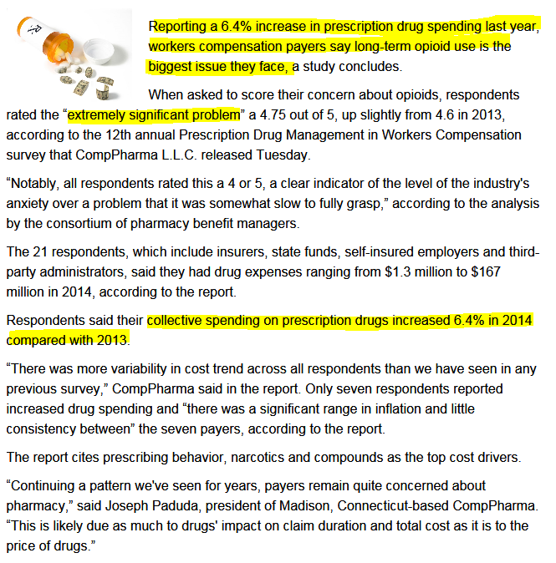


Slide 36
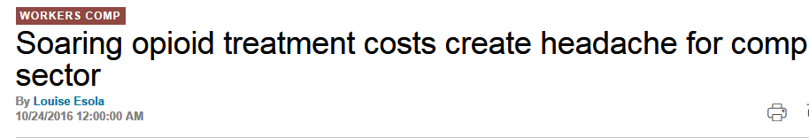
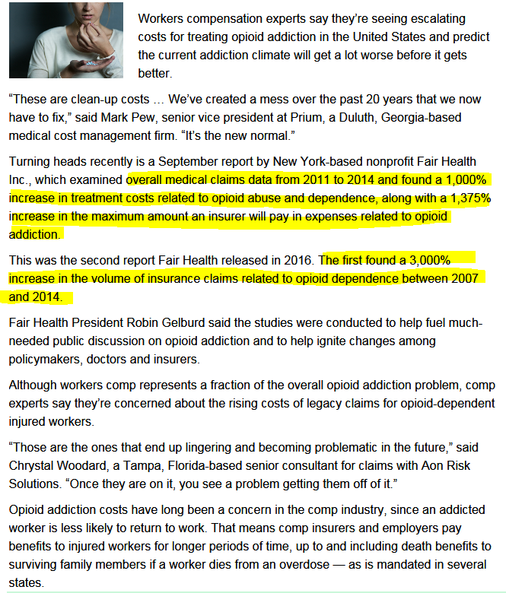

Slide 37
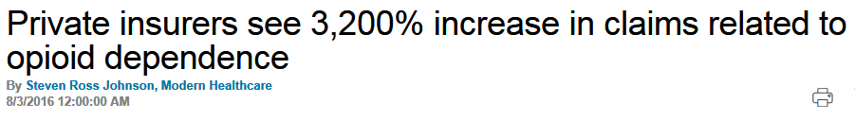
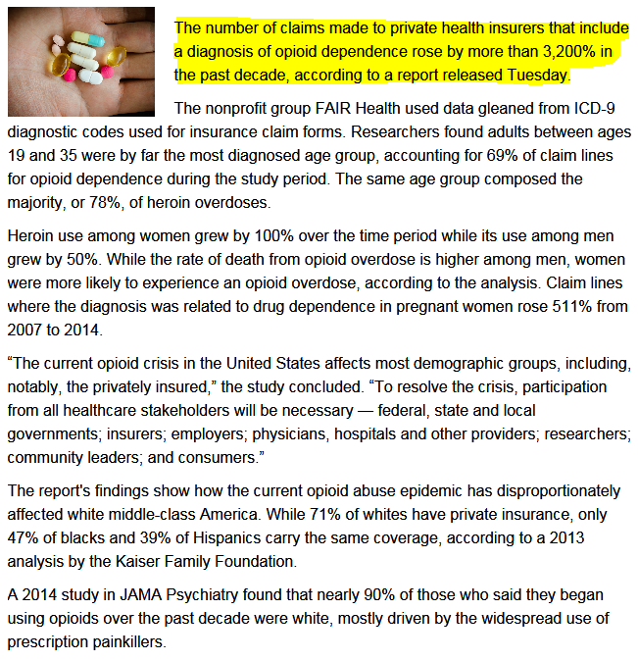

Slide 38
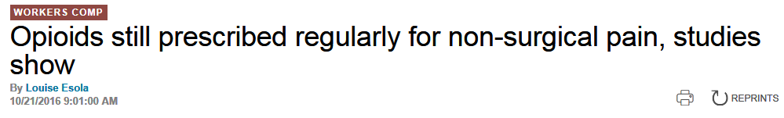
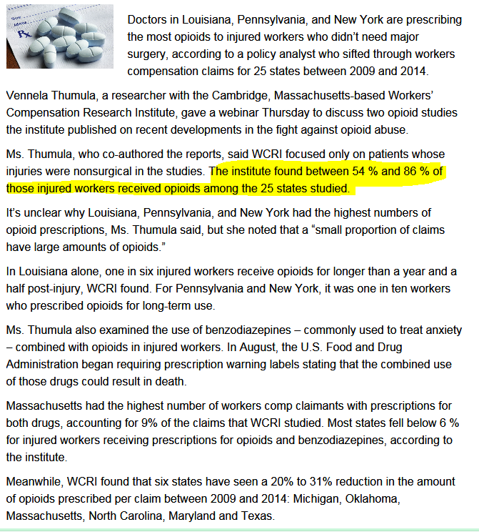

Slide 39
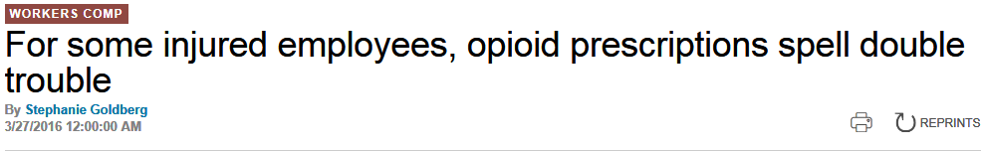
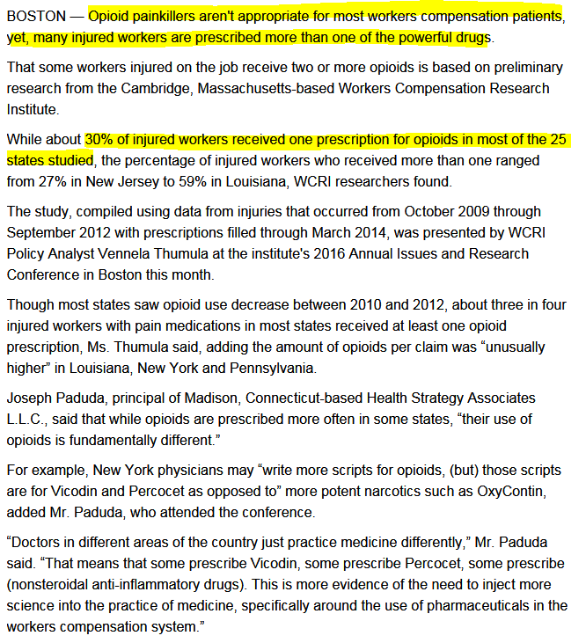

Slide 40
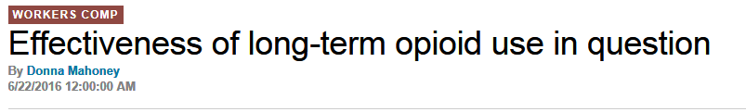
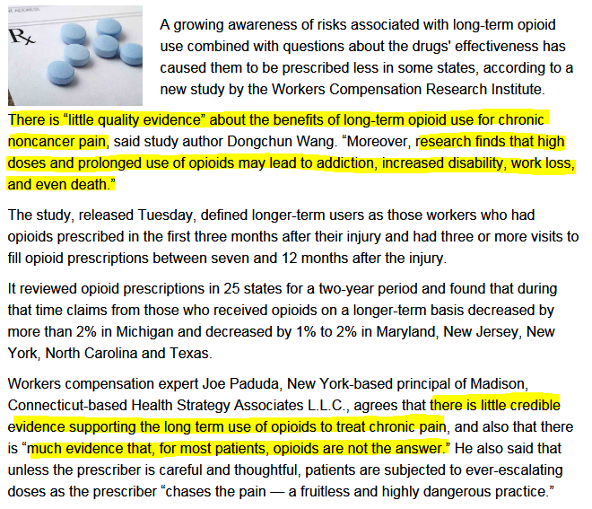

Slide 41
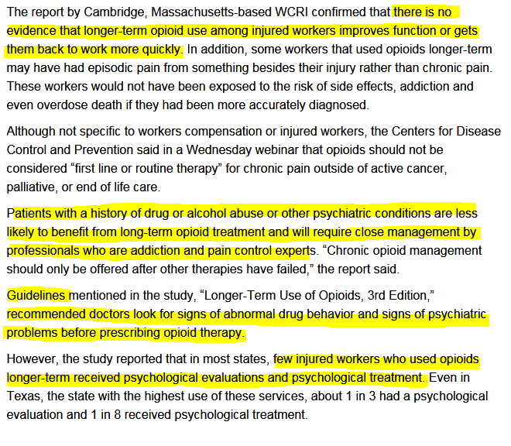

Slide 42
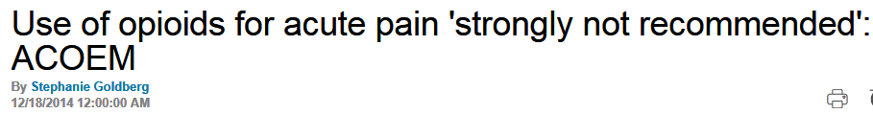
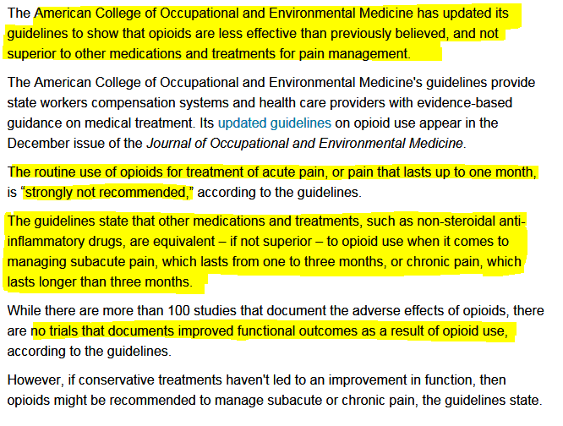

Slide 43
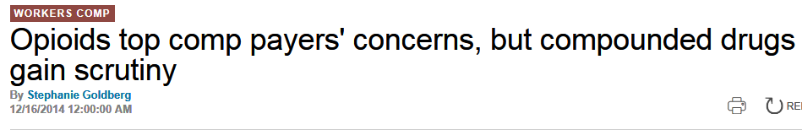
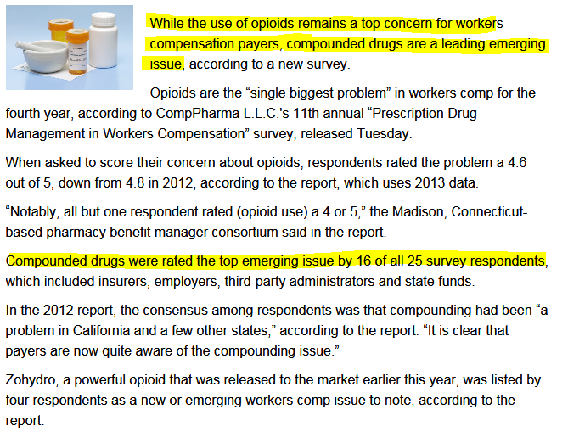

Slide 44
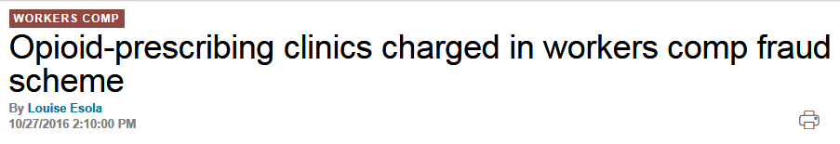
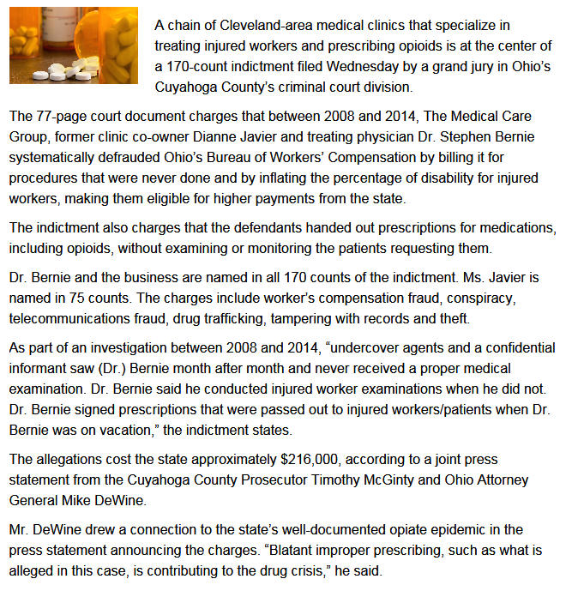

Slide 45
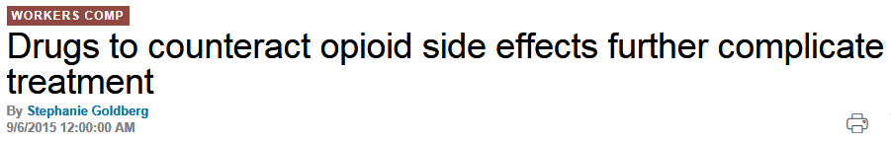
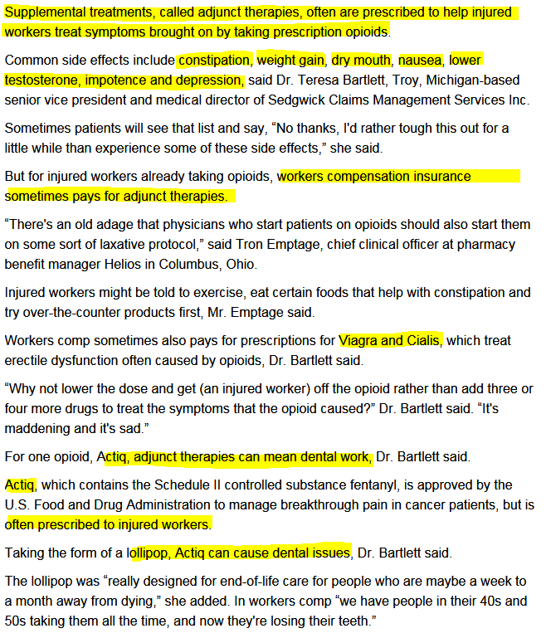

Slide 46
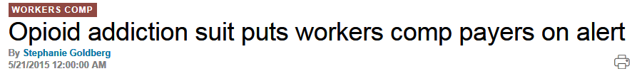
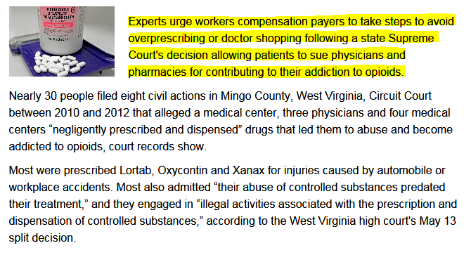

Slide 47
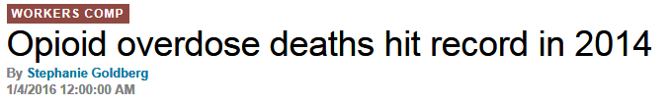


Slide 48



Slide 49



Slide 50



Slide 51



Slide 52



Slide 53



Slide 54


Slide 55




Slide 56


Slide 57



Slide 58



Slide 59



Slide 60



Slide 61



Slide 62



Slide 63



Slide 64



