Slide 1

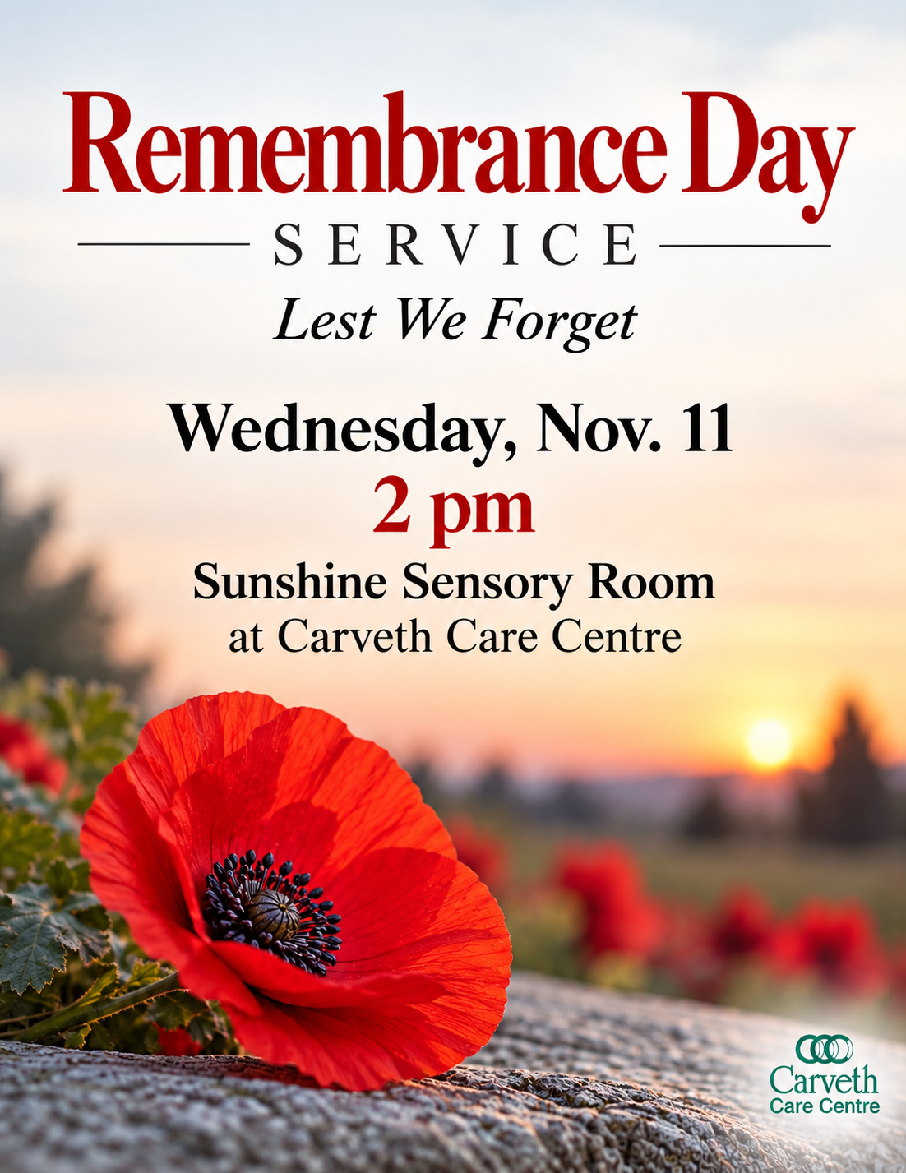

November
2026
Remembrance Day
On Nov. 11, please join us for a moment of silence at 10:30 AM and for a special Remembrance Day service at 2 pm in our Sunshine Sensor Room.
Turkey Winners
Congratulations to the staff who won Thanksgiving turkeys from the Gibson family last month!
Daylight Savings
The days are getting shorter which means it’s time to turn your clocks back one-hour. Remember to turn your clocks back on Nov. 1 at 2 am (or before you go to bed if that’s too early.)
Daily updates
Watch for regular updates about our home on our website and Facebook page.
Staff Spotlight
This month, we are featuring the good work of Sara Dennison, a Residential Aide in our lodge.
Please see details on Page 3.
Interesting facts about November 1. In the US and Canada, November is National Beard Month or No Shave Month. 2. On Nov. 18, 1963, Bell Telephone Company introduced to the public the push button phone. 3. The Erie Canal was formally opened in New York on Nov. 4. 1825. 4. The first mechanically ventilated underwater tunnel in the world, The Holland Tunnell, opened to traffic on Nov. 13, 1927. 5. The Suez Canal opened on Nov. 17, 1896.

Slide 2


Weather or not
Use this November weather lore to predict the weather in future months: As the weather is in November, so it will be in March. Thunder in November means a fertile year to come.
Family Council
We would like to find a few more people to join our Family Council. It’s a small group that meets every month at Carveth for an hour or two. The group tells us what we’re doing well and what we could do better. It’s invaluable feedback because we’re always looking for ways to improve. Please consider joining this fun group at our next meeting. Everyone welcome!
Holiday fun for the family
The weather is getting cooler which means Christmas is around the corner. The Gananoque Santa Claus Parade starts at the high school at 5:30 pm on Saturday, Nov. 28. The Lyndhurst Santa Claus Parade starts at 4 pm on Nov. 21.
Upcoming Christmas events
We have two upcoming Christmas activities: The Carveth Christmas Pop Up Sale Nov. 26 to 28; and an Open House in our lodge from 1:30 to 3:30 pm on Saturday, Dec. 5.
“November comes and November goes,
With the last red berries and first white snows.”
Tell us what you think
Do you have a story idea or feedback for our newsletter? Contact Catherine Reynolds at 613-384-4582 ext. 251 or catherinereynolds@gibsonfamilyhealthcare.com
In Flanders Field
by Lieutenant Colonel John McCrae
In Flanders fields, the poppies blow, between the crosses, row on row, that mark our place; and in the sky, the larks still bravely singing fly scarce heard amid the guns below.
We are the dead; short days ago, we lived, felt dawn, saw sunset glow, loved and were loved, and now we live in Flanders fields!
Take up our quarrel with the foe, to you, from failing hands, we throw the torch; be yours to hold it high. If ye break faith with us who die, we shall not sleep, though poppies grow in Flanders fields.
Did you know this Canadian poem was inspired by the poppy: The iconic red poppy tradition grew out of the poem "In Flanders Fields," written in 1915 by John McCrae, a Canadian military doctor and poet from Guelph, Ontario, after he noticed bright red poppies blooming across the churned-up battlefields of Belgium.
O Canada
O Canada!
Our home and native land.
True patriot love, in all they sons' command.
With glowing hearts, we see they rise, the true north strong and free. From far and wide, O Canada, we stand on guard for thee.
O Canada, we stand on guard for thee.
O Canada, we stand on guard for thee.
Did you know about The Thanksgiving Merger? From 1921 through 1930, Canada held Armistice Day on the Monday of the week of Nov. 11, merging it into a joint holiday with Thanksgiving. This mix of celebration and solemn mourning upset many veterans and the public, leading Parliament to separate the two holidays and establish official Remembrance Day on Nov. 11 in 1931. The 11th Hour Origin: The date and time mark the official end of First World War fighting through an armistice that took effect on the "11th hour of the 11th day of the 11th month" in 1918.

Slide 3


Carveth Retirement Lodge celebrates Sara Dennison
Residential aide is Employee of the Month for November
As a new member of the workforce at Carveth Retirement Lodge, Sarah Dennison has made a big impact on its residents and staff in a short amount of time.
A Residential Aide at Carveth Retirement Lodge for less than seven months, Sarah is the home’s Employee of the Month for November 2026 in recognition of the care and support she provides residents.
Since joining Carveth in May 2026, Sarah has enjoyed getting to know the residents and making a difference in their day-to-day lives. For her, the people she works with are what make the job so rewarding.
“The residents are the best part of the job for sure,” she says with a smile.
Lodge Manager Joe Classen recommended Sarah for the award, recognizing her dedication and the positive contribution she makes to the Carveth team.
“Sarah has been a wonderful addition to our team at Carveth Retirement Lodge,” explains Joe.
“Her commitment to her work and the care she brings to her role help make our home a welcoming place for residents. We’re pleased to recognize her contributions and congratulate her on being named Employee of the Month.”
When she’s not at work, Sarah enjoys photography, watching movies and spending time at home with her two cats, Ellie and Malcolm.
Looking ahead to the next decade, Sarah hopes to keep things simple and focus on what matters most.
“In 10 years, I hope I am healthy, happy and not taking life too seriously,” she says with conviction.
Carveth Retirement Lodge congratulates Sarah on this well-deserved recognition and thanks her for being part of the team. Her appreciation for the residents and the relationships she builds with them reflect the importance of compassion and connection in everyday life at the Lodge.
To learn more about living or working at Carveth, please call 613-382-4752 ext. 110 or visit www.gibsonfamilyhealthcare.com

Slide 4
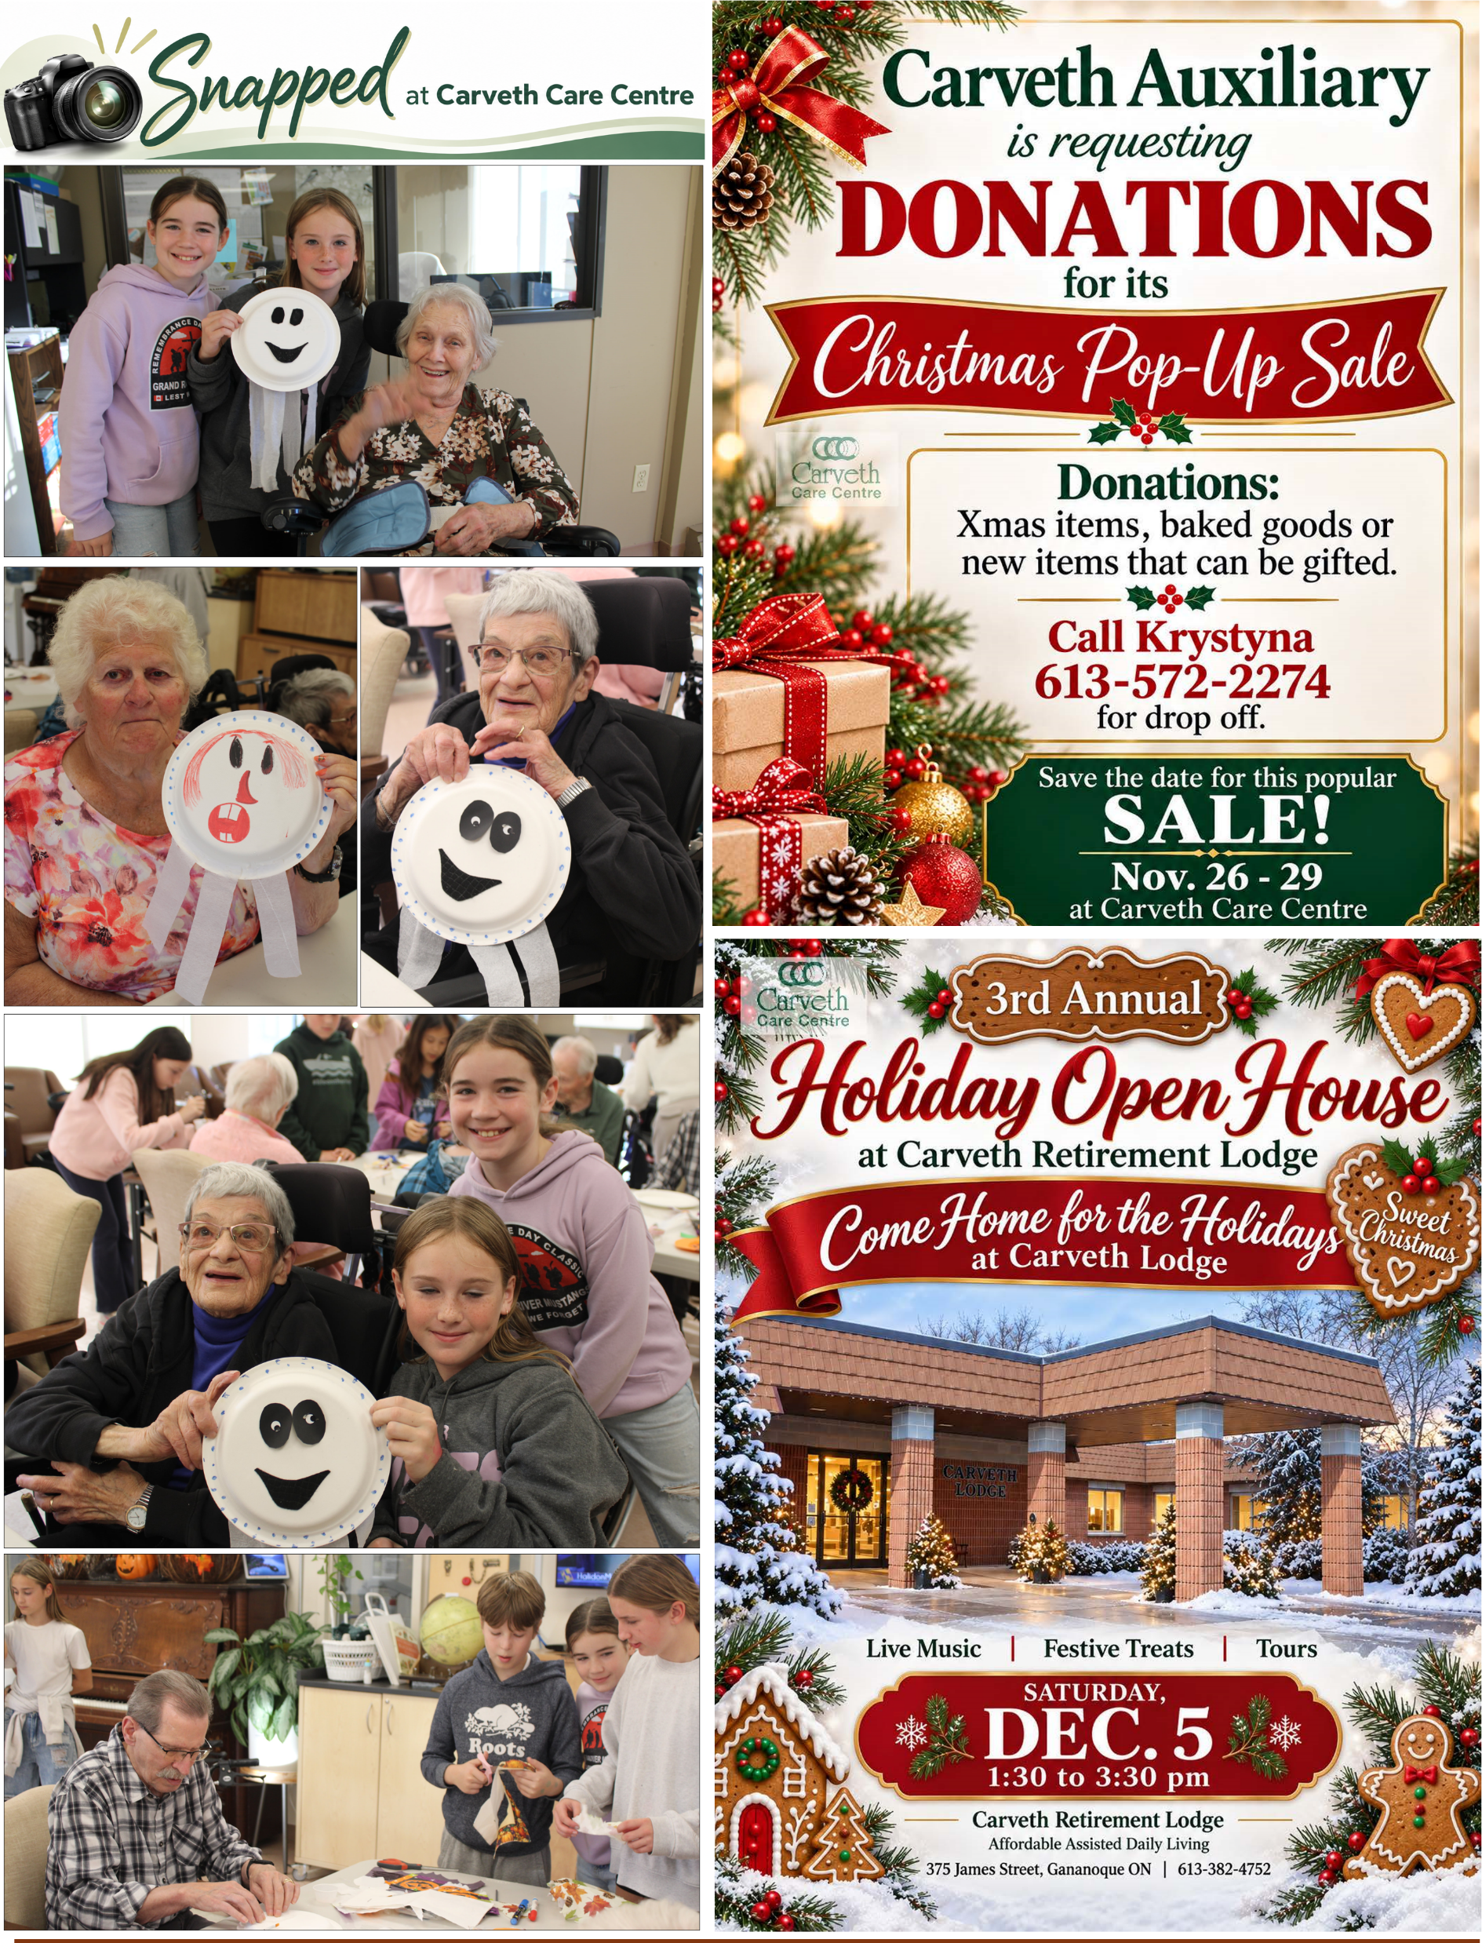

Slide 5
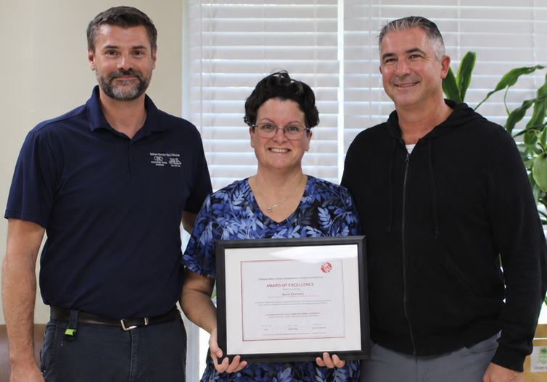
Carveth Care Centre team member receives Award of Excellence
Nicole Chisamore recognized for her dedication to keeping residents safe, comfortable & cared for
At Carveth Care Centre, creating a safe, clean and welcoming
environment for residents takes a dedicated team working behind
the scenes every day.
For Nicole Chisamore, a member of the home’s housekeeping team,
that commitment is personal — and it has now earned her special
recognition. Nicole has received the Award of Excellence from the
Canadian Healthcare Environmental Services Association (CHESA),
celebrating her dedication, professionalism and valuable
contributions to healthcare environmental services.
The award recognizes individuals and teams whose work helps create
clean, safe and welcoming healthcare environments for residents, patients, staff and visitors.
For Nicole, maintaining that environment is about much more than keeping a building clean. It is about caring for the people who call Carveth home.
“Being part of the Carveth housekeeping team, I feel our work is extremely important to the comfort, cleanliness and safety of the residents’ home,” Nicole explains.
Her connection to Carveth Care Centre runs deep. Over the years, she has worked at the home as both a Personal Support Worker (PSW) and a member of the housekeeping department. Her family connections to Carveth, including having her mother live there, have made her work especially meaningful.
With her aunt and other loved ones also connected to the home, Nicole understands firsthand the importance of providing an environment where residents feel safe, comfortable and respected.
“It is important to me that their environment is safe, healthy and clean, and I will go the extra mile, share ideas and, from time to time, put in a little extra of my own time to assure my job is complete,” she says with sincerity.
Nicole is quick to share the credit for her achievement with her colleagues, emphasizing the importance of teamwork and the supportive workplace they have built together.
“I love my work and the team that I work with because each of us brings something valuable and works hard at our job,” she says, adding that housekeeping manager Mark Campbell provides fantastic leadership and treats the team with respect, making coming to work enjoyable.
She also credits her fellow housekeeping colleagues — Amanda, Jen, Kathy, Amy, Shawny and Cass — along with Mark and Tom from the maintenance team, for making her work rewarding and inspiring her to do her best.
“We are a circle of care at Carveth Care Centre,” Nicole said.
Anitha Chandrahausan, Infection Prevention and Control (IPAC) Lead at Carveth Care Centre, shares her congratulations and pride in seeing Nicole’s contributions recognized by CHESA.
“Nicole’s Award of Excellence is a wonderful recognition of the dedication and care she brings to her work every day. Our housekeeping team plays an essential role in infection prevention, resident safety and creating a clean, comfortable home for everyone who lives and works here. Nicole’s commitment to going the extra mile reflects the values we strive to uphold at Carveth Care Centre. We are very proud of her and delighted to see her receive this well-deserved recognition.”
CHESA’s Award of Excellence celebrates the important contributions of healthcare environmental services professionals across Canada, highlighting the meaningful difference their work makes in the lives of others.
For Nicole, the award is a reflection not only of her own dedication but also of the colleagues who support her and the residents who inspire her.
At Carveth Care Centre, her story is a reminder that exceptional care takes many forms. Sometimes, it is found in the everyday work of people who quietly go the extra mile to make a place feel safe, healthy and like home.
To learn more about living or working at Carveth Care Centre, please call 613-382-4752 or visit www.gibsonfamilyhealthcare.com

Slide 6


Slide 7
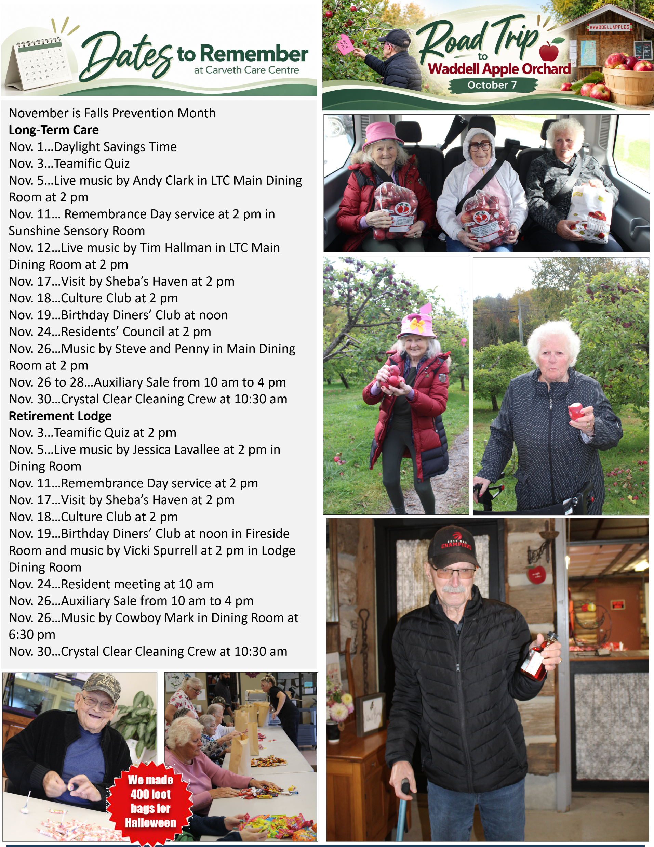

Slide 8


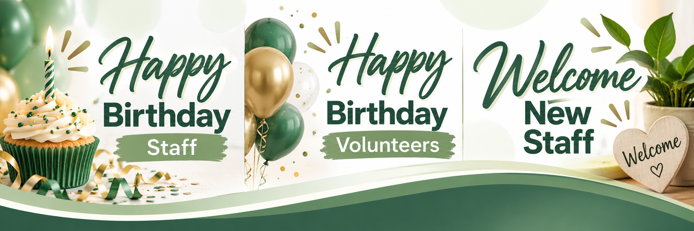

Cassandra A, Nov. 1
Preeti B, Nov. 1
Jennifer O, Nov. 2
Laurie B, Nov. 3
Ferly B, Nov. 3
Varaidzo G, Nov. 11
Krystyna S, Nov. 14
Marcie G, Nov. 15
George H, Nov. 22
Hunter C, Nov. 25
Wendy A, Nov. 27
Margi P, Nov. 28
Amanda G, Nov. 29
Nicole G. Nov. 3
Ann B, Nov. 5
Krystyna S, Nov. 14
Amandeep Kaur, PSW
Gurjindeer Kaur, PSW
Diyaben Patel, PSW
Nandini Nandini, PSW

Slide 9
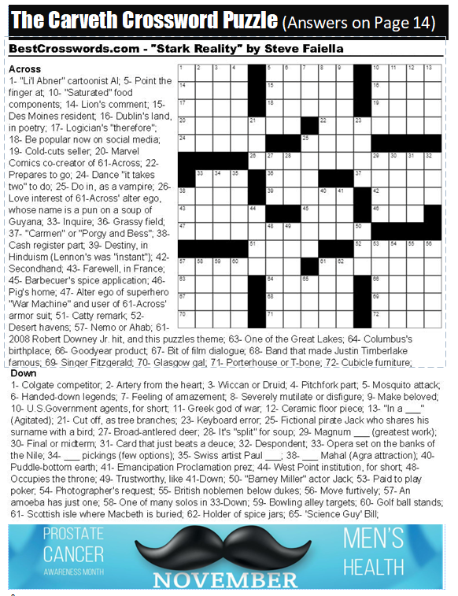
(Answers on Page 15)

Slide 10
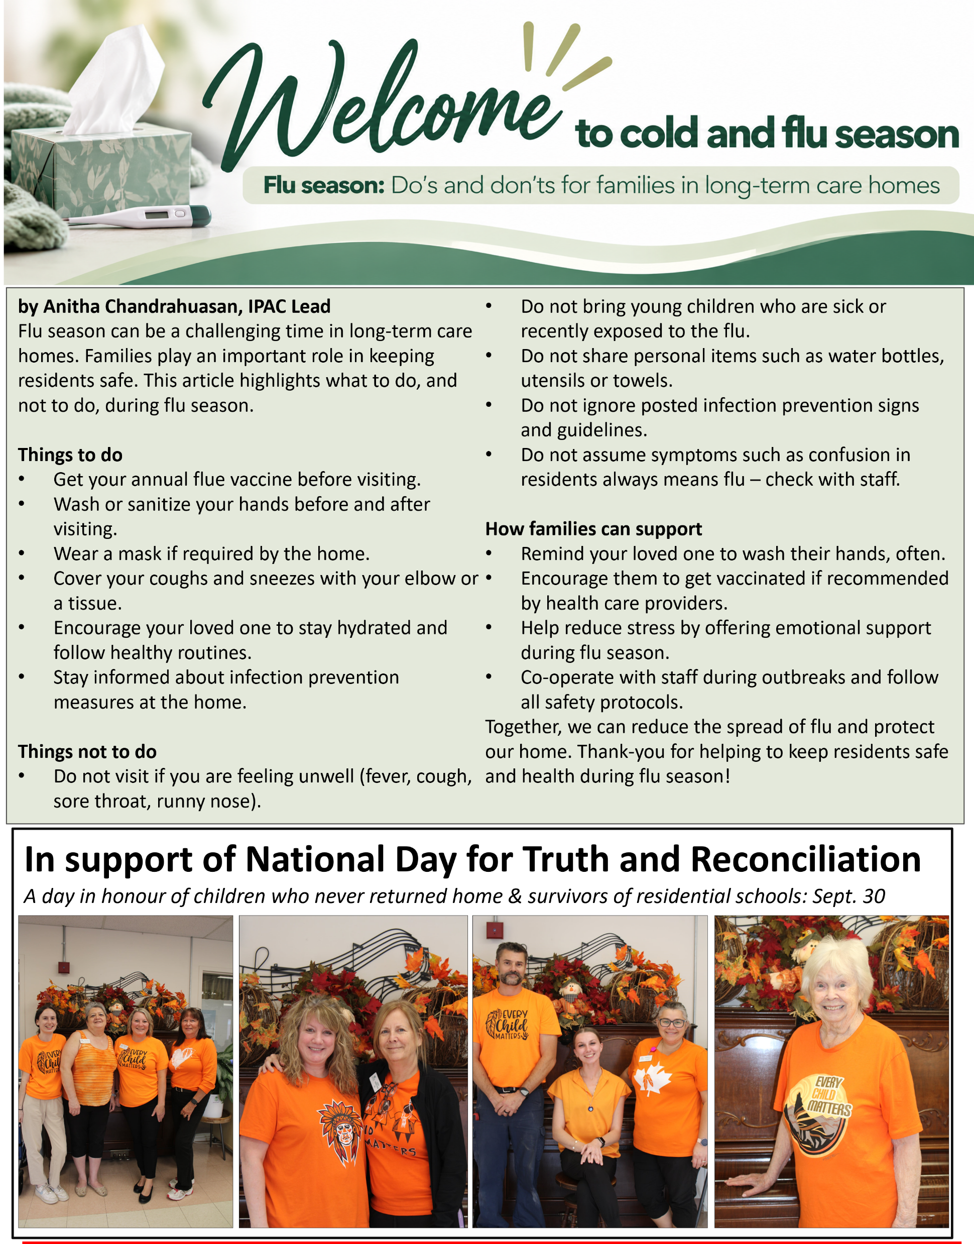

Slide 11

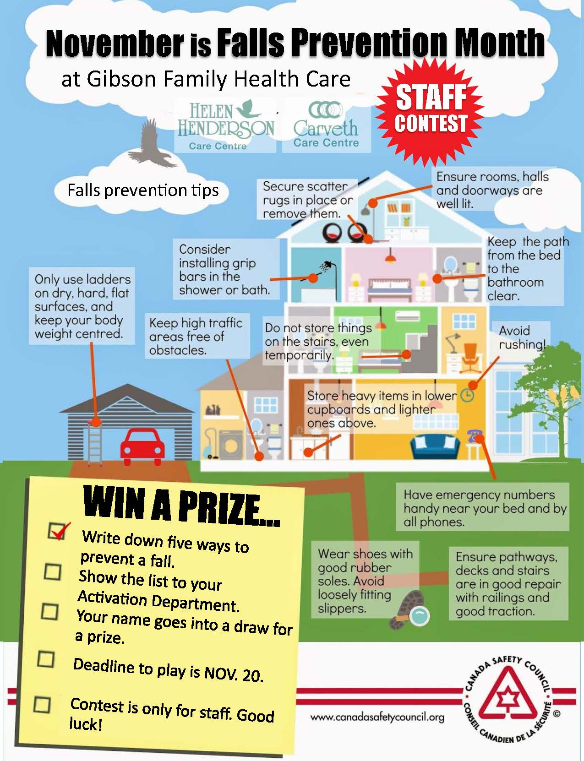
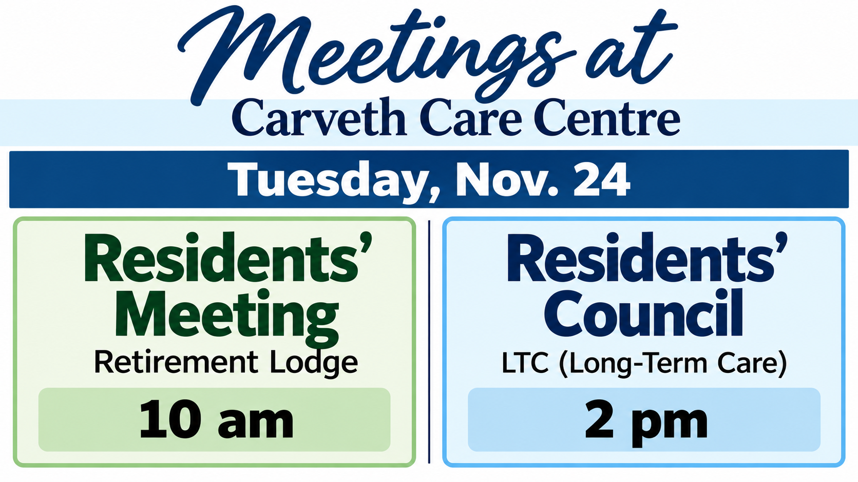

November is Falls Prevention Month
As we age, our risk for falling increases.
People fall due to:
Tripping or slipping due to lose of footing or traction.
Slow reflexes which makes it hard to keep your balance or move out of the way of a hazard.
Balance problems.
Reduced muscle strength.
Poor vision.
Illness.
Consumption of medication or alcohol/drugs.
At Carveth Care Centre, our goal is to prevent falls. Let’s work together to achieve this goal.
Did you know: An older adult who falls once is twice as likely to fall again. Women are three times more likely than men to be hospitalized for a fall-related injury. Falls are the number one cause of injury, emergency department visits, hospitalizations, and injury-related deaths for older adults in Canada.

Slide 12
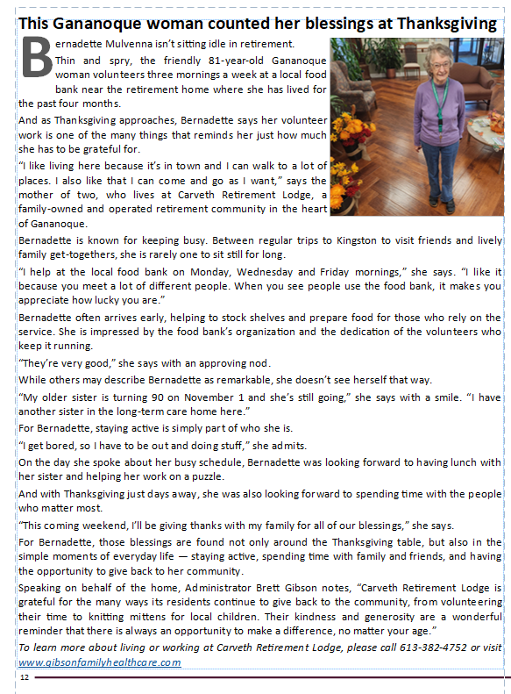
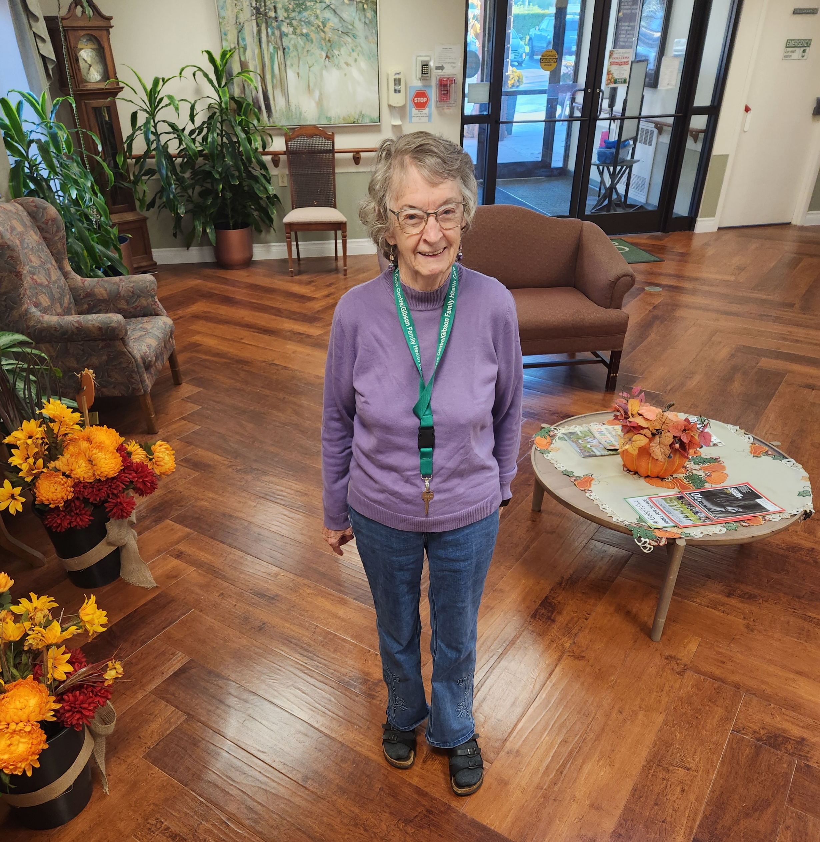

Slide 13
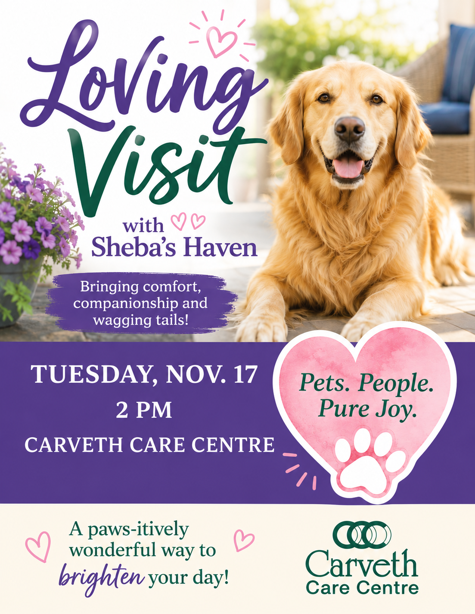

Make it a healthy November
To have a healthy November, focus on staying hydrated, increasing vitamin D intake, and eating seasonal produce such as pumpkin and leafy greens. Stay active with indoor workouts or cold-weather activities, prioritizing eight hours of sleep and manage stress through mindful activities such as reading or yoga. You should also get your flu shot, wash your hands frequently, and plan ahead for holiday events to maintain balance.
Reminders=
Stay hydrated – Drink plenty of water throughout the day, as it’s easy to drink less in colder months.
Increase Vitamin D - With shorter, darker days, supplement your intake through food or supplements.
Eat seasonal foods – Focus on fall produce such as pumpkin, sweet potatoes, dark leafy greens, cranberries and apples, which are packed with nutrients and antioxidants.
Incorporate walnuts – A handful of walnuts provide Omega Threes which can help with heart health.
Mindful eating – During the holidays, practice moderation and fill your plate with lean proteins, colorful vegetables and whole grains.
Healthy snacks – Have snacks such as baby carrots with hummus or a handful of nuts to curb cravings.
Practical tips
Anchor Your Wake-Time, Not Your Bedtime: Shorter days can mess with your natural circadian rhythm. Instead of stressing over an exact bedtime, keep your morning wake-up time consistent within an hour every day—even after late nights—to keep your body clock steady.
Schedule "No-Plan" Days: November kicks off the social and holiday rush. Prevent burnout before it starts by deliberately blocking out quiet, obligation-free days on your calendar to rest and recharge

Slide 14


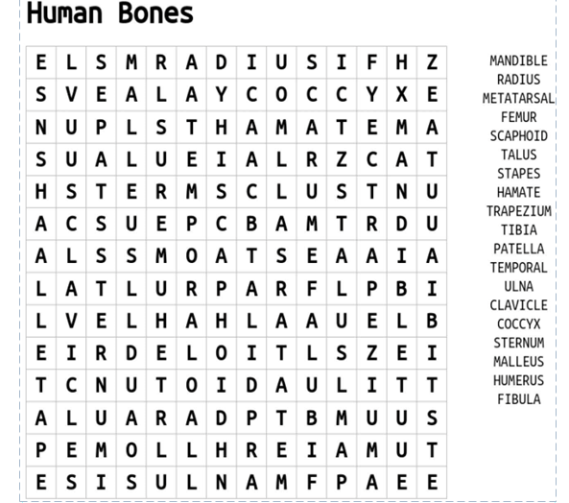
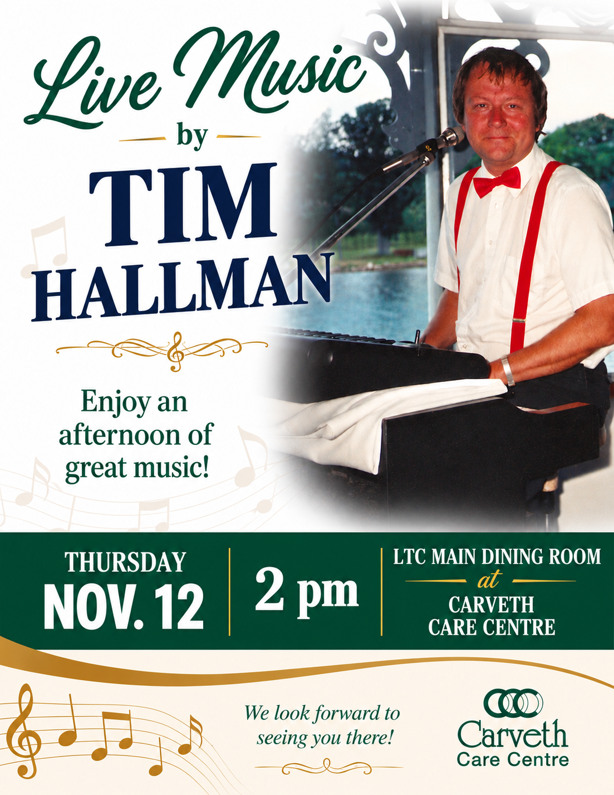
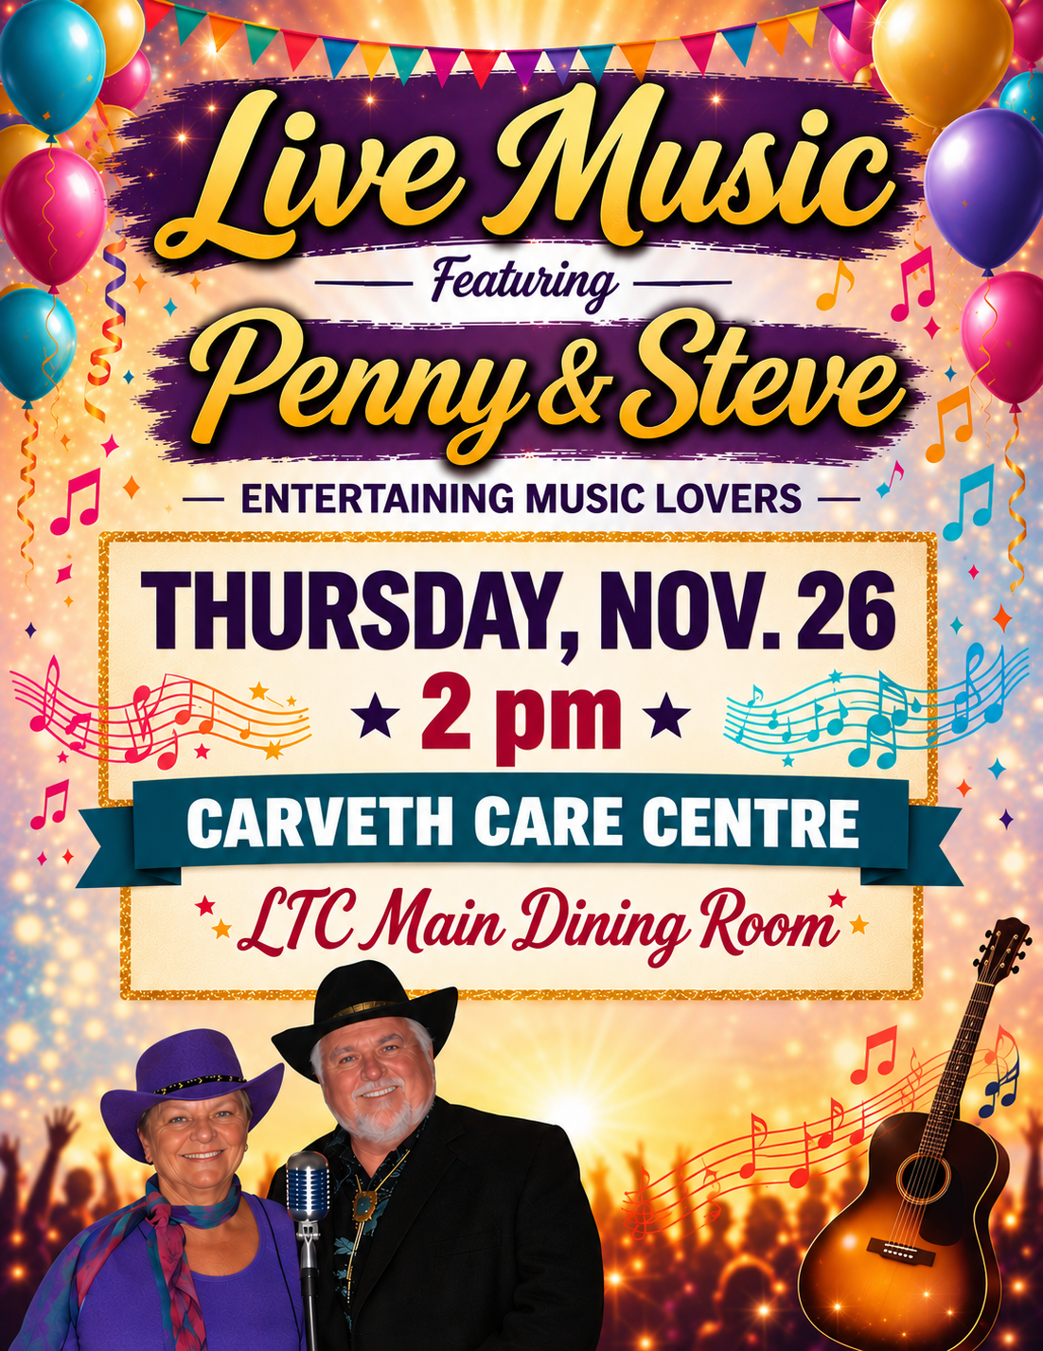
Answers on Page 15

Slide 15

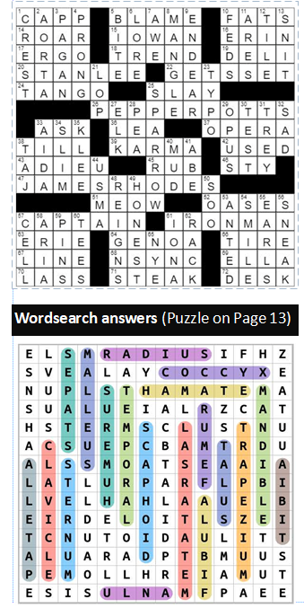

Crossword Answers (Puzzle on Page 9)
(Puzzle on Page 14)
Tips to be productive in bleak winter months: Get moving – moving your body with regular exercise before, after or during work, especially outdoors, helps reduce stress and improve sleep. Spend time outside – If you suffer from Seasonal Affective Disorder (and even if you don’t), get 10 minutes of sunshine everyday if possible. Keep your environment warm – It’s important to have a comfortable environment. Eat well – Watch what you eat and drink. Warm yourself with a cup of green tea. Set goals – Even if you’re feeling a bit sluggish, set new goals and volunteer for something that excites you. Stay healthy – While it’s sometimes difficult or impossible NOT to get sick when everyone else is unwell, do what you can to prevent it.

Slide 16


Welcome
Aimee Campbell
Mary Smith
Elaine Mainse
Wally Vandepol
Yvonne Landon
Lynn Pritchard (Lodge)
Birthdays
Helen W, Nov. 11
Jennifer G, Nov. 15
Heather C, Nov. 19
Eileen G, Nov. 21
Ernest W, Nov. 21
Anneliese S, Nov. 23
Yvonne L, Nov. 25
Susan B, Nov. 26
Mary C, Nov. 27
Elaine D, Nov. 29
Bruce F, Nov. 30
Chris J, Nov. 30
In Memory
Marguerite Graham
Elmer Steacy

Slide 17
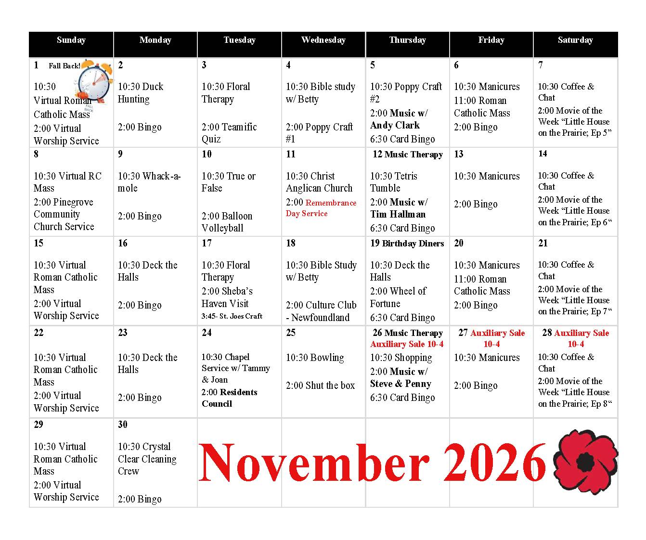

Slide 18
