Slide 1


Slide 2


Tire Care and Maintenance

Slide 3
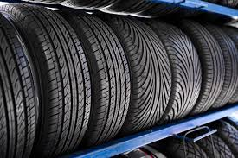
What’s the Right Tire for You?

Slide 4
Open Shoulder vs. Closed Shoulder
Drives
01
02
Local or Regional?
Closed Shoulder or OTR
Gravel Trains or Scrap Haulers
More Stable Ride
Better Wear

Slide 5
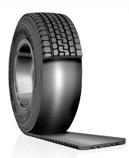
COMPANY NAME
Trailer Retread vs New Tires
Retread:
Quality Casing
Best Tread for You
New Tires:
Tread Depth
Compound for Application
Ins.
Quality Casing

Slide 6

Care for Your Tires

Slide 7

TIA
We follow guidelines provided by the Tire Industry Association to get the very best out of your tires.

Slide 8
I recommend 90 pounds of air pressure for the best over tread wear
What repairs, if any, need to be made?
Replacement at 4/32 seconds at lowest point of tire
Tire Pressure

Slide 9
Summary
All the Right Decisions Can Be Made By:
Risk Assessment
RIST
R- remove debris from mating surfaces
I- inspect components for damage or excessive wear
S- snug and fasten in a star pattern
T- torque to specification
Tire Optix

