Slide 1
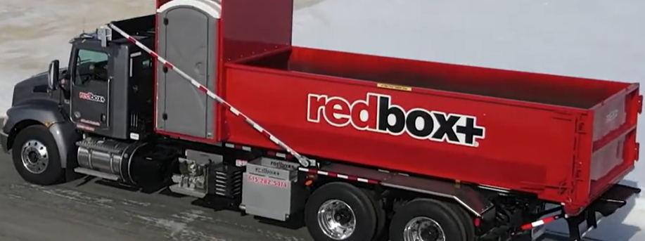
RedBox+ Suspensions

Slide 2
RedBox+ Suspension Systems Overview and Preventative Maintenance Guide
Medium Duty Front Suspension (T370 & T480)
Reyco Model 79KB Drive Axle Suspension System
AG400L Airglide Rear Air Spring Suspension
Hendrickson HAULMAAX Rear Suspension (40K / 46K)

Slide 3
Medium Duty Front Suspension
T370 & T480 Front Suspension Overview
Taper leaf front suspension with various capacities
Two taper leaf springs joined to distribute stress evenly
Steel-backed bronze bushings with graphite lubrication
Features:
  Shot peened spring leaves
  Large diameter U-bolts
  Shock absorbers for road vibration damping

Slide 4
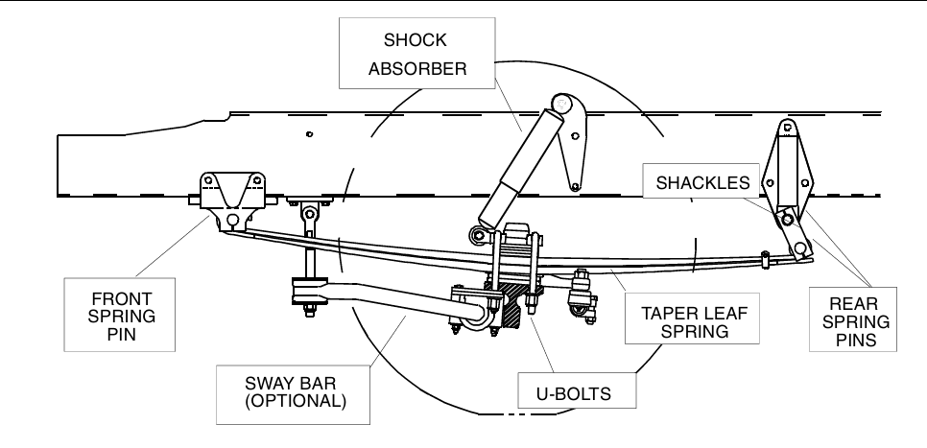
Medium Duty Front Suspension (T370 & T480)

Slide 5
T370 & T480 Front Axle Preventative Maintenance Schedule
Task | Interval | Details
Retorque U-bolts | After 500 miles, then every 5,000 miles | Torque to 245-300 lb-ft (333-408 Nm)
Retorque Shackle Pinch Bolts | After 500 miles, then every 5,000 miles | Torque to 80-90 lb-ft (109-122 Nm)
Lubricate Spring Pins | Every 6,000 miles | Use EP chassis grease or lithium stearate grease (NLGI-1)
Inspect Springs & Bushings | Every service | Check for cracks, wear, and damage; replace as needed
Inspect Shock Absorbers | Every service | Check for leaks, dents, binding; replace if damaged
Visual Inspection | Regularly | Check for loose fasteners, rust, abnormal wear

Slide 6
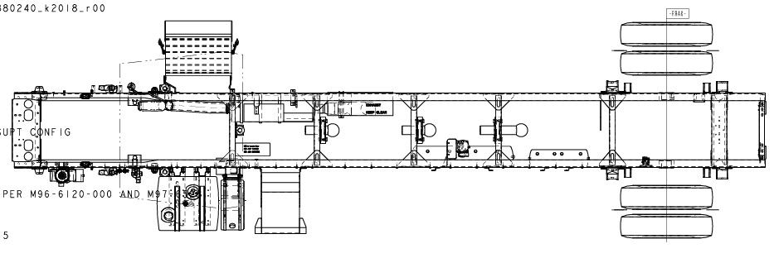
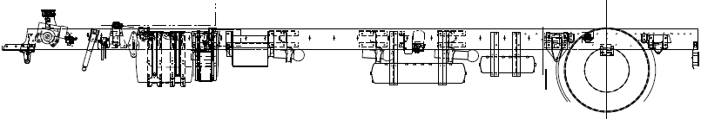

Slide 7
Reyco Model 79KB Drive Axle Suspension
Torque-Leaf steel spring suspension system
Available with flat or parabolic leaf springs (21,000 - 35,000 lbs load)
Features:
  Cast hangers with urethane bushings
  Optional anti-sway bar, shock absorbers,
  Adjustable torque arms or eccentric bushings for alignment
  Redbox+ trucks require a 4.5 degree axle slant

Slide 8
79KB Preventative Maintenance Schedule
Task | Interval | Details
Pre-delivery Inspection | Before operation | Check load spring shims, suspension assembly
First Service Inspection | 1,000 - 3,000 miles | Torque check, visual inspection of springs and bushings
Periodic Inspection | Every 3 months / 600 hours | Check load springs, rebound straps, wear plates, fasteners
Fastener Torque Check | Every 12 months / 2400 hours | Torque per Hendrickson specs (e.g., U-bolts 400-425 ft-lbs)
Shock Absorber Inspection | As needed | Check leaks, dents, proper damping
Alignment Check | As needed | Adjust using torque arms or eccentric bushings
Visual Inspection | Regularly | Look for cracks, loose parts, uneven wear

Slide 9
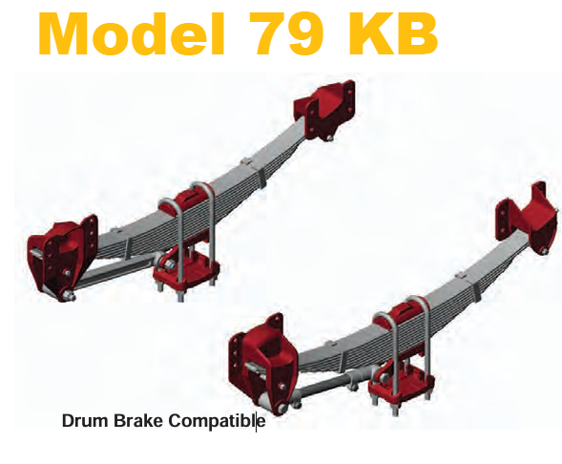
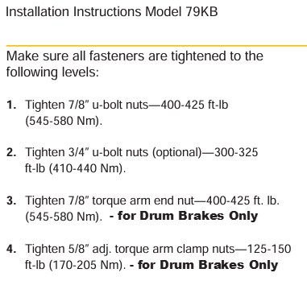

Slide 10
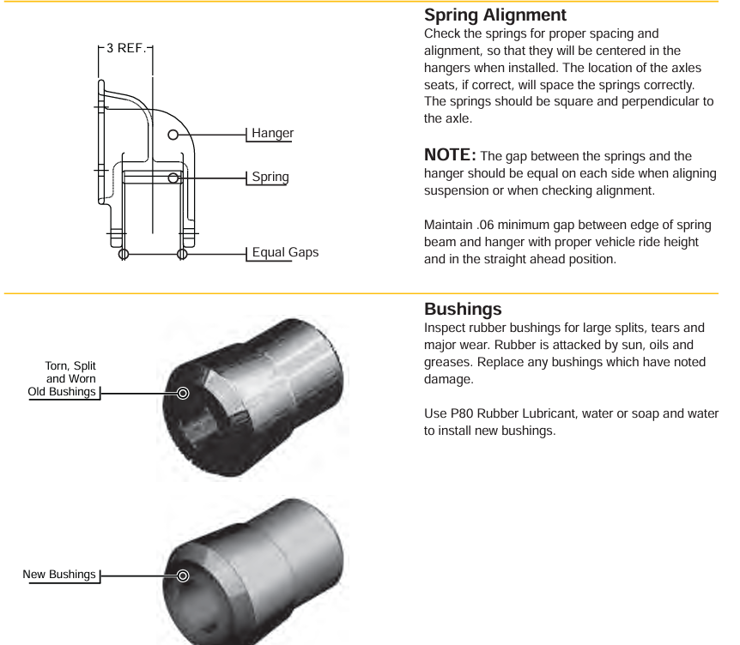
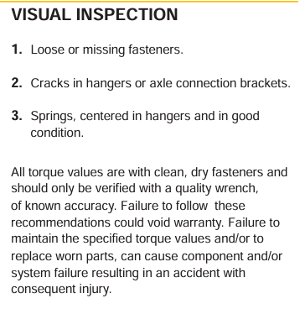

Slide 11
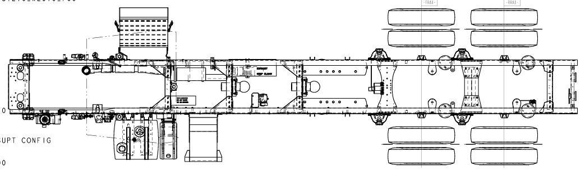
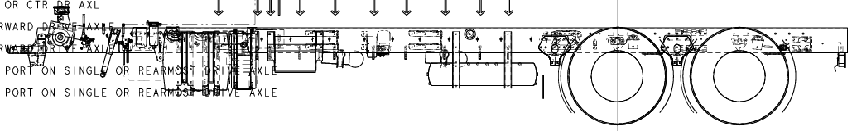

Slide 12
AG400L / AG210L Airglide Rear Suspension
Combination of air springs and taper leaf springs
Rolling-lobe air springs with height control valve for automatic ride height
Tracking rod for axle alignment and roll stiffness
Shock absorbers
Designed for low frame or fifth wheel heights

Slide 13
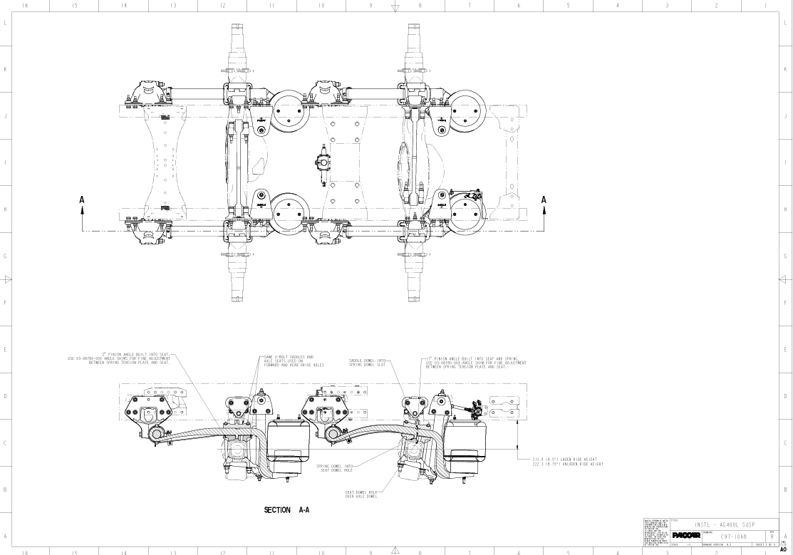

Slide 14
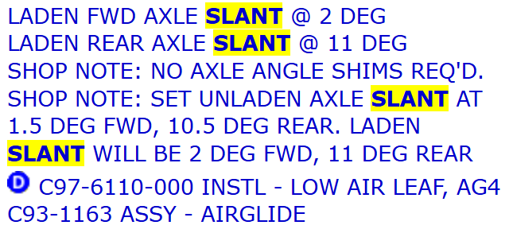


Slide 15

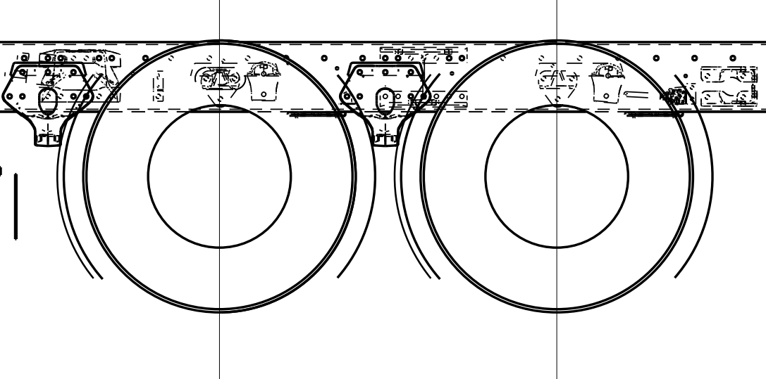
Ride Height is the difference in measurement from the ground to the frame rail flange and the centerline of the axle.
From the factory build notes:
Manual Measurement
Measurement #1
Location: center point between tandems.
Measure from the bottom frame rail flange to the ground and record that measurement
Measurement #2
Location: center point of the axle shaft flange.
Measure from the center point of the axle shaft to the ground and record that measurement
Subtract measurement #2 from Measurement #1 and that is your ride height. The goal is to have 8.75 inches unladen (empty)
Ride
Height

Slide 16
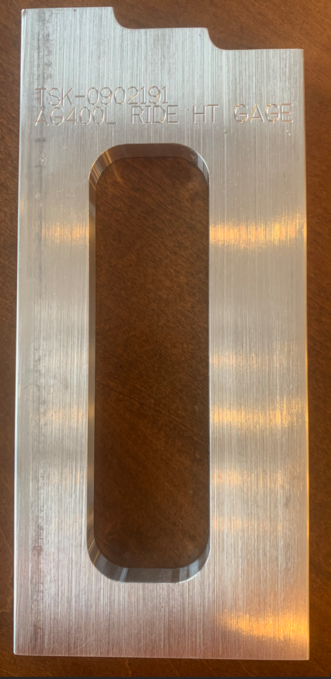
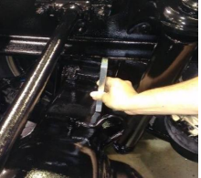
Manual measurement is difficult to complete properly. The suspension bracketry bolted to the frame rail blocks frame rail measurement. Also, the center point of the axle shaft is inside of the wheel/tire surface making it difficult to get an accurate measurement. There are tools that help with the measurement but using the AG400L ride height tool makes measurement more efficient.
Upper Limit shoulder
Steps for checking proper ride height with the Gage
The chassis should be unladen (empty) when checking ride height with the gage
Ensure the air system has at least 110 psi
Air bags should be fully inflated
Ride height should be checked at the rear axle, passenger side
Place the ride height gage between the rear top of the axle housing and the frame rail bottom flange as shown in the pic
The gage should fit between the axle housing and the frame rail flange
The frame rail should not sit on the lower limit shoulder or the upper limit shoulder
If the frame rail is below or above the gage limits then the ride height needs to be checked and set properly by a dealer
Goal
Lower Limit shoulder
***Ensure gage is placed at the rear edge of the top of the axle, not centered on the axle***

Slide 17
AG400L/AG210L Preventative Maintenance Schedule
Task | Interval | Details
Inspect Springs & Bushings | Every 5,000 miles | Check for cracks, wear, rubber bushings
Inspect Plastic Shims | Every 10,000 miles | Replace if damaged
Check Height Control Valve | Every 50,000 miles | Verify operation per manual
Check Ride Height & Pinion Angles | Every 100,000 miles | Adjust shims and valve as needed
Inspect Shock Absorbers | Every 5,000 miles | Check for leaks, damage, proper function
Torque U-bolts | As needed | Follow torque values for cut or rolled threads
Lubrication | Not required | No periodic lubrication needed
Visual Inspection | Regularly | Check for loose fasteners, damage, contamination

Slide 18
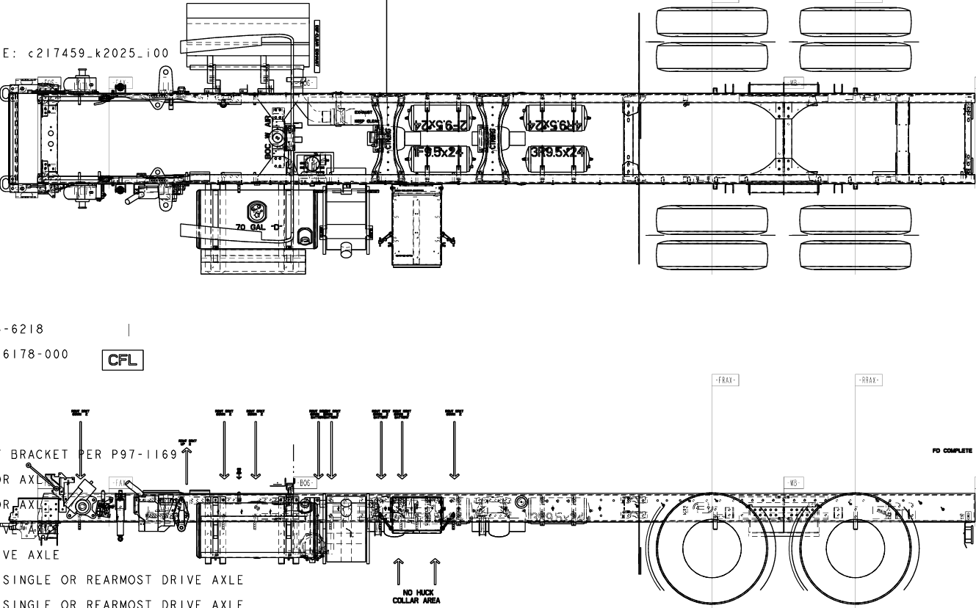

Slide 19
Hendrickson HAULMAAX Rear Suspension
HAULMAAX Suspension Overview
  Rubber vocational rear suspension rated 40,000 - 46,000 lbs
  Equalizing beam without center pivot bushing
  ULTRA ROD torque rods (longitudinal and transverse)
  Progressive load springs with premium rubber bolster springs
  Optional shock absorbers for improved ride and stability
  Designed for vocational trucks: dump, refuse, logging, etc.

Slide 20
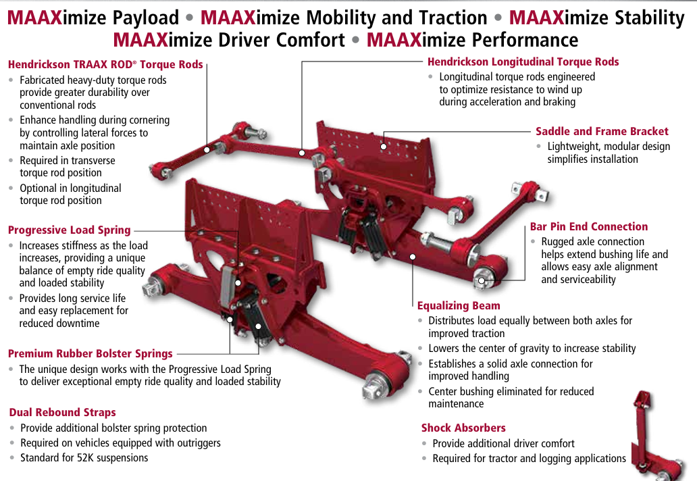

Slide 21
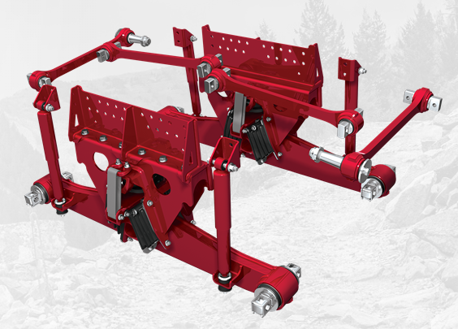
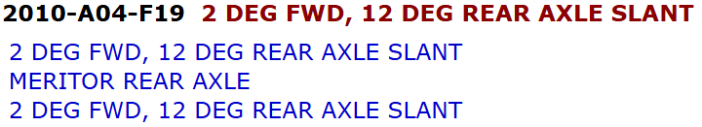

Slide 22
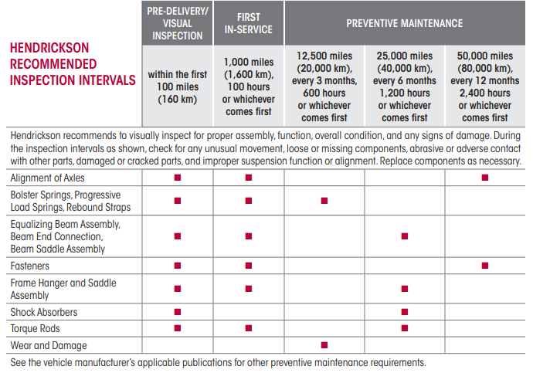
HAULMAAX Preventative Maintenance Schedule

Slide 23
HAULMAAX Torque Specifications
Component | Fastener Size | Torque (ft-lbs)
Saddle to Outboard Frame Bracket | M20 | 310 ± 30
Saddle to Bolster Spring | ½"-13 UNC Flange | 98 ± 7
Load Spring Contact Plate to Beam | 5/8"-11 UNC Flange | 98 ± 7
Bar Pin Bushing Locknut | 1"-8 UNC | 525 ± 75
Upper Shock Absorber | 5/8"-11 UNC | 160 ± 10
Lower Shock Absorber Nylocknut | 5/8"-11 UNC | 80 ± 10
Transverse Torque Rod to Axle | 1¼"-12 UNF | 200 ± 25

Slide 24
Summary and Q&A
Each suspension system requires regular inspection, lubrication (if applicable), torque checks, and component replacement when necessary.
Follow manufacturer torque specifications strictly to ensure safety and performance.
Alignment adjustments are crucial for tire life and ride quality.
Use genuine parts and follow safety and handling precautions during maintenance.
Questions?

