Slide 1
Social Media Best Practices
Paid vs. Organic - What’s the Difference?

Slide 2
Today’s Presentation Agenda:
01
02
03
04
05
Explore organic social media best practices
Discuss effective organic content strategies
Understand various organic social media options
Review paid social media goals and content
Identify key paid social media resources

Slide 3
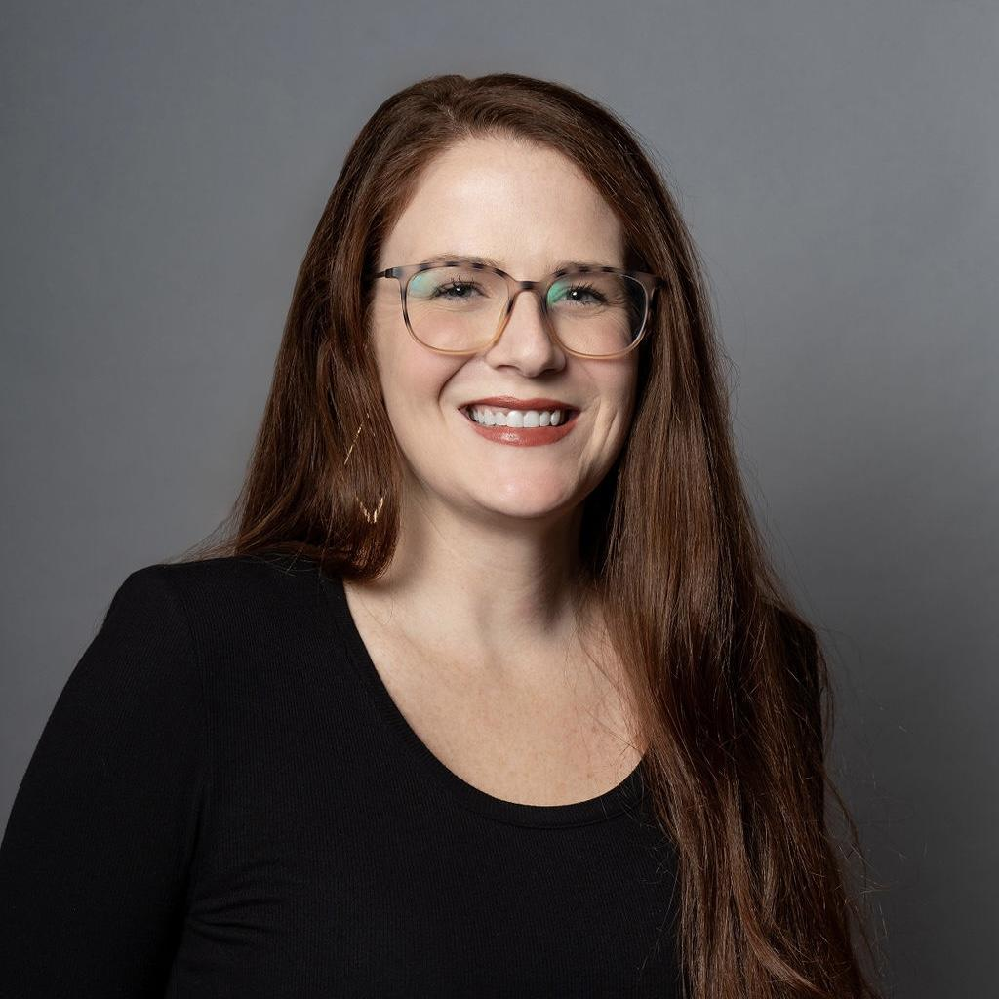
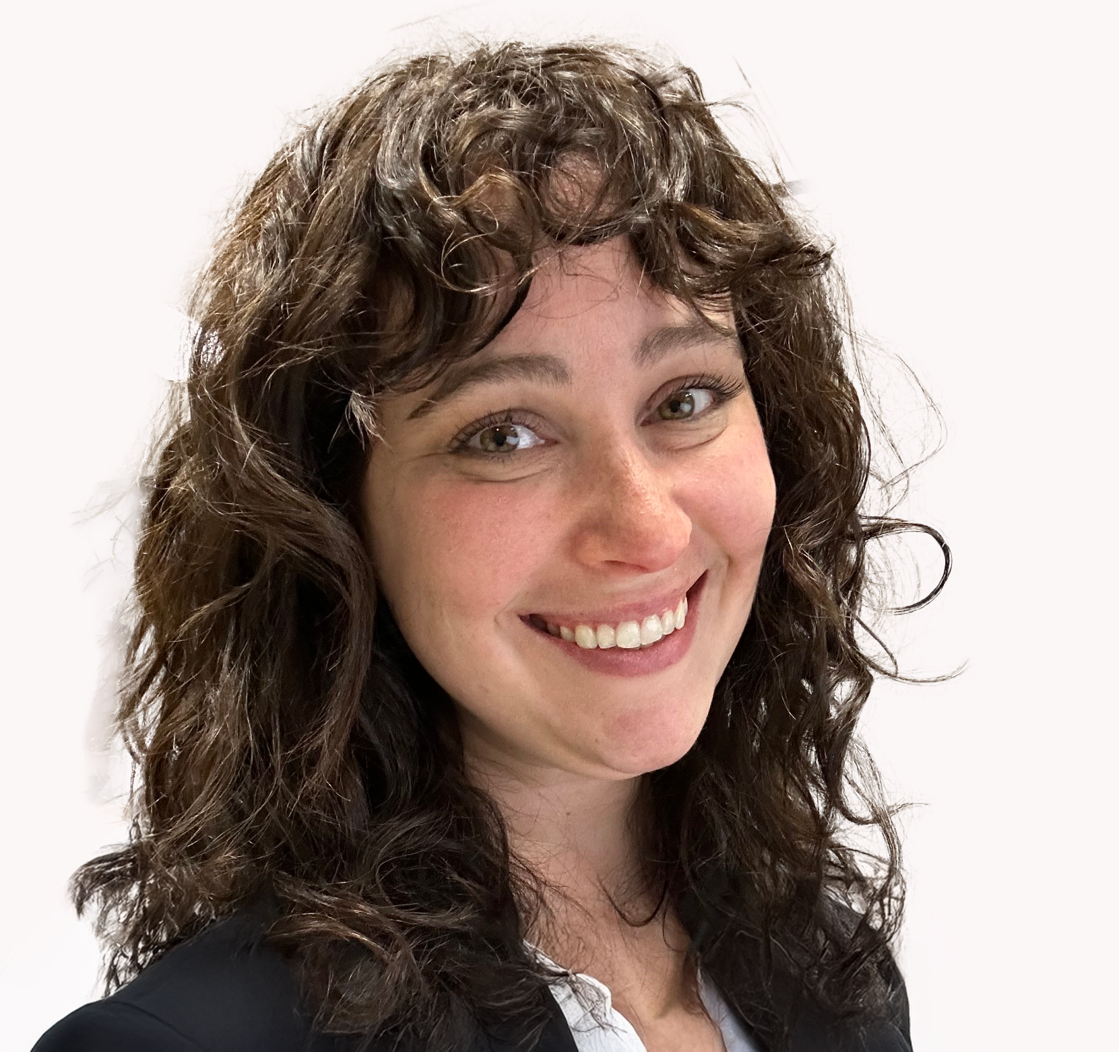
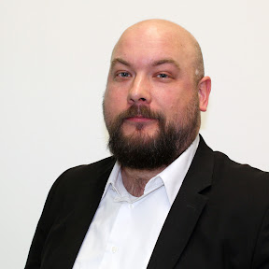
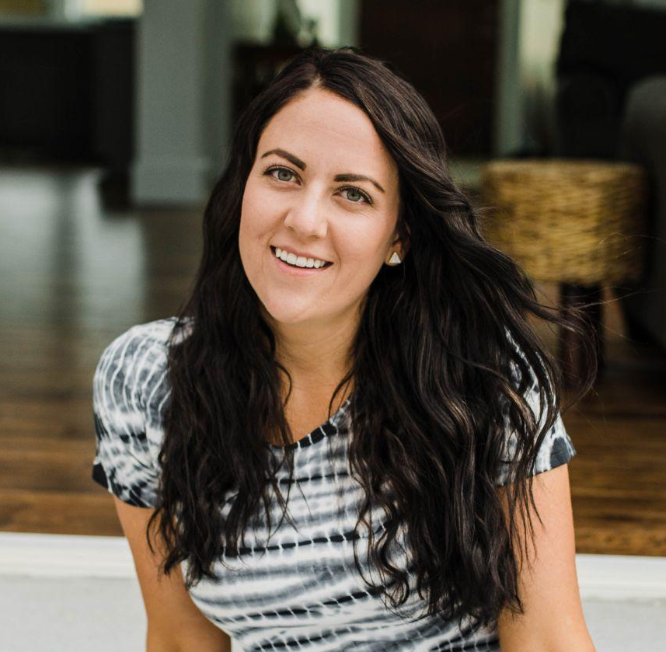
Amy Byrne
Erika Kostamo
Justin Trudell
Marquel Thigpen
Content Director
Social Media Coordinator
Paid Social Media Specialist
WMS Social Media Manager

Slide 4
76%
of customers says social media influenced a purchase within the past 6 months
*Source: Sprout Social’s 2025 State of Social Media

Slide 5
Organic Vs. Paid: What is the difference?
Organic Posting (Unpaid) | Paid Ads (Sponsored)
What it is: Free content posted on your business page. | What it is: Content you pay to promote.
Who sees it: Limited to followers + engagement. | Who sees it: Larger, targeted audience (even if they don’t follow you).

Slide 6
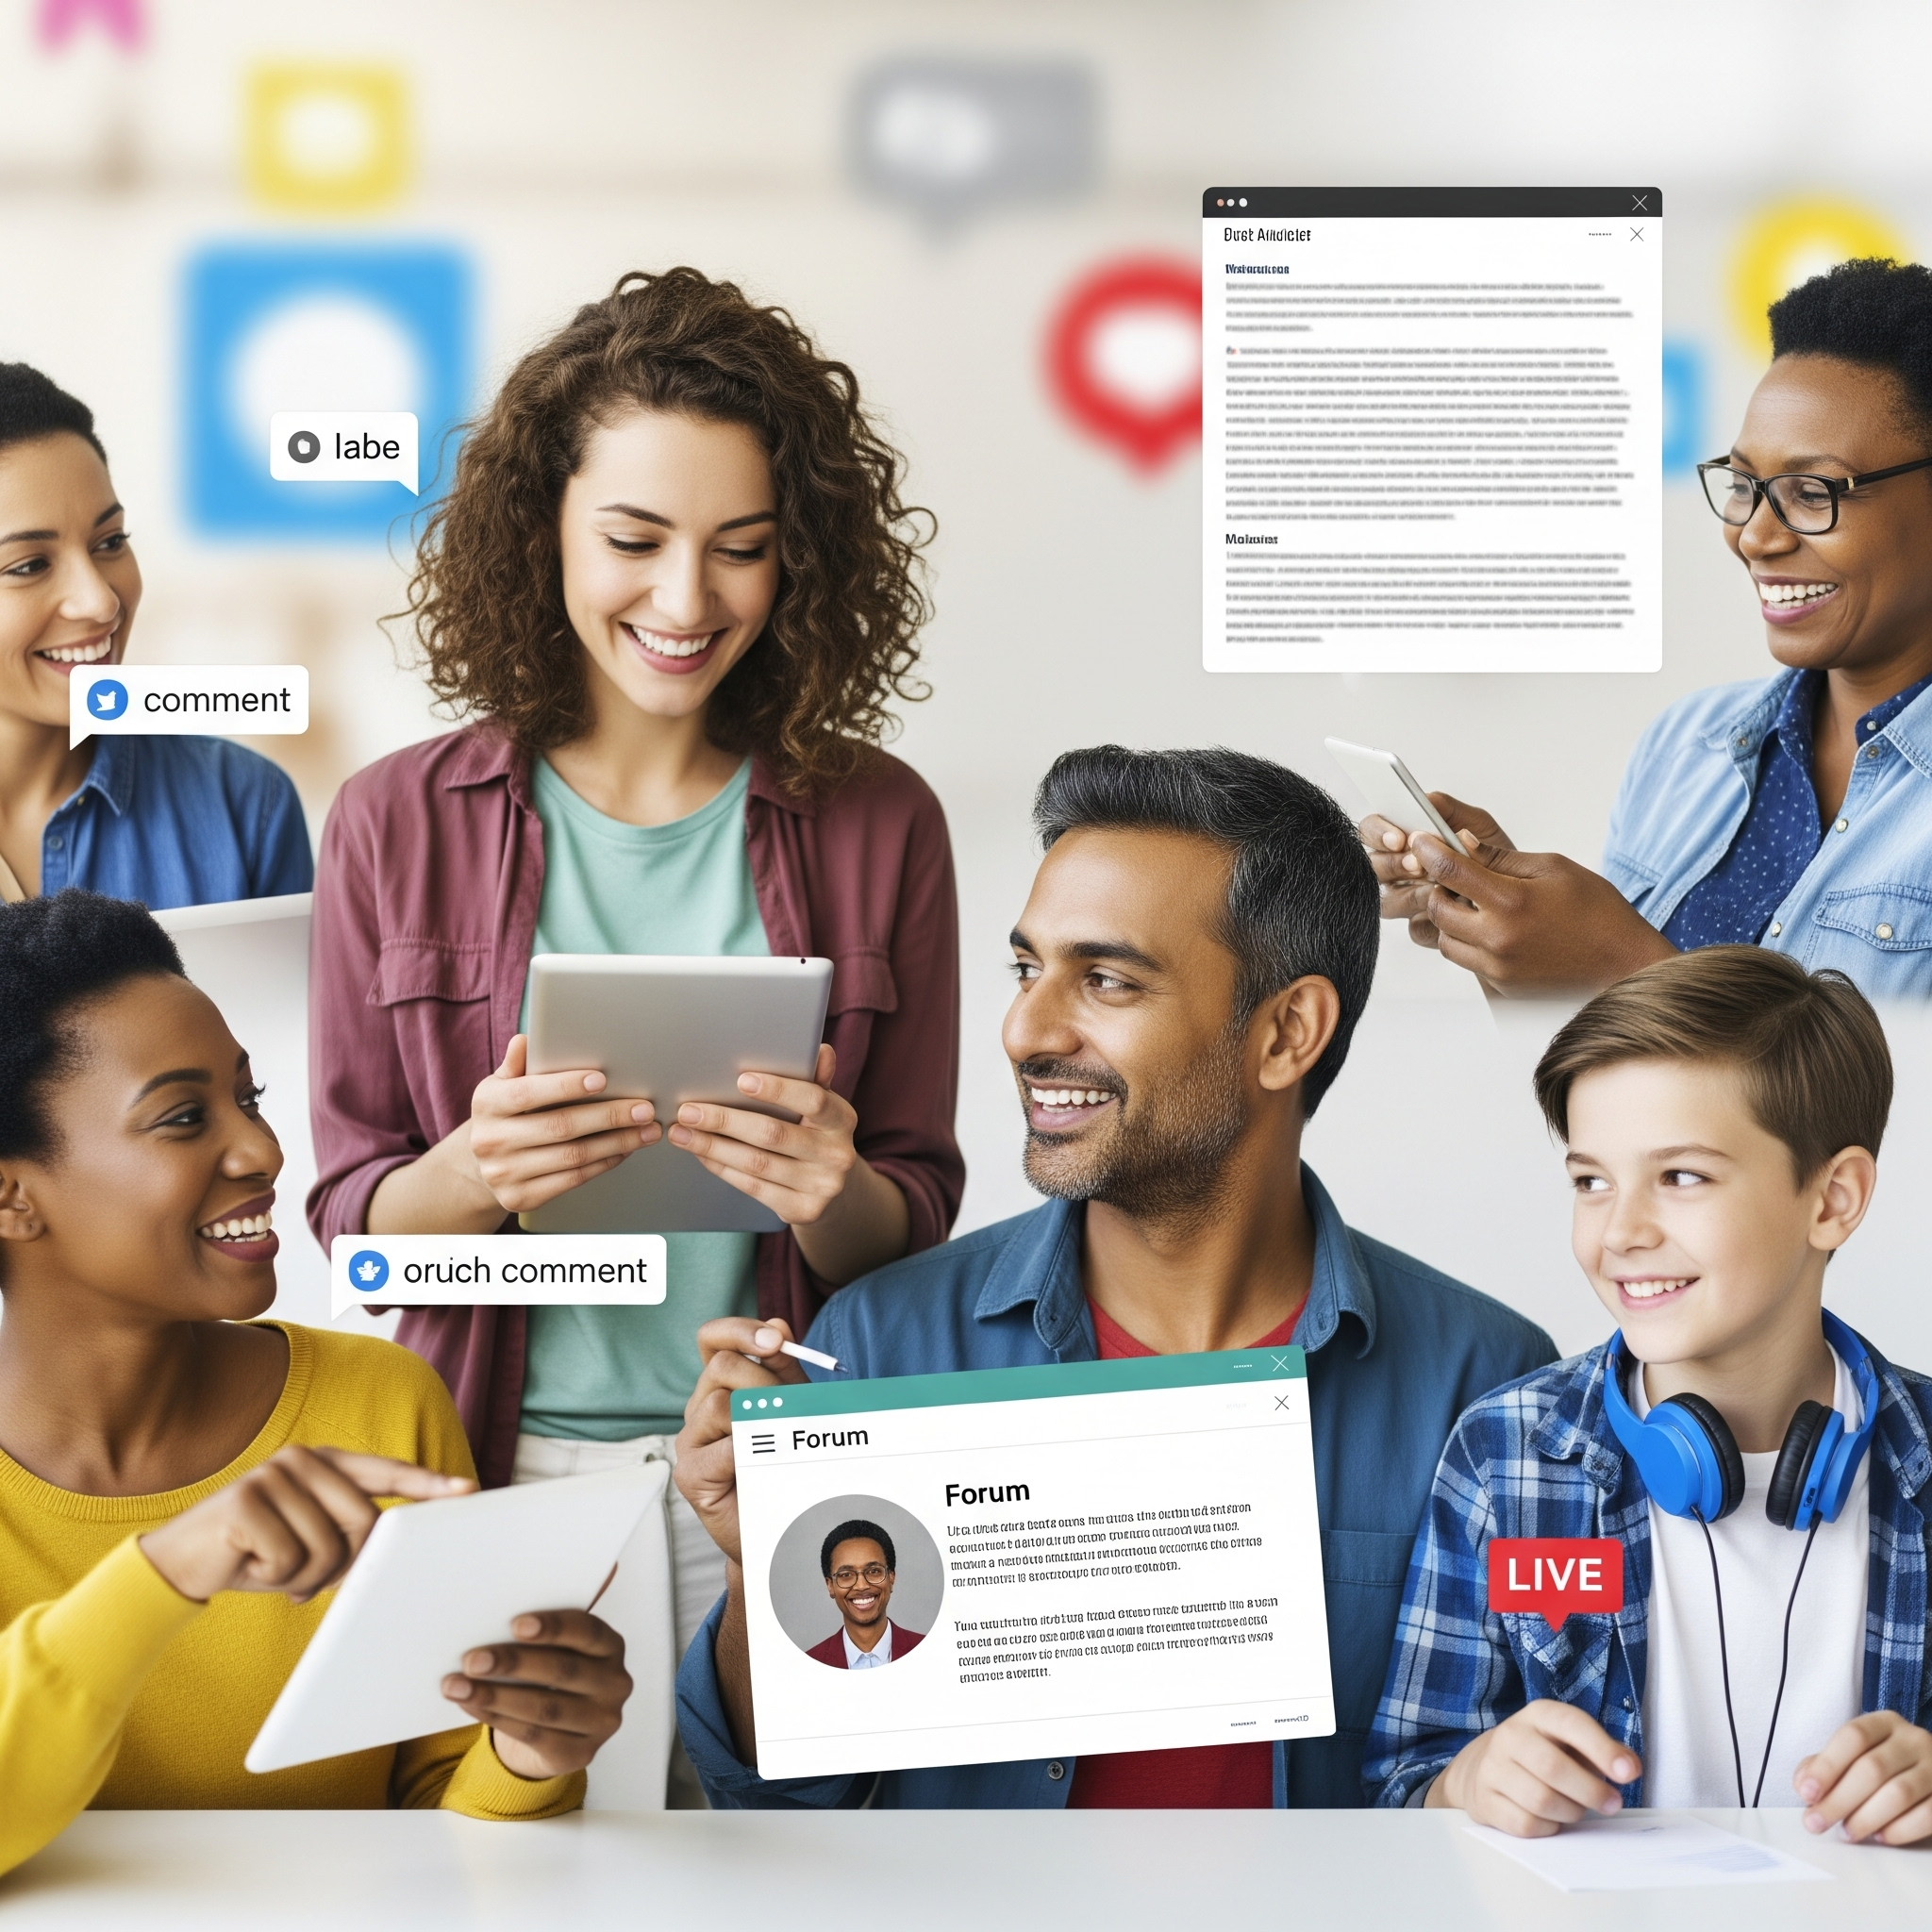
Organic Social: More Than Just A Post
These posts are shown to people that already know your company & follow your page
Builds brand awareness and trust
Fosters a community, not just an audience
Should feel authentic, helpful, and human
Notes:
Organic is the long game.
It nurtures the audience that already knows you–Helps to build that community
It also serves as a “phone book” these days. When people first learn of your company, they look for your online presence before reaching out.

Slide 7
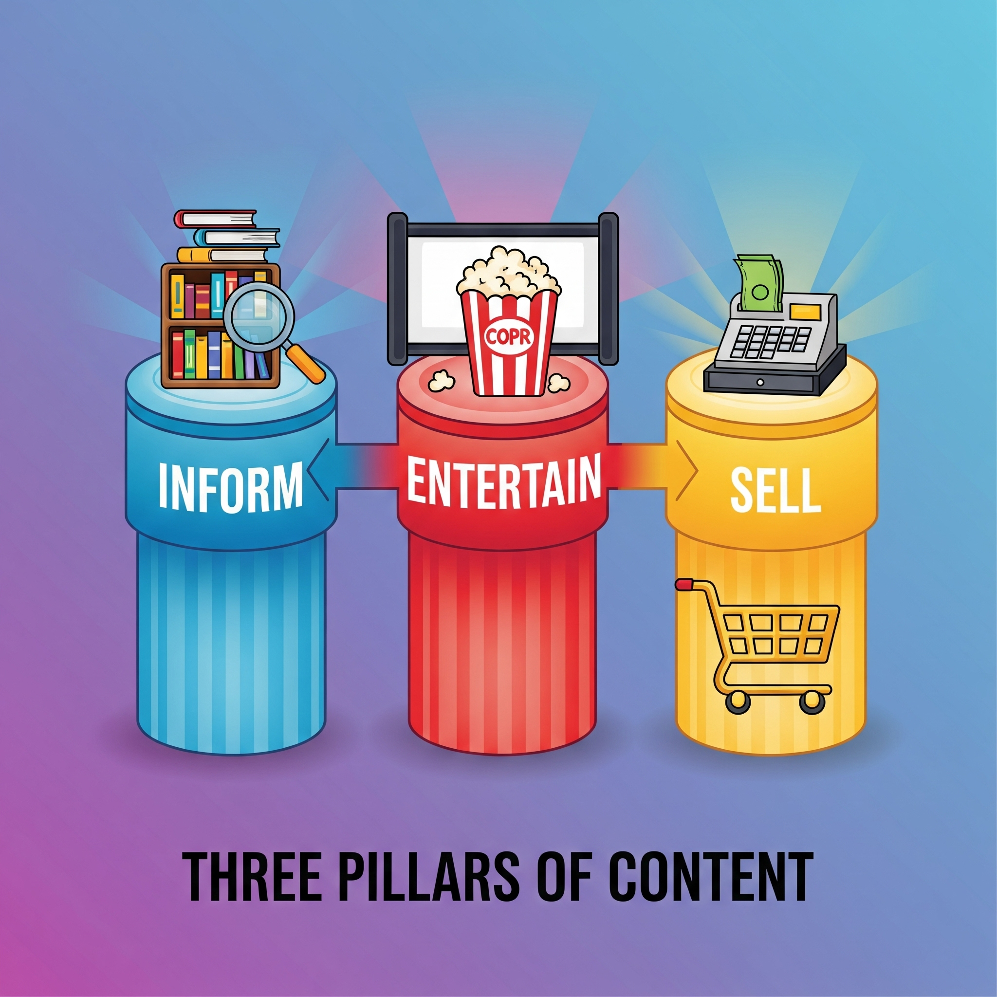
3 Pillars of Organic Content
Inform/Educate: Tips, FAQs, Service Explanations
Entertain: Reels, Memes, Fun Facts, Trends, Team Intros
Sell: Promos, Coupons, CTAs
Notes:
Do not just sell! People are very in-tune to when they are being advertised to, and they get sick of it. No one wants to follow or engage with a constant feed of BUY, BUY, BUY!

Slide 8
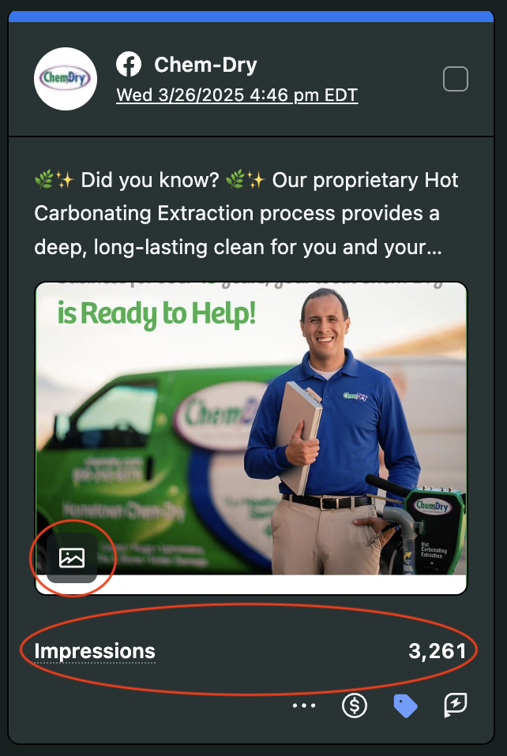
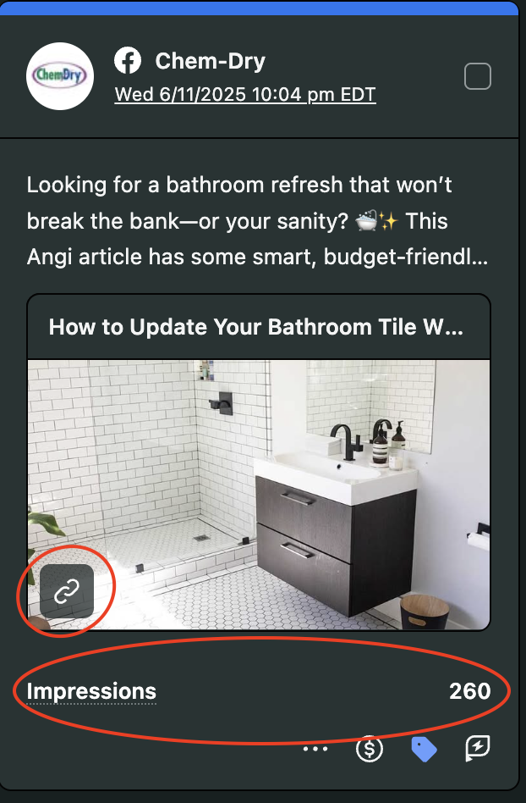
Avoid Constant Sales Pitches & Direct Links
Every post should not include a link
Links kill reach in most algorithms
Focus on value, then direct people where to go to book
Pro-Tip: Include a link in the comment section and call it out in the caption.
Notes:
This one is big. And it’s counter intuitive when your primary reason for being on social media IS to sell.

Slide 9
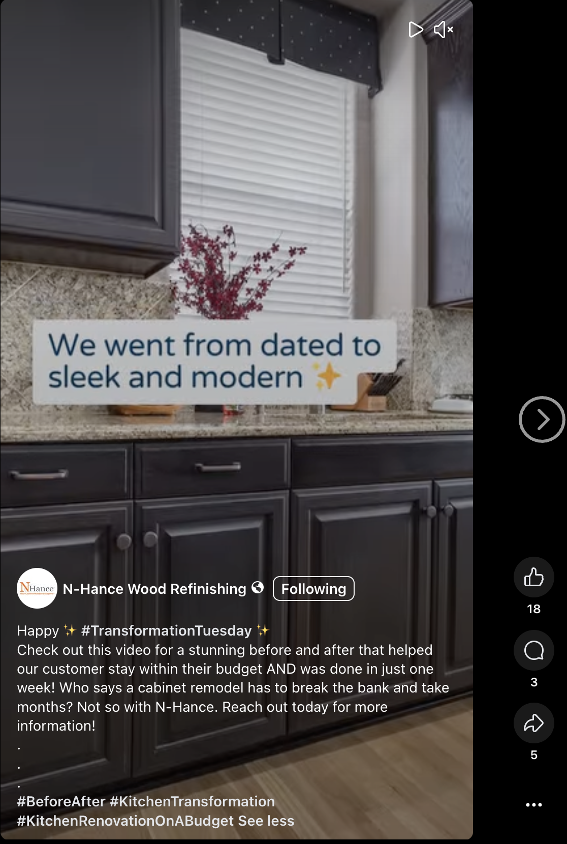
Examples of Great Organic Content
Happy ✨ #TransformationTuesday ✨
Check out this video for a stunning before and after that helped our customer stay within their budget AND was done in just one week! Who says a cabinet remodel has to break the bank and take months? Not so with N-Hance. Reach out today for more information!
.
.
.
#BeforeAfter #KitchenTransformation #KitchenRenovationOnABudget
Reels & Videos
Pillar: Entertain + Inform

Slide 10
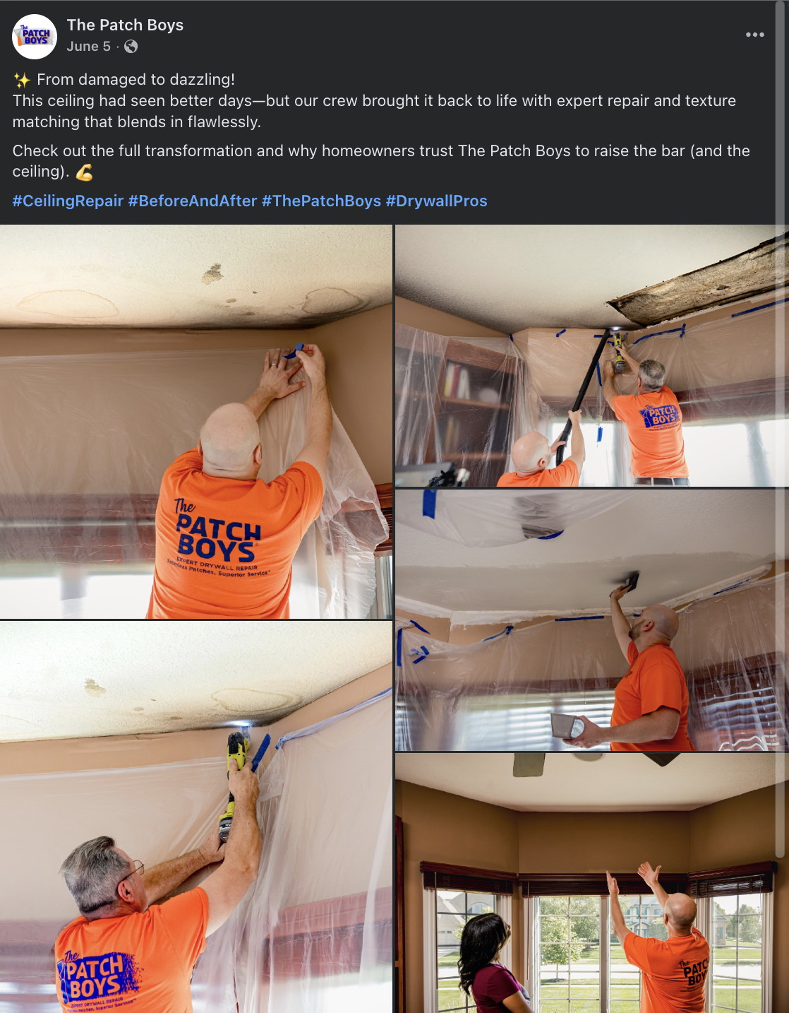
Examples of Great Organic Content
✨ From damaged to dazzling!
This ceiling had seen better days—but our crew brought it back to life with expert repair and texture matching that blends in flawlessly.
Check out the full transformation and why homeowners trust The Patch Boys to raise the bar (and the ceiling). 💪
#CeilingRepair #BeforeAndAfter #ThePatchBoys #DrywallPros
Carousels
Pillar: Inform

Slide 11
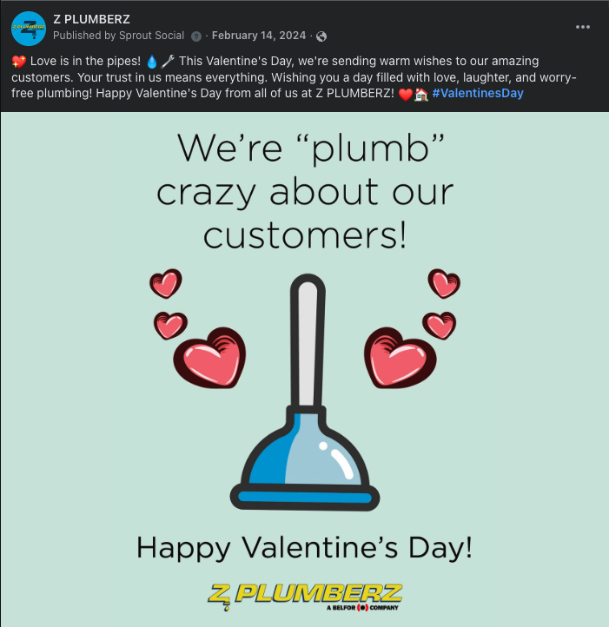
Examples of Great Organic Content
💖 Love is in the pipes! 💧🔧
This Valentine's Day, we're sending warm wishes to our amazing customers. Your trust in us means everything. Wishing you a day filled with love, laughter, and worry-free plumbing!
Happy Valentine's Day from all of us at Z PLUMBERZ! ❤️🏠 #ValentinesDay
Static Post
Pillar: Entertain

Slide 12
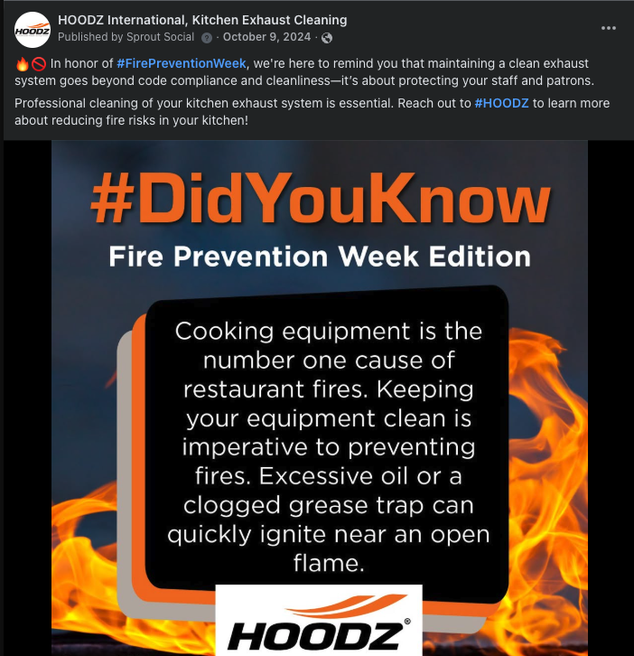
Examples of Great Organic Content
🔥🚫 In honor of #FirePreventionWeek, we're here to remind you that maintaining a clean exhaust system goes beyond code compliance and cleanliness—it’s about protecting your staff and patrons.
Professional cleaning of your kitchen exhaust system is essential. Reach out to #HOODZ to learn more about reducing fire risks in your kitchen!
Static Post
Pillar: Entertain + Sell

Slide 13
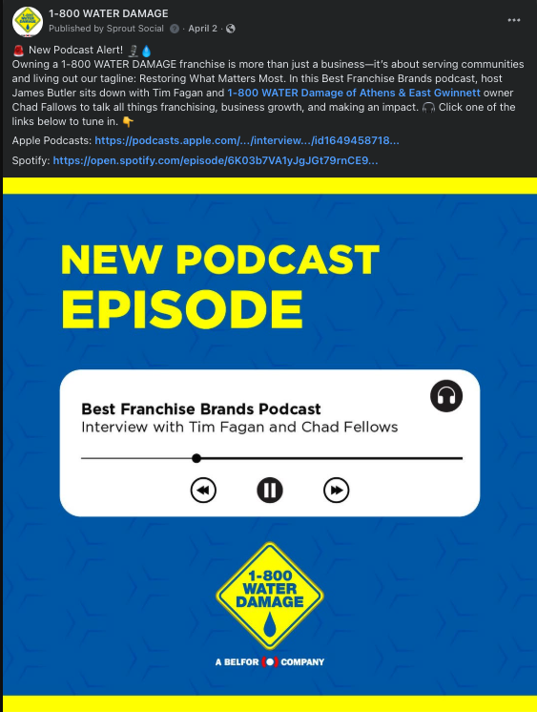
Examples of Great Organic Content
🚨 New Podcast Alert! 🎙️💧
Owning a 1-800 WATER DAMAGE franchise is more than just a business—it’s about serving communities and living out our tagline: Restoring What Matters Most. In this Best Franchise Brands podcast, host James Butler sits down with Tim Fagan and 1-800 WATER Damage of Athens & East Gwinnett owner Chad Fallows to talk all things franchising, business growth, and making an impact.
🎧 Click one of the links below to tune in. 👇
Shared Content
Pillar: Inform

Slide 14
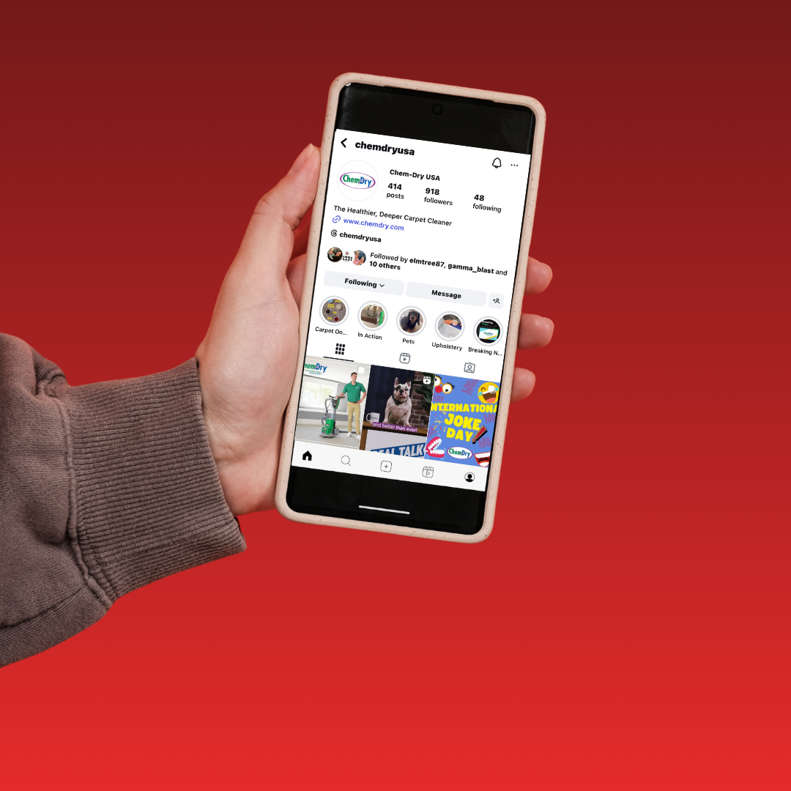
Organic Posts - How to Get It Done
DIY your posts
Sign up for our free Local Social Posting Program
Pay for customized content & posting through a vendor
Pro-tip: Your marketing coordinator can help you with opting into the free posting program and/or preferred vendors.
Notes:
Your marketing coordinator is your point of contact for both opting into the local social posting program and a list of preferred vendors for your brand

Slide 15
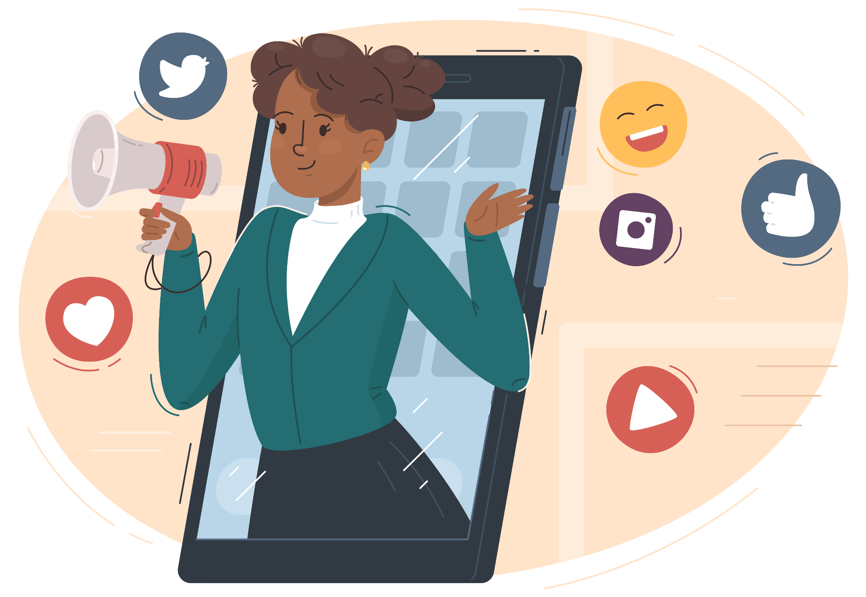
Want to DIY?
Monthly content added to owner drive with images & captions
Use tools like Canva, CapCut, or similar
Share content from national brand accounts
Pro-tip: Images don’t always need to be curated graphics. Share pics from your phone!
Replace image
Notes:
Mention ability to schedule out content in Meta

Slide 16
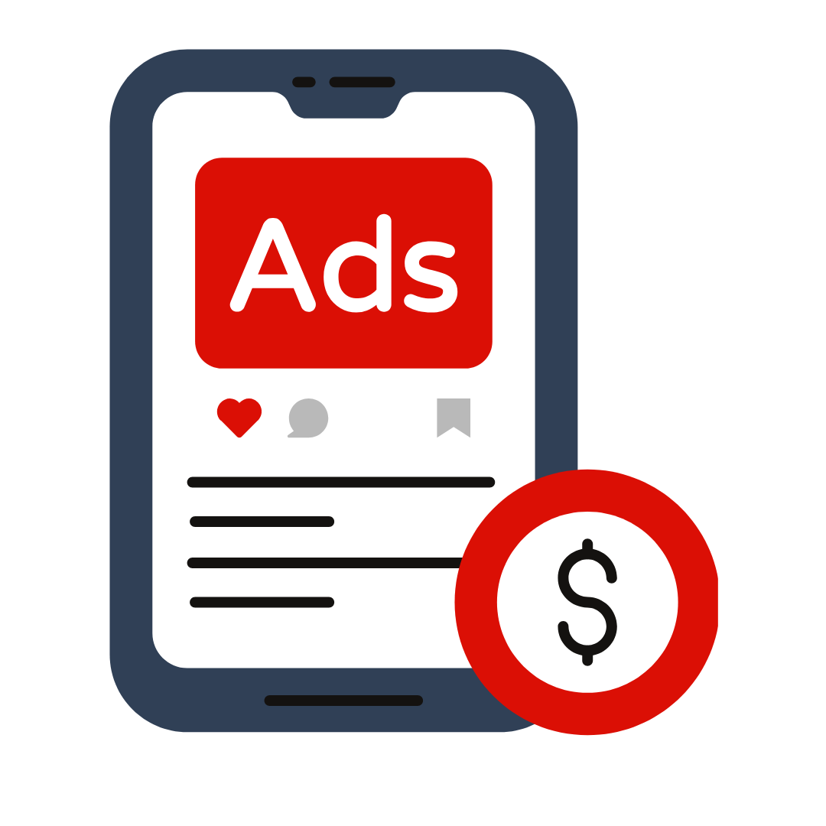
Paid Social: Reaching New Eyes
Drives traffic, leads, or sales
Reaches targeted, new audiences (not just your followers)
Requires different content approaches
Compliments organic social efforts
Notes:
Paid ads are different than just boosting organic content. They should be strategic & targeted

Slide 17

Paid Social Goals
Awareness: eyeballs on your content
Traffic: link clicks & visits to your website
Conversions: phone calls, messages, form fills
Notes:
I personally don’t run awareness ads. I don’t feel that there is a good way to gauge if they are connecting with your audience. We run traffic ads as our top of funnel strategy bc CTR is a good indication of engagement & the right creative.

Slide 18
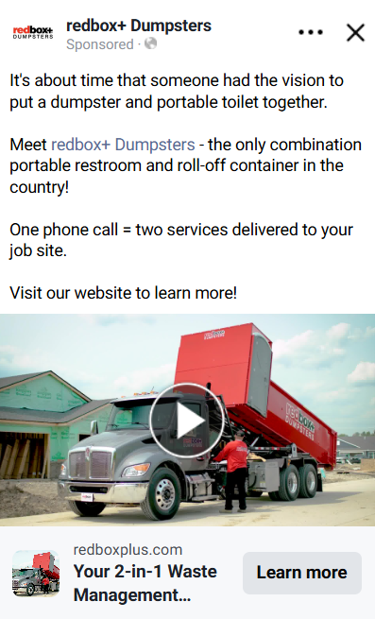
Examples of Paid Social Content
Brand commercials are useful for more than just TV!
Video content is huge on social media right now.
Lean into that trend by using assets that already exist in paid ads to introduce new customers to your business.
Commercials
Great for Traffic Level Ads
Driving potential customers to your website to learn more about you

Slide 19
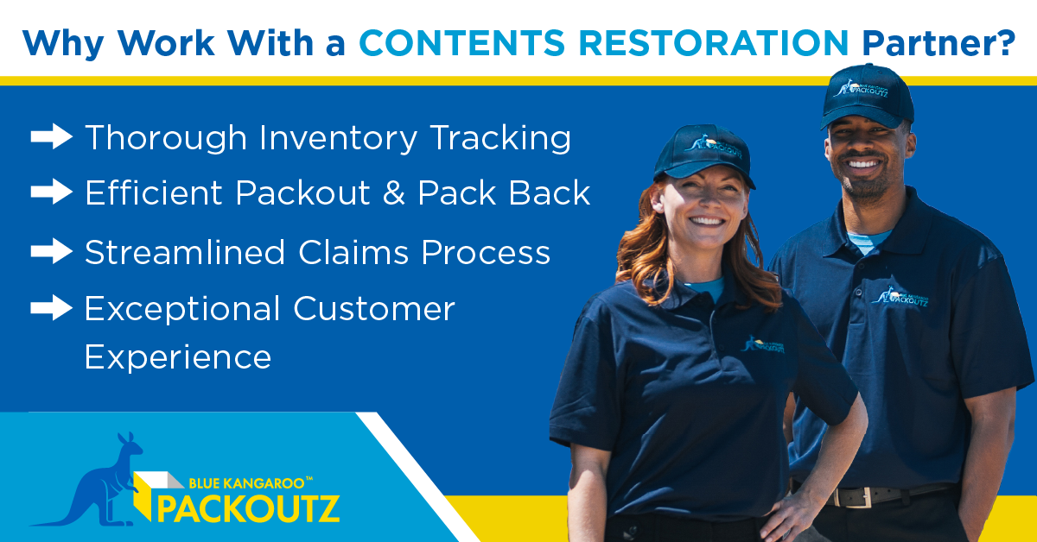
Examples of Paid Social Content
Static images that highlight services or differentiators are great paid content.
They introduce your business & provide just enough information to drive the audience to click through to your site to learn more.
Pro tip: Evergreen static social ads can be found in your owner drive.
Static Brand Promo
Great for Traffic Level Ads
Driving potential customers to your website to learn more about you

Slide 20
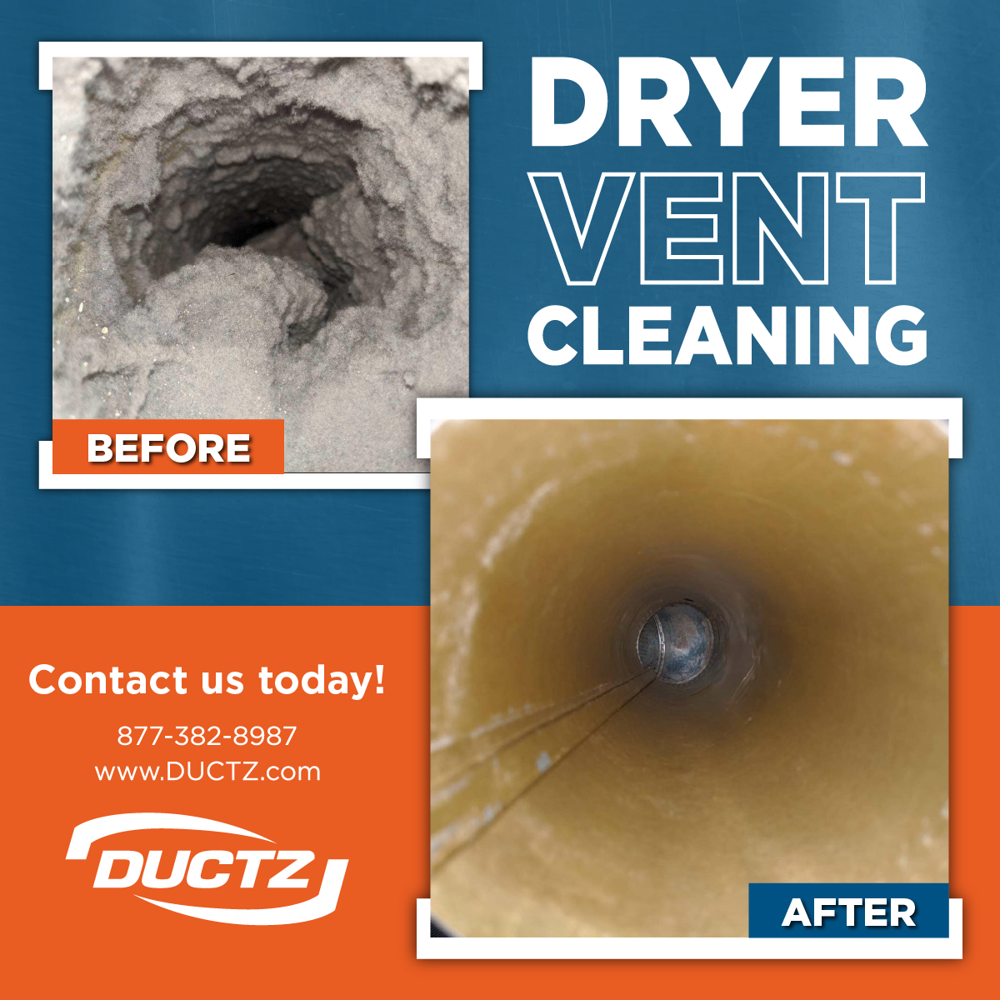
Examples of Paid Social Content
Before & after images are great social proof content.
They show potential customers the impact of your work, which can be a strong driver for both learning more about your business and booking your services.
Before & After
Great for Both Traffic & Conversion Level Ads

Slide 21
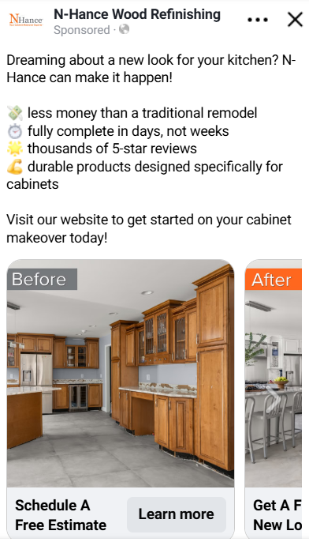
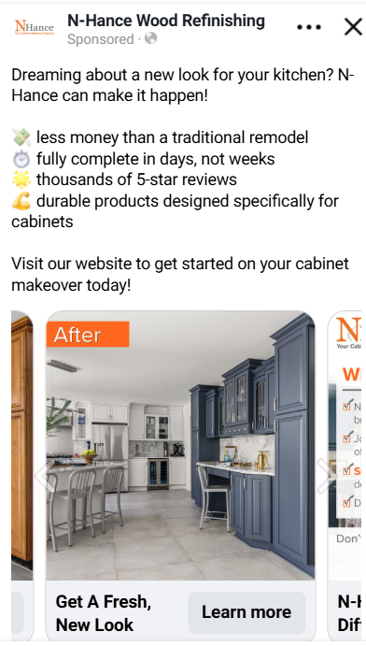
Examples of Paid Social Content
For visual services, carousels are a great way to showcase before & after images.
They allow users to interact with the ad by swiping through the cards at their own pace, increasing the time they spend viewing your content.
Carousels
Great for Both Traffic & Conversion Level Ads
Notes:
Carousels make great before & afters as well!

Slide 22
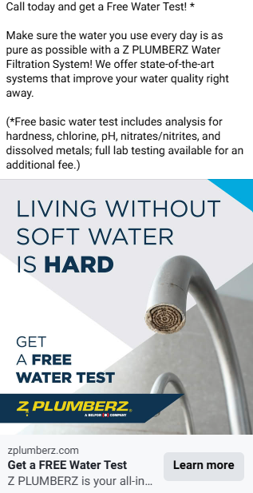
Examples of Paid Social Content
Offers & promotions are a great way to add urgency to your call to action.
They work well as Conversion Ads to generate leads.
The action can be clicking through to your site, making a phone call, sending a message on Meta, or entering their information in a Meta form.
Offers & Promotions
Great for Conversion Level Ads
Lead generating through messages, form fills, and phone calls

Slide 23
Conversion Ads: What to Know Before You Start
Conversion ads often come with a higher cost.
Don’t run message or form fill ads if you are not checking Meta daily.
Don’t run phone call ads if you don’t have a system in place for after hours calls.

Slide 24
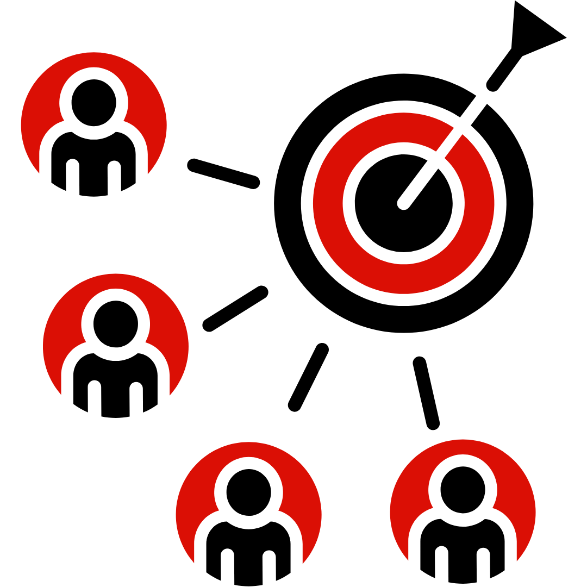
Paid Social Audience Targeting
Paid social allows you to target specific audiences.
You should ONLY target your owned zip codes.
Think about who your customers are, and select demographics that match – age, gender, household income, parents, pet owners, job titles, etc.
Broader audiences work for awareness and traffic campaigns.
Be more specific when targeting for conversion campaigns.

Slide 25
Paid Social - Resources to Get It Done
BFG Paid Social Media Tutorial Video
Evergreen Social Ads + Captions on the Owner Drive
Work with a Vendor for customized, done-for-you support
Pro-tip: Your marketing coordinator can help you with locating evergreen content and/or preferred vendors.

Slide 26
Questions?

Slide 27
Join us next month!
Local PR featuring Ripley PR
Wednesday, August 20th at 4 p.m. EST

