Slide 1

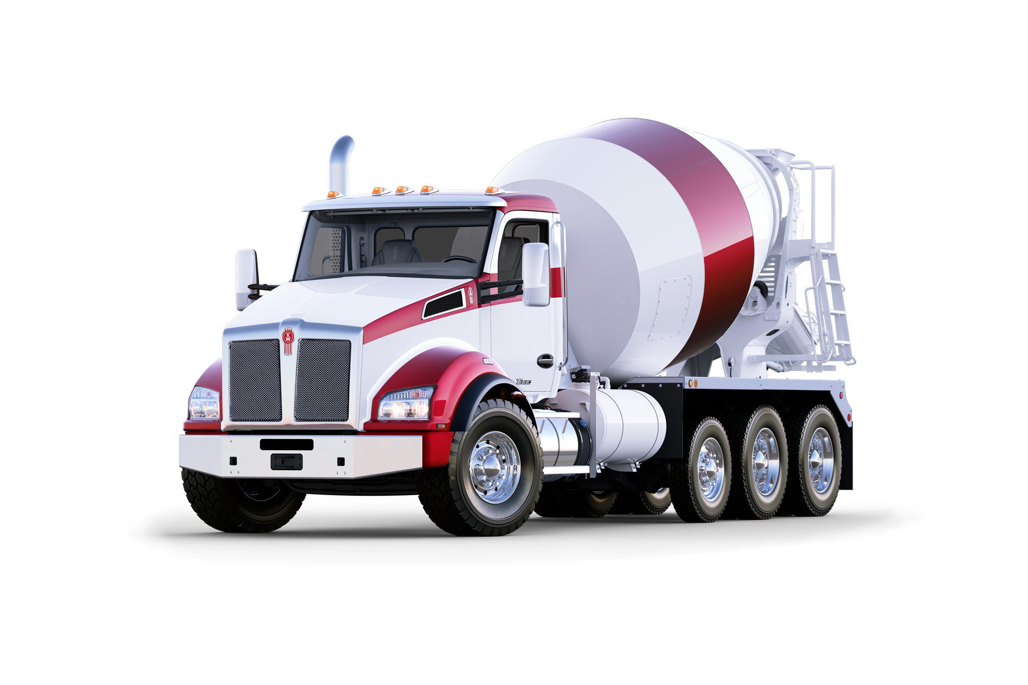
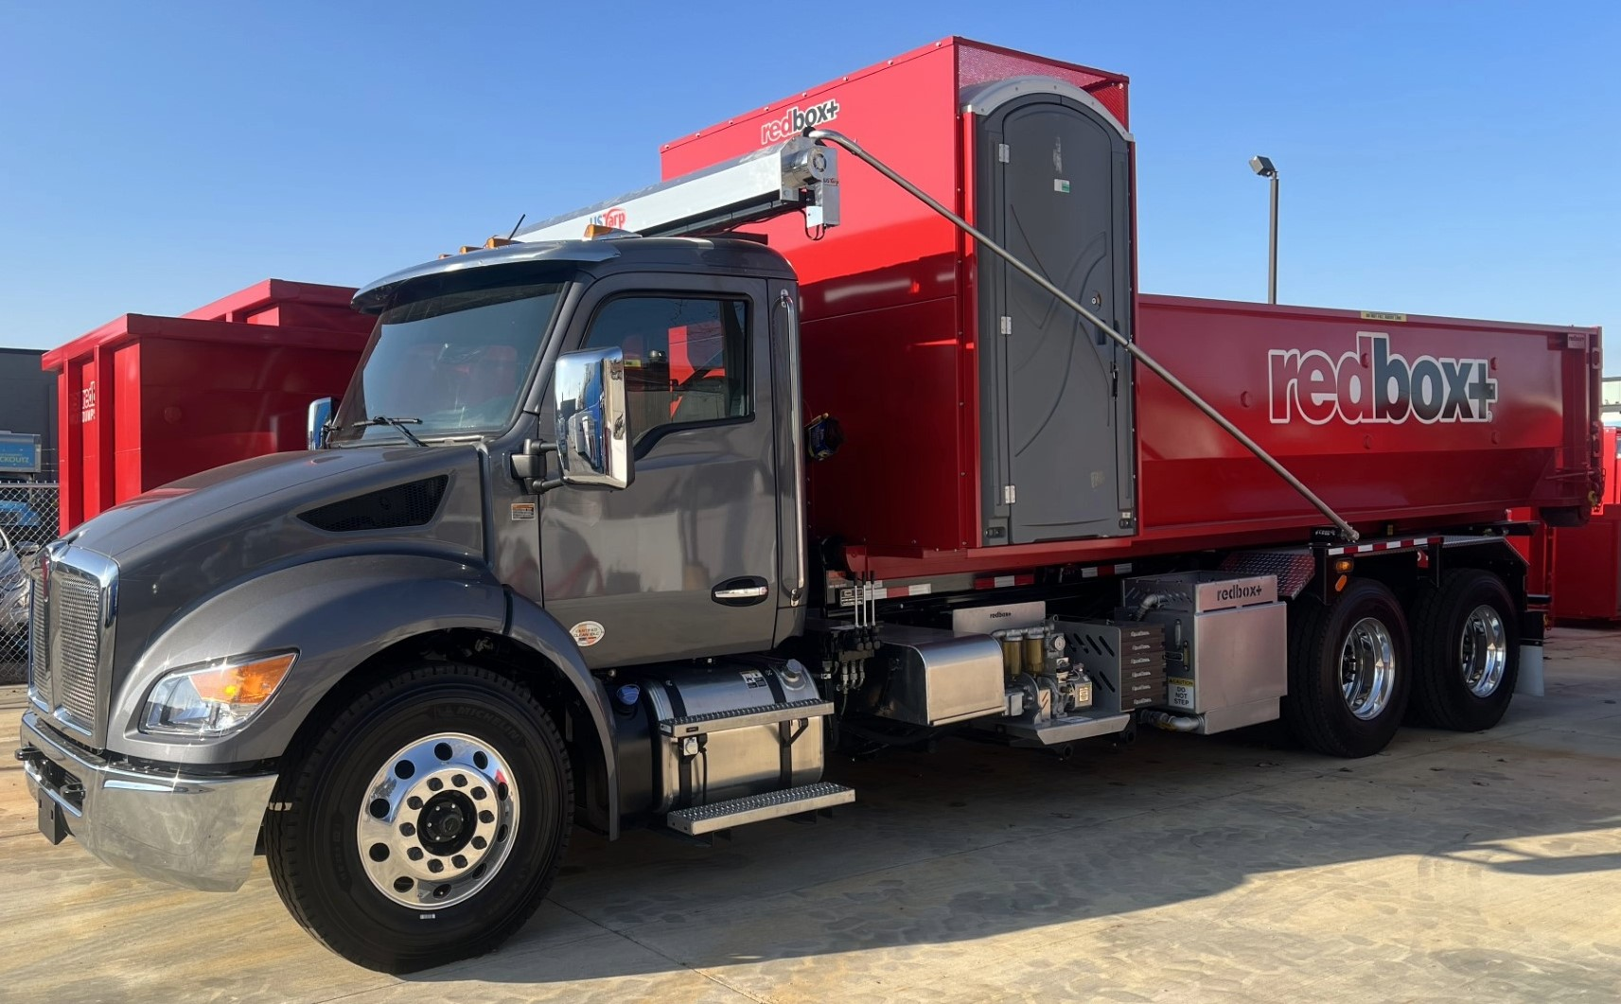

Dash Symbols & Controls Guide For Medium Duty Kenworth Trucks

Slide 2
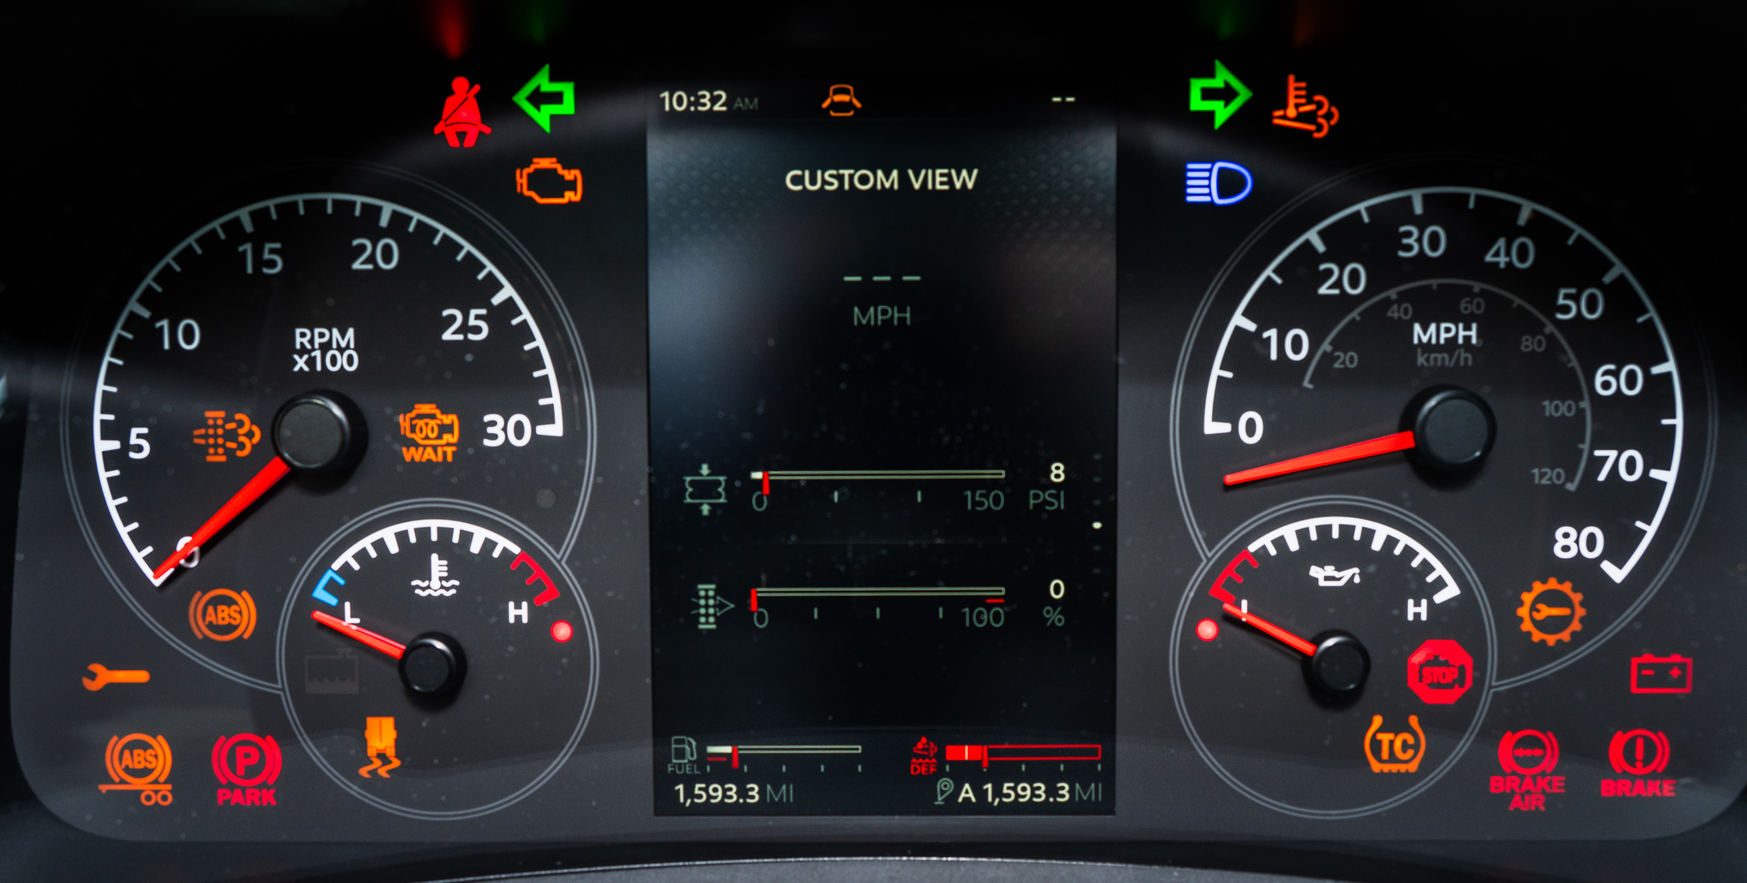
DASH LIGHTS & GAUGES
Emissions, Malfunction Indicator Light
Turn Signal, Left
Turn Signal, Right
Seat Belt Fasten
Driver/ Passenger Door Not Shut
Diesel Particulate (DP) Warning Lamp
DPF Warning Indicator
Light, High Beams
Brakes, ABS Tractor
Transmission Service Needed
Battery
Service Needed
Parking Brake Active
Engine Stop
Immediately
Trailer, Anti-Lock Brakes
Parking Brake
Traction Control (Automatic)
Brakes, Low Air
Axle Stability Control

Slide 3
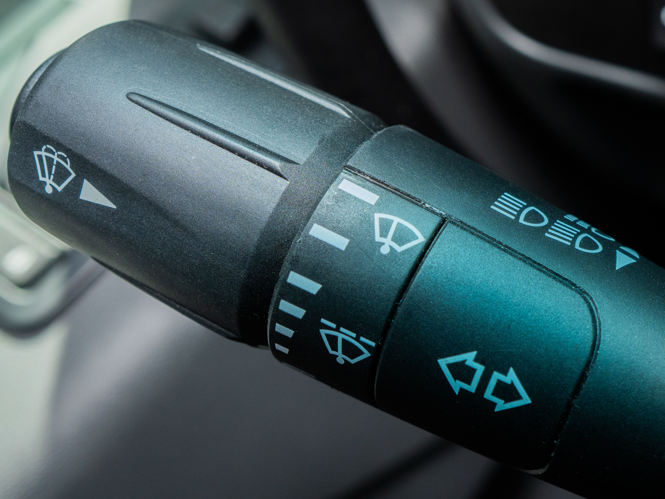
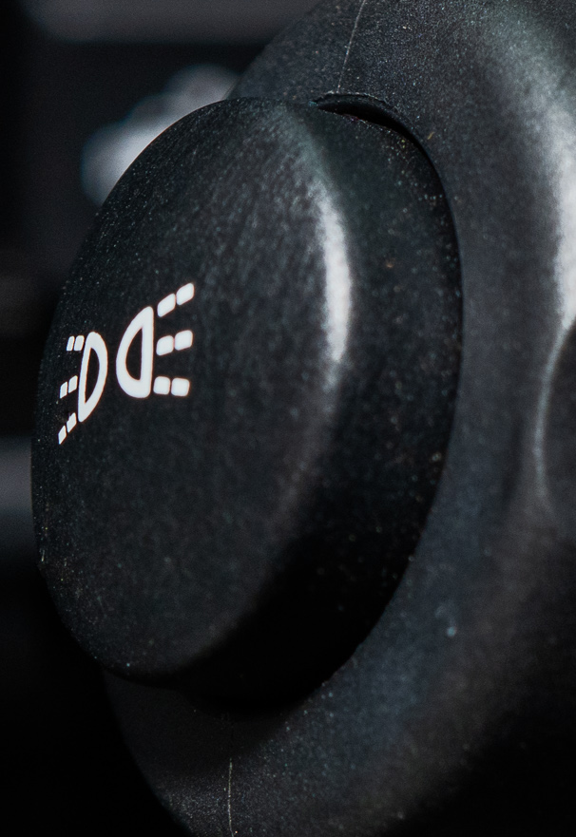
STEERING WHEEL CONTROLS
High Beam: Pull In Turn Signal Toward Steering Wheel Flash High Beams: Push In Opposite Direction
Marker Interrupter
Windshield Spray Collar
Wiper Speed
Turn Signal
Push Down: Left
Push Up: Right

Slide 4
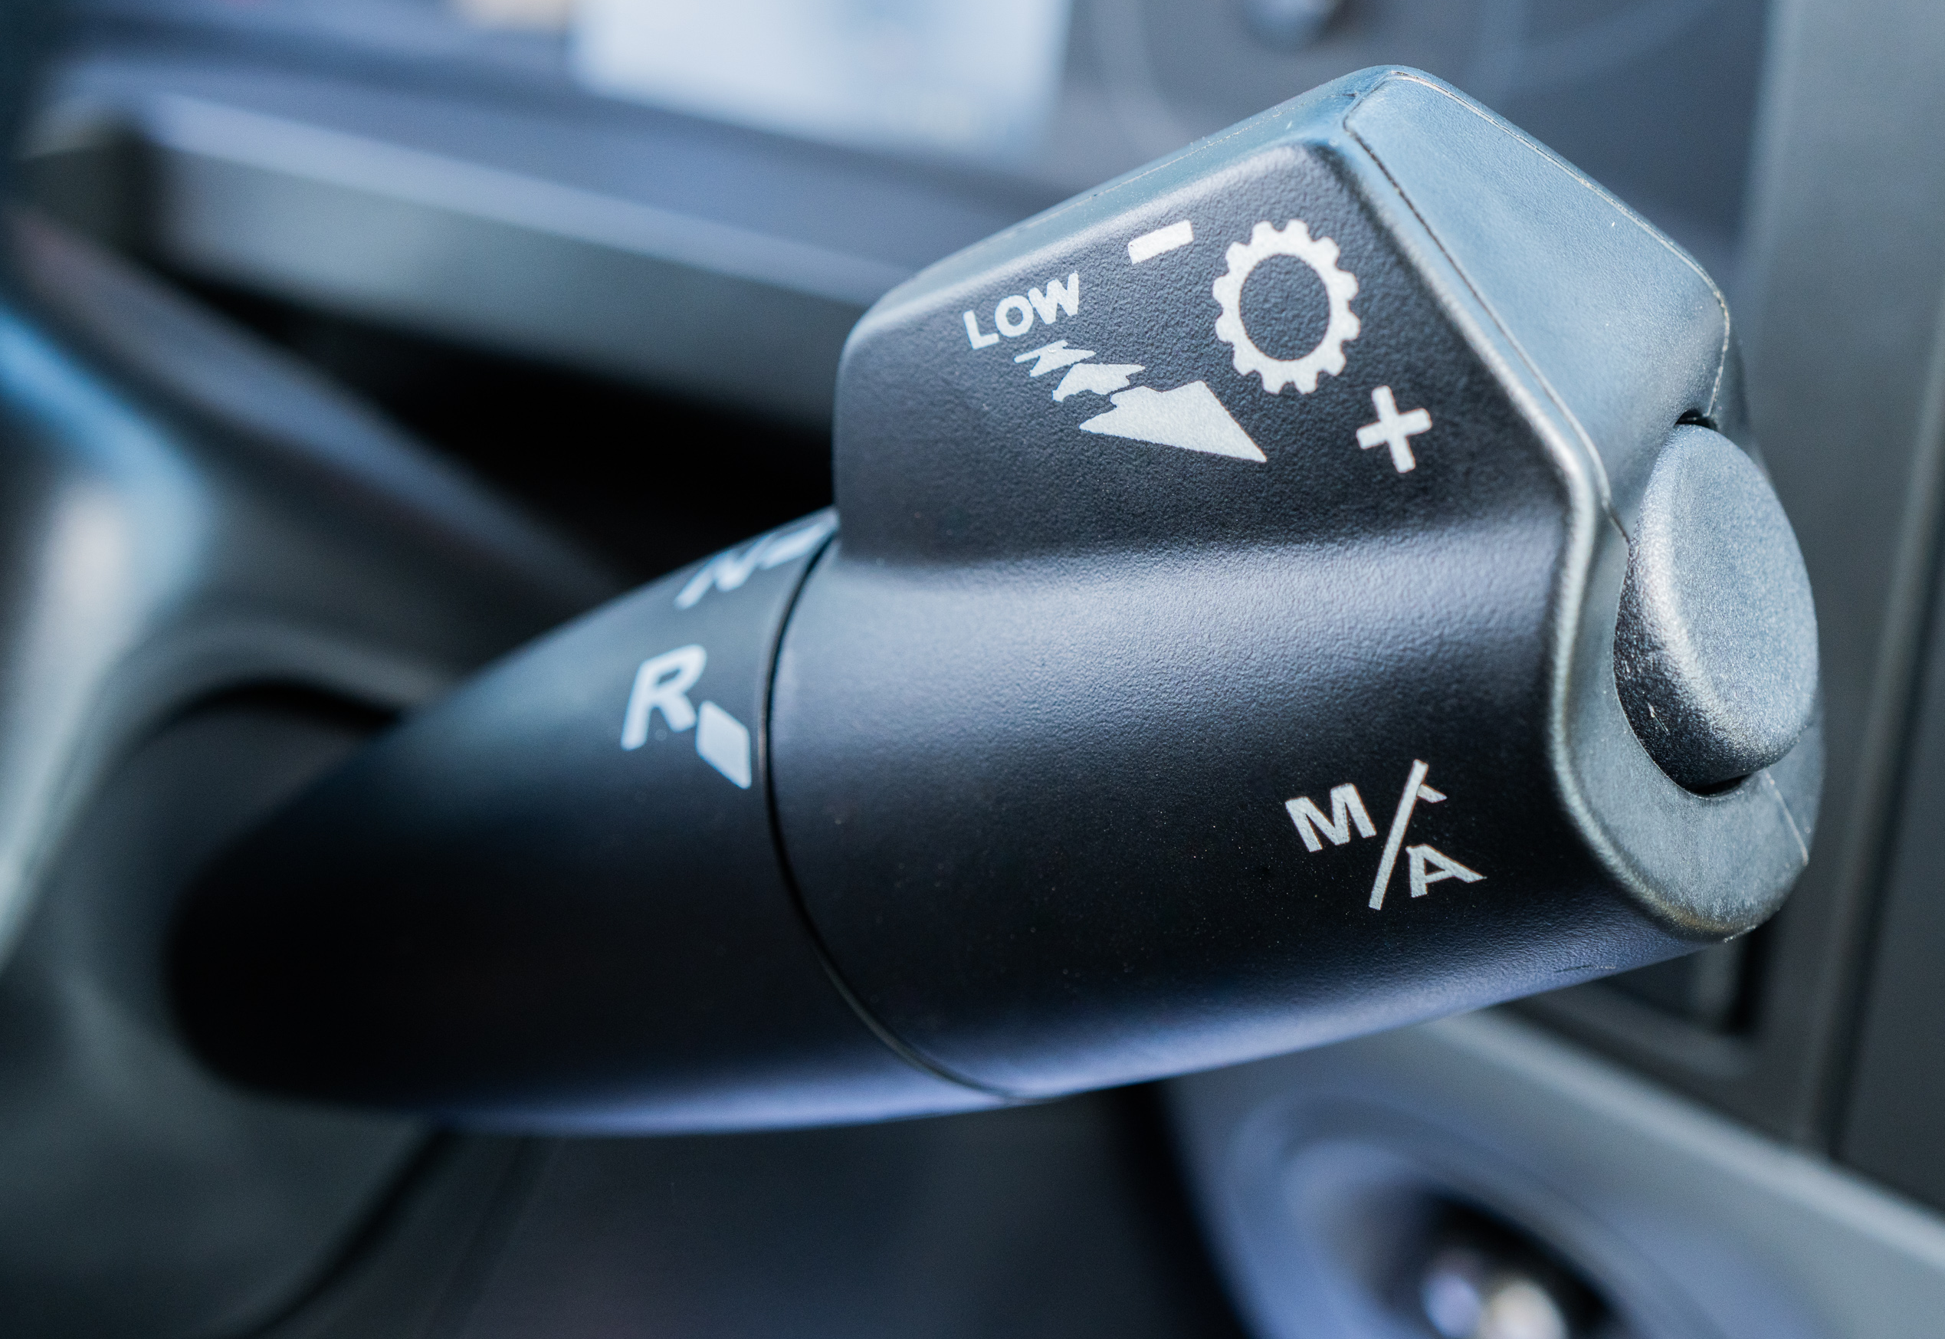
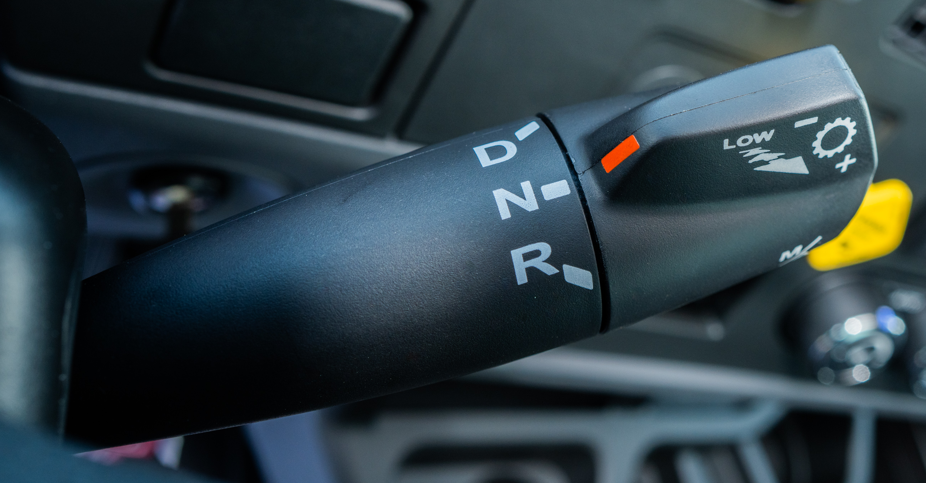
Engine Manual Mode Shift Lever
Manual Shift On/Off
Manual Shift Lever – Up/Down
Manual Shift Lever – Up/Down
Drive, Neutral, Reverse

Slide 5
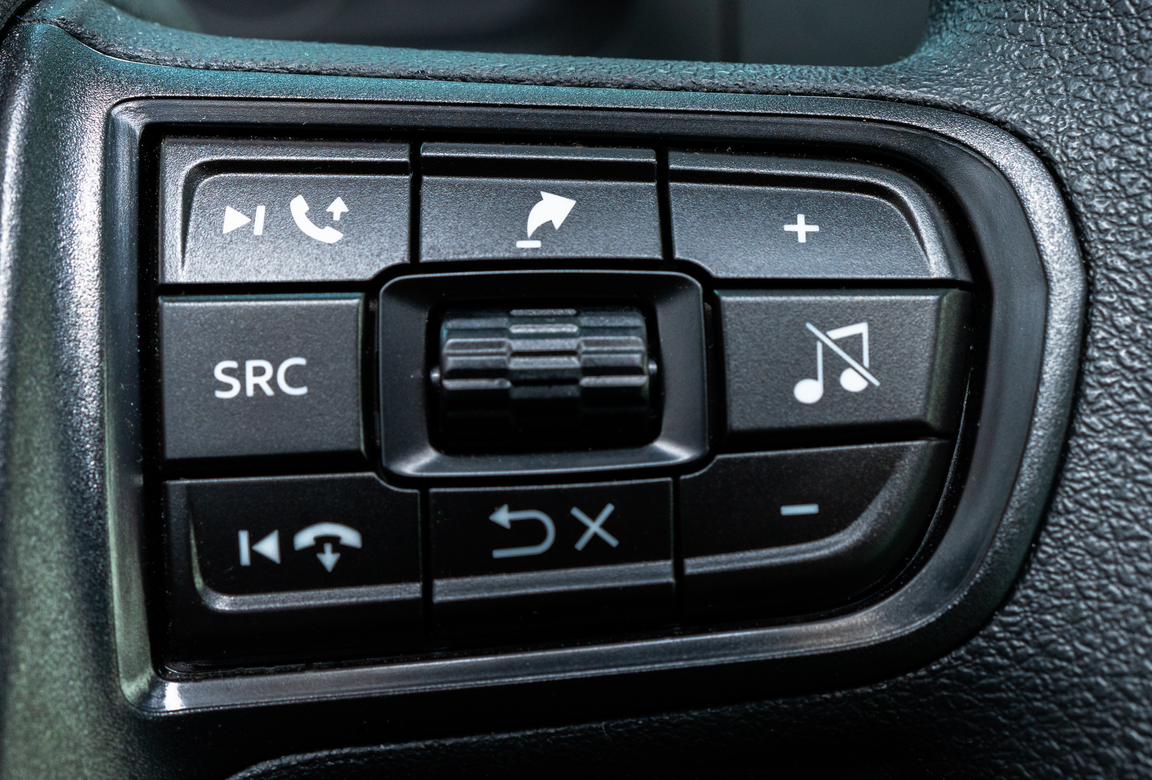
Favorites To Customize Gauges
Customize Gauges
Navigate Screens
Volume Control
Forward Track Radio & Accept Call
Auto ON/OFF Radio Mute
Radio Source
Volume Control
Back Track Radio & End Call
Back or Cancel

Slide 6
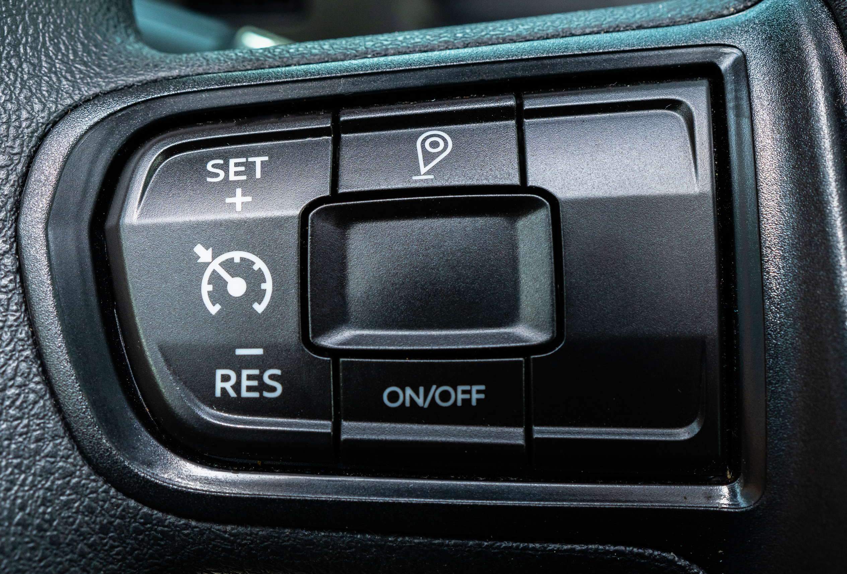
Start New Trip Segment
OK/Select
Set Cruise/ Increase Cruise Speed
Toggle Dash Settings
Resume Cruise/ Lower Cruise Speed
Cruise Control
ON/OFF Button

Slide 7
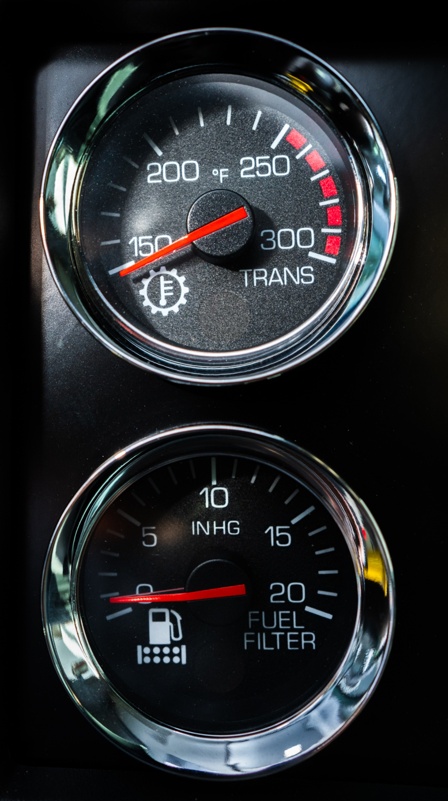
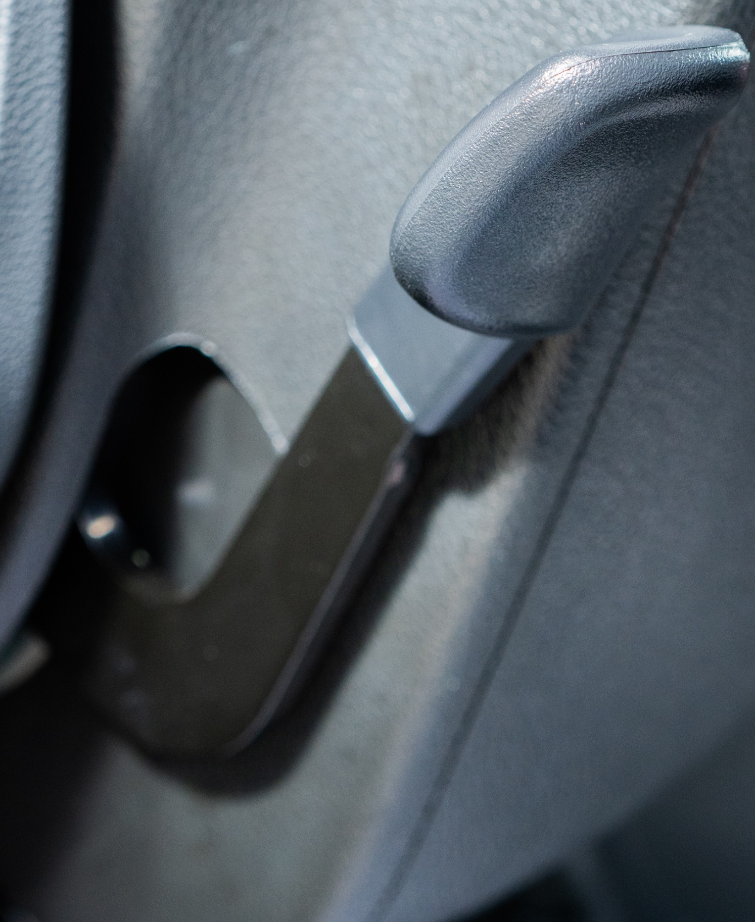
Steering Wheel Tilt Telescopic Lever
Transmission Temperature
Gauge
Fuel Filter Restriction Gauge

Slide 8
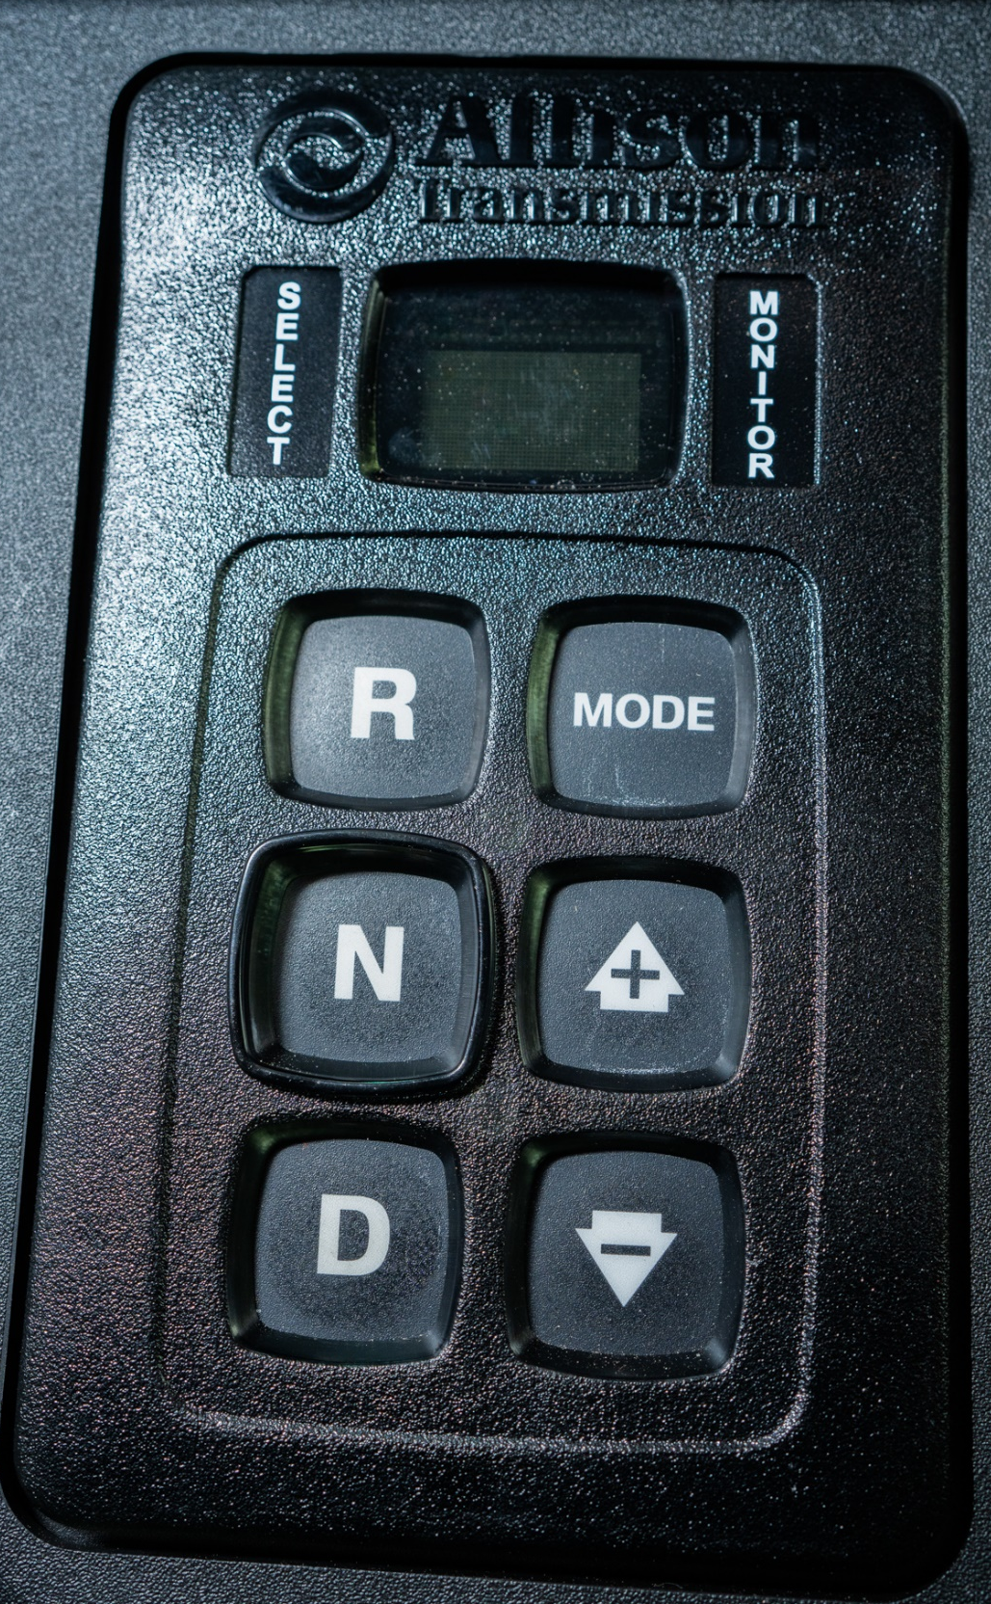
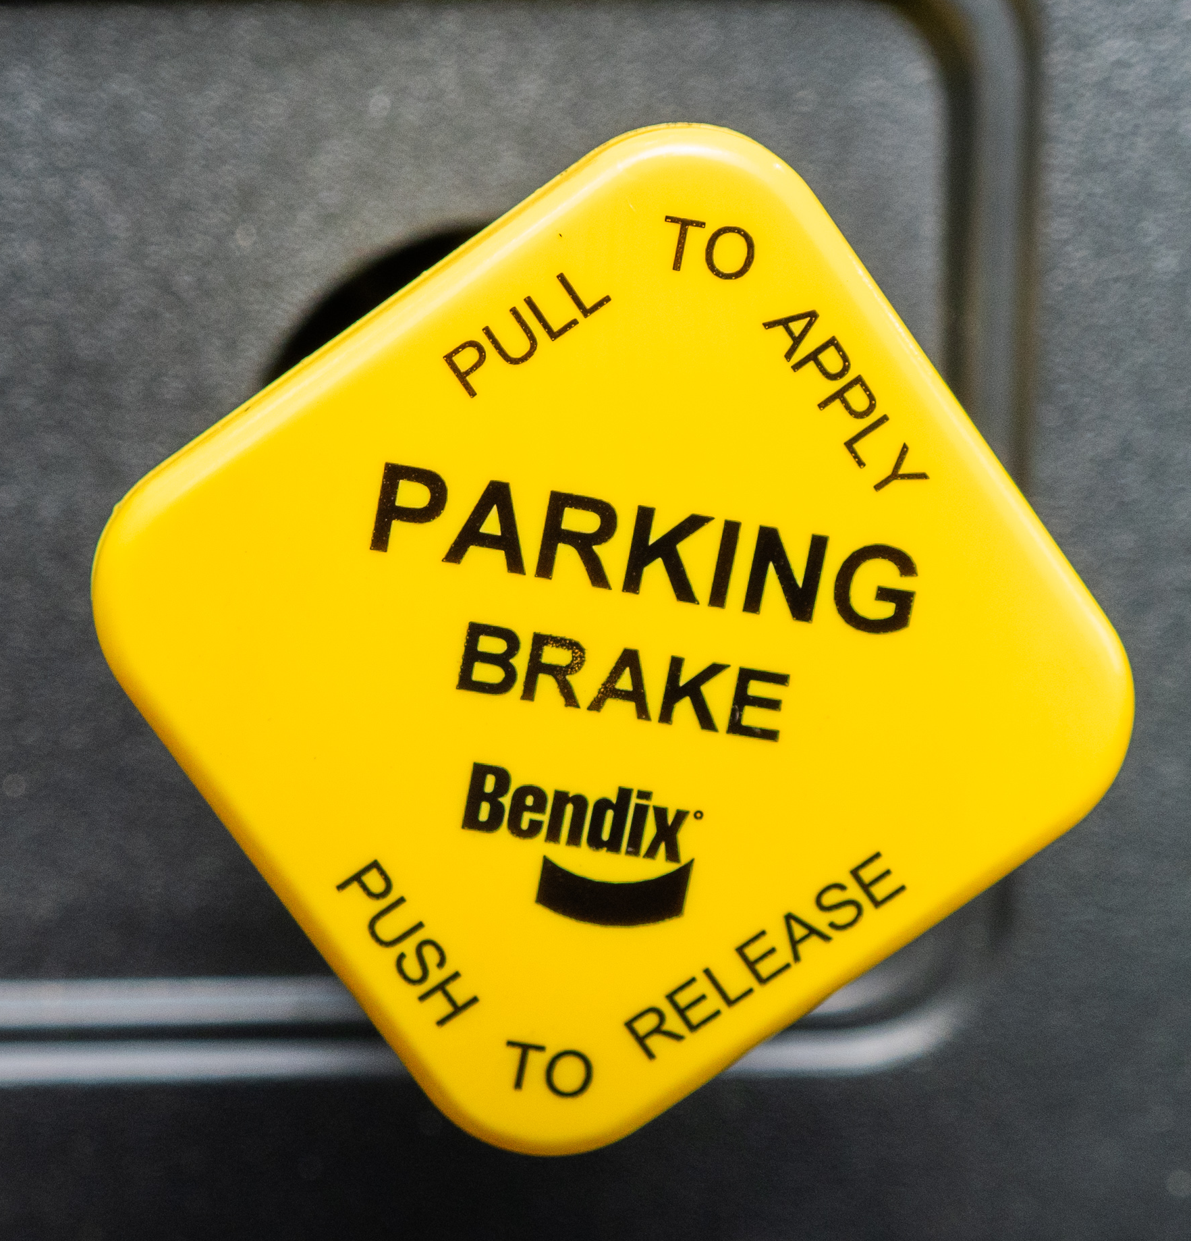
GEARS & BRAKES
Parking Brake
Reverse
Neutral
Drive
Fuel Economy Mode
Manual Forward Shift
Manual Down Shift

Slide 9
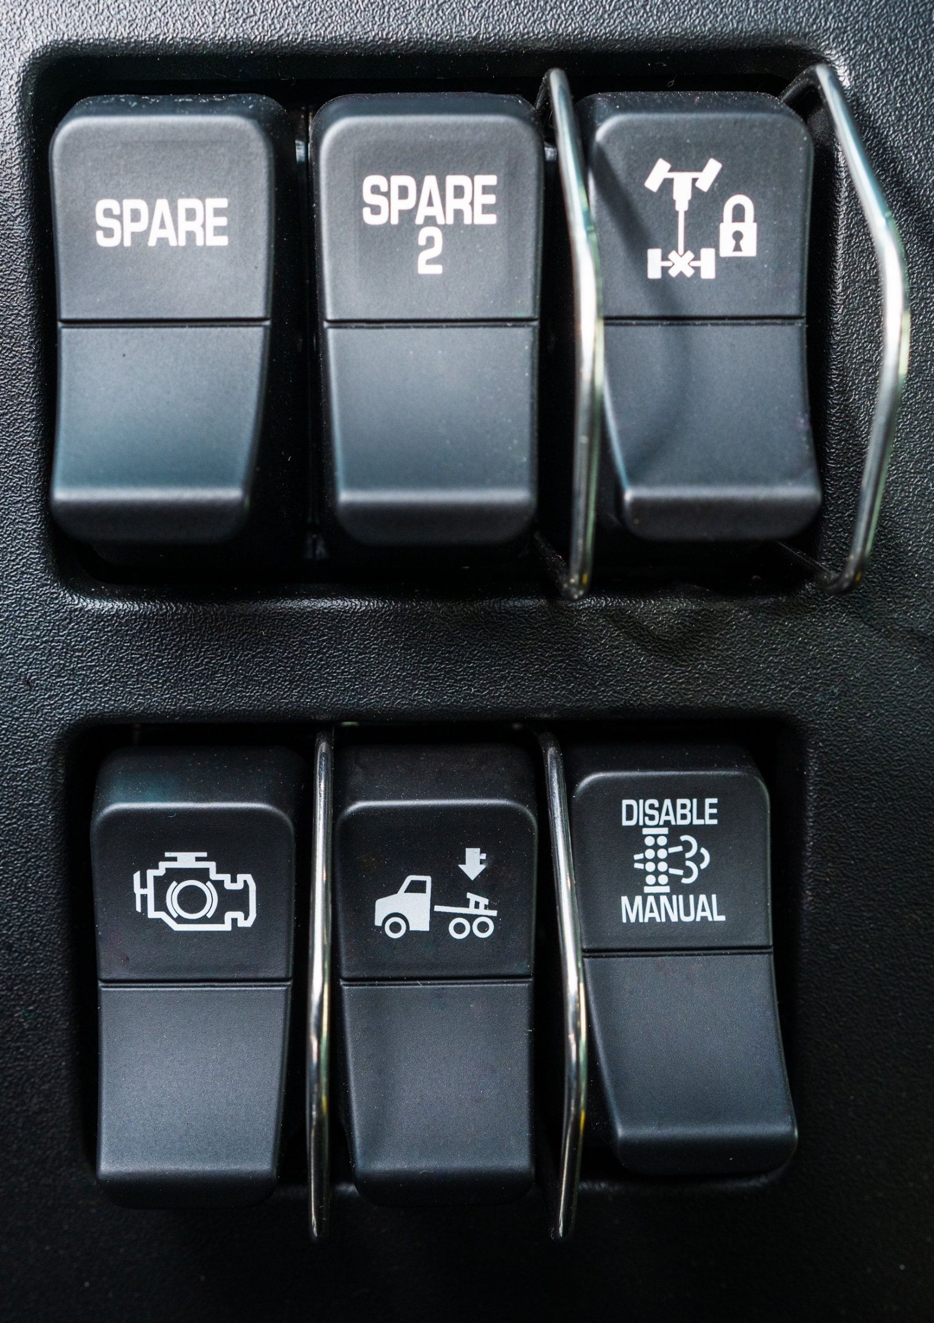
Spare Switches
Differential Lock Control
Engine Brake
Disable Manual Regen
Suspension Dump

Slide 10
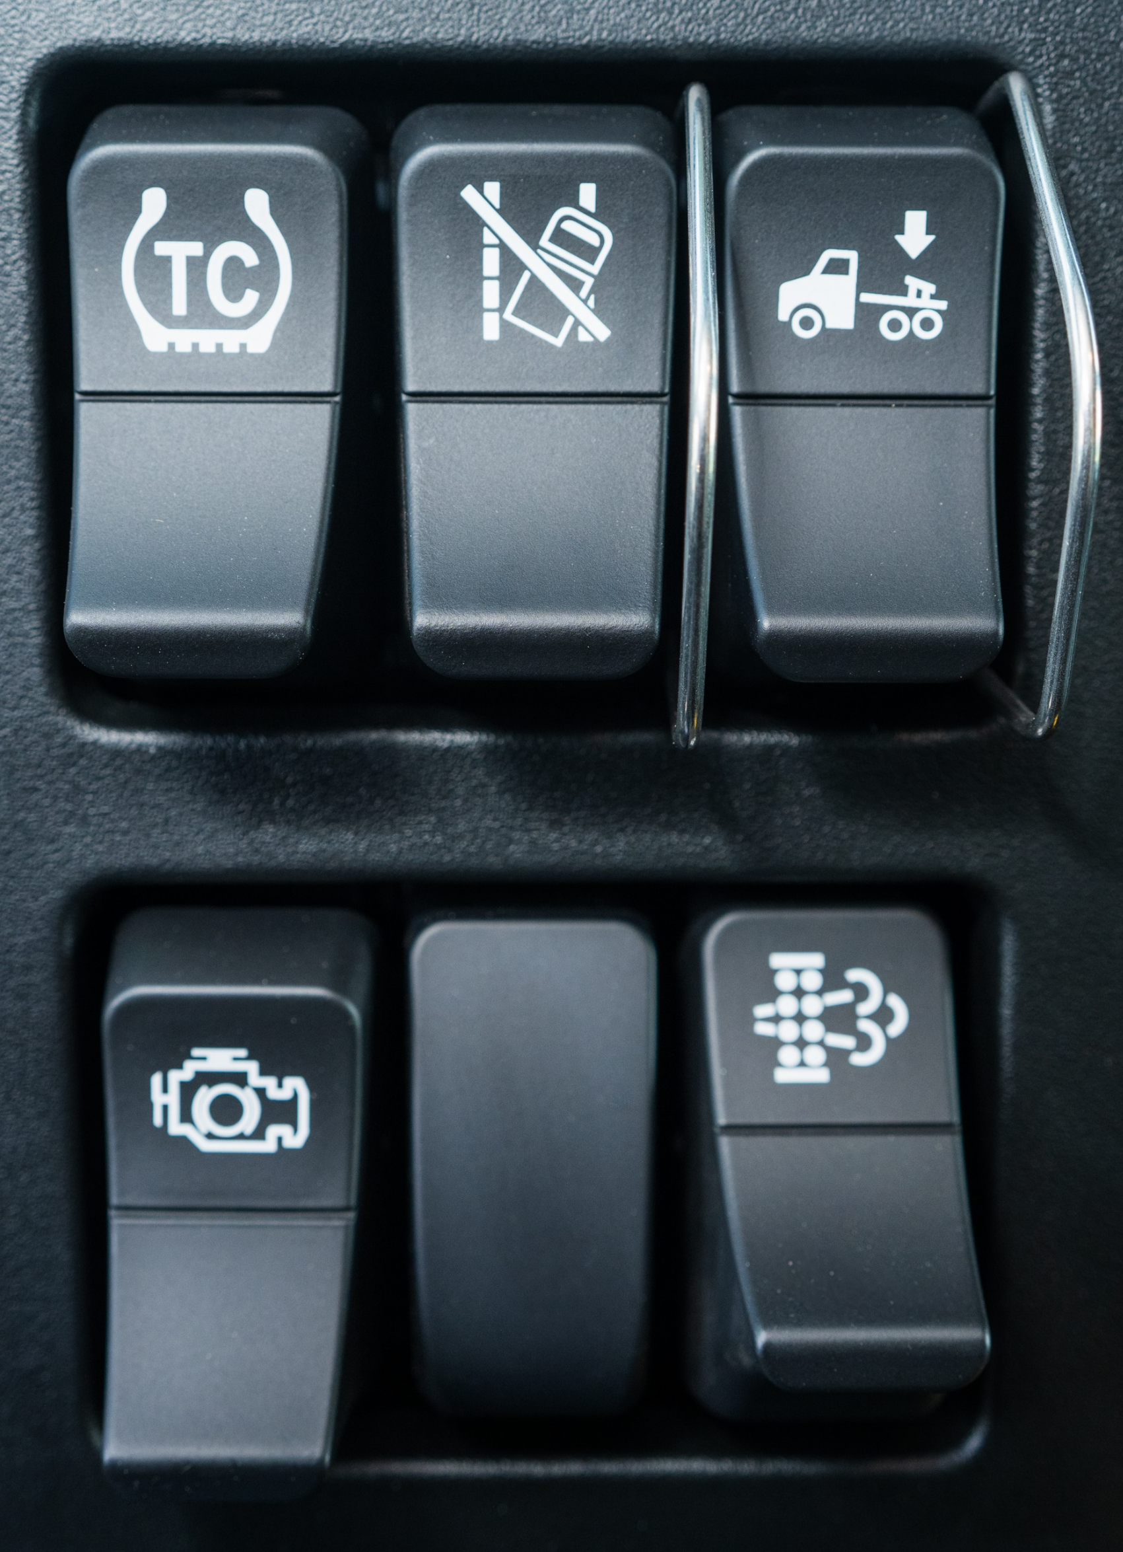
Axle Traction Control
Suspension Dump
Lane Departure
Disable
Engine Brake
Manual Regen

Slide 11
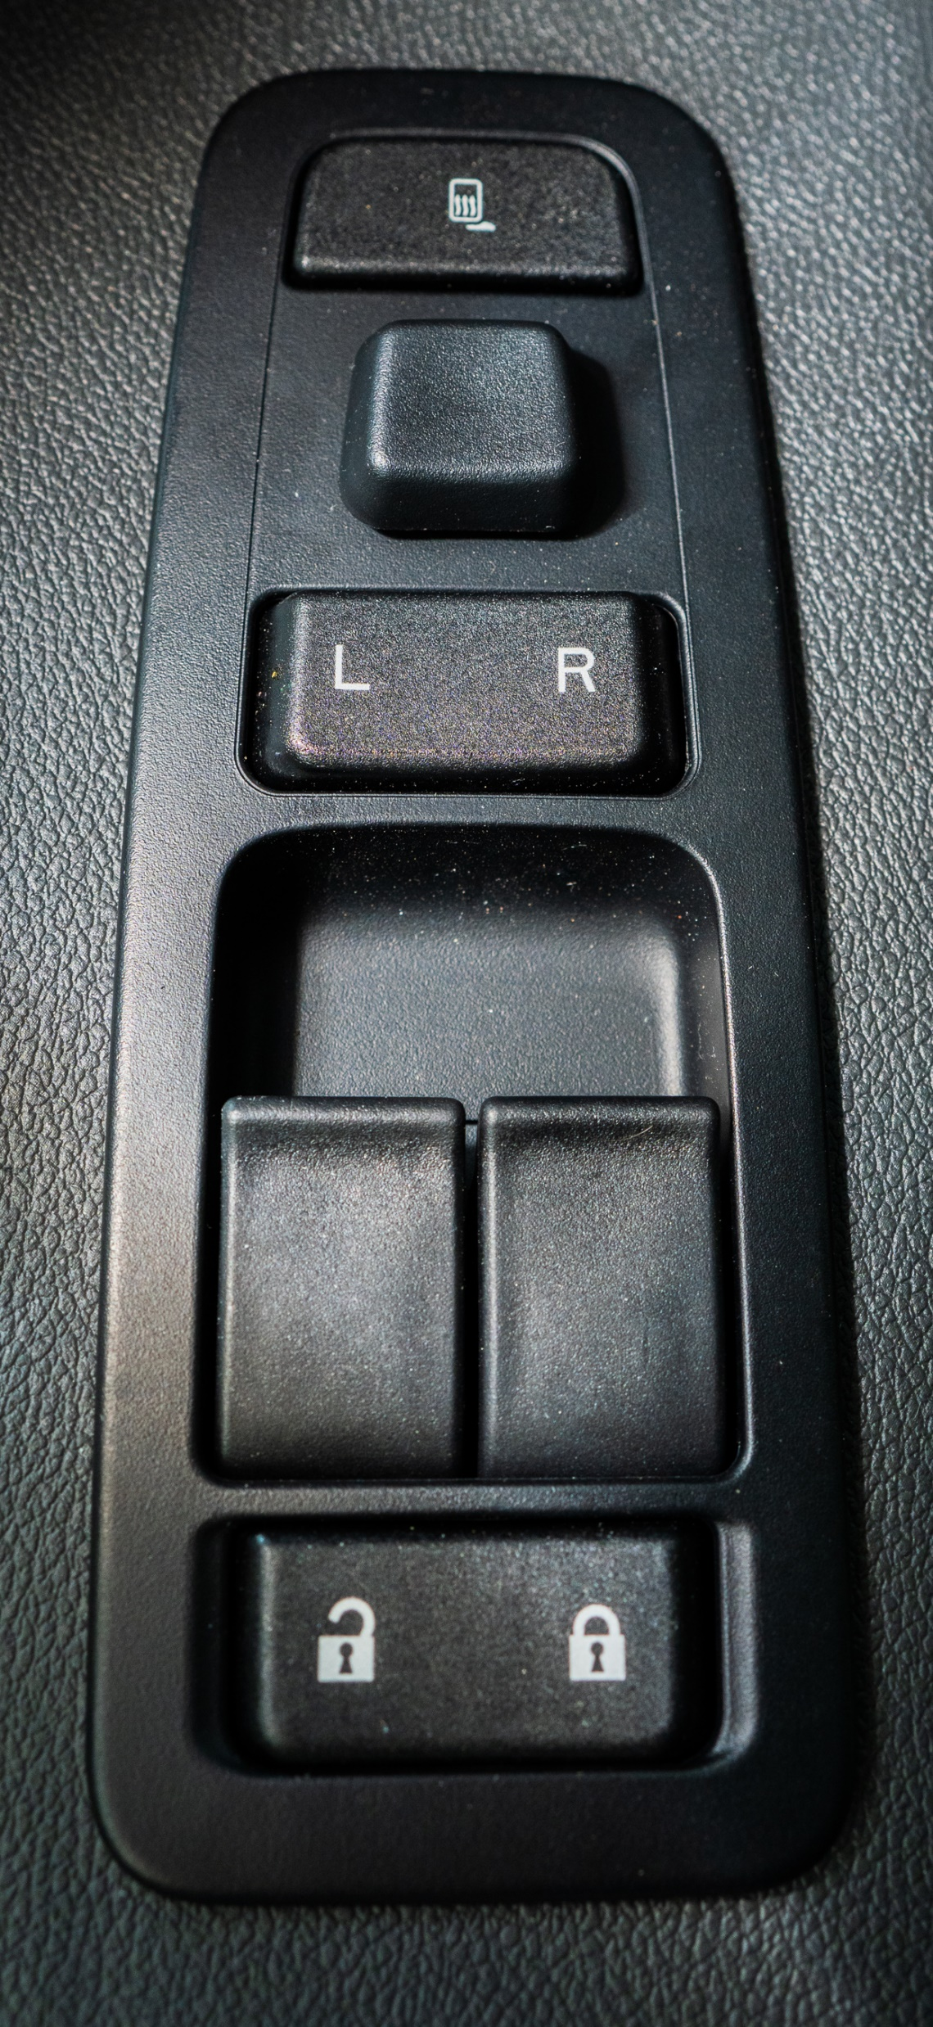
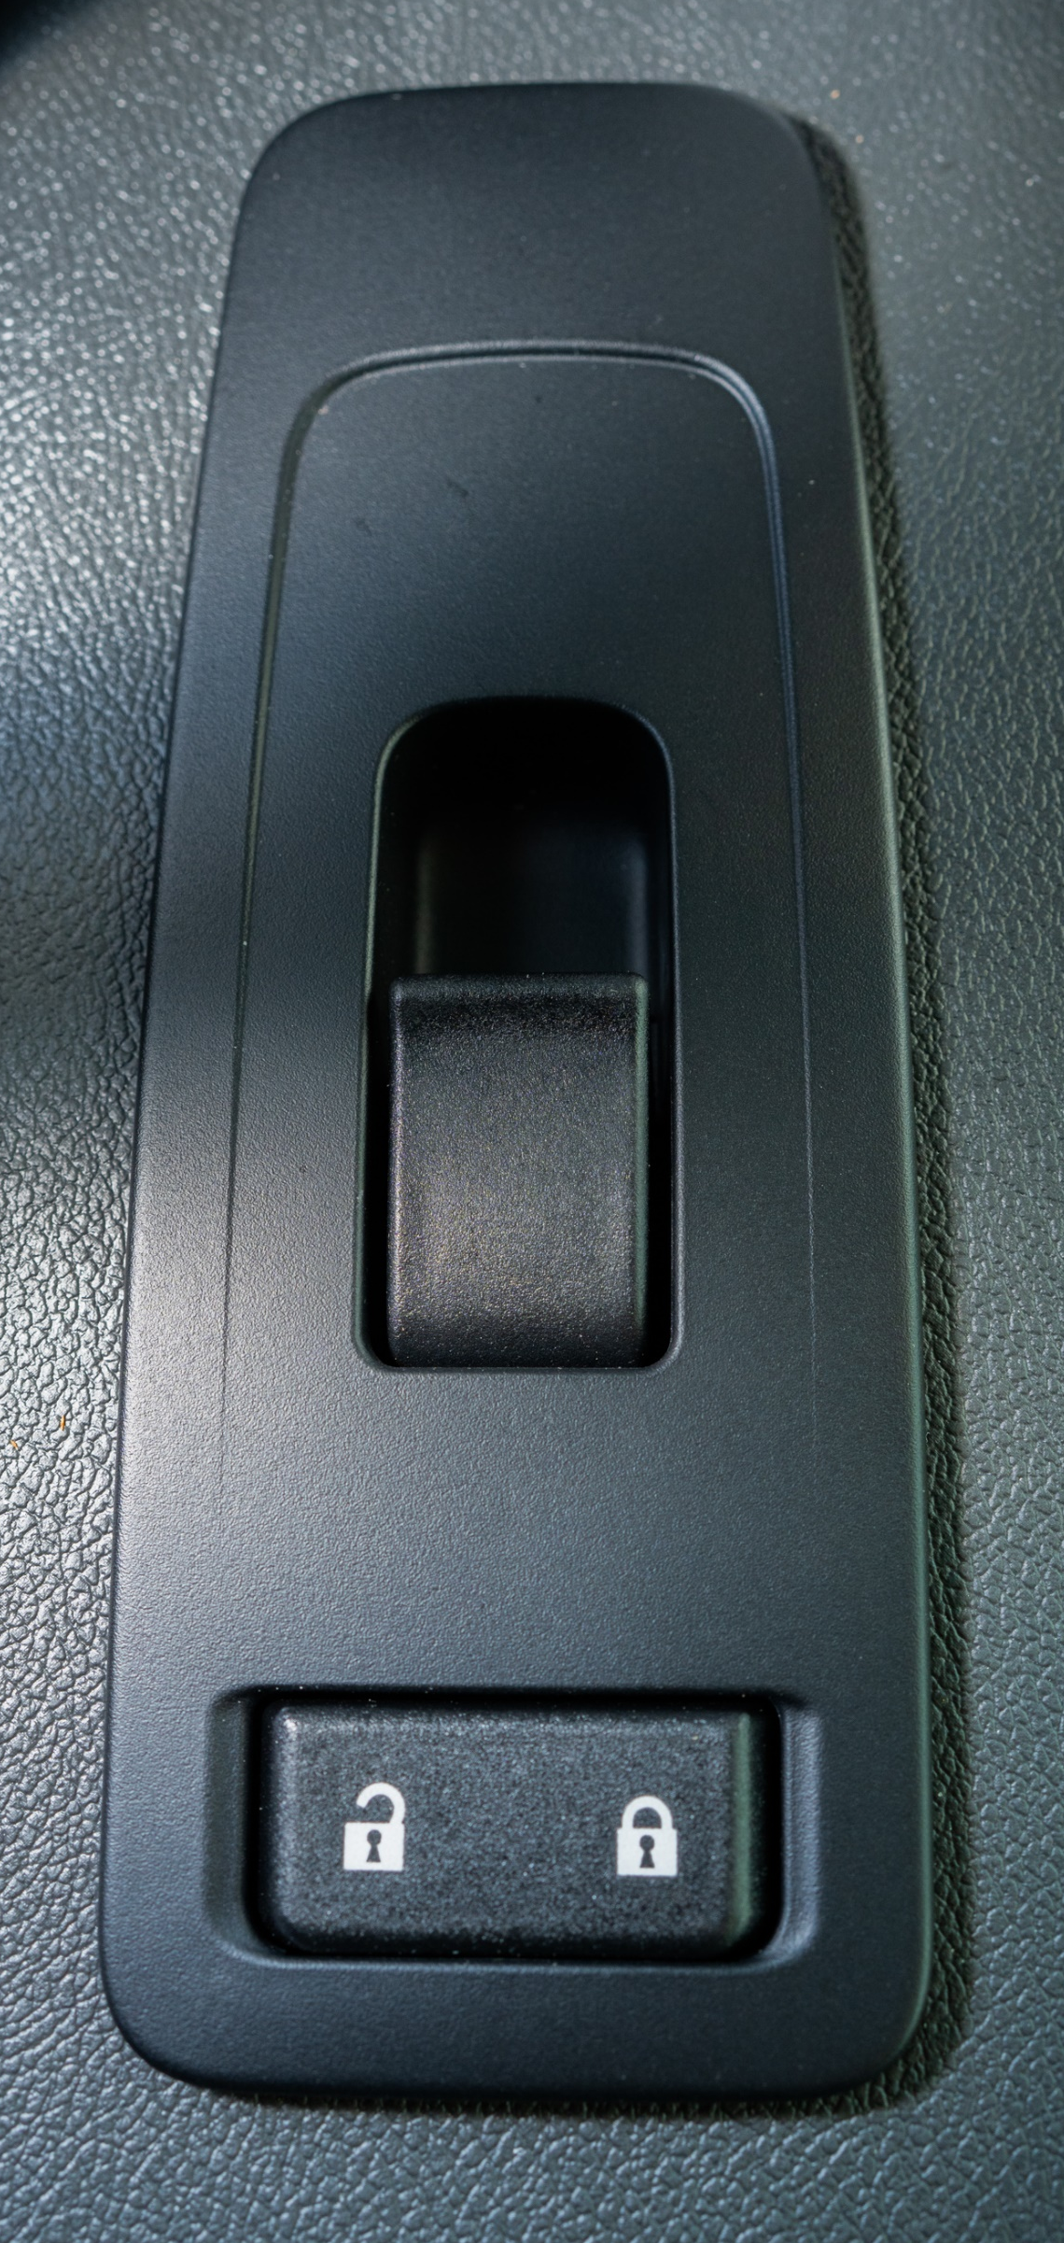
DOOR CONTROLS
Mirror Heat
Mirror Adjust
Window Controls
LH + RH Mirror Adjust
Window Controls
Door Lock
Door Lock

Slide 12
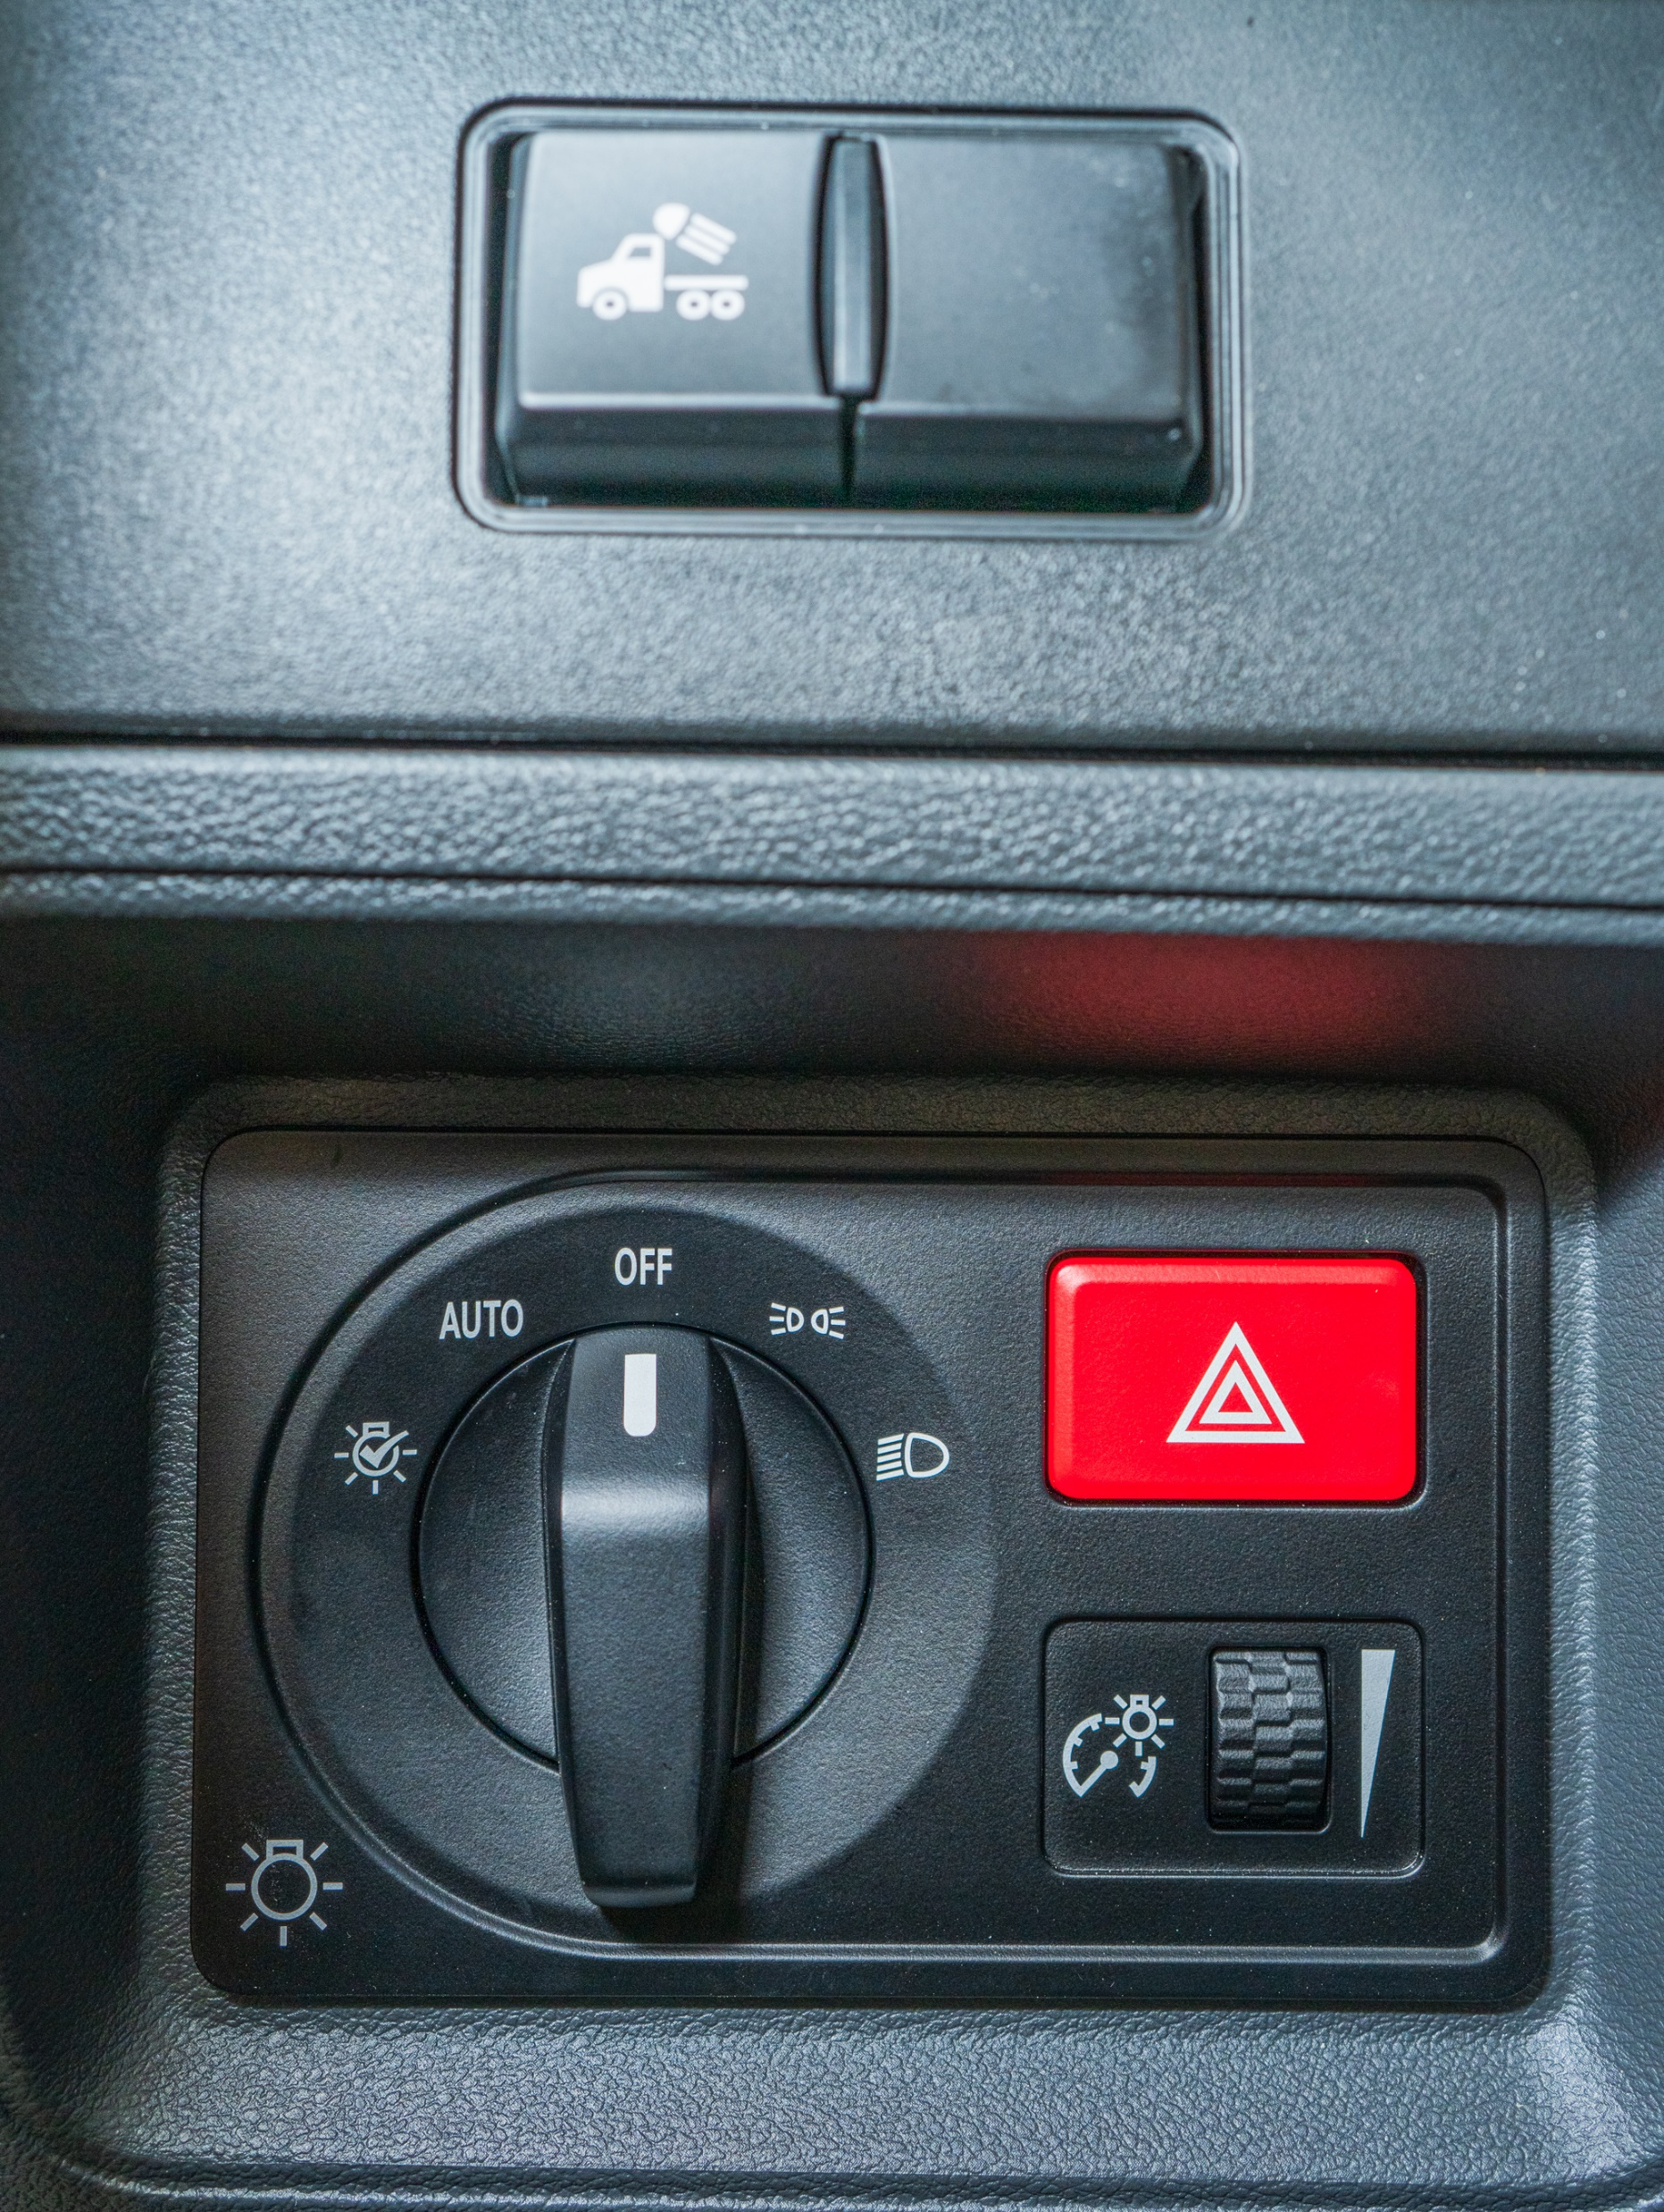
LIGHTS
Lights Flood
Headlights, On
Running Lights
Lights, Off
Hazard Lights
Lights, Automatic On/Off
Lights, Exterior Self Test
Dash Dimmer

Slide 13
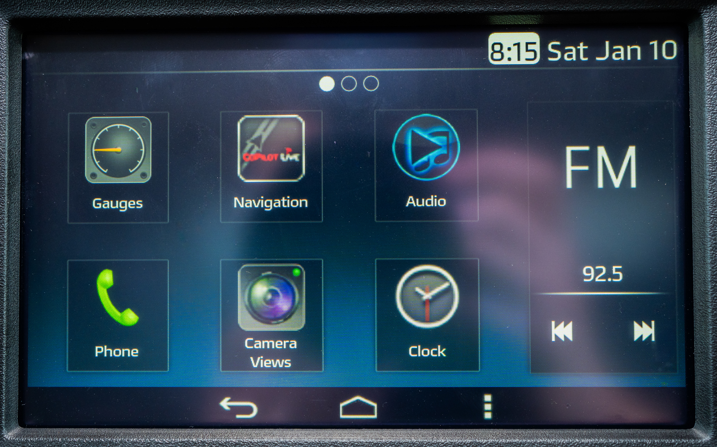
TOUCH SCREEN MEDIA
Swipe For More Menu Options
Media/ Music
View Gauges
Phone Settings
Home/ Main Menu
Clock Settings
Page Back/Return
Options/Settings
Channel Selector

Slide 14
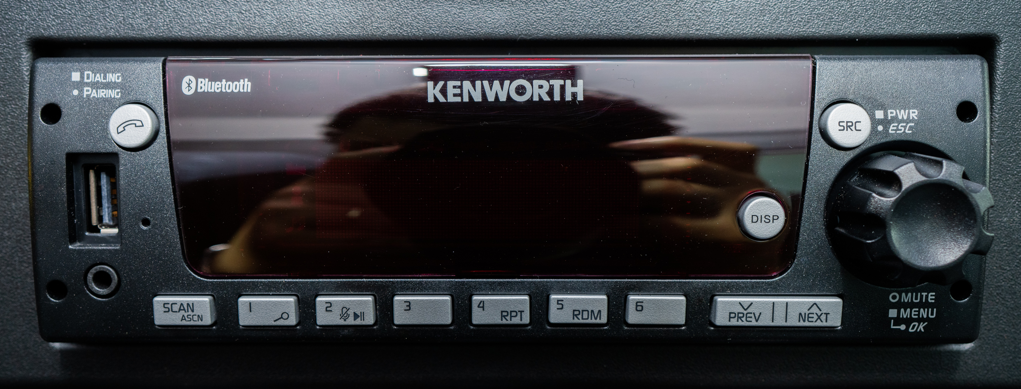
RADIO, NO CD PLAYER
Display Light Dimmer Button
Phone Settings
Pause
Media Source
USB Port
AUX Port
Favorites, Radio (Hold button to save favorite station)
Scan, Radio
Channel Selector
Push: Power/Mute/Select
Turn: Volume/Menu Select

Slide 15
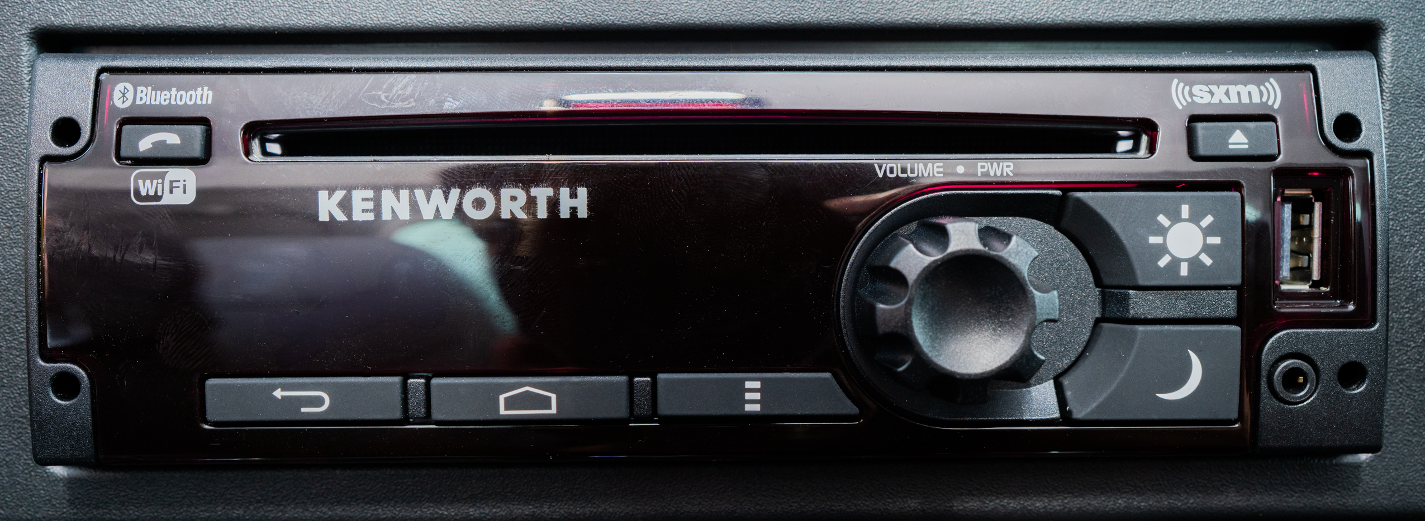
RADIO, WITH CD PLAYER
Push: Power
Turn: Volume Adjust
Phone Settings
Eject Disk
USB Port
Page Back/Return
Home/Main Menu
Day Mode
Night Mode
Options/Settings
AUX Port

Slide 16
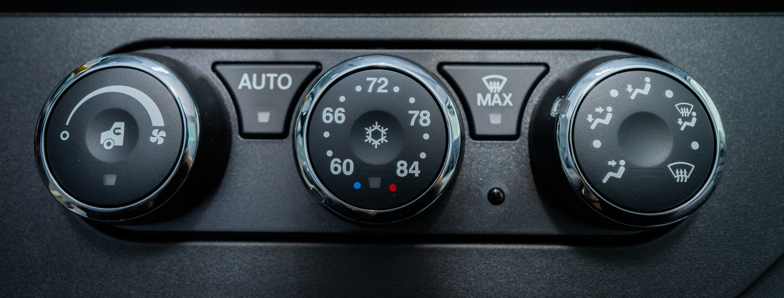
CLIMATE CONTROL
Max Defrost
Automatic Climate Control
Push In For A/C
Push In: Recirculation
Turn Dial: Fan Control
Temperature Control
Air Distribution Dial

Slide 17
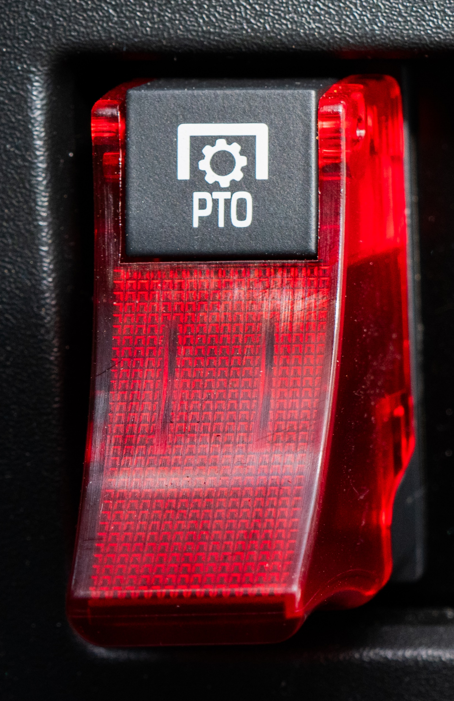
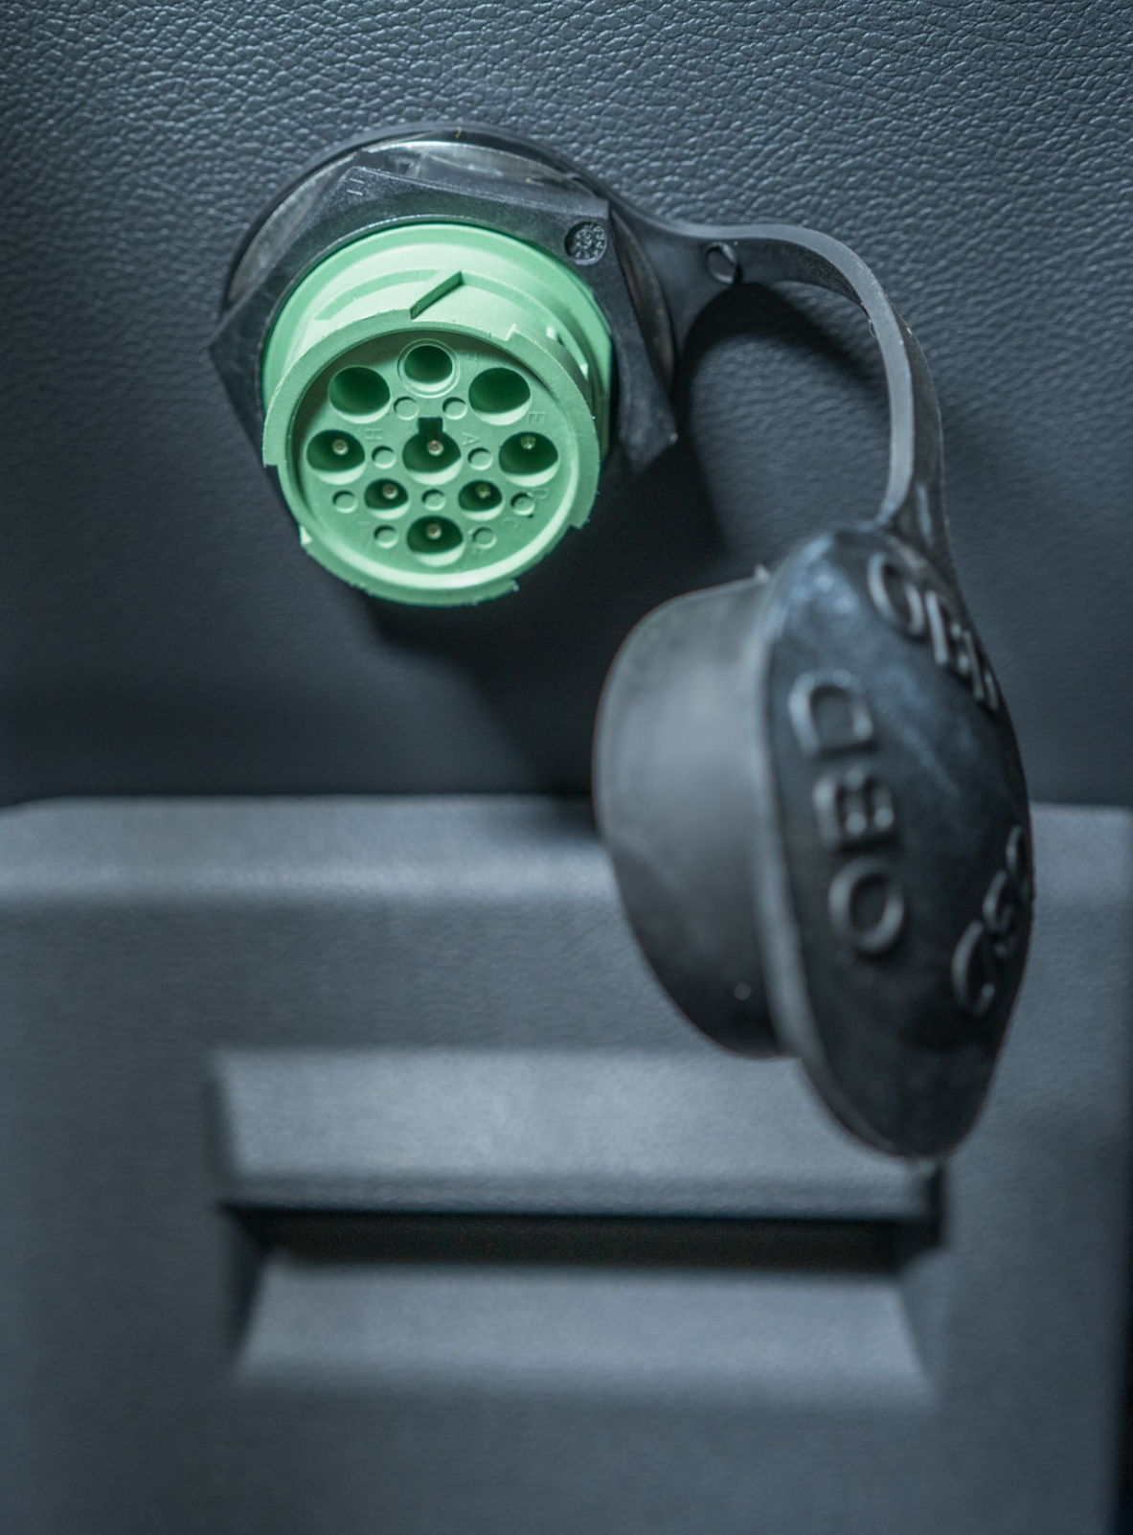
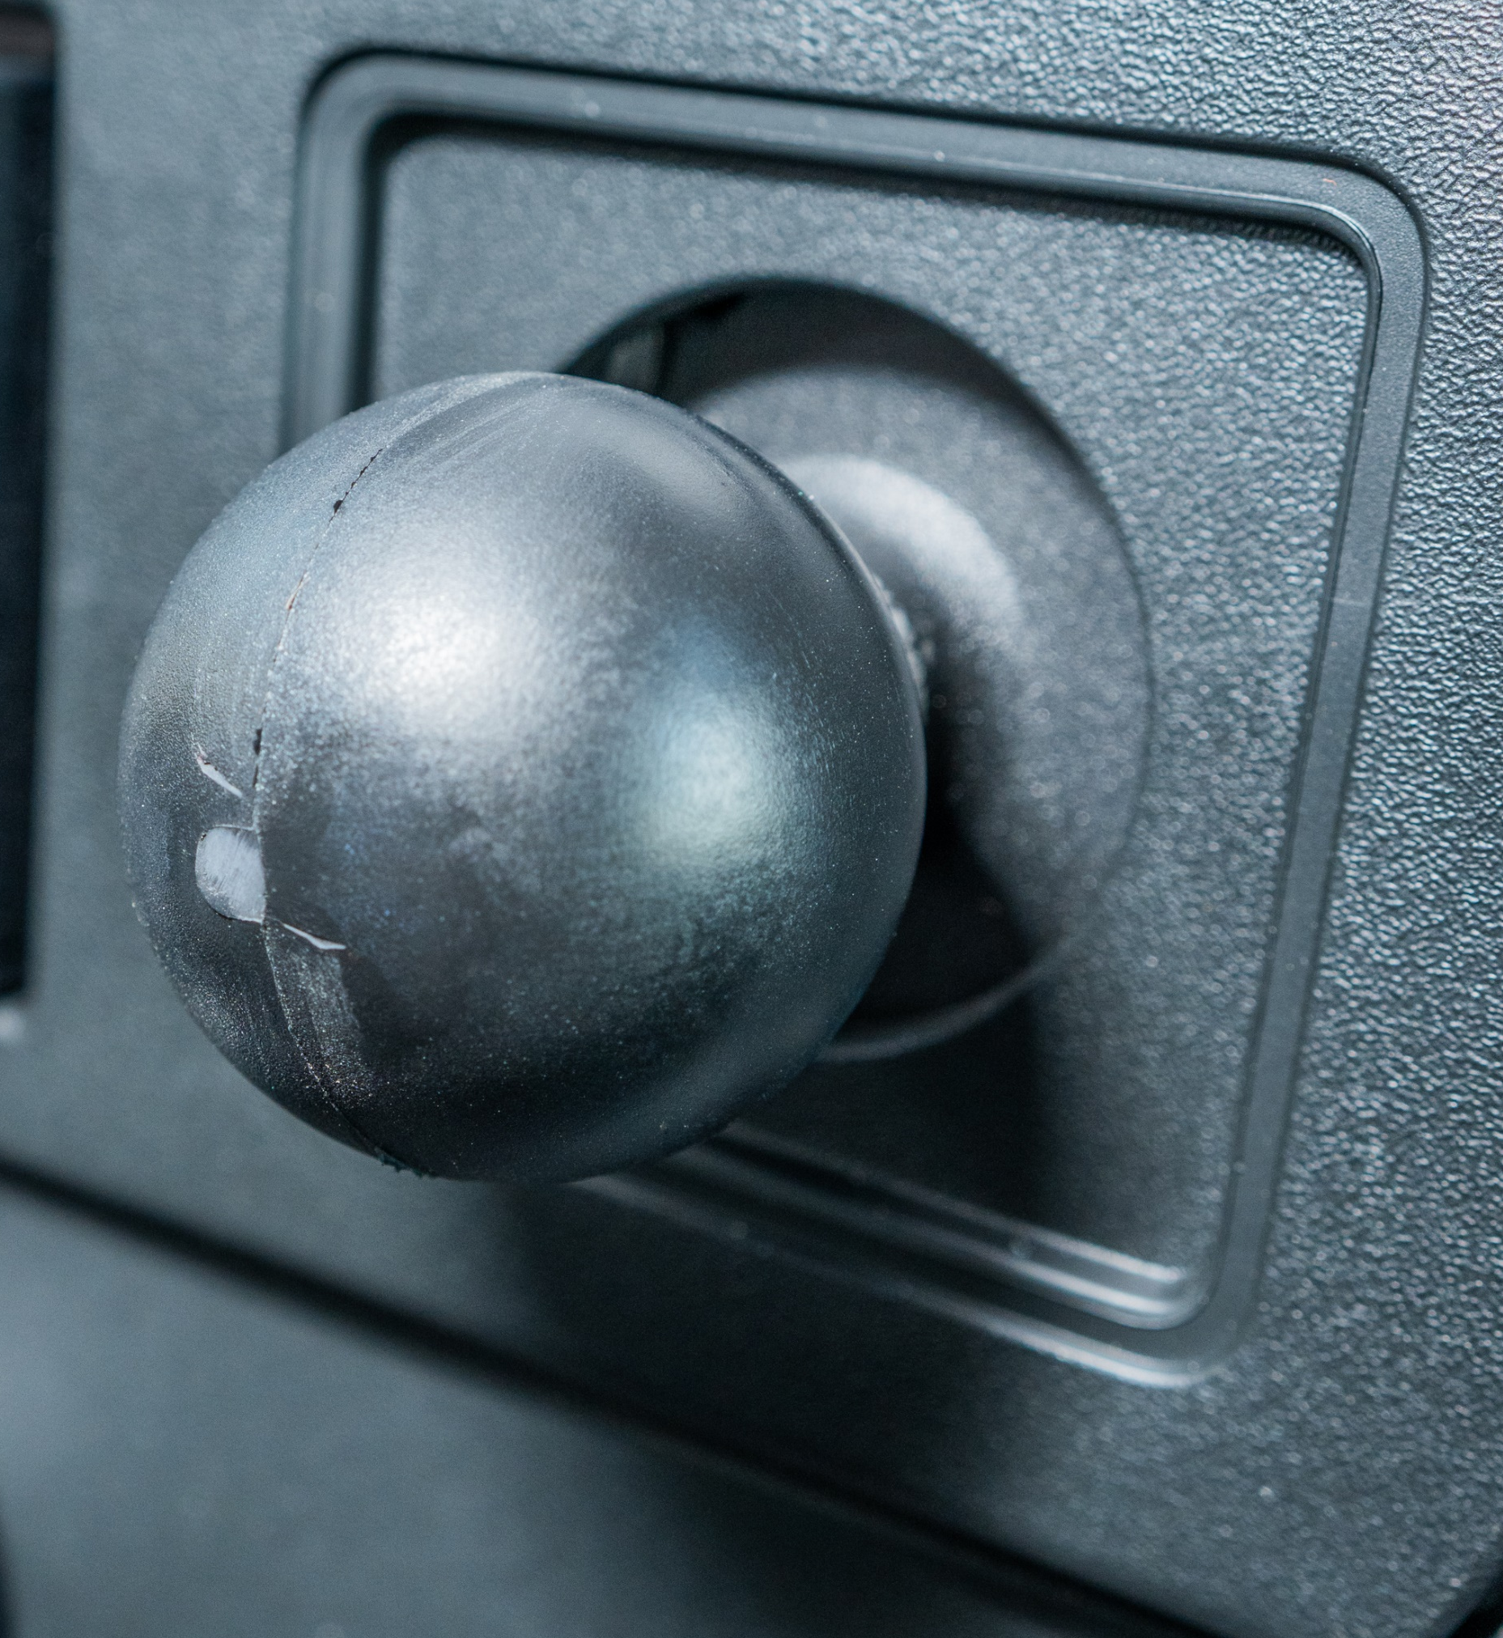
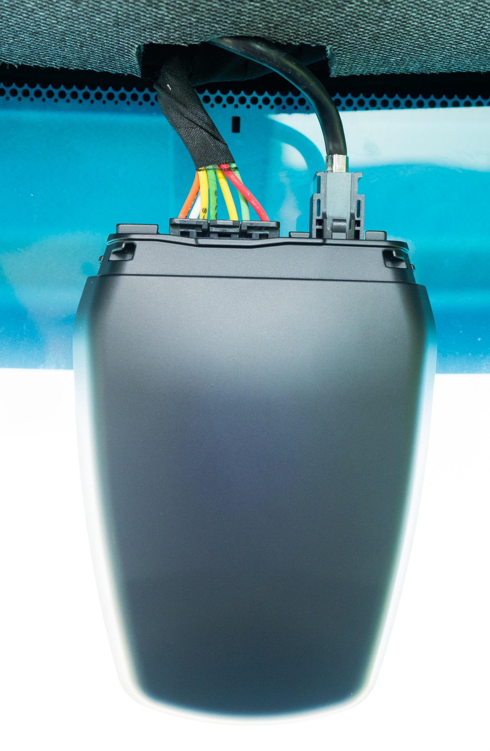

PTO Switch
On-Board Diagnostic Port (OBD)
Ram/Telematic Mount
Fusion Camera
More Questions?
Visit Rihm Kenworth’s YouTube channel for instructional videos.

