Slide 1


Rihm Kenworth Chassis Design, Dash Display & Warranty
Redbox+ Dumpsters Maintenance Academy December 10, 2025 | 8:15–9:30 AM
Presented by: John Bush & Matt Dake

Slide 2

Kenworth T480 vs T370 — Redbox+ Upgrade —
Spec & Options Overview

Slide 3
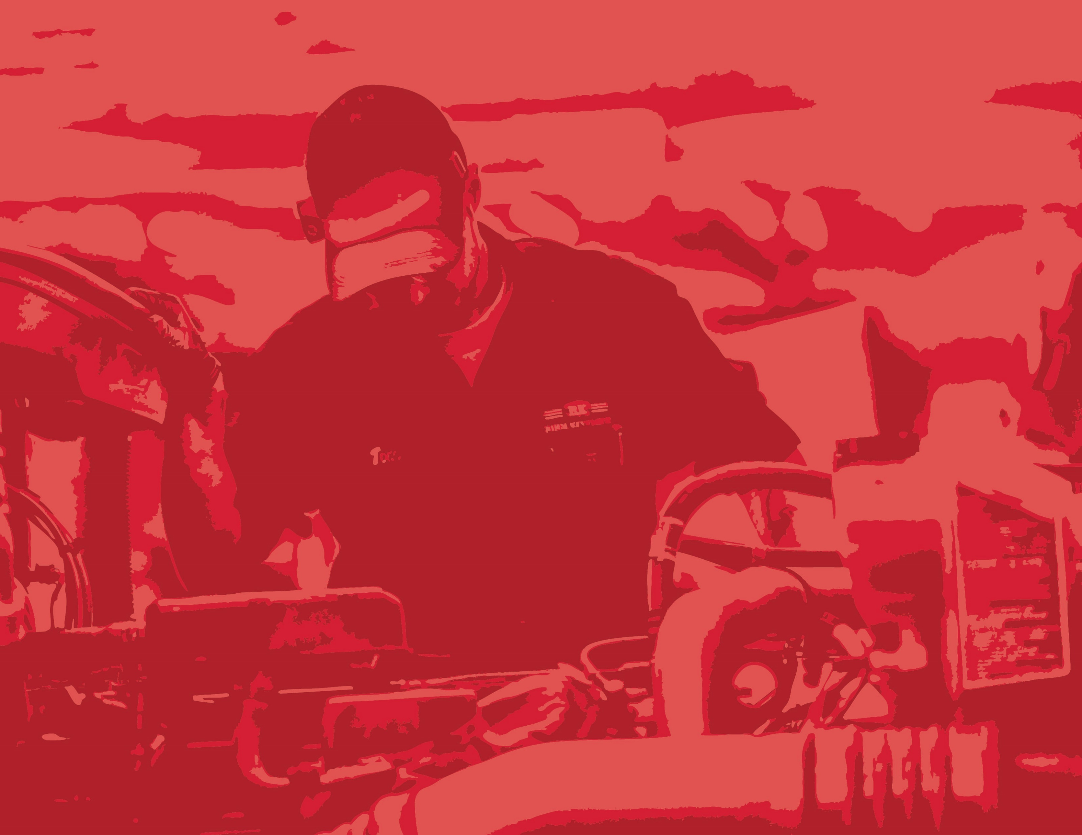
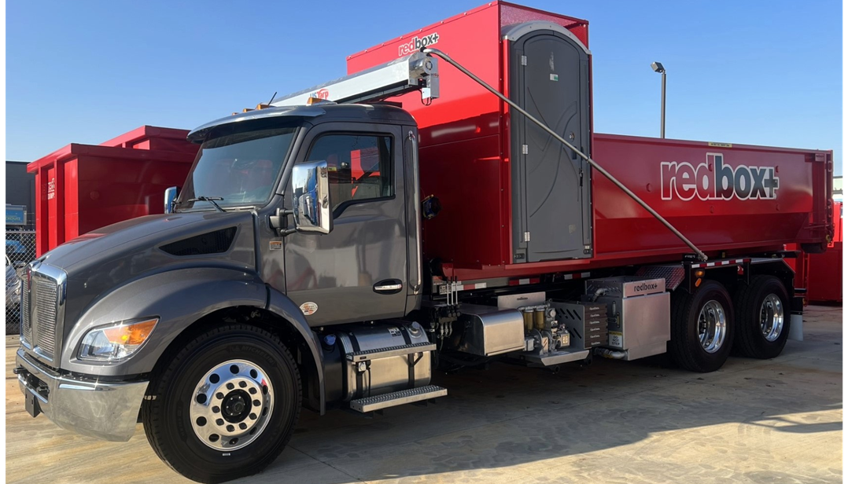
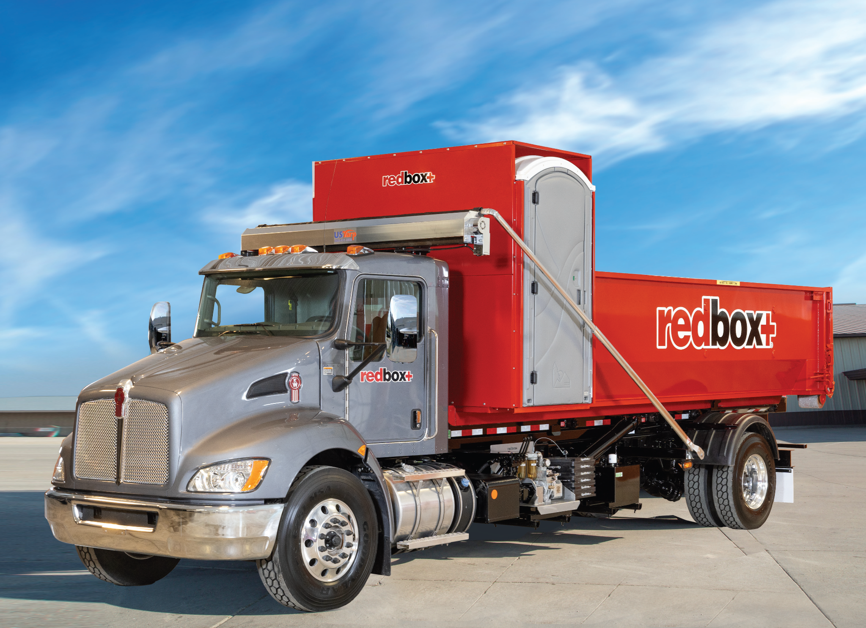
FULL VEHICLE COMPARISON
T480 - Current Platform
T370 — Former Platform
WHY REDBOX+ UPGRADED Strength • Uptime • Future-Ready Architecture

Slide 4
WHY THE UPGRADE TO T480 BABY 8 MATTERS
CAB & DRIVER ENVIRONMENT
✅ 96" wide cab vs 90" on T370
✅ Better visibility & HVAC design
FRAME & STRUCTURE
✅ Heavy-duty frame rails – Frame Inserts
✅ Built for roll-off stress
Brakes
✅ Air Disc
✅ Safety
AXLE SYSTEM
✅ Heavy-duty axles – 20K Front, 46K Rear
✅ Higher payload capacity
ELECTRICAL ARCHITECTURE
✅ New PACCAR electrical network
✅ Offers more functions – Truck Tech+, Electric Park Brake

Slide 5
SPEC & OPTIONS COMPARISON
Category | T370 | T480 Baby 8 | Redbox+ Build
Cab Width | Narrow MD 90” | Wide 2.1 m (~96") | 96" Wide Cab
GVWR Class | Class 7 & 8 | Class 8 | Class 8
Frame | Light Vocational | HD Double Frame | HD Double Frame
Axles | 12K/21K Single & 12K/40K Tandem | 20K/46K Tandem | 20K/46K Tandem
Brakes | Air Drum | Air Drum/Air Disc 2026 | Air Disc March 2026
Electrical | MD Multiplex | PACCAR HD Network | Upgraded Electrical network
Suspension | Air Ride | Haul Maax | Haul Maax
Engine | PACCAR PX 7 & PX9 | PACCAR PX9 | PACCAR PX9
Transmission | Allison 2500 RDS/3000RDS | Allison 3000RDS | Allison 3000RDS
Cab | Stationary | Air Ride Cab | Air Ride Cab
Telematics | N/A | Truck Tech + | March 2026
Parking Brake | Manual Pull Value | Electronic | March 2026

Slide 6
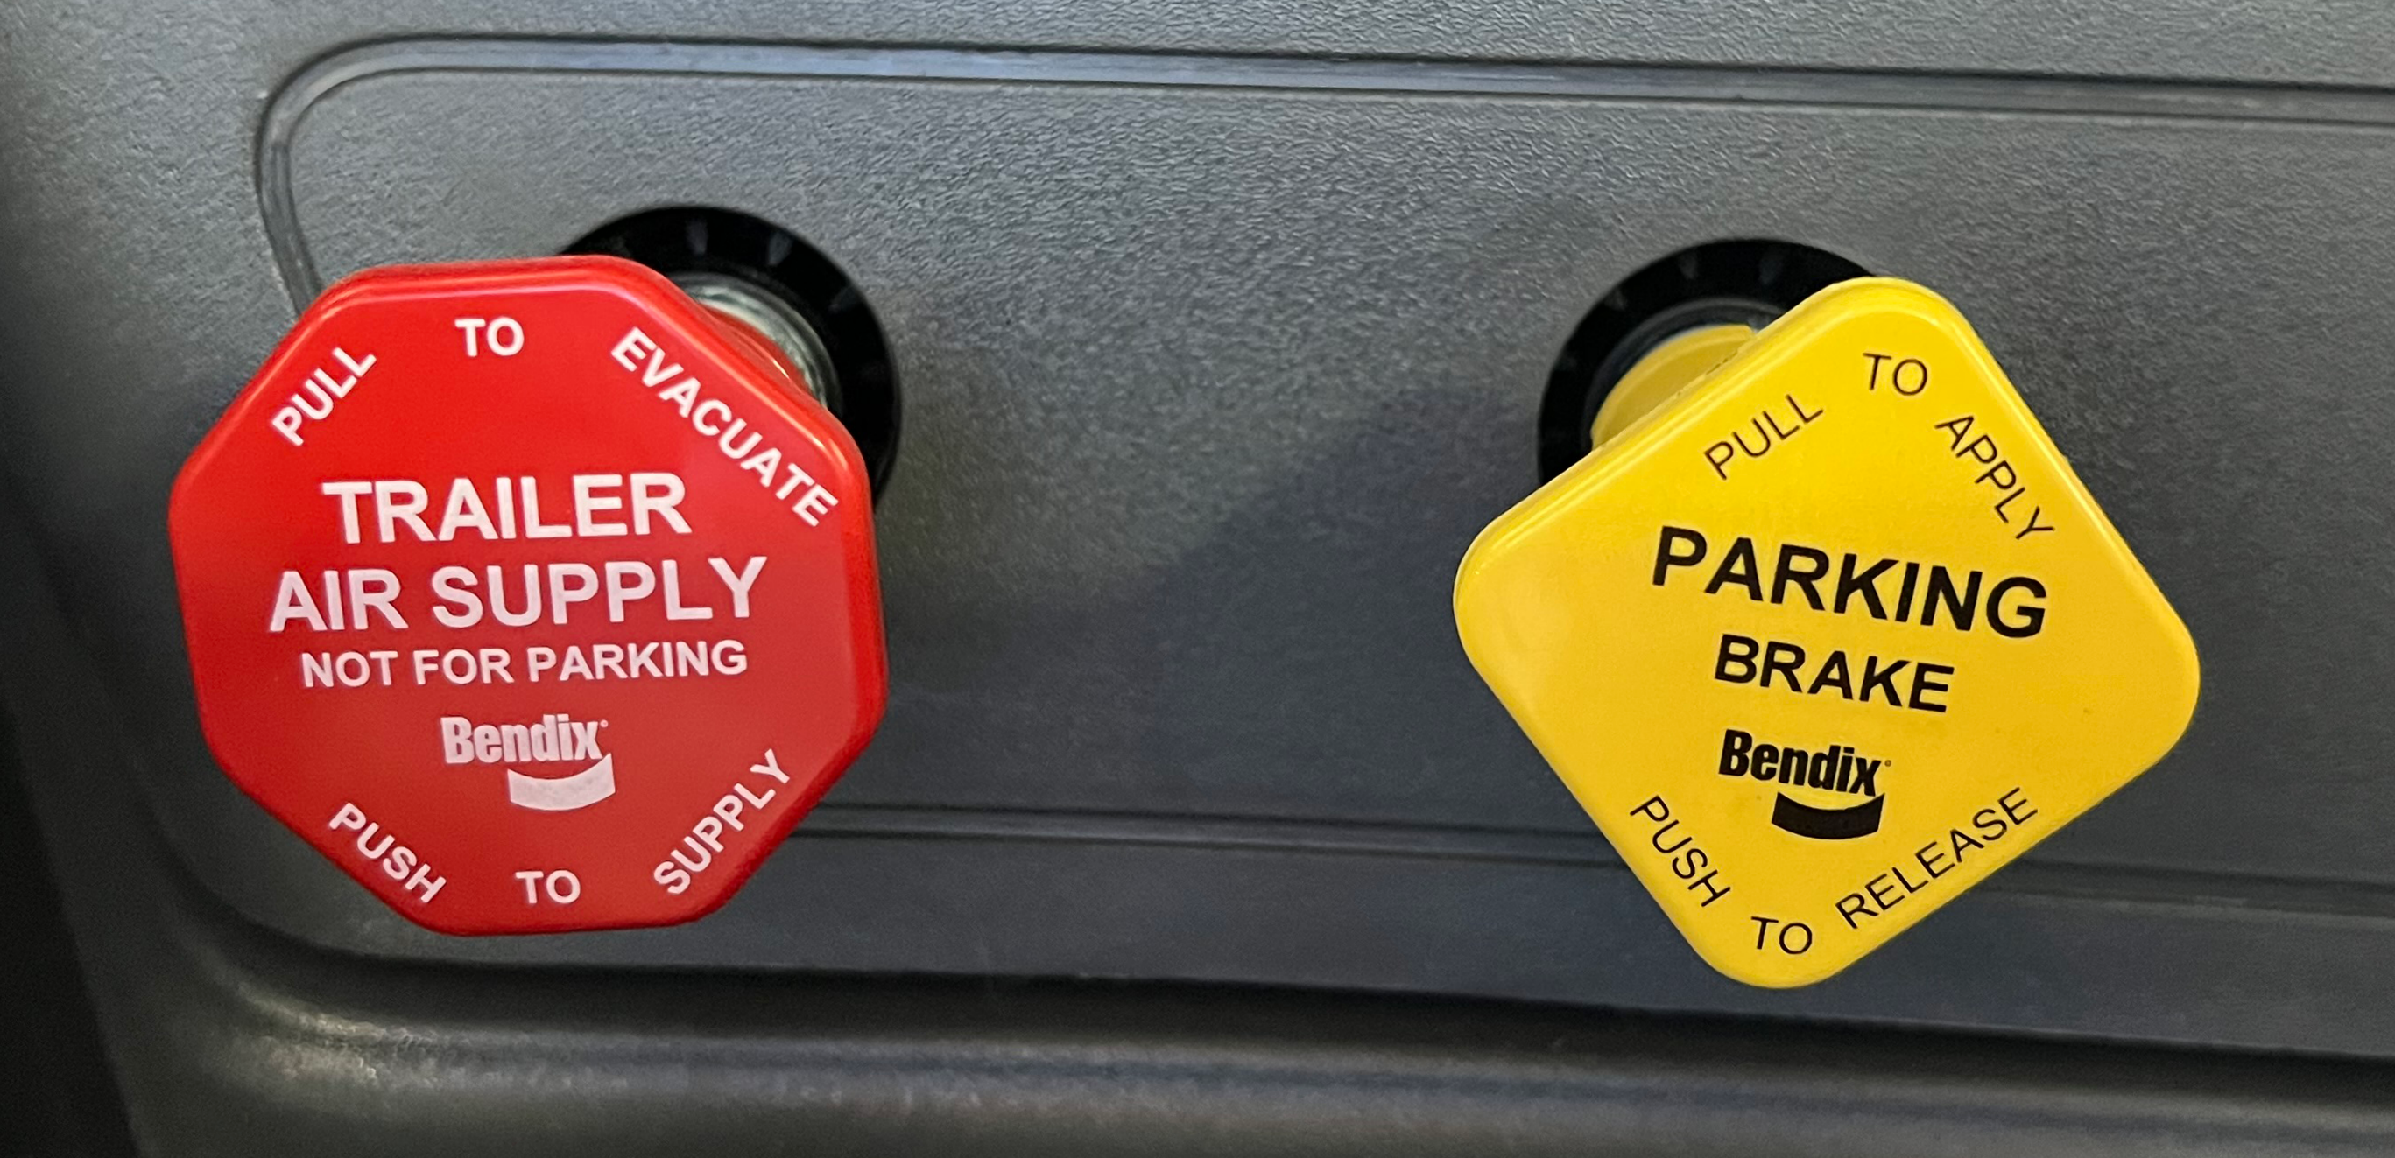
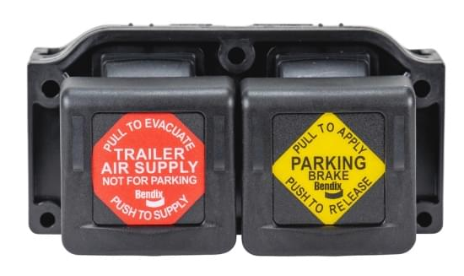
NEW ELECTRONIC PARK BRAKE
Automatic apply at key-off — the truck is always secured when shut down
Roll-away prevention logic — applies if the door opens or seat pressure is lost
Full clamp force every time — no risk of a partially set parking brake
Ideal for city and landfill duty — built for constant stop/start operation
One-touch operation — faster, easier, and safer than the yellow knob
Lower maintenance — fewer air valves, lines, and leak points
OLD
NEW

Slide 7
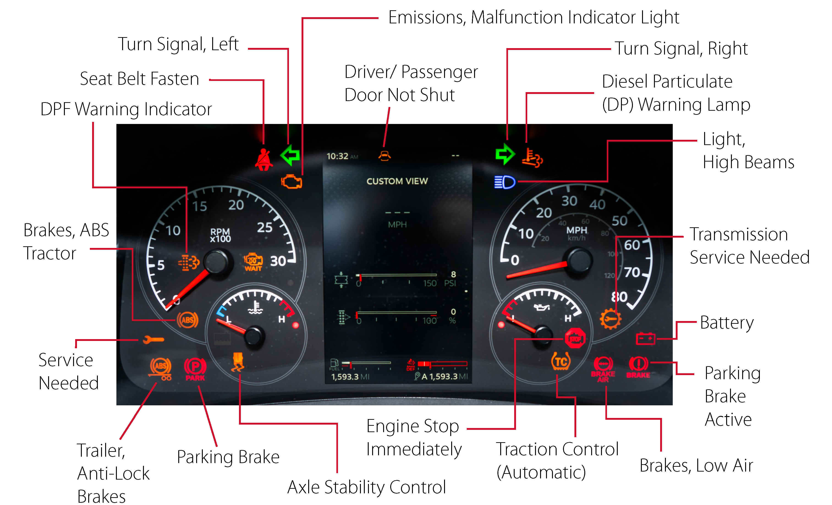
DASH WARNING SYMBOLS & INDICATORS

Slide 8
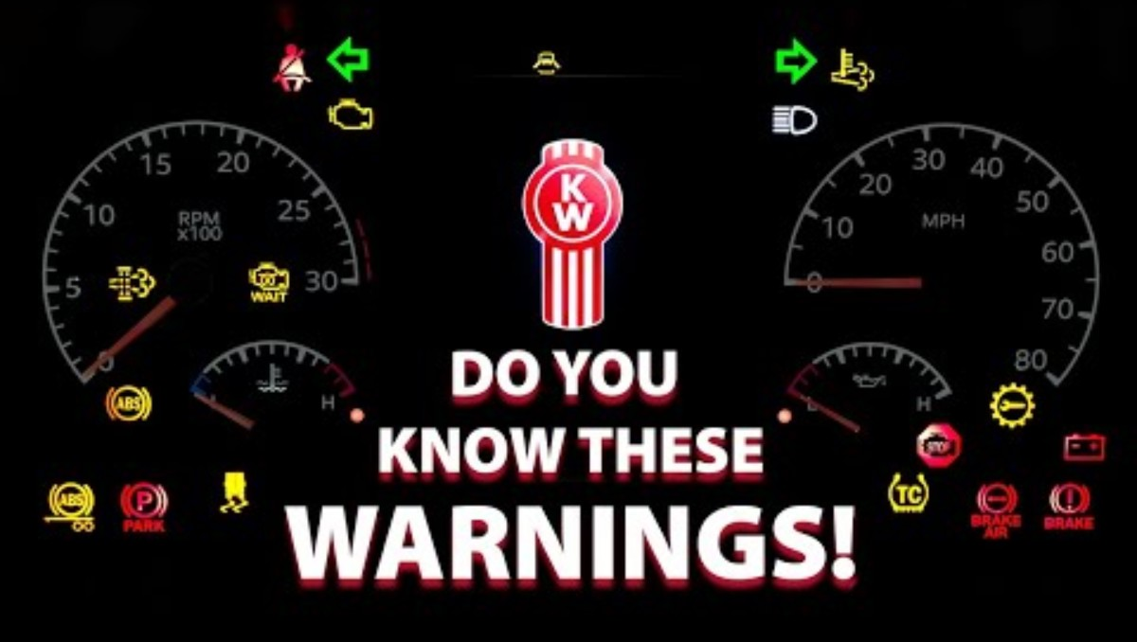
WARNING SYMBOLS & INDICATORS VIDEO

Slide 9
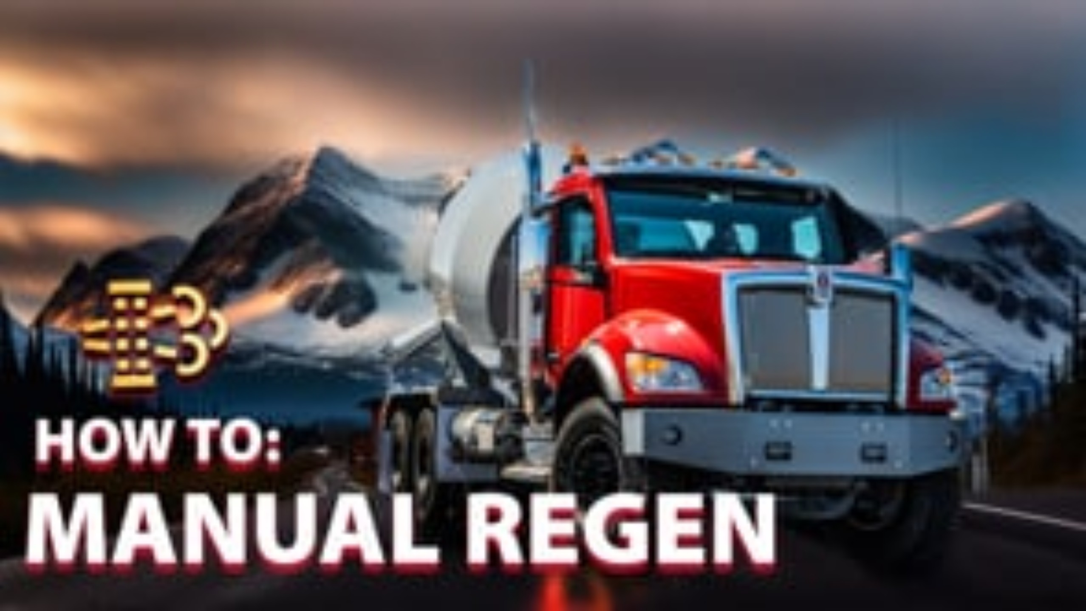
MANUAL REGEN VIDEO

Slide 10
BENEFITS OF KENWORTH TRUCK TECH +
Real-Time Diagnostics | Smarter Service | Maximum Uptime
Factory‑integrated remote diagnostics platform
Monitors engine, aftertreatment and chassis systems
Continuously scans hundreds of fault codes in real time
Alerts the driver, fleet manager, and dealer simultaneously
Runs automatically — no driver interaction required
“Failures don’t start suddenly — they start silently.
Truck Tech+ listens before the driver ever notices.”

Slide 11

KENWORTH TRUCK TECH + VIDEO

Slide 12
WARRANTY COVERAGE (STANDARD VS REDBOX+)
STANDARD OEM WARRANTY | REDBOX+ EXTENDED COVERAGE
ENGINE & AFTERTREATMENT – PACCAR PX-9 2 Years / Unlimited Miles Includes: Internals, turbo, injectors, ECM, emissions defects Excludes: Contamination, wear, maintenance | ENGINE & AFTERTREATMENT – PACCAR PX-9 5 Years / 250,000 Miles Same coverage — extended term
TRANSMISSION – Allison 3000RDS 2 Years / Unlimited Miles Includes: Internals, torque converter, electronics Excludes: Abuse, fluid contamination | TRANSMISSION – Allison 3000RDS 5 Years / Unlimited Miles Same coverage — extended term
MERITOR AXLES – MFS20 20K / RT46-160P 46K Front: 2 yrs / Unlimited Miles Rear: 3 yrs / Unlimited Miles Includes: Gears & housing Excludes: Seals, bearings, overload | AXLES Same coverage (no extension)
BASE VEHICLE / CHASSIS 1 Year / 100,000 Miles Includes: Frame, cab, wiring, HVAC Excludes: Trim & wear items | BASE VEHICLE / CHASSIS 5 Years / 300,000 Miles Same coverage — extended term

Slide 13
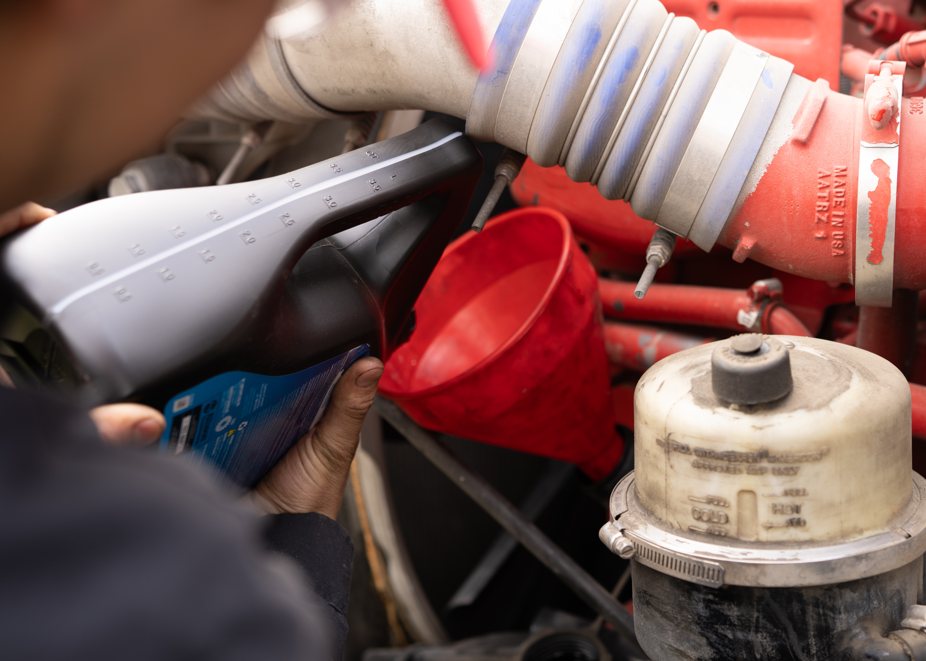
COMMON WARRANTY EXCLUSIONS
(APPLIES TO ALL WARRANTIES)
Accidents or physical damage
Improper maintenance or neglect
Unauthorized modifications
Contamination (fuel, DEF, coolant)
Overloading or misuse
Normal wear items, including:
Brakes
Belts
Filters
Hoses
Fluids
An extended warranty does not change what’s excluded — only how long you’re protected

Slide 14
KENWORTH DEALER VS INDEPENDENT SHOP
✅ KENWORTH DEALERSHIP
Factory-trained Kenworth & engine specialists
OEM diagnostic software with live system access
Warranty-safe repairs & procedures
Correct OEM parts, programming, & calibrations
Full TruckTech+ integration
Complete service history & documentation
Stronger resale value & higher trade-in confidence
⚠️ INDEPENDENT REPAIR SHOP
General-purpose technicians
Generic diagnostic scanners
Higher risk to factory warranties
“Best-guess” parts and settings
No access to TruckTech+ data
Limited repair documentation
Lower resale confidence

Slide 15
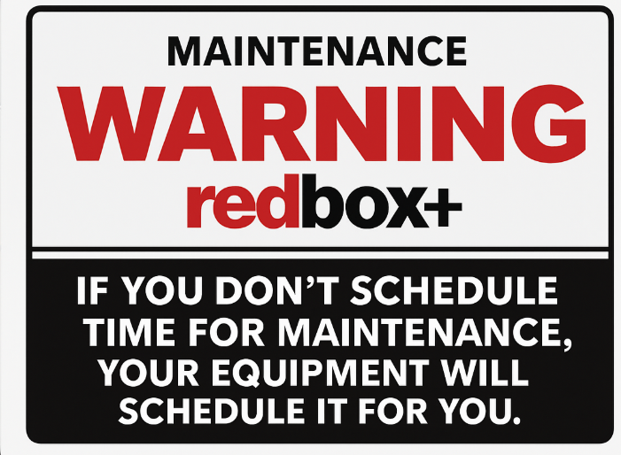
Redbox+ Maintenance Mindset

Slide 16

THANK YOU!

