Slide 1

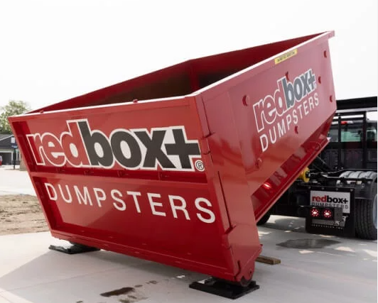
redbox/ BELFOR Freightliner SD+ Product Update
Zach Nykodym 12-10-25
Vocational Truck Sales
Daimler Truck North America

Slide 2
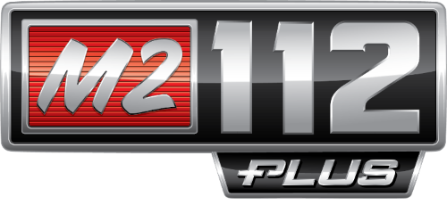
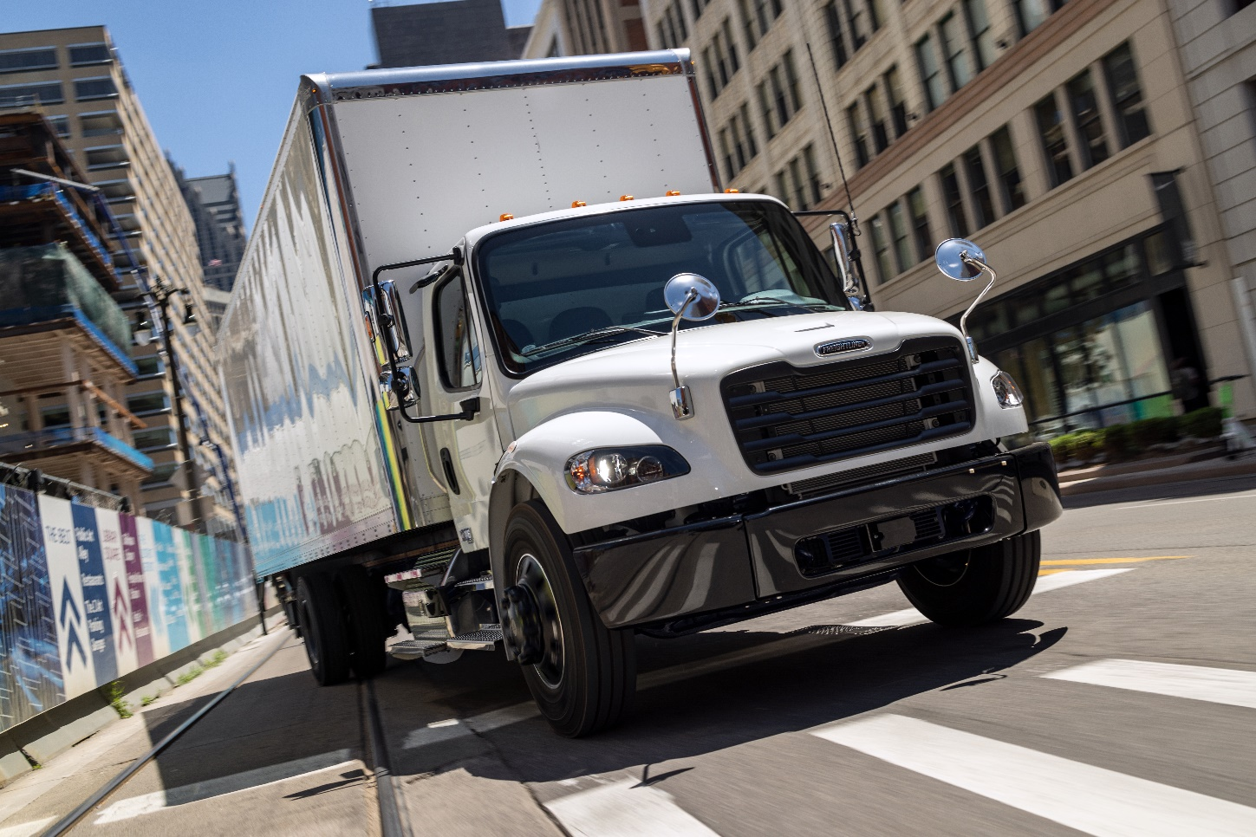
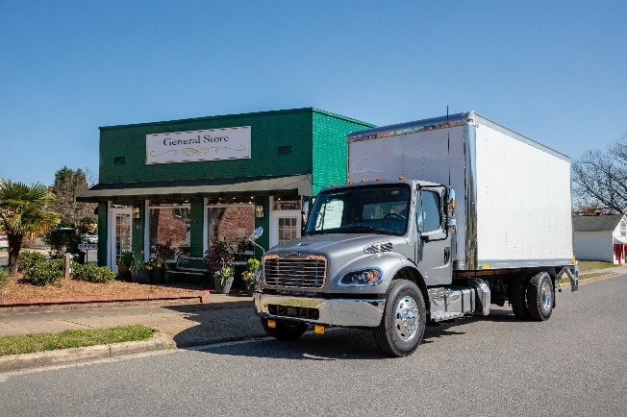

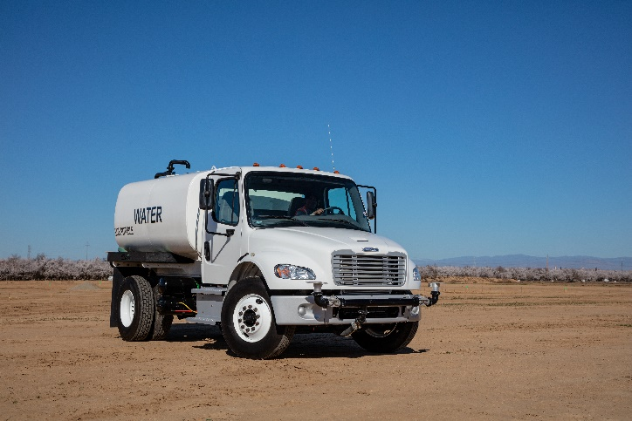
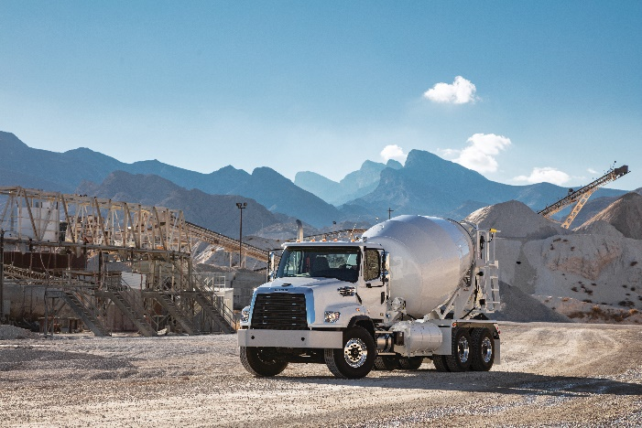

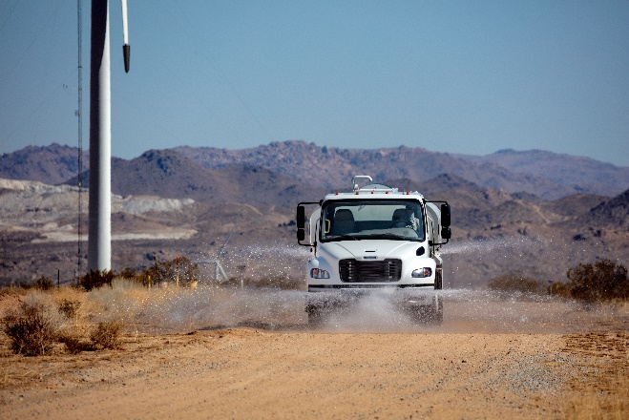
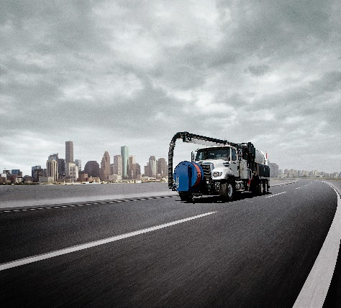
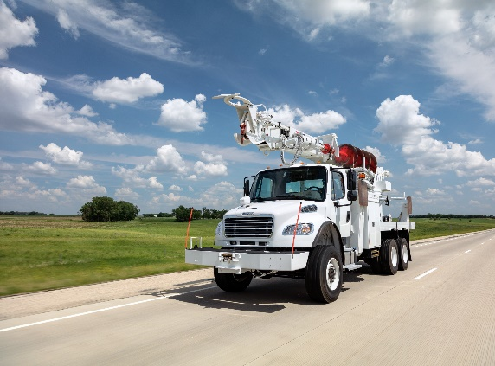
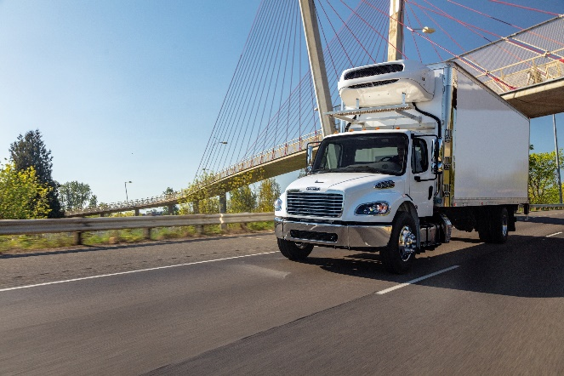
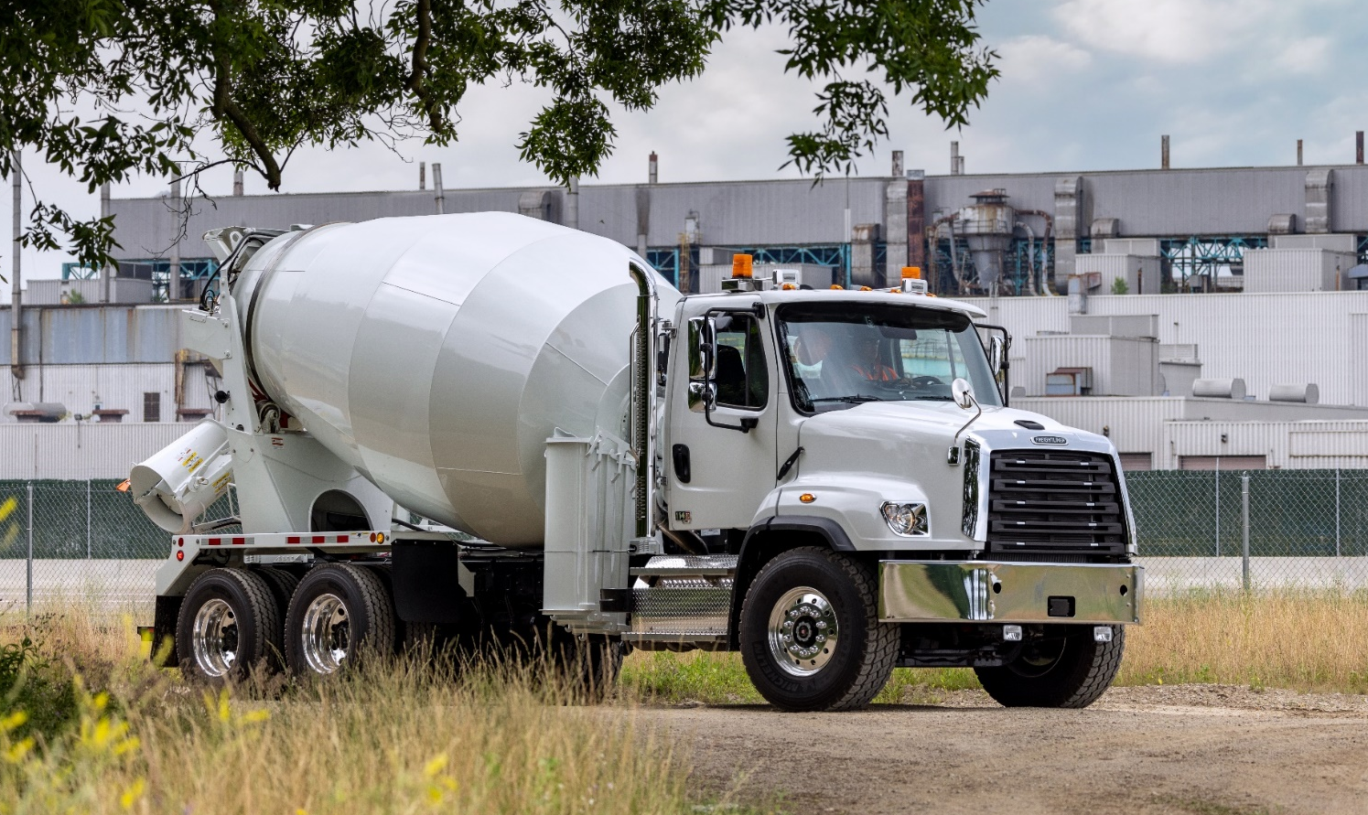

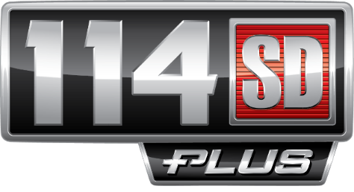

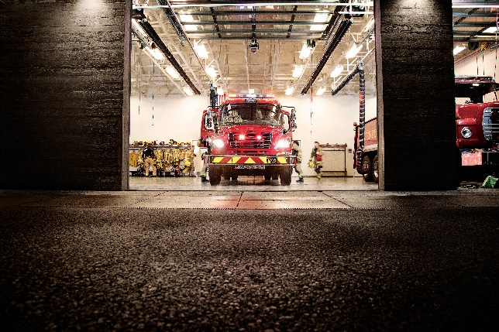
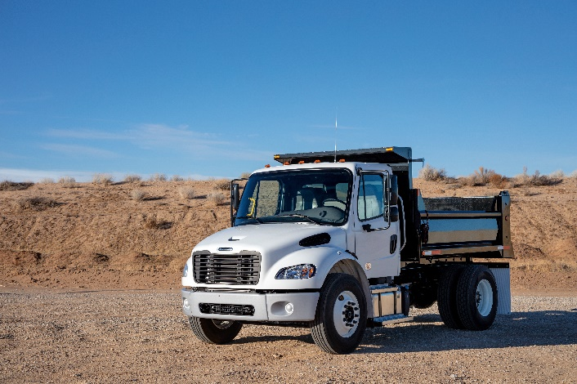
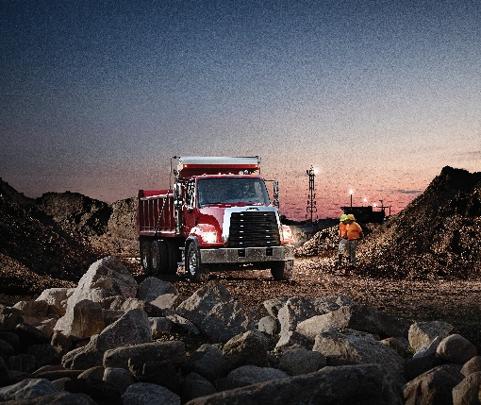
Notes:
DTNA strives to create the most efficient, safest, and dependable trucks in the world.
Today at a 11am EST on all our social media platforms we are excited to introduce the new Plus series Freightliner medium duty and vocational products: M2 106 Plus, M2 112 Plus, 108SD Plus, 114SD Plus.
Designed to create business advantages for our customers that build their bottom line. Today and into the future.
We listened to fleet owners and drivers, and redesigned one of the most widely-trusted medium-duty trucks.
We like to say Freightliner Medium Duty trucks. The best just got better.

Slide 3
Customer Feedback
Enhancements:
Driver Comfort – New Interiors, Dash, Door Panels, Overhead Consoles, Seats, Materials, Fit & Finish, Improved Insulation
Driver Experience – Common 5” LCD Driver Display, new Steering Wheel, Column Stalks, Shifter and Engine Brake. Improved Ergonomics, and Increased Storage
Safety – Introduces Detroit Assurance Active Safety Suite
Drivetrain – DD13 Gen 5 & DT12 (M2 112 & 114SD)
Upfit – QuickFit™ integration, expandable XMCs, and CHEC Tool
Driver Comfort
Upfit
Driver Experience
Plus
Drivetrain
Safety
Notes:
The Freightliner medium duty trucks are the best selling and most durable products in the market, but our customers asked us for more.
Better driver comfort more in-line with some of the new DTNA products, better fit and finish, better ergonomics, nicer seats
Better driver experience- quieter cabs, more familiar feel
More Safety – DTNA is known for the best safety system in the industry and the medium duty market has become familiar with the importance and value of safety systems not only there equipment and drivers but to the overall bottom line of the business
New drivetrain options – adaptation of drivetrain options for medium duty from the DTNA family, bring the best in class
Upfit – Commonality, each product required different tools to interface with and different systems to create controls for.

Slide 4
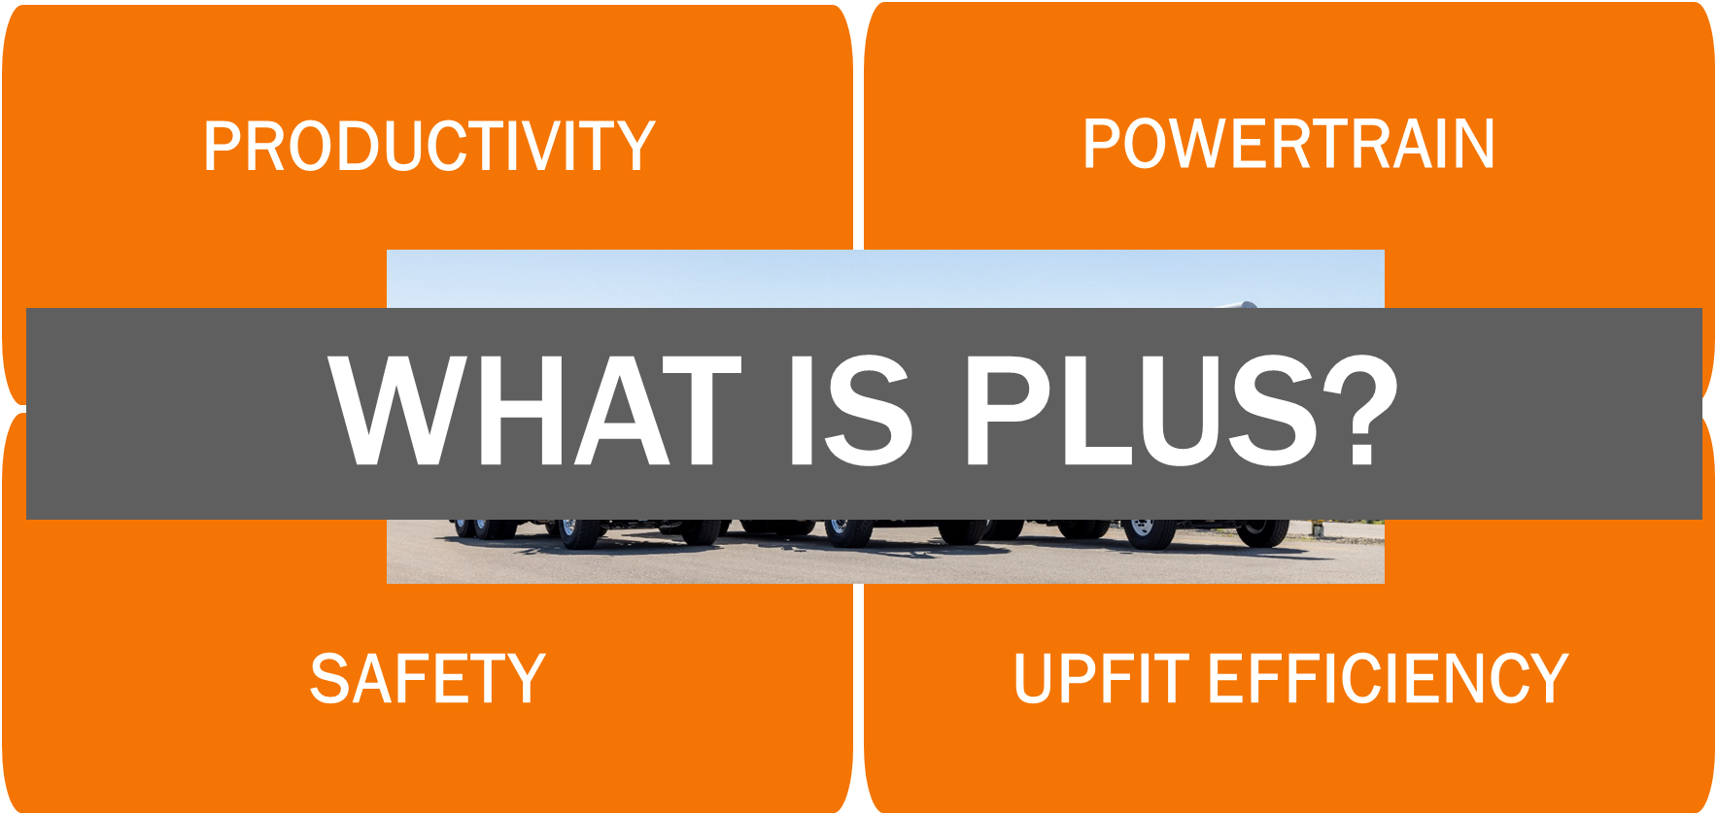
Notes:
So What is Plus.
The Plus series trucks are built on the same solid reliable platform with the same maneuverability and visibility our customers know and has delivered a clear total cost of ownership advantage --
The Plus series adds the additional features our customers have asked for,
Improved Comfort and Productivity
The best safety systems
More Powertrain options
Easier upfit
The new enhancements include
- an all-new interior that takes Freightliner’s lineup to the next level in driver comfort, and improves ergonomics ensuring the job gets done even when those days are long.
-the DA suite of safety systems, ensuring driver safety and mitigating equipment damage that protect your company's bottom line
-and enhanced productivity features like the new electrical architecture to give our up fitters maximum flexibility on how to control and integrate their equipment's, and increased storage for equipment and customization in the cab

Slide 5
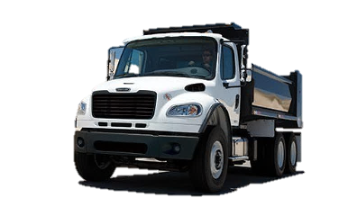

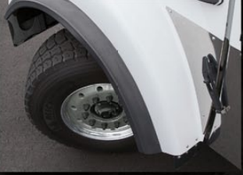
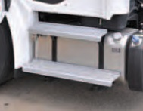
PRODUCT SPEC
Class 6-8
Detroit and Cummins Diesel engines
Eaton and Allison transmissions
Detroit and Meritor axles
Multiple Suspension options
Standard single-channel frame rails from 1.5 million RBM
Optional double-frame rails up to 3.7 million RBM
The M2 Plus and SD Plus series trucks are built on the same solid reliable platform as the current product, with the same maneuverability and the same visibility our customers know and love.
Detroit and Cummins engines
PRODUCT FEATURES
Corrosion-resistant aluminum cab with e-coated steel reinforcement
Multiple Cab configurations
Day Cab,
Extended Cab,
Crew Cab
Up to a 55-degree wheel cut on M2 and up to 50-degree on SD,
set-back front axle,
3 piece bumper
Hood-assist torsion bar, provides minimal effort needed to open hood
See-through fluid reservoirs- Easy-access for pre-trip inspection
Large 2,500 square-inch windshield and low-profile aerodynamic hood
63X14 rear window
65-degree door opening
Low step-in height for easier entry/exit
Clear back of cab packaging
Pre-Trip Access
Durable Cab
2500 Square-inch
Step Height
55-degree wheel cut
Same great quality as M2 and SD legacy models…

Slide 6
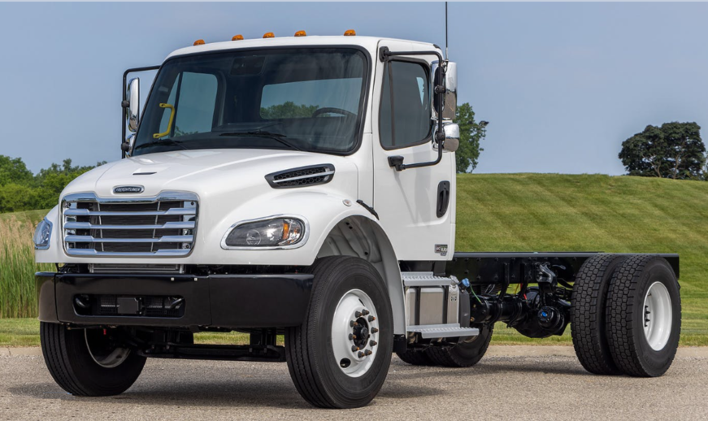

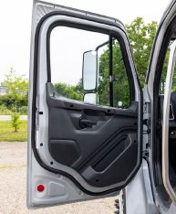
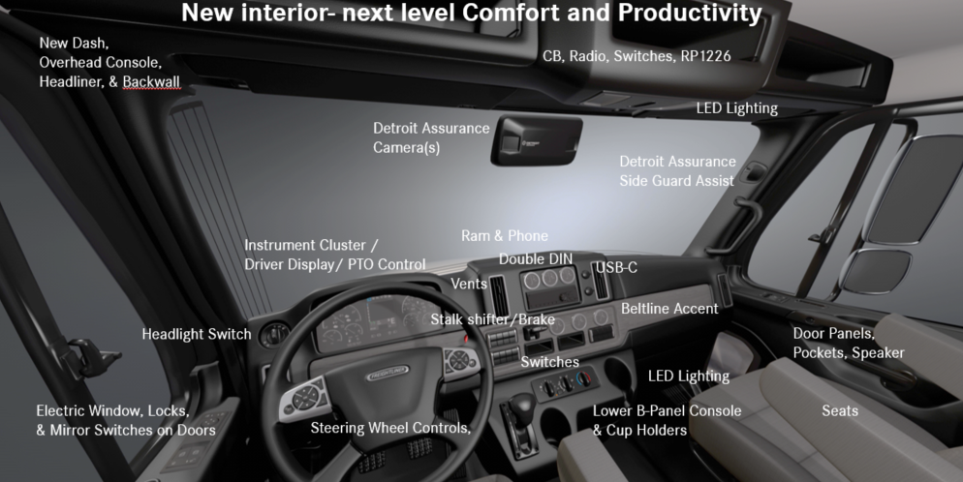
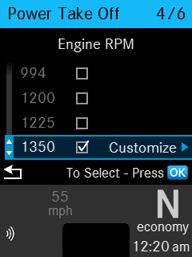
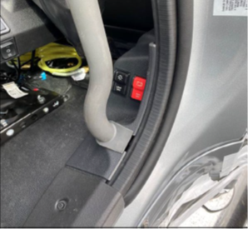


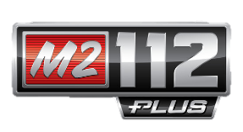
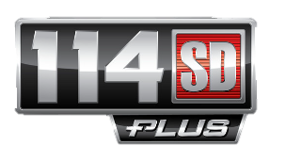
NEW!
The M2 Plus and SD Plus series adds the additional features our customers have asked for…such as driver productivity and improved comfort….
Stylish and modern dash
3 trim levels: Professional, Elite, and Rugged (with vinyl headliner and backwall)
New materials for Dash, Overhead Console, and doors for improved BSR fit and finish
Improved and additional cab insulation for quieter work environment
Ergonomic seat with better adjustability
Easy-to-read 5” LCD Driver Command Center
Steering wheel with integrated controls
Optional Steering column transmission shifter (based on transmission)
Additional storage in doors and center console
Dash and door panel with large map pocket/grab handle
Customizable 2.5x larger overhead console
Phone/I-pad slot mount in upper dash
Improved radio with a variety of options
Improved Speaker location in door
Window controls relocated and improved
Relocated Pre-trip and intelligent battery disconnect
3 trim levels
Quieter Work Environement
Door
Integrated Controls
Pre-Trip
NEW Features and Benefits

Slide 7
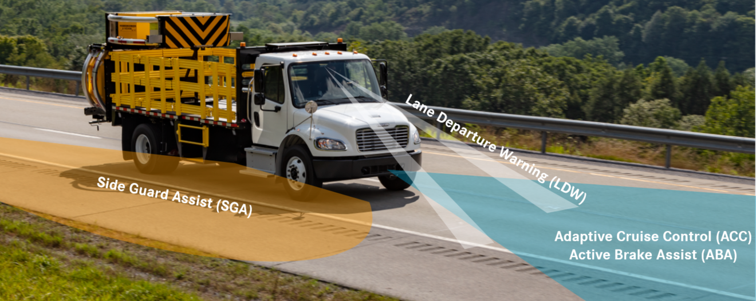


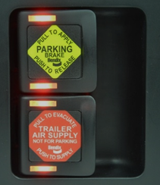
NEW!
The M2 Plus and SD Plus series includes the best safety systems….
DA with ABA 5 for Detroit and Cummins Diesel engines
Detroit Assurance for Cummins and Detroit:
Active Brake Assist 5.0,
Adaptive Cruise Control down to 10mph,
Lane Departure Warning,
Intelligent High Beam,
Auto Headlights/Wipers,
Optional Side Guard Assist, Forward Video Capture, and Driver Facing Camera
Additionally with DT12 transmission:
Adaptive Cruise Control down to 0mph
Traffic Sign Display
Brake Hold
Active Speed Intervention
3 yr Detroit Connect®
Virtual Technician with Detroit engines
Remote Updates
Detroit Connect Analytics
Safety Event Viewer
Opitonal Bendix Intellipark to help prevent rollaway incidents
Optional M2 LED headlamps
LED step lights, and cab lighting for better visibility
Optional Premium floor lighting and reading lights
Optional yellow grab handles
DT12 ACC to Zero
Auto Headlight and Wipers
Side Guard Assist
Detroit Connect
Virtual Tech
Connect Analytics
Safety Event Viewer
Bendix IntelliPark
NEW Features and Benefits
Notes:
ABA 5, ACC, LDW, SGA
Adaptive Cruise Control down to 10mph,
Lane Departure Warning,
Intelligent High Beam,
Auto Headlights/Wipers,
Optional Side Guard Assist, Forward Video Capture, and Driver Facing Camera
Additionally

Slide 8

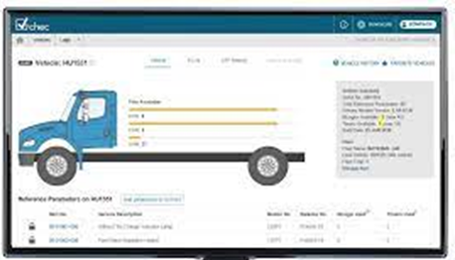
NEW!
With the introduction of the M2 Plus and SD Plus series, Freightliner made upfit consistent with DTNA….
Programmable Switches
Quickfit multiplexed architecture for simpler TEM upfit
Consistent connection and electrical systems across all models
Customizable programmable switches
4-bank programmable switches (16 dash, 24 OH Console)
Existing or custom graphics, tactile feel, backlit
CHEC Tool user-friendly interface for customizing switch parameter
Electrical components relocated to inside cab
Additional options for power outlets and connections
Relocated PDM for improved reliability
Panel removal easy access for fuses and components with out the us of tools
Tufwrap abrasion tape protects chassis wiring
Service and Troubleshooting
Electrical Commonalities – means less down time
Serviceability – dealers working with the same system
Common Part availability
Quickfit Electrical Architecture
-Higher Level TEM Integration
-Common Process for Spec’ing
CHEC Tool
-Add Interlocks
Customizable Dash/Overhead
Serviceability
Consistent Connection Points
NEW Features and Benefits

Slide 9
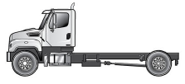
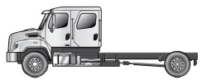
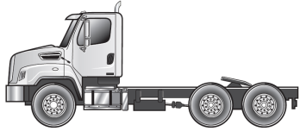
SD Vehicle Configurations
Product Options
108SD
114SD
Set-Back Axle (SBA) Day Cab Truck (108” BBC)
Set-Forward (SFA) Day Cab Truck (114” BBC)
Set-Back (SBA) Extended Cab Truck (134” BBC)
Set-Forward Axle (SFA) Extended Cab Truck (140” BBC)
Set-Back Axle (SBA) Crew Cab Truck (156” BBC)
Set-Back Axle (SBA) Day Cab Truck (114” BBC)
Set-Back Axle (SBA) Extended Cab Truck (140” BBC)
Set-Back Axle (SBA) Crew Cab Truck (162” BBC)
Set-Back Axle (SBA) Day Cab Tractor (114” BBC)

Slide 10
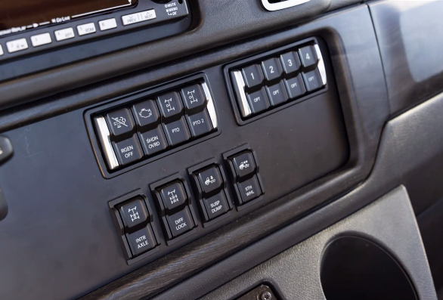
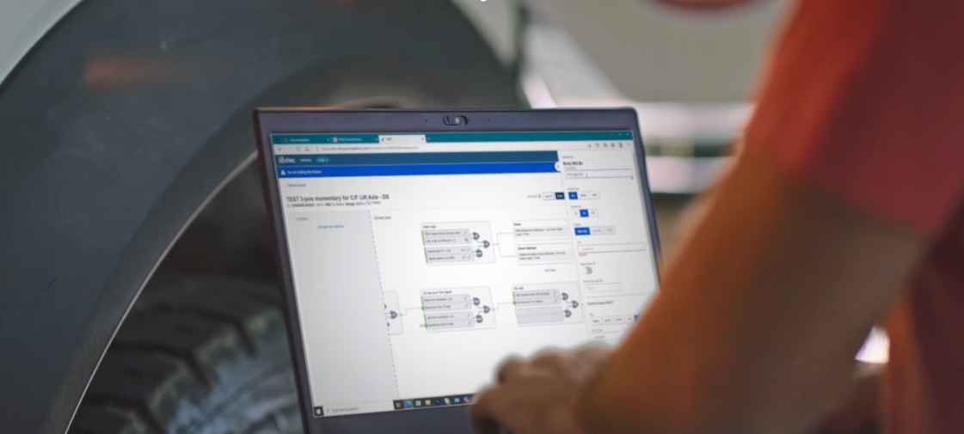
Freightliner Plus series was engineered to lead the industry in Upfit Efficiency
Notes:
(****If you use just these slides for a summary be sure to add the It all Ads Up slide 44 with additional key considerations)
The Plus series was engineered to lead the industry in upfit efficiency with the introduction of the QuickFit™ Electrical System.
QuickFit™ features a new multiplexed architecture that makes integrating truck equipment to the vehicle easier than ever.
QuickFit™ delivers easier access to critical connection points, more power sources, programmable switches, customizable parameters, and interlock features, making upfits more flexible, more reliable, and more durable — all in less time.
The Daimler Truck CHEC Tool provides a user-friendly interface to view and modify electrical configurations and change parameters in minutes, keeping customization fast, seamless and efficient.
With the power of QuickFit™ and CHEC Tool, tasks that were once considered too complex, expensive or impossible can be accomplished more easily and efficiently.
With the introduction of the Plus series trucks, key electrical components were also relocated to provide improved isolation from external variables and road debris that can cause downtime.
A substantial amount of thought and effort went into increasing the reliability of the electrical system on Plus Series trucks. Critical components are now located inside the cab for protection from the environment. We moved the PDM off of the driver’s side fender and mounted directly to the frontwall and enclosed it in a box rated ensuring protection from road debris and harsh environments. This is another quality improvement that resulted from listening to our customers and dealers.
DTNA electrical Commonalities – means less down time
Serviceability – dealers working with the same system
Part availability
–Upfit/programing
Operator experience – familiar with controls -Reduced training time

Slide 11
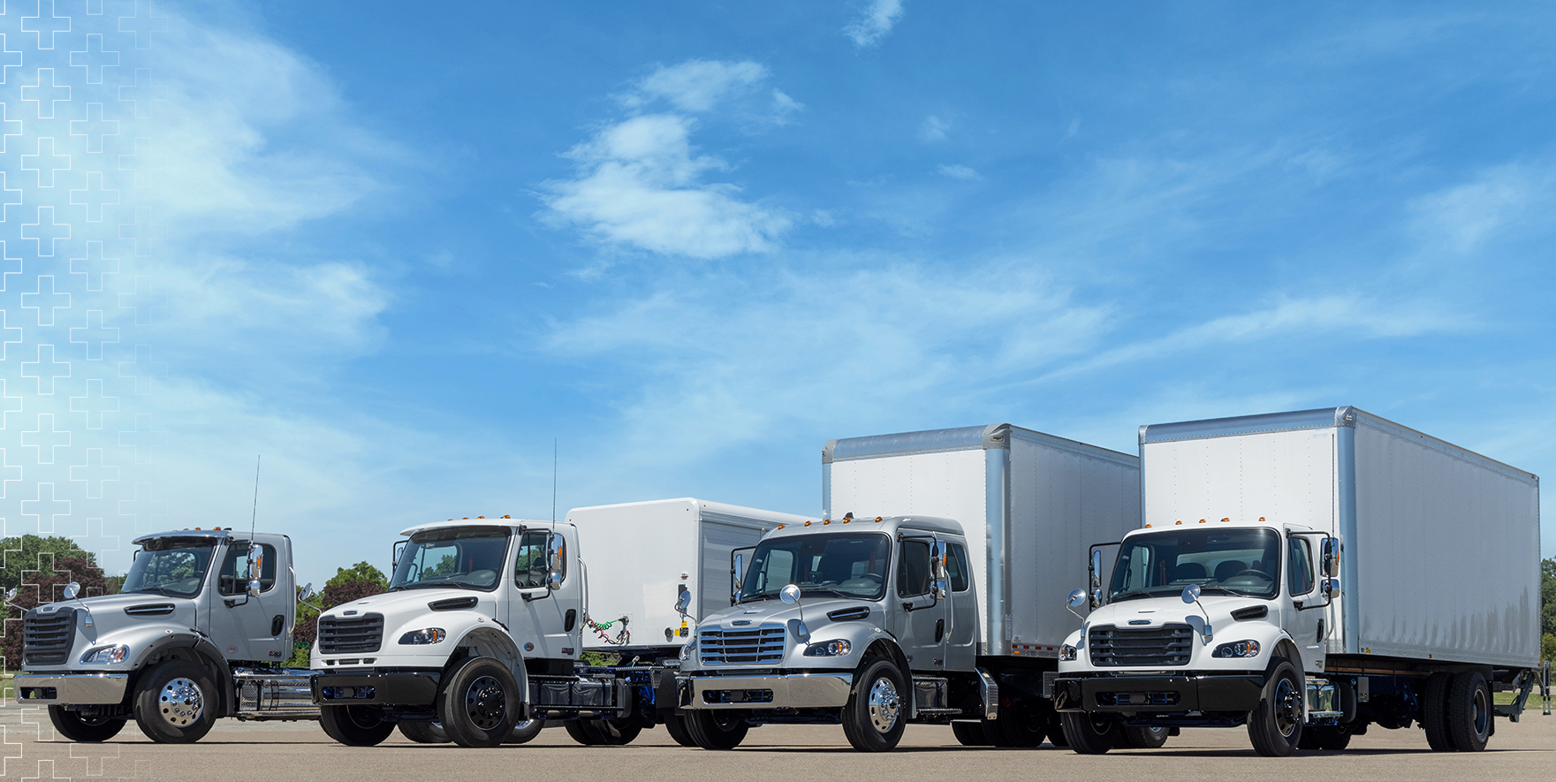
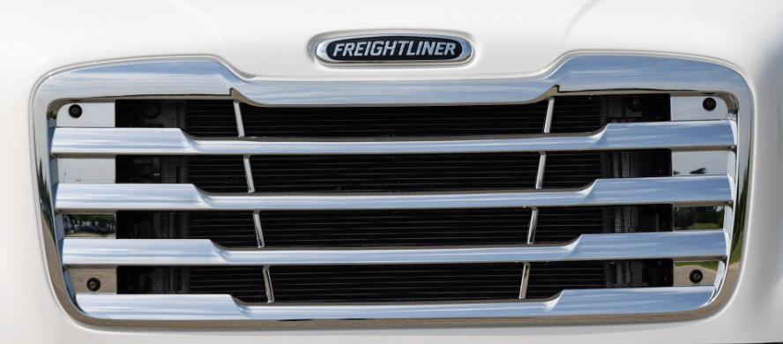
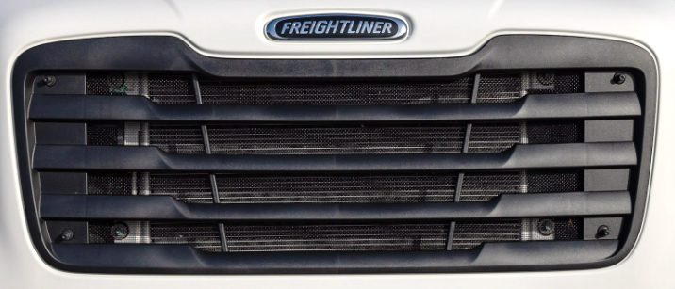
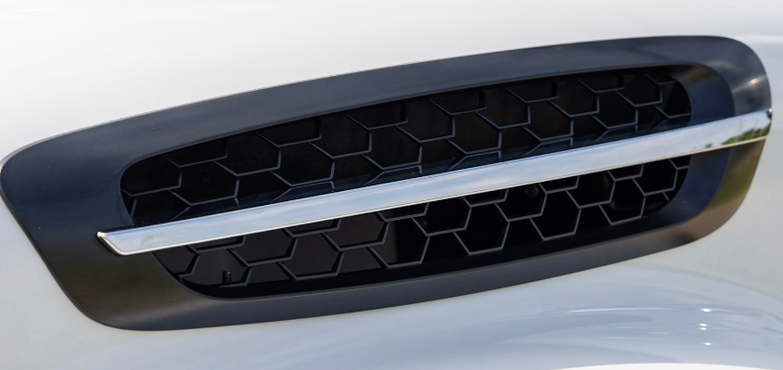
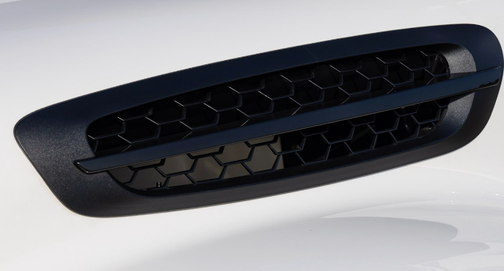
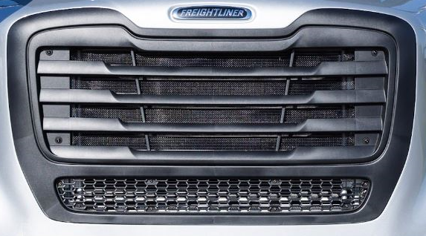
All new grille and air intake cover give the M2 106 Plus and M2 112 Plus an updated look
Optional chromed grille and air intake cover available
Black mold-in color grille and air intake cover standard
11
Mod: 646
Notes:
New for the M2 106 and M2-112is a new grill and air intake opening cover. The design takes styling cues from the Freightliner Cascadia on highway product. This incorporation of the Freightliner family styling insures recognition of our strong brand on and off the highway
The grill and air intake is Available in mold in black color, bright finish, or painted

Slide 12
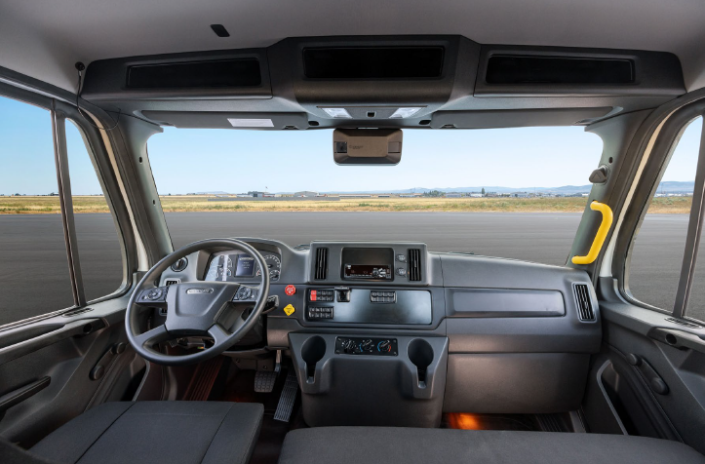
Next level in driver Comfort and Productivity
Notes:
Lets start with Comfort and Productivity
The Freightliner M2 Plus and SD Plus delivers a stylish new interior that is designed with driver comfort, upfit and productivity in mind. The interior of the cab includes a modern dash with an improved easy-to-read driver command center, vocational programmable switches, and a steering wheel with integrated controls. Drivers will find that the new Plus series concept will increase their comfort while effortlessly making them more efficient and productive.
Let’s talk about the highlights to this enhanced design
All-new trim levels designed for customer preference and applications;
With that you also get improved insulation that reduces exterior noise and at the same time provides greater thermal efficiency.
The Dash material has been upgraded to TPO “Thermoplastic Polyolefins … same materials used other DTNA
TPO is less susceptible to BSR “Buzz Squeak Rattle” this provides for better driver comfort, a quieter cab and has better chemical resistance (durability).
The new interior has Driver-centric dash with an easy-to-read driver information center.
A fully customizable switch layout.
Comfortable steering wheel with integrated controls.
An easy-to-use transmission control stalk that allows automated manual and automatic shifting and also includes engine braking functions from the column, for safe and easy operation of the vehicle.
The Configurable dash panel now featuring 2.5X more space for truck equipment manufacturers to utilize.
A relocated speaker from the dash to the door for improved sound – source of customer complaints!
Ergonomic seats with precise adjustability for improved driver comfort and to reduce fatigue.
We are using better foam and did a lot of research on other DTNA trucks to find an optimum contour.
Advantages are not just in the seat but also using the seat
Improved seat Articulation
Improved driver and operator experience – spend hours in their truck

Slide 13
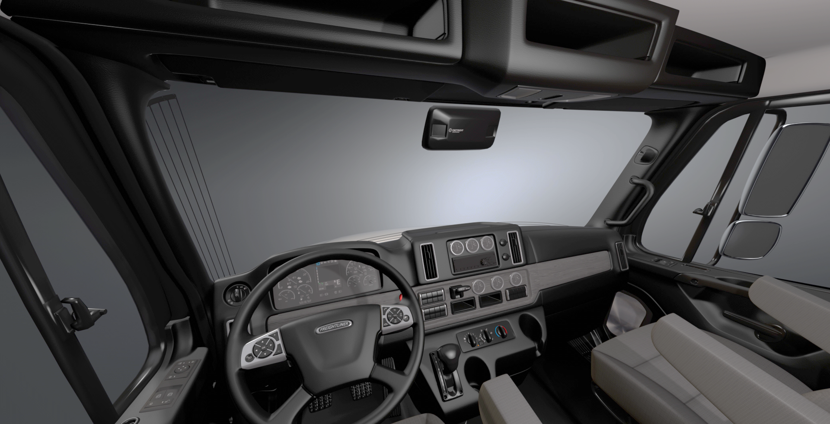
New interior- next level Comfort and Productivity
New Dash,
Overhead Console,
Headliner, & Backwall
CB, Radio, Switches, RP1226
LED Lighting
Detroit Assurance
Camera(s)
Detroit Assurance
Side Guard Assist
Instrument Cluster /
Driver Display/ PTO Control
Ram & Phone
Double DIN
USB-C
Vents
Stalk shifter/Brake
Beltline Accent
Headlight Switch
Door Panels, Pockets, Speaker
Switches
LED Lighting
Electric Window, Locks,
& Mirror Switches on Doors
Lower B-Panel Console
& Cup Holders
Seats
Steering Wheel Controls,
13
Notes:
One of the first things our customers will notice with the new Plus series trucks is the improved fit and finish. The new trucks feature all new dash and door panel materials – Thermoplastic Polyolefins (TPO) – for reduced squeaks and rattles this provides for better driver comfort, a quieter cab and has better chemical resistance (durability).
Overhead Console – more than twice the storage and more customizable, potential for optional a CB, remote radio, an RP1226 connection or up to 24 additional switches
Headliner, & Backwall- now available in the Rugged trim configuration with vinyl for both the headliner and backwall for those environments where it is difficult to keep those areas clean
LED lighting - LED lighting provides better lighting in the cab
Detroit Assurance with ABA, Side guard assist and adaptive cruise control is now available in the Freightliner medium duty product, more details on that later in the presentation
Now standard on the Plus series is electric windows and door locks, these controls have been relocated to the door for easier to reach and to free up more room on the dash
New Headlight switch – when the truck is spec with DA it will come with intelligent high beam control where the system will recognize another vehicle and adjust your high beams accordingly. Auto headlight / auto wipers
New steering wheel controls and New instrument cluster with a 5” driver display screen. The steering wheel can control the radio a blue tooth phone and is used to control the menu’s of the driver display. In this menu you can select things such as pre-set PTO speeds, critical to some applications where the PTO needs to be operated at different rpms depending on the job.
Other controls at the drivers fingertips is the transmission stalk shifter and engine brake control. Not only is this a convenience to the driver but frees up critical dash space. As shown in the picture we still offer t-shifter configurations for the transmissions that need it
New air vents were created for the Plus series to improve air flow through the cab and vent adjustment
On top of the DASH is a mounting slot for your telephone or ipad and an are for an optional RAM mount, there is also optional RP1226 connector access in this area.
The new dash allows for The main b-panel to offer up to 16 programmable switches, with up to 24 additional switches being available in the overhead console
The new dash comes in three new trim levels: Pro, Rugged and Elite, we will discuss some of those features on a further slide
The new door panels are constructed of the same durable and quiet material as the dash and now include a pocket that doubles that has been to tested to the weight of a fully certified door handle
The lower B-panel includes new deeper cup holder to insure your coffee stays where its suppose to.
Also new on the Plus series is standard door step/ puddle lights and option LED floor lighting

Slide 14
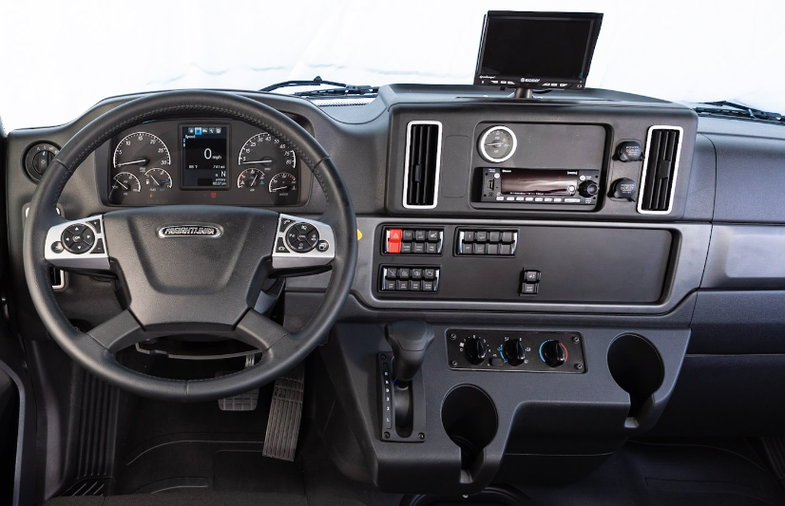
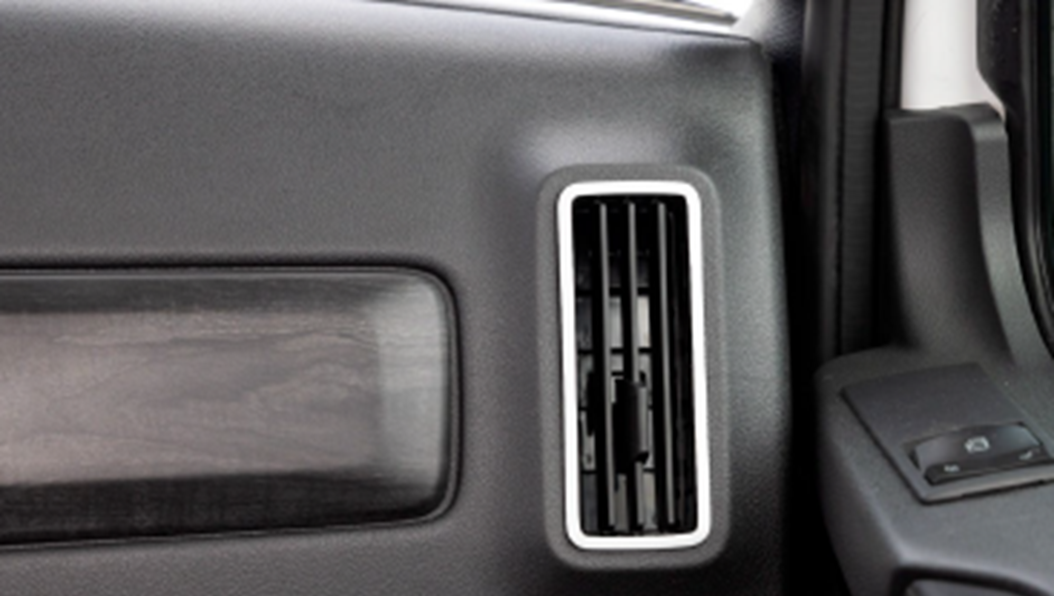
Dash
All new dash with new customizable layout
New Vents improve air circulation through the cab
Mod: 680
Notes:
DASH
The enhanced Freightliner M2 Plus and SD Plus series ergonomic and modern dash (680-029) features an intuitive and highly functional layout. The dash can be customized with multiple switch and gauge combinations or configured to provide additional storage (Mod 734). The flexibility in its design creates an optimal driving experience no matter the medium duty or vocational application. Standard on the top center of the Plus series dash is a unique integrated support mount (Mod 1U1) for tablets or smartphones. This well-thought-out feature gives drivers access to their own customer-supplied map and traffic applications.
The center instrument panel in the b-panel to the right of the driver, is fully customizable to support a combination of switches and gauges and customer or TEM supplied devices such as a backup camera monitor.
The b-panel provides easy to reach and customizable space for additional backlit switches and gauges. The Freightliner heavy-duty vocational switches (Mods 329/4C0/4C1/4C2/4C3/4C4/44V) feature intelligent LED backlighting, durable and long lasting laser-etched graphics, and the flexibility for custom programming. These rugged switches can be easily operated with a gloved hand and are both dust and water-resistant. Additional switches are available for order using the Custom Switch Selector in SpecPro (Mods 35M/48C/4CG/4CH/4E1). The custom switches offer flexibility and can be configured with the QuickFit logic using the CHEC tool. When fewer switches are needed, the extra dash space can be fitted with storage pockets to give the driver additional easy-to-reach storage or a camera monitor. Creating your own custom layout or configuration from the factory, is available through the CHEC tool, prior to the trucks’ build date. Refer to Electrical Architecture and Quickfit System sell sheet for additional information on switches.
The center-mounted dash console contains the HVAC temperature controls and also the new extra-deep cup holders. When the vehicle is spec’d with a column shifter (Mod 345), optional center-console dash storage is available (Mod 734). Additional storage options such as floor or back-wall mounted consoles can be selected in order to meet driver storage needs (Mod 696).
The new dash also includes an all new vent design which significantly improves air flow circulation through the cab keeping the driver more comfortable

Slide 15
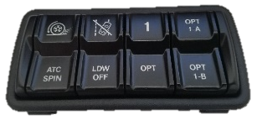
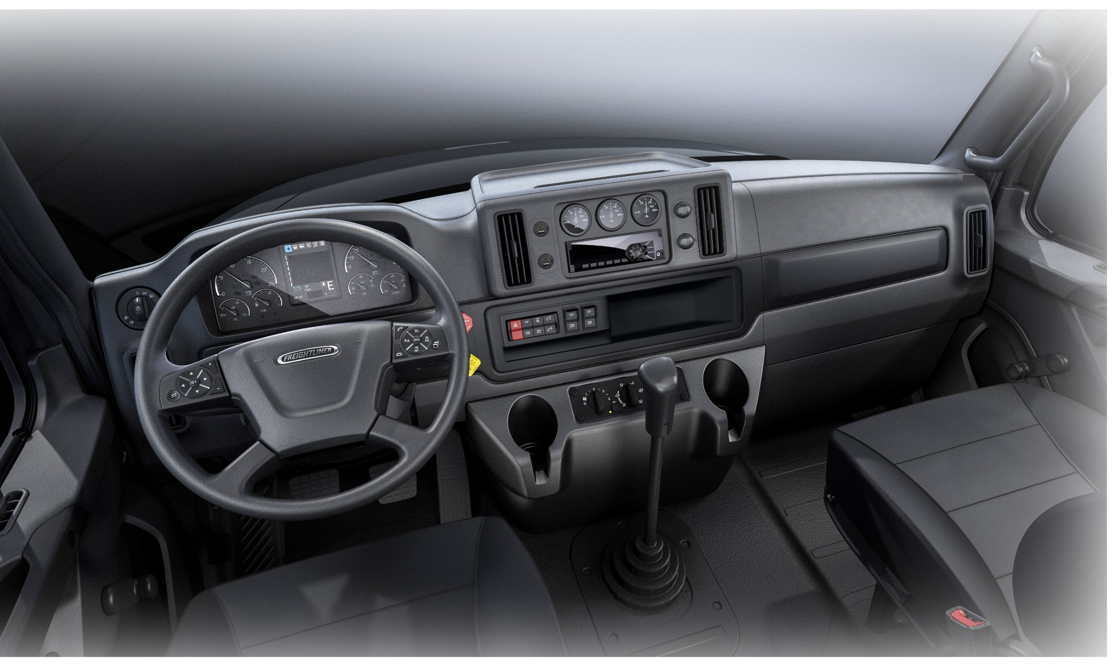
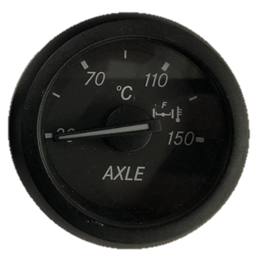
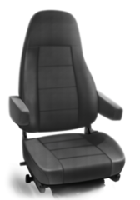
Professional Trim (M2 std.)
Steering Wheel | Black w/ Switches
Gage Bezel | Black Gauge Bezels
Belt Line | Carbon With Base Black Accent
Headliner | Mist Cloth
Backwall | Carbon Cloth
Seat Material | Carbon Vinyl
Mod: 055-017
Notes:
The Freightliner M2 Plus and SD Plus series are available with three distinct trim level packages - Professional, Elite, or Rugged – to optimize the interior depending on application or styling preference.
The Professional trim level package (055-017), standard on the M2 Plus models, and optional on SD Plus, has standard LED cab lighting, multi-function black steering wheel, black switch and gauge bezels, factory installed radio with Bluetooth and USB inputs, carbon black hard trim accents, cloth headliner, cloth back wall, vinyl seats, and black floor mats.

Slide 16
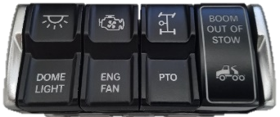
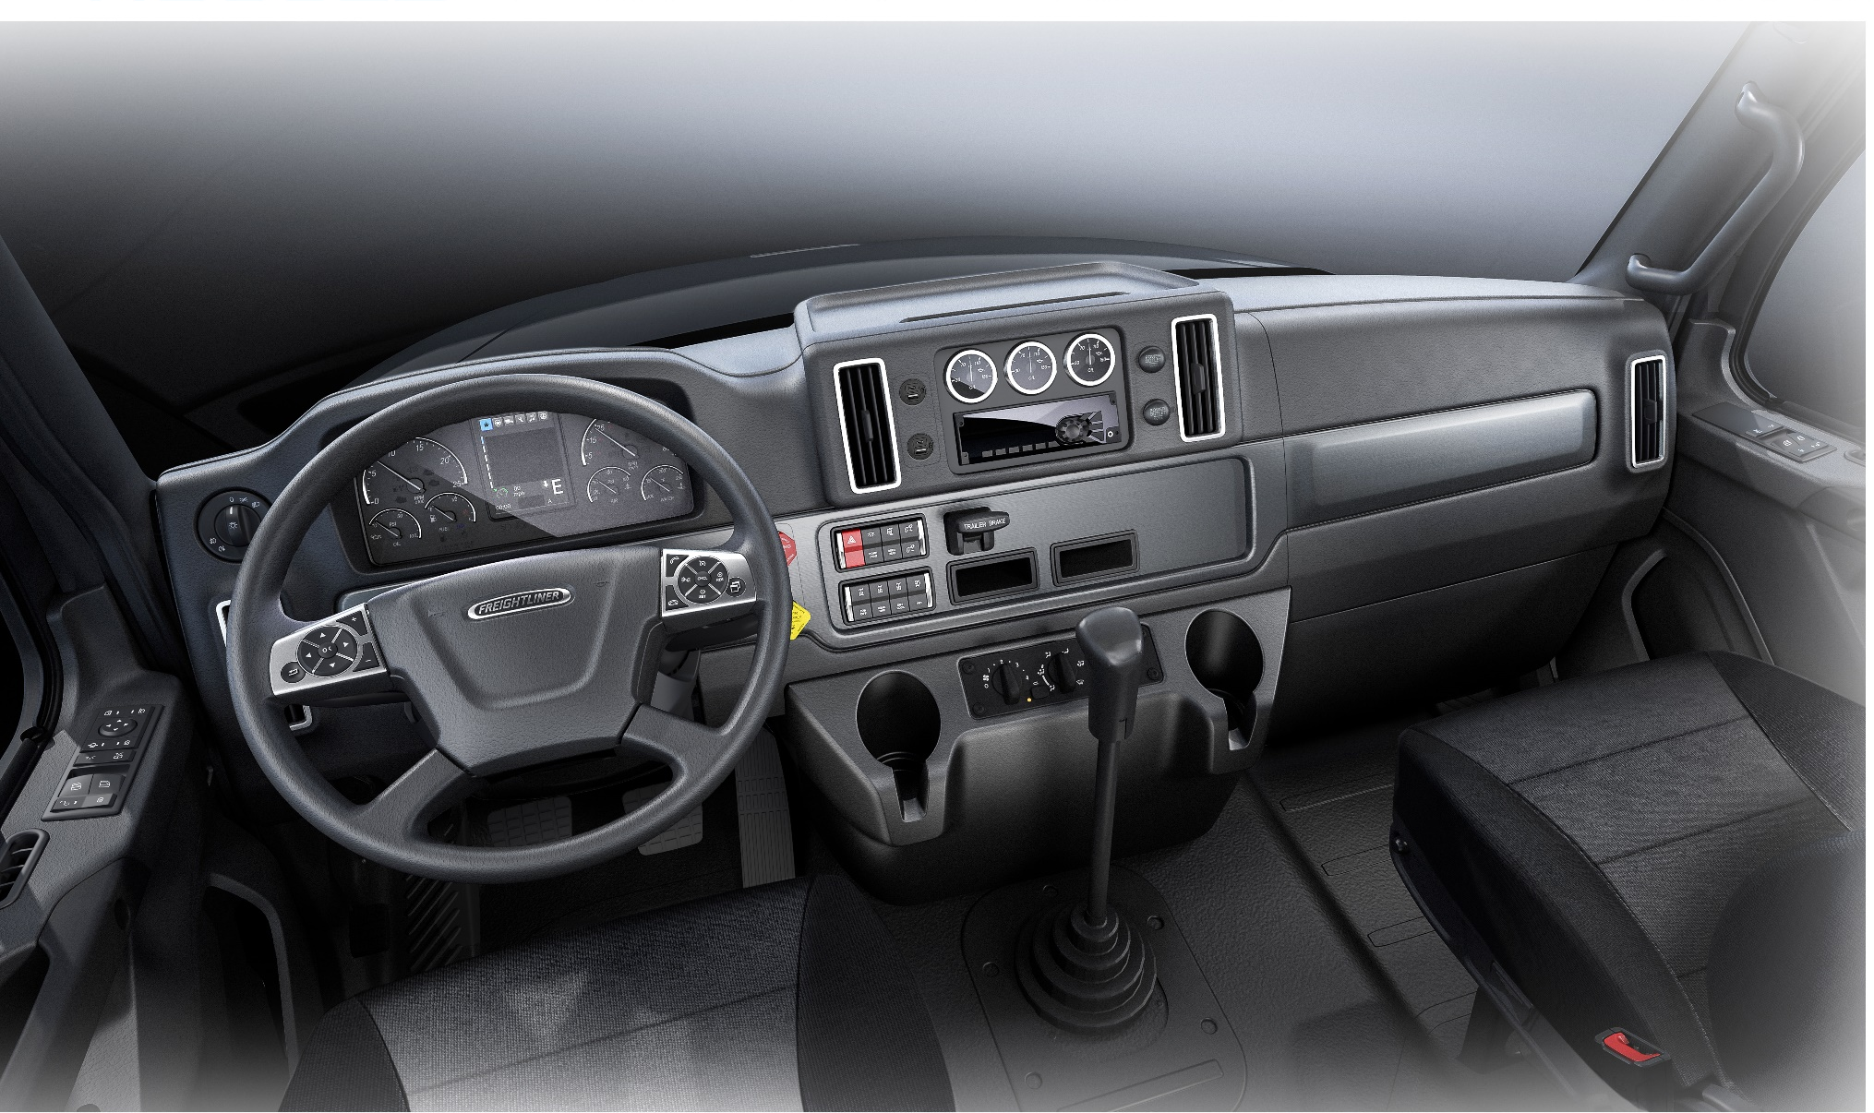


Rugged Trim (SD std.)
Steering Wheel | Chrome Leather wrapped
Gage Bezel | Bright Finish Gauge Bezels
Belt Line | Carbon Premium Gunmetal Accent
Headliner | Premium Gray Vinyl
Backwall | Carbon Vinyl
Seat Material | Two Tone Rugged Textured Cloth
Mod: 055-019
Notes:
The Rugged interior trim level (055-019) is standard with the 108SD Plus and 114SD Plus and optional with the M2 Plus models. Designed with vocational applications in mind, the Rugged trim level features a vinyl headliner and vinyl back-wall providing an easy-to-clean surface after a long day on a muddy job site. This package also offers standard LED cab lighting, leather wrapped multi-function steering wheel, bright switch and gauge bezels, factory installed radio with Bluetooth and USB inputs, gunmetal hard trim accents, two-tone MF50 Rugged cloth seats, and black floor mats.

Slide 17

Elite Trim (M2 & SD opt.)
Steering Wheel | Chrome Leather wrapped
Gage Bezel | Bright Finish Gauge Bezels
Belt Line | Carbon With Premium Wood Accent
Headliner | Mist Cloth
Backwall | Carbon Vinyl
Seat Material | Two Tone Mordura Cloth
Mod: 055-018
Notes:
For those fleets that want a bit more style in their truck interiors, the Elite trim level (055-018), optional on all Plus series models, offers standard LED cab lighting. This package also features a leather wrapped multi-function steering wheel, bright switch and gauge bezels, factory installed radio with Bluetooth and USB inputs, ash grey woodgrain hard trim accents, cloth headliner, vinyl back wall, two-tone Mordura cloth seats, and black floor mats.

Slide 18


New Door Panels and Window Controls
Standard power windows, locks and mirror controls
Newly relocated window controls more intuitive for better ergonomics
New robust mold-in door pockets with integrated, reinforced grab handle for improved safety
Aluminum kick plate optional
Fresnel lens available on passenger-side door
Rubberized door handle with Elite and Rugged interiors for better grip
Door integrated speaker – new! – based on customer feedback
Optional Aluminum Kickplate
New Speaker Location
Map Pocket with Integrated Grab Handle
Relocated Power Window, Lock and Mirror Controls
Mod: 654,655, 678, 693, 750, 769
Notes:
DOOR PANELS
The M2 Plus and SD Plus series door panels feature the same upgraded TPO interior materials as the dash, to reduce noise and provide superior fit and finish (Mod 693). The door panels feature a large map pocket for storage, or an optional metal kick-plate for long lasting durability. The large map pocket includes a reinforced lip for additional grab support that meets the standard FMCSR 399.207(b)(9), for safer entry and exit from the vehicle. There is also a Fresnel window option to increase passenger side visibility. Doors on the Plus series come standard with full power windows, locks, and mirrors with controls ergonomically located on the door arm-rests. The new M2 Plus and SD Plus series door panels now include door-mounted speakers that provide better sound quality and improved driver experience.
DOOR LOCKS AND WINDOW CONTROLS
The M2 Plus and SD Plus series are equipped with standard full electric door and window controls which are located on door arm rests, however two additional options, full manual and manual with mirror heat, are available to meet the needs of other applications. (Mods 654,655,744,743,787).

Slide 19

All-New Ergonomic Seats
Designed for optimal driver and operator comfort
Improved foam material
Newly designed contours
More flexibility in seat position
2 inches additional horizontal adjustment
Additional reclining positions
Modern ergonomic seat cushion contours.
multi-position F/A cushion adjust
Mechanical lumbar adjust
230 mm horizontal adjustment
Horizontal isolator (chugger)
Recline adjust Lever -16° - +36°
Plastic side panels
Fixed damping rate
shock absorber
Mod: 758, 761, 755
Notes:
New seat design
The new seat design is based on long haul designs to insure drivers comfort and support through out long days in a vehicle.
It includes new support contours, new materials, and more flexability in seat position allowing for more horizontal adjustment and reclining positions.
SEAT OPTIONS
Freightliner features a number of comfortable driver (Module 756) and passenger (Module 760) seat options, including Basic, Premium, or Elite packages, designed to meet the operator’s comfort and safety requirements.
• The Basic high-back non-suspension seat is standard for the driver seat.
• The Premium high-back 3-chamber lumbar air suspension seat includes an integrated cushion extension and adjustable shock absorber for added support and comfort.
• The Elite high-back 3-chamber lumbar air suspension seat includes an integrated cushion extension, adjustable shock absorber, forward and rear cushion tilt and heat, providing optimum driver comfort.
• A mid-back non-suspension passenger seat is available for the M2 Plus and SD Plus series with a variety of passenger side under seat storage options or headrests.
• SEATS INC 911 driver and passenger seats, in black or grey, for fire and emergency applications, are available as either mid or high back and include compliant seat sensors and passenger side self-contained breathing apparatus (SCBA).
• 3 point high visibility driver and passenger seatbelts (Mod 763) are available with optional seat belt status indicators and audible alarms.
• The optional RollTek high back 3-chamber lumbar air suspension seat (756-296) includes active bolsters, six-position front and rear cushion adjustment, and the BackCycler system for maximum driver comfort. The BackCycler system inflates and deflates an air bladder in the lumbar area providing lower back support. The Rolltek seat is designed to inflate side-impact airbags, tighten seat belts, and compress air suspension seats to the lowest position to prevent serious injuries in the unlikely event of a rollover.

Slide 20




New Insulation
All new insulation material provides improved noise reduction
New standard package offers insulation in the roof and in the dash around the steering column
Premium insulation package includes higher performance material and added insulation
Mod: 739
Notes:
New standard package offers insulation in the roof and in the dash around the steering column, absorbing noise coming through the front wall
Premium insulation package (739-034) includes higher performance material and added insulation in the back wall and dash around the steering column, top dash and lower cover around cup holders and passenger side
INSULATION
The Plus series features all new insulation material that provides improved noise reduction compared to legacy M2 and SD products today. The new standard package offers insulation in the roof and in the dash around the steering column, absorbing noise coming through the front wall.
A premium insulation package (739-034) is also available and offers a higher performance material compared to the standard offering. The premium package provides insulation in the back wall and around the steering column, cup holders, and passenger side of the dash, provides further noise mitigation and improved cab comfort.

Slide 21

New Steering Wheel and Instrument Cluster
Driver Command Center displays operating information, important vehicle functions, alerts, settings, and more
Multi-function steering wheel features integrated controls for the cruise control, Driver Command Center and more
Power Take Off allows the driver to control the engine speed in PTO mode.
Quick release adjustable steering column
Mod: 540,811
Notes:
DRIVER-FRIENDLY STEERING WHEEL and CONTROLS
The M2 Plus and SD Plus series multi-function steering wheel features integrated push button pads that engage with functions such as cruise control, marker interrupt, radio, Bluetooth®-connected mobile phone, and the Driver Command Center. Steering wheel controls assist in reducing the space needed on the dash and keep the most commonly used controls at the drivers’ finger tips, allowing them to keep their hands on the wheel and their eyes on the road. With the steering wheel controls and the Driver Command Center, operators are able to quickly and easily select information on vehicle performance, maintenance, and infotainment categories, as well as additional menu options. Being able to initiate a digital regeneration or controlling the engine in PTO mode are just a couple of examples of operations available with the multi-function steering wheel that maximize driver comfort and productivity.
The Freightliner Plus series offers a premium 4-spoke 18 inch leather-wrapped steering wheel with bright bezels standard in the Rugged and Elite interior trim packages, to provide a comfortable grip and enhance the look of the vehicle.
The Freightliner M2 Plus and SD Plus series comes standard with a quick release adjustable steering column providing a full range of motion for driver comfort as well as making entry and exit from the vehicle easier. Located on the steering column are multiple control stalks that include an integrated wiper control on the left-hand side and an optional column-mounted transmission shifter on the right-hand side. The column-mounted transmission shifter, available with all automated manual and automatic transmission options, includes RND for shifting, and 3 stalk positions for engine braking controls. Having these engine and transmission functions within easy access allows the driver to keep his focus on the road.
Depending on the transmission configuration, push button shifters (Mod 345) are also available. For Allison 1000/2000 series transmissions, T handle shifters are required.
DRIVER COMMAND CENTER: 5-INCH DISPLAY SCREEN
The Driver Command Center with a 5-inch display screen is center mounted and provides critical information and timely and accurate alerts to the driver in an easy to read format. The display screen is navigable using steering wheel controls, keeping the driver’s hands on the wheel and eyes on the road ahead, and information relevant to the health and performance of the truck at their fingertips. The driver display screen is broken up into three areas: a navigable menu at the top of the screen, the display area (with a screen indicator if there is more than one page), and a static display at the bottom of the screen.

Slide 22







ICU Based PTO Speed Control
PTO Set Speed Selection (customer configurable)
1000 RPM
1250 RPM
1850 RPM
RPM changes
PTO Engaged
Driver is on ANY screen
OR
Vehicle is Stationary
Or
Vehicle Moving
“Short” button press
Incremental Engine RPM Adjustment (customer configurable) (e.g. 25 RPM/press)
“Long” button press
Engine RPM Ramp Adjustment (customer configurable) (e.g. 100 RPM/second)

Slide 23

New Column and Stalk Shifter
Available with Automatic and Automated Manual Transmissions
Includes RND Functionality
Includes 3 positions for engine brake
Other Shifter Options
T Handle / “Cobra”
Push Button
Mod: 345
Notes:
The column-mounted transmission shifter, available with all automated manual and automatic transmission options, includes RND for shifting, and 3 stalk positions for engine braking controls. Having these engine and transmission functions within easy access allows the driver to keep his focus on the road.
--
The Freightliner M2 Plus and SD Plus series comes standard with a quick release adjustable steering column providing a full range of motion for driver comfort as well as making entry and exit from the vehicle easier. Located on the steering column are multiple control stalks that include an integrated wiper control on the left-hand side and an optional column-mounted transmission shifter on the right-hand side. The column-mounted transmission shifter, available with all automated manual and automatic transmission options, includes RND for shifting, and 3 stalk positions for engine braking controls. Having these engine and transmission functions within easy access allows the driver to keep his focus on the road.
Depending on the transmission configuration, push button shifters (Mod 345) are also available. For Allison 1000/2000 series transmissions, T handle shifters are required.

Slide 24




Switches and Dash Mounts
4-bank Programmable Switches (16 Dash, 24 OH Console)
Existing or custom graphics
New switch caps with tactile feel
Brighter backlighting exceeding NFPA requirement w/dim control
Optional RAM Mount available top of dash mounting
Phone/I-pad Slot Mount
710 cm² Panel Space
Plus delivers 2.5X more space for TEMS than the legacy product
Mod: 017,329,4C1 4CH,4C4,734
Notes:
Modules
329 Number of extra hardwire switches
4C1 through 4C4 -Switch location, type, amperage, and wiring
4CH-In Dash Programmable Switches – up to 16
4CG -Overhead Programmable Switches – up to 24
4E1-Overhead Switch location
Up to 4 Hardwire Switches
Dash or Overhead Programmable Switches (16 Dash, 24 OH Console) switches are also "smart" switches, they can be interlocked with all of the areas of the truck and the body. If a customer wants to ensure that the boom on an outrigger can't be extended until the parking brake is set, the truck can be easily programmed that way using the CHEC Tool.
Existing or custom graphics
New switch caps provide tactile feel
Brighter backlighting with dim control
Switches graphics & location can be place in vehicle by customer using CHEC
Also New deeper cup holders with optional configurations

Slide 25






Overhead Console
Reinforced roof structure
Increased overhead storage- 2X
Option flexibility:
Additional switches – Up to 24
RAM mount
CB/Remote Radio
RP1226
Power
Mod: 691,4CG,4E1,1U1, 6TS, 746,747,748,749
Notes:
4CG -Overhead Programmable Switches – up to 24
4E1-Overhead Switch location
Optional RAM Mount (1U1-005)
OVERHEAD AND STORAGE OPTIONS
The Freightliner M2 Plus and SD Plus series overhead compartment offers two times more overhead storage (Mod 691) than the previous models and many options to customize the truck for your application. Some of the optional configurations offered include a center mounted overhead CB provision (Mod 749), remote radio mounting (Mod 746/747/748), and locations for additional switches (Mods 4CG/4E1). The retention lip on all storage shelves is sloped to prevent articles from migrating towards the driver. The Plus series offers multiple overhead configurations to ensure the truck has the ability to meet the requirements of any application and to maximize driver and vehicle productivity.
TELEMATICS PRE-WIRE AND MOUNTING
The Freightliner M2 Plus and SD Plus series offers RAM mount (1U1-001 and 1U1-005) and RP1226 connectors (Module 6TS) in multiple dash and overhead locations in order to provide J1939 network connection for devices from a variety of telematics service providers. It was designed for telematics but can be used for camera controls, other service providers, etc. The RP1226 output connector is available in the overhead console (6TS-006,-008), passenger side dash, (6TS-005,-008,-009), or the passenger side back wall baggage compartment (6TS-007,-009), providing an easy and cost effective upfit and increasing the bottom line.

Slide 26
Pre-Trip and Smart Battery Shutoff
Easy Driver access from the Ground
Smart Battery Shut-Off (293-077)
Prevents battery drain
Pre-trip Lamps Inspection (81Y-001)
Mod: 293, 81Y
Notes:
BATTERY DISCONECT
New for the M2 Plus and SD Plus series is the Smart Battery Shut-Off disconnect option (293-077). The Smart Battery Shut-Off disconnects the batteries to specific high current loads to prevent battery drain, but continues to allow minimum power for the vehicle computers to ensure the integrity of those systems for battery shutoff and pre-trip lamp inspection
These switches are located at lower b-pillar floor for easy driver access without entering the truck to improve productivity of pre-trip inspections.

Slide 27


















Engine Availability Engine ratings may be limited by model selected
B6.7
200-325HP,
520-750lb-ft.
L9
260-380HP,
860-1250lb-ft.
L9N
250-320HP,
730-1000lb-ft.
X12
350-500HP,
1250-1700lb-ft.
ISX12N
320-400HP,
1150-1450lb-ft.
200-240HP,
560-660lb-ft.
260-350HP,
660-1050lb-ft.
370-525HP, 1250-1850lb-ft.
NEW
*Available with straight trucks only, tractors with exceptions
Mod: 101
Notes:
The Plus series of trucks is available with a variety of engines to give our customers both choice and flexibility in how they configure the vehicle for different applications

Slide 28

Detroit DD13 Gen 5
New vocational ratings up to 525 HP and 1850 lb/ft
Updated swirl piston and head design coupled with an increased compression ratio saves fuel
Asymmetric Injection - biases fueling to increase temperatures going into the aftertreatment system
Engine Brake Strategy - increase downstream temperatures and contribute to improved ATS performance
ThermoCoasting –reduces temperature drops associated w/ coasting resulting in more completed driving regens, reducing parked regens
Thermal Control Valve – maintains high exhaust temperatures in low or no load situations, ensuring aftertreatment performance in nearly all operating conditions
All new aftertreatment
60+ lbs. Weight Reduction
Smaller Dimensions
Increased NOx Conversion
1 DPF vs 2 from GHG17
Increased DPF Maintenance Intervals
It All Adds Up - New system Significantly Reduces the need for Parker Regens
Mod: 101
Notes:
Available in the 114SD and M2-112 is the new DD13 Gen 5 engine
DETROIT DD13 GEN 5
-The newly enhanced DD13 Gen 5 features new ratings, superior combustion, performance, and reliability improvements to the industry- leading DD13 platform. New ratings, from 370-525 hp, and 1250-1850 lb-ft will have higher additional power at the upper end of the RPM band and more torque at the low end compared to the current DD13.
-The DD13 Gen 5 has been strengthened to handle higher compression ratios while the new swirl piston design will improve combustion.
-
Asymmetric Injection at Idle – While not a new technology for Detroit, this feature will assist with regens. It activates during idling to increase temperatures going into the after treatment at times where harmful hydrocarbons build up. This feature will disable fuel going into select cylinders while fueling others at higher rates to increase loads and temperatures and improve ATS performance.
Engine Brake Strategy – New with DD13 Gen 5, the engine brakes will now use the 3 rear cylinders to brake while on the low and medium setting instead of the front 3 like previous versions. This will increase downstream temperatures and contribute to improved ATS performance. Standard engine braking remains as powerful as ever.
Thermocoasting – New with the DD13 Gen 5 this feature will activate the engine brakes during a driving regen to reduce the temperature drops that are associated with coasting. When a truck begins to coast it removes load and heat at a fast rate and an ATS needs heat to perform at optimum levels especially during a regen. Thermocoasting will activate the engine brakes when a driver begins to coast even if they engine brakes are not enabled, continuing to power at the same time and therefore not slowing the vehicle down any further. The result is a more complete regen and likely for a shorter duration.
Thermal Control Value – New with the DD13 Gen 5, the Thermal Control Valve provides optimal heat to the new Aftertreatment System for fewer parked regens. By modulating back pressure in low load or high idle situations, the TCV forces the engine to generate more heat, effectively maintaining the ATS under all operating conditions. The TCV requires no driver input and offers smooth quiet operation. The TCV also works with the DD13s integrated Jacob’s Engine Brakes to further increase braking power.
These updates result in the ability to maintain optimal aftertreatment performance in nearly all operating conditions, including extended low-load PTO operation. The new DD13 Gen 5 is ideal applications such as: construction and utility.
-Additionally, the new after treatment system will extend the DPF cleaning intervals, reduce the overall vehicle weight by 60 lbs, and create improved SCR performance.
ThermoCoasting – when paired with a DT12 transmission, the engine powers on 3 cylinders and brakes on 3, reducing temperature drops associated w/ coasting while keeping zero torque at the flywheel, resulting in more completed driving regens

Slide 29







Transmission Availability
NEW
DT12 -OHE | DT12-DHE | DT12-V | 1000 HS/ RDS | 2100 HS/ RDS | 2200 HS/ PTS | 2500 HS | 2500 RDS | 3000 HS | 3000 RDS | 3000 EVS | 3500 EVS | 3500 RDS | 4000 HS | 4000 RDS | 4000 EVS | 4500 RDS | 4500 EVS | 4700 RDS | Man | Endurant
 |  |  |  |  |  | Standard
 |  |  |  |  |  |  |  |  | Standard
 |  |  |  |  |  |  |  |  | Standard
 |  |  |  |  |  |  |  |  | Standard
Mod: 342
Notes:
The Plus series of trucks is available with a variety of transmissions to give our customers both choice and flexibility in how they configure the vehicle for different applications

Slide 30

Detroit DT12-V
Engineered for Upfit and Productivity. Period.
Over $100 million in global investment to specifically engineer for the needs of vocational customers
Existing features adapted to meet vocational customer needs: Hill Start Aid, Creep mode, Auto Neutral, Descent Control, Kick- Down mode, and more
Revamped oil system reduces oil capacity for improved maintenance, and gets to operating temperature quicker to get working sooner
Rear and bottom PTO with factory installed Chelsea and Muncie options for improved upfit
3 new vocational features
Paving Mode for easy operation during road work
Rock-Free mode to get unstuck from difficult job sites
Off-Road mode to tackle rough terrain
Speeds | 12 Forward / 4 Reverse
Max Torque | 2,250lb-ft
GCW Rating | 160,000lbs
PTO | Rear & SAE side
Mod: 342
Notes:
The new Detroit DT12 transmissions are now offered to support both on-highway and vocational applications. The DT12-V vocational series includes enhancement features such as Offroad Mode, Rock Free Mode, and Paver Mode to help get the job done. The DT12-HE is the on-highway series with improved ratios and oil system, reduced parasitic losses, maximizing fuel efficiency, and increasing the bottom line.
DETROIT DT12-V VOCATIONAL TRANSMISSION
The new vocational DT12 automated manual transmissions, identified DT12-V and DT12-VX, have large robust planetary gears and a new gear set design that improves GCW ratings and torque inputs with wider overall ratios, promoting improved startability and low speed maneuverability. The vocational transmissions are designed with a bottom mount PTO and the ability to take on more demanding jobs, maximizing durability and productivity.
DT12-V 160,000 lbs GCW
DT12-VX 330,000 lbs GCW
AUTOMATED MANUAL TRANSMISSION
The DT12 is an automated manual transmission, offering the benefits of both a manual and an automatic transmission. It is lightweight like a manual with an efficient clutch instead of a torque converter. And like an automatic transmission, automatic shifting or clutch engagement is handled by a computer controlled air system. In addition, the transmission is controlled by a column mounted stalk (DC 345-078), which also controls the engine brake, and is easily within reach so drivers do not have to remove their eyes from the road. A novice driver can jump behind the wheel and quickly get to work, providing maximum productivity.
TRANSMISSION OIL DISTRIBUTION AND THERMAL CONTROL
The DT12’s new oil pump provides a more continuous flow of oil at all speeds and in all operating conditions. The DT12’s bottom-mounted oil intake allows the oil to be picked up at the lowest level and recirculated by spraying it onto the gear mesh, ensuring ample lubrication in tough conditions, resulting in less parasitic loss due to oil splash. Oil is cooled when diverted to the adaptive bypass to maintain oil at an optimal temperature for any running application. The oil system allows the transmission to warm up faster providing increased performance with less risk of damage.
POWER TAKE-OFF (PTO)
DT12-HE, DT12-V, and DT12-VX offer an 8-bolt bottom PTO opening, providing dependable performance for heavy haul, logging, construction, farm, mining, and oil field applications. Allowing dual PTO usage further increases job flexibility and application coverage with a bottom, 7 o’clock position PTO opening to accommodate third party Chelsea and Muncie PTOs, increasing application coverage and flexibility in vocational applications.
The DT12 also offers a rear mounted, 4 o’clock position power take-off (PTO), ideal for bulk-haul tractor applications that load/unload while stationary. The PTO can accept a direct mounted pump for wet kits, or a flanged driveshaft for blowers or remote pumps.
With ratios ranging from 1:1 to 1:1.76 the PTO can adapt to several applications from fuel tankers to walking floor trailers.
ACTIVE DRIVELINE PROTECTION
The Transmission Control Module calculates the torque wind-up in the driveline and regulates the engine torque control, reducing or eliminating cab jerking or rocking, maximizing driver comfort. Smooth reapplication and/or removal of driveline torque during shift control protects critical driveline components from damage or excessive wear, reducing maintenance costs and increasing the bottom line.
AUTO NEUTRAL
If the engine is shut off or the parking brake is applied, with the transmission still in gear, the DT12 will sound an alarm and automatically shift to neutral. Auto neutral is a standard feature on all DT12 transmissions minimizing the risk of transmission damage and safety concerns.

Slide 31

The most comprehensive and innovative suite of Safety and connectivity systems is now available with Freightliner’s vocational and medium-duty truck lineup
Notes:
We understand even minor damage to a truck can be expensive in lost revenue, downtime waiting for parts, cost of parts and rental replacements
The Plus series comes with all new electrical architecture, common with other DTNA products which now gives our medium duty customers access to the industry-leading Detroit Assurance 5.0 suite of safety systems with Active Break Assist 5.
Customers who select the combination of Detroit engine and DT12 transmission will have access to the Detroit’s best-in-class full suite safety systems. Seen on other DTNA models.
In addition to being available with all Detroit engine models, customers will for the first time be able to order certain Detroit Assurance features when spec’ing a Cummins engine. Now, fleets will have access to best in active safety regardless of powertrain option selected.
Safety features including Active Brake Assist, Lane Departure Warning, and Side Guard Assist allow for increased safety on the road or jobsite. Additional features like Adaptive Cruise Control, which automatically adjusts cruising speed to maintain a safe following distance, will become available with Plus series start of production in Q3 2023.
Available exclusively with Detroit engines and DT12 transmissions, Adaptive Cruise Control (ACC) automatically adjusts the cruising speed to maintain a safe following distance.
Additional safety features include Lane Departure Warning, Side Guard Assist, and more.
Side radar and rear and front cameras allow a 360° visibility for improved pedestrian detection.
A Premiere option of comprehensive and innovative Detroit Connect® Suite of Connectivity Systems as trusted source for information about vehicle performance that empowers better decision-making for operators and fleet owners is now also available.
-Within minutes of a fault event, Virtual Technician remote diagnostic service informs fleets of the severity of the fault, and when, where and how to best fix the issue.
-Remote Updates uses secure, over-the-air programming capabilities to make engine parameter and other updates.
-Detroit Connect Analytics provide users with on-demand, automated analysis, identifying behaviors and trends, and providing actionable insights on fuel consumption and safety performance data.
-Safety Event Viewer enables visibility into driver safety performance, notifying fleets of collision mitigation events. It will show the time, date and location of an event, plus the vehicle speed at the time of the event and duration of the event.
This record keeping allows Detroit Connect users to monitor and track all critical events and take action to increase the safety of trucks on the road and job site (standard with Detroit Assurance with Active Brake Assist 5).

Slide 32
Detroit Connect
Telematics
Integrated Telematics Service Provider
Factory Integrated Solution
Over the Air software and parameters
Detroit Connect Portal
Virtual Technician
Remote Updates
Safety Event Analytics
Standard
813-1C8 Detroit Connect Platform Hardware 8D1-203 3 Yrs Detroit Connect Base Package with DD engines
8D1-303 3 Yrs Daimler Connect Base Package with Cummins
Mod: 813
Notes:
DETROIT CONNECT
Detroit Connect is a suite of connected vehicle services designed for vehicles equipped with Detroit engines to access insights into fleet health and performance. Detroit Connect includes: Virtual Technician remote diagnostic service, Remote Updates for powertrain software and access to engine performance (DDEC reports), and the safety event viewer.
DETROIT CONNECT PORTAL
Included with a Detroit Connect subscription is access to the Detroit Connect portal. The Detroit Connect portal provides an intuitive, easy-to-use interface to access vehicle data history and fault code insights delivered via Virtual Technician, for both Detroit and Cummins engines. The portal is an easy way to keep tabs on fleet performance to help customers make the best decisions on their vehicles and drivers, ultimately improving the bottom line.
VIRTUAL TECHNICIAN
Detroit Connect Virtual Technician is a remote diagnostic service for Freightliner trucks equipped with Detroit engines. Virtual Technician allows operation managers and owner-operators to know within minutes when their vehicles experience powertrain fault events. Information provided includes the severity of the fault, as well as when, where, and how to best fix the issue causing the fault. This helps customers make informed service decisions, allowing them to avoid the added costs incurred with unnecessary trips to a service location.
Remote Updates uses secure, over-the-air programming capabilities and a cellular connection to allow fleets to facilitate select engine parameter changes. Remote Updates enables truck fleets to change select engine parameter settings on one or a hundred trucks, all from a single location, and all at the same time.
Note: Detroit-initiated engine and other powertrain-related electronic controller updates can also be delivered remotely.
SAFETY EVENT ANALYTICS
The Freightliner M2 Plus and SD Plus models, when spec’d with a Detroit engine and Detroit Assurance, come with the safety event viewer in the Detroit Connect portal. Safety events such as collision mitigation, Electronic Stability Control (ESC) and Roll Stability Control (RSC) alerts, hands-off-wheel alerts, and active speed interventions are displayed in the Portal. Information shown includes the time, date, location, speed and duration of the event. This record keeping allows Detroit Connect users to keep track of critical events, and take action to increase the safety of trucks on the road or jobsite.

Slide 33



IntelliPark
Helps prevent rollaway incidents by automatically setting the spring brakes.
Driver-friendly, as it uses electronic switches that are easy to apply (reducing fatigue) and are illuminated (allowing at-a-glance checks of parking status).
Enhances driver training by providing data, delivered via SafetyDirect® by Bendix, to notify your fleet about close calls, and help your fleet track issues as part of your overall safety program.
Intellipark Auto-Park will automatically set the Spring Brakes when driver selects Park Brake “PB” on the T-shifter (for Allison 1000/2000K transmissions only)
Mod: 882
Notes:
882-028- (1) E-PARKING BRAKE SYSTEM WITH WARNING INDICATOR
882-032 - (2) E-PARKING BRAKE SYSTEM WITH WARNING INDICATOR
882-029-(1) E-PARKING BRAKE SYSTEM W/ DASH CONTROL AUTONEUTRAL & WARNING INDICATOR
882-036 -(2) E- PARKING BRAKE SYSTEM W/ DASH CONTROL AUTONEUTRAL & WARNING INDICATOR
INTELLIPARK
The M2 and SD Plus series now offer the Bendix Intellipark as an option (Mod 882). Intellipark uses interlocks which can engage the parking brake electronically if the system detects that the driver does not have control over the vehicle and it is not parked. The system will determine the driver does not have control when the ignition power is on, vehicle speed is near zero, the accelerator pedal is below 10%, and the foot brake is not being applied. In that scenario, the rollaway mitigation feature can engage after about 30 seconds and automatically park the vehicle to help mitigate rollaways. With cable shifted Allison 1000/2000K transmissions only, Intellipark Auto-Park will automatically set the Spring Brakes when driver selects Park Brake “PB” on the T-shifter. Intellipark Roll Away Prevention automatically sets the Spring Brakes if the driver opens the door or exits the vehicle without properly setting the parking brakes when interlocks are met.
Intellipark features:
• Helps prevent rollaway incidents by automatically setting the spring breaks.
• Driver-friendly, as it uses electronic switches that are easy to apply (reducing fatigue) and are illuminated (allowing at-a-glance checks of parking status).
• Enhances driver training by providing data, delivered via SafetyDirect® by Bendix, to notify your fleet about close calls, and help your fleet track issues as part of your overall safety program.
Visit the Bendix website for additional information

Slide 34




New Electrical System –New Packaging
CPC
ASAM
FWD
CTP
BCA
CGW (was SGA)
FRONT WALL
Exterior Routing
VRDU
DASH BHC
DASH CONTROLLERS
Interior Routing
XMC2
Inside the Cab
XMC1
PASS-THROUGH GROMMET
PDM-i
MOD 320
FWD
PDM-e
Notes:
Most electronic control units are now stored in the cab for easy access to key components, without having to use tools. The new packaging provides protection of these vital electronics from the elements improving the longevity of the components

Slide 35






Dash
Top Cover & Center Tray
TPO
Cascadia & 49X Carryover
Main Dash Substrate
TPO
Cascadia & 49X Modified
ICUC
Gauges + 5” Color Display
Dash Main Structure
PC/ABS
CPC
Carryover from M2/SD
New Part
LH + RH Stalk Controls
Clock Spring
Steering Angle Sensor
Auxiliary Panel
2mm Aluminum
Steering Wheel
MuFu Switches
Steering Column
Adjustable Version Shown
Lower Console
TPO
ASAM
VRDU
VPDM
Gateway
XMC Modules
1 or 2
HVAC

Slide 36





Dash Panel Removal
Remove Lower Panel then Upper
Remove Vents to access screws

Slide 37



Relocated PDM
Terminal Lever Lock
Bulkhead Connector
Improved Reliability and Durability
Robust mounting to frontwall
IP69K ingress protection rating
Battery Connect Access (High Current Power Distribution)
Under hood PDM (Fender Mounted)
High Power Distribution (PNDB)
Powertrain PDM (Fender Mounted)
PDMe
Existing
Plus Series
Mod: 442
Notes:
The new Power Distribution model has been moved off the fender and up on the firewall to reduce the vibration and exposure to the elements.

Slide 38

Power Distribution Modules (PDM)

Slide 39


Severe Duty Harness - Tufwrap
Engineered for Toughness and Durability:
Chassis wires are wrapped in TufWrap abrasion tape - standard
Keeps wires in tight bundle to prevent rubbing and chaffing
Protects against harsh road chemicals and debris for durability
Optional protection includes the standard abrasion tape, outer twist wrap, and connector back shells
Mod: 44Z
Notes:
Freightliner provides abrasion tape wrapped chassis wires (DC 44Z-002) on the Plus series models, keeping them in a tight bundle to prevent them from rubbing and chaffing against each other and also protecting them from harsh road chemicals and debris. Ideal for most applications, the standard abrasion tape used to wrap the exterior harnesses has eliminated the need for convoluted tubing, increasing uptime and productivity. For the toughest applications the Freightliner offers a heavy duty harness protection option to maximize durability and productivity. The heavy duty harness three stage protection (DC 44Z-005) includes abrasion tape, a secondary protection of a spiral twist tube wrapping, and a back shell connector protection to maximize durability. This option is ideal for snow plow, logger, mining, and oil field applications.

Slide 40


QuickFit™ –Best In Class TEM Interface
TEM-dedicated, factory-installed logic processors, power access, defined connection points, programmable switches, native vehicle data, and easy to use customization software replaces redundant TEM content
Eliminate need for harnesses rework or digging behind the dash
Connector strategy:
Easier to find connectors that are labelled and on brackets
Consolidating separate Engine, Transmission, PTO, Body Lighting,
Optional Switch connectors into 2 round Deutch style connectors
Increased switch portfolio, utilizing laser etching labels
Increased capability:
J1939 backbone available at TEM connection
More power: up to 30 Amp per hardwire switch
Optional high current power sources up to 200 Amp
Increased reliability: replacing switches and relays with solid state I/O
Notes:
The M2 and SD Plus Series introduces the QuickFit Interface System, an all new electrical architecture designed to make it easier than ever before to integrate truck equipment to the vehicle’s electrical power sources
The QuickFit System provides power and interface connection points on the back-wall behind the driver seat. In addition, an optional extension harness is available for routing through body equipment or the frame as needed.
The QuickFit Interface System features an advanced multiplexed electrical architecture designed for easy TEM interface, programming, and access to power. This architecture uses a centralized processer to manage the inputs and outputs over the network, with logic and interlocks added through programming and not wiring or relays. Information travels using the same wire for multiple inputs and outputs, reducing the need for additional harnesses, increasing efficiency and functionality.

Slide 41


Body Lighting TEM Interface Connector
The Body Lighting Wiring Interface provides body builder access to power lighting signals; stop, turn signals, reverse, Clearance etc.
RP1427 Compliant Circuits
Bracket Mounted Connector
Selectable locations, Back of Cab or End of Frame
Recommended for all body lighting integration.
Cannot cut/tap wiring for body lighting.
Notes:
The QuickFit body lighting interface connector (Module 353) is a connector for TEMs, providing signals and power for connections to body lighting and equipment. The QuickFit Connector is a size 24 round connector and is located on the back of cab with blunt cuts or capped circuits or at the end of the frame. Note: it is critical that the wiring not be spliced into and that the TEM uses the body interface connector.

Slide 42
QuickFit™ Benefits
Factory Warranty
Components are covered by Freightliner’s factory warranty and are serviceable at all dealer locations - streamlines the service experience
Expands TEM Service Network
Logic updates can be loaded into CHEC by customer’s TEM at any time; customer can use any Freightliner dealer to download the TEM’s new CHEC program
Lowers upfit cost
QuickFit™ can eliminate redundant controllers and Power Distribution panels to reduce total cost
Programmable switches can eliminate in-cab control towers
Improves Customer’s Experience
Simplifies creation of complex interlocks to better protect operators, workers, and equipment
Enables use of Programmable switches to communicate and specific graphics for improved operator experience

Slide 43




Custom Logic – CHEC Tool
CHEC stands for Custom Hardware and Electronics Configurator
Provides visibility into the multiplexed electrical systems.
Empowers TEMs/Dealers to search, create, and test custom logic on our controllers.
Tracks a history of changes up to the present electrical configuration, not just as built.
Reduces the mystery around custom logic by using graphics and plain text.
Notes:
CUSTOM HARDWARE AND ELECTRONICS CONFIGURATOR (CHEC TOOL)
DTNA’s proprietary CHEC Tool is the interface to the Plus Series’ programmable controllers. It enables TEMs and dealers to view and modify electrical configurations in the Quickfit programmable modules and PTO parameters on the Plus Series, giving them the power to customize inputs and outputs and change parameters within minutes, drastically reducing upfit time.

Slide 44
CHEC Benefits
Simple and Quick Customization
Create custom parameters to meet your needs
Extensive library of existing parameters with functionality schematics
Upfitter Friendly
Organize vehicles,
Build configurations
Save custom vehicle templates to match your organization
Re-useable Configurations
Update one vehicle or an entire fleet
Compare vehicle configurations
Online learning
Simulation and Troubleshooting
Simulate Custom Logic to validate prior to vehicle flashing
View existing vehicle configuration before vehicle arrives

Slide 45




Upfit Resources
Technical Resource Guide
Technical Training
CHEC
DiagnosticLink
Makes technical details of the products accessible to a variety of audiences
www.dtnaconnect.com
Technical training outlet for TEMs, including CHEC
www.dtnaarc.com
Web-based customization of programmable logic and PTO configuration
www.dtnaconnect.com
Vehicle parameterization and uploading of CHEC features to vehicle computers
Consult your dealer
Notes:
TECHNICAL RESOURCE GUIDE (TRG)
The Technical Resource Guide is a key resource for dealers and TEMs to learn about technical features, dimensions, and attributes of the M2 and SD Plus Series. The TRG not only covers detailed technical information such as dimensions and connector pin outs but also offers data codes for each option and a new Overview option that assembles introduction and feature pages.

Slide 46

Thank You
Thank You

Slide 47
Plus Resources
General Specs: Freightliner website at https://freightliner.com/trucks/
Presentations: Plus Series Resource Hub on DTNA Portal at
https://dtnacontent-dtna.prd.freightliner.com//content/dtna-portal/en/sales/Plus-Series-Resource-Hub.html
What is Plus Series
SD Product Update
M2 Plus Series
Images and Logos
Plus Series Reveal
Webinar: Plus Series Product Enhancement Webinar https://dtnacontent-dtna.prd.freightliner.com/content/dam/dtna-portal/en/sales/ftl/plus-series-resource-hub/Enhanced%20FTL%20M2%20SD%20Launch%20Plan%20Webinar.mp4
Sell Sheets at https://dtnacontent-dtna.prd.freightliner.com/content/sellsheets/sellsheet-search.html
Technical Resource Guides (TRGs) on DTNA Portal (go to Menu>Sales>Vocational Sales Resources> Technical Resource Guides and filter for brand/model/component) https://portal-dtna.prd.freightliner.com/portal/#/techresourceguides
Press Release: Daimler update on Plus Series https://northamerica.daimlertruck.com/pressdetail/freightliner-upgrades-industry-favorite-models-in-new-2022-09-13

Slide 48
Plus Resources
Training: Freightliner Sales Training Academy:
Freightliner Plus Series Walkaround Part 1: Introduction and Exterior https://dtna.logicbay.com/logicTrak/rse_course_wrapper.jsp?courseid=8729&coursesession=current&coursestatusid=0&ch=0
Freightliner Plus Series Walkaround Part 2: Interior https://dtna.logicbay.com/logicTrak/rse_course_wrapper.jsp?courseid=8730&coursesession=current&coursestatusid=0&ch=0
Freightliner Plus Series Walkaround Part 3: Safety, Connectivity, and Quick Fit https://dtna.logicbay.com/logicTrak/rse_course_wrapper.jsp?courseid=8732&coursesession=current&coursestatusid=0&ch=0
Freightliner Plus Series Walkaround Part 4: Powertrain Components and Summary https://dtna.logicbay.com/logicTrak/rse_course_wrapper.jsp?courseid=8731&coursesession=current&coursestatusid=0&ch=0
Notes:
New training modules

