Slide 1


DOT Requirements: Theory & Regulations
A Classroom Guide to Vehicle Inspections, Safety, and Compliance

Slide 2


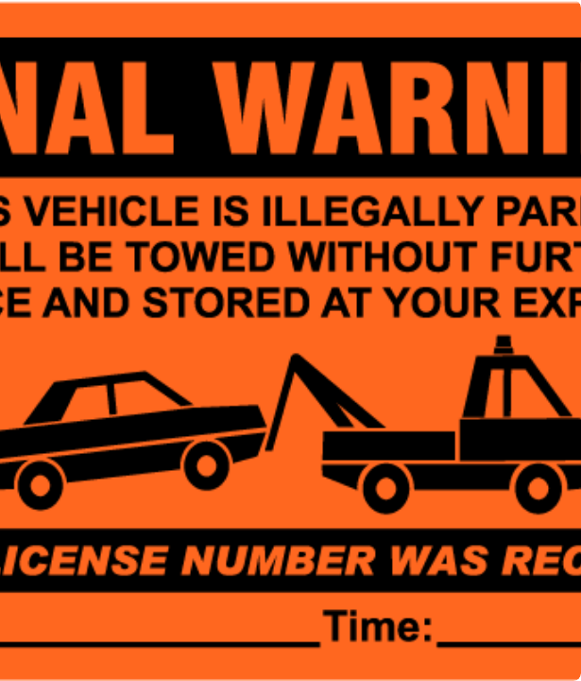
Why Inspections are Mandatory
Driver & Public Safety: The primary goal is to ensure the vehicle is safe to operate.
Legal Compliance: Required by law under FMCSR § 392.7 (Pre-Trip) and § 396.11 (Post-Trip).
Prevent Breakdowns: Identify and fix minor issues before they become major, costly repairs.
Avoid Violations: Proactively find and fix issues that would lead to fines or Out-of-Service (OOS) orders.

Slide 3








What is a Commercial Motor Vehicle (CMV)?
A vehicle is subject to DOT/FMCSA regulations (driver qualification, maintenance, etc.) if it meets any of these criteria in commerce:
By Weight
Passengers (For-Hire)
Passengers (Private)
By Material
The vehicle has a gross vehicle weight rating (GVWR) or gross combination weight rating (GCWR) of 10,001 pounds or more.
Transports Hazardous Materials (HazMat) in a quantity requiring placarding, regardless of vehicle size.
Designed to transport more than 8 passengers (including the driver) for compensation.
Designed to transport more than 15 passengers (including the driver), not for compensation.

Slide 4
The Main 5 Levels of DOT Inspection
Level I: North American Standard Inspection The most comprehensive. A full check of the driver (logs, license, med card) and a detailed vehicle inspection, including components underneath the truck.
Level II: Walk-Around Driver/Vehicle Inspection Includes all driver checks from Level I, but the vehicle inspection is a "walk-around" that doesn't involve getting under the vehicle.
Level III: Driver-Only Inspection Focuses entirely on the driver's credentials: HOS logs, CDL, medical certificate, and other required paperwork. No vehicle inspection is performed.
Level IV: Special Inspection A one-time, limited inspection to examine a specific feature (e.g., brakes, a recall item) or to gather data for a study.
Level V: Vehicle-Only Inspection An inspection of the vehicle (with no driver present) that can be performed at the carrier's location, a terminal, or roadside.

Slide 5
What the Carrier & Driver Must Do (General)
Carrier Responsibilities :
Under § 396.3(a): The motor carrier must systematically inspect, repair, and maintain – or cause to be systematically inspected, repaired, and maintained.
The motor carrier must repair any defects or deficiencies noted by the driver on the DVIR, or certify that immediate repair is not necessary,
Driver Responsibilities :
Before operating the vehicle: complete a pre-trip inspection (visual & functional checks) Use the 7-point walk-around, and should review previous report.
At end of shift/day: complete (if required) a post-trip inspection report per § 396.11

Slide 6
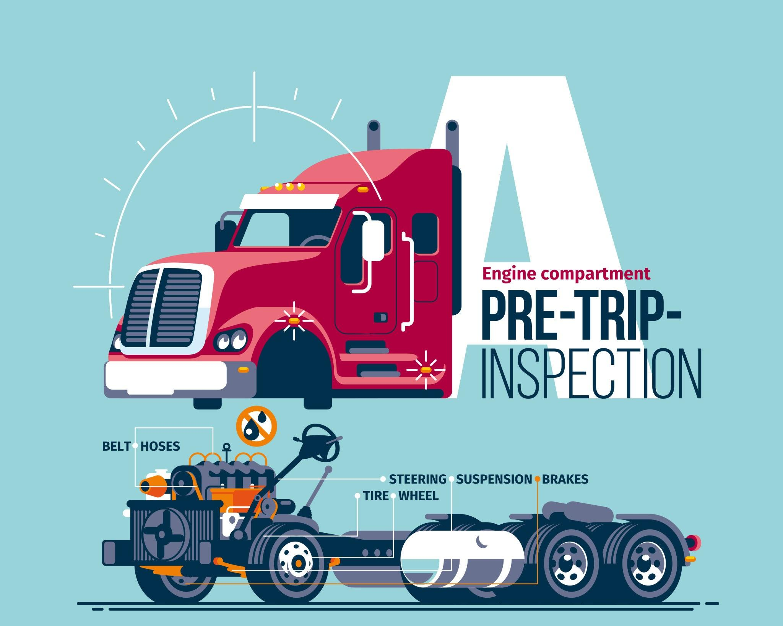

Slide 7

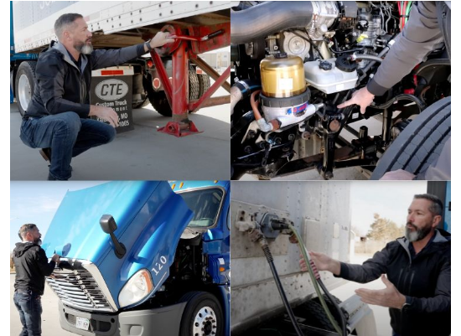
Pre-Trip Inspection (§ 392.7)
The "Walk-Around"
•
General: Look for leaks, damage, and vehicle stance.
•
Front: Lights, steering components, engine fluids, belts, hoses.
•
Sides: Tires (tread, pressure, cuts), wheels (lugs, seals), suspension (springs, U-bolts).
•
Rear: Lights, reflectors, coupling (fifth wheel, pintle), doors, splash guards.

Slide 8
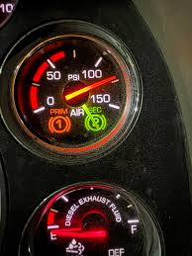

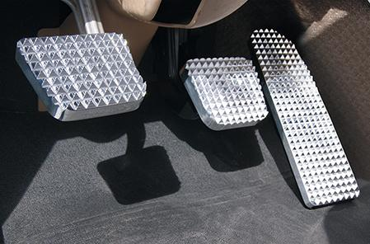
Pre-Trip Inspection (§ 392.7)
In-Cab & Brakes
•
In-Cab: Seatbelt, mirrors, horn, wipers, fire extinguisher, warning triangles.
•
Brakes: Test air brakes (check for air loss, low-pressure warning, and compressor cut-out).
•
Paperwork: Review the *previous* DVIR. If defects were noted, ensure a signed certification of repair is present *before* operating.

Slide 9


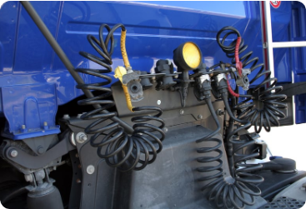

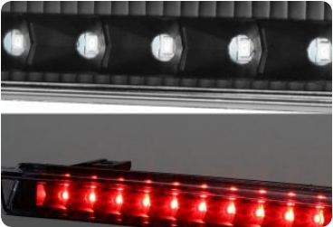
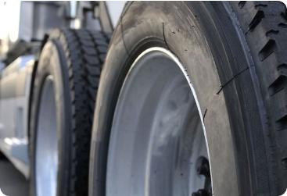
CORE INSPECTION CHECKLIST
Service & Parking Brakes
Lighting Devices & Reflectors
Tires, Wheels & Rims

Slide 10

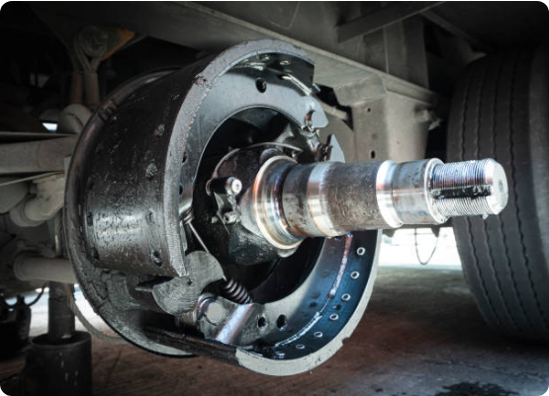
Post-Trip Inspection (§ 396.11)
Purpose: To identify any defects that developed during the day's operation.
Process: A thorough walk-around, similar to the pre-trip, checking all key safety components.
The Key: This is the inspection that is formally documented on the DVIR (if defects are found for trucks, or always for buses).
This report allows the motor carrier to schedule and complete repairs *before* the vehicle is dispatched for its next trip.

Slide 11
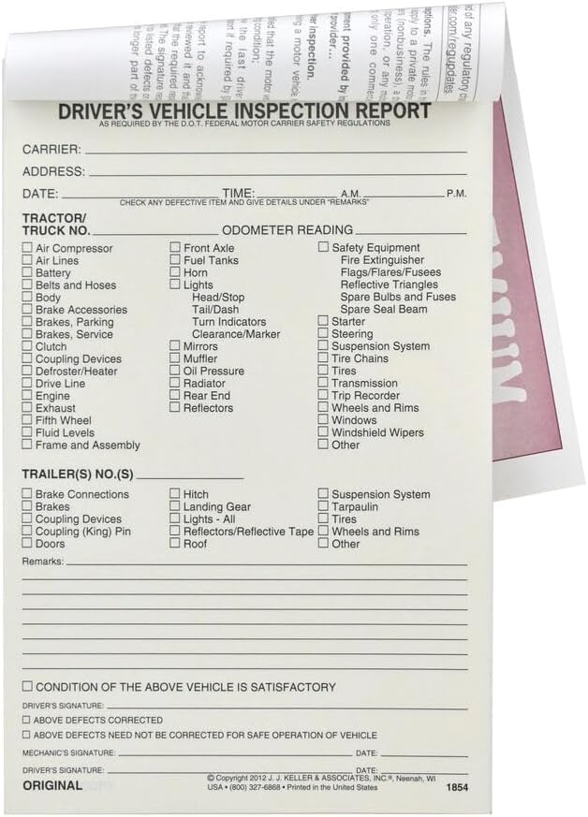
The Driver Vehicle Inspection Report (DVIR) (§ 396.11)
What is it? A formal written report completed by the driver at the end of each workday to document the vehicle's condition.
Property-Carrying: A DVIR must be submitted only if a safety-related defect is found or reported.
Passenger-Carrying: A DVIR must be submitted every day, even if no defects are found.
Driver's Signature: The driver must sign the report to certify that the inspection was
completed.

Slide 12


ANNUAL DOT INSPECTION

Slide 13
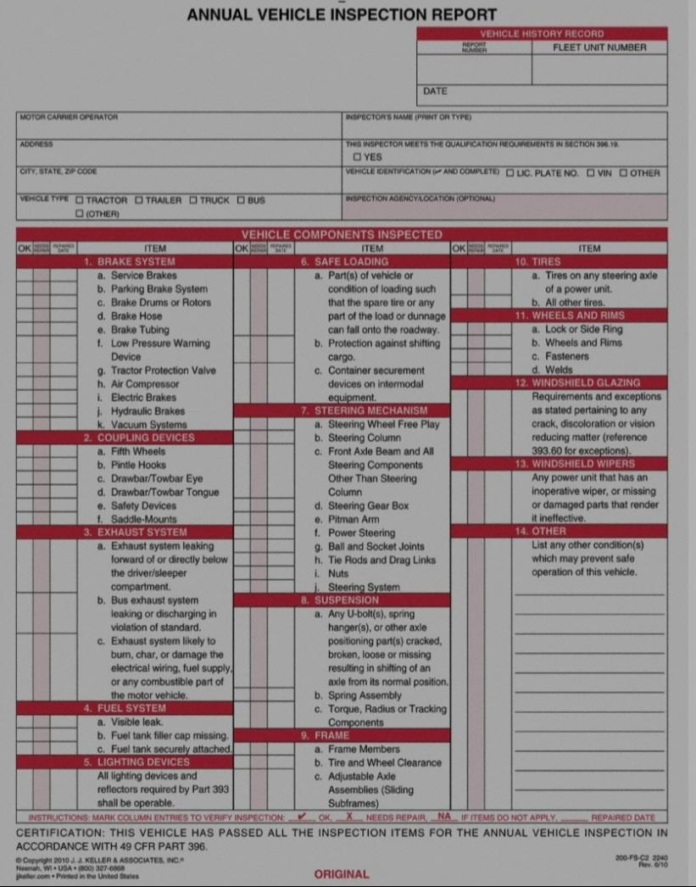

COMPLIANCE REQUIREMENT
Federal law (49 CFR 396.17) mandates that every commercial vehicle must undergo an inspection at least once every 12 months.
QUALIFIED INSPECTOR
Inspections must be performed by a qualified individual who understands FMCSA regulations and can identify defective components. This can be a 3rd party shop or a certified internal mechanic.

Slide 14


Critical OOS Violations: Brakes & Tires
Brakes
Tires
An OOS order is issued if 20% or more of a vehicle's service brakes are defective.
Tire failures can be catastrophic, especially on a steer axle.
•
Brakes out of adjustment
•
Steer Tires: Less than 4/32" tread depth.
•
Audible air leaks
•
Other Tires: Less than 2/32" tread depth.
•
Oil-soaked brake lining
•
Audible air leak.
•
Cracked or broken drums
•
Deep cuts exposing cord or belts.
•
Sidewall bulges.

Slide 15
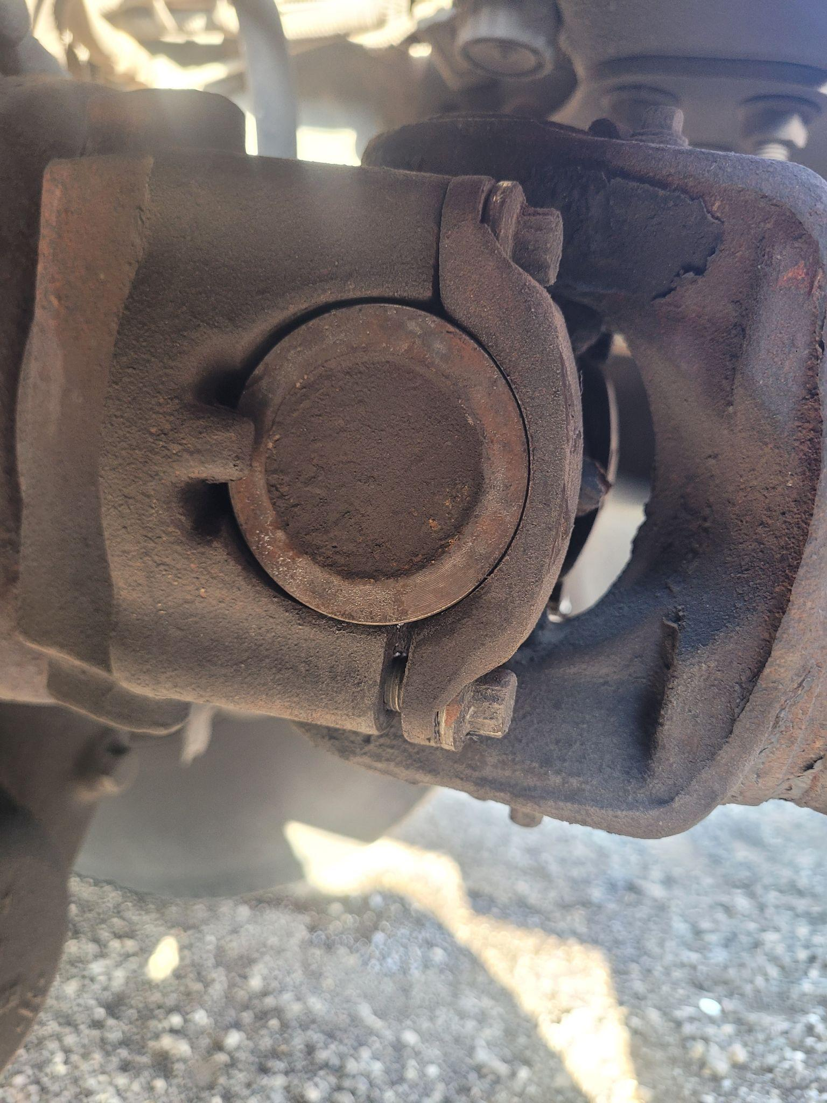
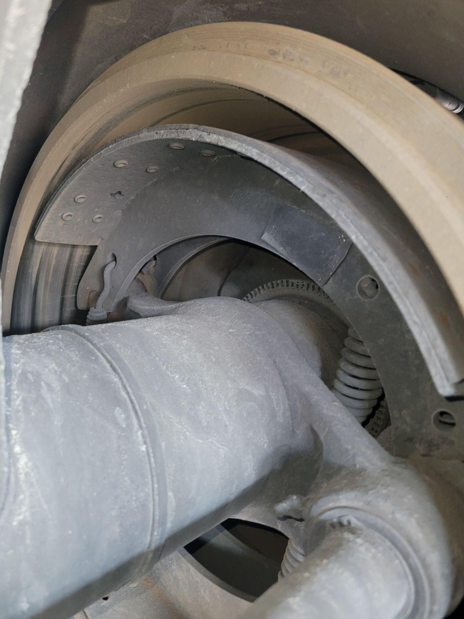

Slide 16
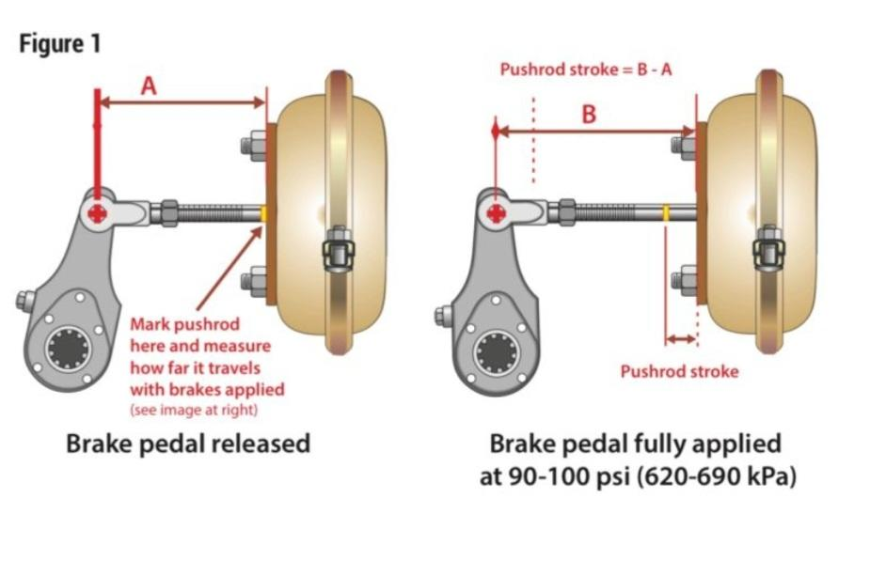
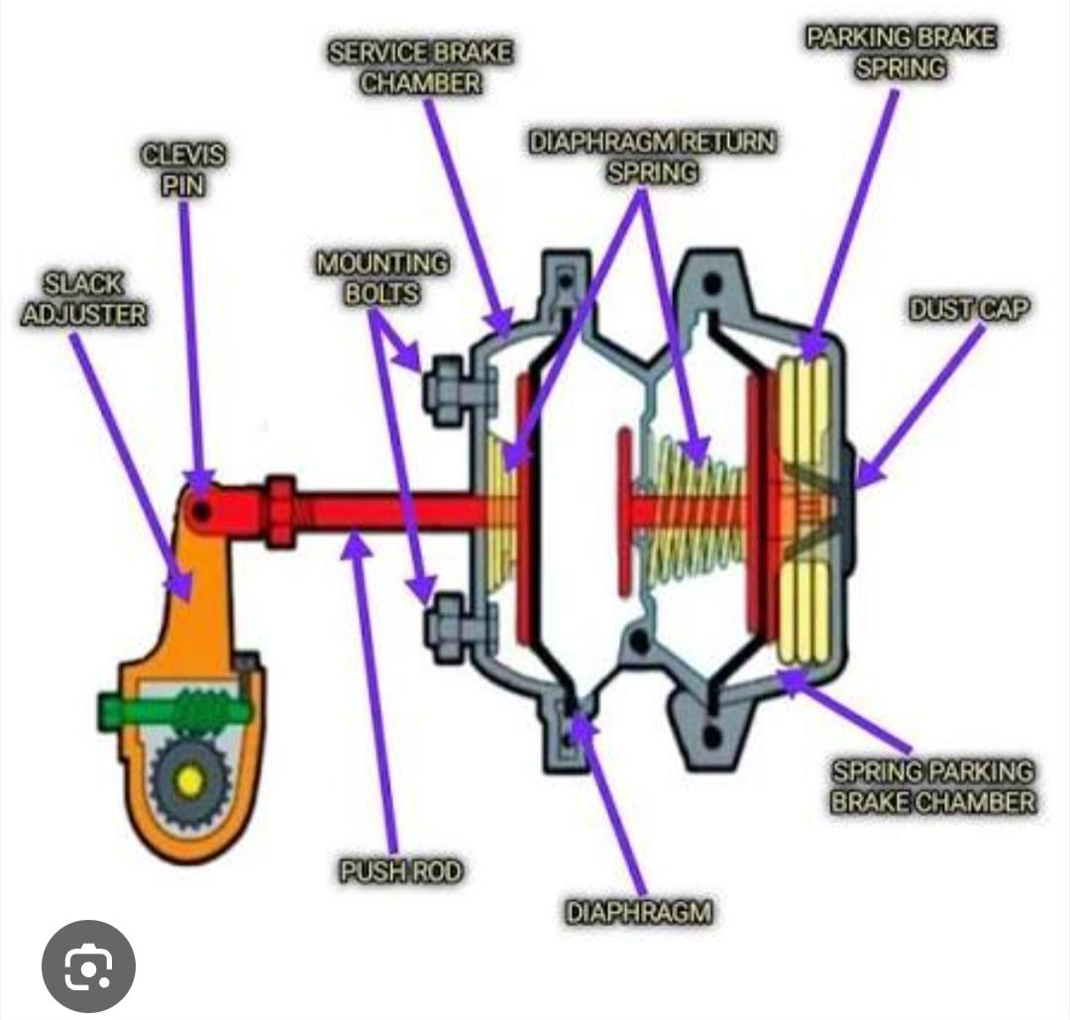
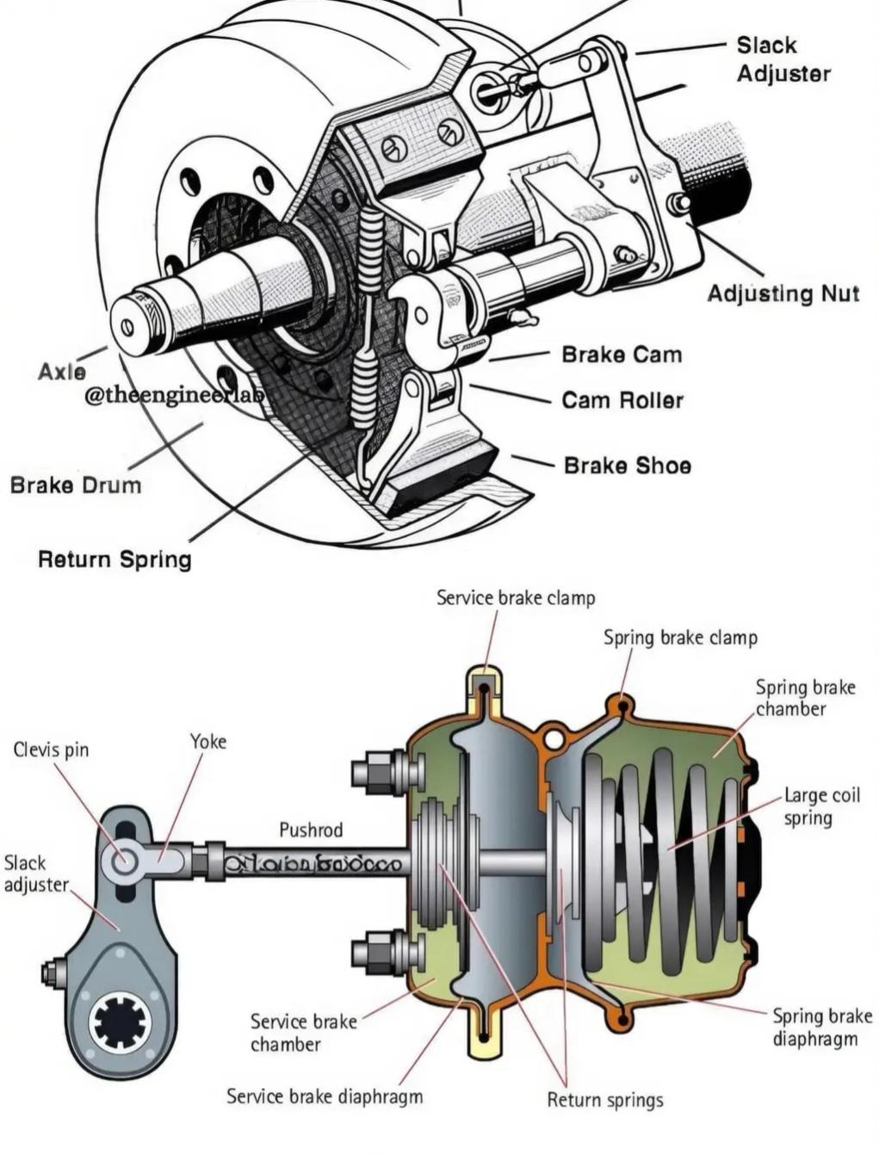

Slide 17






More Critical OOS Violations
Lights
Cargo Securement
Driver
Inoperative required lights, such as headlights, brake lights, tail lamps, or turn signals.
Failure to secure a load, insufficient tie-downs, or improper blocking and bracing.
Operating without a valid CDL, an expired medical certificate, or a violation of Hours of Service (HOS) rules.

Slide 18






DOT Documentation: Who, What, Where?
Required documents are split between the driver, the vehicle, and the company's home office.
For the Driver (In-Cab)
For the Vehicle (In-Cab)
For the Company (At Office)
Valid License (CDL/Chauffeur's)
Valid Registration (Cab Card / IRP)
Medical Examiner's Certificate
Proof of Liability Insurance
Driver Qualification Files (DQF)
Record of Duty Status (HOS/ELD)
Proof of Annual Inspection
Drug & Alcohol Program Records
pre-trip/post-trip inspection reports (DVIRs)
IFTA License & Decals (if interstate)
Full Maintenance & Repair History
Proof of UCR & Operating Authority
Accident Register

Slide 19
🚛 Record Retention Requirements (FMCSA)
Record Type | Retention Period
Driver Qualification File | Employment + 3 years after
Drug & Alcohol (positive/refusal) | 5 years
Drug & Alcohol (negative) | 1 year
Hours of Service (logs/ELD) | 6 months
Vehicle Maintenance Records | 1 year + 6 months post-sale
Annual Inspection | 14 months
DVIR | 3 months
Accident Register | 3 years

Slide 20
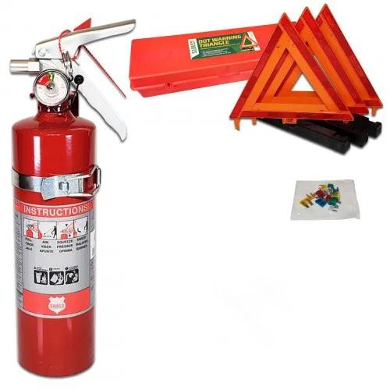
Key Onboard Safety Equipment (Required by FMCSA/DOT):
Fire Extinguisher:
5 B:C / 10 B:C
Must be properly charged, mounted securely.
Warning Devices (for Stopped Vehicles):
Three Bi-Directional Emergency Reflective Triangles.
Must be ready for immediate use to warn approaching traffic if the vehicle stops on the roadside.
Alternative Three liquid-burning flares.

Slide 21
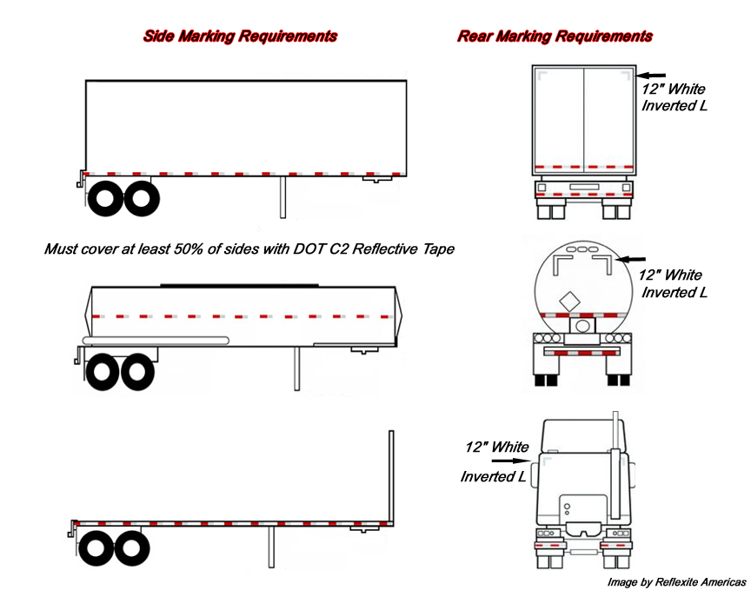
Required reflective tape (§ 393.11)
specifically DOT C2 tape, is mandatory for commercial trailers over 80 inches wide with a gross vehicle weight over 10,000 pounds to enhance visibility. This tape must be alternating red and white segments, and placement requires covering at least 50% of each side, the entire lower rear bar, and an inverted "L" shape on the top rear corners

Slide 22
Thank you for your attention.

