Slide 1
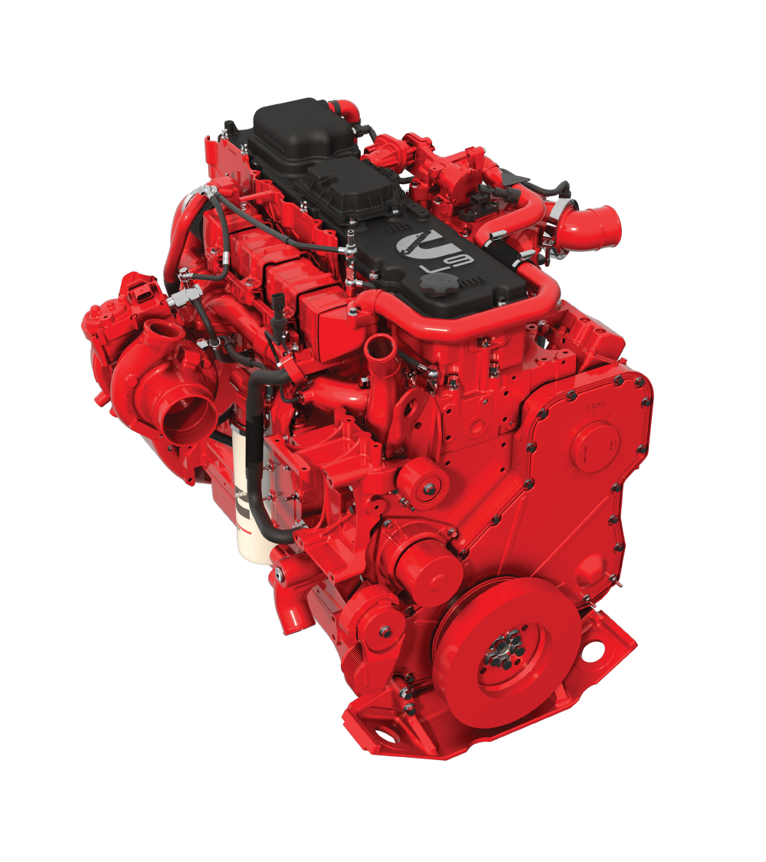
Cummins Update
Greg Bohn
Account Executive On-Highway Business
Rob Craig
Technical Support Manager
ON-HIGHWAY L9
RedBox Maintenance Academy

Slide 2
Agenda
X10 Update (Greg Bohn)
L9 Routine Maintenance (Rob Craig)
Quickserve Online (Rob Craig)
Live Demo
Diagnostic Service Tool (INSITE / Guidanz Diagnostic Toolkit) (Rob Craig)

Slide 3
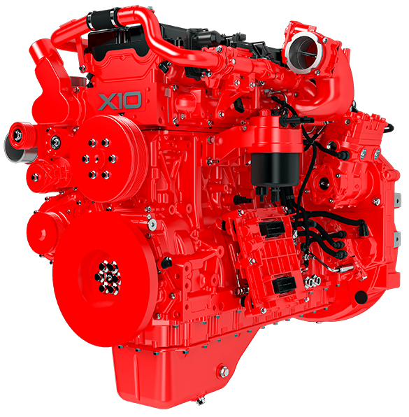
Highlights
Next in the Cummins HELM™ platform launching in North America in 2027 demonstrating Cummins’ continued commitment to advancing internal combustion technology.
The X10 architecture uses a belt-driven, high output 48-volt alternator and aftertreatment heater solution optimized for increasingly stringent emission standards.
Improved GHG Efficiency & Fuel Economy built upon Cummins’ Uptime legacy.
Ratings up to 450 hp / 1250 ft-lb available.
Extended maintenance intervals to reduce visits to the shop and minimize cost of operation.
Optimized for a diverse range of applications such as P&D, Vocational, Regional Haul, Transit bus, Recreational Vehicle and Emergency.
Base Warranty: 2 years / 250k miles for truck & transit, 5 years / 100k miles for EV/RV (no change from current product).
Coming Soon
Product Timeline
Highlights
Overview
Walk-Around
Ratings
Product Comparison
Features
Applications
Validation
Powertrain

Slide 4
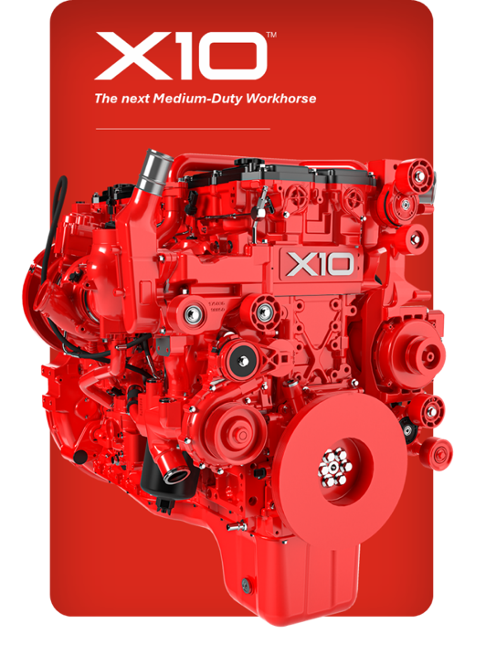
Overview
Differentiators
CARB27 and EPA27 Compliant
New State of the Art Platform with Improved GHG Efficiency & Fuel Economy
Ratings up to 450 hp / 1650 ft-lb available
Maintaining market required REPTO and FEPTO capabilities seen in the current L9
Extended maintenance intervals to lower total cost of operation
Primary Applications
Value package
Reliability
Durability
Increased power
Harsh duty cycles
Vocational
Body builder
Maintenance Event | Target
Oil and filter | Up to 75k mi / 1500 hr
Valve lash adjustment | 150k mi
DPF clean | MD 225k mi & HD up to 800k mi
DEF change | 225k mi
Base warranty | 2 yr / 250k mi
Latest Update: December 9, 2024
Product Timeline
Highlights
Overview
Walk-Around
Ratings
Product Comparison
Features
Applications
Validation
Powertrain

Slide 5


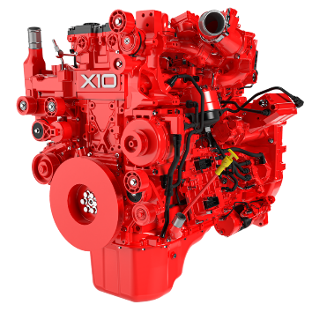



Engine Walk-Around
Power Cylinder:
Fuel System:
New piston bowl and higher compression ratio for optimized efficiency and power
9.9L, 450HP / 1650 ft-lb torque
2200 Bar fuel-lubed pump for better PM control and fuel efficiency improvement
Incorporates thermal recirculation valve to aid in cold starts and priming pump for efficient startability
Lube & Cooling:
Air Handling:
Dual Thermostat and improved coolant system design to reduce parasitics
Addition of CCV (closed crankcase ventilation) to meet regulatory requirements
Cartridge style lube and fuel filters to improve cost of maintenance & environmental impact
Improved efficiency through use of new, larger VG turbo
Heavy-duty EGR cooler delivers emission reductions
Electronics:
48V Smart Alternator and Integrated Power Distribution to power aftertreatment heaters
New CM3550 supports safety, cyber security and software improvements
Base Engine:
Sculpted block and head delivering engine weight reduction
DOHC cylinder head design and new cam carrier enables advanced valvetrain technology and High-Power Density brake
Multiple capacity oil pan options providing longer oil drain interval options
Engine and injector harness support new components, packaging and ease of maintenance
Maintenance Monitor with virtual sensors to optimize service intervals
* Information is preliminary and may be subject to change.
FUEL EFFICIENCY
MAINTENANCE
REGULATORY
RELIABILITY
Product Timeline
Highlights
Overview
Walk-Around
Ratings
Product Comparison
Features
Applications
Validation
Powertrain

Slide 6

Ratings
Engine Family | Engine Rating HP | Peak Torque Lbs-ft | Peak Torque Speed RPM | Governed Speed RPM | HD Truck | MD Truck | Refuse | Vocational | Shuffle Bus | Transit Bus | Recreational Vehicle | Emergency Vehicle
MD | 320 | 1000 | 1200 | 2200
MD | 350 | 1050 | 1200 | 2200
MD | 360 | 1150 | 1200 | 2200
MD | 370 | 1250 | 1200 | 2100
MD¹ | 380 | 1150 | 1200 | 2200
MD | 380 | 1250 | 1200 | 2100
MD¹ | 400 | 1250 | 1200 | 2200
MD¹ | 450 | 1250 | 1200 | 2200
HD¹ | 350 | 1150 | 1000 | 1900
HD | 350 | 1350 | 1000 | 1900
HD | 370 | 1250 | 1000 | 1900
HD | 380 | 1450 | 1000 | 1900
HD² | 400 | 1650 | 1000 | 1900
HD | 410 | 1450 | 1000 | 1900
HD | 450 | 1450 | 1000 | 1900
HD² | 450 | 1650 | 1000 | 1900
¹ Restricted to applications shown ² EX Rating available
Product Timeline
Highlights
Overview
Walk-Around
Ratings
Product Comparison
Features
Applications
Validation
Powertrain

Slide 7

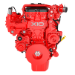
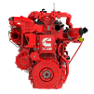

Current Product Comparison
 | L9 | X10 |  | X12
 |  | Medium-duty | Heavy-duty
Displacement | 8.9L | 9.9L | 9.9L | 11.8L
Cylinders | Inline 6 | Inline 6 | Inline 6 | Inline 6
Compression Ratio | 20.2:1 | 20.5:1 | 20.5:1 | 18.3:1
Ratings (By Family) | 260-380hp / 860-1250 lb-ft | 320-380 hp / 1000-1250 lb-ft | 350-450 hp / 1350-1650 lb-ft | 350-500hp / 1350-1700 lb-ft
Engine Weight (Dry) | 769 kg, 1695lb | 850kg, 1874lb |  | 930 kg, 2050lb
Aftertreatment Weight | 80 kg, 177lb | 135 kg, 298lb | 148 kg, 326lb |  | 110 kg, 243lb
Total System Weight | 849 kg, 1872lb | 985 kg, 2272lb | 998 kg, 2200lb |  | 1040 kg, 2293lb
Oil Drain Interval | Up to 50k miles | Up to 75k miles |  | Up to 75k miles
Aftertreatment | 10LX | TM10 | TM13 |  | 13SS
Latest Update: July 10, 2025
Product Timeline
Highlights
Overview
Walk-Around
Ratings
Product Comparison
Features
Applications
Validation
Powertrain
1/3

Slide 8
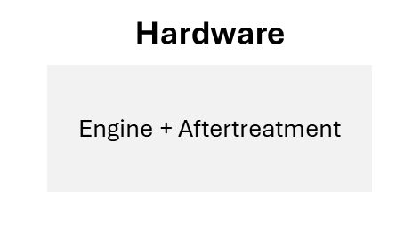
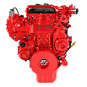

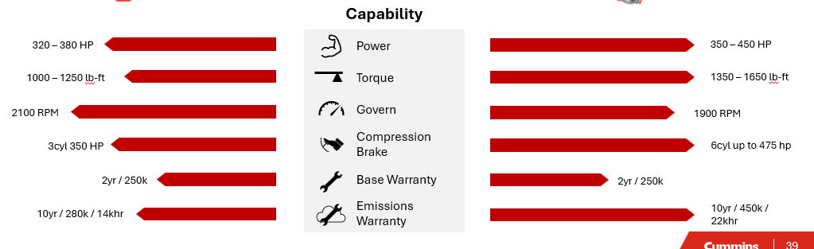
Ratings Comparison (Truck)
MEDIUM-DUTY
HEAVY-DUTY
X10 + TM10
X10 + TM13
Product Timeline
Highlights
Overview
Walk-Around
Ratings
Product Comparison
Features
Applications
Validation
Powertrain
2/3

Slide 9
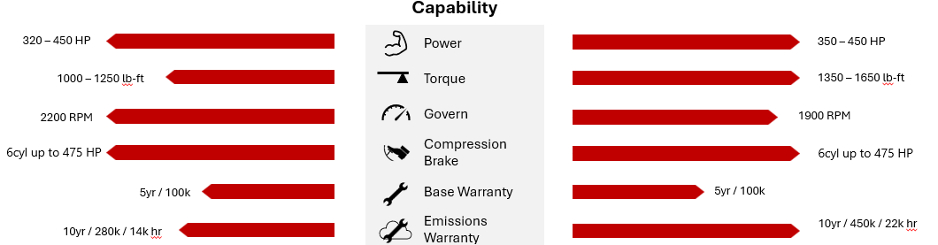
Ratings Comparison (EV/RV)
MEDIUM-DUTY
HEAVY-DUTY
X10 + TM10
X10 + TM13
Product Timeline
Highlights
Overview
Walk-Around
Ratings
Product Comparison
Features
Applications
Validation
Powertrain
3/3

Slide 10
Winning With POWER TAKE-OFF
Front Engine PTO
Vocational customers demand having the right PTO capabilities to meet their daily needs
The X10 builds on REPTO capabilities and carries similar FEPTO capabilities from the L9 & X12 that have been proven in the market
X10 REPTO capability is a valued advantage for the vocational market and provides several advantages over FEPTO
No need for extended frame or bumper
Extended wheelbase without exceeding length restrictions which leads to improved maneuverability, visibility and drivability
Simplified hydraulic system for increased reliability
Rear Engine PTO
Product Timeline
Highlights
Overview
Walk-Around
Ratings
Product Comparison
Features
Applications
Validation
Powertrain
1/2

Slide 11
Winning With Engine Braking
Protects Your Investment: Engine braking helps reduce wear on mechanical brakes, lowering maintenance costs and improving total cost of ownership (TCO)
Advanced Braking Power: The X10 features the new High Power Density brake from Jacobs Cummins Drive and Braking Systems – delivering up to:
Up to 475 hp of braking power for heavy-duty
350 hp for medium-duty
Engineered to Lead: With enhanced braking performance, the X10 raises the standard in the mid-bore market, providing even more value to customers
Product Timeline
Highlights
Overview
Walk-Around
Ratings
Product Comparison
Features
Applications
Validation
Powertrain
2/2

Slide 12
Target Applications
Perform efficiently in diverse applications and duty cycles across the medium and heavy-duty markets.
Vocational
Transit
Specialty
Mixers, dump trucks, refuse trucks, plows, etc. with high idle time and uptime priorities.
30’ and 60’ urban busses. Stop and go duty cycle demanding durability.
Power on demand and reliability.
See More
See More
See More
P&D
Regional Haul
Day to day operation focused on lowering cost.
Tractor trailer day cab operations looking for fuel efficiency and extended maintenance.
See More
See More
Product Timeline
Highlights
Overview
Walk-Around
Ratings
Product Comparison
Features
Applications
Validation
Powertrain
1/6

Slide 13

Vocational Application
Differentiators
Delivers up to 1650 lb-ft of torque with increased ratings over the L9 and similar ratings to the X12
Provides enhanced REPTO/FEPTO capabilities
Features a wet-sleeve design, continuing the reliability legacy of Cummins based on extensive experience with the X15
Designed with braking capabilities up to 475 HP and will also have the option to equip Cummins-owned Jacobs Engine Brakes
Primary Applications
Value Package
Reliability
Durability
Increased power
Harsh duty cycles
Vocational
Body builder
Maintenance Event | MD Target | HD Target
Oil and filter** | Up to 32k mi / 1500 hr | Up to 32k mi / 1500 hr
Valve lash adjustment | 300k mi
DPF clean | 225k mi | Up to 800k mi
DEF filter | 300k mi
Base warranty | 2 yr / 250k mi
Latest Update: January 31, 2025
*Quickserve should be used for official maintenance schedule by ESN. **Very dependent on oil pan size selected this is high capacity shown
Product Timeline
Highlights
Overview
Walk-Around
Ratings
Product Comparison
Features
Applications
Validation
Powertrain
2/6

Slide 14

Transit Application
Differentiators
The dual overhead cam architecture increases the angle between the intake and exhaust valves, optimizing the X10’s ability to implement efficiency-boosting technologies
Cummins allows customers to set their engine ECM software for over-the-air updates based on custom time and location, delivering the latest software automatically without requiring additional action or approval
Designed to meet strict emissions regulations while maintaining durability and reliability
Primary Applications
Value Package
Efficiency
Reliability
Serviceability
Transit
Maintenance Event | Target
Oil and filter | 15k / 1500 hrs
Valve lash adjustment | 45k mi
DPF clean | 5000 hrs
DEF filter | 60k mi / 6500 hrs
Base warranty | 2 yr / unlimited mi
Latest Update: January 31, 2025
*Quickserve should be used for official maintenance schedule by ESN. **Very dependent on oil pan size selected this is high capacity shown
Product Timeline
Highlights
Overview
Walk-Around
Ratings
Product Comparison
Features
Applications
Validation
Powertrain
3/6

Slide 15
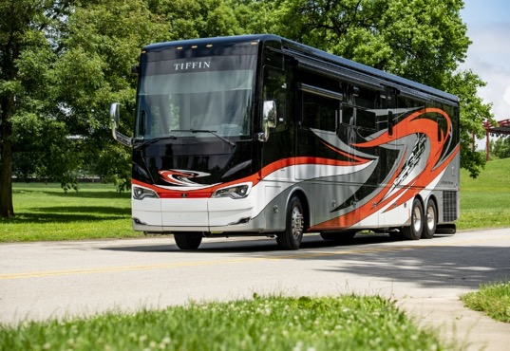

Recreational vehicle & Emergency vehicle Application(s)
Differentiators
Designed for efficiency and longevity, the X10 minimizes the need for frequent maintenance, offering lower service costs
Delivering up to 450 hp and 1650 lb-ft torque, improving towing capacity and driving comfort even with heavy loads or challenging terrains
Cummins Sales & Service Network offers RV owners access to thousands of service locations, ensuring they have the resources and information needed to stay informed and maintain optimal performance
Primary Applications
Value Package
Reliability
Lower total costs of ownership
Serviceability
Recreational Vehicle
Maintenance Event | Target
Oil and filter | Up to 32k mi / 1500 hr
Valve lash adjustment | 300k mi
DPF clean | MD 225k mi & HD up to 800k mi
DEF change | 300k mi
Base warranty | 5 yr / 100k mi
Latest Update: January 31, 2025
*Quickserve should be used for official maintenance schedule by ESN **Very dependent on oil pan size selected this is high capacity shown
Product Timeline
Highlights
Overview
Walk-Around
Ratings
Product Comparison
Features
Applications
Validation
Powertrain
4/6
Notes:
Include rv and fire truck as application
Create differetiated fourth bullet point, specific to fire, focusing on PTO

Slide 16
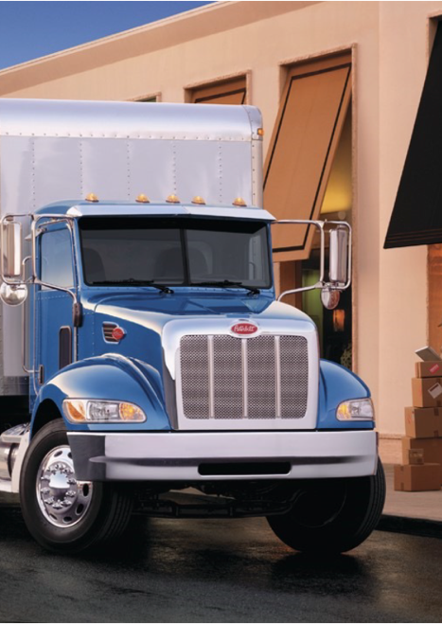
Pickup & Delivery Application
Differentiators
Features a new cartridge-style filters that reduce costs by up to 30%, by replacing only the filter media during maintenance versus traditional spin-on filters
Equipped with Automatic Engine Shutdown, which turns off the engine during extended idle periods to reduce fuel consumption and engine wear
Targets up to 4% fuel economy improvement over the current L9
Boasts Cummins’ full suite of digital features and capabilities from the point of sale to stay ahead of unplanned maintenance events
Primary Applications
Value Package
Uptime
Lower TCO
Serviceability
Pickup & Delivery
Maintenance Event* | MHD Target | HHD Target
Oil and filter** | Up to 50k mi / 2500 hr | Up to 50k mi / 2500 hr
Valve lash adjustment | 300k mi
DPF clean | 225k mi | up to 800k mi
DEF filter | 300k mi
Base warranty | 2 yr / 250k mi
Latest Update: January 31, 2025
*Quickserve should be used for official maintenance schedule by ESN. **Very dependent on oil pan size selected this is high capacity shown
Product Timeline
Highlights
Overview
Walk-Around
Ratings
Product Comparison
Features
Applications
Validation
Powertrain
5/6

Slide 17

Regional Haul Application
Differentiators
Features a new cartridge-style filters that reduce costs by up to 30%, by replacing only the filter media during maintenance versus traditional spin-on filters
Designed to meet the latest emissions standards, the X10 will be EPA27 and CARB27 compliant
Experience Cummins integrated powertrain designed to deliver seamless performance, efficiency and durability
Primary Applications
Value package
Fuel efficiency
Durability
Reliability
Regional haul
Maintenance Event* | MHD Target | HHD Target
Oil and filter** | Up to 50k mi / 2500 hr | Up to 75k mi / 2500 hr
Valve lash adjustment | 300k mi | 300k mi
DPF clean | 225k mi | up to 800k mi
DEF filter | 300k mi | 300k mi
Base warranty | 2 yr / 250k mi | 2 yr / 250k mi
Latest Update: January 31, 2025
*Quickserve should be used for official maintenance schedule by ESN. **Very dependent on oil pan size selected this is high capacity shown
Product Timeline
Highlights
Overview
Walk-Around
Ratings
Product Comparison
Features
Applications
Validation
Powertrain
6/6

Slide 18


Global Platform Validation
Global Platform Validation
8.8 million mi
6 years
54,500 hours
research & development
in-house and overload testing
on-road testing
Global Production 3,000+ engines
Planned Validation For X10
4 years
12,620 hours
2.5 million mi
research & development
in-house and overload testing
on-road testing
Product Timeline
Highlights
Overview
Walk-Around
Ratings
Product Comparison
Features
Applications
Validation
Powertrain
1/2

Slide 19

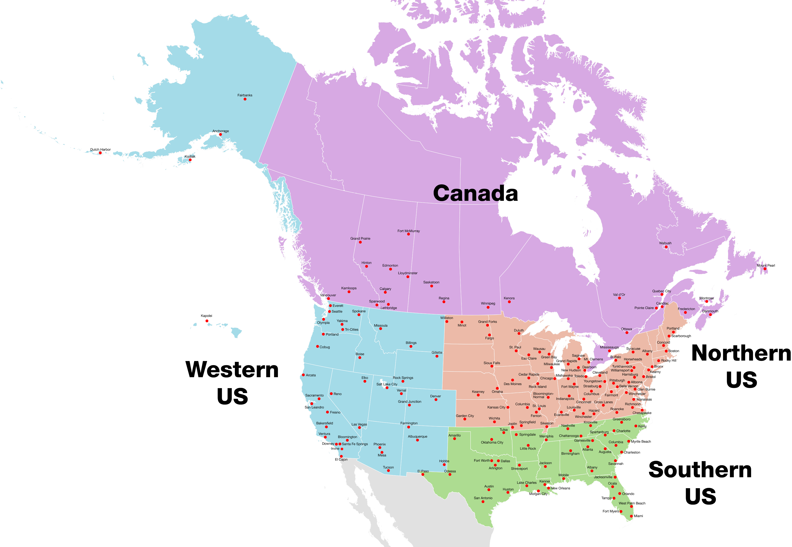








Field Test Facts
40% Vocational
35% Haul
25% Bus
Product Timeline
Highlights
Overview
Walk-Around
Ratings
Product Comparison
Features
Applications
Validation
Powertrain
2/2
Notes:
Tested throughout US& Canada we’re focusing on getting all of the environments:
A variety of applications in the humid deep south
Dump trucks in dry, dusty Southwest
Canadian heavy hauler
Bulk hauler running up the Rockies
Snow plow near the great lakes
Alaskan residential refuse with a lot of stop & go
So we’re not only testing diversity of application, but also extremes in environment and temperatures.

Slide 20
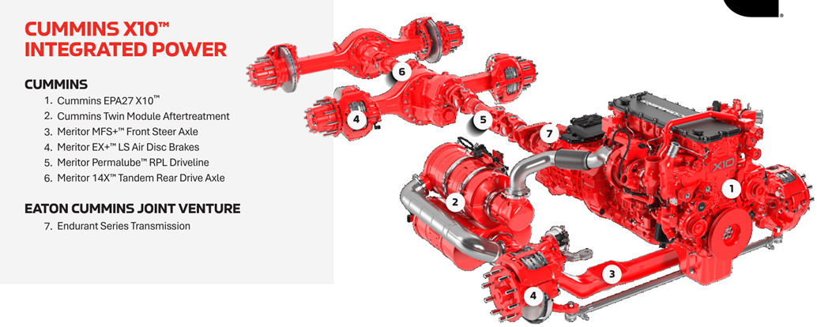
Integrated Power
Engine
Walk-around
Connected Solutions
Extended Features (EX)
Torque Curves
Aftertreatment
Cummins HELM™
Product Timeline
Highlights
Overview
Walk-Around
Ratings
Product Comparison
Features
Applications
Validation
Powertrain
1/5

Slide 21
Torque Curves
EPA 2024 X12 500/1700
EPA 2027 X10 HHD 450/1650
Product Timeline
Highlights
Overview
Walk-Around
Ratings
Product Comparison
Features
Applications
Validation
Powertrain
2/5

Slide 22
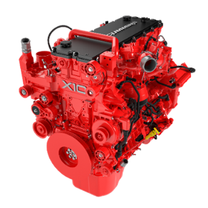

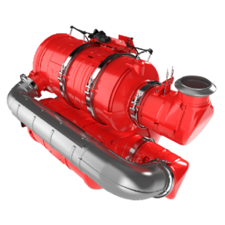

Simple Architecture: Electric Aftertreatment Heat
To meet stricter 2027 NO_{X} regulations, Cummins is introducing an electronic heating system that enhances SCR (Selective Catalytic Reduction) performance by speeding up aftertreatment warm-up–especially during cold starts and idle.
How It Works
When the engine is cold (like at start-up or idle), the Engine Control Module (ECM) tells the alternator to create a 48V electrical load by converting mechanical energy into electricity.
The ECM then sends signals to:
Heater Control Module (HCU) on X15, or
Directly to the alternator for B7.2 and X10 platforms, instructing which heater(s) to power.
Current flows to the heaters, which act like resistors – converting electrical energy directly into heat in the exhaust stream.
Why It Matters
Fast-warm up = better NO_{X} reduction from the start
On-demand thermal management improves efficiency and engine performance
Maintenance-free design: Alternator and heaters are built to last the life of the engine
Product Timeline
Highlights
Overview
Walk-Around
Ratings
Product Comparison
Features
Applications
Validation
Powertrain
3/5

Slide 23







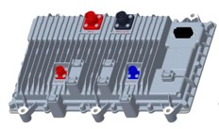

Electric Aftertreatment Heat New Components
Engine
Hardware:
Dedicated 48V alternator, mounted on the cold side of the FEAD
Driven by a single belt from the damper
Software:
Uses J1939 CANBUS communication
ECM sends signals to the alternator and Heater Control Unit (HCU) (X15 only)
Aftertreatment
Hardware: Two 5kW heaters, each with two high-voltage connections
Software: None required at the aftertreatment level
Heater Control Unit (HCU) (X15 only)
Location: Chassis-mounted
Function: Manages and distributes power independently to each heater, ensuring efficient and responsive thermal management
Product Timeline
Highlights
Overview
Walk-Around
Ratings
Product Comparison
Features
Applications
Validation
Powertrain
4/5

Slide 24




Building Our Legacy
Legacy L9 & X12
Cummins HELMTM
Performance
Reliability
Durability
Serviceability
One Global 10L Experience
GHG Reduction
Improved Fuel Economy
Meet Future Emissions Legislation
Clean sheet engine, 100% change in parts/components
NO_{X} reduction
EPA and CARB Compliance
Fuel efficiency improvement
Uptime
Maintenance
Performance
Product Timeline
Highlights
Overview
Walk-Around
Ratings
Product Comparison
Features
Applications
Validation
Powertrain
5/5

Slide 25
Agenda
X10 Update (Greg Bohn)
L9 Routine Maintenance (Rob Craig)
Quickserve Online (Rob Craig)
Live Demo
Diagnostic Service Tool (INSITE / Guidanz Diagnostic Toolkit) (Rob Craig)

Slide 26

L9 | Daily Checks
Daily Maintenance
Air Intake Piping – Check
Air Tanks and Resevoirs – Drain
Coolant Level – Check
Crankcase Breather Tube – Check
Fan, Cooling – Check
Fuel-Water Separator – Drain
Lubricating Oil Level – Check
Aftertreatment Exhaust Piping – Check
Diesel Exhaust Fluid (DEF Level - Check

Slide 27
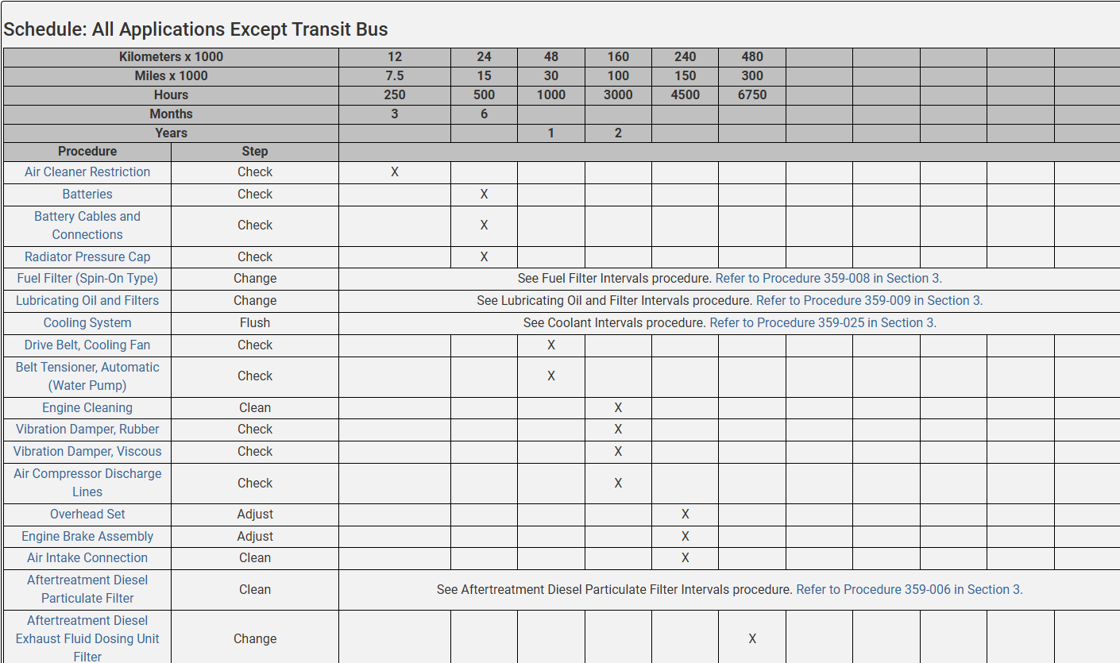
L9 | 2024 Maintenance Schedule
Can be referenced in Quickserve Online

Slide 28

L9 | Oil Drain Interval Schedule
Total Oil Capacity* | Engine Distance or Run Time | Fuel Economy
(Oil Pan + Lube Filter) |  | Extreme Severe | Severe | Normal | Light
 |  | < 2.9 mpg | 3 – 4.9 mpg | 5 – 7.9 mpg | > 8 mpg
 |  | (<1.2km/liter) | (1.3 - 2.1km/liter) | (2.1 – 3.3 km/liter) | (>3.4 km/liter)
≥ 29 U.S. qt | Miles | 6,000 | 15,000 | 30,000 | 50,000
(27.4 liters) | Kilometers | 9,600 | 24,000 | 48,000 | 80,000
 | Hours | 1,200 | 1,500 | 1,500 | 1,500
< 29 U.S. qt | Miles | 5,000 | 12,500 | 25,000 | 40,000
(27.4 liters) | Kilometers | 8,000 | 20,000 | 40,000 | 64,000
to > 23 U.S. qt (21.8 liters) | Hours | 1,000 | 1,200 | 1,200 | 1,200
≤ 23 U.S. qt (21.8 liters) | Miles | 5,000 | 10,000 | 20,000 | 30,000
 | Kilometers | 8,000 | 17,000 | 33,000 | 53,000
 | Hours | 1,000 | 1,000 | 1,000 | 1,000
Drain the oil and change the lube filter according to engine distance OR run time from the table OR 18 months, whichever comes first.
Notes:
Cummins bases it’s oil drain specifications on duty cycle and rate of oil degradation. As fuel consumption rate increases, the rate of oil degradation increases.

Slide 29
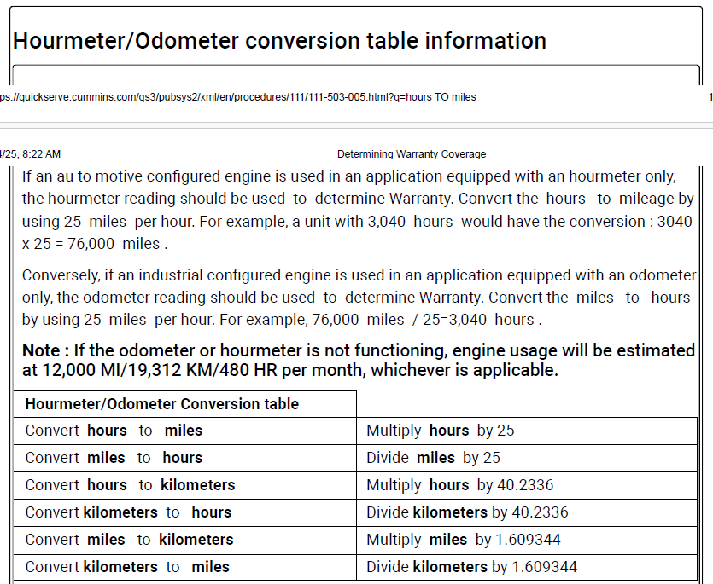
Hourmeter/Odometer Conversion Table

Slide 30
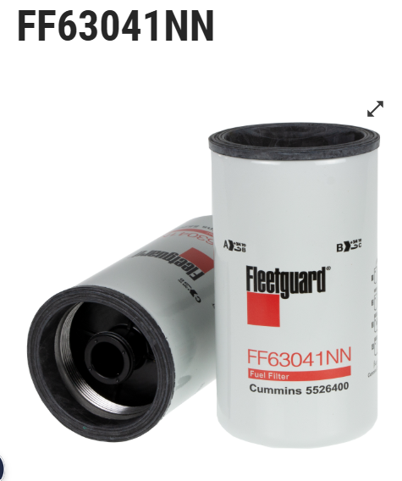
L9 | Fuel Filter Intervals
Table 1: Pressure Side Fuel Filter (Primary)
Kilometers | Miles | Hours | Months
80,000 | 50,000 | 1500 | 18
Table 2: Suction Side Fuel Filter (Prefilter with Water in Fuel Sensor)1
Kilometers | Miles | Hours | Months
80,000 | 50,000 | 1500 | 18
Determine the maximum recommended fuel filter change interval in (miles, hours, or months whichever occurs first)
The equipment/vehicle OEM may use a non-Cummins branded stage 1 fuel filter. See equipment manufacturer service information for interval details
Notes:
Fuel filter change interval may be reduced to various factors such as fuel cleanliness or use of biodiesel blends above B5.
Fuel filter intervals for engines running biodiesel blends greater than B5 must be reduced to half of the value shown in the table.

Slide 31
L9 | Coolant Interval
Coolant Interval
Table A |  | Glycol Check |  |  | SCA |  | Coolant Replacement
Coolant Type | Additive Type | Interval (hrs) | Test Strip | Refractometer | Interval (hrs) | Test Strip | Interval (hrs)
Conventional | SCA | 500 | CC2602 CC2602A CC2602B CC2602M CC2602AM | CC2806 | 500 | CC2602 CC2602A CC2602B CC2602M CC2602AM | 1500
Hybrid | SCA |  |  |  |  |  | 4000
Hybrid | Organic |  |  | CC8998 | N/A* | N/A | 4000
ELC/OAT | Organic |  |  |  | N/A | N/A | 6000
*If extender is used, follow coolant manufacturer's guideline
Definitions:
ELC – Extended Life Coolant
OAT – Organic Additive Technology
Notes:
Fuel filter change interval may be reduced to various factors such as fuel cleanliness or use of biodiesel blends above B5.
Fuel filter intervals for engines running biodiesel blends greater than B5 must be reduced to half of the value shown in the table.

Slide 32
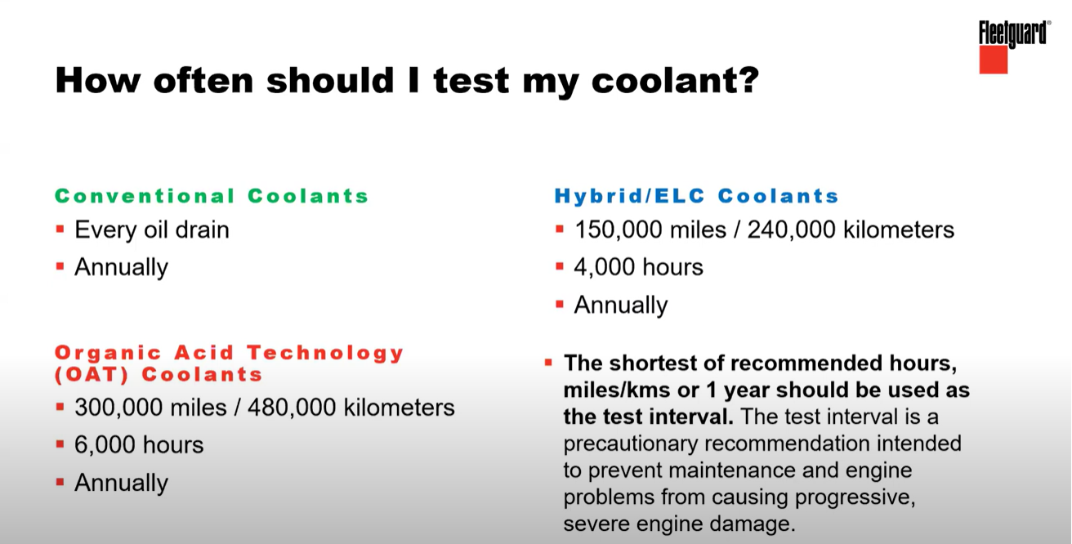
Notes:
So how often should you be testing your coolant. Really goes back to Total Cost of Ownership and what you want to mess with. If you are using a conventional product really should be testing every oil drain or annually if you are not hitting mileage or hour interval. Hybrid coolant the number is pretty significantly different. Using Organic Acid Technology coolant.
Our recommendation is the shortest of recommended hours, miles, or 1 year should be used as the test interval. Really a precautionary measure intended to prevent maintenance and engine problems.

Slide 33
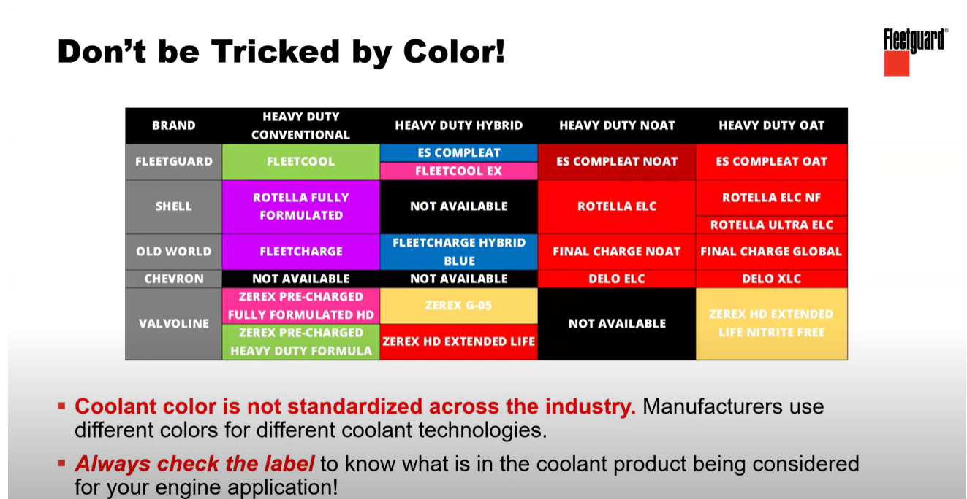
Notes:
Don’t be tricked by determining the type of coolant by color. Coolant color is not standardized across the industry. Not a good best practice if an engine comes in with orange coolant to just add an orange colored coolant. You really need to be sure it meets the right specifications for the engine.

Slide 34
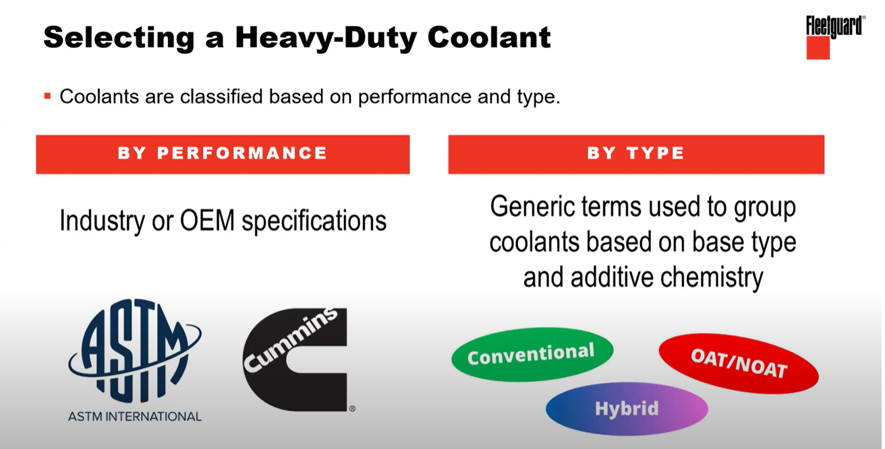
Notes:
Some things you can look for that will help you determine what type of products you should be using. Really if you break down coolants, coolants can be classified in two different ways by performance and by type. When we talk about performance we are referring to industry specifications or more strict OEM specifications. The other way is by type, to group coolants based on their chemistry. Conventional, Hybrid or extended life coolants, or OAT/NOAT coolants organic coolants. Cummins, engine OEMS often have their own specifications.

Slide 35
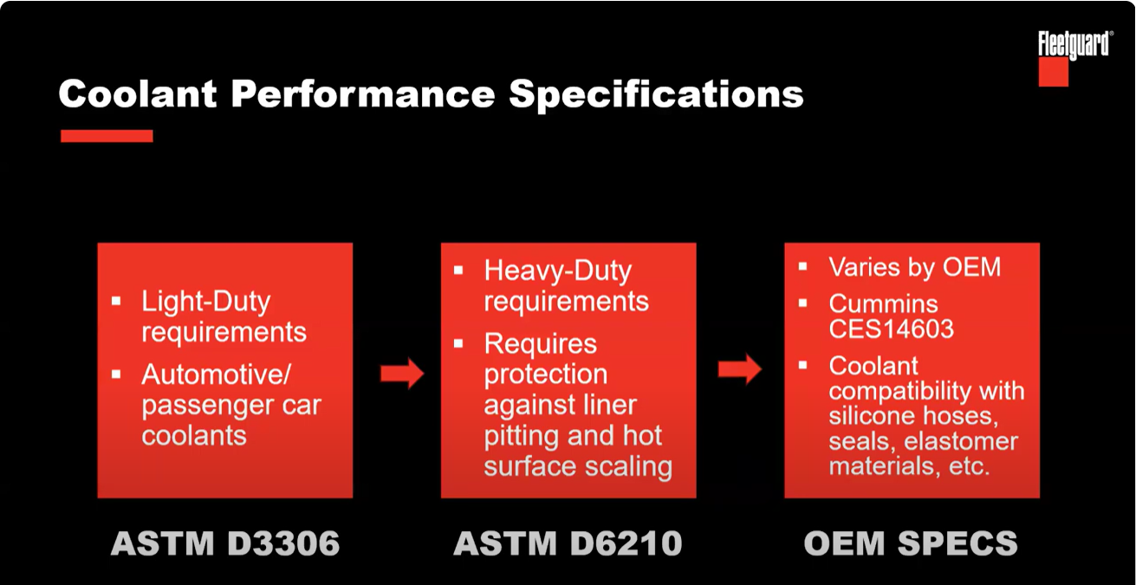
Notes:
If we go back to Performance specifications, there are a few numbers to keep in mind, the first is the ASTM (American Society Testing Materials) industry standard organizations, governing bodies that manage things like heavy duty engine coolant standards. The D3306 is really for light duty engines or automotive grade applications.
The middle number ASTM D6210 is an industry specification and means this coolant meets requirements for heavy duty diesel engines. You need to ensure the coolant your using is a product that meets ASTM D6210. If it’s a heavy duty diesel engine you need to see ASTM D6210 industry specification.
On top of the industry specification you will also see OEM specs. Cummins spec CES14603 builds on top of the industry spec. It also meets things that Cummins calls attention too such as compatibility with silicone hoses, seals, etc.

Slide 36
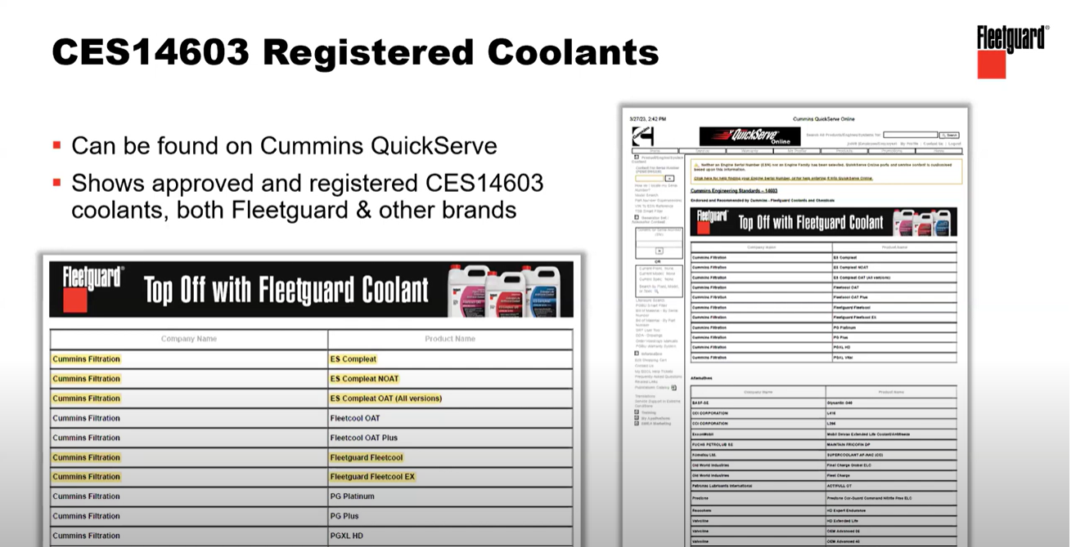
Notes:
You can go to Quickserve Online to locate which Fleetguard coolants and other coolants in the industry are approved to meet Cummins CES14603 spec

Slide 37
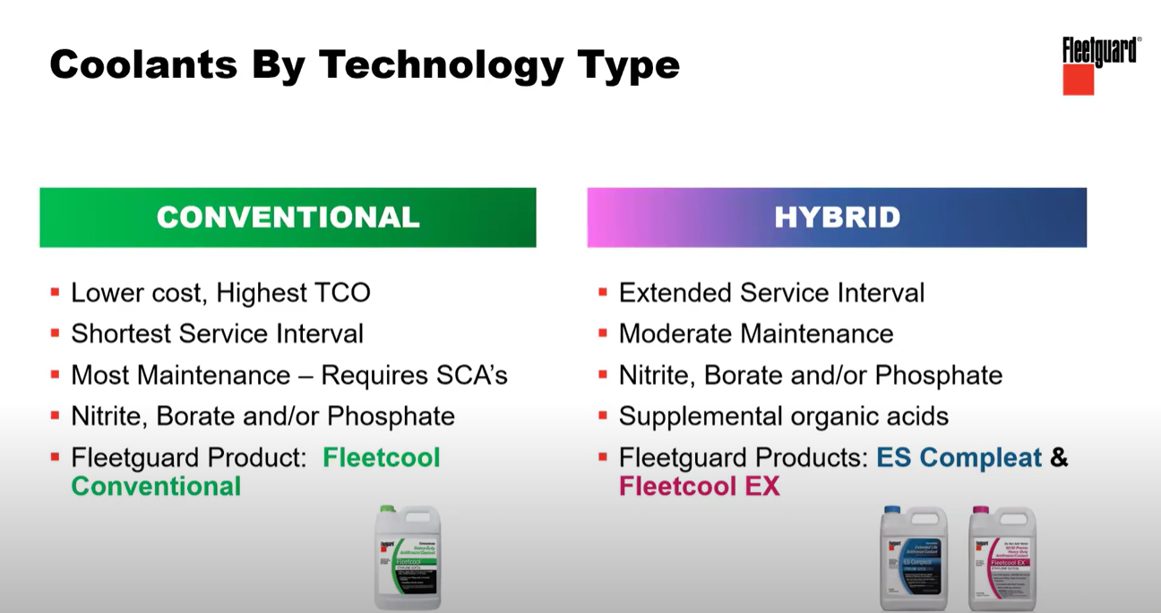
Notes:
Conventional Coolants are generally what is seen in the marketplace today, they do require more maintenance and watch the products more closely and are generally green in color.Still offered in marketplace today but most OEMS have left this in the dust and moved away from it. Most customers are not watching their coolant maintenance closely.
Hybrid coolants do provide extended life. They blend conventional with some other additives that provide better protection. Fleetguard ES Compleat is a Cummins Hybrid product and is blue in color

Slide 38
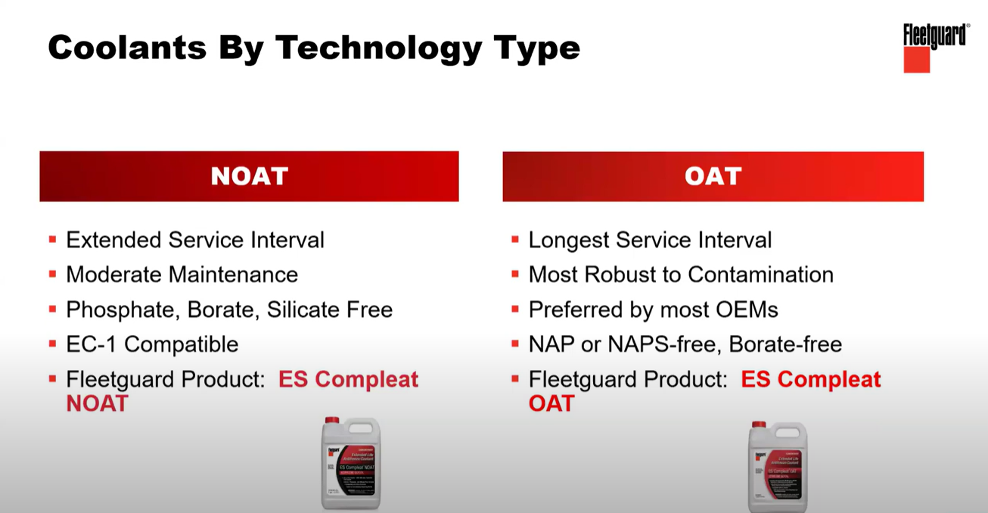
Notes:
Then we really start moving into where the industry has gone last 10 years. These are organic acid technology type coolants. Nitric organic acid technology coolants-NOAT. The main difference if the type of inhibitors used to prevent corrosion. NOAT uses Nitrate and is generally used in cooling systems that contain copper and brass.
Then you have your organic acid technology coolant -OAT. They offer better service life, testing, and service requirements. Get more benefit for protection, less hassle in terms of testing and maintenance.
ES complete OAT and ES Complete NOAT is offered by Cummins. Why OEMs are using them is they provide best protection and longest life. One thing to point out on NOAT, EC-1 is for CAT engines that wants to use our coolant.

Slide 39
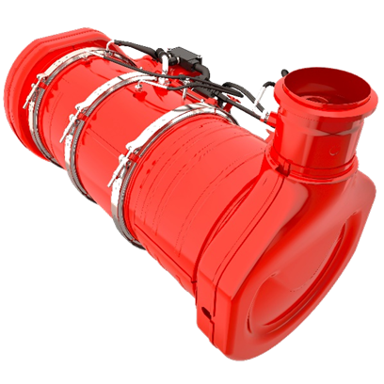
L9 | Aftertreatment DPF Filter Intervals
Table 2: Diesel Particulate Filter (DPF) Maintenance Intervals
Truck | Transit Bus
6500 hours | 5000 hours
200,000 miles
Table 1: Maintenance Fault Code
Maintenance Item | Cummins® Fault Code Number | Fault Code Description
Aftertreatment DPF | 5383 | Aftertreatment 1 Diesel Particulate Filter Ash Load Percent - Data Valid But Above Normal Operating Range - Least Severe Level. The aftertreatment DPF requires cleaning or replacement.
DOC
Urea Dosing & Mixing
Cummins Particulate Filter
The following conditions require more frequent DPF maintenance
Use of engine lubricating oil that does not meet API CK-4
Excessive oil consumption
Frequent or extended use of engine brakes
Extended idle
Selective Catalytic Reduction (SCR) Catalyst

Slide 40
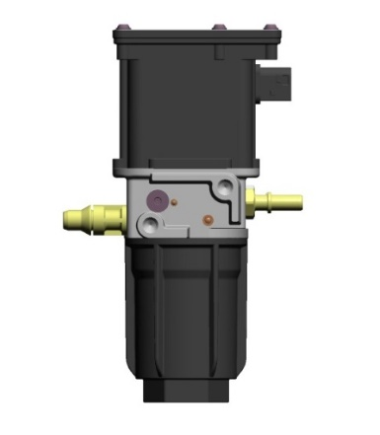
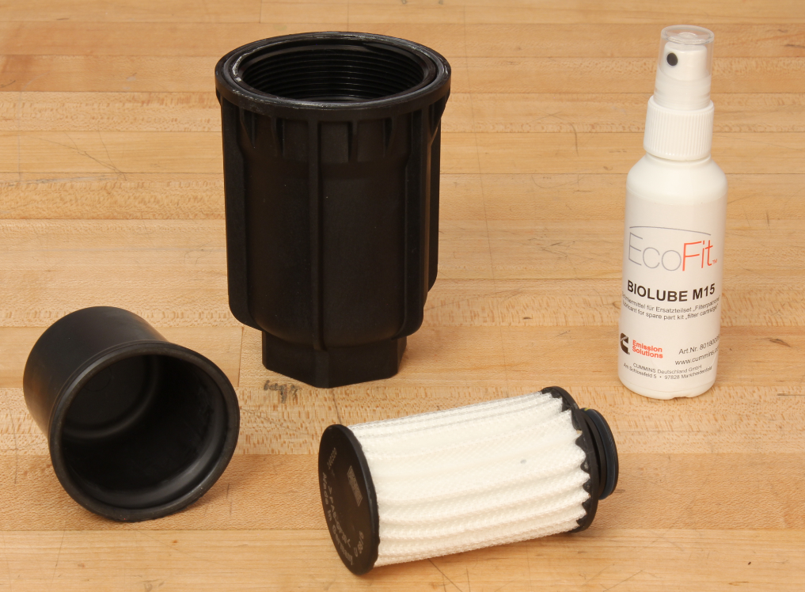
DEF Pump Filter Maintenance
DEF dosing unit filter replacement is the second maintenance item for aftertreatment system.
DEF dosing unit filter replacement occurs at 6750 hours or 300,000 miles whichever comes first
DEF system both Cummins and OEM require proper clean care

Slide 41
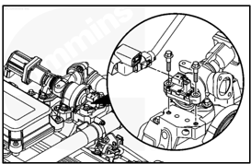
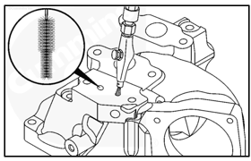
Best Practice
Cleaning EGR differential sensor and ports:
EGR Valve cleaning procedure can be found in procedure 011-022 EGR Valve
Look at intake air connection for EGR diff port cleaning
Packed or dirty EGR diff sensor and ports can create downstream issues in aftertreatments
Mid Range - Cleaning every 4500 hours
Mid Range - Differential Port (DP) cleaning procedures can be found in procedure 10-080 Air Intake Connection – Also 5579934 service bulletin
Intake Air Connection Cleaning & Port Cleaning
MidRange

Slide 42
Agenda
X10 Update (Greg Bohn)
L9 Routine Maintenance (Rob Craig)
Quickserve Online (Rob Craig)
Live Demo
Diagnostic Service Tool (INSITE / Guidanz Diagnostic Toolkit) (Rob Craig)

Slide 43

Web-based diagnostic program that allows you to troubleshoot Cummins electronic engines.
Access to all Engine Manuals
Access to Service Bulletins and Technical Service Bulletins (TSBs)
Access to Fault Code Search and Symptom Search
Access to Warranty Manual
QSOL Free Version – Up to 5 Engine Serial Numbers when using the free version, gives the user access to all the features listed above.
QSOL Paid Version (Currently $810 yearly subscription) – Access to all the features listed above and the following additional features.
Unlimited number of Engine Serial Numbers
Access to Field Action information (Campaigns, TRPs, ATCs)
Access to Cummins Service Training

Slide 44
Agenda
X10 Update (Greg Bohn)
L9 Routine Maintenance (Rob Craig)
Quickserve Online (Rob Craig)
Live Demo
Diagnostic Service Tool (INSITE / Guidanz Diagnostic Toolkit) (Rob Craig)

Slide 45
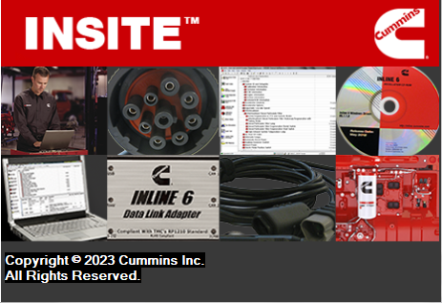
INSITE™ ENGINE DIAGNOSTICS – Yearly subscription
INSITE™ is a Microsoft Windows based electronic service diagnostic program that allows you to troubleshoot Cummins electronic engines.
Insite Pro (Current Price $840) – Activation key required – All of the same capabilities of Lite, but allows ECM calibration download and Programable Data Device (PDD) calibrations
Insite Basic – Read only software – This the basic software when loading Insite – Insite will revert to this when your license expires – will not allow any ECM changes or diagnostics – Read Only
Insite Lite (Current Price $785) – Activation key required– Performs all functions except ECM calibrations
INSITE requires - Cummins USB Inline 7 RP1210 or equivalent datalink connector
Notes:
When the Insite subscription expires you revert to basic and is a “read only”. You will get expiration notifications 30 days prior
In “read only” it will allow you to connect and make work orders/image but will not allow any changes, fault code clearing
With Insite Pro you will be able to update calibration revisions but not be allowed to a change base calibrations to a different calibration unless directed by a repair event (TSB, ECM rom booted etc.. ) This does require a fleet count at an extra charge
You will not be allowed to change a base horsepower or torque – Changing HP & Torque can only be done when approved by a certified Cummins dealer or distributor

Slide 46

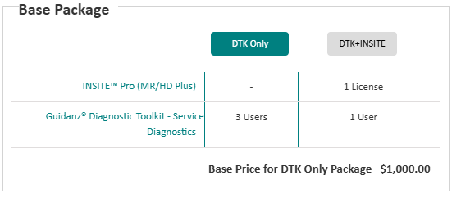
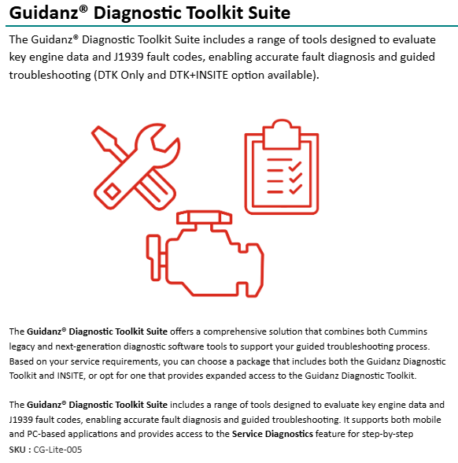
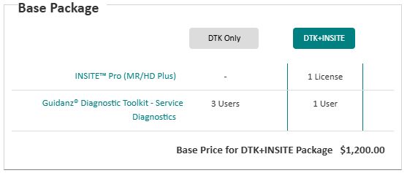
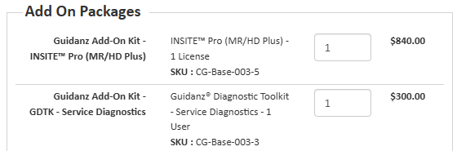
Guidanz Diagnostic Toolkit Subscription Options

Slide 47
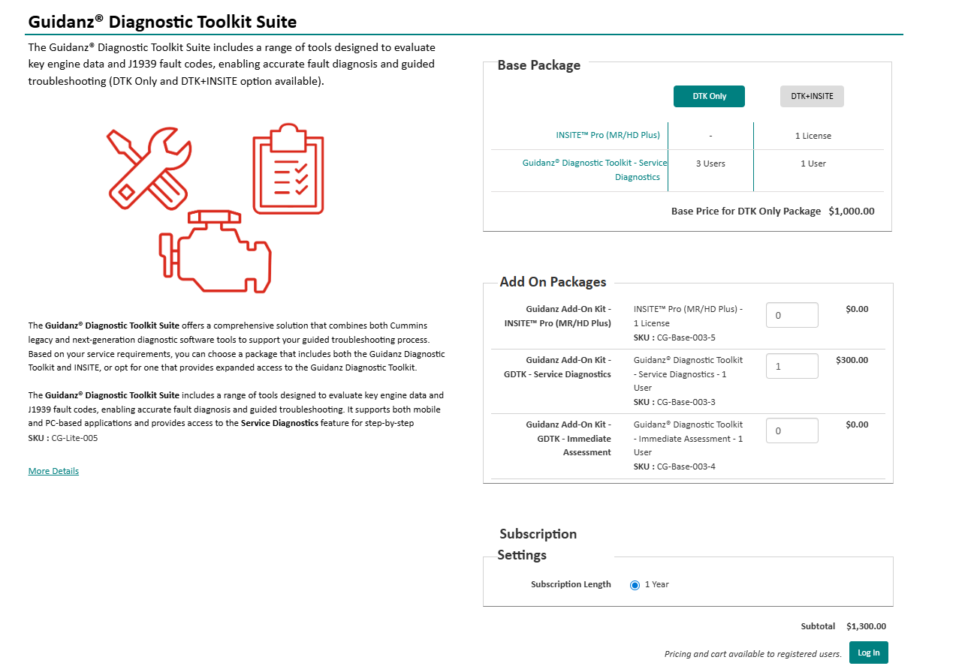
Guidanz Diagnostic Toolkit Subscription Options

Slide 48
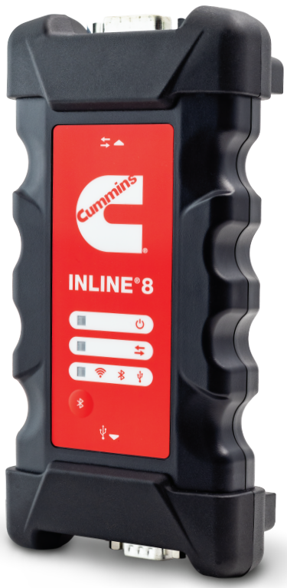
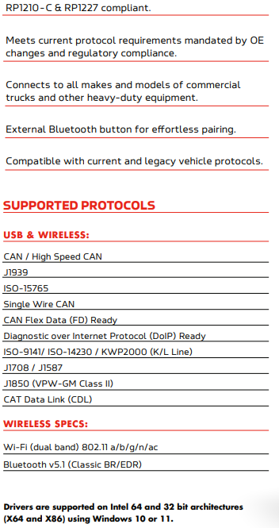
Inline 8 Datalink
Adapter
P/N 6576526
Works with Mobile/Windows Version

Slide 49
Q+A

