Slide 1

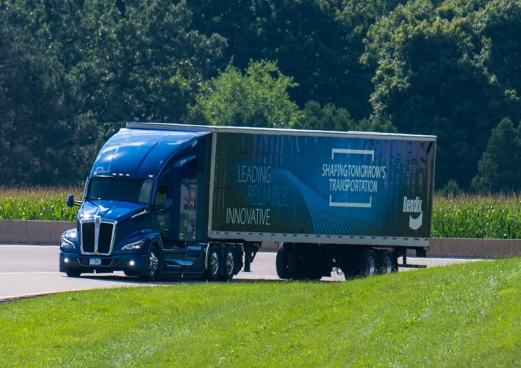
Product Maintenance
Presented by: Moe Alkholany
Technical Solutions Support Specialist
Bendix Tech Team

Slide 2
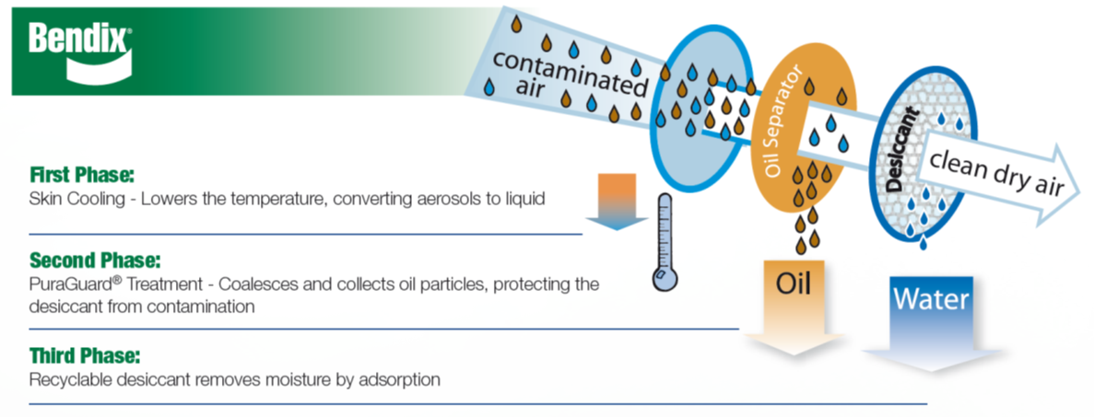
PuraGuard® Oil Coalescing Cartridge
Product Overview
Bendix® unique positioning of the oil coalescing media before the desiccant improves long term drying performance
Notes:
How does the process work, emphasizing the technology used Bendix (Not all Oil Coalescing systems are the same)

Slide 3
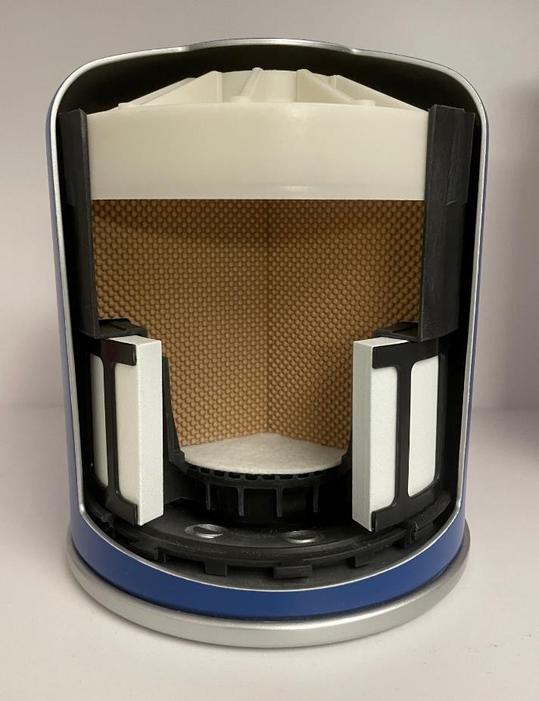
PuraGuard® Oil Coalescing Cartridge
Product Overview
PuraGuard’s unique construction places the oil coalescing media before the desiccant bed which improves long-term drying performance. The coalescing filter consists of 17 layers of filter media and is placed in a vertical orientation which uses gravity to help remove oil droplets
Notes:
Bendix advanced technology, is a pre-desiccant filter using a special threated media

Slide 4
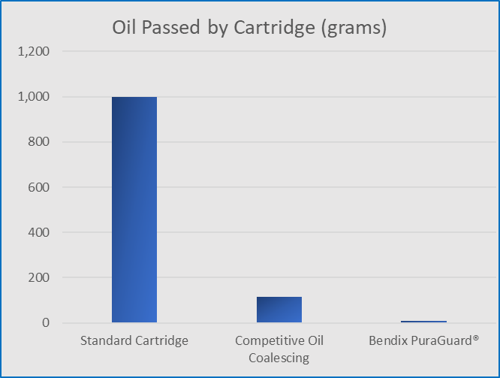
PuraGuard® Oil Coalescing Cartridge
Effects of No or Low-Quality Oil Coalescing
Ref: Eaton Bulletin #TAIB-1006

Slide 5
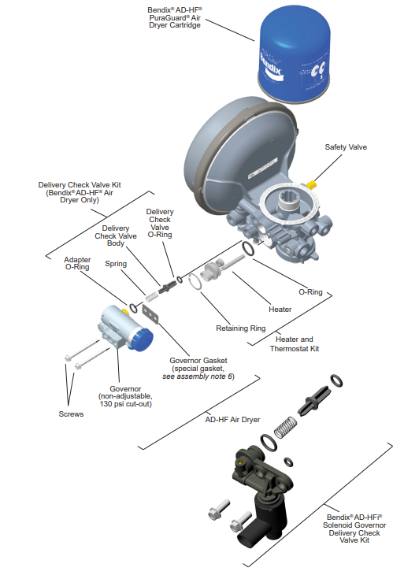

Slide 6
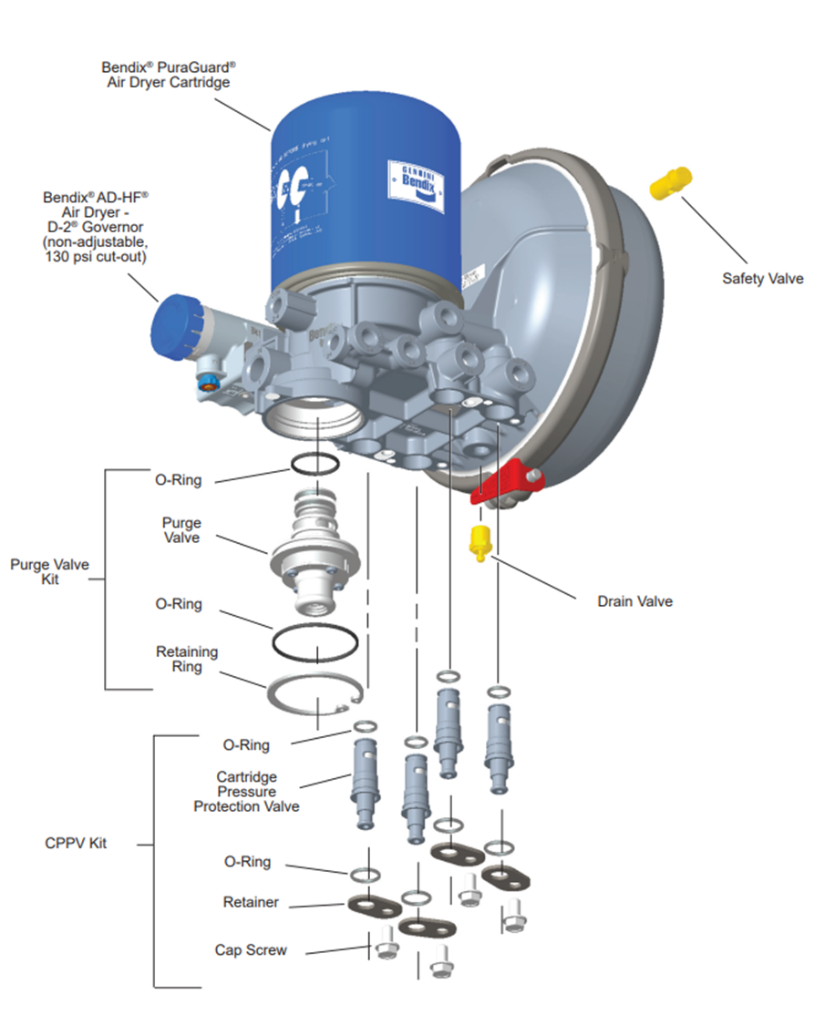

Slide 7
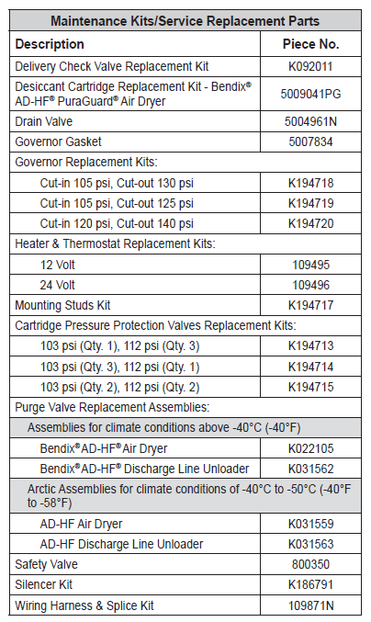
Aftermarket Service Parts
AD-HF air dryers are sold as SC (Service New with Core Charge)Purge Valve & Heater are common with the AD-IS®
Delivery Check Valve (DCV) is the same as used on the AD-9si®
4 Pressure Protection Valve (PPV‘s) kits currently released (based on pressure settings)
New 41mm cartridge PN: 5009041PG
K160650SC and K164018SC are Standard Purge Air Dryers
K160648SC and K160649SC are Extended Purge Air Dryers
4 Pressure Protection Valve (PPV) kits are released –same price
Notes:
Parts Review

Slide 8
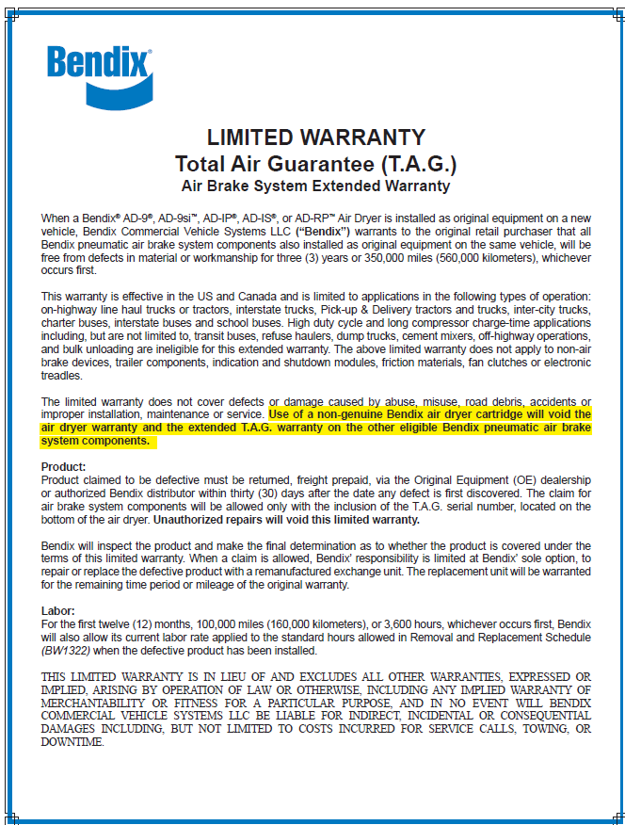
Total Air Guarantee – T.A.G
Notes:
Another Reason why to maintain you vehicle with all Genuine Bendix Parts

Slide 9
Things to check for during an inspection.
Pushrod home position. (Brakes released)
Pushrod free stroke.
Applied stroke length. (Power stroke)
Lining material thickness & condition.
Seized or damaged components.
Excessive play in any components.
Always remember that an ABA is only as good as it is installed and maintained.

Slide 10
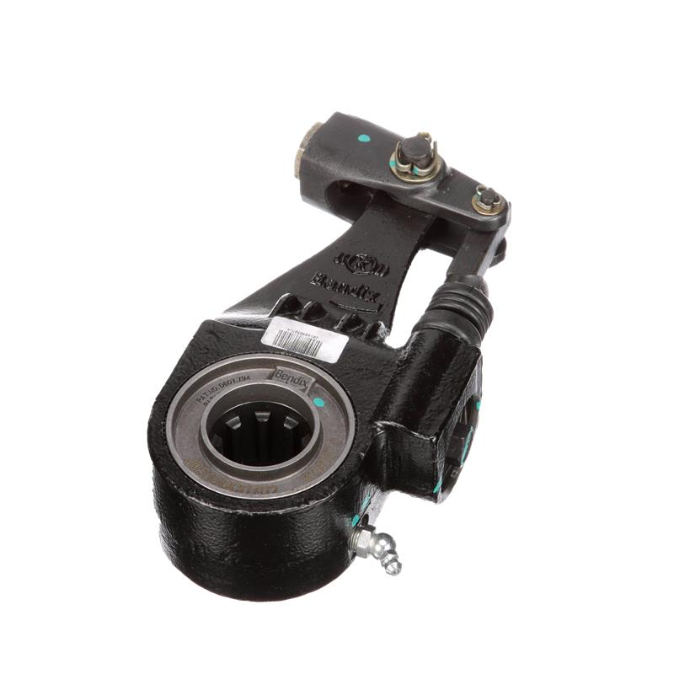
Bendix Versajust Automatic Slack Adjusters

Slide 11
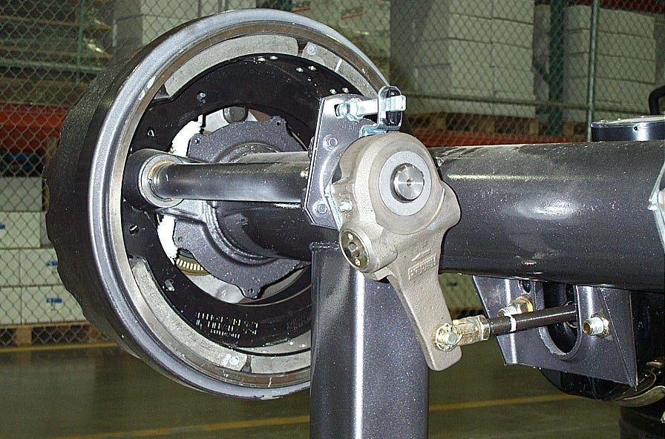
Brake Adjustment & Inspection involves all components from the chamber to the drum!
Bracket, tube, bushings & Seals
Brake Friction & Brake Drum
Brake shoes & Springs
Cam, Rollers & Bushings
Chamber & Bracket
Spider & Anchor
Pushrod
Slack Adjustment
Clevis & Bushing
Notes:
Instructor: See Bw-7258 or BRSM-0033 ES & EB Service Manual – page # 14
Part number is located on the concave side of the cam lobes.
Head, splines and journals are heat treated as per OEM requirements.

Slide 12
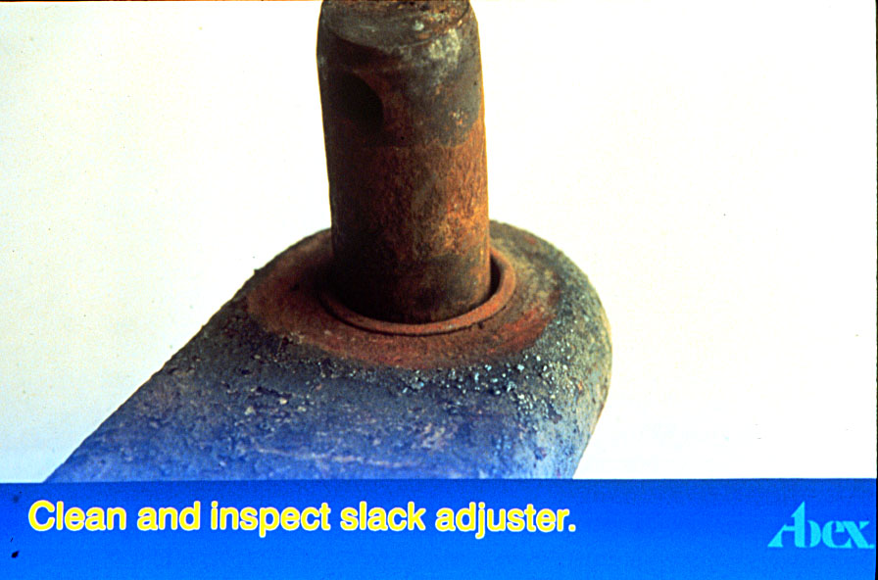
Inspect Slack Adjuster Bushing For Wear
Notes:
One source of stroke problems is worn out clevis pins
Remember a brake system is a system of levels a fulcrums, each one of them must be in good working order for the system to work well
Ware at any one of the points will increase the overall stroke at the push rod and decrease the performance of the brake system

Slide 13
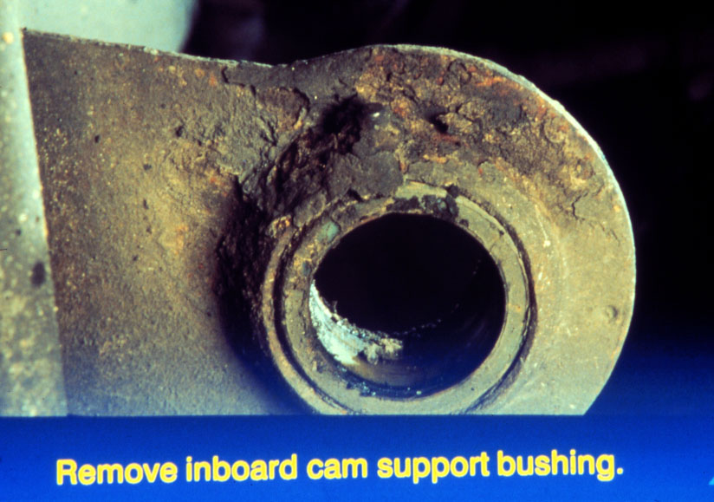
Inspect Camshaft Bushing
Notes:
Worn camshaft bushings will cause improper and premature lining wear. Previous slide is and indication of worn camshaft bushings and improper axial end play.

Slide 14
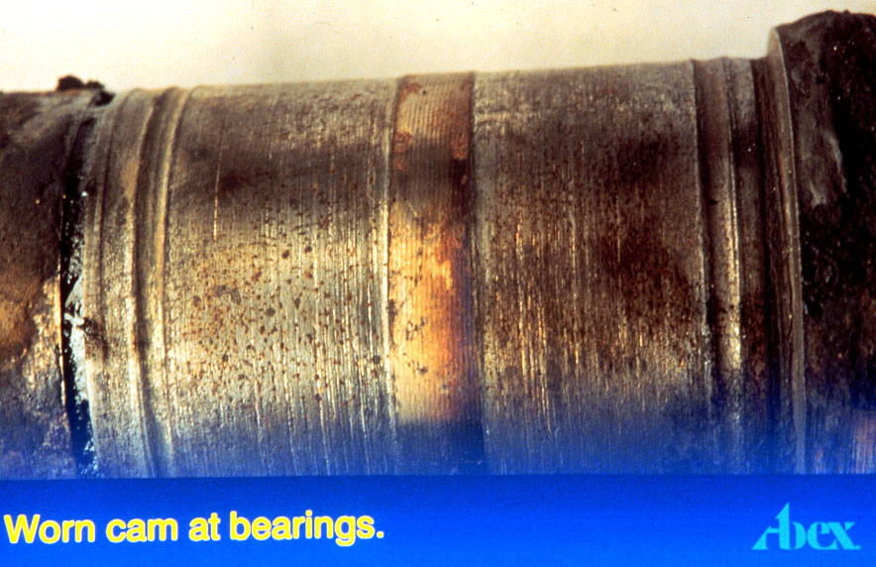
Worn Camshaft Bearing Surface

Slide 15
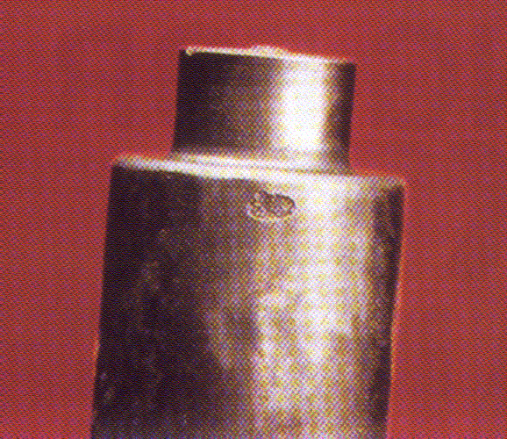
Old Hardware & Fatigued Springs
Notes:
Old hardware and fatigued springs need to be replaced.

Slide 16
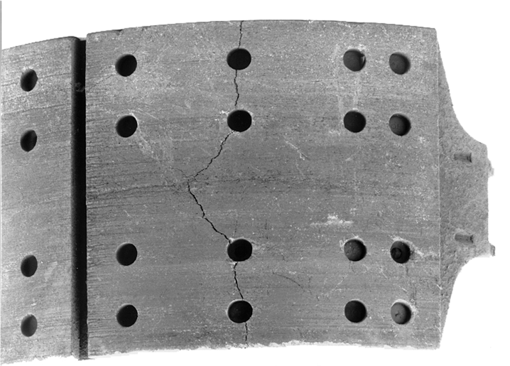
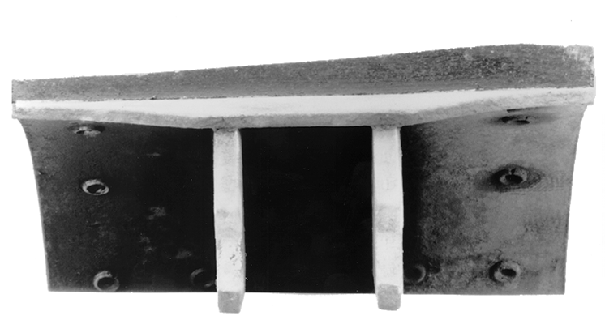
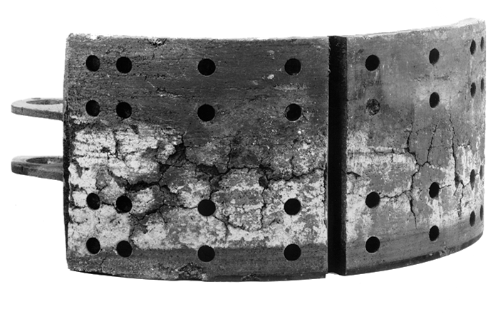
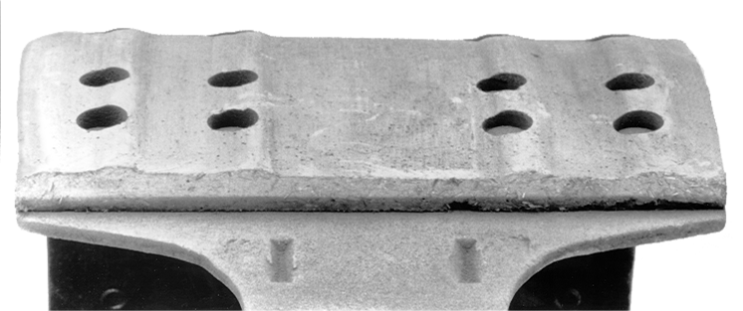
Inspecting Brake Shoes.

Slide 17

B2Bendix.com
The one-stop shop for all your Bendix needs

Slide 18
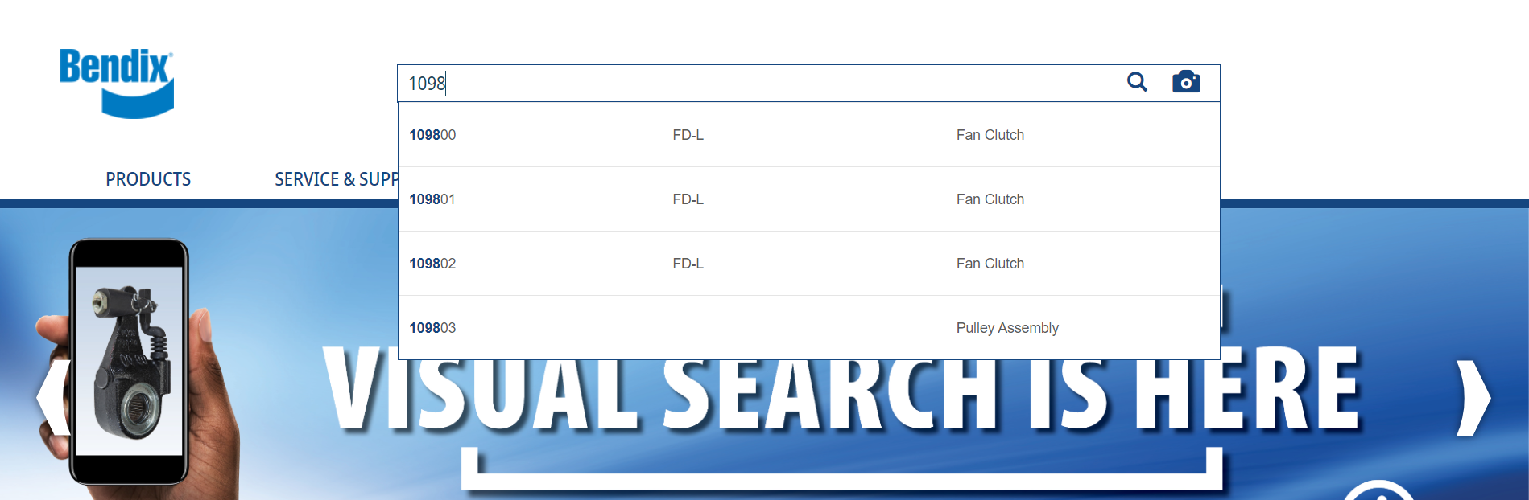
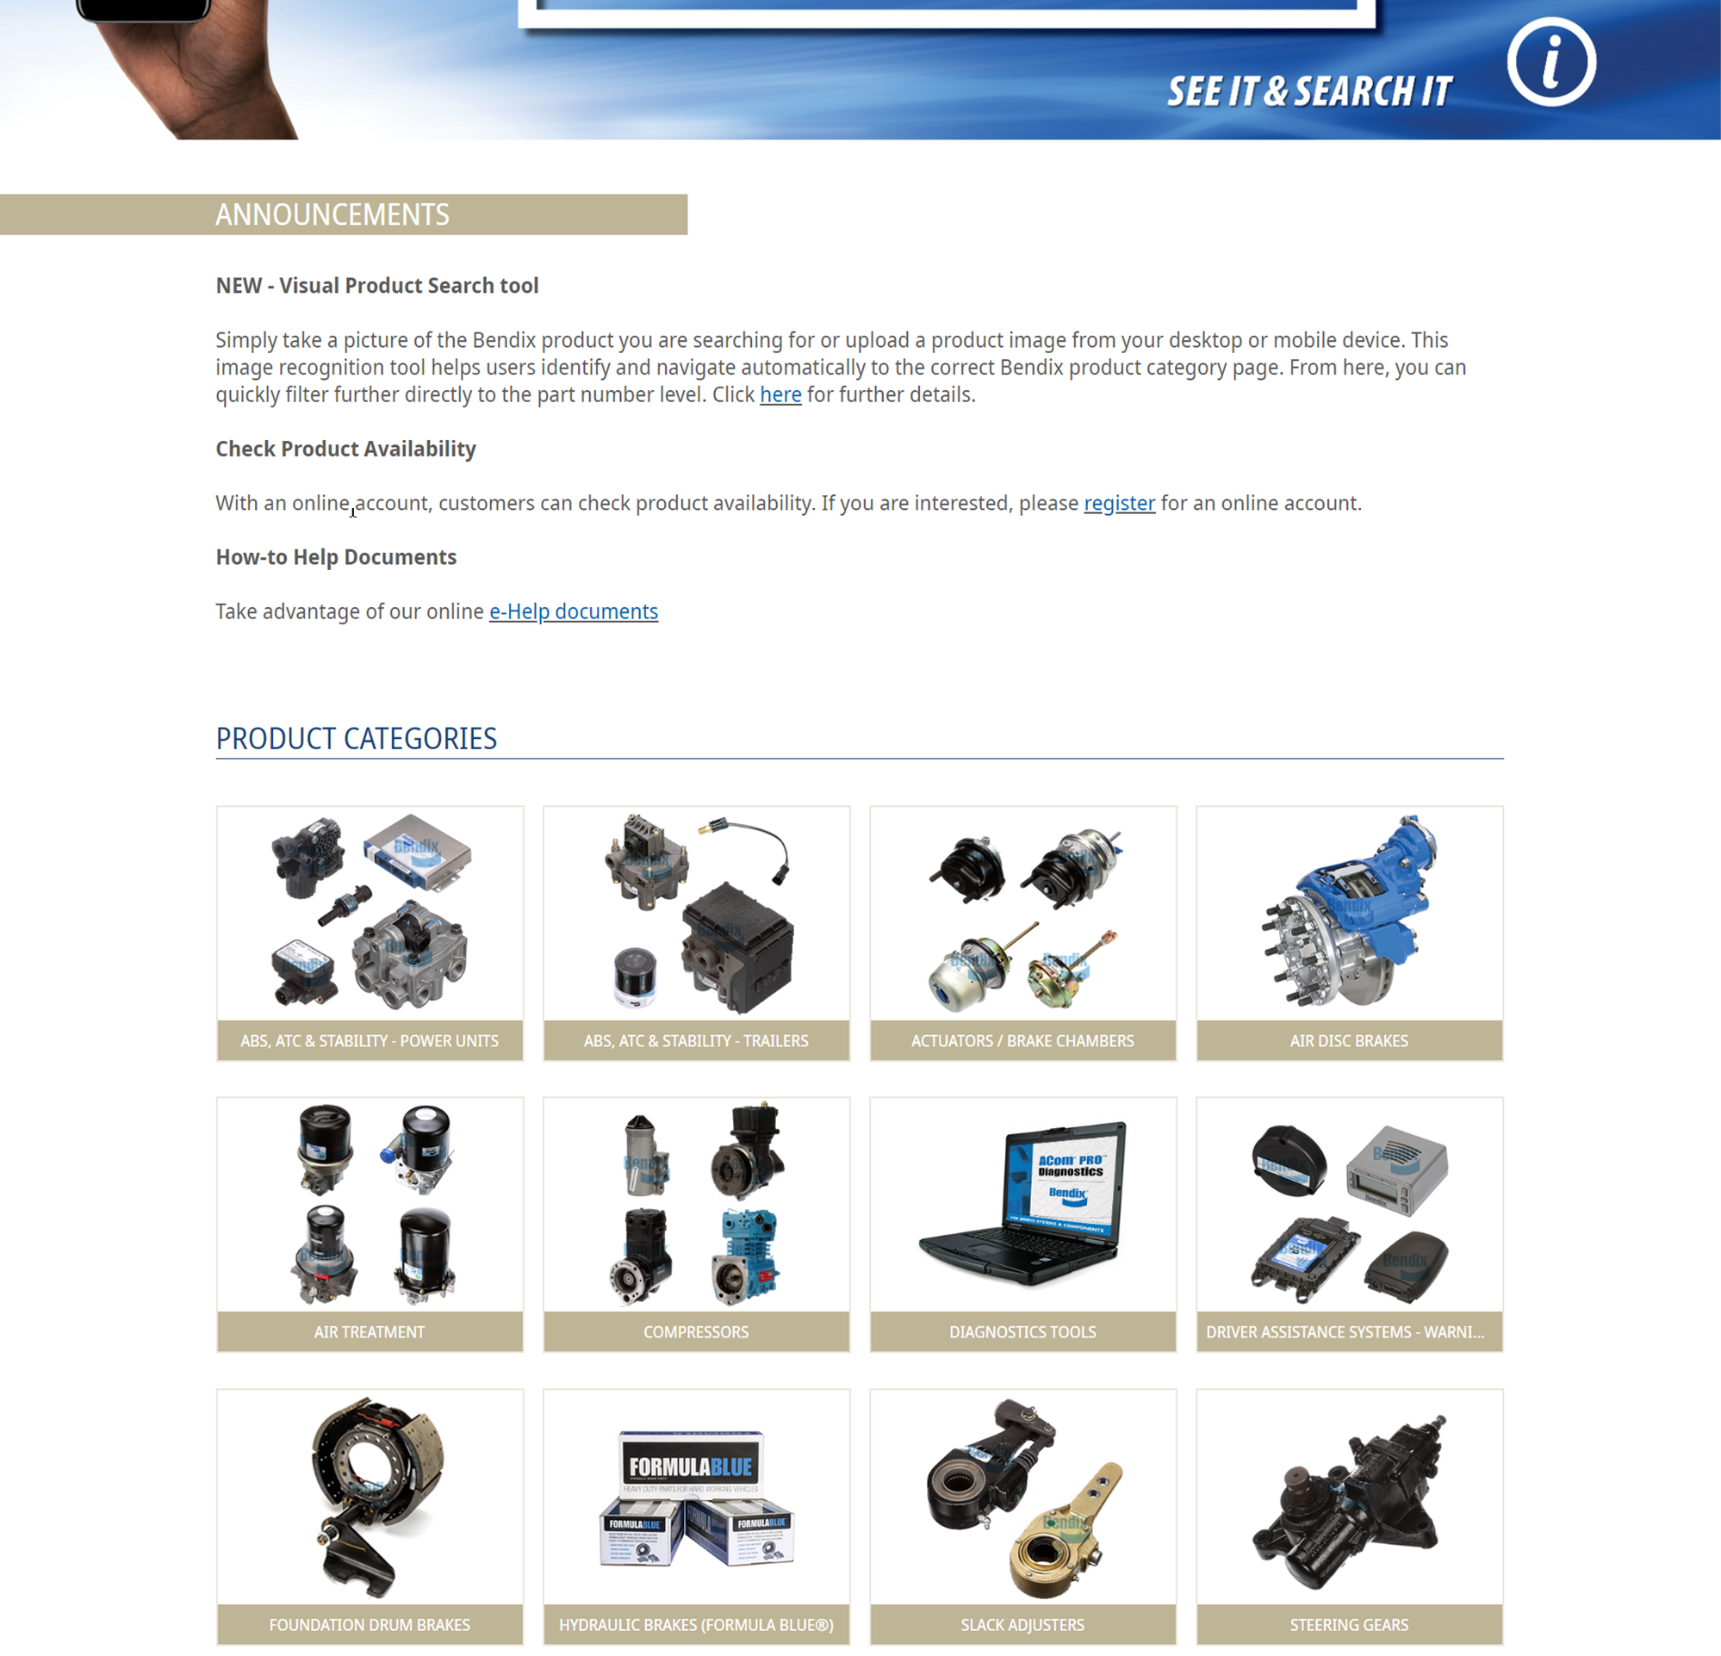
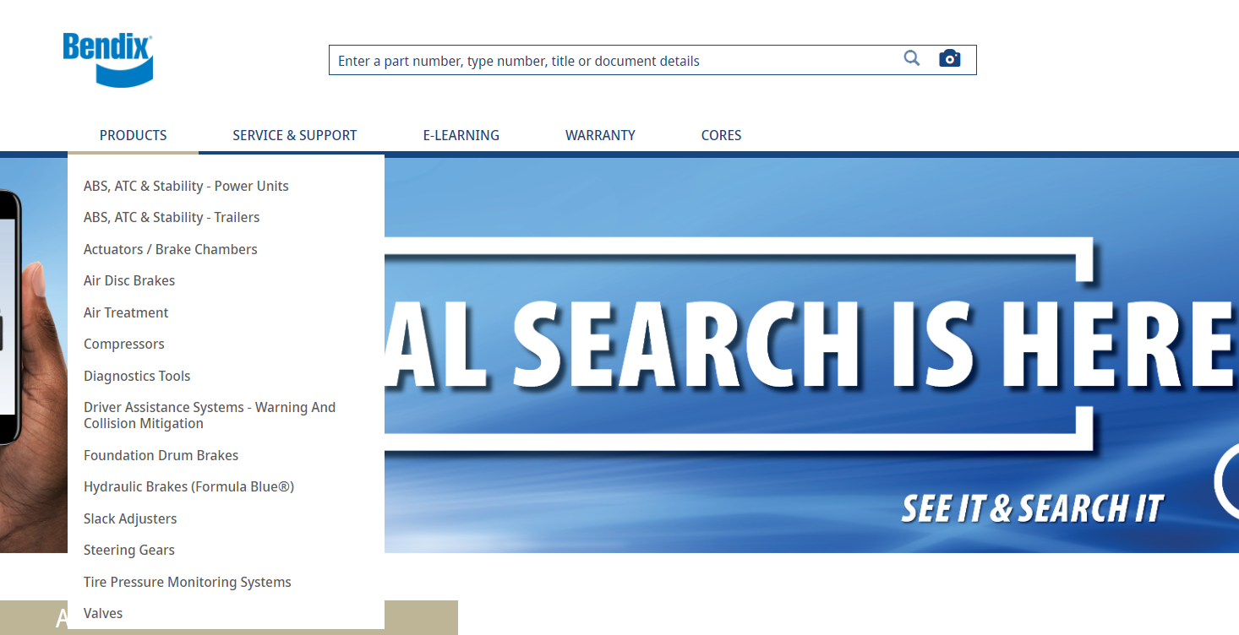
How to Search
Site Search Bar… with Visual Search
Main Landing Page…
Landing Page Navigation Bar…

Slide 19
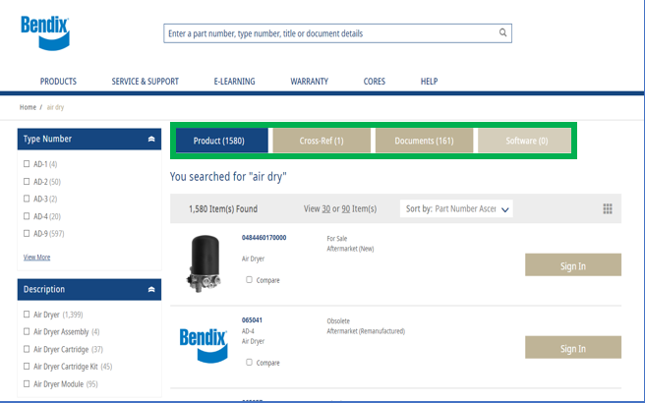
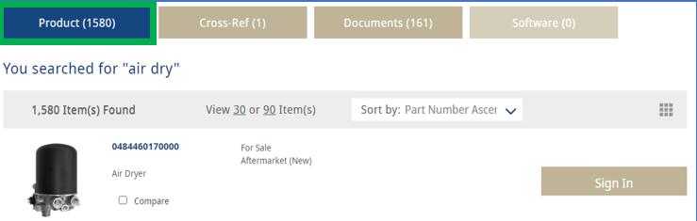
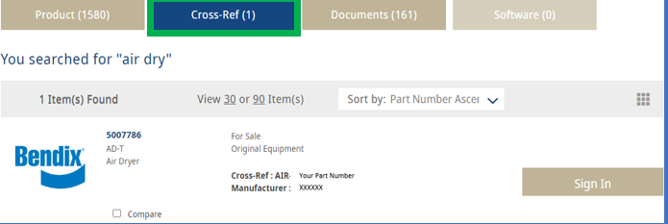
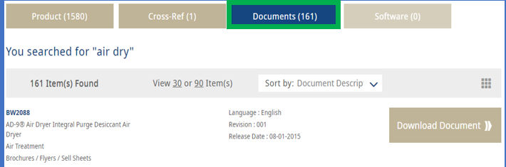
Organizing Search Results
Select from the Products, Cross-References, Documents, and Software Tabs

Slide 20
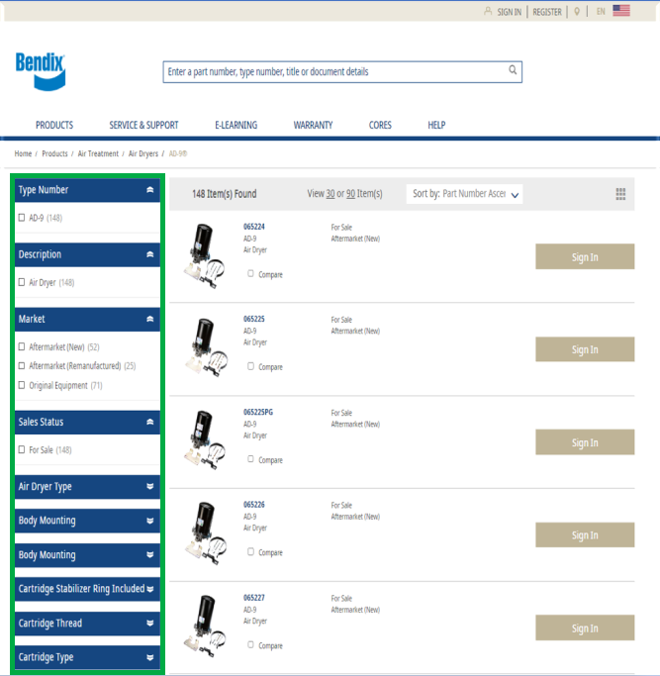
Search Using Facets (Filters)
Filter Search Results on the Product List Page (PLP) by technical product Information

Slide 21
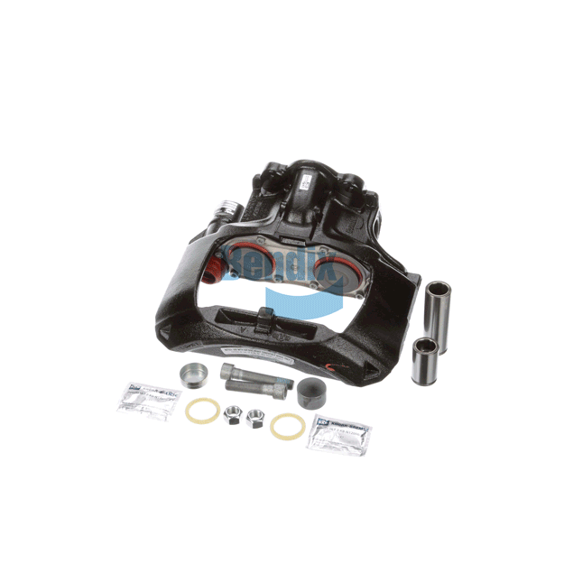

Product Information Available
Over 25,000 Parts to search with more thank than 10,000 product images and 360° spins
Detailed technical data & supporting documents
Displays related service and replacement products
Document library
Compare feature
Cross-Reference search

Slide 22
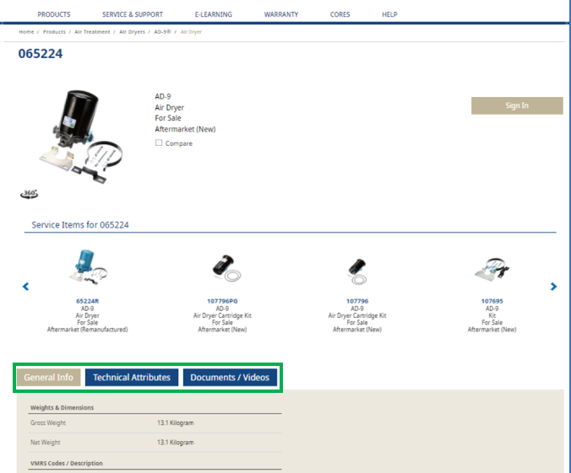
Information on the Product Detail Page:
Product Detail Page (PDP) content:
Related Service Items
General Part Information
Technical Attributes
Documents / Videos

Slide 23
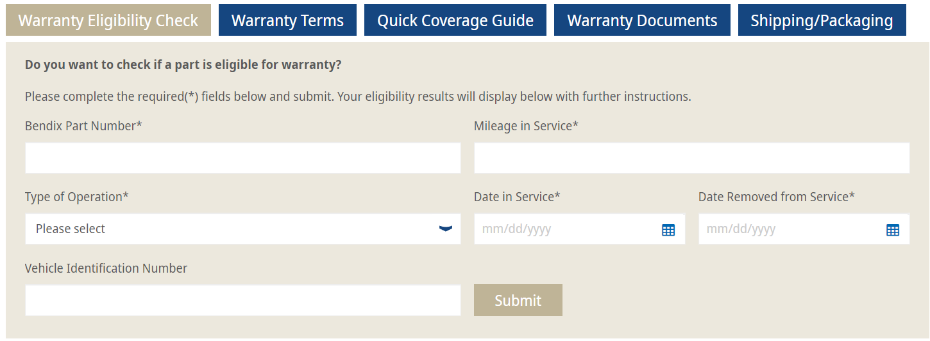
Check Product Warranty Eligibility
From the Warranty Landing Page

Slide 24
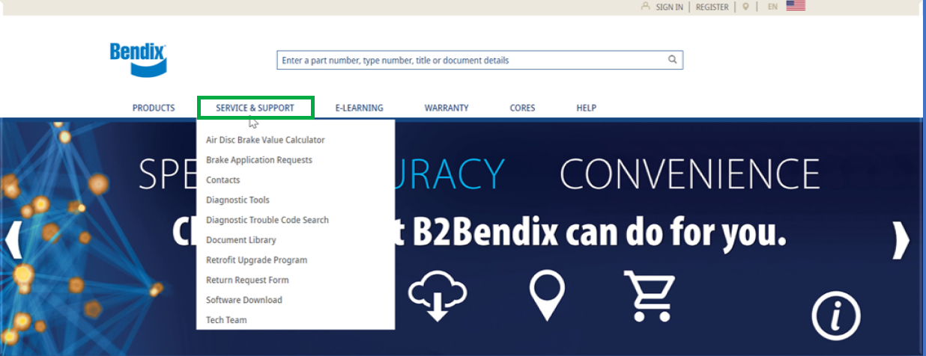
Support Information
Under Service & Support Header
Notes:
Service Support Resource – Tech Team

Slide 25
Available Marketing Collateral
SD-08-12046 Service Data for AD-HF® and AD-HFi®
S-1669_US_000 AD-HF Installation Instructions
S-1342_US-006 Cartridge Installation
BW8210 AD-HF Sell Sheet
AD-HF Rev 1 (10/2020) PowerPoint Overview
YouTube Videos
Introduction to the AD-HF
Servicing the AD-HF Air Dryer
Spin-On Cartridge Identification
Notes:
Replaceable PPV, unlike AD-IS replace whole dryer. This is a ‘rebuildable’ Dryer

Slide 26

Technician support & resources
B2Bendix.com (Products, service and support, e-learning, warranty, cores)
Brake-school.com (video-based products and system training)
Bendix in-person and virtual product schools, schedule on Bendix.com > BW2297
Bendix Knowledge-dock.com (blogs, tech tips, podcasts, position papers)
Bendix YouTube channel (Tech Talks, Driving With Videos)
In-person product demos (see your Bendix account manager)

Slide 27
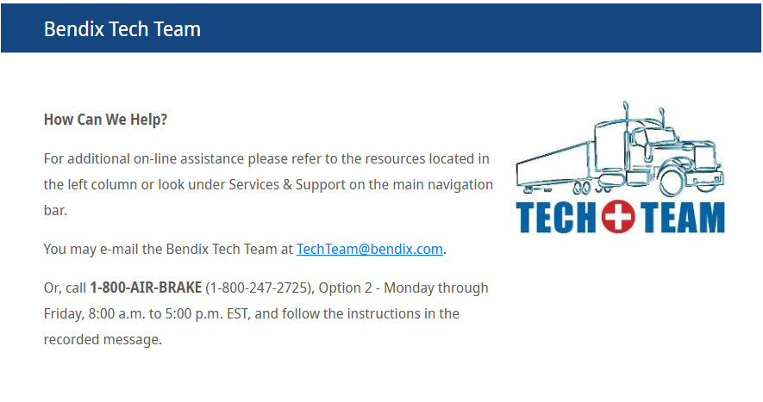

Slide 28
Questions
Bendix Contact Account Rep | Information
Kent Klausing Regional Field Sales – NW Account Manager Rihm KW | Phone #: 651-280-0069 Kent.Klausing@Bendix.com
Jason Hutchison Regional Field Sales – NE Account Manager RedBox | Phone #: 440-225-1944 Jason.Hutchison@Bendix.com
Moe Alkholany Technical Support Tech Team | TechTeam@Bendix.com 800-AIR-BRAKE (800-247-2725)

