Slide 1
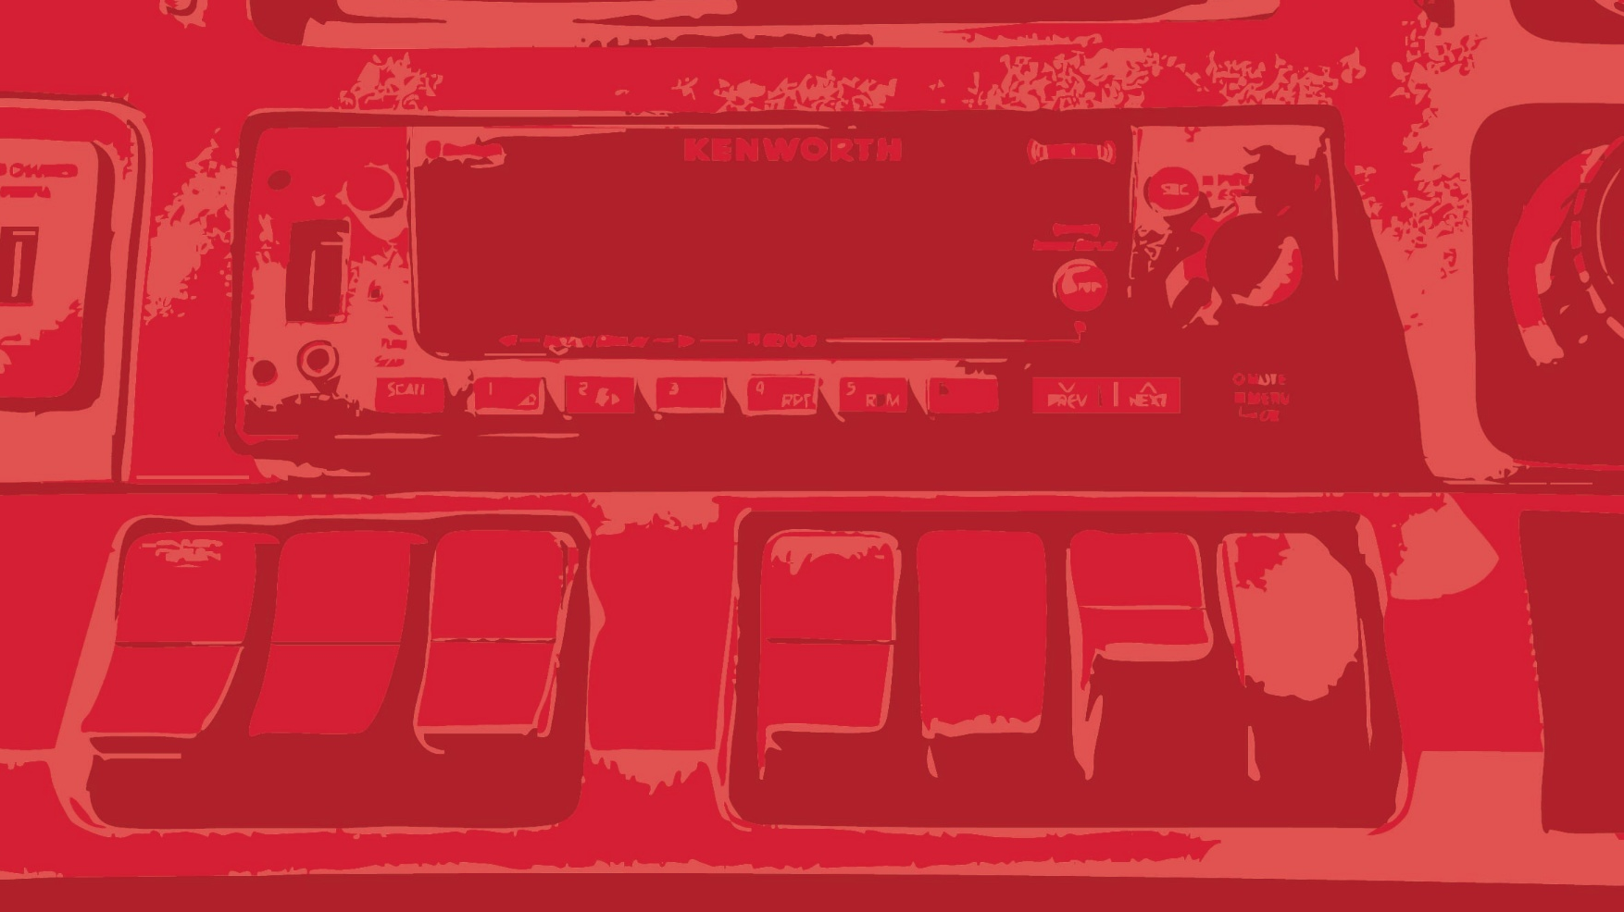
BASIC ELECTRICAL TROUBLESHOOTING & DIAGNOSTICS
Understanding the Electrical System of the 2024 Kenworth T480
Presented By: Bob Perry, Fleet Aftersales Manager
Notes:
Welcome! Today we’ll cover the basics of the Kenworth T480’s 12-volt electrical system — where to find key components, how to identify common issues, and what steps to take before calling for service.

Slide 2

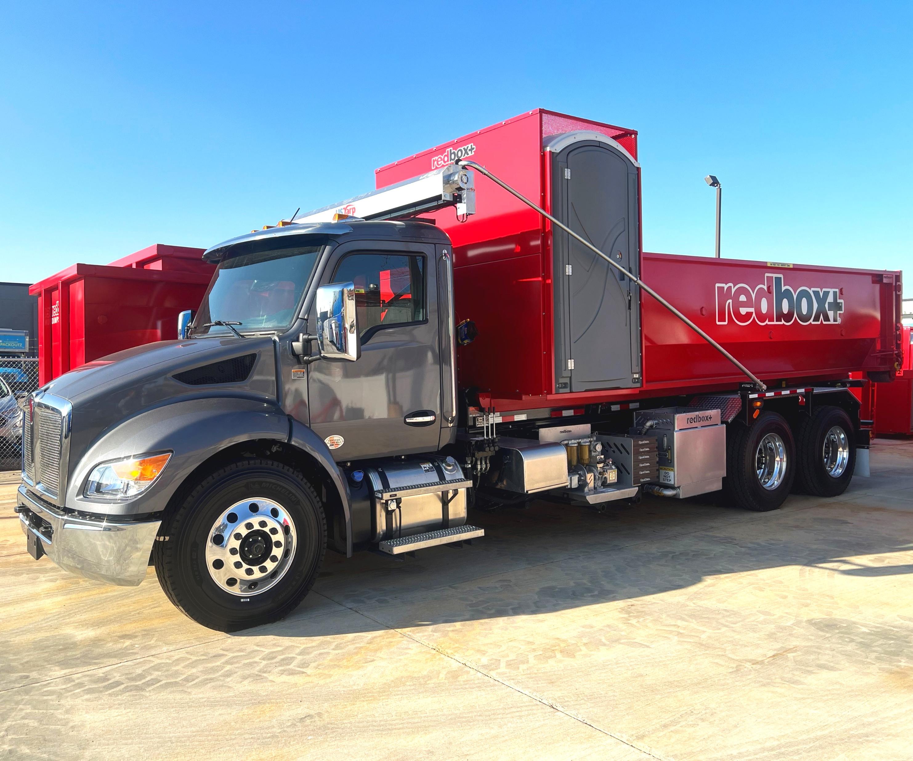


12-VOLT ELECTRICAL SYSTEM OVERVIEW
Powers starting, lighting, and accessories.
Supplied by batteries and the alternator.
Protected by fuses and relays.
Ground returns complete the circuit.
Notes:
Think of electricity like water pressure — it flows through wires and components. Good connections and clean grounds keep that flow steady and prevent voltage drops.

Slide 3
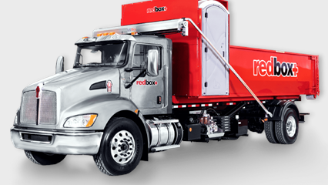
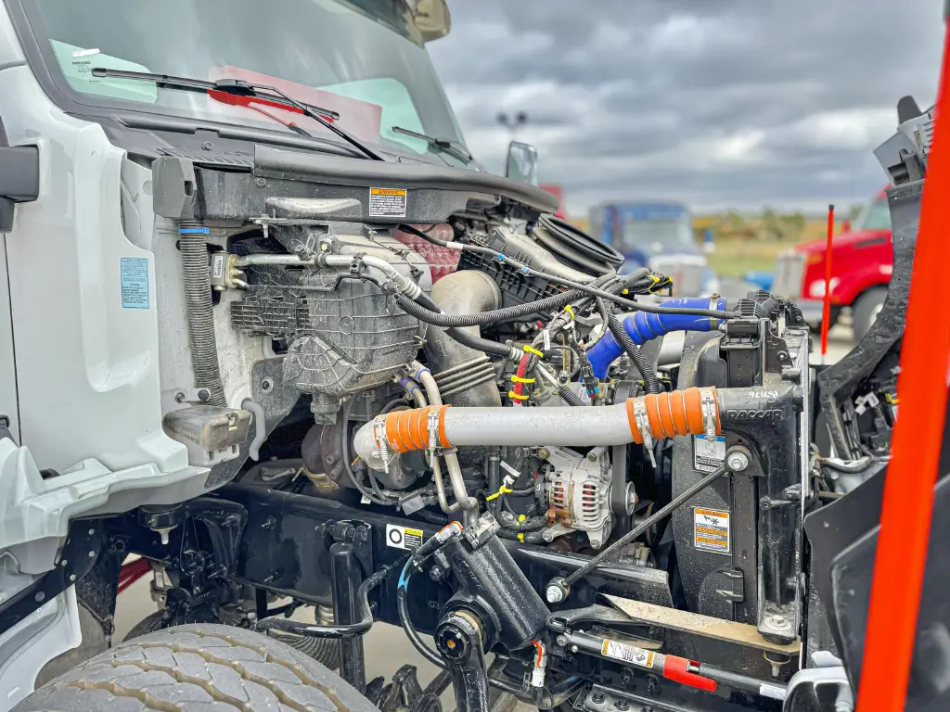
MAIN ELECTRICAL COMPONENTS
Battery: Stores 12V power.
Starter Motor: Cranks the engine.
Alternator: Recharges the batteries.
Power Distribution Center (PDC): Houses fuses and relays.
Ground Straps: Complete the return path for all circuits.
Notes:
All these parts must work together. A loose cable, corroded terminal, or weak battery can affect several systems at once.

Slide 4
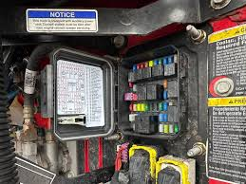
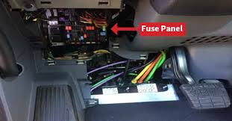
FUSE & RELAY LOCATIONS
Under hood Power Distribution Center (PDC): on driver firewall/fender.
Cab Fuse Panel: below the driver’s dash.
Notes:
These are your first stop when something quits working. Most electrical problems start with a blown fuse or poor connection here.

Slide 5
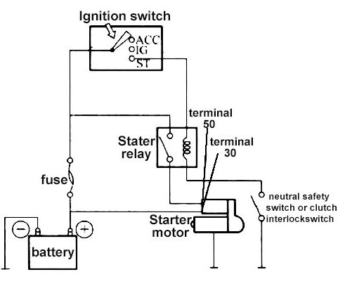

STARTING SYSTEM POWER FLOW
Battery
Ignition Switch
Starter Relay
Starter Motor
Engine Crank
Notes:
When you turn the key, voltage passes through a relay to the starter motor. If any link in that path is open, the engine won’t crank. Always start your checks at the battery and work forward.

Slide 6
COMMON STARTING PROBLEMS
SYMPTOM | LIKELY CAUSE | QUICK CHECK
No crank / no click | Weak or dead batteries | Verify >12.4V; tighten terminals
Click, no start | Bad relay or poor ground | Check relay, inspect ground strap
Slow crank | Corroded cables or weak battery | Clean and tighten connections
No dash power | Blown fuse | Inspect cab fuse panel
Notes:
Most starting issues come from battery or connection problems. Always rule those out first — they’re fast, simple fixes.

Slide 7
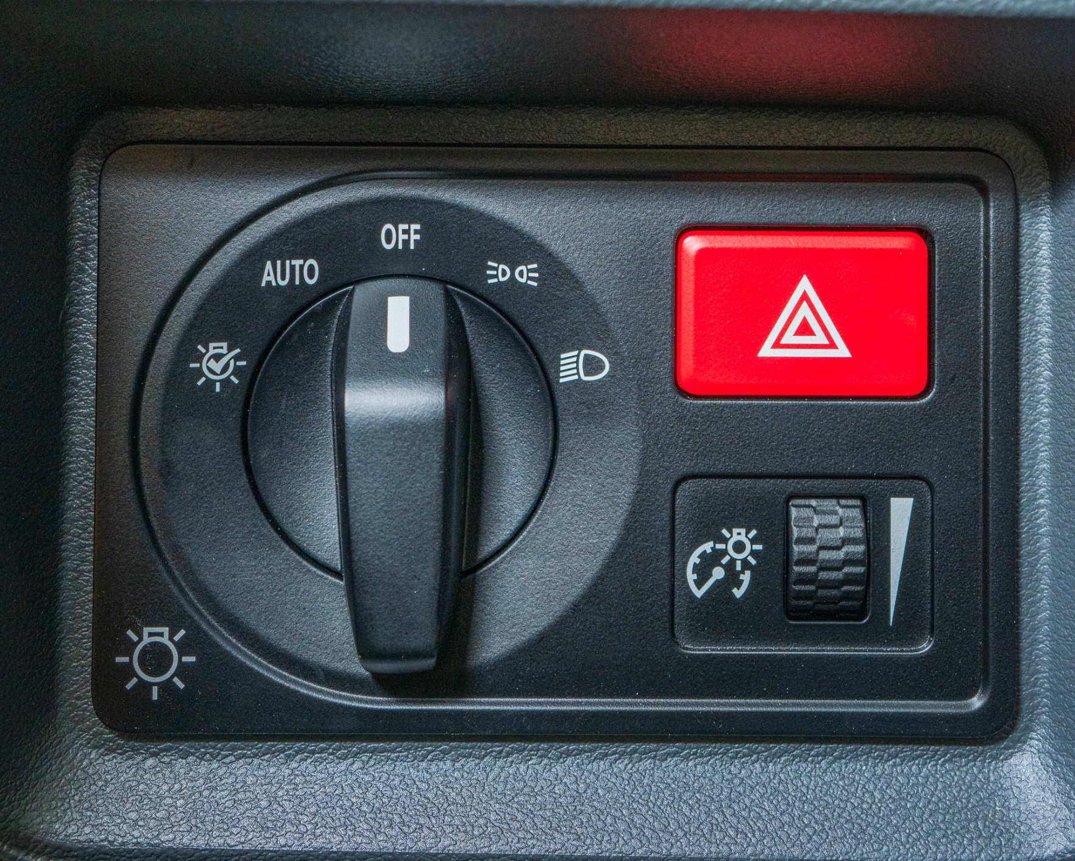
LIGHTING SYSTEM OVERVIEW
Circuits include headlights, markers, brake & turn, dash lights.
Controlled by switches and relays.
Protected by fuses and grounded to the frame.
Notes:
Lighting issues are often simple — blown fuse, bad bulb, or poor connection. Always check the ground before replacing parts.

Slide 8
COMMON LIGHTING PROBLEMS
SYMPTOM | LIKELY CAUSE | QUICK CHECK
Headlight out | Burned bulb or blown fuse | Replace bulb or check fuse
Marker lights out | Corroded ground | Clean and reattach connection
Dash lights dim | Low voltage | Check alternator output
Turn signals erratic | Loose connector | Inspect plug pins
Notes:
If multiple lights fail at once, suspect a shared ground or connector. Start at the simplest points — the fuse or the ground.

Slide 9
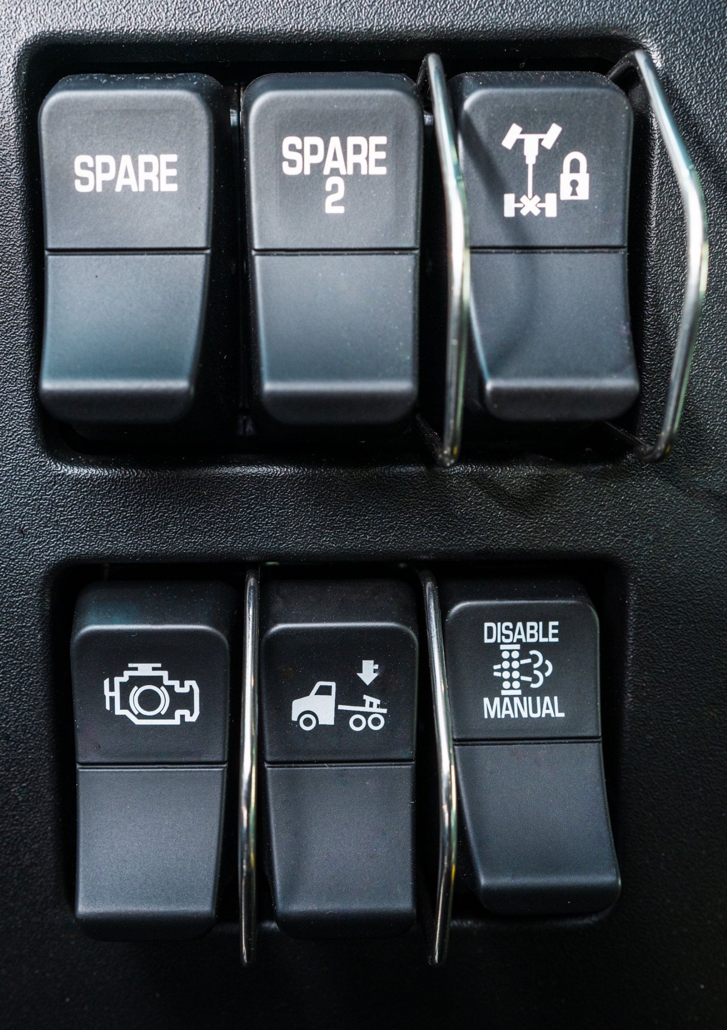
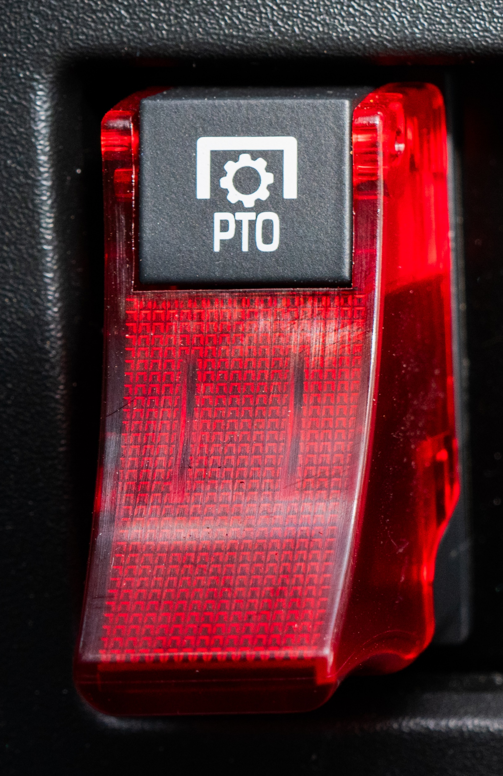
SWITCHES & CONTROLS
Common switches: Headlight, Engine Brake, Fan, PTO.
Each sends a low-voltage signal to a relay.
Relay completes the circuit to operate the component.
Notes:
Switches rarely fail on their own. If several stop working, look for a single power feed or shared fuse behind the dash.

Slide 10
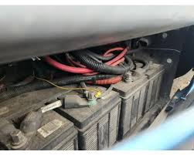
ELECTRICAL SYSTEM CARE
Keep terminals clean and tight.
Inspect cables for corrosion.
Check fuse panels for moisture.
Use dielectric grease on connectors.
Avoid accessory overload.

Slide 11

STAY POWERED. STAY RELIABLE.
Know your fuses and cables.
Start simple with every issue.
Preventive care saves downtime.
Notes:
Clean connections prevent 90% of electrical issues. A little preventive care goes a long way.

Slide 12
SCENARIO #1: TRUCK WON’T CRANK AFTER SITTING OVERNIGHT
Driver turns key → no crank, no click.
Interior lights appear dim.
Batteries were last inspected 3 months ago.
What’s the FIRST thing you check?
What do dim lights usually tell you?
Notes:
This is the most common real-world complaint. Dim lights are a giveaway that voltage is low. Encourage drivers to check battery connections and voltage before assuming the starter is bad.

Slide 13
SCENARIO #1 SOLUTION: NO-CRANK CONDITION
Likely Causes:
Weak or drained batteries
Loose terminals
Corroded cable ends
Faulty starter relay
Correct Response:
Check battery voltage (>12.4V).
Inspect terminals (tight, clean).
Check for corrosion at ground strap.
Notes:
The key message: start with the simple, visible checks before assuming expensive components have failed.

Slide 14
SCENARIO #2: LIGHTS FLICKERING WHILE DRIVING
Driver notices headlights dimming and brightening.
Marker lights flicker on bumps.
No related dash warnings.
What is the most likely cause?
Fuse? Bulb? Connector? cable?
Notes:
This is almost always a loose connection issue. Drivers should be trained to suspect loose connections before replacing bulbs.

Slide 15
SCENARIO #2 SOLUTION: FLICKERING LIGHTS
Likely Cause:
Loose or corroded cable
Pin-fit issues in harness connectors
Correct Response:
Inspect connector near affected light circuit.
Clean and tighten connection.
Verify fuse seating in cab panel.
Notes:
Flickering almost never comes from fuses. Grounds and connectors are the real culprits

Slide 16

Quick Review: Question #1
What are the first two things you should check during ANY electrical problem?
Notes:
read symptoms, not guess parts.

Slide 17
Quick Review: Question #1
What are the first two things you should check during ANY electrical problem?
ANSWER:
Clean and tighten connection.
Verify fuse seating in cab panel.
Notes:
golden rule: fuses and grounds fix the majority of electrical complaints.

Slide 18
Quick Review Question #2
A truck clicks when the key is turned but does not start. What does this usually mean?

Slide 19
Quick Review Question #2
A truck clicks when the key is turned but does not start. What does this usually mean?
ANSWER:
Weak battery and loose connections.

Slide 20
REAL-WORLD EXAMPLE: CORRODED GROUND STRAP
Battery cable appeared “okay” from above.
Underside was fully corroded.
Caused intermittent no-start and lighting issues.
Notes:
Many issues hide under cable insulation or behind the bolt surface. Inspection matters

Slide 21
REAL-WORLD EXAMPLE: MISDIAGNOSED STARTER FAILURE
Truck towed in for “bad starter.”
Actual problem: battery negative cable loose.
Repair cost: $0.
Downtime: Completely avoidable.
Notes:
.

Slide 22
KNOWLEDGE CHECK (FINAL REVIEW)
Where is the cab fuse panel located?
What’s the normal battery voltage?
What causes flickering lights?
What’s the first thing to inspect in a no-start?

Slide 23
KNOWLEDGE CHECK (FINAL REVIEW)
Where is the cab fuse panel located?
What’s the normal battery voltage?
What causes flickering lights?
What’s the first thing to inspect in a no-start?
Answers
Under dash drivers' side near left foot
>12.4 volts
Loose connector near headlight
Loose or corroded battery cable

Slide 24
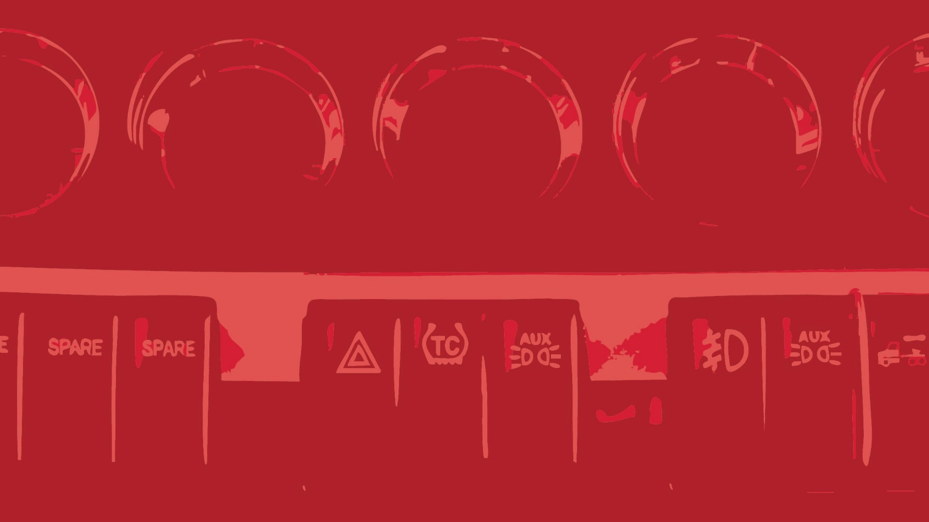
THANK YOU!
Notes:
Understanding the basics gives you confidence to handle small problems before they become big ones. Thanks for learning today!

