Slide 1



Student-Athlete Leader Training
Greater Frisco FCA

Slide 2

So all of us who have had that veil removed can see and reflect the glory of the Lord. And the Lord—who is the Spirit—makes us more and more like him as we are changed into his glorious image. ‭‭
2 Corinthians‬ ‭3‬:‭18‬ ‭NLT‬‬
Notes:
4

Slide 3
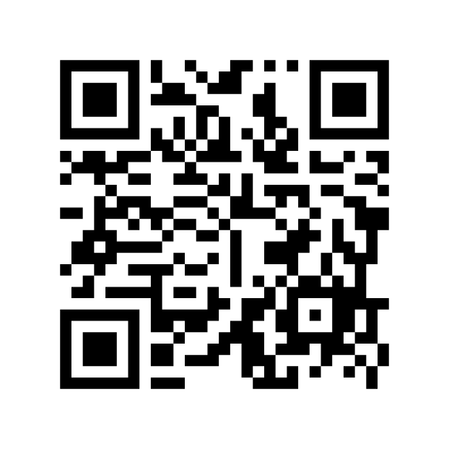
Student- Athlete Leader Information
Notes:
5

Slide 4
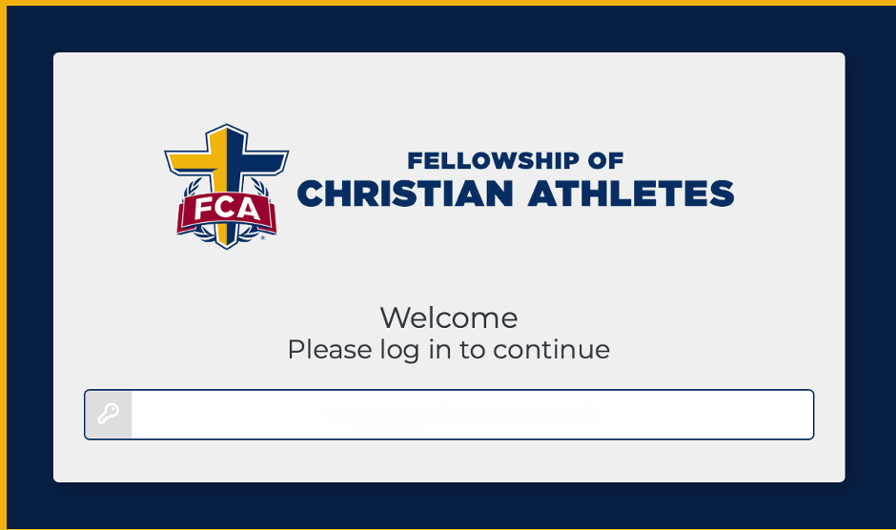
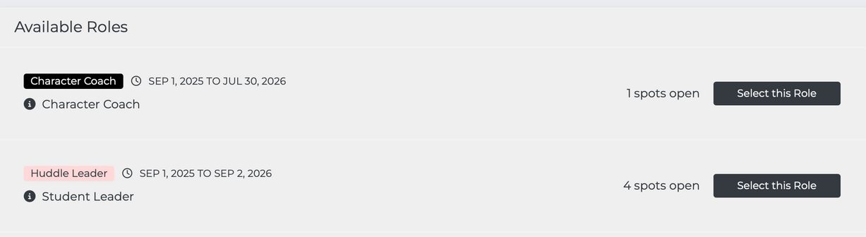

Create VIP account
•Check email for link
•Apply for your Student Leader Role
•Create account
•Parent consent
•Personal info
•References with emails
•Community Christian Statement
•Spiritual Profile
•Waivers

Slide 5


Upcoming Events​
  October 22, 2025 Fields of Faith
  March 28, 2026 Day of Champions
  June TBD, FCA Golf Tournament
Notes:
6

Slide 6

What is FCA?
Vision:
To see the world transformed by Jesus Christ through the influence of coaches and athletes. ​
Notes:
9

Slide 7
What is FCA?
Mission:
To lead every coach and athlete into a growing relationship with Jesus Christ and His church.
Notes:
9

Slide 8
What is FCA?
Values:
Integrity | Serving | Teamwork | Excellence​
Notes:
9

Slide 9

Strategy
DISCIPLE:
Someone who is in a growing relationship with Jesus Christ and His church.
Notes:
9

Slide 10

Notes:
12

Slide 11
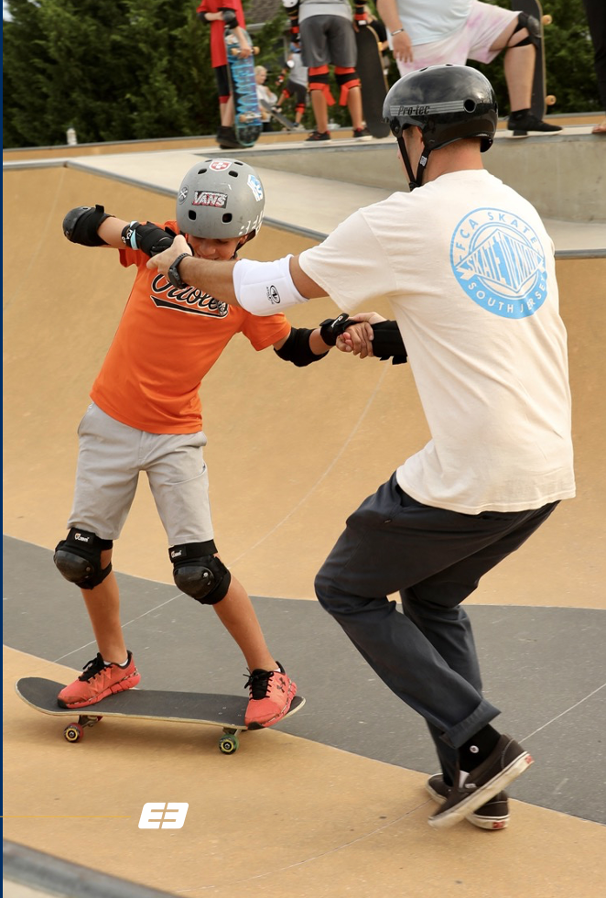
ENGAGE
1.Engage God First
2.Engage the Heart
3.Engage with the Gospel
4.Engage to Multiply

Slide 12

Notes:
13

Slide 13
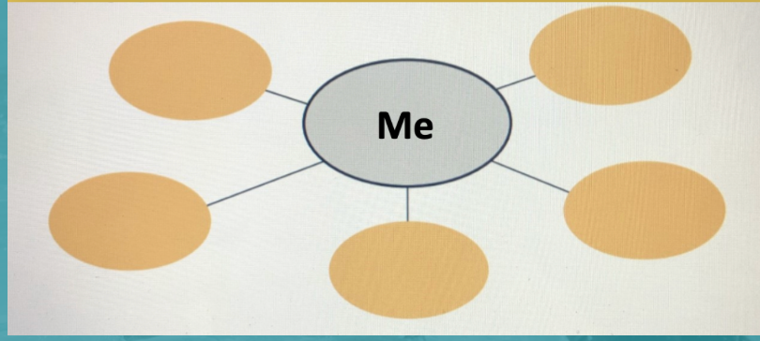

ENGAGE TO MULTIPLY
E3 MAP – page 30 ​E3 Playbook
In the diagram, write your name in the middle circle. In the outer circles, write the names of five people who are close to you relationally but far from God. Then, begin to pray for these people regularly and find ways to Engage them with the Gospel.
Notes:
15

Slide 14

Notes:
13

Slide 15

Equip
1.Equip with Prayer
2.Equip with Scripture
3.Equip with Community
4.Equip with a Clear Plan

Slide 16
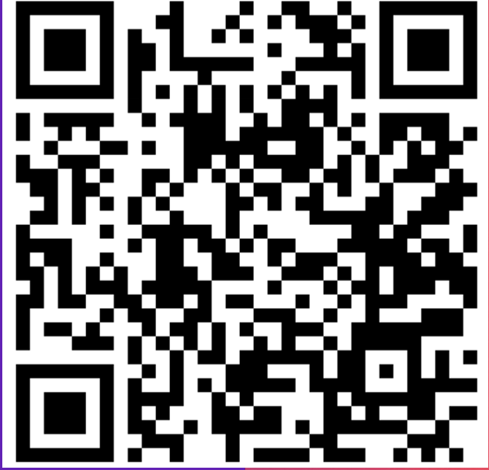
DAILY IMPACT​

Slide 17
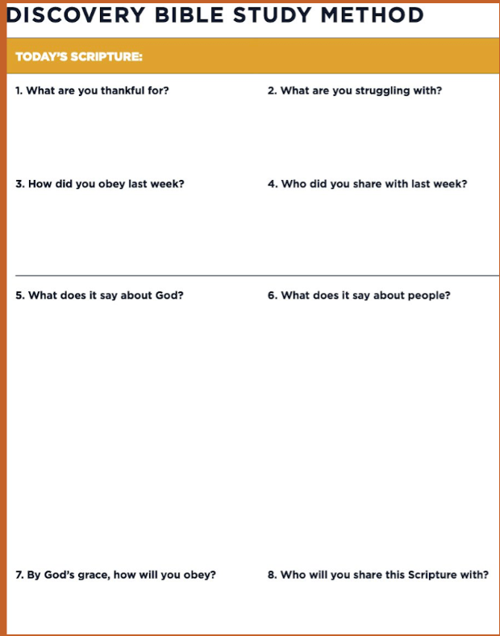

So all of us who have had that veil removed can see and reflect the glory of the Lord. And the Lord—who is the Spirit—makes us more and more like him as we are changed into his glorious image.
2 Corinthians 3:18

Slide 18


Slide 19
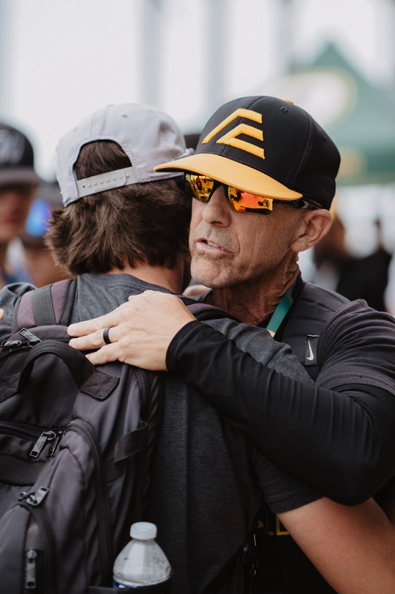
Empower
1.Empower by Modeling
2.Empower by Assisting
3.Empower by Watching
4.Empower by Launching

Slide 20
Guidelines to your Meetings​​

Slide 21



Which one represents your meetings?​

Slide 22

Remember The 4 Ws​
resources.fca.org
  Welcome​
  Warmup​
  Workout​
  Wrap-up​

Slide 23
WELCOME
Before
  Set the Tone
  Snacks
  Music Playing
  Connection
During
  Welcome
  Greeting
  Prayer

Slide 24

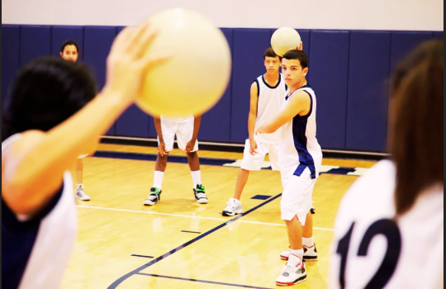
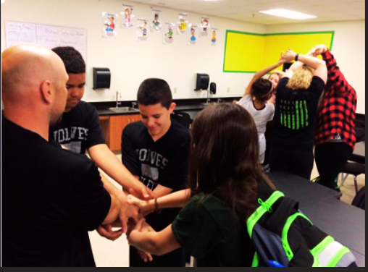
Warm
Up
  Game​
  Skit​
  Video

Slide 25


Workout
  The Four​
  The Core​
  Bible Study in Small Groups​ “DBS”
  Student Speaks​
  Student Testimony​
  Coach Speaks​
  Guest Speaker (1x-2x monthly)​
  Rap ​
  Drama​
  Worship​

Slide 26

WRAP
UP
  Recap​
  Challenge (DBS)​
  Upcoming Events​
  Close in Prayer

Slide 27



Don’t Forget!
RESOURCES
E3 Playbook – Discovery Bible Study Training / Method / Studies​
resources.fca.org​
fcaglory.org
fca.org/resources​
fca.org/virtual​
The Four​
The Core​
pursuegod.org​
PROMOTE MEETINGS
  Posters
  Social Media
  Announcements

Slide 28
Contact Us
Weldon Swann​
wswann@fca.org​
Grace Turk​
gturk@fca.org​
Kip Bledsoe​
kbledsoe@fca.org
Website:​
greaterfriscofca.org
Instagram:​
@greaterfriscofca​
Facebook:​
Greater Frisco FCA​

