Slide 1

Arsenal Colorado
Competitive U11 Orientation

Slide 2


Register Online for AGT / Tryout
Returning Arsenal Players:
Log into Playmetrics app and click on registration button
New to Arsenal Players:
Click on registration link on home page www.soccerfortcollins.org
Create account in Playmetrics (or add players to existing account)
Complete registration steps

Slide 3
Tradition
Established in 1978
United Soccer Coaches Club Standards Advanced Assessment Member
Nationally recognized for best practices
Continuously recognized as a Premier Club in Colorado and Region IV

Slide 4
Excellence
College Placement
(120 players in the last 10 years!)
Championship Teams
36 State Cup Champions
39 Far West Regional Appearances
4 Region IV Finalists
3 Region IV Champions
4 National Championship Appearances
3 National Finalists
4 Presidents Cup Champions
1 Presidents Cup National Champion
Arsenal Colorado Excitement
Projecting 67 competitive teams for 2026/27 Seasonal Year
Notes:
Are all these numbers correct?

Slide 5
Arsenal Colorado Foundations
Player & Coaching Development
Consistent with national standards of US Soccer, US Youth Soccer and USC
Competition Platforms
Colorado Soccer Association (CSA)
Elite Clubs National League – Regional League (ECNL RL) (U13-U19)
Pre-ECNL (U11-U12)
US Youth N1 (U13-U19)
Notes:
Are all these numbers correct?

Slide 6










Partnerships
Notes:
Are all these numbers correct?

Slide 7
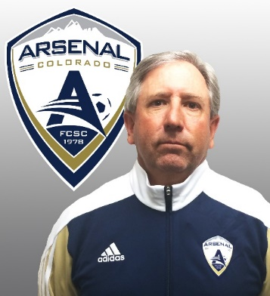
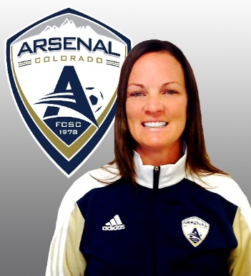
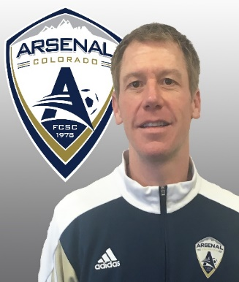
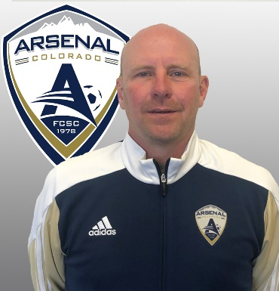
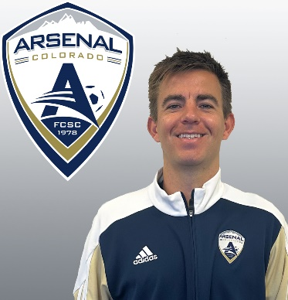
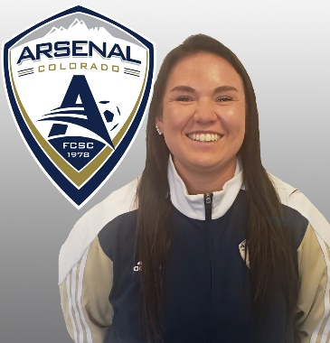
Coaching Staff
Dave Shaffer
Technical Director
Academy Director
Jayme Beamer
Director of Coaching
U13-U19 Girls Competitive
Peter Nash
Director of Coaching
U13-U19 Boys Competitive
Trey Harrington
Director of Goalkeeping
Collin Audley
Director of Coaching
U11 – U12 Boys and Girls Competitive
Mary Casson
Director of Coaching
U5 – U10 Boys and Girls Rec/PDL
Notes:
Are all these numbers correct?

Slide 8

Dave Shaffer
Technical Director/Academy Director
USSF “A” License
USC Advanced National Diploma
40 years of coaching experience
30 years at Arsenal Colorado
20 year member of CSA League Operations Committee
Member of the Colorado Soccer Association Hall of Fame
Notes:
Are all these numbers correct?

Slide 9
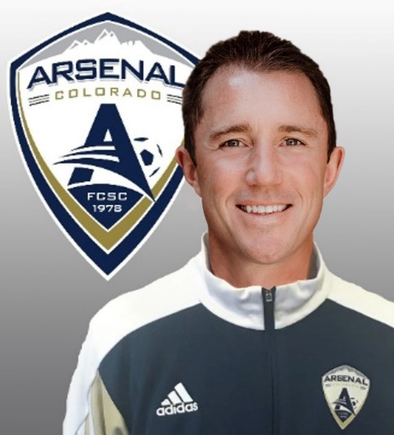
Phil Cooper
Director of Coaching, U11-U12 Boys & Girls Competitive
USC Premier Diploma
St. Gregory University, D-I
Colorado Girls ODP Assistant Coach `99
2 State Cup Championship
1 President’s Cup Championship
17 years coaching in Fort Collins
Notes:
Are all these numbers correct?

Slide 10

Peter Nash
Director of Coaching, U13 – U19 Boys Competitive
USSF “A” License
USC Advanced National Diploma
4 years Women’s Assistant - University of Richmond (D-1)
5 Year ECNL Coach – (U13-U15 + U23) Richmond United (VA)
U23 ECNL Champion (2015) – Richmond United (VA)
4 years Director of Coaching (U12 – U19) – Richmond Strikers (VA)
23 years collegiate, high school, and competitive coaching experience
5 years at Arsenal Colorado
Notes:
Are all these numbers correct?

Slide 11
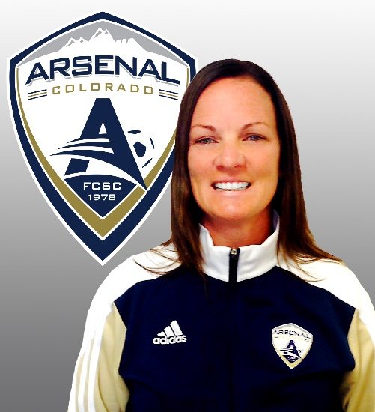
Jayme Beamer
Director of Coaching, U13 – U19 Girls Competitive
USSF “B” License
USC Director of Coaching Diploma
USC Premier Diploma
USSF Youth National License
6 year ODP Coach
95/96 US National Team Pool/H.S. All-American
George Mason University, D-I
10 years W-League veteran
18 years at Arsenal Colorado
U.S Soccer Referee Federation Certified Grade 9 Referee 2019
Notes:
Are all these numbers correct?

Slide 12
Coaching Staff
Total experience includes …
USSF A license or USC Premier Diploma 6
USSF B License or USC Advanced National 5
USSF C License or USC National Diploma 3
USSF D License or USC Regional Diploma 23
Notes:
Are all these numbers correct?

Slide 13
Player Placement Objective
Identify and group players of like ability
Benefit of grouping by ability?
Enhances player development and overall experience!
Notes:
Are all these numbers correct?

Slide 14
Structure
Multiple teams per age group
Allows for players to develop at their own unique rate based on current physical & emotional stage
Earn promotion with level of team & level of competition
Allows for players to train/play “up”
Always a higher level team and competition
Notes:
Are all these numbers correct?

Slide 15
Player Evaluation Criteria
Technical Abilities (dribble, pass, shoot)
Tactical Awareness (decision-making)
Athleticism (speed, fitness, agility)
Psychology (attitude, competitiveness)
Notes:
Are all these numbers correct?

Slide 16
U11 AGE GROUP TRAINING
Monday, May 4th Boys: 4:30 – 6:00 Complex
Girls: 6:00 – 7:30 Complex
Tuesday, May 12th Boys: 4:30 – 6:00 Complex
Girls: 6:00 – 7:30 Complex
Part of the overall player identification and selection process
AGT’s will consist of a technical warm-up and scrimmaging
Notes:
Are all these numbers correct?

Slide 17
Player Evaluation Date
Arsenal Colorado Player Identification
Arsenal Colorado Soccer Complex
Goalkeepers May 21st U11 Boys 4:15 - 4:45 pm
Players May 21st U11 Boys 4:45 – 6:00 pm
Goalkeepers May 21st U11 Girls 5:45 - 6:15 pm
Players May 21st U11 Girls 6:15 – 7:30 pm
Notes:
Are all these numbers correct?

Slide 18
Team Placement
Coaches meet for player placement directly after Tryout session
Coaches contact their players by phone!
All player notifications will begin immediately after Tryout session
Start with Academy team work our way through all teams
Families will receive an email of their acceptance and will need to register within 24 hours
Families need to have an answer of acceptance or decline when the coach calls, please be mindful of others
One family’s delay in decision-making affects everyone!
Notes:
Are all these numbers correct?

Slide 19
League Structure
Champions League (seeded by historical data)
Premier 1, Premier 2, Premier 3
Promotion & Relegation occur between seasons
Centennial League (club placement)
Elite, Platinum, Gold, Silver, Bronze
No Promotion & Relegation - club places team each season
Notes:
Are all these numbers correct?

Slide 20
CSA State League
Year: 16 - 18 games
8/9 in the Fall and 8/9 in the Spring
Half games at home (Complex) and half away
“Away” may be anywhere in Colorado
Fall Season
Begins August 29th
Ends early November
Spring Season
Begins mid-March (you will play games over spring break)
Ends mid-May
Notes:
Are all these numbers correct?

Slide 21
Pre-ECNL
Year:
Academy & Gold teams
Boys & Girls
7 additional games over the course of the year
Tiered structure
Academy teams in Tier 1, Gold teams in Tier 2
Potential Regional and Post seasonal events
Participating clubs: Arsenal, Edge, Pride, Rapids, Real, Rush
Fall Season
4-5 games in the fall
Spring Season
2-3 games in the spring
Notes:
Are all these numbers correct?

Slide 22
Tournament Information
Most teams participate in 3 tournaments during the seasonal year (Fall/Spring)
U11 teams typically travel within Colorado for tournaments; Academy and Gold teams may travel out-of-state
Notes:
Are all these numbers correct?

Slide 23
Training Programs
Club Staff Training
Academy Style Training (AST)
Tech Nights
Weekly Goalkeeper Training
Game and Tournament Support
Coaching Development
Notes:
Are all these numbers correct?

Slide 24
Player Fees (due to team)
Exact amount: determined by the team coach and parents as part of the process of forming and approving the team’s annual financial statement. Organizational team meetings scheduled by club – early June.
Fees include: costs for practice space, equipment, clinics, tournaments, social activities, and coaches expenses.
Notes:
Are all these numbers correct?

Slide 25
Player Fees (due to team)
Fees due to the team:
Tournament Entry Fees
Team coach reimbursements
Team equipment
Social activities
PlayMetrics
Practice space
Techne subscription
Yearly AVERAGE: Academy: $500
Gold: $400
Royal - Black: $300
Notes:
Are all these numbers correct?

Slide 26
Player Fees (due to Club)
2026/27 registration fees for U11: (payment plan) (fees subject to change)
Academy $2,065 / year Gold $1,945 / year Royal, Blue, White, Black $1,565 / year
Uniforms: (team price – $250) (ordered through soccer.com) Required – 2 jerseys, 2 shorts, 2 socks, 1 training jersey Optional – warm-ups, backpack, training short
Fee and uniforms scholarship available to qualified players
In the past 5 years more than $270,000 has been awarded in scholarships
Notes:
Are all these numbers correct?

Slide 27
Player Fees (due to Club)
Fees cover…
Club Registration
Colorado Soccer Association fees
Games / referees / insurance
Training Programs
Coaches Compensation
Club Overhead
Soccer Complex field maintenance / prep
Notes:
Are all these numbers correct?

Slide 28
Arsenal Colorado
Again, the Objective of Player ID’s is to…
Allow coaches the opportunity to fully evaluate every individual …
Group players based on like-ability..
Players achieve maximum development!
Notes:
Are all these numbers correct?

Slide 29
2026/27 U11 Coaching Staff
Boys Girls
Academy Kris Banghart Mary Casson
Gold Andy Ross TBD
Royal Neil Johnson Jenny Kehl
Blue TBD Stephen Gomez
White Charles Trodick Nick Weitenberner
Black TBD TBD
Red TBD TBD
Notes:
Are all these numbers correct?

Slide 30
Arsenal Contacts
Dave Shaffer, Technical Director shaffer@soccerfortcollins.org
Collin Audley, U11-U12 Boys & Girls Director audley@soccerfortcollins.org
Jayme ‘Beamer’ Halsey, U13-U19 Girls Director beamer@soccerfortcollins.org
Peter Nash, U13-U19 Boys Director nash@soccerfortcollins.org
Mary Casson, U5-U10 B & G Rec/PDL Director casson@soccerfortcollins.org
Trey Harrington, Goalkeeping Director Harrington@soccerfortcollins.org
Brenda Hampson, Director of Member Services office@soccerfortcollins.org
Notes:
Are all these numbers correct?

Slide 31
Arsenal Colorado
Thank you for the privilege of working with your children and welcome to our FAMILY!
Notes:
Are all these numbers correct?

