Slide 1




Preparing
for the Future
WHAT YOU NEED TO KNOW BEFORE HIGH SCHOOL

Slide 2
WHEN I GROW UP...

Slide 3







CONVERSATION STARTERS AT HOME
CAREER EXPLORATION
THINK ABOUT:
WHAT DO THEY ENJOY DOING? WHAT ARE THEY GOOD AT?
CAREERS COME IN MANY FIELDS: HEALTHCARE, TECHNOLOGY,
EDUCATION, ARTS, ETC.
HOW COLLEGE HELPS THEM GET TO THEIR DREAM JOB.

Slide 4



WHY THINK ABOUT COLLEGE NOW?
  COLLEGE OPENS DOORS TO MORE CAREER OPPORTUNITIES.
  HIGHER EDUCATION OFTEN (BUT NOT ALWAYS) LEADS TO BETTER EARNING POTENTIAL.
  STARTING EARLY HELPS YOU EXPLORE YOUR
  INTERESTS AND SET GOALS.

Slide 5






WHAT IS COLLEGE?
A PLACE WHERE YOU LEARN SPECIALIZED SKILLS FOR A CAREER.
DIFFERENT TYPES OF COLLEGES:
COMMUNITY COLLEGES (2 YEARS)
UNIVERSITIES (4 YEARS OR MORE)
TRADE SCHOOLS (SPECIALIZED SKILLS)

Slide 7





WHAT IS THE
ACT?
A STANDARDIZED TEST USED FOR COLLEGE ADMISSIONS.
MEASURES SKILLS IN ENGLISH, MATH, AND READING (SCIENCE and WRITING are now OPTIONAL.)
HELPS COLLEGES SEE HOW READY YOU ARE FOR THEIR PROGRAMS.

Slide 8


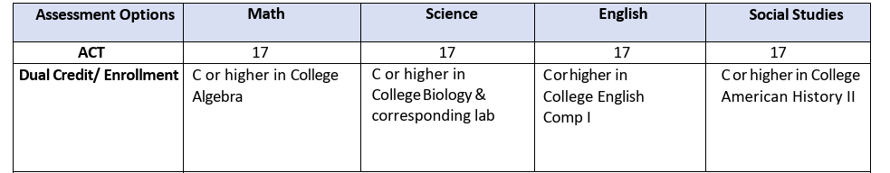
WHY THE ACT MATTERS
  CAN IMPACT COLLEGE ADMISSIONS.
  SCHOLARSHIPS MAY DEPEND ON YOUR ACT SCORE.
  A GOOD SCORE CAN OPEN MORE OPPORTUNITIES
  CAN BE SUBSTITUTED FOR STATE TEST GRADES
STUDENT ATHLETES: WHILE NCAA CHANGED RULES TO REQUIRE SUBMISSION OF THE ACT, STUDENT ATHLETES ARE STILL REQUIRED TO MEET THEIR CHOICE SCHOOL’S ACT REQUIREMENTS AND REQUIREMENT CAN BE ADDED BACK IN AT ANY TIME.

Slide 9

STATE TEST SCORES
DETERMINE COURSE
PLACEMENTS IN HIGH SCHOOL
ACT TEST SCORES
DETERMINE COURSE
PLACEMENTS IN COLLEGE

Slide 10
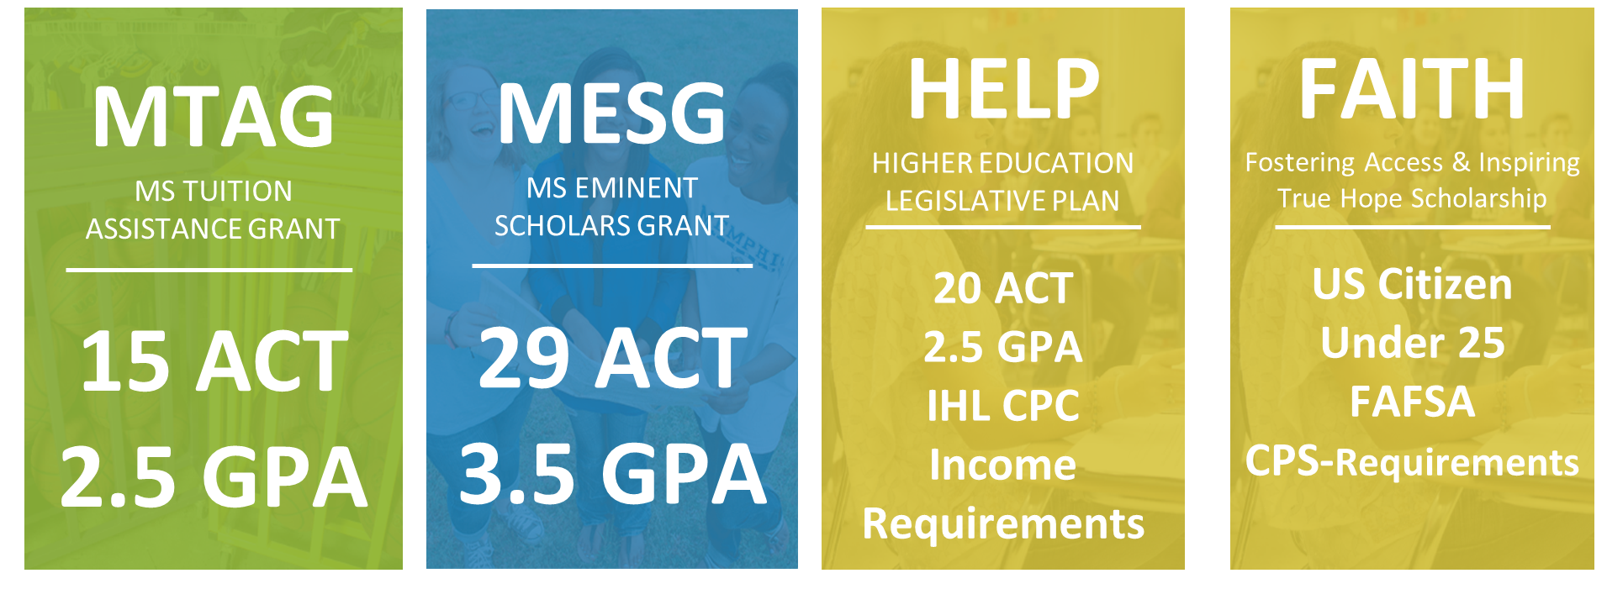
ACT FINANCIAL AID
MTAG--UP TO $500 PER ACADEMIC YEAR FOR FRESHMEN AND SOPHOMORES AND $1,000 PER ACADEMIC YEAR FOR JUNIORS AND SENIORS
MESG--MESG AWARDS UP TO $2,500 PER ACADEMIC YEAR
HELP--TUITION AND REQUIRED FEES AT A PUBLIC INSTITUTION

Slide 11



ACT SCHOLARSHIPS
DEAN’S AWARD:
ACT COMPOSITE SCORE 20 -23,
ONE-HALF OF THE TUITION PER SEMESTER.
PRESIDENT’S AWARD:
ACT COMPOSITE SCORE BETWEEN 24 -28
FULL TUITION COVERAGE PER SEMESTER.
BOARD OF TRUSTEES AWARD:
ACT COMPOSITE SCORE BETWEEN 29 -36 FULL SCHOLARSHIP COVERING TUITION, ROOM, AND BOARD PER SEMESTER.
  ACT SCORE: 21-24
UP TO $3500/YR based on GPA
  ACT Score: 25-29
UP TO $5000/YR based on GPA
  ACT Score: 30-32
UP TO $8000 BASED ON GPA
  ACT Score: 33-36
UP TO $10,500/YR based on gpa
STUDENTS WITH A 34+ ACT/SAT EQUIVALENT SCORE WILL RECEIVE A ONE-YEAR SCHOLARSHIP FOR ON-CAMPUS HOUSING VALUED AT THE COST OF THEIR PORTION OF A DOUBLE OCCUPANCY ROOM
PRESIDENTIAL ACADEMIC SCHOLARSHIP:
GPA OF 3.5 AND AN ACT 32+
FULL TUITION, ROOM AND BOARD
PROVOST ACADEMIC SCHOLARSHIP:
GPA OF 3.25 AND AN ACT 25+
TUITION ONLY.

Slide 13
PREPARING FOR THE ACT
  FOCUS ON CORE SUBJECTS (ENGLISH, MATH, READING).
  TAKE PRACTICE TESTS TO BECOME FAMILIAR WITH THE FORMAT.
  DEVELOP GOOD STUDY HABITS NOW.

Slide 14

ACT TEST TIPS
  TEST EARLY AND TEST OFTEN!
  LEARN TO MASTER TIME-MANAGEMENT (SPACE OF THE DAY)
  LEARN THE FORMAT OF THE TEST
  PROCESS OF ELIMINATION
  PRACTICE MAKES PERFECT!

Slide 15
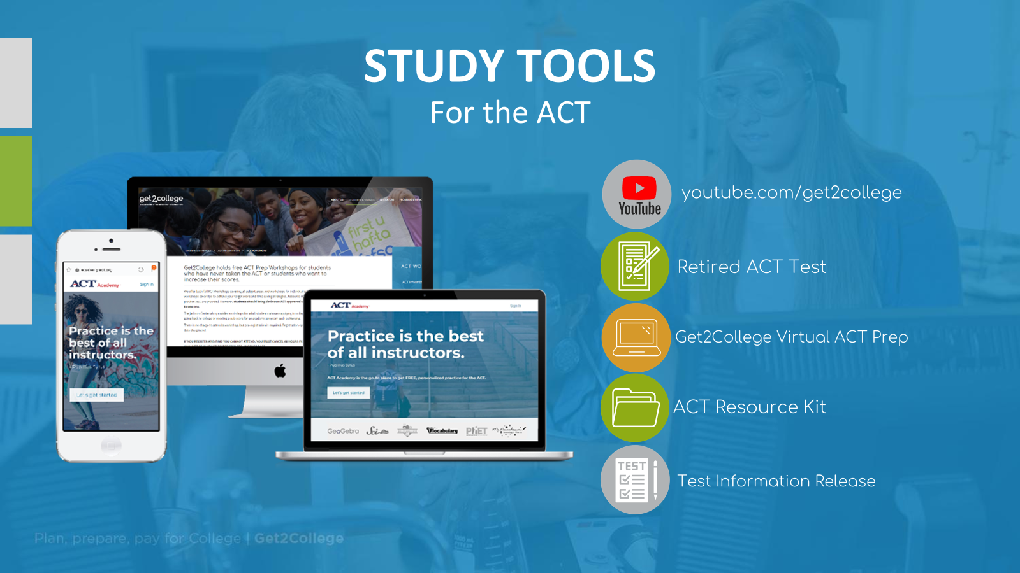

Slide 16
BALANCING COLLEGE PREP AND FUN
COLLEGE IS NOT ALL ABOUT ACADEMICS—GET INVOLVED IN:
  SPORTS
  CLUBS
  VOLUNTEERING
THESE EXPERIENCES HELP BUILD YOUR SKILLS AND COLLEGE APPLICATIONS.

Slide 17
SETTING GOALS NOW
CREATE SHORT-TERM GOALS
(E.G. STATE TESTS, IMPROVING GRADES).
THINK ABOUT LONG-TERM GOALS
(E.G., EXPLORING COLLEGES).
TALK TO YOUR SCHOOL COUNSELOR ABOUT YOUR
PLANS.

Slide 18
  KEEP YOUR GRADES UP.
  EXPLORE YOUR INTERESTS THROUGH HOBBIES AND CLASSES.
  TALK TO YOUR FAMILY AND TEACHERS ABOUT YOUR GOALS.
  RESEARCH COLLEGES AND CAREERS THAT EXCITE YOU.
NEXT
STEPS
STUDENTS

Slide 19
  ENCOURAGE STRONG STUDY HABITS & TIME MANAGEMENT
  EXPLORE CAREER & COLLEGE READINESS EARLY
  DEVELOP LIFE SKILLS & RESPONSIBILITY
FINANCIAL LITERACY
DECISION MAKING
PROBLEM-SOLVING
COMMUNICATION SKILLS
NEXT
STEPS
PARENTS

Slide 20
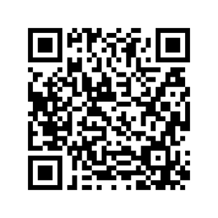
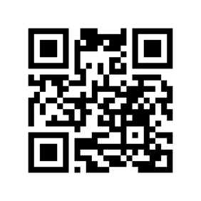
Thank You
ACT.ORG
GET2COLLEGE

