Slide 1
The Liturgical Year
How did you do? Are you a millionaire ?
In the next few minutes, I would like to familiarize you with the handout on your table.
I hope this will help you see the big picture of how the Liturgical Year can help you keep Christ as your (one and only) King.

Slide 2
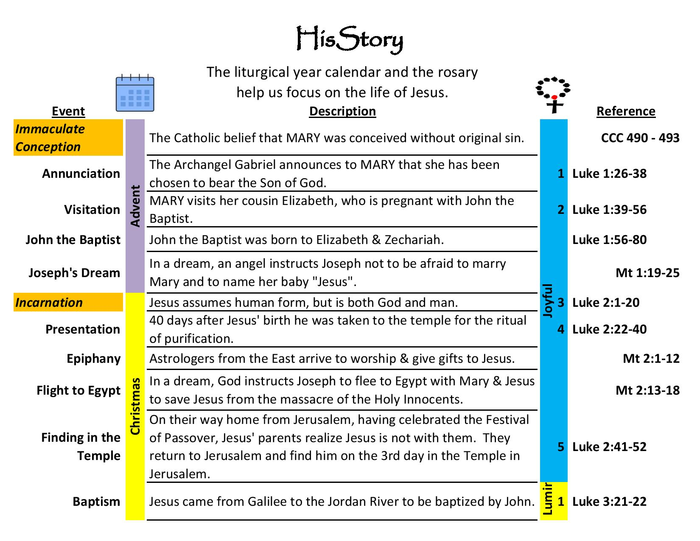

Slide 12
Christ the King
If Christ is truly the King of our Life, then the rhythm of the liturgical year and the rosary should be the heartbeat of our daily life.
We welcome the calendar & repetition. It helps us focus on the different aspects of Jesus’ life which will help us transform our lives and become closer to God.

