Slide 1
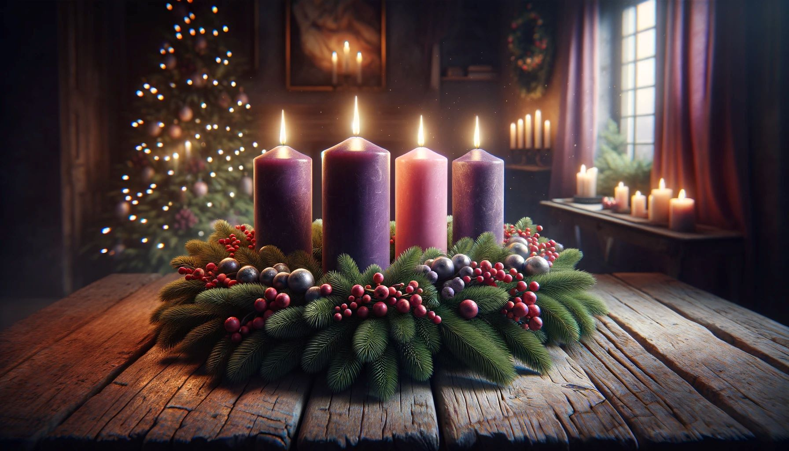
Intergenerational Advent and Christmas
St. Cecilia
Faith Formation

Slide 2




St Cecilia Edition

Slide 3
St Cecilia Edition
$ 500
Believers are required to fast
The Jessie Tree is used in both seasons
The The seasons of Advent and Lent are similar because:similar because
Fasting is required
Jessie Tree is used in
both seasons
A:
B:
Vestments are green except for 1 Sunday
Reflection is encouraged
C:
D:

Slide 4
St Cecilia Edition
$ 500
The seasons of Advent and Lent are similar because:
is FF
Fasting is required
Jessie Tree in used in
both seasons
A:
B:
Vestments are purple except for 2 Sundays
Reflection is encouraged
C:
D:

Slide 5
14
13
12
11
10
9
8
7
6
5
4
3
2
1
$ 1 MILLION
$ 500,000
$ 250,000
$ 100,000
$ 50,000
$ 30,000
$ 20,000
$ 10,000
$ 7,000
$ 5,000
$ 3,000
$ 2,000
$ 1,000
$ 500

Slide 6
St Cecilia Edition
$ 1000
Which liturgical color is most commonly used during Advent?Which liturgical color is most commonly used during Advent?
Green
White
A:
B:
Purple
Red
C:
D:

Slide 7
St Cecilia Edition
$ 1000
Which liturgical color is most commonly used during Advent?
Green
White
A:
B:
Purple
Red
C:
D:

Slide 8
14
13
12
11
10
9
8
7
6
5
4
3
2
1
$ 1 MILLION
$ 500,000
$ 250,000
$ 100,000
$ 50,000
$ 30,000
$ 20,000
$ 10,000
$ 7,000
$ 5,000
$ 3,000
$ 2,000
$ 1,000
$ 500

Slide 9
St Cecilia Edition
$ 2000
Who told Mary and Joseph to go to Bethlehem?
An angel
A dream
A:
B:
Gabrial, the Archangel
Caesar Augustus
C:
D:

Slide 10
$ 2000
Who told Mary and Joseph to go to Bethlehem?
An angel
A dream
A:
B:
Gabrial, the Archangel
Caesar Augustus
C:
D:

Slide 11
14
13
12
11
10
9
8
7
6
5
4
3
2
1
$ 1 MILLION
$ 500,000
$ 250,000
$ 100,000
$ 50,000
$ 30,000
$ 20,000
$ 10,000
$ 7,000
$ 5,000
$ 3,000
$ 2,000
$ 1,000
$ 500

Slide 12
St Cecilia Edition
$ 3000
The optional fifth candle in the center of the Advent wreath is …
Rose
Green
A:
B:
Purple
White
C:
D:

Slide 13
St Cecilia Edition
$ 3000
The optional fifth candle in the center of the Advent wreath is…….
Rose
Green
A:
B:
Purple
White
C:
D:

Slide 14
14
13
12
11
10
9
8
7
6
5
4
3
2
1
$ 1 MILLION
$ 500,000
$ 250,000
$ 100,000
$ 50,000
$ 30,000
$ 20,000
$ 10,000
$ 7,000
$ 5,000
$ 3,000
$ 2,000
$ 1,000
$ 500

Slide 15
St Cecilia Edition
$ 5000
What is the name of the third Sunday of Advent?
Laetare Sunday
Rejoice Sunday
A:
B:
Gaudete Sunday
Emmanuel Sunday
C:
D:

Slide 16
St Cecilia Edition
$ 5000
What is the name of the third Sunday of Advent?
Laetare Sunday
Rejoice Sunday
A:
B:
Gaudete Sunday
Emmanuel Sunday
C:
D:

Slide 17
14
13
12
11
10
9
8
7
6
5
4
3
2
1
$ 1 MILLION
$ 500,000
$ 250,000
$ 100,000
$ 50,000
$ 30,000
$ 20,000
$ 10,000
$ 7,000
$ 5,000
$ 3,000
$ 2,000
$ 1,000
$ 500

Slide 18
St Cecilia Edition
$ 7000
What does the Advent wreath symbolize?
Eternal life
The four Gospels
A:
B:
The Holy Trinity
God’s never ending love
C:
D:

Slide 19
St Cecilia Edition
$ 7000
What does the Advent wreath symbolize?
Eternal life
The four Gospels
A:
B:
The Holy Trinity
God’s never ending love
C:
D:

Slide 20
14
13
12
11
10
9
8
7
6
5
4
3
2
1
$ 1 MILLION
$ 500,000
$ 250,000
$ 100,000
$ 50,000
$ 30,000
$ 20,000
$ 10,000
$ 7,000
$ 5,000
$ 3,000
$ 2,000
$ 1,000
$ 500

Slide 21
St Cecilia Edition
$ 10,000
Which prophet foretold the coming of the Messiah and is often read during Advent?
Ezekiel
Daniel
A:
B:
Isaiah
Jeremiah
C:
D:

Slide 22
St Cecilia Edition
$ 10,000
Which prophet foretold the coming of the Messiah and is often read during Advent?
Ezekiel
Daniel
A:
B:
Isaiah
Jeremiah
C:
D:

Slide 23
14
13
12
11
10
9
8
7
6
5
4
3
2
1
$ 1 MILLION
$ 500,000
$ 250,000
$ 100,000
$ 50,000
$ 30,000
$ 20,000
$ 10,000
$ 7,000
$ 5,000
$ 3,000
$ 2,000
$ 1,000
$ 500

Slide 24
St Cecilia Edition
$ 20,000
Which of the following are omitted during the Sunday Mass in Advent?
The Prayer of the Faithful
The Alleluia before the Gospel
A:
B:
The Gloria after the Penitential Act
The second hymn following Communion
C:
D:

Slide 25
St Cecilia Edition
$ 20,000
Which of the following are omitted during the Sunday Mass in Advent?
The Prayer of the Faithful
The Alleluia before the Gospel
A:
B:
The Gloria after the Penitential Act.
The second hymn following Communion
C:
D:

Slide 26
14
13
12
11
10
9
8
7
6
5
4
3
2
1
$ 1 MILLION
$ 500,000
$ 250,000
$ 100,000
$ 50,000
$ 30,000
$ 20,000
$ 10,000
$ 7,000
$ 5,000
$ 3,000
$ 2,000
$ 1,000
$ 500

Slide 27
St Cecilia Edition
$ 30,000
Which of the following saints have their feast day during Advent?
Saint Ambrose
Saint Nicholas
A:
B:
Saint John of the Cross
Saint Pope John Paul II
C:
D:

Slide 28
St Cecilia Edition
$ 30,000
Which of the following saints have their feast day during Advent?
Saint Ambrose
Saint Nicholas
A:
B:
Saint John of the Cross
Saint Pope John Paul II
C:
D:

Slide 29
14
13
12
11
10
9
8
7
6
5
4
3
2
1
$ 1 MILLION
$ 500,000
$ 250,000
$ 100,000
$ 50,000
$ 30,000
$ 20,000
$ 10,000
$ 7,000
$ 5,000
$ 3,000
$ 2,000
$ 1,000
$ 500

Slide 30
St Cecilia Edition
$ 50,000
How many Magi were there?
3
4
A:
B:
7
Who knows?
C:
D:

Slide 31
St Cecilia Edition
$ 50,000
How many Magi were there?
3
4
A:
B:
7
Who knows?
C:
D:

Slide 32
14
13
12
11
10
9
8
7
6
5
4
3
2
1
$ 1 MILLION
$ 500,000
$ 250,000
$ 100,000
$ 50,000
$ 30,000
$ 20,000
$ 10,000
$ 7,000
$ 5,000
$ 3,000
$ 2,000
$ 1,000
$ 500

Slide 33
St Cecilia Edition
$ 100,000
Which of the following scripture readings is presented during every Advent season regardless of biblical cycle?
The Baptism of Jesus
The Visitation between Mary and Elizabeth
A:
B:
Joseph‘s dream to take Mary into his home as his wife
The genealogy Jesus
C:
D:

Slide 34
St Cecilia Edition
$ 100,000
Which of the following scripture readings is presented during every Advent season regardless of biblical cycle?
The Baptism of Jesus
The Visitation between Mary and Elizabeth
A:
B:
Joseph’s dream to take Mary into his home as his wife
The genealogy of Jesus
C:
D:

Slide 35
14
13
12
11
10
9
8
7
6
5
4
3
2
1
$ 1 MILLION
$ 500,000
$ 250,000
$ 100,000
$ 50,000
$ 30,000
$ 20,000
$ 10,000
$ 7,000
$ 5,000
$ 3,000
$ 2,000
$ 1,000
$ 500

Slide 36
St Cecilia Edition
$ 250,000
In the song “The 12 Days of Christmas” the first day of “A Partridge in a Pear Tree” refers to the Catholic Doctrine of:
Commandments
Jesus
A:
B:
Trinity
Bible
C:
D:

Slide 37
St Cecilia Edition
$ 250,000
In the song “The 12 Days of Christmas” the first day of “Apartridge in a Pear Tree” refers to the Catholic Doctrine of:
Commandments
Jesus
A:
B:
Trinity
Bible
C:
D:

Slide 38
14
13
12
11
10
9
8
7
6
5
4
3
2
1
$ 1 MILLION
$ 500,000
$ 250,000
$ 100,000
$ 50,000
$ 30,000
$ 20,000
$ 10,000
$ 7,000
$ 5,000
$ 3,000
$ 2,000
$ 1,000
$ 500

Slide 39
St Cecilia Edition
$ 500,000
Which feast often marks the beginning of Advent?
Feast of St. Andrew
Feast of the Immaculate Conception
A:
B:
Feast of Christ the King
Feast Epiphany
C:
D:

Slide 40
St Cecilia Edition
$ 500,000
Which feast often marks the beginning of Advent?
Feast of St. Andrew
Feast of the Immaculate Conception
A:
B:
Feast of Christ the King
Feast of the Epiphany
C:
D:

Slide 41
14
13
12
11
10
9
8
7
6
5
4
3
2
1
$ 1 MILLION
$ 500,000
$ 250,000
$ 100,000
$ 50,000
$ 30,000
$ 20,000
$ 10,000
$ 7,000
$ 5,000
$ 3,000
$ 2,000
$ 1,000
$ 500

Slide 42
St Cecilia Edition
$ 1 MILLION
How long does the Christmas season last in the Catholic Church ?
8 days
12 days
A:
B:
Octave of Christmas
Until the Baptism of the Jesus
C:
D:

Slide 43
ESIL Edition
$ 1 MILLION
How long does the Christmas season last in the Catholic Church?
8 days
12 days
A:
B:
Octave of Christmas
Until the Baptism of the Jesus
C:
D:

Slide 44
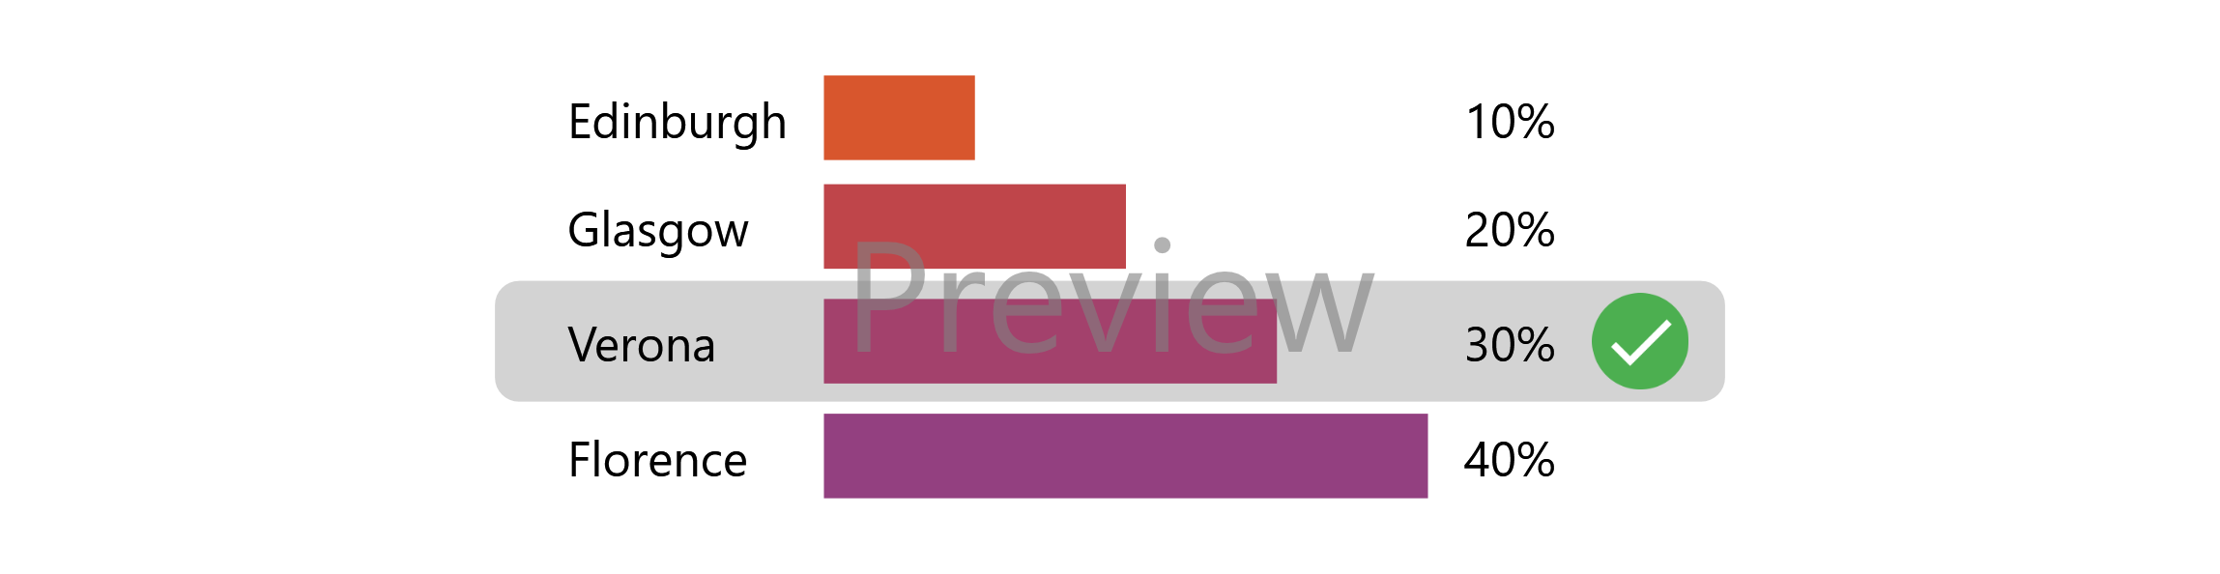
Winners?
Anyone get 12 or more correct?
Anyone get 10 or more correct?
Anyone get 8 or more correct?
Anyone get less than 4 correct?

Slide 45
Who wants to be a Millionaire– Links for Sound Download
https://millionaire.fandom.com/wiki/Music_scores
Main Theme: https://www.soundboard.com/sb/sound/904527
Wrong answer: https://www.soundboard.com/sb/sound/904547
Right answer: https://www.soundboard.com/sb/sound/904544
Call a friend: https://www.soundboard.com/sb/sound/904546
1.000.000 music: https://www.soundboard.com/sb/sound/904542
500.000 music: https://www.soundboard.com/sb/sound/904541
125.000 music: https://www.soundboard.com/sb/sound/904540
64.000 music: https://www.soundboard.com/sb/sound/904539
2.000 – 30.000 music: https://www.soundboard.com/sb/sound/904538
50 – 1000 music: https://www.soundboard.com/sb/sound/904537
Start sound: https://www.soundboard.com/sb/sound/904536

Slide 46

Just for a warm-up Solve these Emoji movies

Slide 47

Jurassic Park

Slide 48

Psycho

Slide 49

E.T.:The Extra-Terrestrial

Slide 50
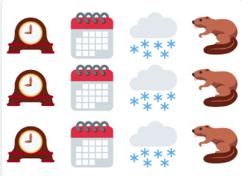
Groundhog Day

Slide 51

Cast Away

Slide 52
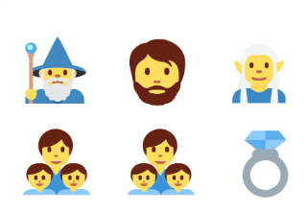
The Lord of the Rings: The Fellowship of the Ring

Slide 53

The Hangover

Slide 54

Madagascar

Slide 55
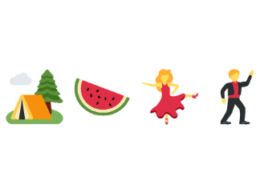
Dirty Dancing

Slide 56

Forest Gump

