Slide 1

VIENNA YOUTH SOCCER
Annual General Meeting
June 8, 2026
EST. 1975 | Celebrating 50 Years of Youth Soccer Excellence
Vienna, Virginia | Serving Fairfax County

Slide 2
Meeting Agenda
AGM | June 8, 2026
01
Call to Order
05
2025–2026 Annual Report
02
Roll Call
06
Strategic Plan 2027–2030
03
Approval of Minutes
07
Adjournment
04
2026–2027 Board of Directors
Vienna Youth Soccer | Annual General Meeting | June 8, 2026
Notes:
7:02 Call to order

Slide 3
1
Call to Order
A LIFETIME OF SOCCER - VIENNA YOUTH SOCCER

Slide 4
2
Roll Call
A LIFETIME OF SOCCER - VIENNA YOUTH SOCCER

Slide 5
Roll Call & Board Attendance
Item 2
Board of Directors
Staff Present
✓ Heather Helmstetter
✓ Nausheen Khan
✓ Kevin James
✓ Paul Dennis
✓ Melissa Burgum
✓ Oscar Leon
✓ Greg Cullison
✓ Alanna Baker
✓ Puja Tucker
✓ Jayme Van Horn
✓ Nicole Buckley
✓ Adam Coolbaugh
✓ Marshall Ramos
✓ Anand Ramana
✓ Stephen Bird
✓ Ashlie Strackbein
✓ Christina Ulen
Vienna Youth Soccer | Annual General Meeting | June 8, 2026
Notes:
Jayme Van Horn - Attended for vote on BODs
Nausheen Khan - Attended for vote on BODs
Alana Baker - After vote on slate and minutes
Derek Kung - DId not attend
25 votes for yes, approved BOD. Online votes!

Slide 6
3
Approval of Minutes
A LIFETIME OF SOCCER - VIENNA YOUTH SOCCER

Slide 7
Approval of Minutes
Item 3
BOD Meeting | June 6, 2025 (AGM Meeting - Minutes | June 6, 2025)
Vienna Youth Soccer | Annual General Meeting | June 8, 2026
Notes:
Approval of minutes - Motion Marshall second Paul - Everyone present approved

Slide 8
4
2026–2027 Board of
Directors
Election & New Member Introduction
A LIFETIME OF SOCCER - VIENNA YOUTH SOCCER

Slide 9

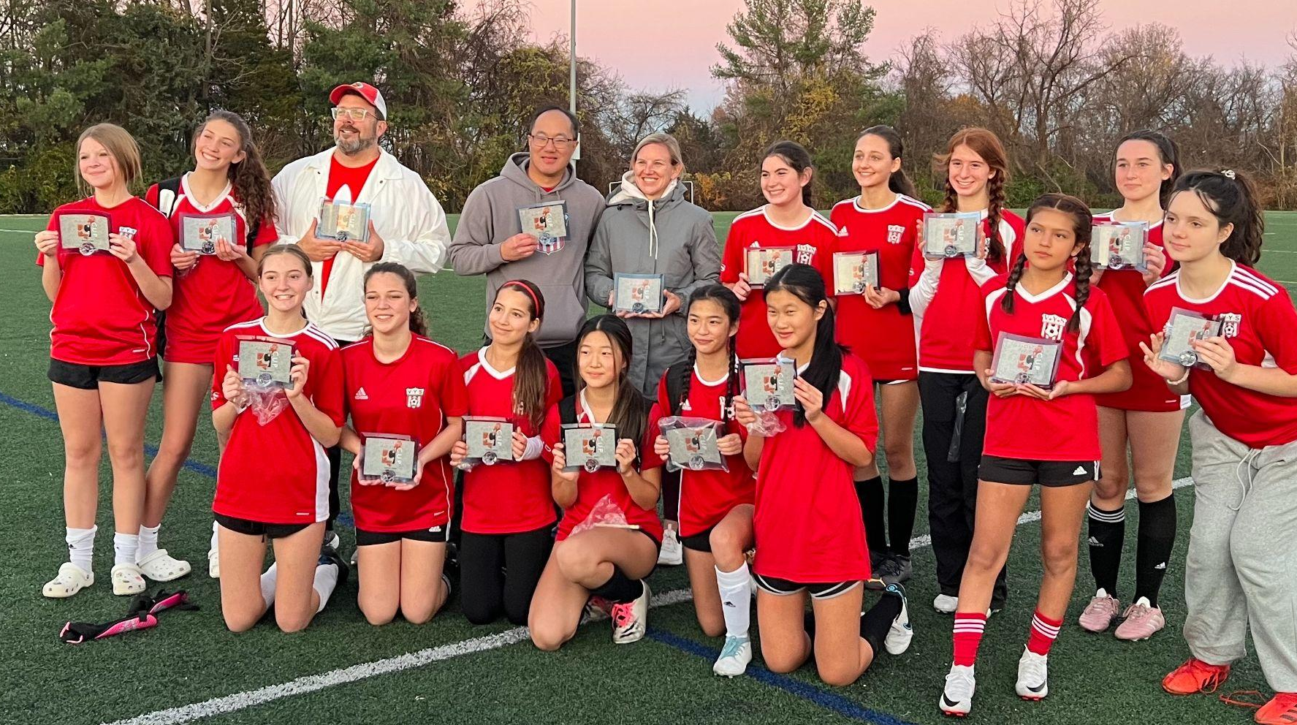


Incoming Board Member
Item 4A
Hansel Oh
At-Large Board Member – Proposed 2026–2027
Professional Experience
Brivo – Marketing Strategy
VYS Connection
VYS House Coach
Family
Daughter participates in House & Travel programs
Vienna Youth Soccer | Annual General Meeting | June 8, 2026

Slide 10
2026–2027 Proposed Board Slate
Item 4B
OFFICERS
President
Vice-President & Treasurer
Secretary
Paul Dennis
Melissa Burgum
Jayme Van Horn
AT-LARGE MEMBERS
Greg Cullison
Marshall Ramos
Ashlie Strackbein
Christina Ulen
Nausheen Khan
Nicole Buckley
Alanna Baker
Derek Kung
Anand Ramana
Hansel Oh
Vienna Youth Soccer | Annual General Meeting | June 8, 2026
Notes:
Motion to approve 26/27 Greg Cullison & Heather Helmstetter

Slide 11
5
2025–2026 Annual
Report
Club Numbers • Programs • Community • Partners
A LIFETIME OF SOCCER - VIENNA YOUTH SOCCER

Slide 12
2025–2026 | Club at a Glance
5A | Annual Report
5,569
447
392
Total Players Served
Teams
Financial Aid Scholarships
↑ 13% from 2024/25
House & Travel Programs
Awarded This Year
11
27
4
Programs Offered
FCPS/FCPR Facilities
Futsal Courts Developed
Across All Age Groups
Used Across the County
At FCPS Schools
Vienna Youth Soccer | Annual General Meeting | June 8, 2026
Notes:
KJ Report on Number of 50th years

Slide 13
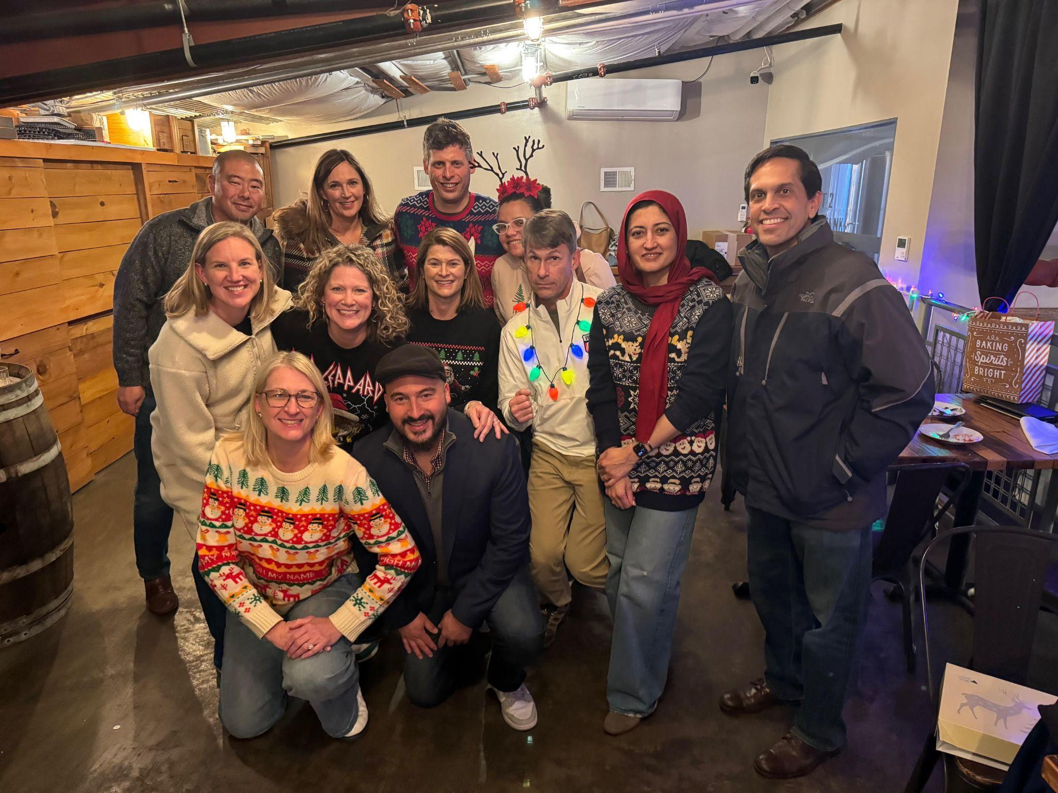
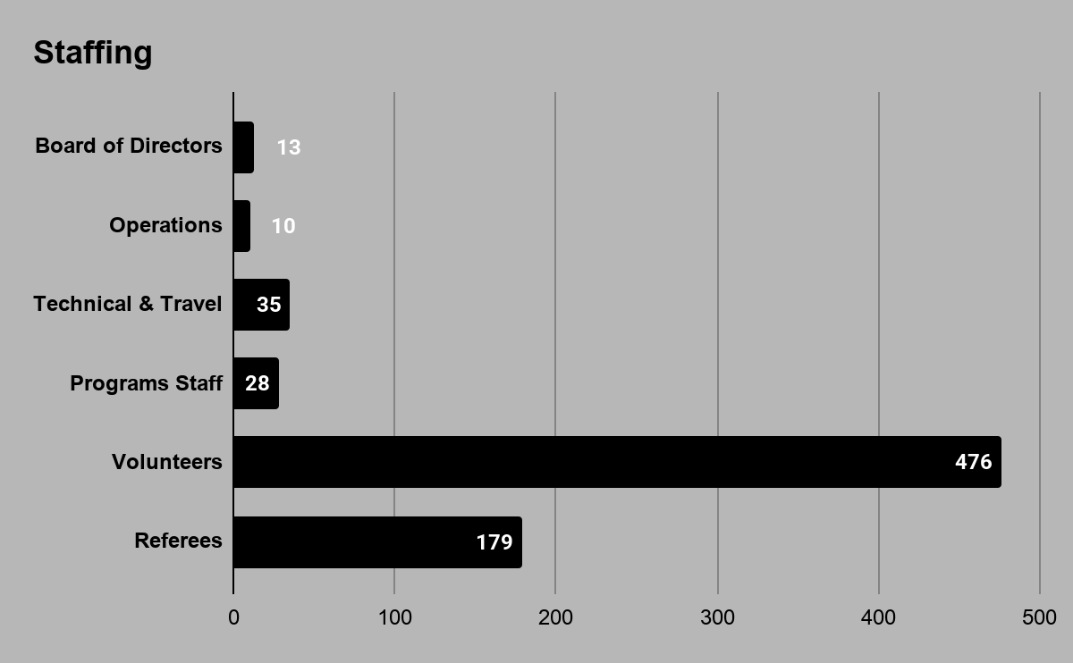
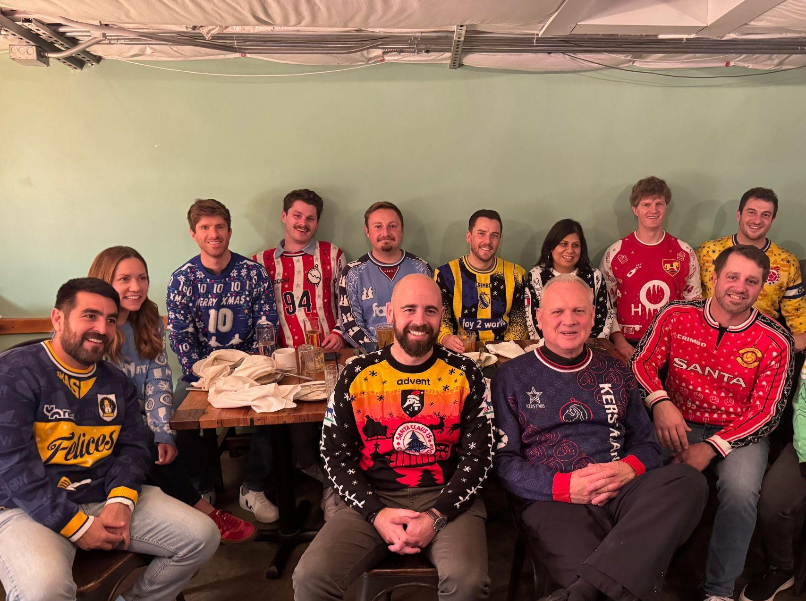
2025–2026 | Club at a Glance
5A | Annual Report
Vienna Youth Soccer | Annual General Meeting | June 8, 2026

Slide 14
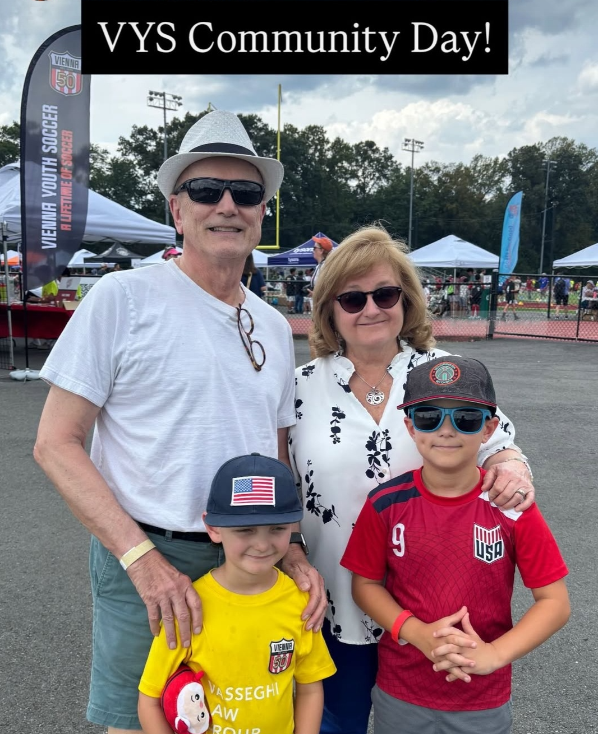


50th Year
ANNIVERSARY
EST. 1975 | Serving Fairfax County for 50 Years
Community Day
September 6, 2025 | Oakton High School
2,500+ participants · U7-U8 Games · 3v3 Tournament · Sponsor Engagement
Celebration Event
October 25, 2025 | Caboose Commons, Fairfax
Volunteer & Partner Recognition ·
Jerseys · Logo Launch
Vienna Youth Soccer | Annual General Meeting | June 8, 2026

Slide 15
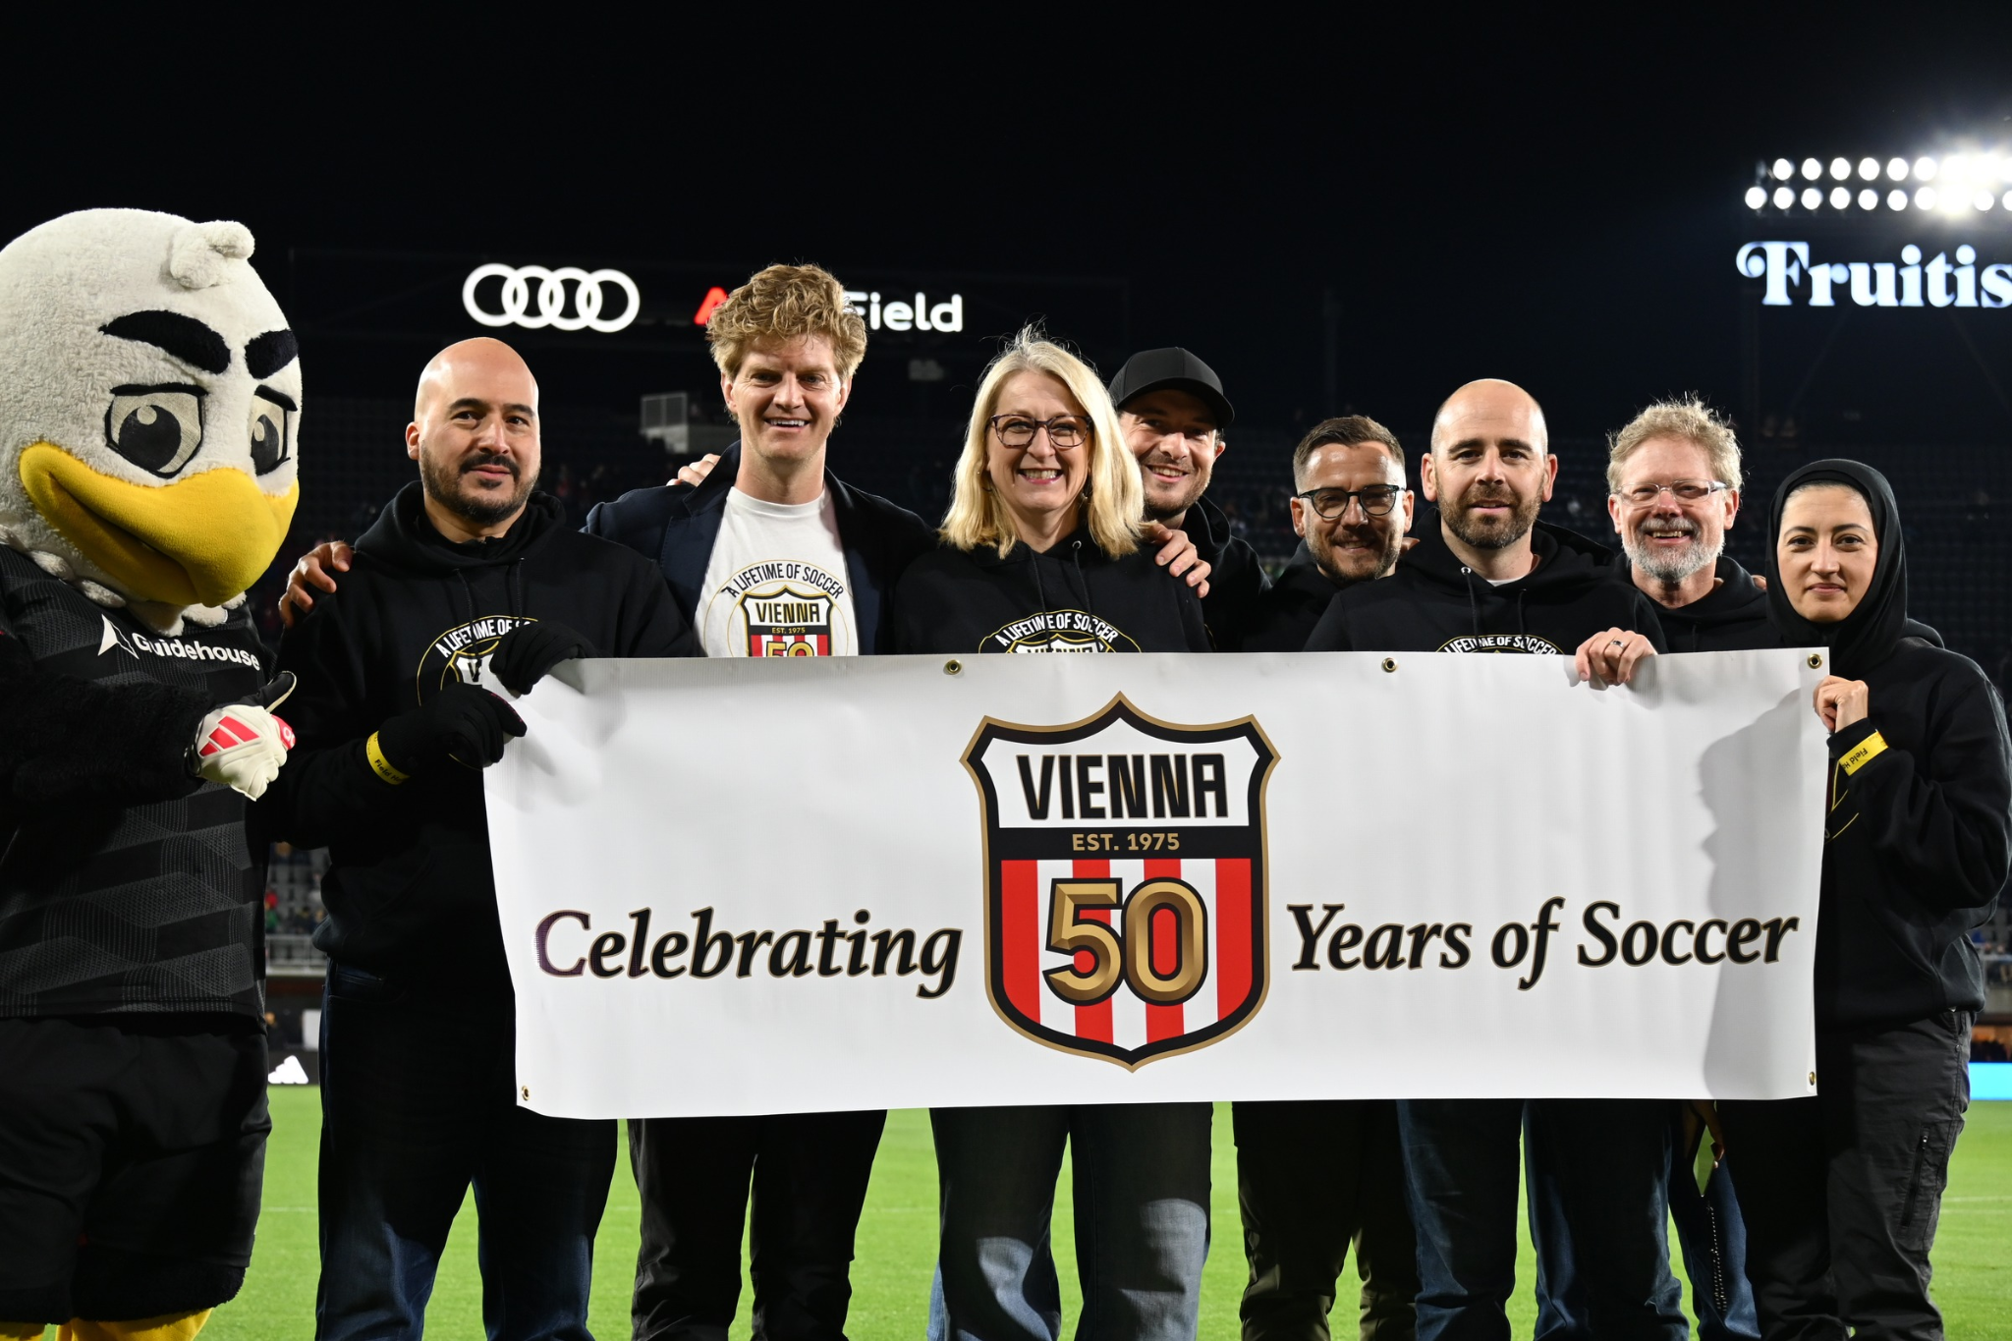
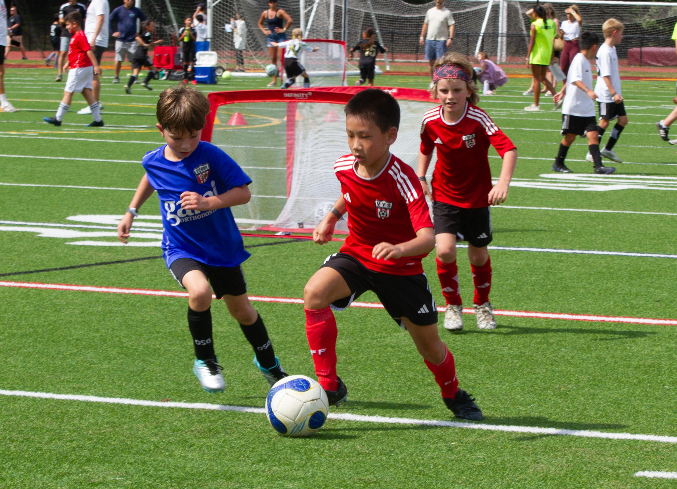
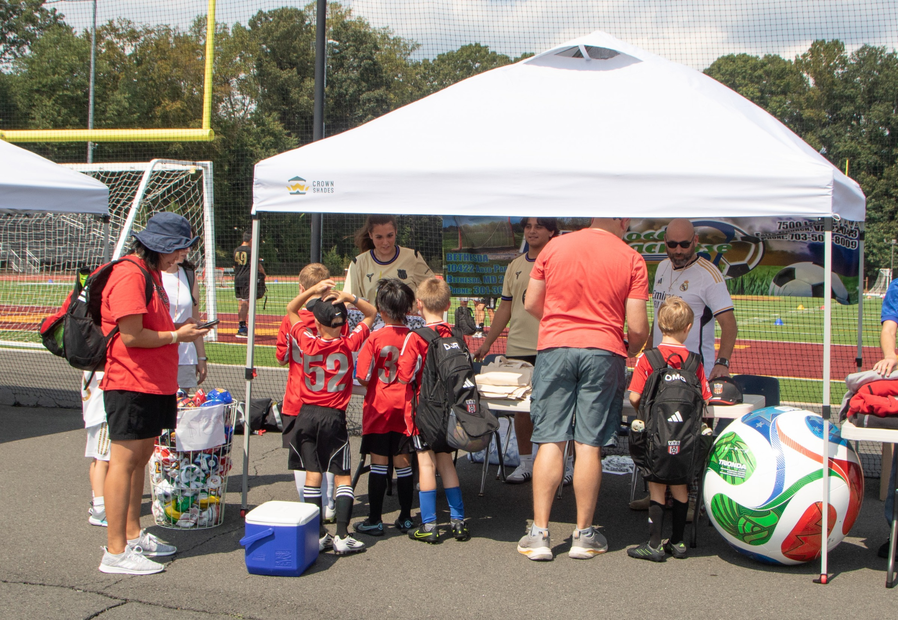
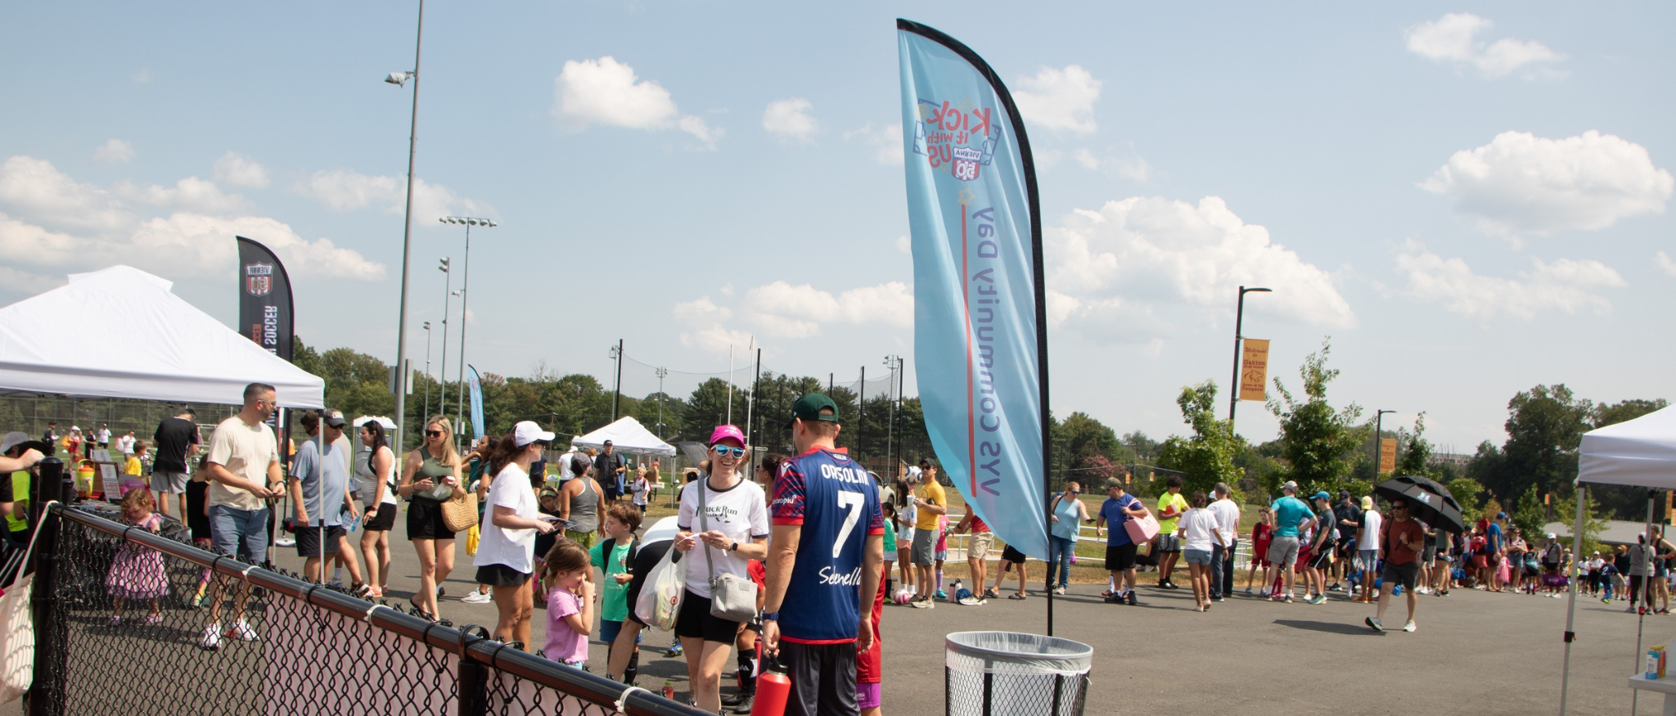
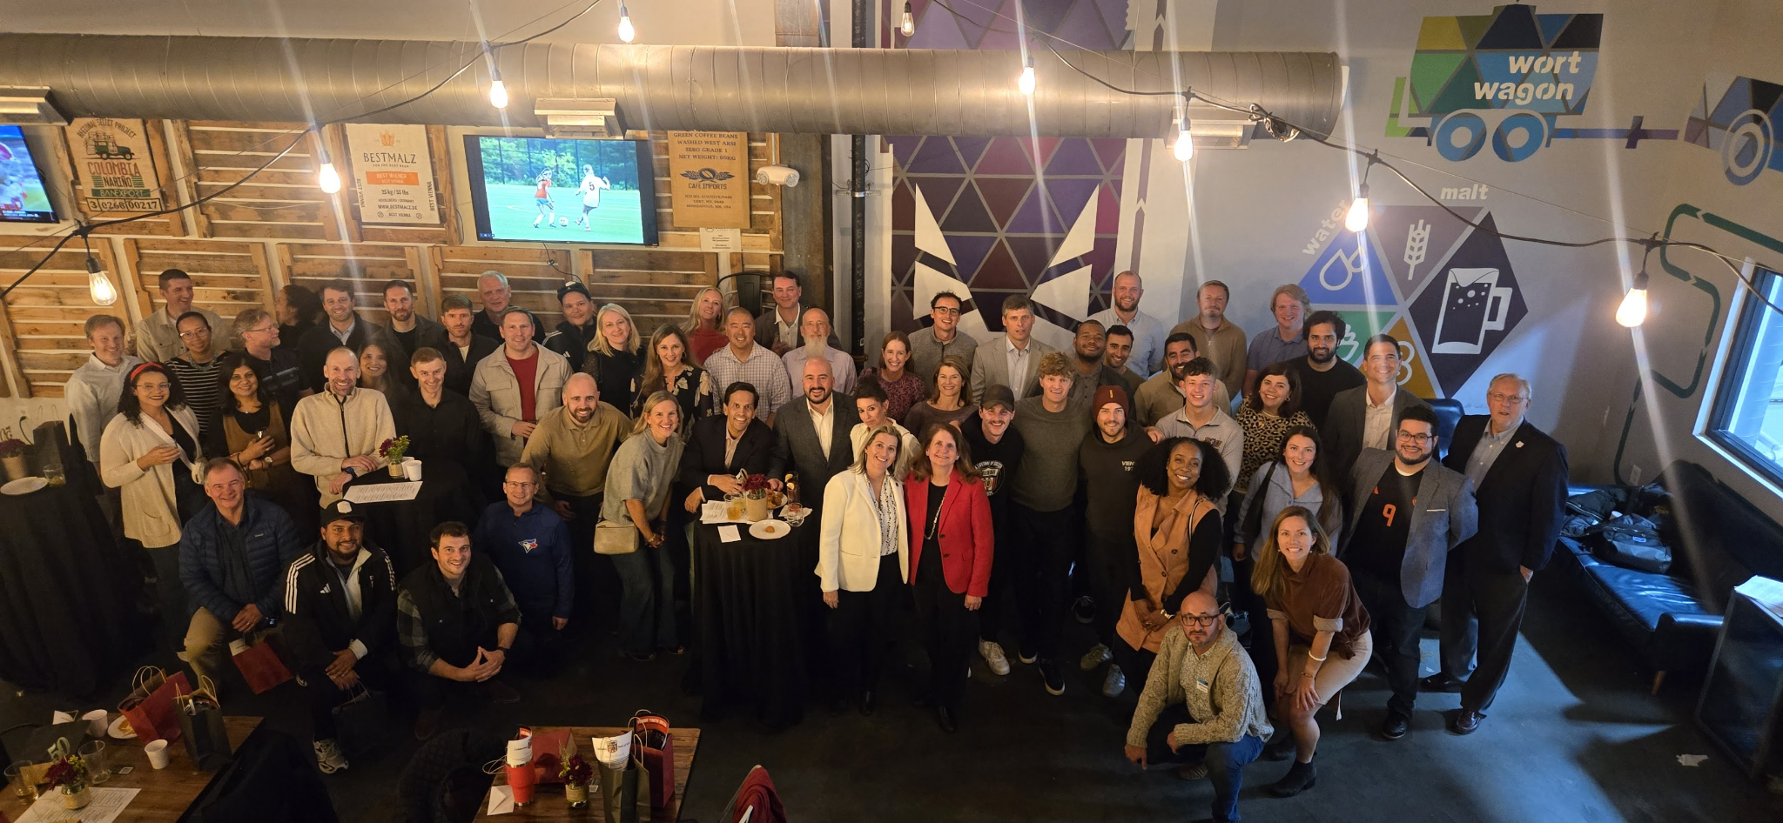
50th Anniversary Highlights
5B | Annual Report
Volunteer & Partner Recognition
📷
📷
📷
3v3 Tournament Action
Sponsor Booths
📷
📷
Community Day Opening
Celebration Even at Caboose Commons
Vienna Youth Soccer | Annual General Meeting | June 8, 2026

Slide 16




Governance & Finance
5C | Annual Report
Governance
Finance
Staff Leads
Paul Dennis · Greg Cullison · Nausheen Khan · Anand Ramana
Melissa Burgum · Alanna Baker · Derek Kung · Christina Ulen
Puja Tucker · Oscar Leon · Kevin James
KEY ACCOMPLISHMENTS
Annual review of all insurance policies completed
Financial Aid Policy updated and approved (May 2026)
Financial review and 990 completed by JM&M (Jones, Maresca & McElwaney P.A.)
New Investment Policy implemented and approved (May 2026)
Vienna Youth Soccer | Annual General Meeting | June 8, 2026

Slide 17
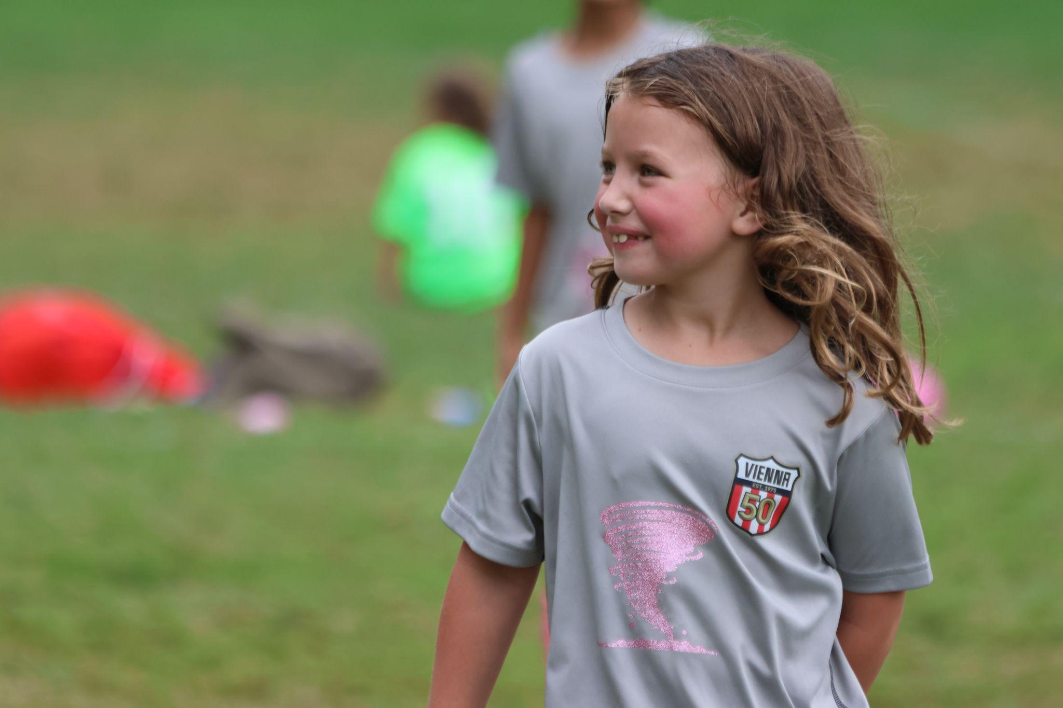
House Programs
5E | Annual Report
3,527
403
1,798
3,339
Unique House Players
House Teams
House Games Played
House Practice Hours
Referee Development
→ 50+ new referees since May 2025
→ 5 referee mentors active
→ 179 referees in MySoccerLeague platform
Coaching Education
→ 23 Grassroots Courses: 300+ coaches
→ 3 National D Courses: 57 coaches
→ National C License hosted by VYS in 26/27
Safeguarding
→ 100% Background Check completion
→ 100% SafeSport completion for active coaches
Vienna Youth Soccer | Annual General Meeting | June 8, 2026

Slide 18
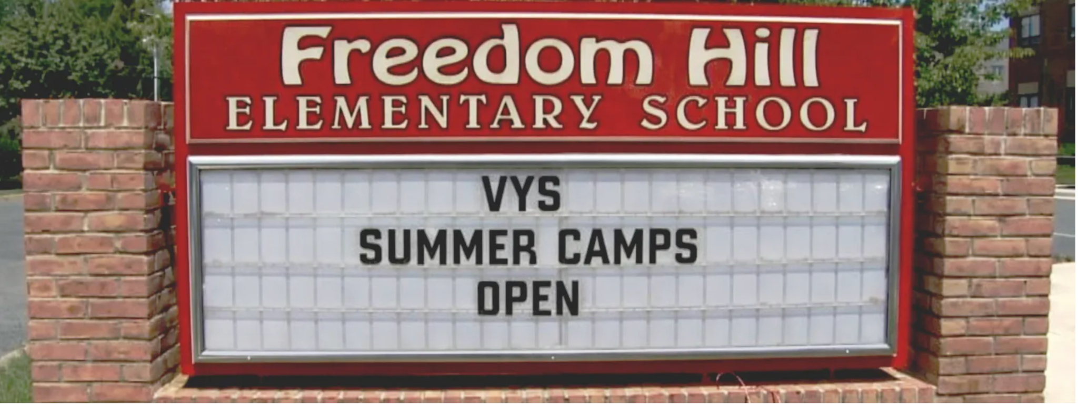
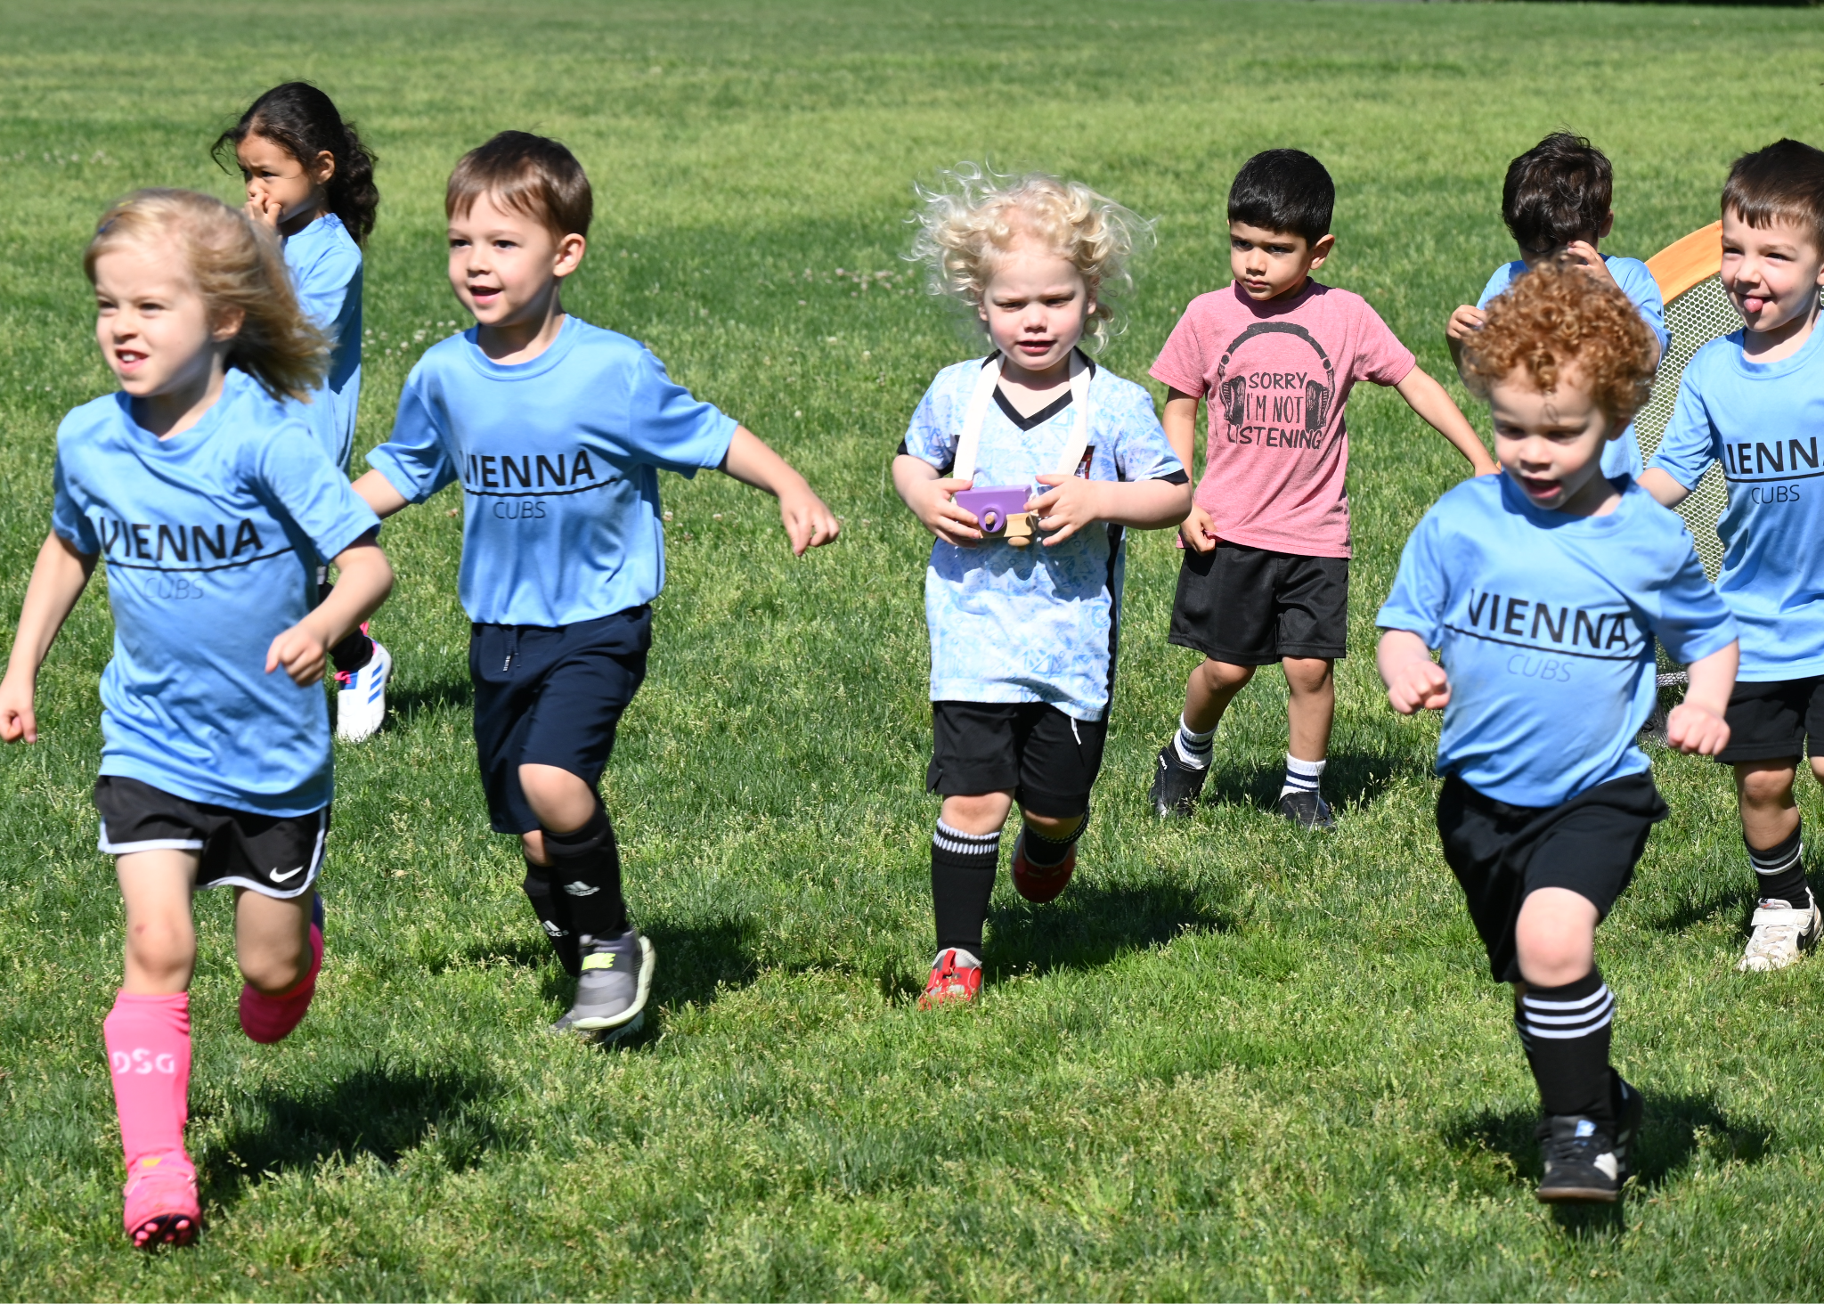
Programs — Summer Camps & U4 Cubs
5F | Annual Report
Summer Camps 2026
▸ Freedom Hill Elementary secured for 2026 camps
▸ Full gymnasium, STEM lab & 3 soccer fields
▸ Arts & Crafts + Multi-Sport in curriculum
▸ World Cup themed activities & games
▸ Extended day: early drop-off & late pick-up
U4 Cubs
U4 Cubs Program
▸ New Record of 158 players
Program Staff
▸ Program Staff: 15 of 28 staff supported summer programs/camps
U4 Cubs Program — Spring 2026
Vienna Youth Soccer | Annual General Meeting | June 8, 2026

Slide 19
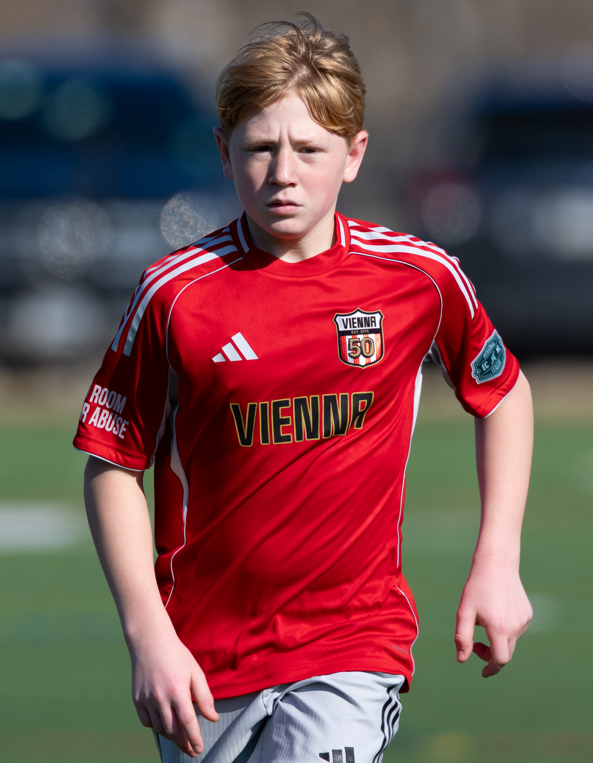

Adrian -1
Travel Program
5G | Annual Report
Travel Academy Membership 25/26
Leagues 2026/27
Girls +45%
Boys
+55%
ECNL National League | Fairfax Virginia Union
ECNL Regional League | Vienna Youth Soccer
National League 1 | Vienna Youth Soccer
NCSL | Vienna Youth Soccer
Coaching Licenses Awarded 2025/26
"No Room for Abuse" Campaign — Raising awareness of verbal & physical abuse against referees
▸ A License: Stephen Lehany · Austin Roser
▸ B License: Brady Knotts · John Ciampa
▸ C License: Kate Morford · Kevin Nobles
▸ D License: Aidan Pond · Connor Simon · Danny Navarro
▸ Coach Educator D License: Stephen Bird
▸ B In Progress: Luke Turney · Adam Coolbaugh · Jonathan Muehlke
▸ Coach Educator D License In Progress: Oscar Leon
Vienna Youth Soccer | Annual General Meeting | June 8, 2026

Slide 20
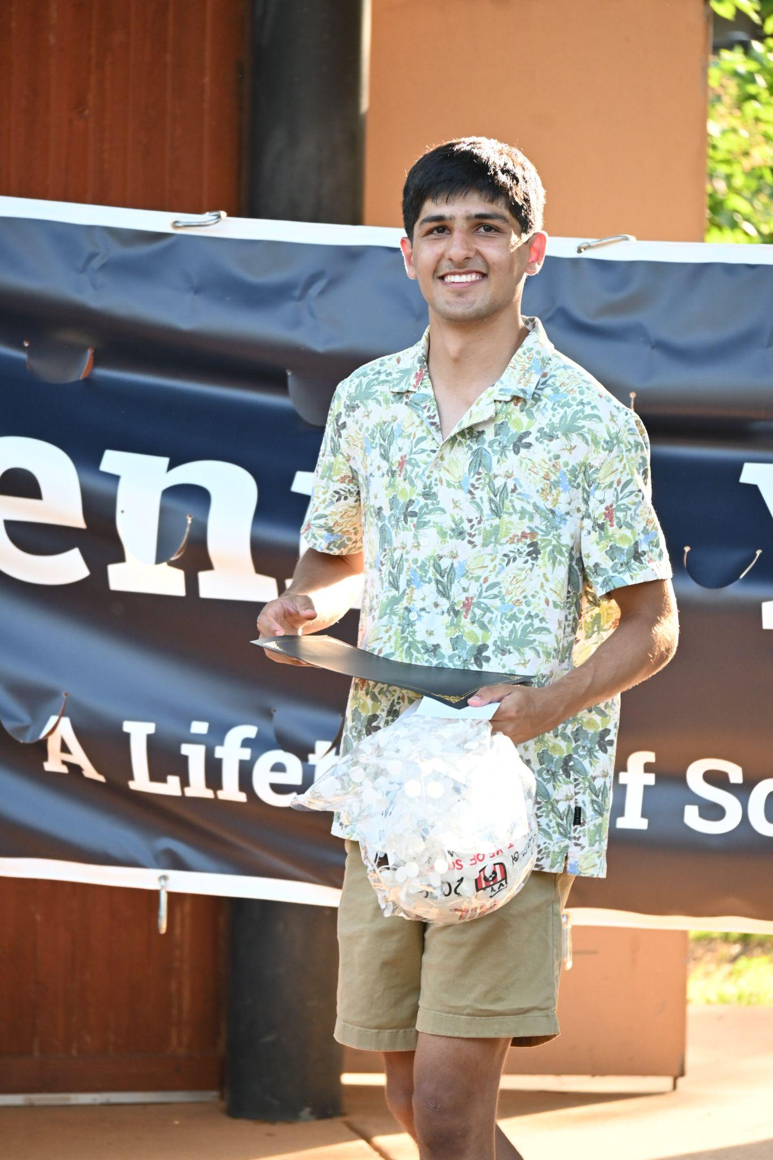
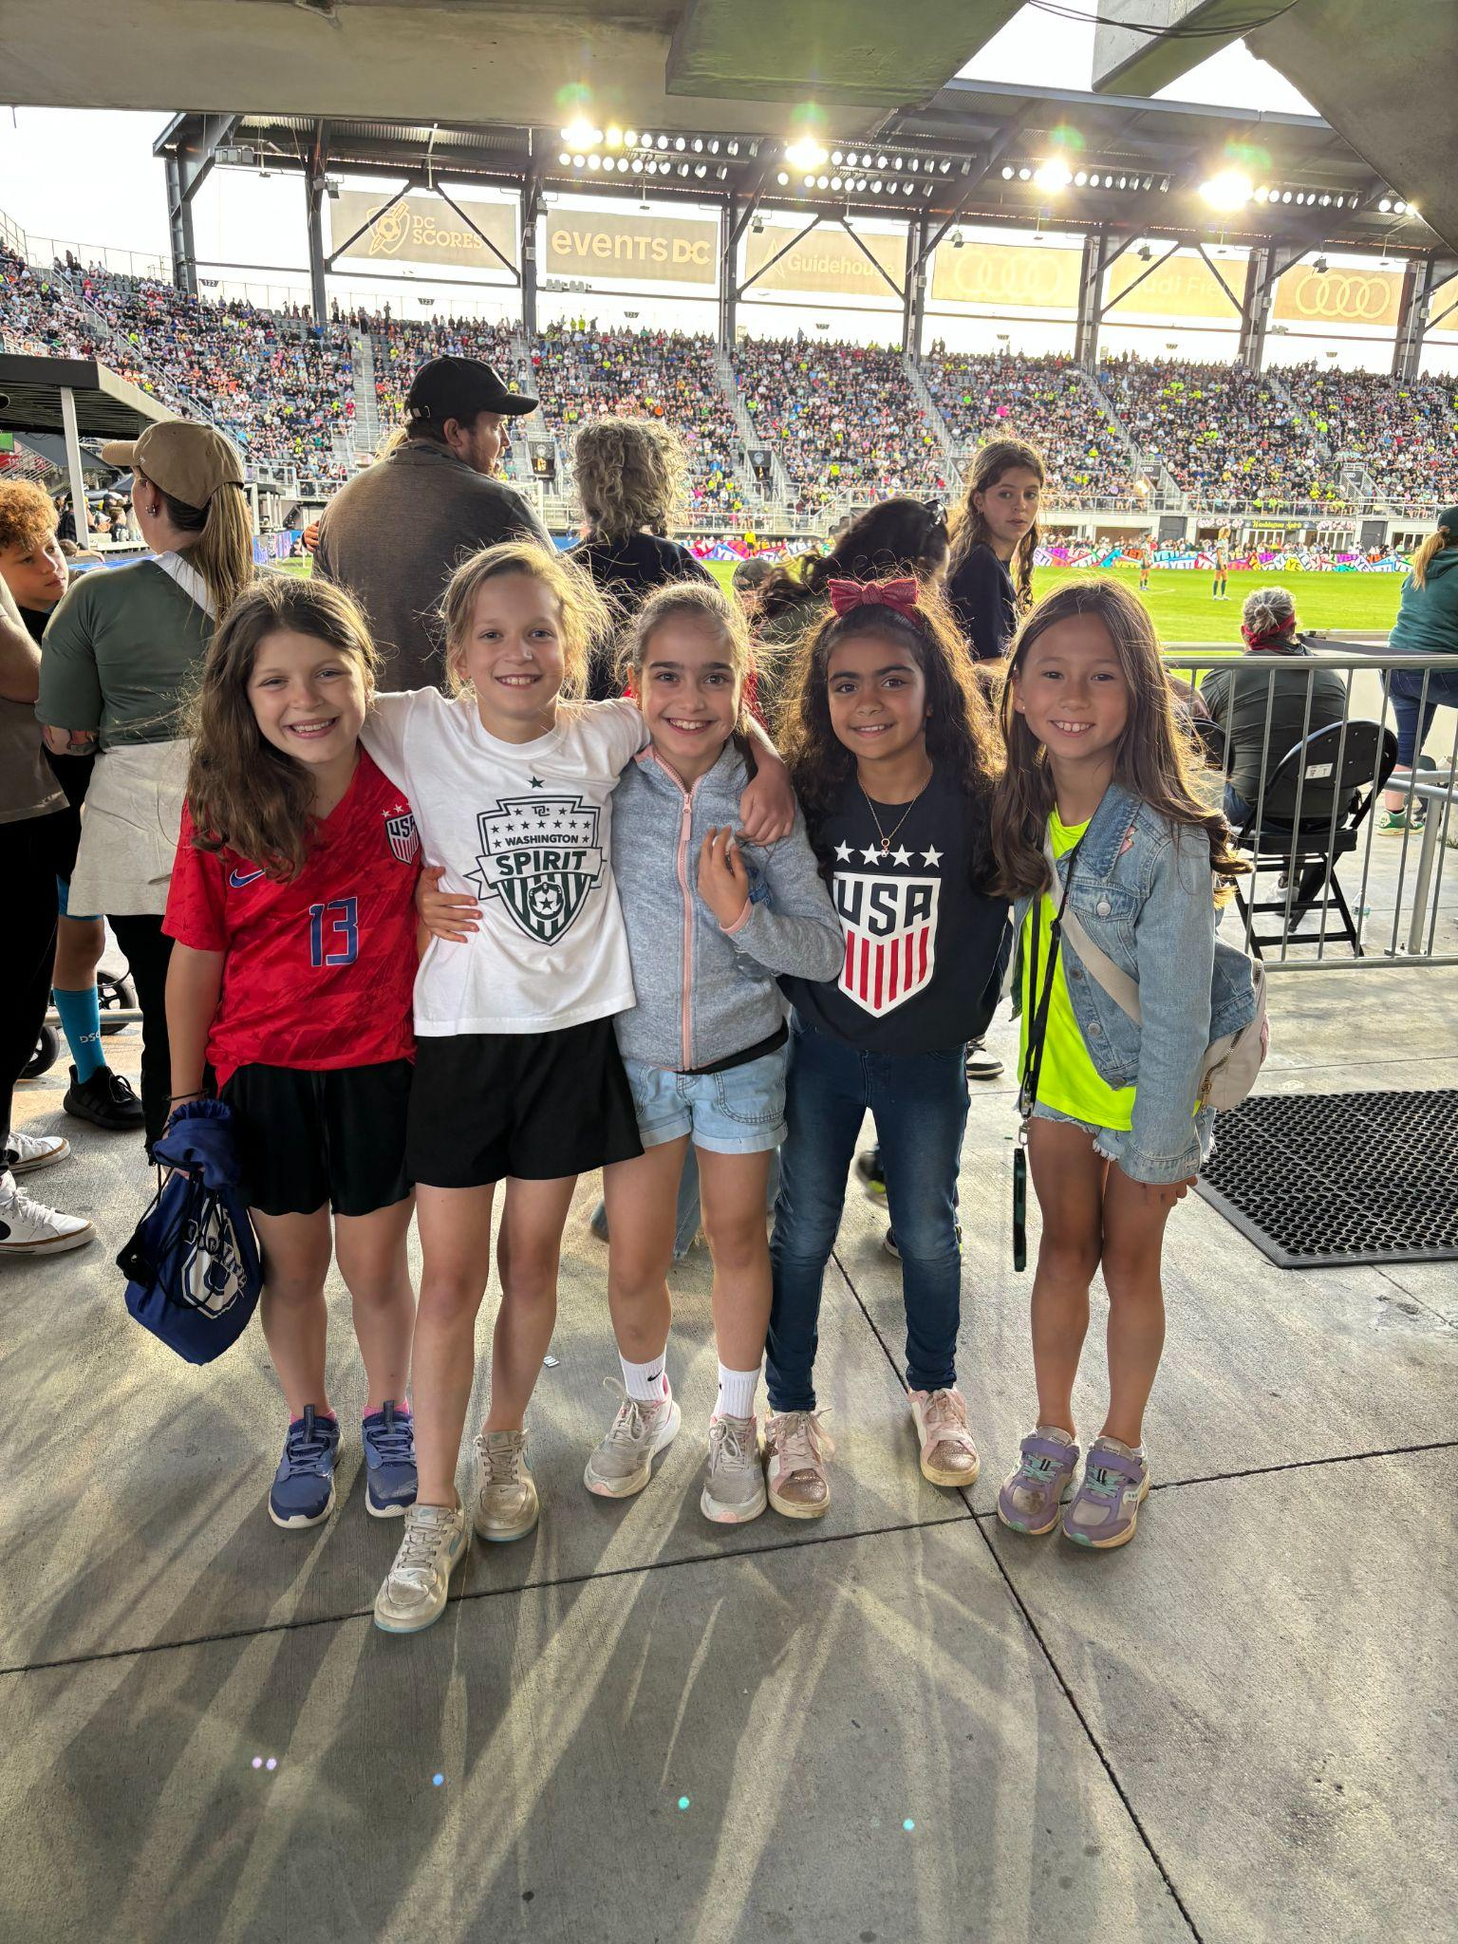



Marketing & Community Development
5H | Annual Report
547
729K
470K
342K
New Social Media Followers
Instagram Views
Facebook Views
Google Ad Impressions
Senior Night
120+ attendees (+166%) · $10,000+ in scholarships
· 8 recipients · 27 applicants (record)
Spirit & DC United
Fall 25: 200 Spirit Tickets + 225 DC Tickets
· Spring 26: 211 Spirit + 200 DC Tickets · 90+ player experiences each
Recycle Your Game
$14,700+ equipment donated — 58.73% increase largely due to Community Day
Player Volunteers
59 volunteers · 130+ student hours toward school requirements
Vienna Youth Soccer | Annual General Meeting | June 8, 2026

Slide 21


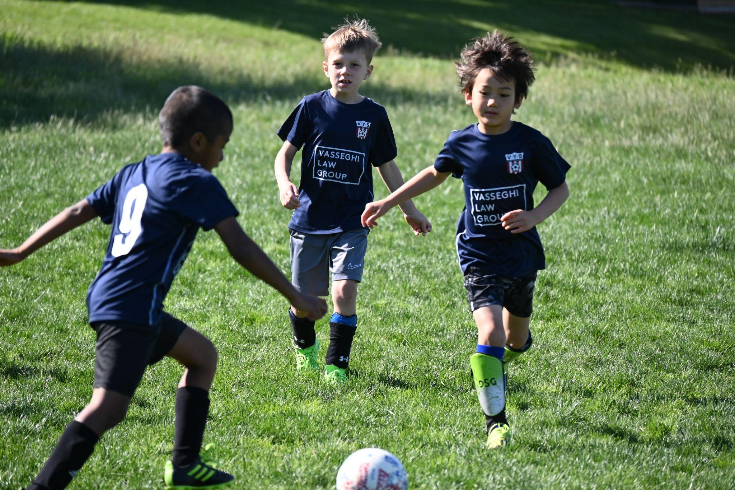
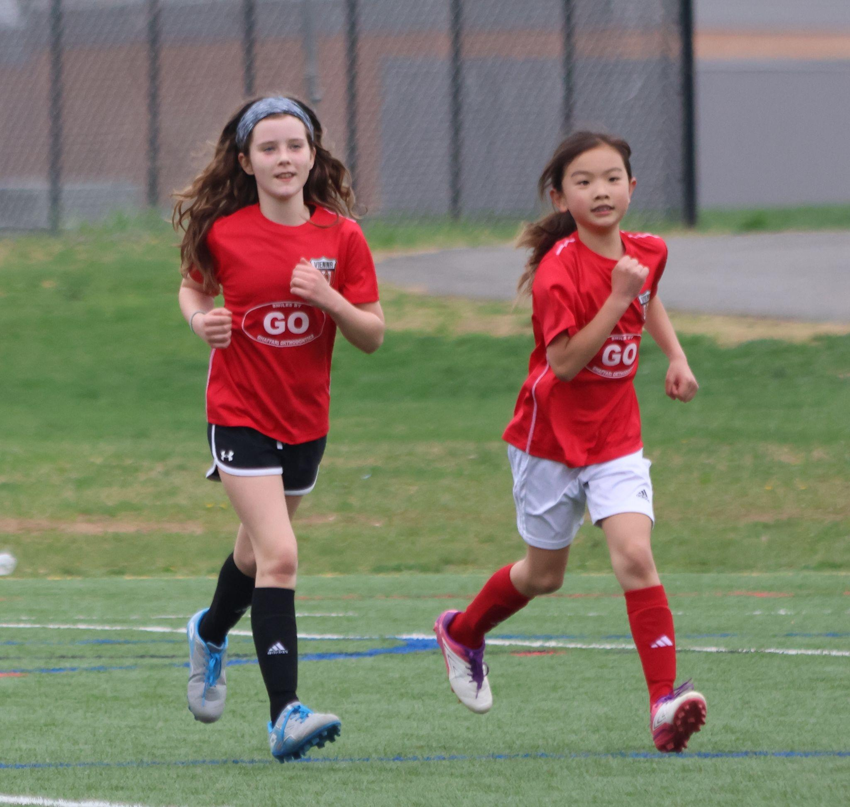
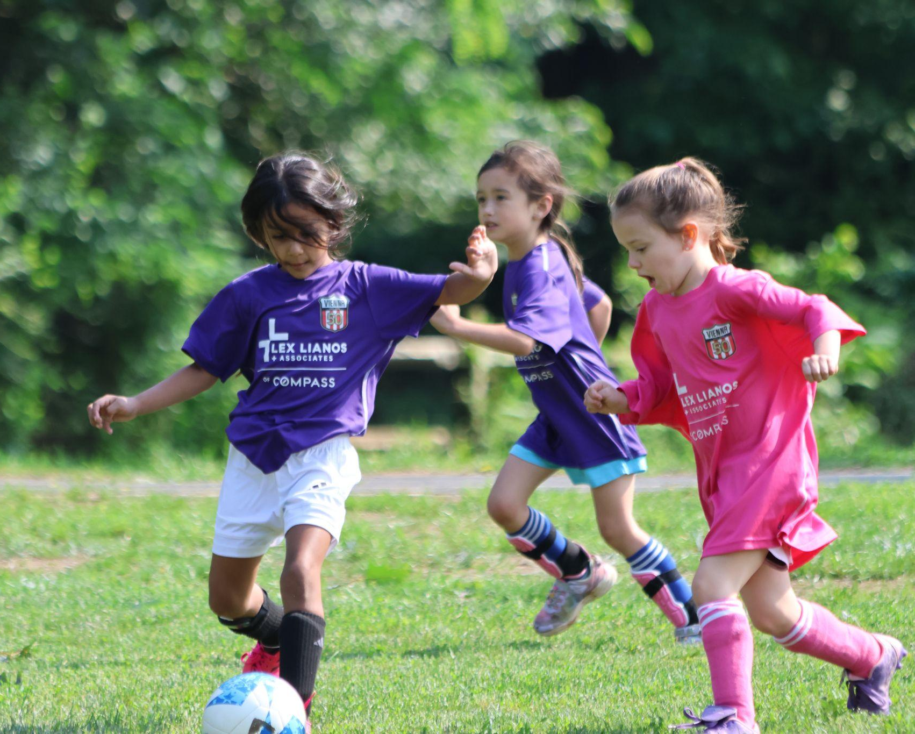

2025–2026 Club Sponsors
5I | Annual Report
Thank you to our incredible sponsors for making VYS possible!
HOUSE PROGRAM SPONSORS
U7 House Sponsor
U5 House Sponsor
U10 House & Winter Programs Sponsor
Vienna Youth Soccer | Annual General Meeting | June 8, 2026

Slide 22



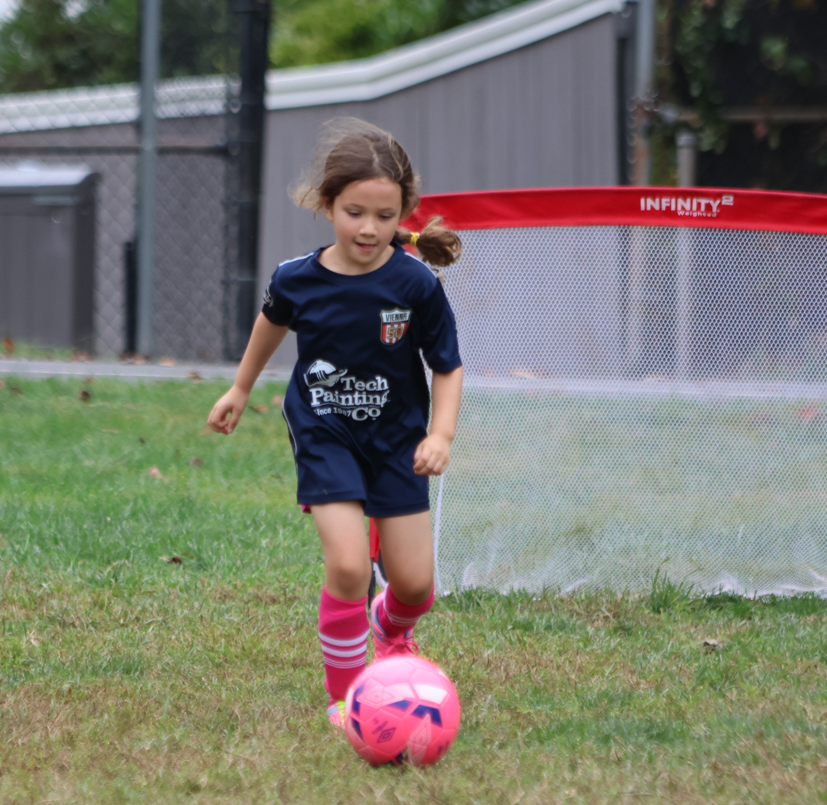
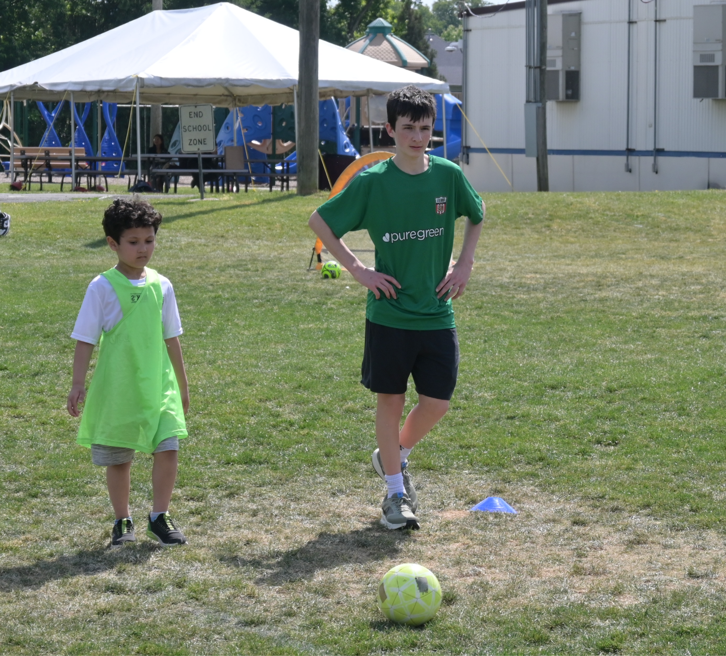
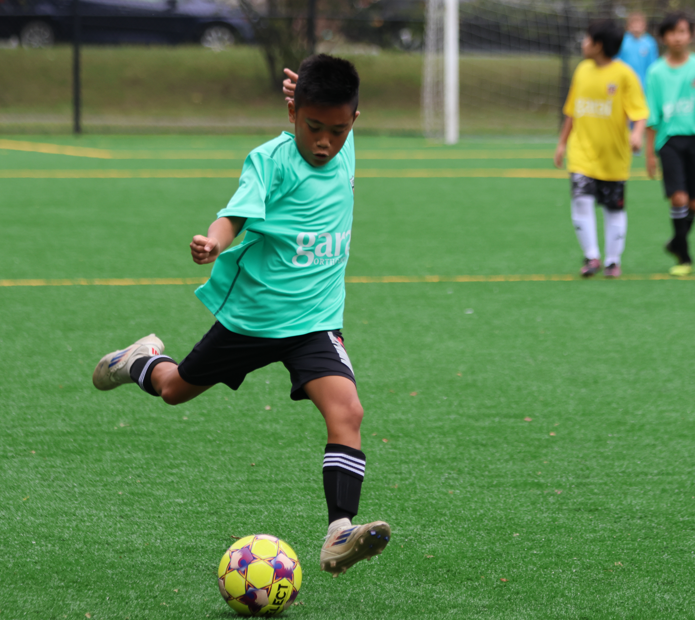
2025–2026 Club Sponsors
5I | Annual Report
Thank you to our incredible sponsors for making VYS possible!
HOUSE PROGRAM SPONSORS
U6 House & Summer Camps Sponsor
Top Soccer Sponsor
U11 & U12 House Sponsor
Vienna Youth Soccer | Annual General Meeting | June 8, 2026

Slide 23




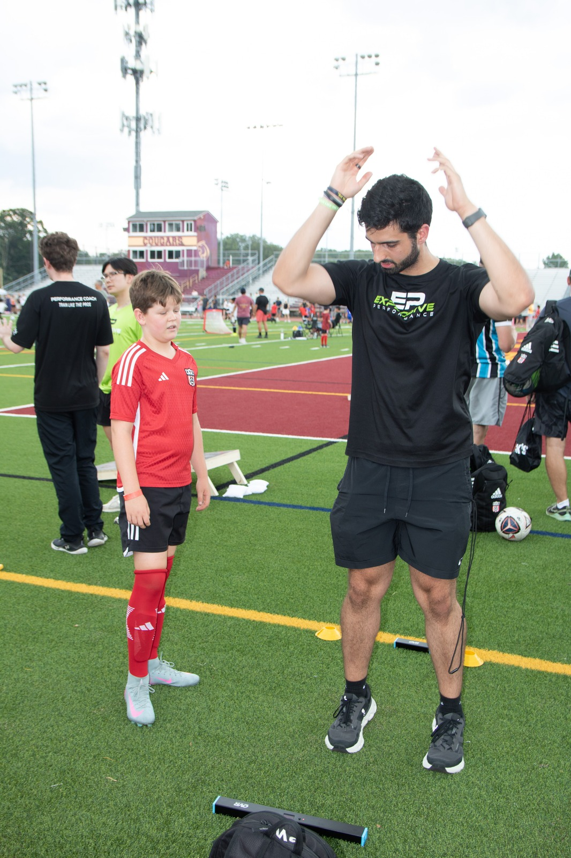
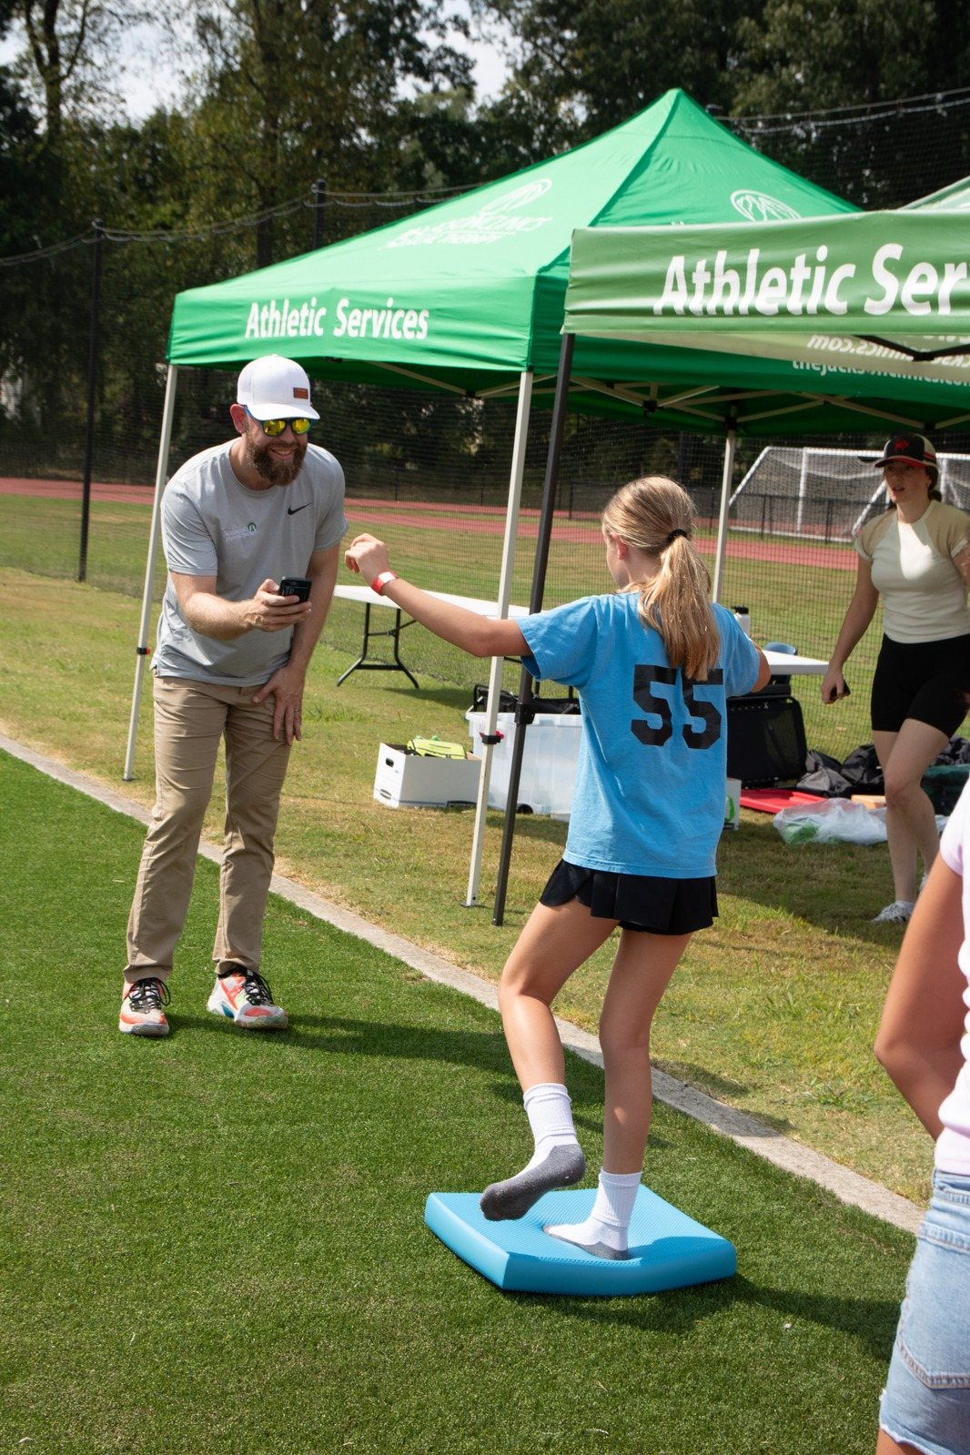
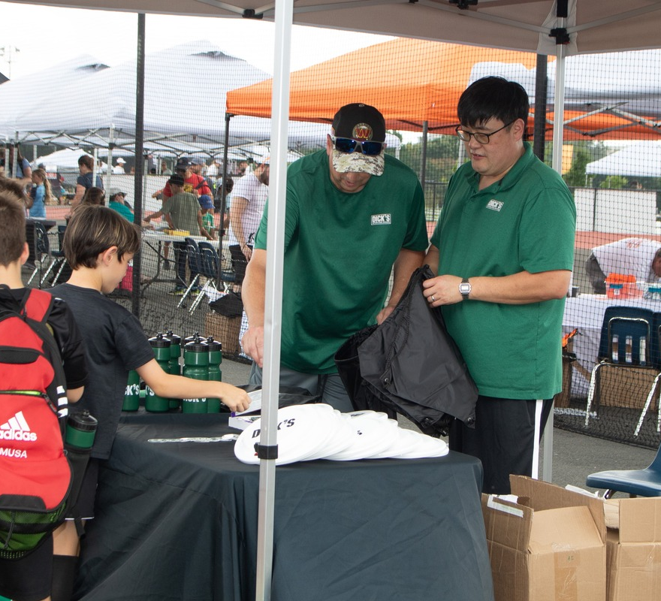
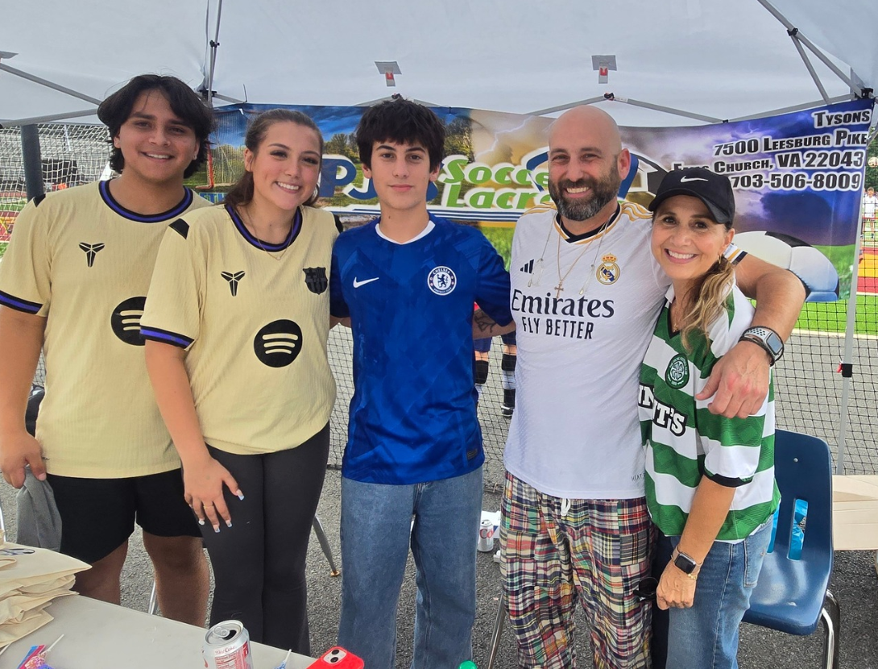
2025–2026 Club Partners
5I | Annual Report
Thank you to our incredible sponsors and partners for making VYS possible!
Vienna Youth Soccer | Annual General Meeting | June 8, 2026

Slide 24











Community Partners
5I | Annual Report
Our partners help us serve the Vienna community year-round
We are grateful for the continued support of our community partners
Vienna Youth Soccer | Annual General Meeting | June 8, 2026

Slide 25
6
Strategic Plan
2027–2030
Serving Vienna & Fairfax County since 1975
A LIFETIME OF SOCCER - VIENNA YOUTH SOCCER

Slide 26





Vienna Youth Soccer
STRATEGIC PLAN 2027–2030 | Serving Vienna & Fairfax County since 1975 • ~5,000 Players Annually
Vienna Youth Soccer places players at the center of the experience, emphasizing long-term development, positive culture, and fair play both on and off the field. Through responsible governance and sustainable practices, VYS ensures that these values and experiences endure, creating a legacy of soccer that positively impacts future generations.
Vision: To build character, confidence, and a lifelong love of soccer by providing high-quality, positive soccer experiences for all players in the Vienna community.
Mission: To provide children of all abilities living in and near Vienna the opportunity to participate in a high-quality soccer experience for players of all skill levels.
FIVE PILLARS, ONE COMMUNITY
01
02
03
04
05
Safeguarding
& Compliance
Member
Experience
Organizational Sustainability
Community
Engagement
Developing Great Coaches
Keeping every player safe.
Clear safety standards, referee support, and a club-wide culture of No Room For Abuse.
Making every experience count.
Improving player experience, empowering volunteers, and making VYS easier to navigate for every family.
Building a club that lasts.
Investing in great staff, growing our volunteer base, and forming partnerships that power our mission.
Deepening our roots.
Partnering with local schools and organizations, welcoming new families, and proudly sharing the VYS story across Vienna and Fairfax County.
Coaches shape every player's journey.
Clear pathways for coach education, support, and positioning VYS as a regional leader in coaching development.
A Lifetime of Soccer • No Room For Abuse | Programs: TOPSoccer · U4 Cubs · U5–U19 Rec · U7-U8 Futures · U9-U19 Travel ·U11-U19 ECNL · FVU Pathway · Coaching Education

Slide 27

Vienna Youth Soccer — Est. 1975 — A Lifetime of Soccer
www.vys.org
Notes:
Motion to close Melissa Burgum & Nicole Buckley
All in favor
—----
Motion to open meeting in Annand & Nicole Buckley (7:43PM)
Bird, Puja, Adam & Oscar
Role Cole: Derek Kung, Christina
Motion to close motion Marshall second Annand to approve 7:44pm

