Slide 1
Southwestern Texas Synod Assembly
Rev. Norma Malfatti
Senior Director, DEM Relationships
Notes:
2 minutes: Introduce yourself, and offer thanks for the invitation to be at the assembly. Talk about your background, etc.

Slide 2



ELCA Vision Statement: A world experiencing the difference God’s grace and love in Christ make for all people and creation.
Congregations
Synods
Churchwide Organization
Notes:
The ELCA is a connected church. We are a church of 2.7 million members in nearly 8,300 congregations and worshiping communities across the U.S. and in the Caribbean region. We are a church with three expressions: congregations, synods, and the churchwide organization. In each expression, we are called to boldly live out our mission in God’s world and share the good news of Jesus Christ.
Together as one church, we are working toward the ELCA’s vision of a world experiencing the difference God’s grace and love in Christ make for all people and creation. No single expression or part of the church can realize this vision alone. We are stronger together, as one church. Though moments of division may arise through politics or external factors that can distract us from the word of God and the teachings of Christ, we must never forget that we are connected and called to love one another, to love our neighbors as ourselves.

Slide 3
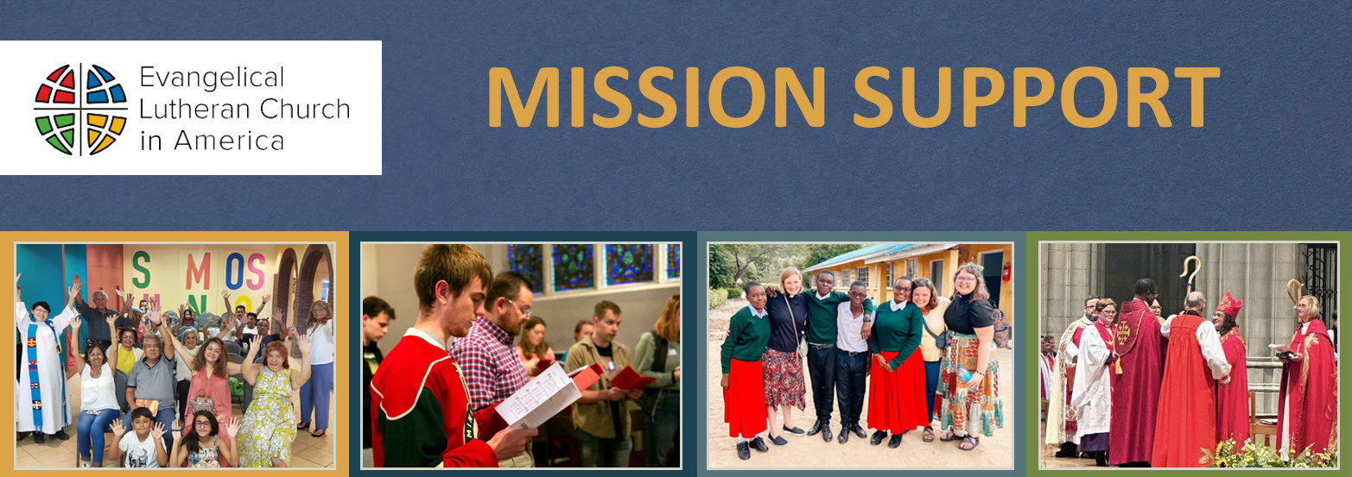
Connected, we’re doing more than any one person, congregation or synod could do alone, making an impact and supporting ministry all around the world. Thank you!
Notes:
One way to love and serve your neighbors is to turn faith into action by making a financial gift — an offering — to your congregation. Each year, ELCA congregations share a portion of their offerings to fund ELCA ministries in their synods and beyond. This type of sharing is called “Mission Support.”
Through your generosity, churchwide ministries received $[FILL IN] in Mission Support from this synod.
Mission Support fuels the ministry of this church and empowers people like Mary. Mary had set her sights on the ELCA Young Adults in Global Mission program since she was in confirmation.
The YAGM program, as it’s known, invites adults ages 21-35 into a transformative year of international service. As they walk alongside global companions, volunteers are shaped by the witness of neighbors.
With an interest in immigration and Spanish skills, Mary was assigned to Mexico City to serve in a long-term immigration shelter. Through her YAGM year, Mary’s passion to work for justice and give dignity to all God’s children grew. She returned to the U.S. to serve as a recruiter for YAGM, giving back to a program that gave her so much.
Mission Support made it possible for Mary to have this experience.

Slide 4
Return on Investment
Notes:
[Presenter instructions: Please pick ONE of the following four story slides to include here. We have provided one for each of the three regions of the US, as well as a story from the Caribbean Synod. If in doubt, use the one closest to the synod where you are speaking. Place the ones you choose not to use at the end of the presentation for your reference if desired - not to be shown during the presentation - or delete them. Below is the script for this slide.]
By being a member of this church and by giving in the offering plate or donating directly to Where Needed Most or a specific program like ELCA World Hunger, you support so many people - our neighbors - who need our support now more than ever.
I would like to share with you a story that demonstrates a powerful return on your investment.
[Go to next slide]

Slide 5
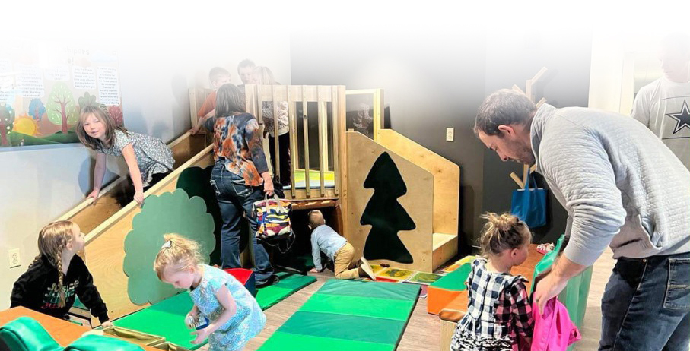

Central U.S. – Monument, Colorado and Mazomanie, Wisconsin
ELCA Ministry with Children Grants Program
Notes:
Across the ELCA, children’s ministries are finding new ways to welcome, nurture, and care for young people — often with limited resources. Through the ELCA Ministry with Children Grants program, those dreams are becoming a reality.
In communities like central Wisconsin and Colorado, small grants have helped congregations create safe, joyful spaces where children can play, learn, and experience God’s love. An old school building was transformed into a vibrant community center. A simple play area became a place of belonging for toddlers and families. A weekly family night expanded to include boys from a nearby foster home, offering consistency, care, and connection.
These ministries aren’t about growth for growth’s sake. They’re about showing up for children who need stability, encouragement, and a place where they feel welcome, especially those who are most vulnerable.
These grants reflect the long reach of generosity and the power of shared commitment. When you give to the ELCA, your support helps congregations live out their call to serve beyond their walls — creating places where children are seen, valued, and surrounded by love.

Slide 6
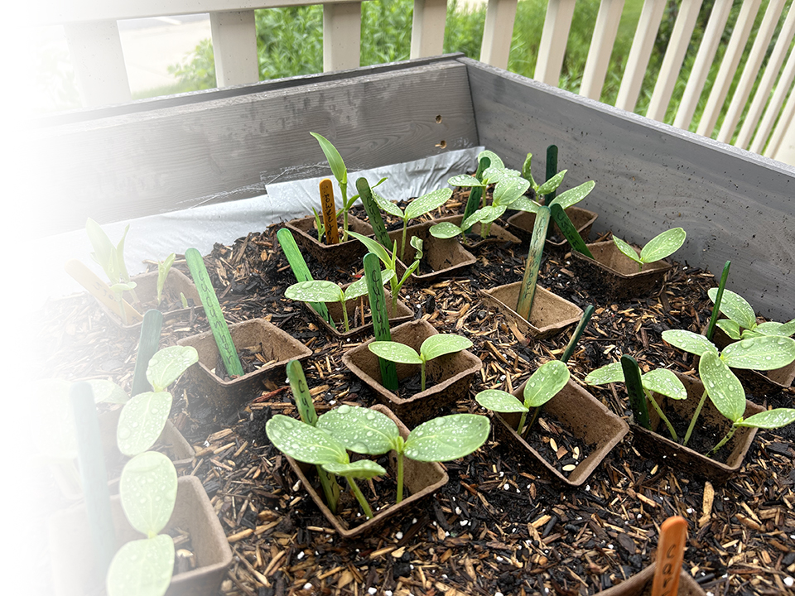
ELCA World Hunger
Last year, ELCA World Hunger worked in 58 countries, including the United States, addressing the root causes of hunger and poverty.
Notes:
We know many individuals and congregations give and serve our communities. We are especially grateful for how you choose to join us in the work of ELCA World Hunger, which is our church’s coordinated response to hunger and poverty.
Last year, your synod gave $[FILL IN] to ELCA World Hunger. Thank you.
Grace Lutheran Church in Fairmont, Minnesota has multiple feeding ministries supported by ELCA World Hunger, including a food pantry and community meals. But teenagers Jenna and Georgia wanted to do more. An ELCA World Hunger Daily Bread Grant helped them buy seeds and tools to plant a community garden, so they can provide even more food and connection to their neighbors in need.
Last year, a record 664 Daily Bread grants were awarded — covering all 65 synods — thanks to your gifts.

Slide 7
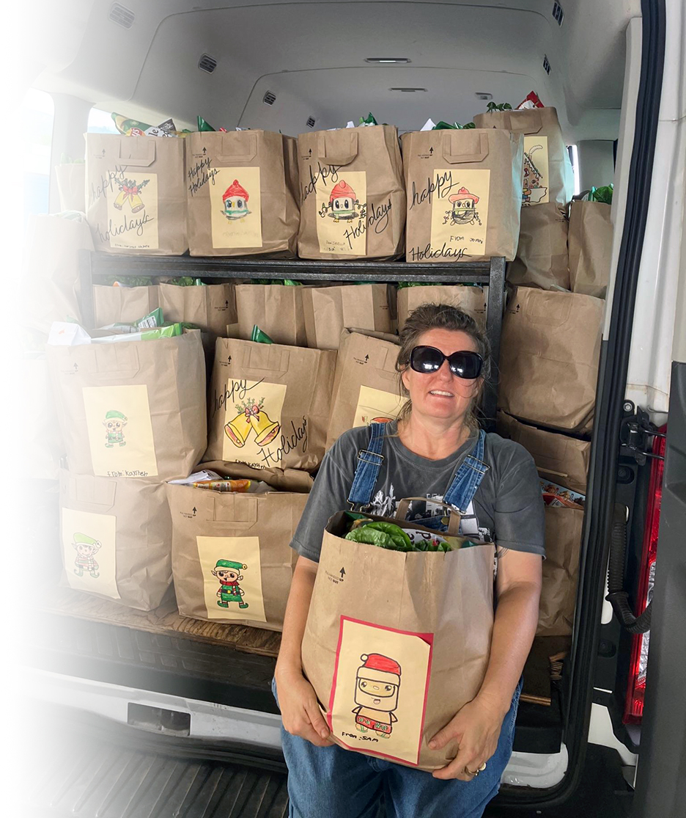
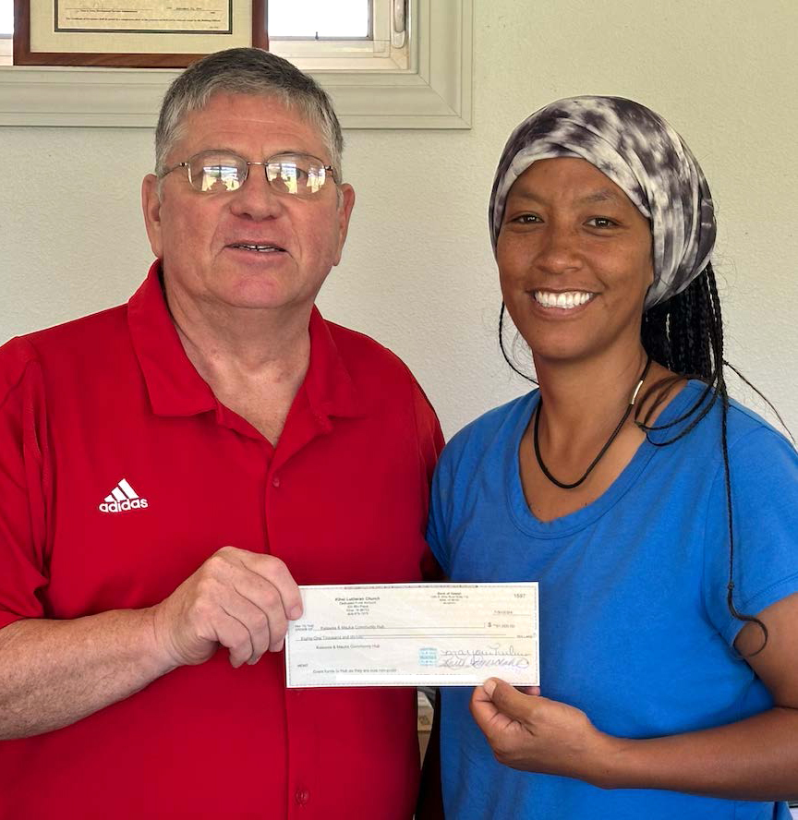
Lutheran Disaster Response
Lutheran Disaster Response is our church's way of walking with communities impacted by disasters. In 2025, we served neighbors in 51 countries including the United States.
Thank you!
Notes:
Lutheran Disaster Response (LDR) is known for its long-term approach to working with communities. I want to share a story of how we continue to work in Maui, three years after the devasting 2023 wildfires.
LDR has accompanied Kihei Lutheran Church and other partners in Hawaii since the immediate aftermath of the fires. LDR helped the Kelawea Mauka Community Hub — a community-led program that offers fresh food such as fruits, vegetables, milk, and eggs — buy a new van for deliveries. Thanks to your support, neighbors in need who are rebuilding from the fires can get fresh food delivered. LDR is also responding to the recent floods in Hawaii.
Strong community connections and collaboration are important in times of disaster. Working together, we can be there to support disaster survivors for as long as needed. Once again, thank you for your synod’s support of LDR, giving $[FILL IN] last year.
LDR showed up in 2024

Slide 8
Your Synod’s Presence
Deacon Darcy Mittelstaedt – Committee on Appeals
Ms. Elizabeth Dieringer – Nominating Committee
Ms. Pamela Vetter – ELCA Foundation Endowment Fund
Mr. Brett Kraemer – Portico Board of Pensions
Ms. Jessica Garrett – synod representative to the
young adult network
Notes:
[Presenter instructions: Insert committee members – for each CW/CWA committee and what synod they’re from​]
​
This church benefits from the gifts of time and talent offered by faithful volunteers throughout the ELCA who serve on committees and engage in special efforts with and for the churchwide organization. We offer special thanks for the people from this synod who work with us and foster this important connection across the three expressions of our church.

Slide 9




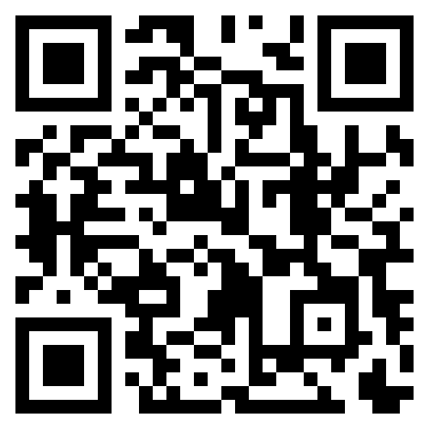

Church Property Resource Hub
Resourcing Faith-driven Church Property Stewardship
Learn more at ELCA.org/CPRH or email CPRH@elca.org
Notes:
The Church Property Resource Hub is an online platform that connects congregations and synod leaders with information, organizations, and guidance for faithful and effective stewardship of church property.
A new initiative of the ELCA, the Church Property Resource Hub was developed in response to requests from synod and congregation leaders for support in navigating the challenges and opportunities that buildings and land present for congregational vitality and the wider mission of the church.
Through the hub, you can:
-Explore courses and resources that address many aspects of property stewardship, including space sharing, mission exploration, community engagement, and more.
-Connect with a network of colleagues and professionals who can answer questions and partner with you.
-Be inspired by stories of congregations that are creatively responding to property challenges.
Learn more at ELCA.org/CPRH.

Slide 10
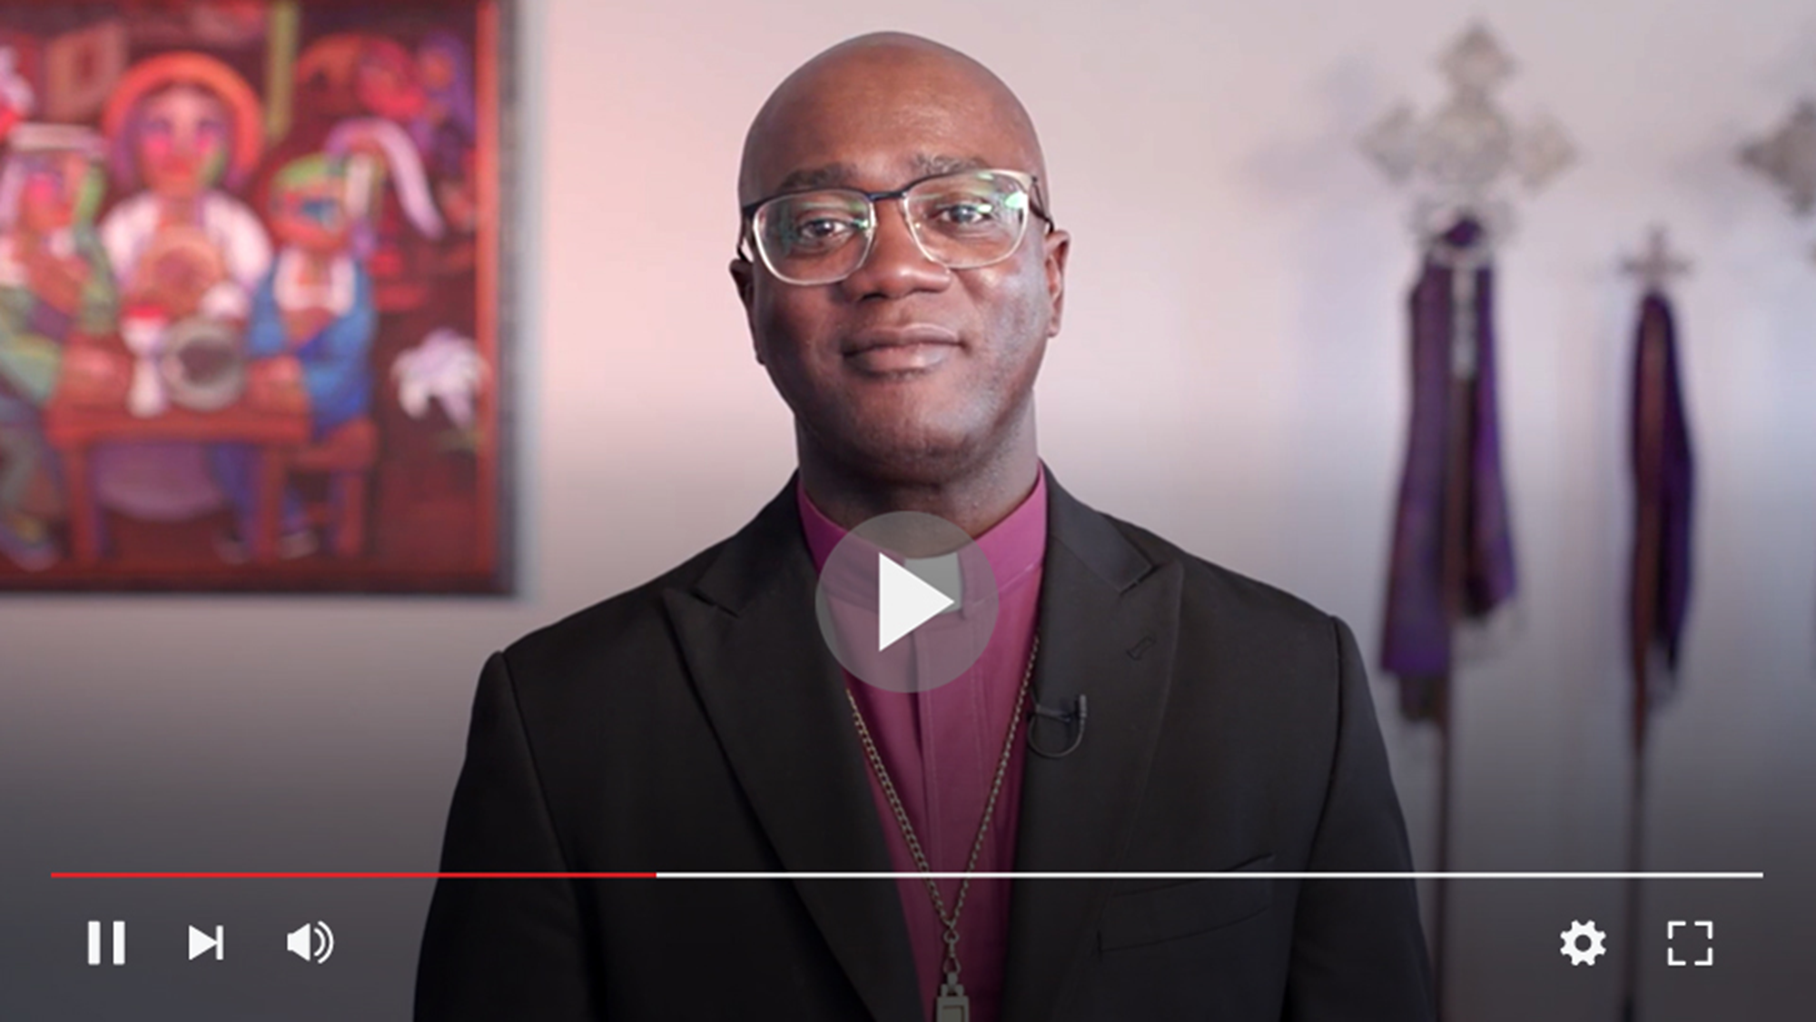
Notes:
And now, I would like to introduce our presiding bishop, Yehiel Curry, and share his first synod assembly video with you. From the West Coast to the East Coast of the United States to the Holy Land, Bishop Curry explores the importance of being a connected church in God’s kingdom, knowing that we are stronger together than alone.
I hope you enjoy the video. [PLAY VIDEO]​

Slide 11
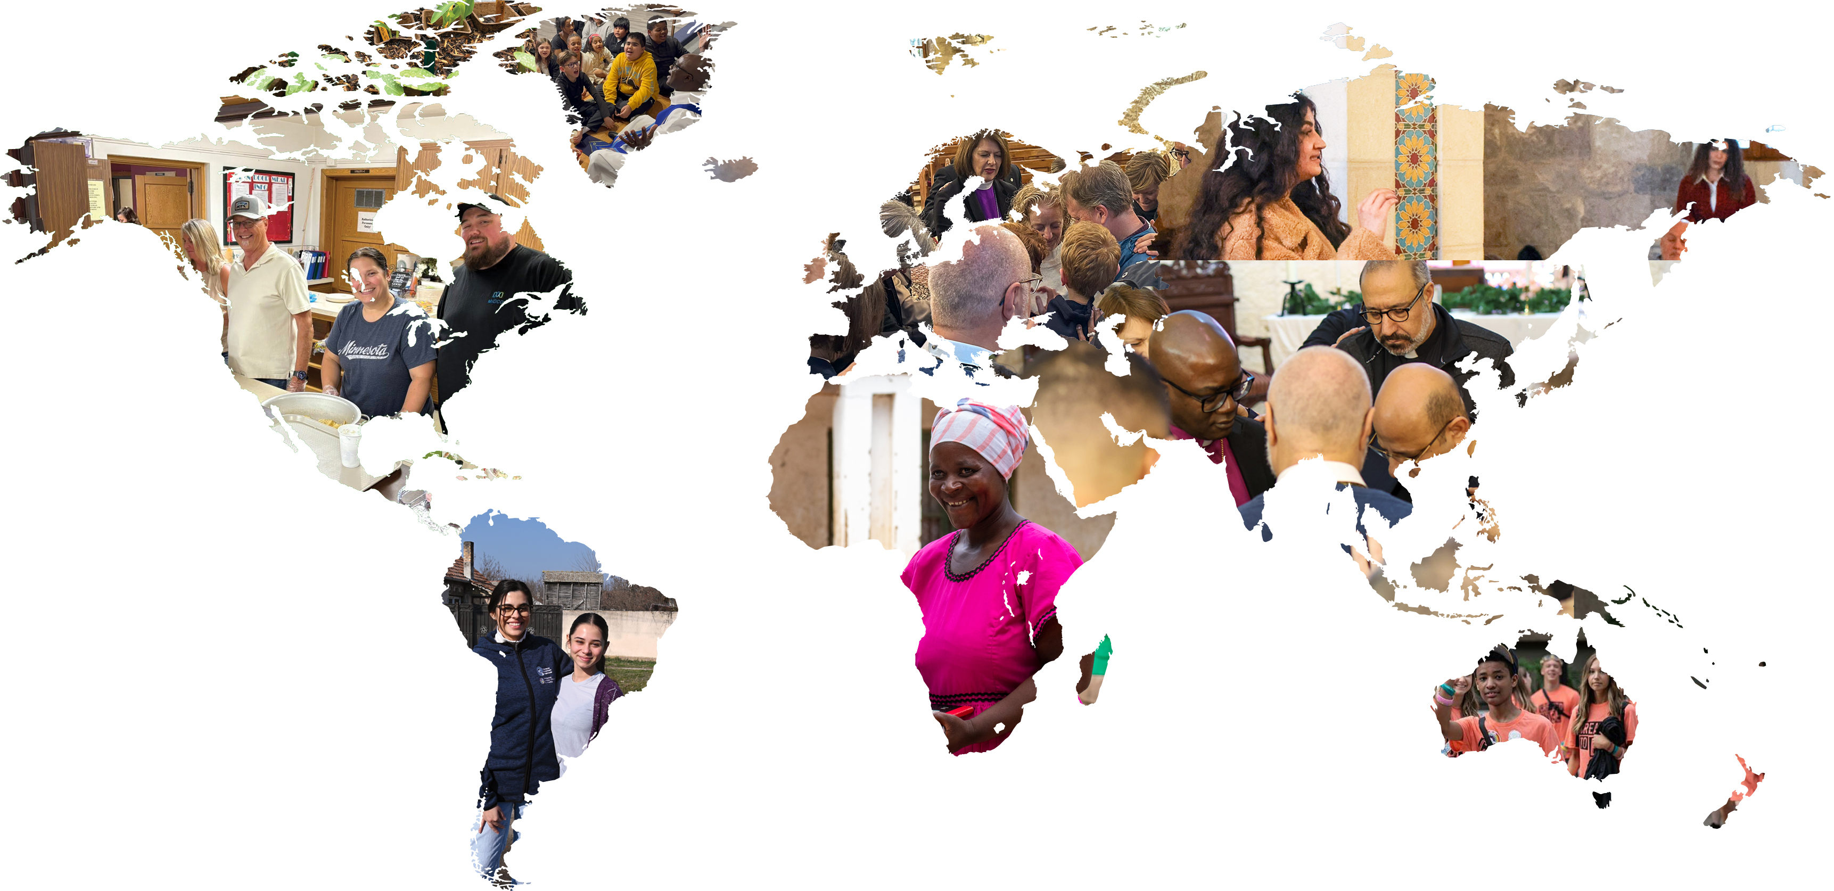

Notes:
Your generosity helps us share God’s love right here at home and throughout the world. You are not only a part of your congregation and synod — you are also part of a national church that works across the country, in the Caribbean, and around the world in the service of our neighbors.
​ Together as the ELCA, we envision a world experiencing the difference God’s grace and love in Christ make for all people and creation. This is the ELCA’s vision, and I invite you to connect with Lutherans and non-Lutherans alike as we work toward this vision together.
Thank you.

Slide 12
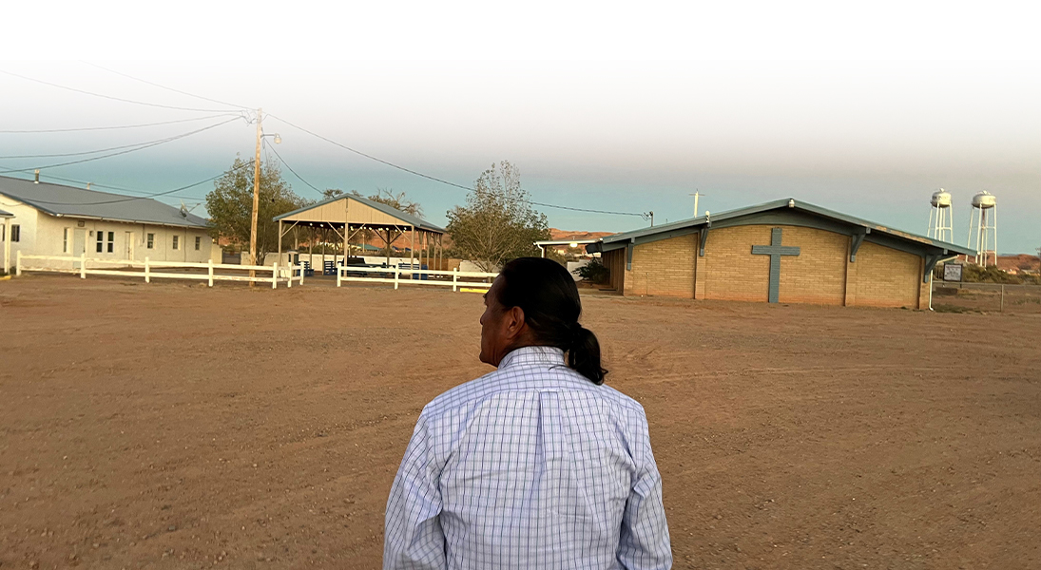
Western U.S. – Rock Point, Arizona
Navajo Evangelical Lutheran Mission
Notes:
There has been some push back – why do we do land acknowledgments and land back
In the high desert of the Navajo Nation, community is built one relationship at a time. For more than 70 years, the Navajo Evangelical Lutheran Mission has walked alongside the people of Rock Point, Arizona — not as outsiders but as neighbors.
Here, access to basics many of us take for granted is not guaranteed. Some families still travel miles each week just to collect water. In response, the mission opened its well, offering water freely to anyone who needs it. That same spirit of care shows up in hot meals shared daily, food distributed to families, and a small school where Navajo children are nurtured, taught, and encouraged to dream.
This ministry is led by Navajo leaders, shaped by Navajo culture, and rooted deeply in the community it serves. It is a living example of what it means to be a connected church — listening first, responding with humility, and serving with love.
When you give to the ELCA, your generosity makes such ministries possible — connecting Christ’s love to real needs, real people and real hope, right where they are.

Slide 13
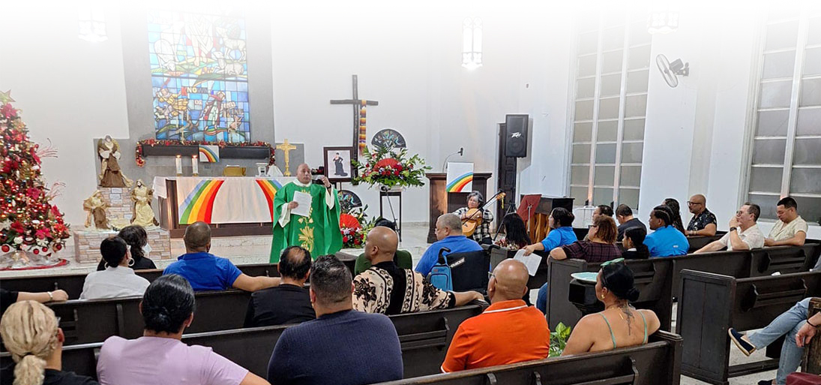
Caribbean – Rio Piedras, Puerto Rico
Our House for All: A program serving students and neighbors of the University of Puerto Rico in Rio Piedras
Notes:
What you see here is more than a worship service. It’s a living example of our church showing up where we are needed most. Just steps from the University of Puerto Rico, Nuestro Casa para Todos (“Our House for All”) has become a place of refuge, relationship, and renewal for students and neighbors alike.
This ministry was born when an unused church building was reopened with a simple invitation: come as you are. University students began gathering for shared meals, conversation, music, and prayer. Many arrived carrying stress, uncertainty, or distance from the church. What they found was a community that listens, welcomes without judgment, and stays present late into the evening when support is hardest to find.
Led by the Caribbean Synod, this ministry also serves the wider community, hosting workshops, offering basic necessities, accompanying immigrants, and creating space for honest dialogue and healing. Worship here reflects Lutheran tradition while embracing creativity and inclusion.
When you give to the ELCA, your generosity helps make ministries like this possible — connecting faith to real lives, supporting students and neighbors, and opening wide church doors to all who are seeking belonging, hope, and grace.

Slide 14
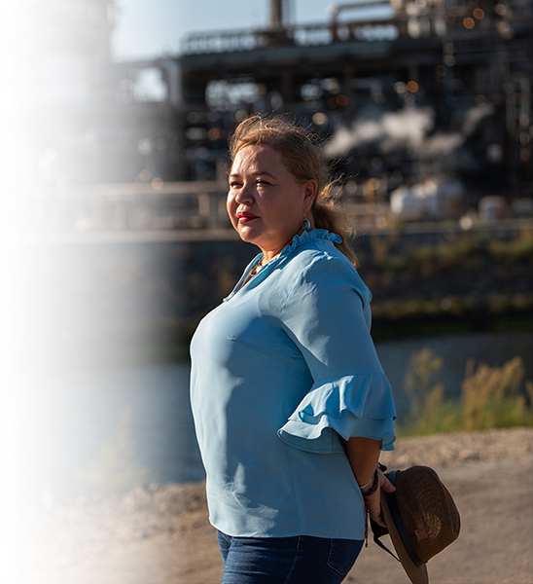
Eastern U.S. – New York City, NY
Trinity Lutheran Church
Notes:
Magali Sánchez‑Hall’s story is one of courage, community, and the quiet power of accompaniment. Years ago, she arrived at Trinity Lutheran Church in Brooklyn as a survivor — an immigrant without legal status and single mother seeking safety after escaping abuse. What she found there was more than shelter. She found a church that listened, believed in her, and walked with her through every step of healing.
Through ELCA Latino Ministries and the leadership of the Rev. Hector Carrasquillo, Magali was invited not only to receive care but also to lead. She volunteered, taught, organized, and discovered gifts she didn’t yet know she had. When fear returned, the church remained, answering late‑night calls, offering prayer, and reminding her of her worth and her light.
With the support of this ministry, Magali rebuilt her life, pursued an education, and became a scholar and advocate for environmental and social justice. Today, she credits the ELCA community that saw not a victim but a future leader.
When you give to the ELCA, your generosity helps create ministries like this — places of refuge, empowerment, and transformation, where lives are restored and light is set free to shine.

Slide 15

Notes:
Leaders from across the ELCA are invited to gather for renewal, learning, and connection at the Rostered Ministers Gathering July 6-9 in Indianapolis. This gathering is for all ELCA deacons, pastors, bishops, and candidates approved for call, offering them a rare opportunity to step away from daily demands and reconnect with one another and with God.
The 2026 theme, “Woven Together,” centers on the ties that bind us as leaders in Christ’s church. Each day focuses on a different thread of our shared calling: woven together with God, for creation, as community, and as rostered ministers.
Planned programming includes daily worship, keynote speakers, workshops, small groups, and affinity groups designed to equip, connect, and renew leaders for ministry today.
Visit ELCA.org/rmg to learn more, view the event schedule and full slate of presenters, and register.
ELCA congregations, thank you for supporting your ministers’ efforts to grow in faith and leadership, so they can continue serving the call God has placed in front of them.

Slide 16
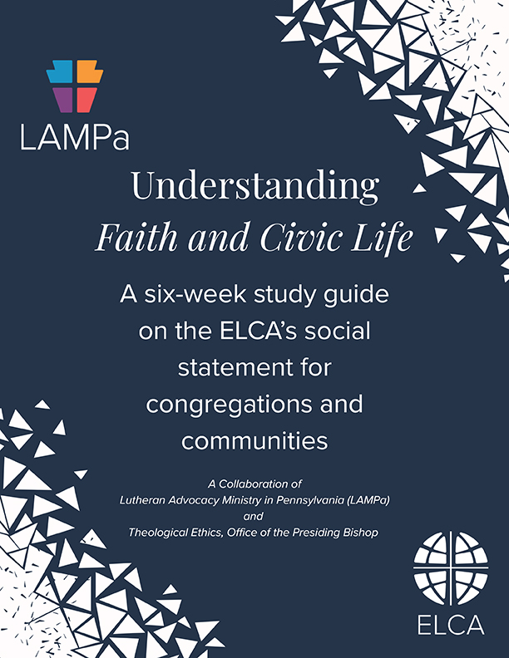
Faith and Civic Life social statement
Learn more at
ELCA.org/civicsandfaith
Notes:
The 2025 ELCA Churchwide assembly adopted the social statement Faith and Civic Life: Seeking the Well-being of All. This was the result of a five-year deliberative process that involved hearing from members across the ELCA. This new social teaching sets forth broad theological, ethical, political, and social insights that address questions about, and obstacles to, the flourishing of civic life today.
Sections of the social statement explore the nature of power, religious liberty, Christian vocation, law and gospel in relation to society, and the U.S. constitutional form of government. It affirms the biblical insight that civic engagement is a way to participate in God’s work of fostering well-being and offers a constructive proposal for the relationship between religious organizations and government. We invite you to consider using the accompanying study guide with your congregation or small group. The social statement and study guide can be found at ELCA.org/CivicsAndFaith.
Laurie Jungling is talking about this

Slide 17
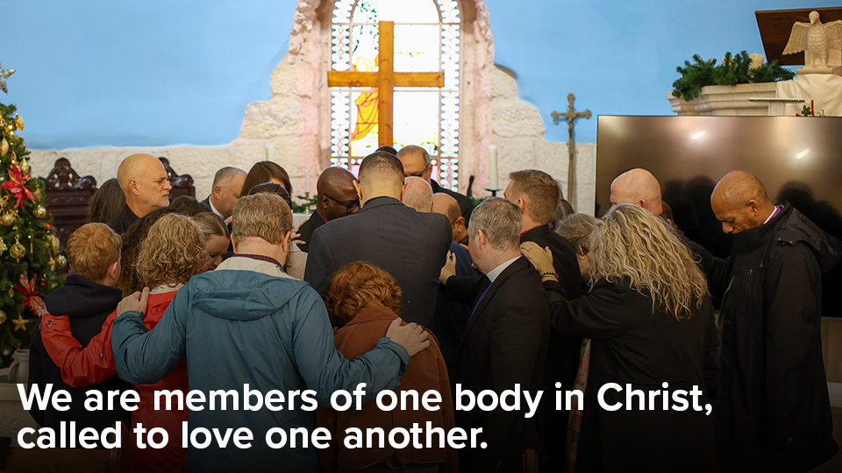
Notes:
Before we continue, let us pause and acknowledge that we are living in times of divisiveness, anger, and fear. Nearly two thousand years ago, the apostle Paul wrote that we are members of one body in Christ and that “if one member suffers, all suffer together with it.”
This follows the commandment Jesus gave us during his ministry on earth: “Love one another.”
Today, it seems difficult to love one another when we struggle to even communicate. How can we love when we harbor so much animosity toward others? How can we love those who appear to hate us for our worldview? How can we love those who are most vulnerable and are suffering more than anyone realizes?
Jesus said that what is impossible for humans is possible for God. Let us pray then for God’s guidance. Here is a prayer from Evangelical Lutheran Worship, page 76:
O God, where hearts are fearful and constricted, grant courage and hope. Where anxiety is infectious and widening, grant peace and reassurance. Where impossibilities close every door and window, grant imagination and resistance. Where distrust twists our thinking, grant healing and illumination. Where spirits are daunted and weakened, grant soaring wings and strengthened dreams. All these things we ask in the name of Jesus Christ, our Savior and Lord. Amen.

