Slide 1
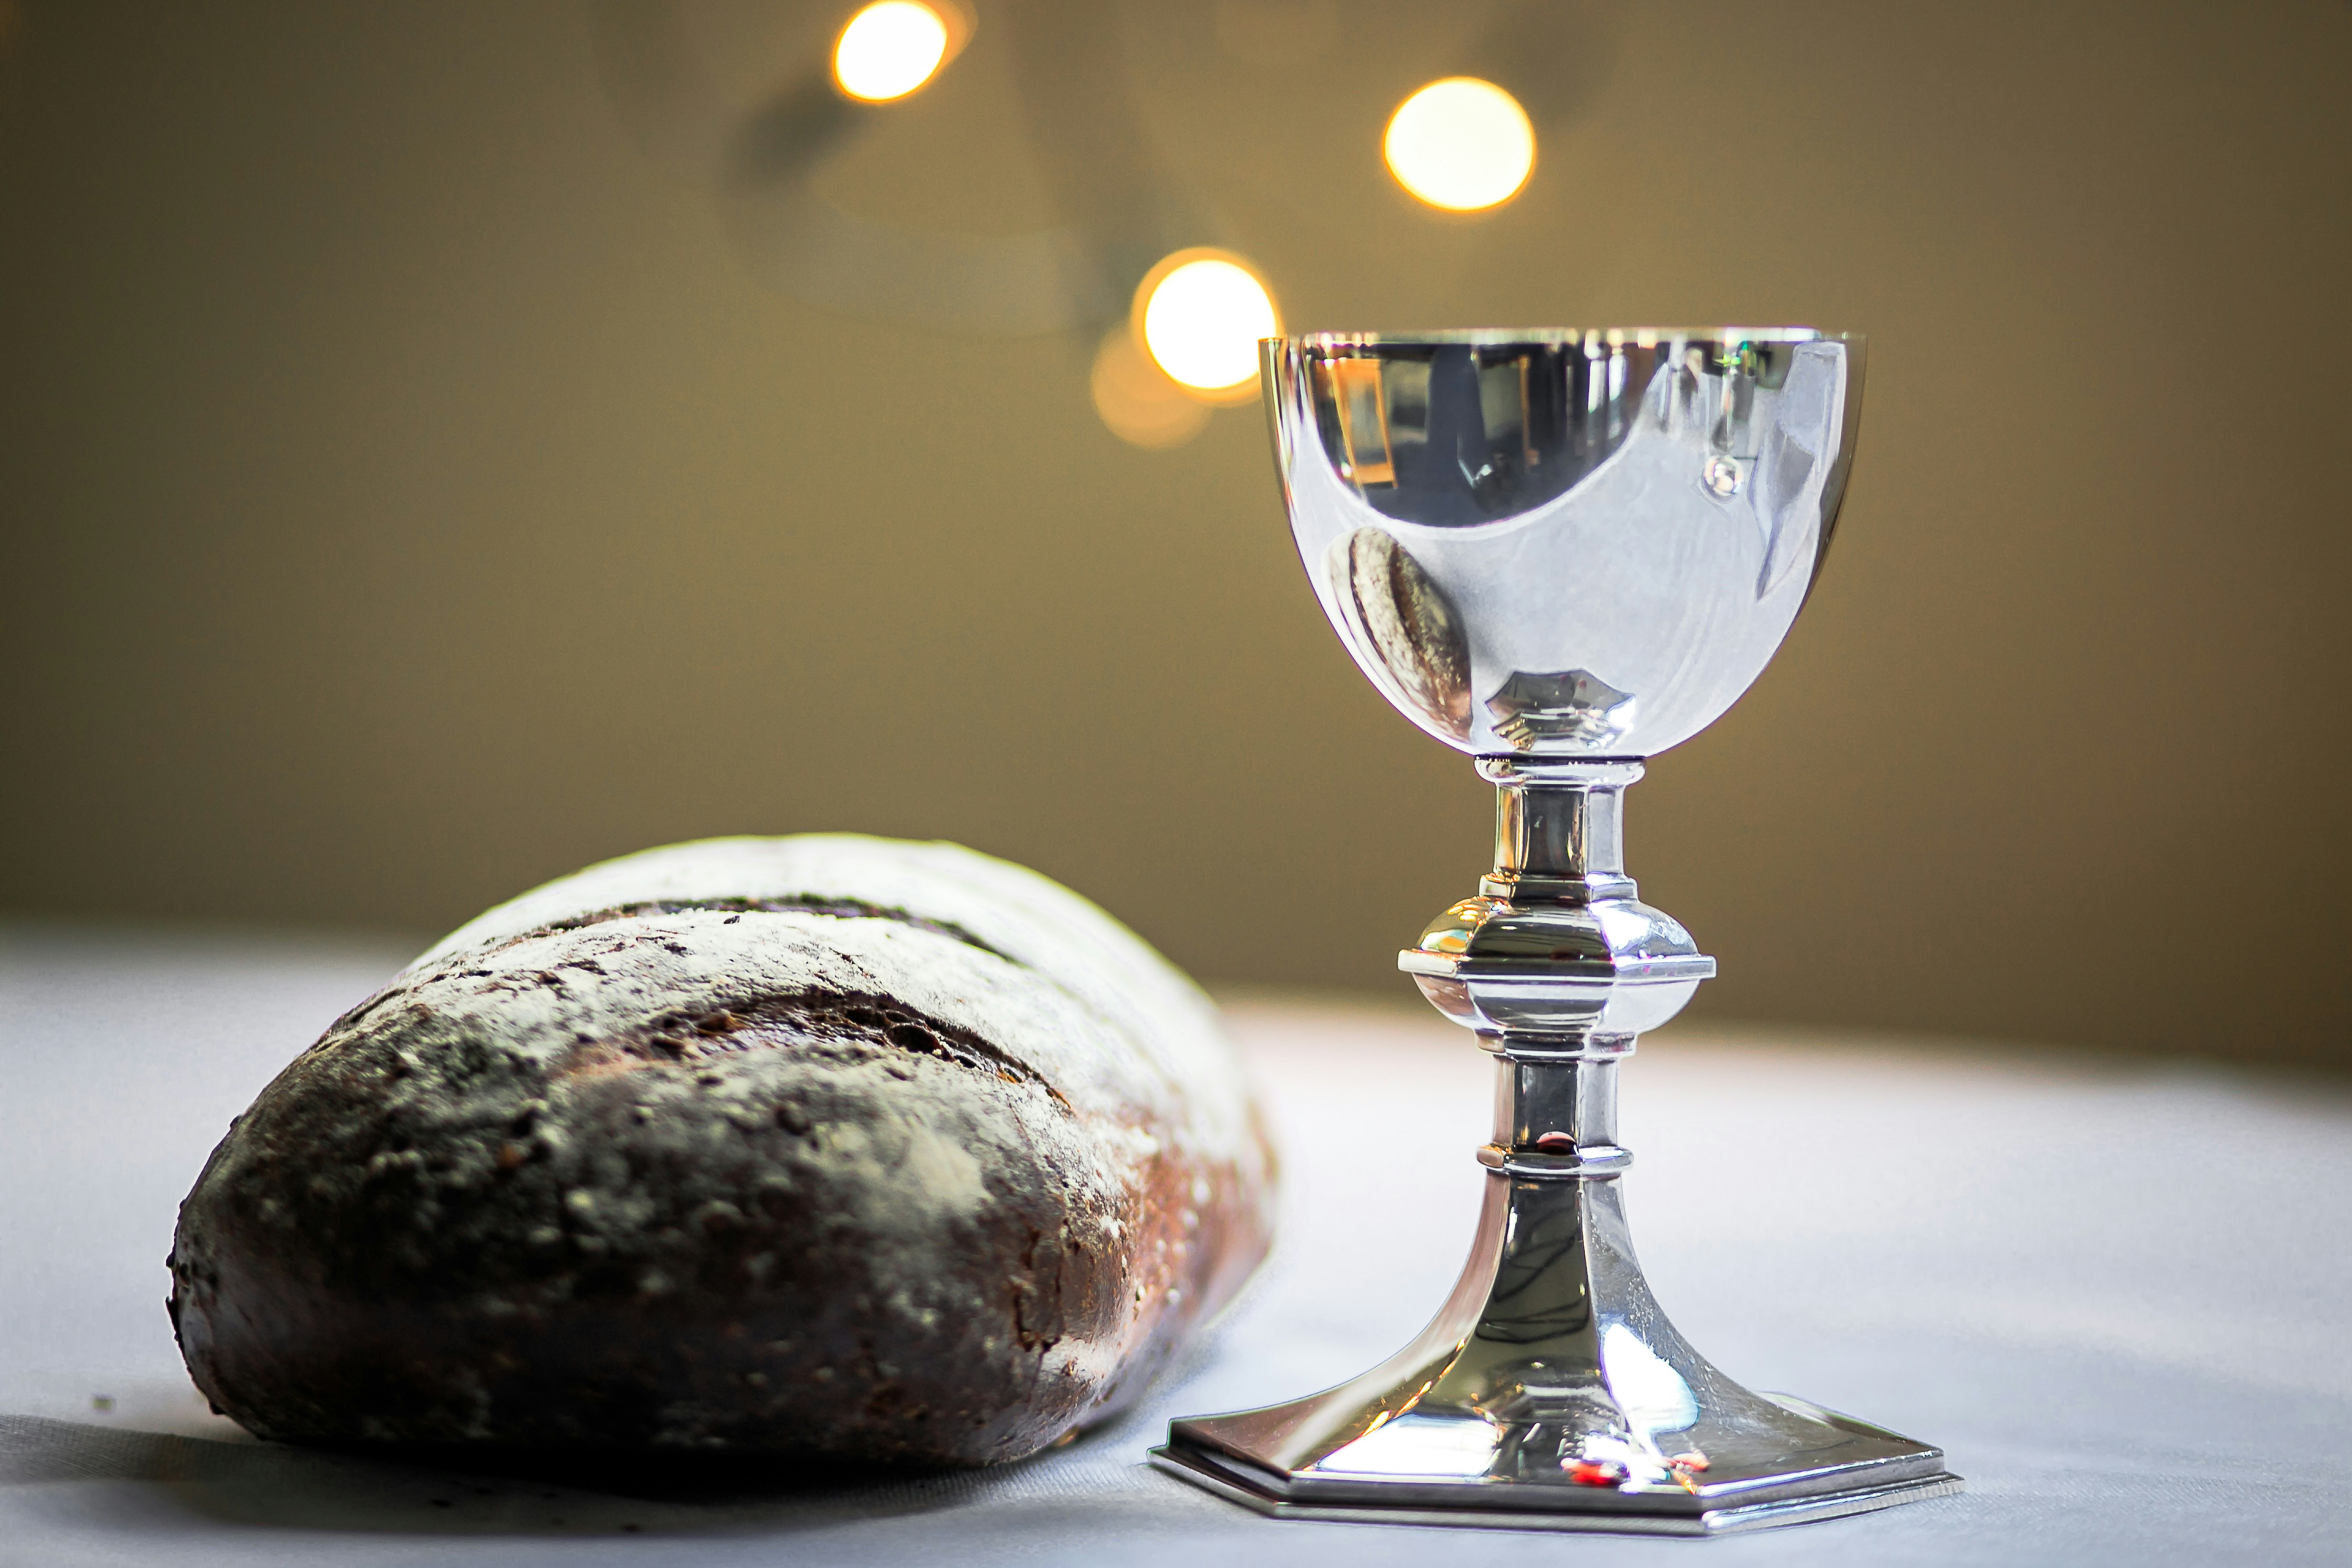

God be with you in all love, lift your hearts to God above. It is right and good to give our thanks and praise. Holy, holy, holy Lord. God of power, God of love. Sing Hosanna, Christ has come in God’s own name.
Refrain: People needing, Spirit leading, Jesus feeding all who come to him. Bread for tending, cup for mending, Spirit sending us to serve the world. On the night his life was giv’n, Jesus took the bread of heav’n. Thanking God, he broke it all. Remember me. Then he took the common cup, new forgiveness lifting up. Thanking God, he gave to all. Remember me. (Refrain) We remember God in Christ, holy living sacrifice. So like him, in thanks and praise ourselves we give. We embrace his mystery, how he died and set us free. As he rose, he’ll come again. In Christ we live. (Refrain) On these gifts of wine and bread, and your people in this place. Pour your Spirit, gift divine giving us Christ. By the Spirit, make us one. One in Christ to serve the world. That on earth your will be done till Christ shall come. (Refrain) People needing, Spirit leading, Jesus feeding all who come to him. Bread for tending, cup for mending, Spirit sending us to serve the world.
Photo by James Coleman on Unsplash and Liturgy by https://wrumc.org/blog/2023/07/02/communion

