Slide 1
Mixed Ecology of Being Church
Honoring our past while trusting the Spirit to grow something new
Rev. Norma Malfatti
Senior Director, DEM Relationships
Notes:
Across the United States, participation in inherited forms of church has declined.
Now, when I say inherited forms of church, I mean the way of being church that I grew up in, and likely you did you. We inherited this way of being church from our parents and grandparents and so many generations before that. I loved and still love this way of being church – I wouldn’t be standing here without my growing up church or the church I’m a part of today and likely many of you wouldn’t be here either. So I want to be clear, the inherited way of being church has and is faithful and good.
Despite this decline in participation people are still hungering for meaning, welcome, belonging, God’s justice, and spiritual growth. The question before us is not whether the church should change, but how we remain faithful to the gospel in a changed world.

Slide 2
Why Does a Mixed Ecology Matter?
A mixed ecology approach invites us to hold together:
the inherited or traditional church, and
new expressions of Christian community
—not as competitors, but as partners in God’s mission.
Notes:
A mixed ecology approach invites us to hold together:
the inherited or traditional church, and
new expressions of Christian community
—not as competitors, but as partners in God’s mission.

Slide 3
What is a “Mixed Ecology”?
A mixed ecology of church is the intentional coexistence of:
Inherited forms of church (congregations, multi-point parishes, and even denominations as a whole), and
Contextual, missional, experimental expressions of Christian community
Each is distinct, interdependent, and equally church.
Notes:
Let’s start with a definition: A mixed ecology of church is the intentional coexistence of:
Inherited forms of church (congregations, multi-point parishes, and even denominations as a whole), and
Contextual, missional, experimental expressions of Christian community
Each is distinct, interdependent, and equally church.
If you remember back to middle school or high school earth science, you may have learned about ecosystems - forests, prairies, lakes — all different, with their own plants and animals that thrive there.
A few years ago, when serving as the DEM in Minneapolis, one of our synod authorized worshiping communities, Cristo Obrero hosted a bilingual VBS on a farm and kids from all over the area came to sing, make crafts, learn Bible stories and explore the land. One of the unique things about this farm is that it includes an ecotone.

Slide 4
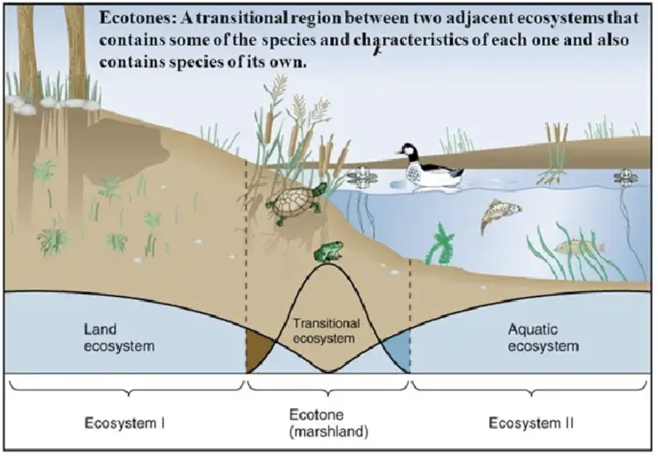
Notes:
Ecotones are areas where two different ecosystems meet and intermingle, like when prairies meet water, creating a marsh. Different than a singular ecosystem, an ecotone is a dynamic space, acting as a bridge between two ecosystems where they integrate. Because of this intersection, ecotones are a home to species from the ecosystems that feed into it while also serving as a home to species unique to the ecotone – in essence, they have a richer and stronger diversity than any singular ecosystem because of their interactions.
In other words, an ecotone’s health comes from diversity, not uniformity.
An ecotone’s health is also dependent on the health of the ecosystems that feed into it.

Slide 5
Ecotones & a “Mixed Ecology”?
Diversity of Christian expression is healthy and vibrant
A mixed ecology resists two false choices:
“Tradition alone will save us,” or
“Everything old must be replaced.”
Notes:
We can translate ecotones into a mixed ecology model in two ways.
First, diversity of Christian expression in healthy and vibrant.
Second, a mixed ecology resists two false choices:
“Tradition alone will save us,” or
“Everything old must be replaced.”
A mixed ecology affirms both continuity and innovation.

Slide 6
Why a Mixed Ecology in the ELCA?
The Augsburg Confession tells us that the church is:
The assembly of all believers among whom the gospel is purely preached and the sacraments are administered according to the gospel… *
It is not necessary for the true unity of the Christian church that uniform ceremonies, instituted by human beings, be observed everywhere. *
*The Augsburg Confession, Article VII: Concerning the Church in The Book of Concord: The Confession of the Evangelical Lutheran Church, ed. Robert Kolb and Timothy J Wengert (Minneapolis: Fortress Press, 2000)
Notes:
The Augsburg Confession tells us that the church is:
The assembly of all believers among whom the gospel is purely preached and the sacraments are administered according to the gospel…
AND that
It is not necessary for the true unity of the Christian church that uniform ceremonies, instituted by human beings, be observed everywhere.
Notice what is not required:
a single structure
a single style
a single cultural form

Slide 7
Why a Mixed Ecology in the ELCA?
Core Lutheran Theological Lenses Supporting Mixed Ecology:
Justification by grace → We are freed from anxiety about institutional survival
The priesthood of all believers → Ministry is not confined to clergy or buildings
The means of grace → God meets us in embodied, contextual ways
Notes:
This gives Lutheran theology a built‑in flexibility – remaining faithful to core values and theological beliefs like
being justified by grace
the priest hood of all believers and
the means of grace (like proclamation of the Word and the Sacraments)

Slide 8
We need the Inherited Church
The inherited church is a treasury of wisdom, not a failed experiment.
In a mixed ecology, the inherited church becomes:
a spiritual home base
a teaching and sacramental anchor
a support system
Notes:
The inherited church:
carries theological depth and accountability
safeguards the sacraments
forms people through worship, preaching, and pastoral care
offers stability across generations
It is a treasury of wisdom, not a failed experiment.
In a mixed ecology, the inherited church becomes:
a spiritual home base
a teaching and sacramental anchor
a support system for emerging ministries and the leaders who help co-create them with the people they gather with.

Slide 9
We also need new expressions of the church
Faithful mission requires contextual imagination
New expressions of church:
start with listening rather than programs
prioritize relationship over attendance
shape worship and community with people, not for them
Notes:
Many people today will never cross the threshold of a church building for any number of reasons—but people do and will gather:
around meals
around serving their neighbors and helping all to experience the difference that God’s love in Jesus makes in the world
in digital or nontraditional spaces
in neighborhoods, workplaces, and communities of affinity
New expressions of church:
start with listening rather than programs
prioritize relationship over attendance
shape worship and community with people, not for them
This is not “watering down” the gospel—it is incarnation – authentic to the experiences of the people who show up. We have so many letters from Paul that sometimes feel like they contradict themselves because those were letters sent authentically to those communities and helping them understand what following Jesus looked like in their context.

Slide 10
Mixed Ecology and the Missio Dei
A mixed ecology helps the church:
notice where the Spirit is moving
join rather than control
adapt without losing its core values and theology
Inherited and emerging churches need each other:
tradition gives roots
innovation gives reach
Notes:
While I don’t know who originally said this, one of my mentors regularly said these words to me when I was in seminary:
The church does not have a mission—God’s mission has a church.
God is already at work in the world. A mixed ecology helps the church:
notice where the Spirit is moving
join rather than control
adapt without losing its core values and theology
Inherited and emerging churches need each other:
tradition gives roots
innovation gives reach

Slide 11
Mixed Ecology Requires Trust
Mixed ecology is not simply a strategy—it is a spiritual posture.
Engaging a mixed ecology requires:
humility from established communities
patience with experimentation
trust that the Holy Spirit is still calling, gathering, enlightening, and sanctifying the church
Notes:
Mixed ecology is not simply a strategy—it is a spiritual posture.
It requires:
humility from established communities
patience with experimentation
trust that the Holy Spirit is still calling, gathering, enlightening, and sanctifying the church
We are not preserving a museum. We are participating in the living body of Christ in the world.

Slide 12
A Mixed Ecology: Rooted & Reaching
“For all that has been—Thanks. For all that shall be—Yes,”
Notes:
A mixed ecology of church allows us to say—with confidence and hope—
We honor what has been. We embrace what is emerging. And we trust God with what is still becoming.
In the words of Dag Hammarskjöld, the second UN Secretary-General
“For all that has been—Thanks. For all that shall be—Yes,”

