Slide 1
Transitions from Children’s services to adult services
Children with Disabilities Team

Slide 2


Slide 3
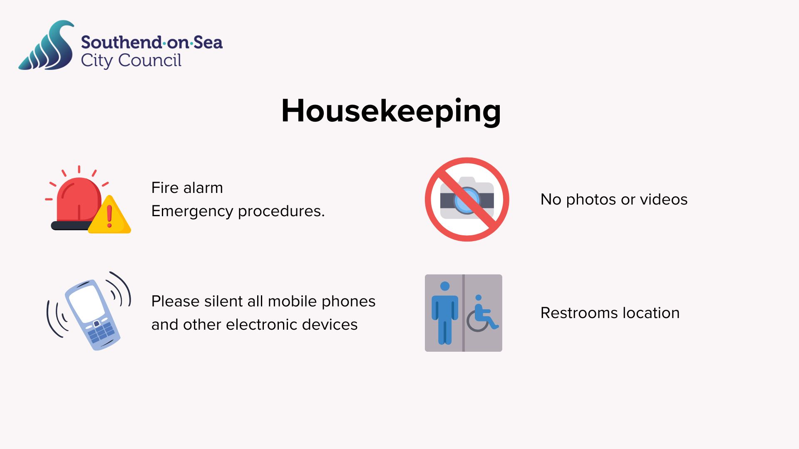

Slide 4
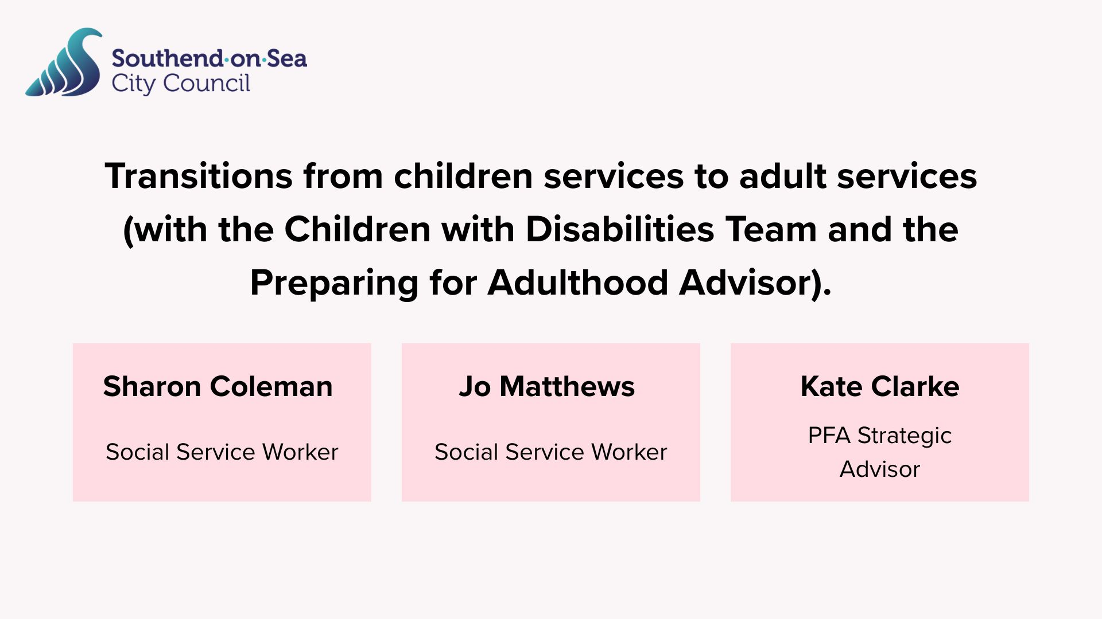

Slide 5
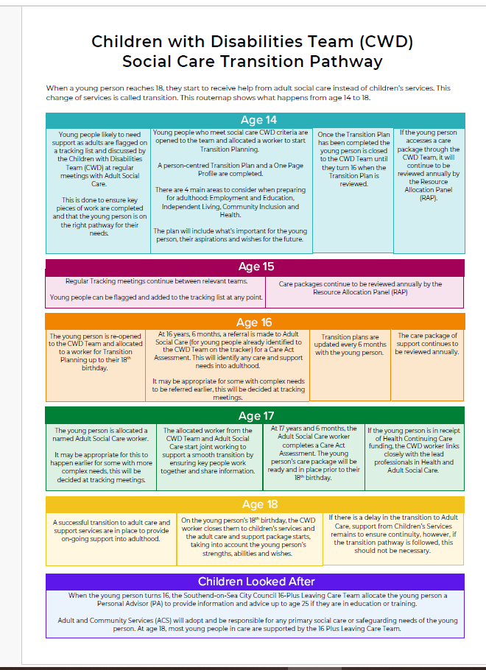
CWD team transitions Route Map

Slide 6
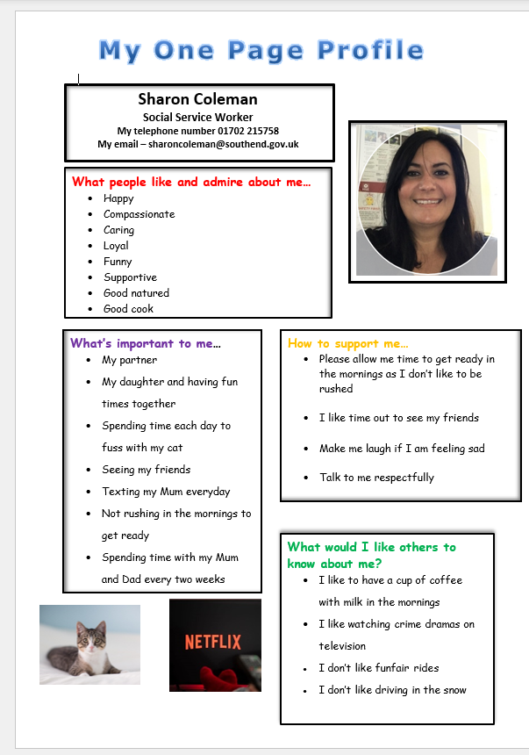
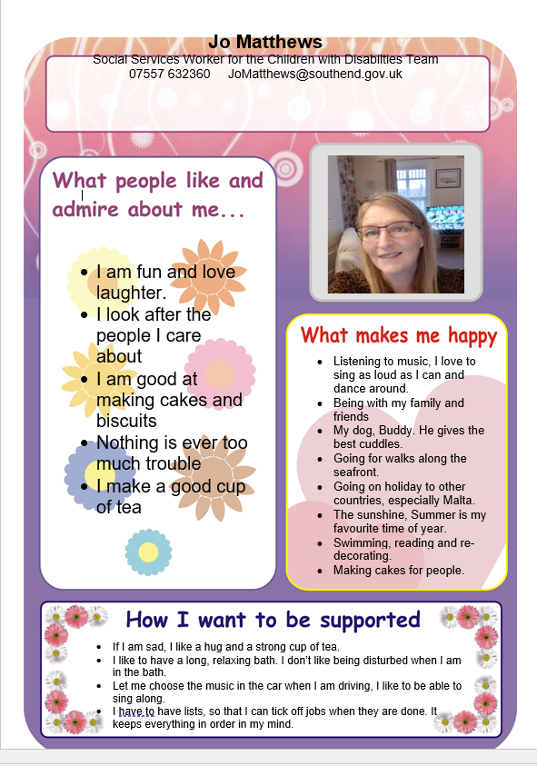
One-page profiles
Sharon Coleman
Jo Matthews

Slide 7
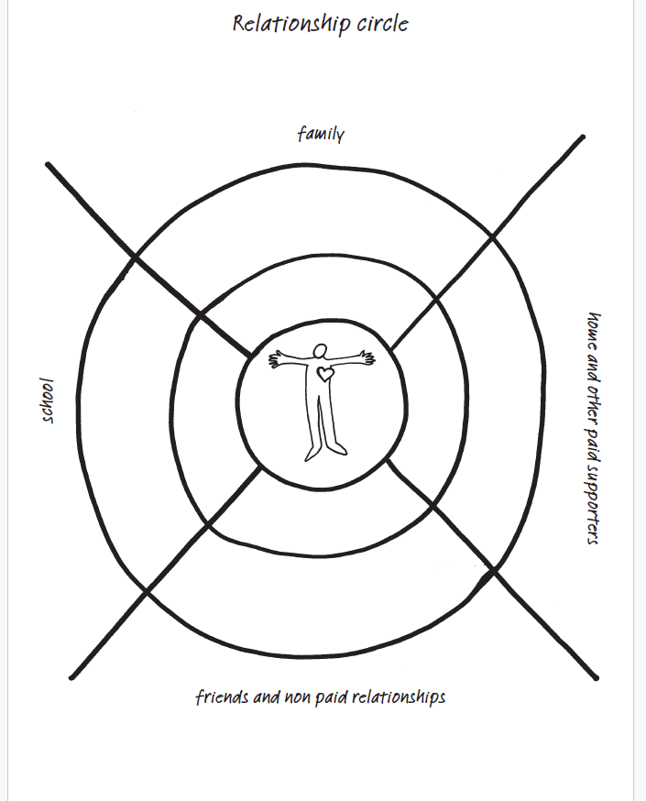
Relationship circle

Slide 8





Main themes of discussion in Annual Reviews

Slide 9


Slide 10


Slide 11





Journey Times (Southend Civic Centre to destination)
 | Train + Bus + Walk | Car
SECG - Southend | 10 mins | 2 mins
SECG – Luckyn lane Basildon | 1hr | 30 mins
SECG - Thurrock | 40 mins | 45 mins
USP – SEEVIC | 50 mins | 20 mins
SACC - Southchurch | 20 mins | 5 mins
Writtle - Chelmsford | 1hr 20 mins | 40 mins
GAPS TCHC - Basildon | 1hr | 30 mins

Slide 12


Thank you for listening, please visit us on our stall outside, where we will be happy to answer any questions, you may have.

