Slide 1


Slide 2
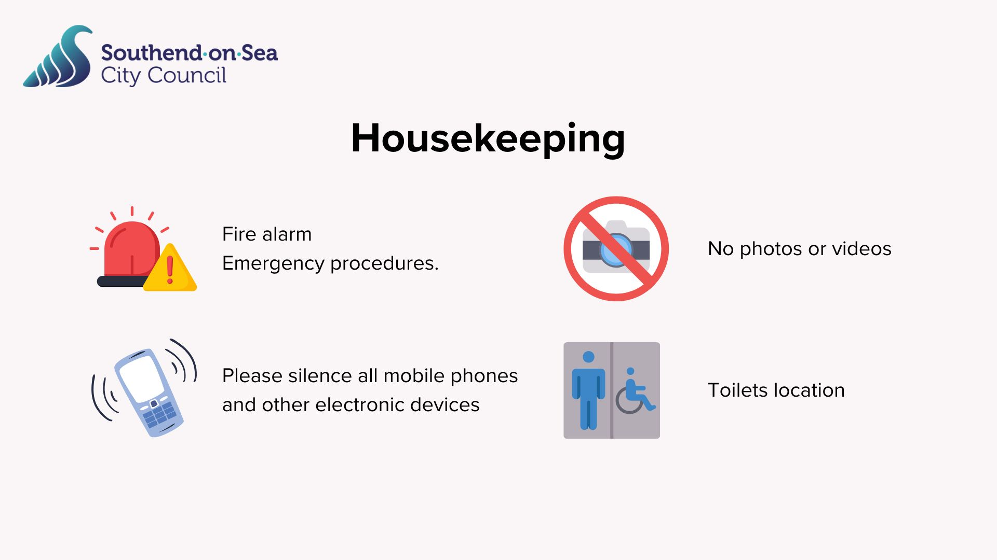

Slide 3
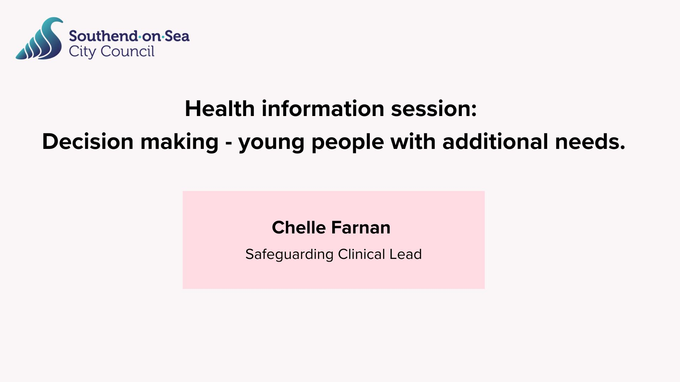

Slide 4


Decision making - young people with additional needs
Presented by:
Chelle Farnan – Regional Safeguarding Clinical Lead
Notes:
Standard title slide

Slide 5

Thank you for inviting me to speak today
Here’s the boring legal bit!
This presentation will be a general overview of the legal frameworks and what the process should look like.
My presentation cannot be taken as legal advice.
I cannot comment or give guidance on individual circumstances.
Please hold your questions until the end as I may cover what you are going to ask further on in the presentation.
If we we’re doing this on-line I would now ask you all to put yourselves on mute!

Slide 6


Introduction
When a child becomes 16 years old they have reached the age of consent, and this is regardless of their abilities and needs.
As a learning disability nurse of 37+ years and parent to a trio of young adults (see photo), one of whom has special educational needs and disabilities, I can tell you now (and I’m sure you’ll all agree) they don’t just wake up on their 16th Birthday with a sudden ability to make decisions!
NB: I sought consent from each of my three children to use this photo … and guess which one withheld it ☺
The ability to make decisions is a journey not a destination, firstly, lets look at the relevant legal frameworks.

Slide 7

Making choices and decision making
Under what legal framework?
As said, in England & Wales when a person reaches the age of 16 years, they have reached the age of consent (Family Law reform Act 1969, s8. & Mental Capacity Act 2005).
This is regardless of their maturity, level of ability, competency, their experiences or even diagnosis, Ref: MASMC – MASMC (myadultstillmychild.co.uk).
Notes:
Plain slide with subhead and bullets

Slide 8


The concept of autonomy is arguably the central principle in healthcare ethics
“Autonomy finds its clinical expression in the obligation to seek informed consent.” BMJ 2011
Before any intervention, a practitioner must ask themselves;
“Under what legal framework am I able to do so?”
There must be a basis in law …
Capacity
Consent
When you are without consent, only then do you move to seeking alternatives.
Consent is not just the absence of ‘No’ to the offered intervention (that is just passive acquiesce) it is an enthusiastic ‘Yes’!
If someone is so incapacitated that cannot say ‘No’,
then they cannot say ‘Yes’ either.

Slide 9


Myth-Busting: Next of Kin
Did you know that there is no legal basis for ‘Next of Kin’ (NoK)?
The term ‘Next of Kin’ is often used in Health and Social Care as a euphemistic shorthand for ‘Who is the person we communicate with about you?’
In law NoK has no status when the patient is alive - it is misleading too because it does not clarify if this is the person who is the nearest relative of the patient or the person most important to the patient. Indeed, these can often be different people.
If someone is in hospital and unable to consent to treatment, NoK have no legal right to give consent on their behalf unless certain legal procedures are in place, such as;
  A Lasting Power of Attorney (LPA) https://www.hampshiresab.org.uk/lasting-power-of-attorney/
  A Deputyship Order from the Court of Protection.
There is only one situation where ‘next of kin’ is legally valid; this is if someone sadly dies without leaving a will.
In this case, the deceased person’s estate will be passed on to the person or people who are their closest blood relation, also termed as their next of kin.
NoK-Booklet-for-interactivepdf.pdf (bournemouth.ac.uk)

Slide 10
Making choices and decision making
Under what legal framework?
There are three depending on the age of the child or young person/adult broadly speaking as follows:
For children aged 0-15 years it is ‘Parental Responsibility’.
  However, a child can also be found to be ‘Gillick Competent’ to make their own choices and decisions, including giving or withholding consent.
  The closer the child is to 16 years old, the more likely they would be considered Gillick Competent.
  If the child is not, parents retain the legal ability to consent for their child, until they are 18.
At 16 years, the Mental Capacity Act 2005 is applicable to young people aged 16+.
  They now have the legal right to consent for themselves, if they have the mental capacity to do so.
  Where they do not, parents continue to have the legal right to consent on their behalf until 18.
  Additionally, the MCA can also be used to make ‘Best Interest’ decisions.
At 18 years, the person is now a young adult, and no-one can make choices and decisions for them including giving or withholding consent unless specific legal steps are taken,
  including the MCA’s Best Interest. This is the far simplest route to alternative decision making.
MASMC – MASMC (myadultstillmychild.co.uk).

Slide 11

Scope of Parental Responsibly (PR) – what is it?
The scope of parental responsibility includes the rights, duties, and authority a parent has over their child's upbringing and property, such as making decisions about education, medical treatment, and naming the child.
For major decisions, all individuals with parental responsibility must agree, while routine decisions can often be made by just one parent.
The scope of responsibility also extends to ensuring the child is financially supported and protected.

Slide 12
Limits and limitations to Parental Responsibility
Court orders:
A court can make a decision if parents cannot agree on a major issue. The child's welfare is the court's paramount consideration.
Diminishing scope:
The extent of parental responsibility generally decreases as a child gets older and becomes more capable of making their own decisions.
Human rights:
The exercise of parental responsibility is limited by the child's human rights. For example, parental consent cannot override the law in cases of deprivation of liberty, even if the parent consents, Ref: Weightmans.
Removal of responsibility:
A court can remove parental responsibility in extreme cases, such as abuse or neglect. A person's parental responsibility can also be suspended if they are convicted of killing the other parent, a rule introduced by Jade's Law.

Slide 13

Guidance re Parental Responsibility in England and Wales: An overview of parental responsibility in
England and Wales, including how it is gained and lost.
Parental responsibility in England and Wales - House of Commons Library (parliament.uk)

Slide 14
Gillick Competence: how is this established?
Gillick Competence is based on common law, not a statutory test, so there will be variation in how people frame the criteria.
For a child to be found to be Gillick competent they must be able to:
  Understand the nature and implications of the treatment, which would include the likely effects and potential side effects.
  Understand the implications of not pursuing the treatment, including nature, likely progress and consequences of any illness that would result from not receiving the treatment.
  Retain the above information long enough for the decision-making progress to take place; and,
  Be of sufficient intelligence and maturity to weigh up the information and arrive at a decision.
The bar may be set higher for children to be found Gillick competent than it is for a mental capacity assessment where, to be considered capacitous, a person aged 16 and over only needs to be able to understand, retain and, use and weigh ‘relevant information’.
To be found Gillick competent a child must be able to demonstrate “a full understanding of the consequences”.
Where they do not, those with PR can make the decision for them.
References:
Johnston QC and Roper QC (2022) Medical Treatment: Decisions and the Law at [4.5]
https://www.mentalcapacitylawandpolicy.org.uk/book-review-medical-treatment-decisions-and-the-law-4th-edition/
Bevan Brittan (2022) Children - which decision counts? Part One: Medical Treatment Decisions

Slide 15
Making choices; making decisions
The Mental Capacity Act 2005
The MCA presumes that a person aged 16 and over have the capacity to make their own decisions unless proven otherwise (they have had an assessment showing they don’t) and aims to support and protect them in decision making.
Where the person has been assessed as not being able to make the decision the MCA sets out how decisions can be made in their ‘Best Interest’.
A person’s rights under the MCA are:
To make their own decisions.
Assumption of capacity.
Support to make decisions.
Any decisions made for the person must be in their Best Interest.
What is the Mental Capacity Act? – Mind
The MCA is underpinned by five principles.

Slide 16
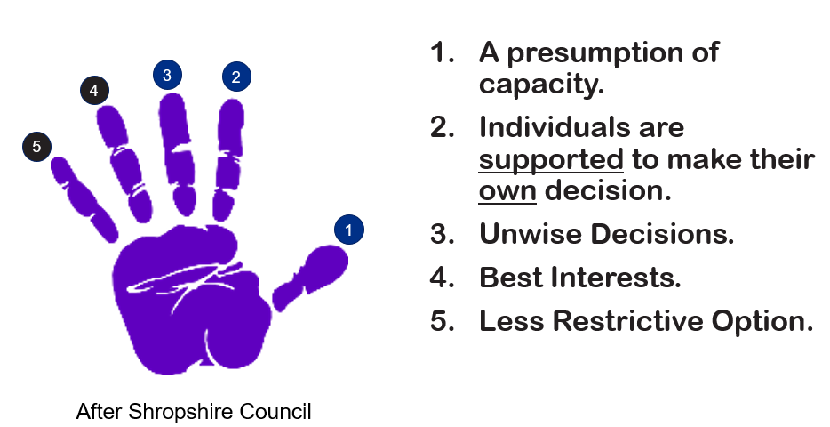
The Five Principles of the Mental Capacity Act 2005

Slide 17
Who is the Best Interest Decision Maker?
“Wherever possible all individuals should be involved in decisions about their care and treatment.
Every effort should be made to ensure that their views are sought and shared.
Where individuals are unable to express their wishes a Best Interest decision should be made.
The decision about who is the Best Interests decision maker is a crucial point.
For day-to-day decisions about care or activities of daily life, it is likely to be the person’s primary carer. This will often be the parent(s) who may have already cared for that young person/adult all their lives making decisions under parental responsibility. But from the age of 16, this is governed by the MCA, and not an automatic right under parental responsibility.
For decisions about serious medical treatment, the law regards the decision maker as being the person responsible for delivering the treatment – e.g., the key surgeon or doctor.
Understandably, this can cause distress and conflict where a parent who has made every decision all the child’s life is then told that the parent is not the sole decision maker when a child over 16 needs serious medical treatment.”
Who is the best interests decision maker? – MASMC (myadultstillmychild.co.uk)

Slide 18
Best Interest Check List – professionals should
Avoid making assumptions based on age, appearance, condition or behaviour.
Consider the person’s own known wishes, values feelings and beliefs.
Take account of the views of family and informal carers regarding the care or treatment.
Consider if the decision can be delayed until the person regains capacity.
Involve the person in decision-making, even if they lack capacity to consent.
Demonstrate that all views and evidence have been considered
  - especially pertinent if there is conflict.
Provide clear objective reasons to support why a decision is in the person’s best interest.
Take account of any Independent Mental Capacity Advocate (IMCA) involved.
Take the less restrictive alternative or intervention.
Best Interest Checklist taken from Department of Health 2007 – MCA Acute Hospitals Training Set
The best interests checklist - Mental Capacity Toolkit

Slide 19

It should always be the Less Restrictive Option that achieves the desired outcome

Slide 20

Developing decision making ability
As a parent being told that you are no longer the decision maker can be quite a shock.
Conversations with the child and their family about the Mental Capacity Act must start before the child reaches the age of consent at 16 – ideally no later than age 14 / year 9 EHCP review. However, it is never too late to start!
Professionals can’t make a best interest decision about someone without knowing them, so that logically involves consulting with their parents and others that know them well.
Applying the MCA principles as everyday ways of working means routinely involving children and young people in discussions about their care as they begin to mature towards age 16 by applying MCA principles 1 & 2 into everyday practice.

Slide 21

Developing decision making ability – Cont.
Start off small, decision making is a skill, and like any other, can be acquired and built upon with support and practice and families are absolutely key in doing so.
By professionals working with families towards being prepared for the age of 16 (from around 14 years or year 9 in terms of the educational health and care plans) this will give everybody plenty of time to start acclimatising themselves to the notion that we need to start considering young people/adults as competent to make their decisions in the first instance.
And it is only if and when we establish the child or young person/adult are unable to do so that we move to any other kind of decision-making legal basis, such as the Mental Capacity Act’s Best Interest.

Slide 22

Discussions with professionals
Early discussions (before your child’s 16th birthday) with the health professionals in the child or Young Person’s life, such as their GP or Hospital Consultant are essential to ensure a smooth move from Parental Responsibility to MCA.
You can also contact NHS England directly via: england.contactus@nhs.net

Slide 23

X
The 18th Birthday should be seen, not as a cliff-edge, but as a Trench!
To be crossed

Slide 24


Via the
Mental Capacity Act

Slide 25
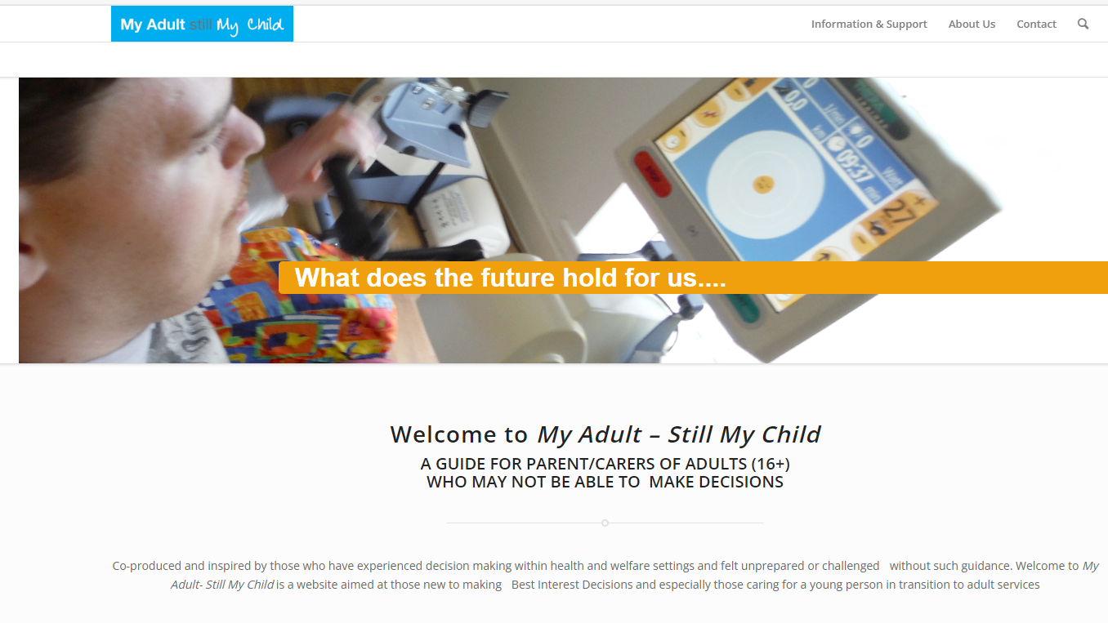
MASMC – MASMC (myadultstillmychild.co.uk)

Slide 26
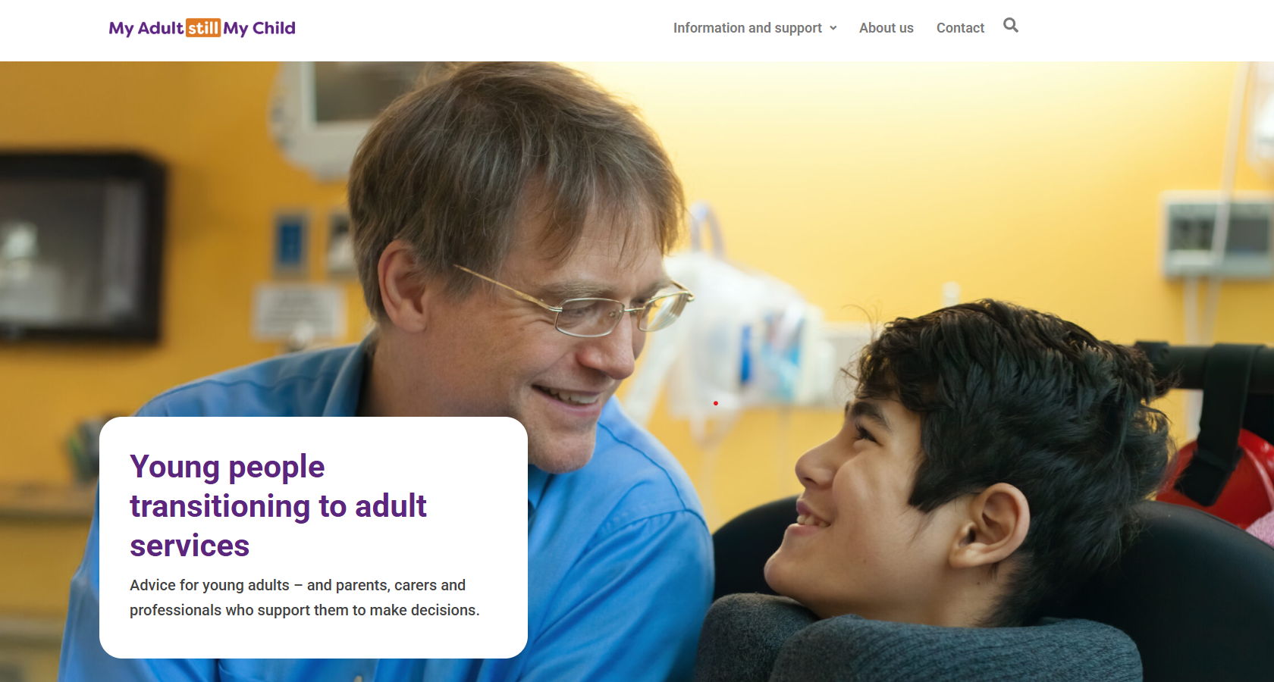
https://myadultstillmychild.co.uk/

Slide 27
Take Away Messages
When a child becomes 16 years old they have reached the age of consent, and this is regardless of their abilities and needs.
Conversations with the child and their family about the Mental Capacity Act must start before the child reaches the age of consent at 16 – ideally no later than age 14 / year 9 EHCP review.
Early discussions (before 16th birthday) with the professionals in the child or Young person’s life, such as their GP are essential to ensure a smooth move from Parental Responsibility to MCA.
Whilst it is possible to rely on consent from those with parental responsibility for a 16- or 17-year-old who is unable to consent for themselves in some circumstances, this does not cover decisions where they fall outside of the ‘scope of parental responsibility’.
Matters that would not be covered by parental consent can include (but are not limited to):
  Any situation that gives rise to a deprivation of liberty for a 16- or 17-year-old who cannot consent for themselves which is due to a lack of mental capacity.
  High impact decisions such as organ donation or sterilisation.
  Where there is refusal or objection by the child and they are a Gillick-competent child or a *capacitated young person.
*i.e. there are no reasons to doubt capacity as per principle 1 of the MCA

Slide 28
No Decision about me
without me

Slide 29
In Summary
It is generally accepted that the closer the child is to 16, that there is a stronger expectation that healthcare professionals should be assessing for both Gillick-competence and (for those aged 16+) capacity under the Mental Capacity Act 2005 in relation to gaining consent.
The MCA applies to those aged 16+ and any scope for parental consent will cease at age 18.
The MCA has a robust legal framework to guide decision making.
It makes absolute sense to use the MCA for those aged 16 and 17 for these reasons and more; not least of which is it can help to build decision making ability in the young person in readiness for age 18 when the MCA will be solely available (outside of a court order or Lasting Power of Attorney (LPA)).
Capacity is not based on age, diagnosis, appearance, condition or behaviour.
Approach every contact with the mindset that the child or young person/adult has the ability to make this decision, (always give the benefit of doubt); and where they do not, they can participate in some meaningful way – they should be central to the conversations.
Best interest - it’s not just a license to ride roughshod over young people’s choices, likes, wishes and preferences; these must be taken into consideration.
Adopt the “No decision about me without me”.
Notes:
Right to advocacy – Article 39
Section 35, Mental Capacity Act 2005
Section 35 places a duty on local authorities to make independent mental capacity advocates available to represent and support any person (including children aged 16 and 17) in connection with decisions made under the Act. This includes decisions about care, treatment and provision of accommodation.

Slide 30

Resources

Slide 31
The Mental Capacity Act (2005) – more detail
Applies to decisions/treatment for both physical health and mental health needs.
Also applies to welfare and financial decisions.
Allows decisions to made by the ‘decision maker(s)’ subject to acting in the persons best interests, using the least restrictive option and other safeguards Who is the best interests decision maker? – MASMC (myadultstillmychild.co.uk).
Uses criteria based on assessment of capacity - not diagnosis.
Best interest decisions can only be taken for those assessed as lacking capacity for the decision, at the time the decision needs to be taken (time and decision specific).
As soon as the person regains the power to the make the decision (mental capacity), any best interest actions ceases for them.
Practitioners are protected from liability for decisions taken in a person’s best interest under Section 5 of the MCA 2005.

Slide 32

https://share.google/images/mrXAivVnmmZr2vUdp

Slide 33
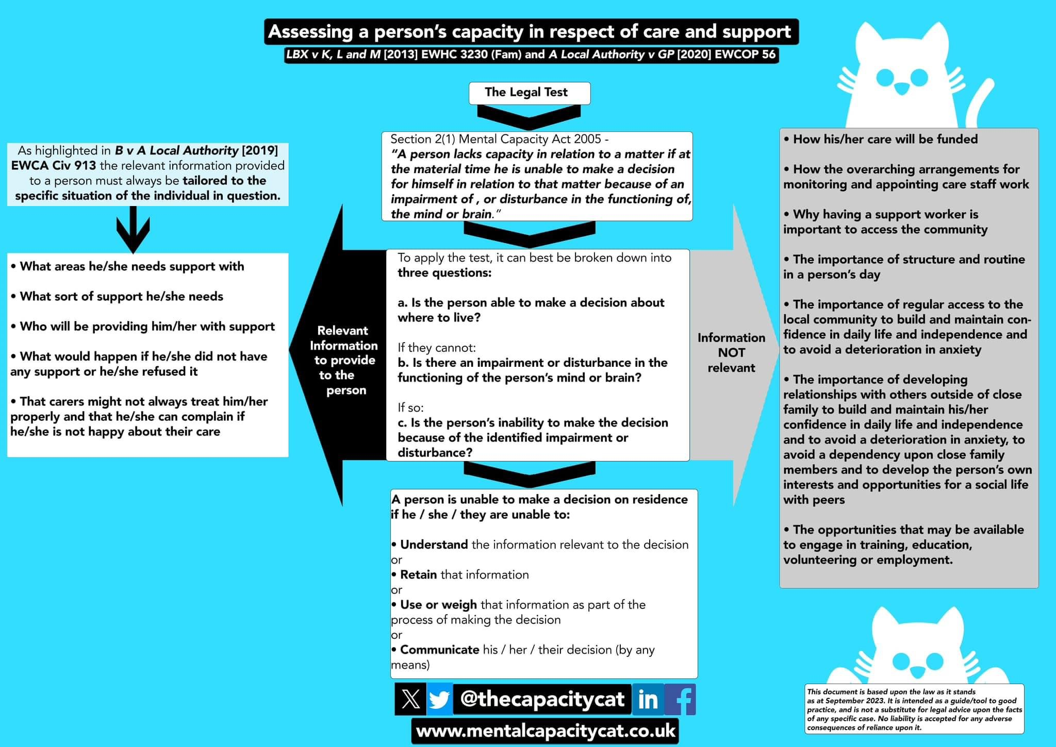
Capacity
Assessment

Slide 34
Making choices; making decisions; consent
Resources
Consent to treatment - Children and young people - NHS (www.nhs.uk)
Mental Capacity Act 2005 | Parents Guide To Support | YoungMinds
What is The Mental Capacity Act? | Mencap
What is the Mental Capacity Act? - Mind
Mental Capacity Act – MASMC (myadultstillmychild.co.uk)
Who is the best interests decision maker? – MASMC (myadultstillmychild.co.uk)
Notes:
Plain slide with subhead and bullets

Slide 35

Full page image slide
Any Questions please?

Slide 36
End slide

Slide 37


