Slide 1

Land Use Planning, Threats, and Looking Ahead
Friends Summit | May 12, 2026 | Denver, Colorado
Nick Mills, Kara Matsumoto, Jora Fogg

Slide 2



Nick Mills
Associate Public Lands Policy Director
Kara Matsumoto
Senior Policy Director
Jora Fogg
Associate Public Lands Policy Director (CA)

Slide 3
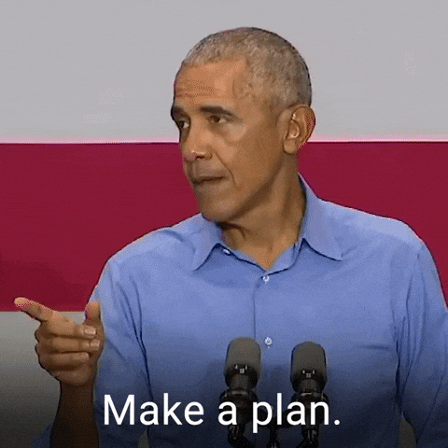
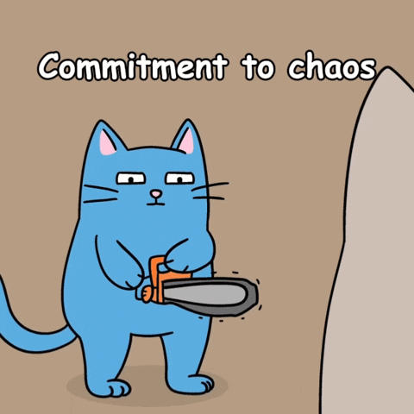

Session overview
What is land use planning?
How is planning threatened or changing?
What tools can we still use?

Slide 4
Resource Management Planning
Notes:
nick starts with title, intros, overview then goes into presentation

Slide 5
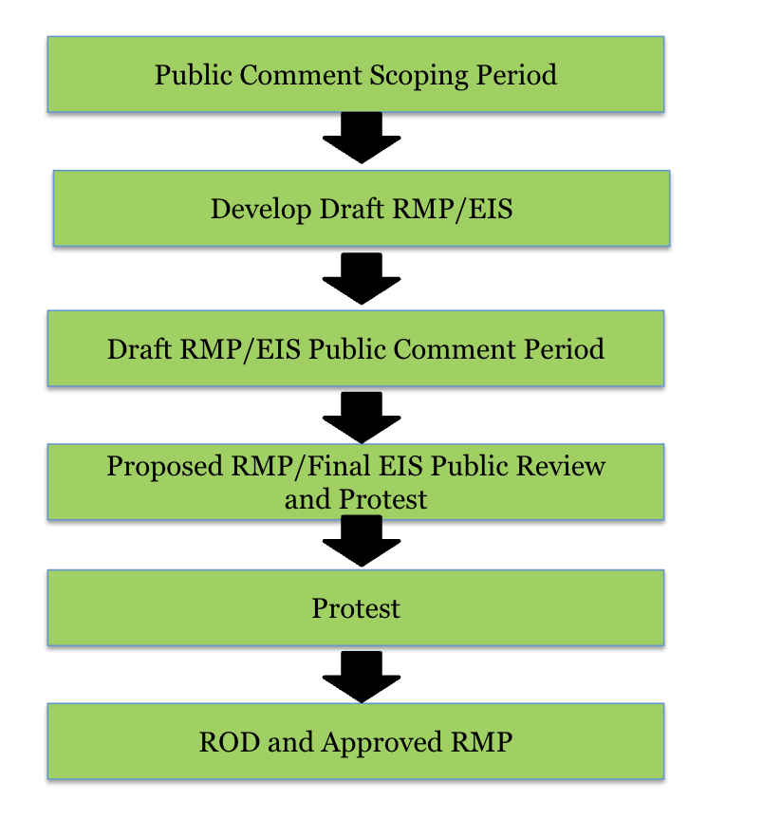
Why BLM Planning Matters
Determines long term management (often 15-20+ years) for millions of acres
Sets rules for conservation, energy development, and recreation
The planning stage is one of the most important stages to influence outcomes
Notes:
nick - talk about planning at a broad level, but there are different types of planning

Slide 6
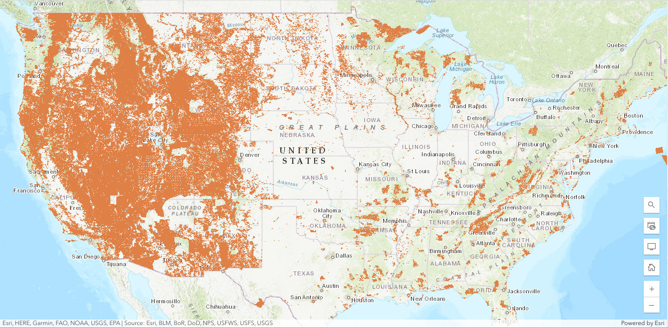
Orange: All federal lands
Notes:
orange is all federal lands,

Slide 7
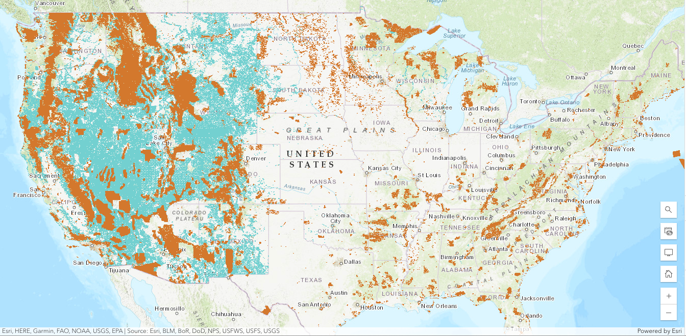
Blue: BLM Lands
Notes:
blue is blm lands

Slide 8
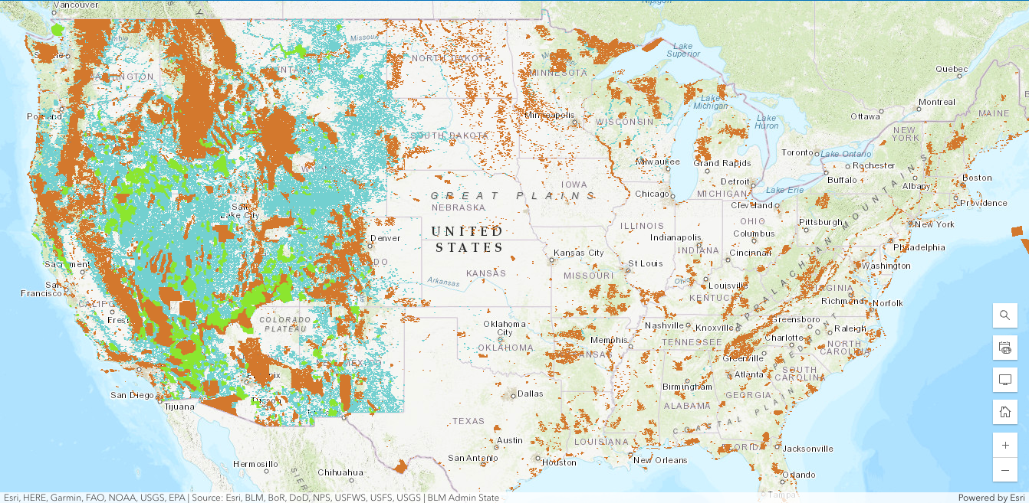
Green: Protected BLM lands
Notes:
green is protected blm lands

Slide 9
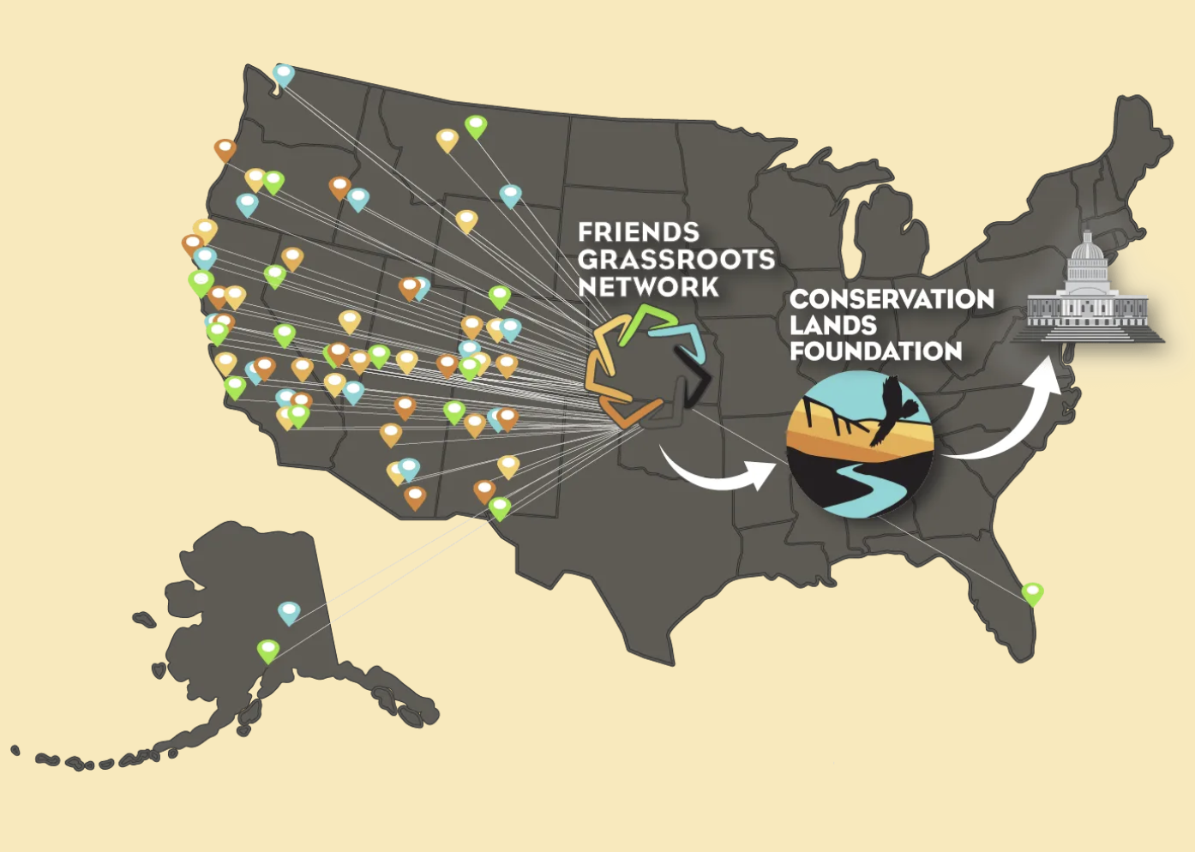

Slide 10






Recreation
Research
Ecosystems
Mental Health
Cultural and Spiritual
Extractive Industries
Icons by SHAHAREA, Satawat Anukul, Yosua Bungaran, Narakom Chanchittakam, Sendiko Designs, ridhobadal

Slide 11
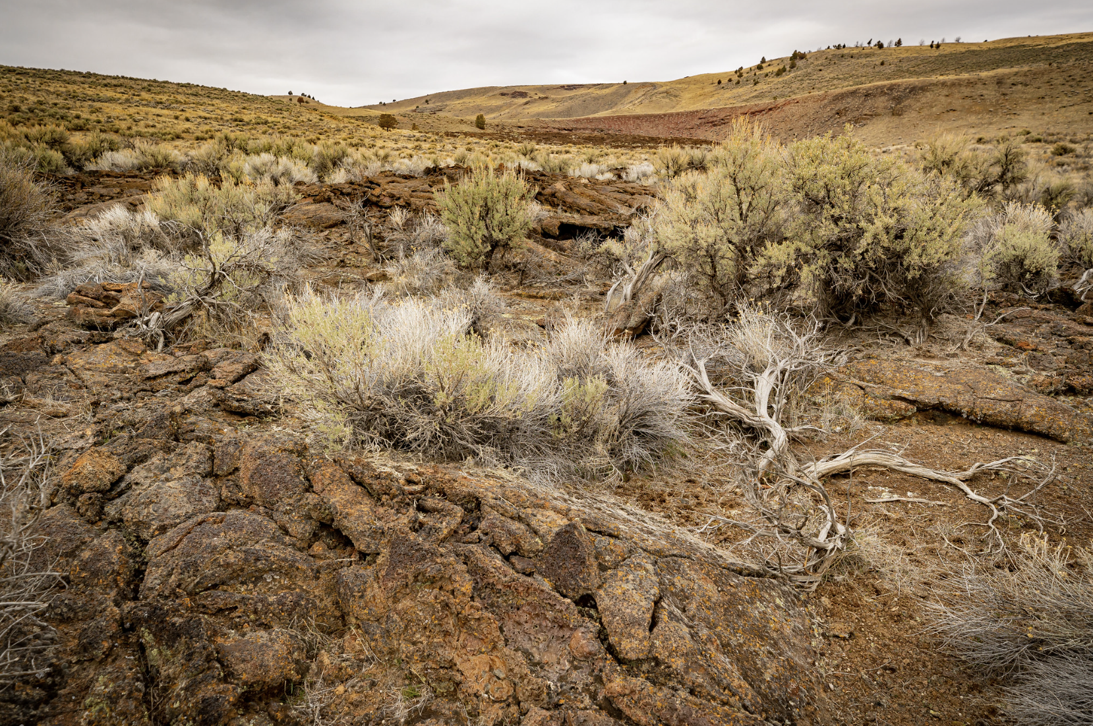
What is an RMP?
Resource Management Plans (RMPs)
BLM’s blueprint for land management
Required under Federal Land Policy and Management Act
Governs:
  Allowed uses
  Conservation designations
  Future project decisions
All actions must be consistent with the RMP

Slide 12

The Planning Process
BLM planning cycle:
Scoping
Data + inventory
Alternatives
Draft plan
Final plan
Implementation
Public Input is built in throughout

Slide 13
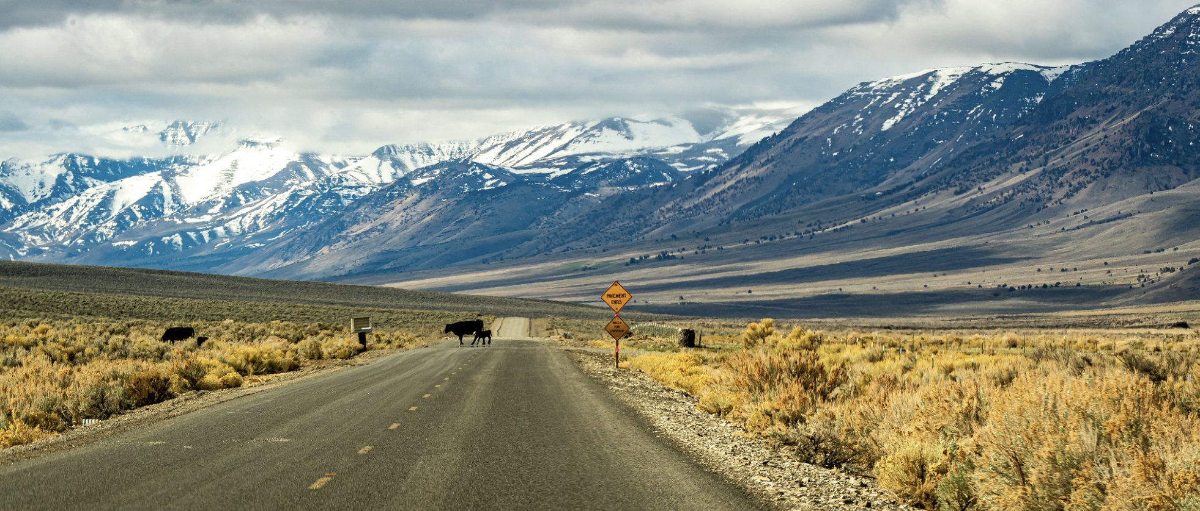
Stage 1: Scoping
Issues identified
Public submits concerns, data, and conservation proposals
Important engagement moments include:
  ACECs, LWCs, and Alternatives

Slide 14
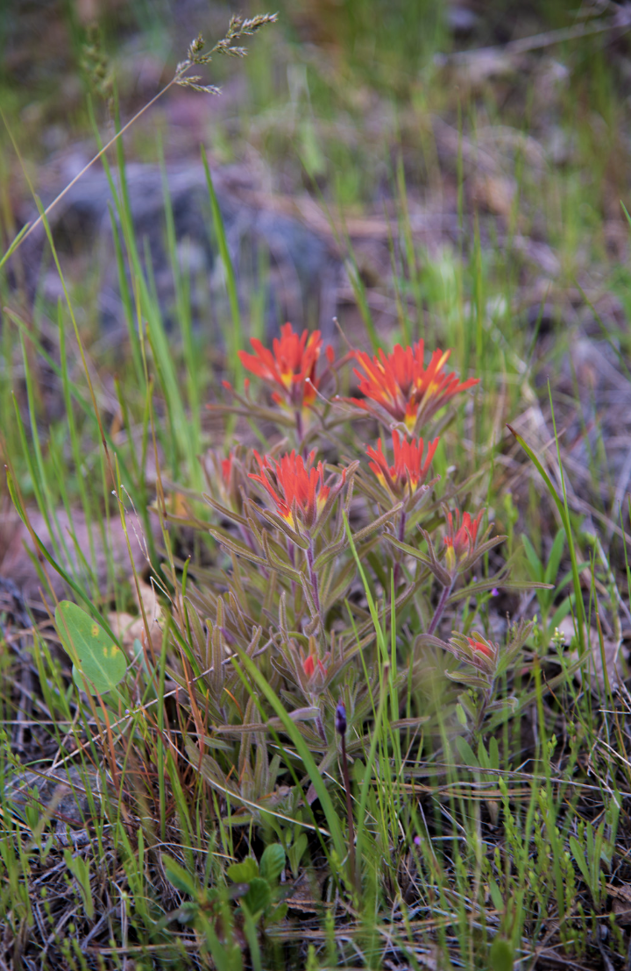
Stage 2: Data and Analysis
Identify priority resources + conflicts
Habitat, recreation, grazing, energy, cultural sites, wilderness characteristics
Inventory + evaluate Lands with Wilderness Characteristics (LWCs)
FLPMA requires BLM to maintain current inventory information
Analyze ACEC relevance + importance criteria
Special values: cultural, scenic, wildlife, ecological

Slide 15
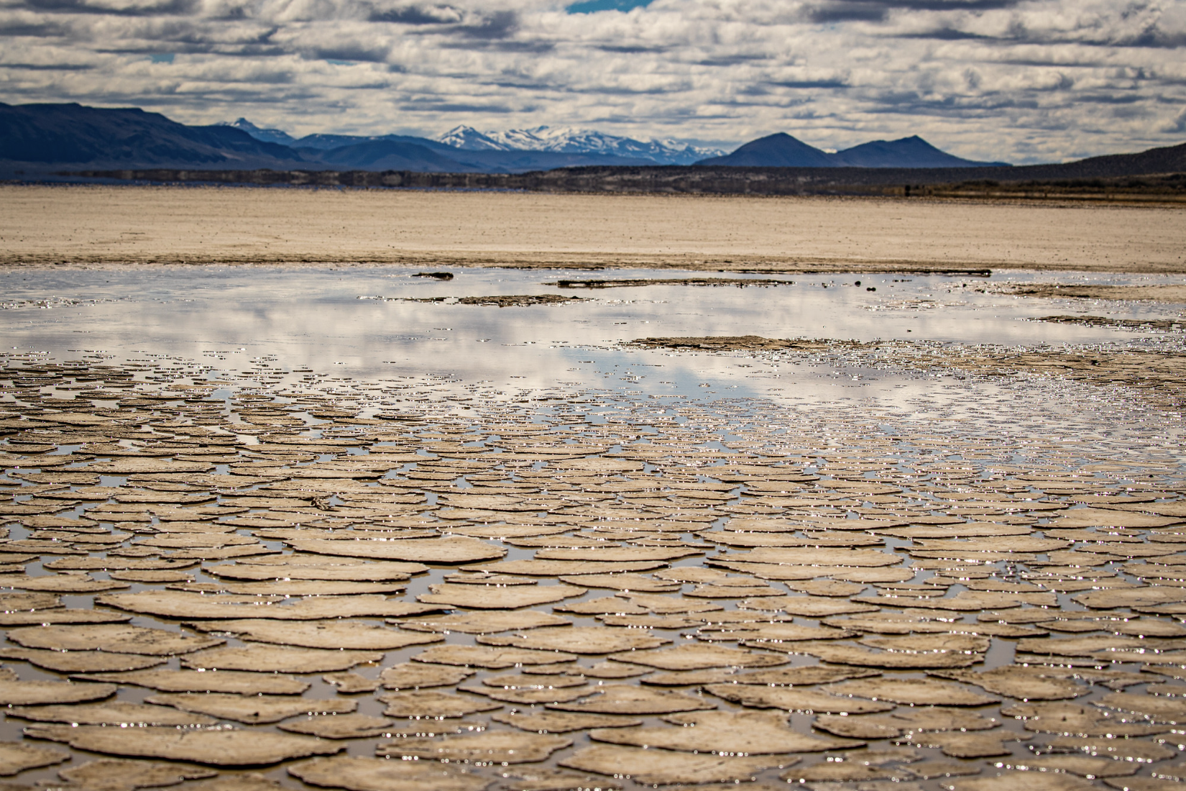
Stage 3: Alternatives
BLM develops management options
Could include development heavy alternatives or conservation heavy alternatives
ACECs, LWCs, and other designations can be

Slide 16

Stage 4: Draft RMP / EIS
Draft plan released
Preferred alternative identified
Public comment period - ideally 90 days, but we’ve seen shorter
Major opportunity to
  Improve protections
  Identify legal flaws

Slide 17
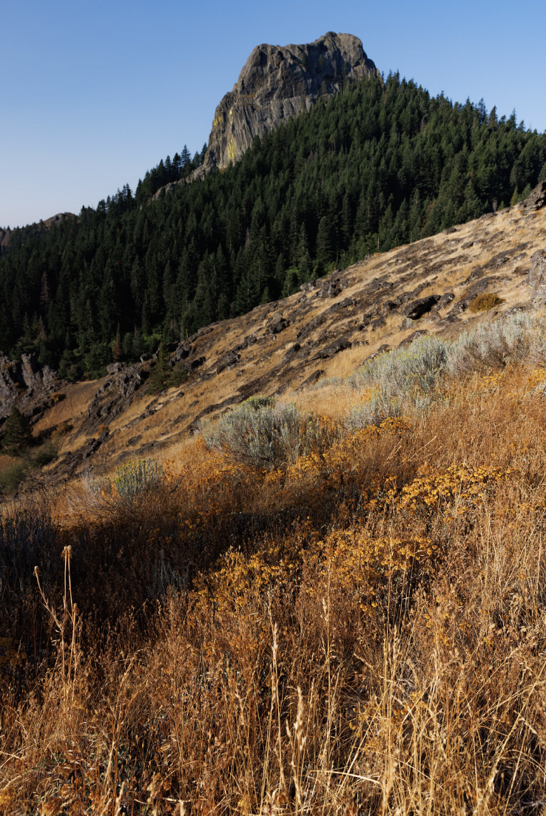
Stage 5: Final Plan
Proposed RMP / Final EIS
30-day protest period
60-day governors review
Last chance to challenge before decision

Slide 18
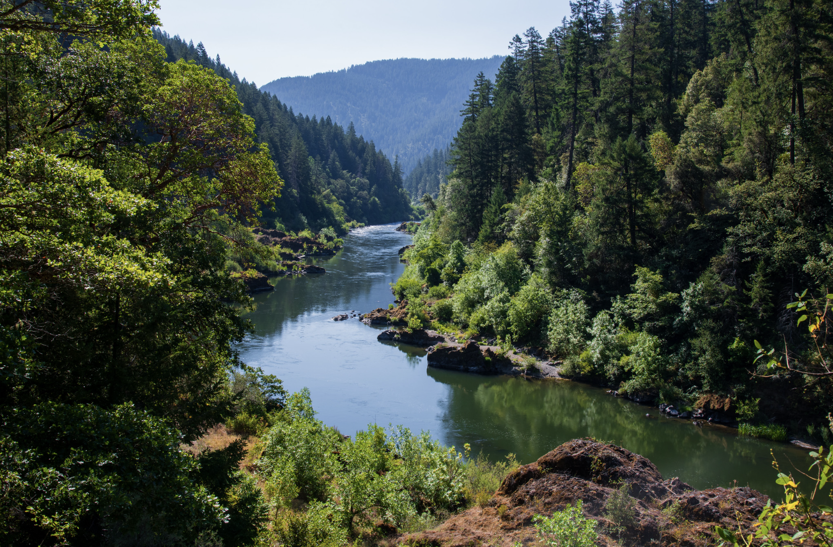
Stage 6: Decision and Implementation
Record of Decision (ROD)
Plan finalized
Becomes legally binding
Implementation begins
Then…
Monitoring
Amendments
Revisions

Slide 19

Where you have power
Scoping
Help define issues, alternatives, and resources BLM must analyze
Draft comments
Build the administrative record and identify legal or scientific deficiencies
Protests
Challenge inconsistencies with FLPMA, NEPA, and BLM policy before approval
Litigation
Courts can require BLM to revise plans, redo analysis, or reconsider management decisions

Slide 20

What BLM Must Do
Legal obligations still apply
Multiple use + sustained yield
Prevent unnecessary or undue degradation
Maintain current resource + wilderness characteristic inventories
Involve the public

Slide 21

Key Takeaways
Long-term decisions happen here
Early engagement = biggest impact
You can shape outcomes

Slide 22
National Environmental Policy Act changes
Congressional Review Act threats
One Big Beautiful Bill changes
Rescission of the Public Lands Rule
Threats and changes to land use planning
Notes:
kara begins

Slide 23
National Environmental Policy Act
CEQ implementing regulations
CEQ rescinds regulations
NEPA becomes law
Jan 1, 1970
May 24, 1977
Nov 29, 1978
Jan 20, 2025
Jan 8, 2026
Feb 24, 2026
Executive Order 11991
Executive Order 14154
DOI Final Rule and NEPA handbook update
Notes:
Decodification: Approximately 80% of DOI's prior NEPA regulations were rescinded from the Code of Federal Regulations (CFR) and moved into the non-codified Departmental Handbook. This allows DOI to update procedures more quickly without formal rulemaking.
CEQ Independence: Following CEQ's January 2026 rescission of its own binding regulations, DOI now relies directly on the NEPA statute itself rather than supplemental CEQ rules.
Narrowed Effects Analysis: The handbook moves away from analyzing "direct," "indirect," and "cumulative" effects. Instead, it focuses strictly on impacts with a "reasonably close causal relationship" to the proposed action, excluding effects outside an agency's regulatory authority.
Mandatory Limits: It strictly enforces statutory deadlines (one year for EAs; two years for EISs) and page limits (generally 150 pages for EISs).
Economic Weighing: Officials may now formally weigh economic effects (e.g., job creation, wages) against environmental impacts during decision-making.
Removal of Climate/Justice Requirements: The requirement to identify an "environmentally preferred alternative" based on climate or environmental justice benefits has been eliminated.
Reduced Public Comment: Mandatory public comment is now only required when a Notice of Intent is issued for an EIS. Comments on draft environmental documents or EAs are now at the discretion of the "responsible official".
Expanded Categorical Exclusions (CXs): Agencies can now rely on other agencies' CX determinations for similar actions and combine multiple CXs to cover complex projects.
Applicant-Prepared Documents: New procedures allow project sponsors or their contractors to prepare EISs and EAs under agency supervision to expedite timelines

Slide 24
National Environmental Policy Act
a statement of purpose and need that briefly summarizes the underlying purpose and need for the proposed agency action
a reasonable range of alternatives
the reasonably foreseeable environmental effects of the proposed agency action
notice of intent to prepare an environmental impact statement . . . shall include a request for public comment on alternatives or impacts and on relevant information, studies, or analyses with respect to the proposed agency action

Slide 25
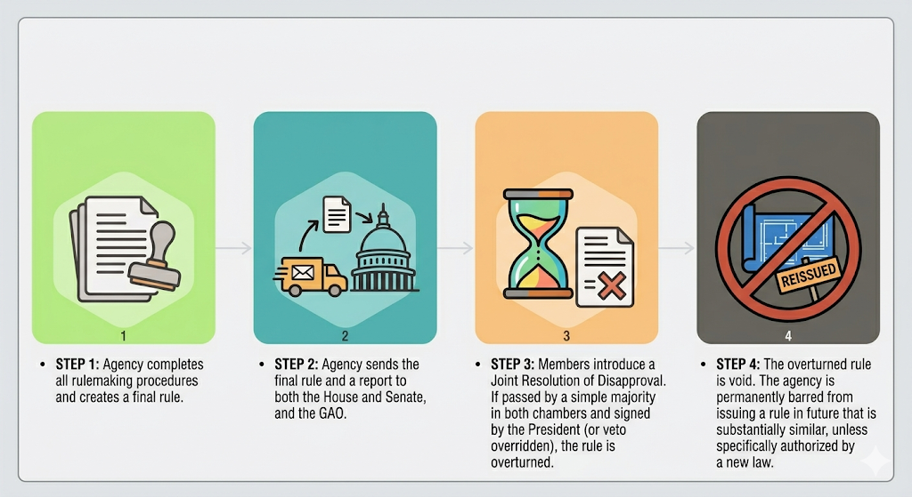
Congressional Review Act

Slide 26
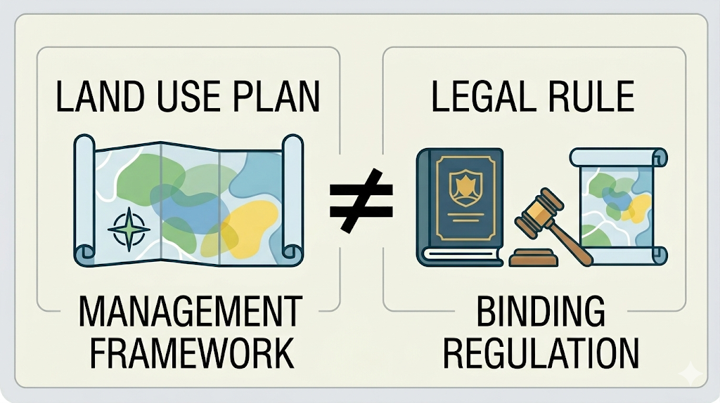
Congressional Review Act

Slide 27
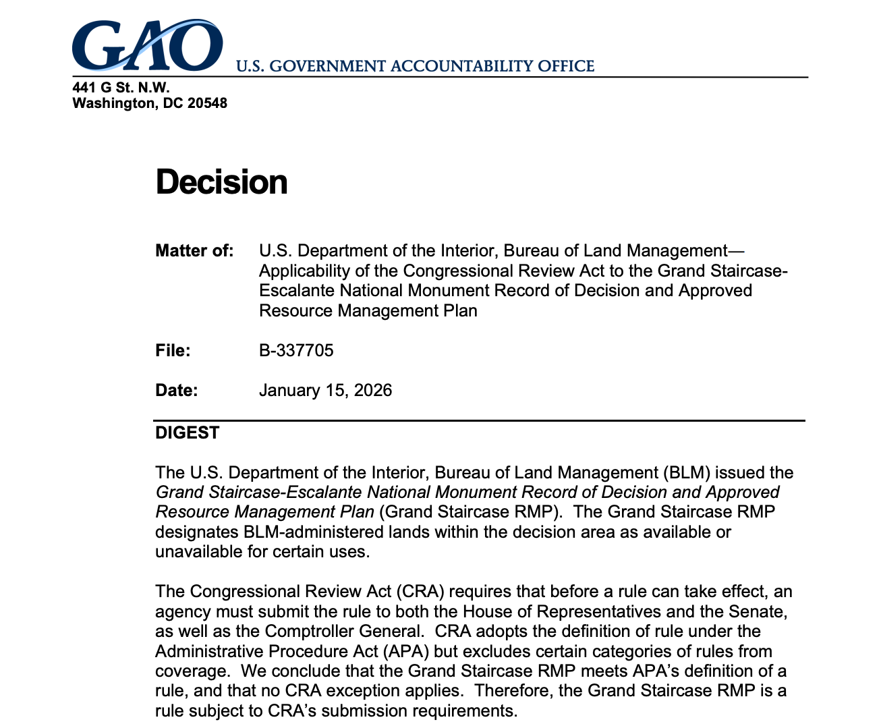
Congressional Review Act
Public Comment Scoping Period
Develop Draft RMP/EIS
Draft RMP/EIS Public Comment Period
Proposed RMP/Final EIS Public Review
and Protest
Protest
ROD and Approved RMP

Slide 28
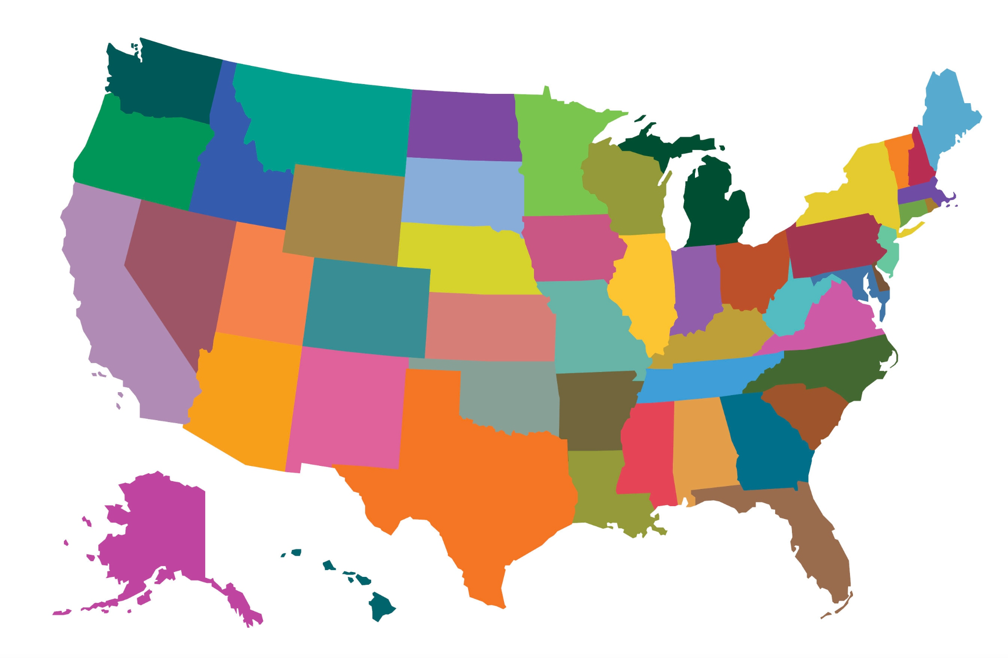
Congressional Review Act
Miles City
North Dakota
Boundary Waters
Buffalo
NPRA IAP
Arctic Refuge Leasing Plan
Central Yukon
Grand Staircase-Escalante National Monument (pending)

Slide 29
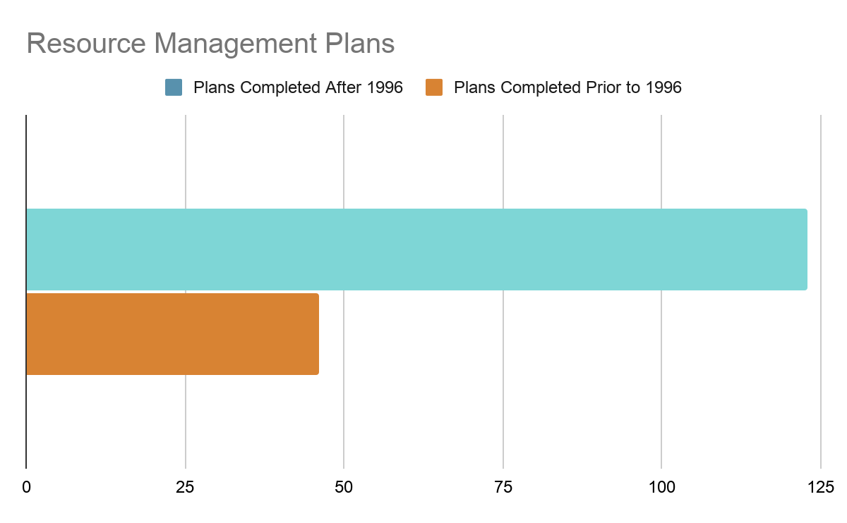
Congressional Review Act

Slide 30
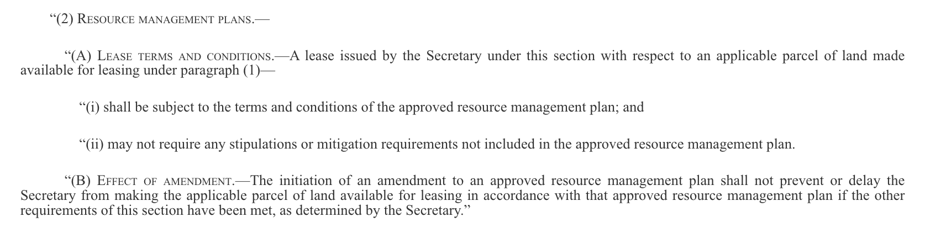
One Big Beautiful Bill / 2025 Reconciliation Act

Slide 31
One Big Beautiful Bill / 2025 Reconciliation Act
BLM must address the 2025 Reconciliation Act in its planning
To the extent that the agency agrees that the Act changes its discretion over leasing and subsequent lease development, the agency faces additional burdens in developing RMPs
BLM must close additional areas to leasing and outline mitigation requirements in planning
Failure to do so constitutes violations of both NEPA (hard look requirement) and FLPMA (unnecessary and undue degradation)

Slide 32



Public Lands Rule
Protection
Restoration & Mitigation
Science & Data
Areas of Critical Environmental Concern
Intact landscapes
Undue and unnecessary degradation
Restoration outcomes
Mitigation hierarchy
Restoration and mitigation leasing
Indigenous Knowledge
Land health evaluations
Watershed Condition Assessmemnts
Icons by Karsacipta, IconPai, and Funtasticon

Slide 33
Public Lands Rule
The term “multiple use” means the management of the public lands and their various resource values so that they are utilized in the combination that will best meet the present and future needs of the American people; making the most judicious use of the land for some or all of these resources or related services over areas large enough to provide sufficient latitude for periodic adjustments in use to conform to changing needs and conditions; the use of some land for less than all of the resources; a combination of balanced and diverse resource uses that takes into account the long-term needs of future generations for renewable and nonrenewable resources, including, but not limited to, recreation, range, timber, minerals, watershed, wildlife and fish, and natural scenic, scientific and historical values; and harmonious and coordinated management of the various resources without permanent impairment of the productivity of the land and the quality of the environment with consideration being given to the relative values of the resources and not necessarily to the combination of uses that will give the greatest economic return or the greatest unit output.

Slide 34
Tools to engage in comment letter writing and Land Use Planning
Notes:
Jora- how many people are actively working on comment periods right now? project level. what RMPs do we have coming up?

Slide 35

Utilize other laws and policy that still apply
FLPMA (provisions include: ACECs, non impairment, undue and unnecessary degradation, public engagement)
Monument/NCA manual (6220, 6100)
interim management guidance
National Conservation Lands Act
Consultation and the National Historic Preservation Act
Cooperating agency status
ESA (HR1897 was recently pulled)
Special Status Species Management (manual 6480)
Language in legislation or proclamation
Know your state laws and policies and leverage them (example: CEQA Joshua Trees)
Principles of the Public Lands Rule still apply
Notes:
Jora- PLR conservation mandate. all the other laws and policies above are ways you can continue to apply the PLR

Slide 36

Cooperating Agency status
Who?
  Tribes
  State agencies
  County government
  NGOs
Any of these entities should request cooperating agency status however;
NEPA requires lead agencies to:
  Request participation of cooperating agencies at the earliest practicable time;
  Give consideration to any analysis or proposal created by a cooperating agency;
  Include cooperating agencies in developing a schedule for completing the environmental review; and
  Grant any meeting requests
Notes:
Jora- Tribes can do both consultation and cooperating agency status, bolsters both. cooperating agency status can be requested for EISs by Sovereign Nations, state agencies and counties. In states that have favorable administrations this can be a useful tool to influence selection of alternatives (sometimes even draft an alternative) and the record of the decision

Slide 37
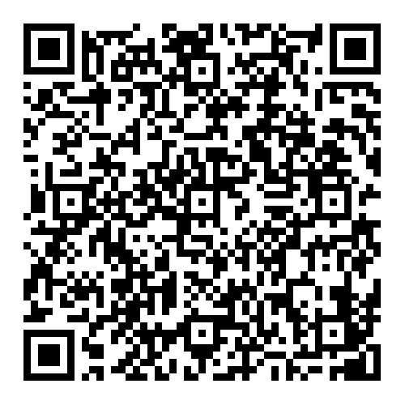
Public Lands Rule Rescission
Overview of Rescission published yesterday:
Decided Tribes don't need to be consulted;
Elimination of conservation/restoration lease program;
Land health standards (LHS) revert to pre- public lands rule era (may revisit a separate rule for LHS;
ACEC’s can only be nominated through a planning process and management will go back to 1983 guidance.
Continue to support consideration and use of the conservation and restoration tools still available in BLM policy.
Scan to access more information on BLM’s conservation mandate

Slide 38

Community alternatives
Community Alternatives are usually prepared by groups prior to scoping
Submit to BLM well ahead of the DEIS
Set up meeting with local BLM to discuss the alternative
Borrow from examples: Mojave Trails, Berryessa, Uncompahgre
Bonus if a cooperating agency will contribute to a community alternative
Notes:
example Mojave trails, berryessa, north fork for Umcomphadre. lean on your FGN community to share their alternative

Slide 39

Public Engagement
Even if public comment opportunity is limited or not given, comments should be submitted
When necessary submit FOIA requests to obtain PoO, NOPAs and correspondences
Utilize action alerts, comment portals, letter writing parties, event postcards
Notes:
Jora

Slide 40
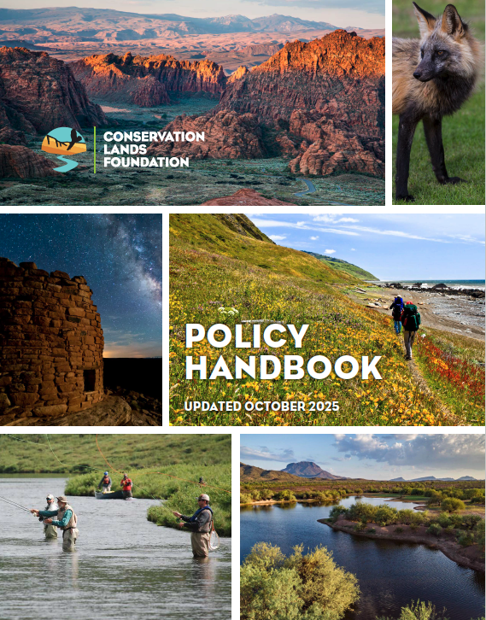
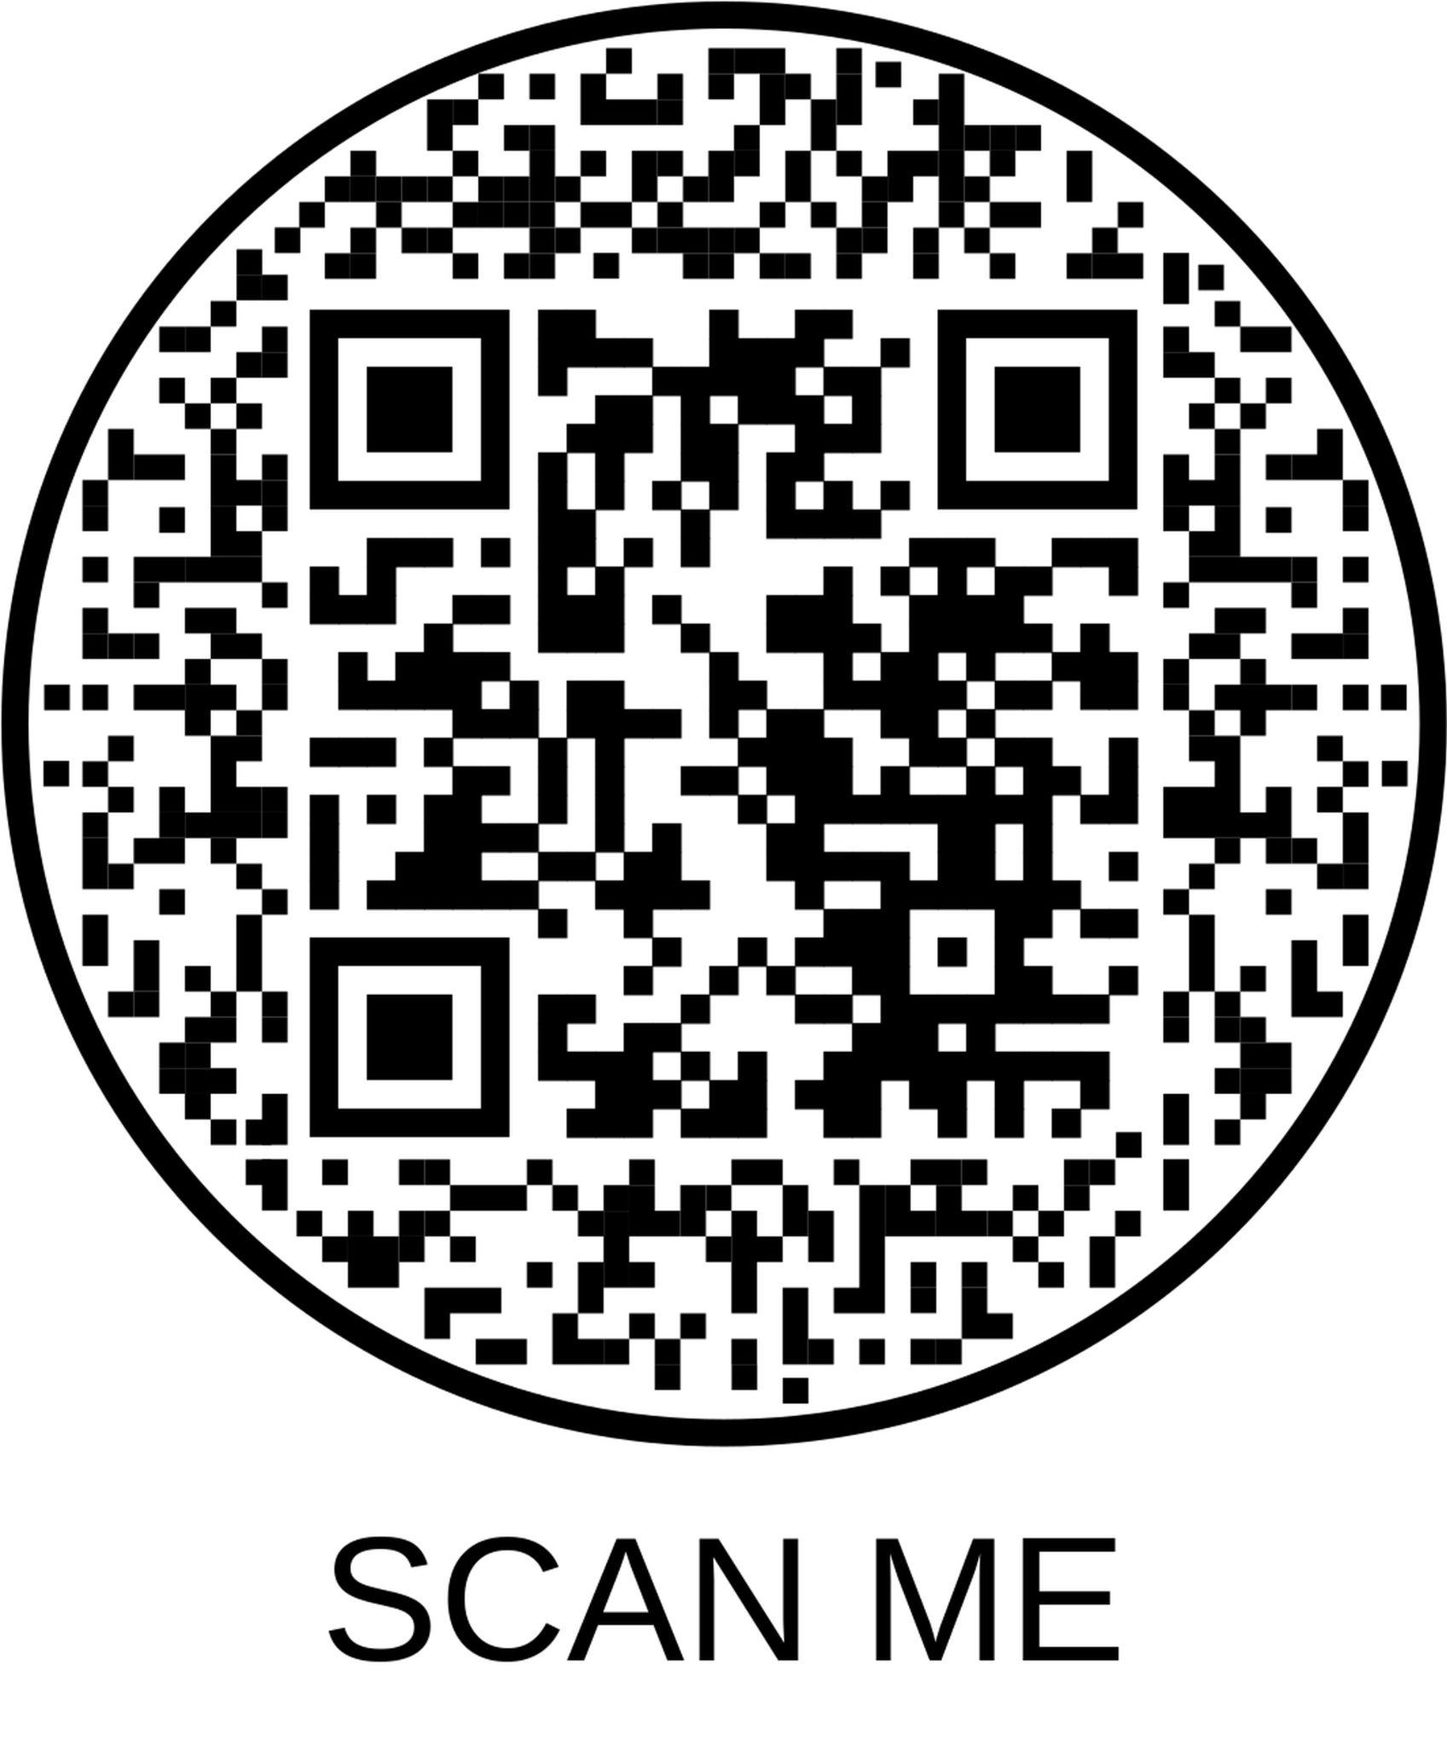
Conservation Lands Foundation Policy Handbook
Notes:
pages 18-26 have more details. we have hardcopies to take home

Slide 41
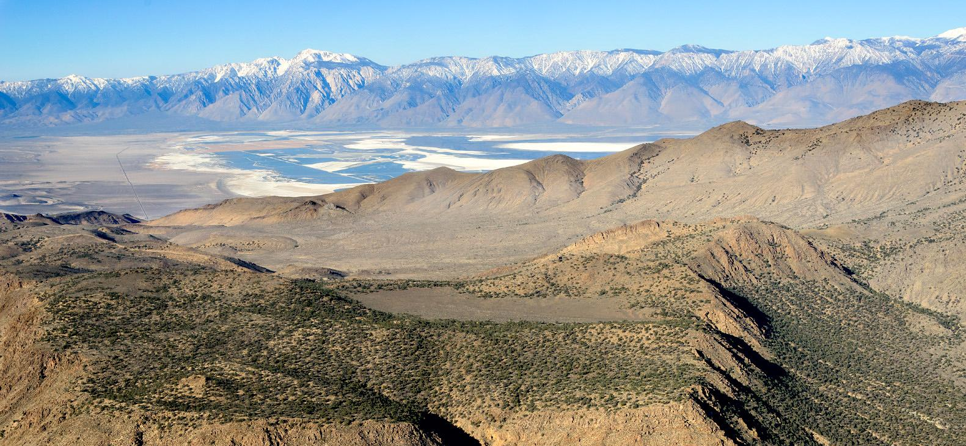
Questions?
Kara Matsumoto, Senior Policy Director kara@conservationlands.org, 240-997-6928
Nick Mills, Associate Public Lands Policy Director nick@conservationlands.org
Jora Fogg, CA Associate Public Lands Policy Director, jora@conservationlands.org, 360-259-4275
Notes:
all

