Slide 1
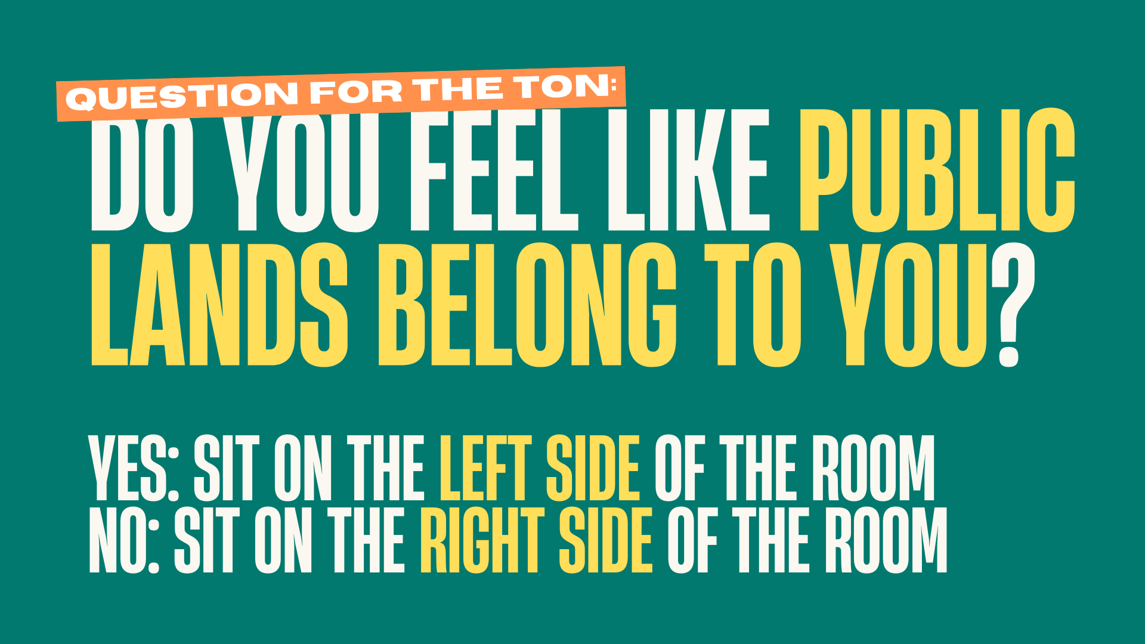
Notes:
Alright, as you’re getting settled, I’m going to have you do something a little annoying right off the bat but I promise it’ll make sense later so just go with me for a second.
Do you feel like public lands belong to you? If yes, sit on the left side and if no, please sit on the right side.
Thank you for entertaining me. I promise this serves a purpose, we’re going to come back to this in a little bit, so just put a pin in it.
For now, just notice where you landed, you made that decision pretty quickly and probably more based on how it felt than anything else.

Slide 2
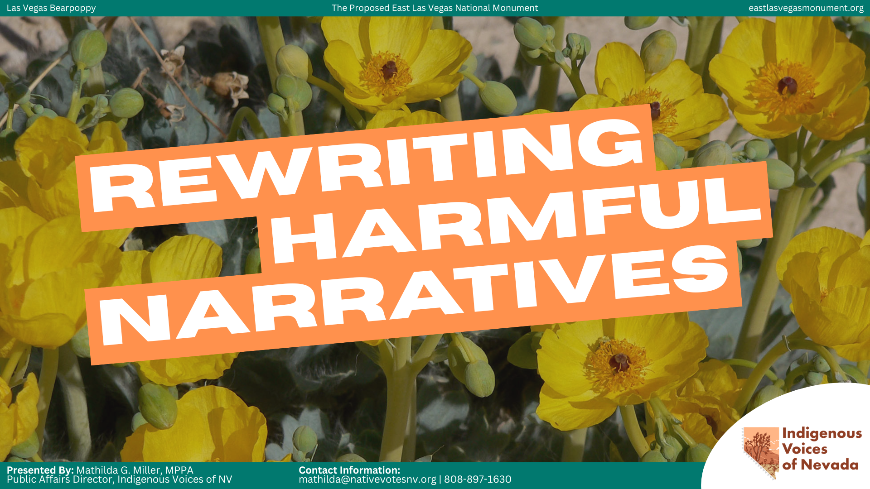
Notes:
Now that I’ve caused you all to hopefully make new friends, welcome everyone! Thank you for being in community with me this morning. My name is Mathilda Miller. I am Kanaka Maoli, which means I am Native Hawaiian, and I have the honor of serving as the Public Affairs Director of Indigenous Voices of Nevada. I’m based in Las Vegas.
My title is basically a fancy way of saying that I do our elections, policy, and comms, all the things that keep you very busy.
But a big part of my work is figuring out how we actually get real life, everyday folks to engage with the issues we care about, in a way that lands, and in a way that sticks.
A lot of what I’m going to share today comes directly from that work. So let’s ground what we’re actually here to do.
This session is about rewriting harmful narratives. And I want to be really clear about what that means because we hear the word “narrative” being thrown around a lot.
Narratives aren’t just stories we tell. They’re the assumptions people already have before we ever open our mouths.
They shape what folks believe is possible, who they trust, and if they even hear you in the first place.
So when our messaging doesn’t land, it’s usually not because we said the wrong thing. It’s because we’re speaking into a narrative that we don’t understand.
And that has real consequences: people don’t show up, they don’t trust us, or worse
We unintentionally reinforce the very narrative we’re trying to change.
I’m an Aquarius so naturally, I am an insane realist so I want to acknowledge a few things: we only have 50 minutes together. And I’ll be honest, what I’m about to walk you through took a few weeks to build and train my team on so I’m going to compress that for you into 50 minutes. Which means we’re going to move with intention.
The good news is, everything you need to actually replicate this with your team is in your packet.
One more thing: this is going to challenge how you currently think about your messaging. And that’s intentional.
Because if it doesn’t feel a little uncomfy, we’re probably not getting to the root of anything.
That’s the work we’re going to do together.

Slide 3
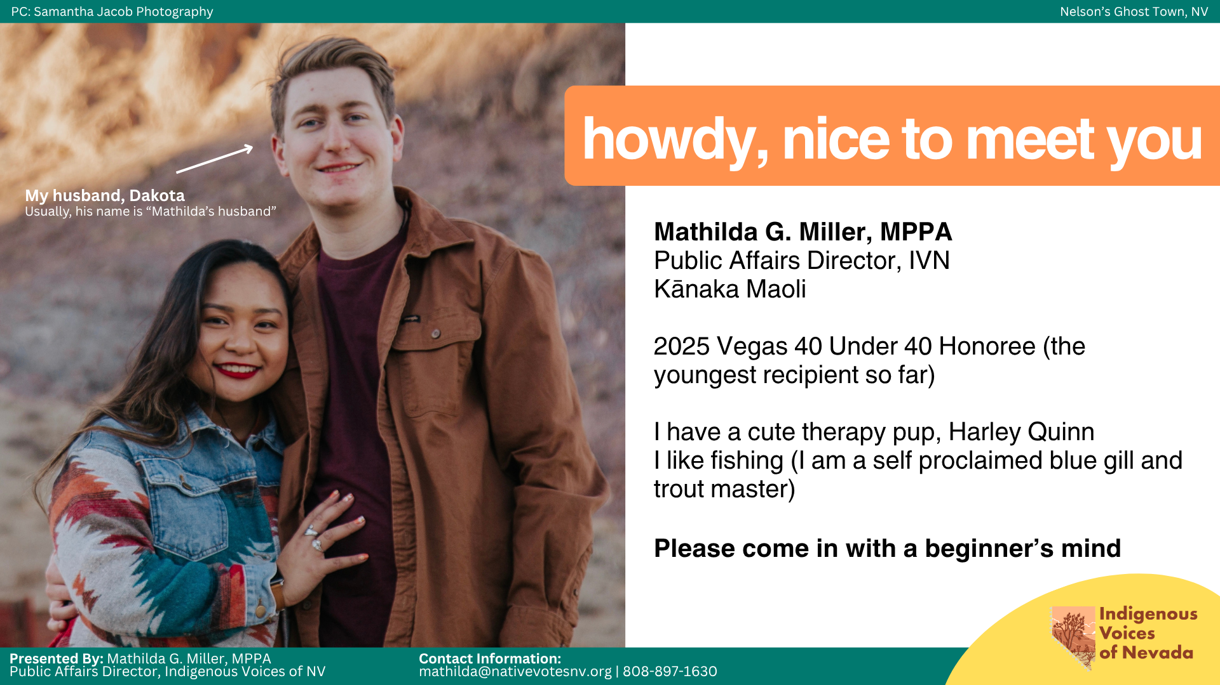
Notes:
If you’re anything like me, you probably want to know a little bit more about the people you’re talking to. I’m a really big believer that the work we do is personal. Most of the time, there’s something in our story that drives us to show up in this work.
And sometimes, that shows up in ways you didn’t plan at all.
For me, that was in undergrad where I was one class away from accidentally minoring in Marriage and Family Therapy. At the time, it just felt like easy classes to take. But looking back, it completely shaped how I communicate and how I approach this work.
Because a lot of what we’re doing (whether we name it or not), we’re working with how people experience and respond to the world around them. And that’s a big part of why you’re here today.
Now, I know every single person in this room is incredibly smart, talented, and brilliant. You know you work. You know your communities. The only thing I’m going to ask of you today is to come in with a beginner’s mind.
What that means is: even when something has worked for us before, even when we feel like we already know what we’re doing, we stay open to the idea that there might be a better, unknown way to reach people.
Because the moment we decide “this is how I’ve always done it,” we stop learning and we start missing the very people we’re trying to reach.
So for the next 50 minutes, I just ask that you stay open, stay curious, and be willing to challenge your own instincts a little bit.

Slide 4
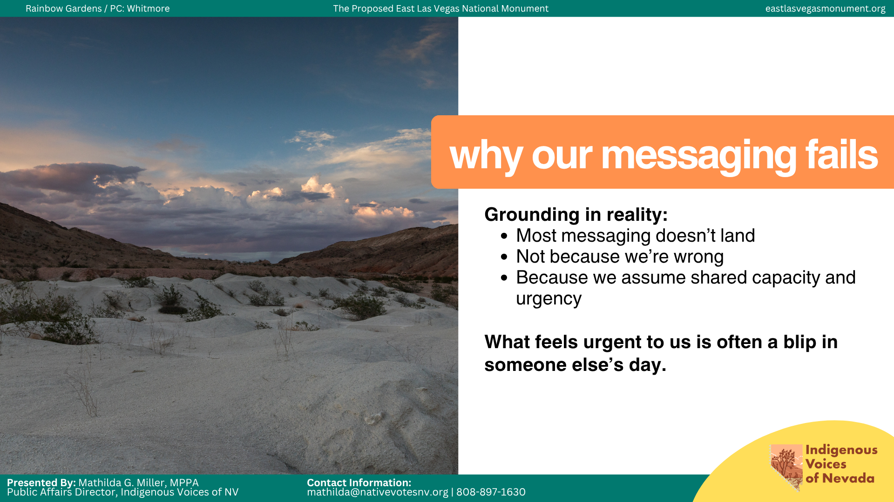
Notes:
I’m going to say the quiet part out loud: most of our messaging doesn’t land. It’s not because we’re doing a bad job or our reach isn’t high enough, it’s because we’re operating at a level of urgency that most people aren’t living in.
What feels like a crisis to us, we’re asking folks to treat it like their top priority, when it’s competing with everything else in their life.
Rent is too high. Prescription drugs are unaffordable. Utility costs keep rising. Families are being torn apart.
People are carrying a lot before we ever open our mouths.
But we show up with: this is urgent, this matters, and we need you to act now.
And for a lot of people, that doesn’t feel like an invitation, it feels like one more demand.
And when our messaging feels like a demand, people don’t lean in. They tune out.
That’s why people don’t engage, show up, and that’s why it feels like we’re talking and no one’s listening.
It goes back to what we just did earlier: people respond based on how something feels in the moment. If it feels overwhelming, they shut down.

Slide 5
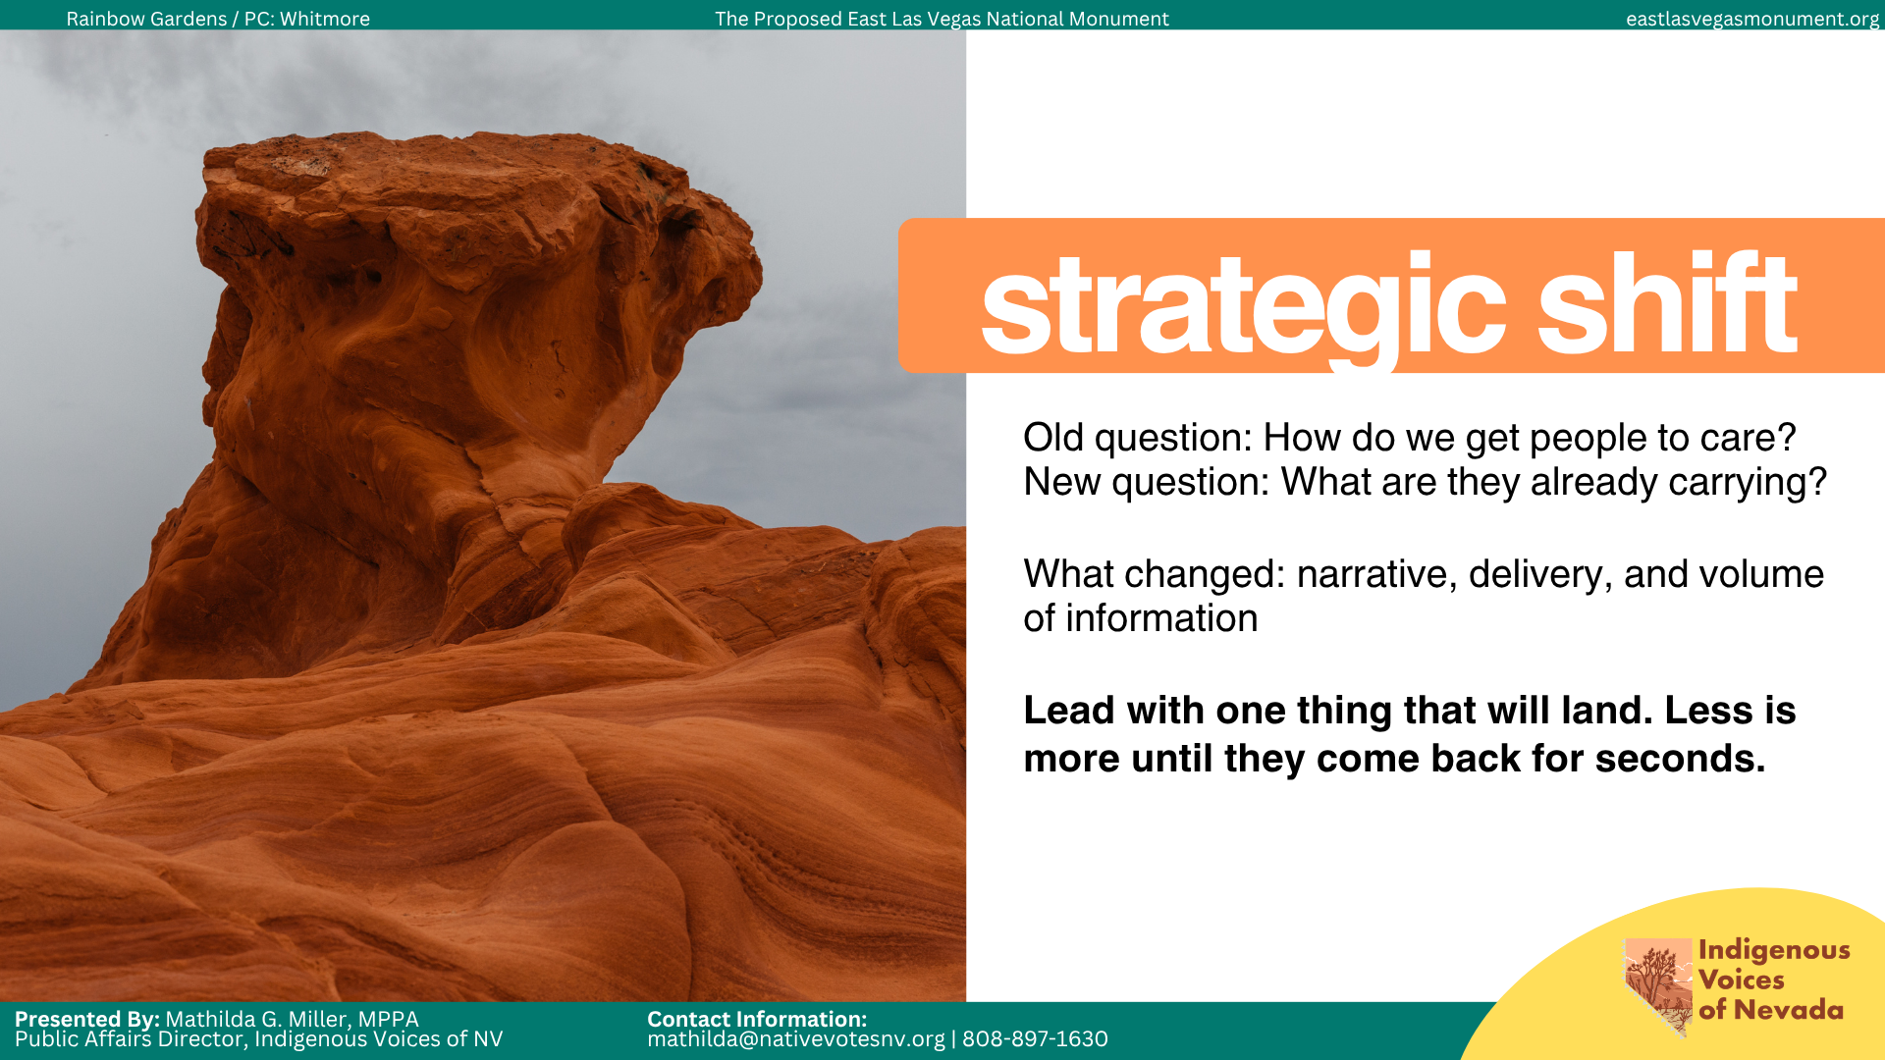
Notes:
So if that’s the problem, we have to change the question from “how do we get people to care” to “what are people already carrying when we walk into the conversation?”
People don’t engage with issues, they engage with what connects to their reality.
And the moment you ask that question, every shifts. You stop trying to convince people and you start meeting them where they actually are.
Before, we were leading with everything we wanted people to know. Now, we lead with what we know will land for your specific community interest.
And that changes the narrative: not just what we say but how we say it and what we choose to lead with. Most importantly, we stop overwhelming people.
Because when someone is already carrying a lot, more information doesn’t make it clearer, it just makes it heavier and that’s where we lose people.
So instead, we lead with one thing. One clear entry point, one thing that connects to their reality, one thing that makes it easier to engage.
For example, when we write statements, op-eds, messaging guidelines, or talking points, we want to include everything. All the stats, quotes, and context. In our minds, more information means stronger messaging but in reality, it just makes it harder to enter.
What actually pulls people in is when you focus on the one thing they’re already feeling but haven’t fully named yet.
Using the Pearce confirmation as an example, IVN crafted the c3 response, we had everything under the sun: a coalition statement, toolkit, and all the context we could possibly include. But none of that is what gets someone, or the media, to stop and engage.
What gets their attention was this: the title, “A Nomination That Could Redefine Public Lands as We Know Them.”
Yes, this is clickbait and that’s what we want but it does an important thing: it answers a question people didn’t realize they had yet, “what does that mean for me?”
That’s the entry point. Not everything we know, just the thing that makes someone pause.

Slide 6
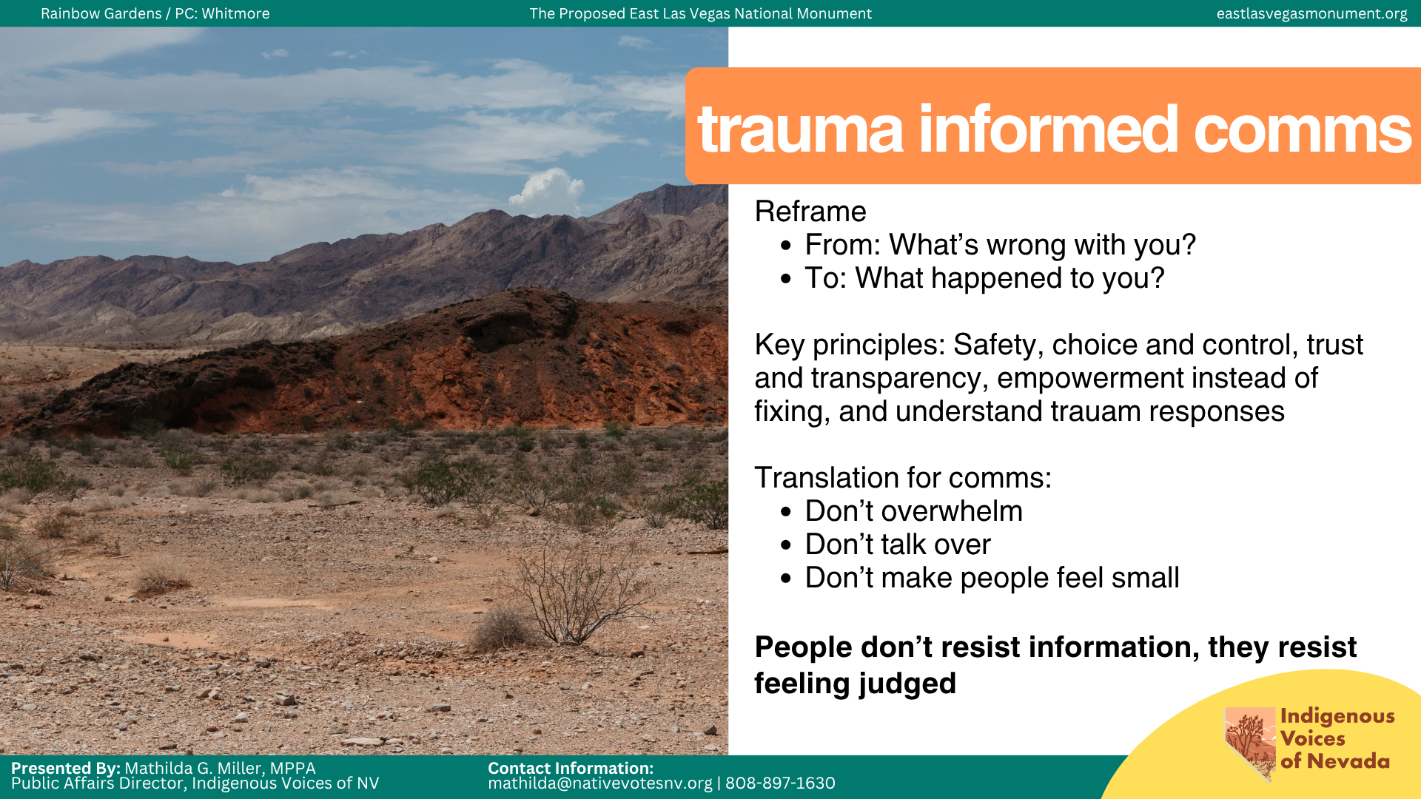
Notes:
Now I want to ground what we mean when we say trauma-informed communication. Before we talk about it in politics, I want to start with where this actually comes from. It definitely did not come from organizing, does anyone know where it came from?
It came from healthcare, social services, and healing work.
At it’s core, it starts with one simple understanding: People’s behavior makes sense when you understand what they’ve lived through.
And this should sound familiar because it’s exactly what we’ve been talking about. It asks a different question.
We’re not asking “what’s wrong with you” but “what happened to you?”
And that shift changes everything.
In those spaces, trauma-informed communication is built on a few core principles. I want you to hold onto these because we’re about to bring them directly into our work. There are a few tenants: safety, choice and control, trust and transparency, empowerment, and understanding trauma responses.
Safety: People are not put in situations where they feel exposed, judged, rushed, or trapped. This connects directly to what we talked about earlier, when our messaging feels overwhelming or demanding, people don’t lean in, they shut down.
Choice and Control: Trauma takes away control. So trauma-informed communication gives it back. People are given options. They’re not forced to share. They’re not pressured to participate. They can say no. They can engage on their own terms.
Trust and Transparency: Nothing is hidden. People know: what’s happening, why it’s happening, what will be done with what they share, and what comes next. Because when that’s missing, people feel used, or caught off guard.
Empowerment, not fixing: This work does not treat people as broken. It recognizes resilience. It centers people as capable, even when they’re struggling. The goal is not to rescue people. It’s to support their power.
Understanding responses: Things like withdrawing, anger, silence, not rusting right away, not committing immediately. None of those are character flaws, they’re survival responses that made sense at some point.
Now, one really important thing to name: Trauma-informed communication is not about making things comfortable. It’s about making them safer.
We still talk about hard things. We still challenge systems. We still have real conversations. We just don’t create unnecessary harm on top of what people are already carrying.
Now here’s where this becomes our work. All of this was built on the understanding that systems and environments can either support people or make harm worse. And the way we communicate is part of that system.
The spaces we ask people to engage with are not neutral. They’re government systems, legislative processes, media environments. And for many communities, especially for Tribal communities who have a long history of government-inflicted trauma, those systems are a source of harm.
So when we ask people to engage, we are not asking them to step into something neutral. We are asking them to step into something that may already feel unsafe. And if we don’t account for that we will continue to miss people.
So what we’re doing is taking those same principles and applying them to how we communicate, how we build engagement, and how we move at the speed of trust.
So if our communication ignores that, it won’t land. Not because people don’t care but because we didn’t account for what they’re carrying and that is trauma-informed advocacy.

Slide 7
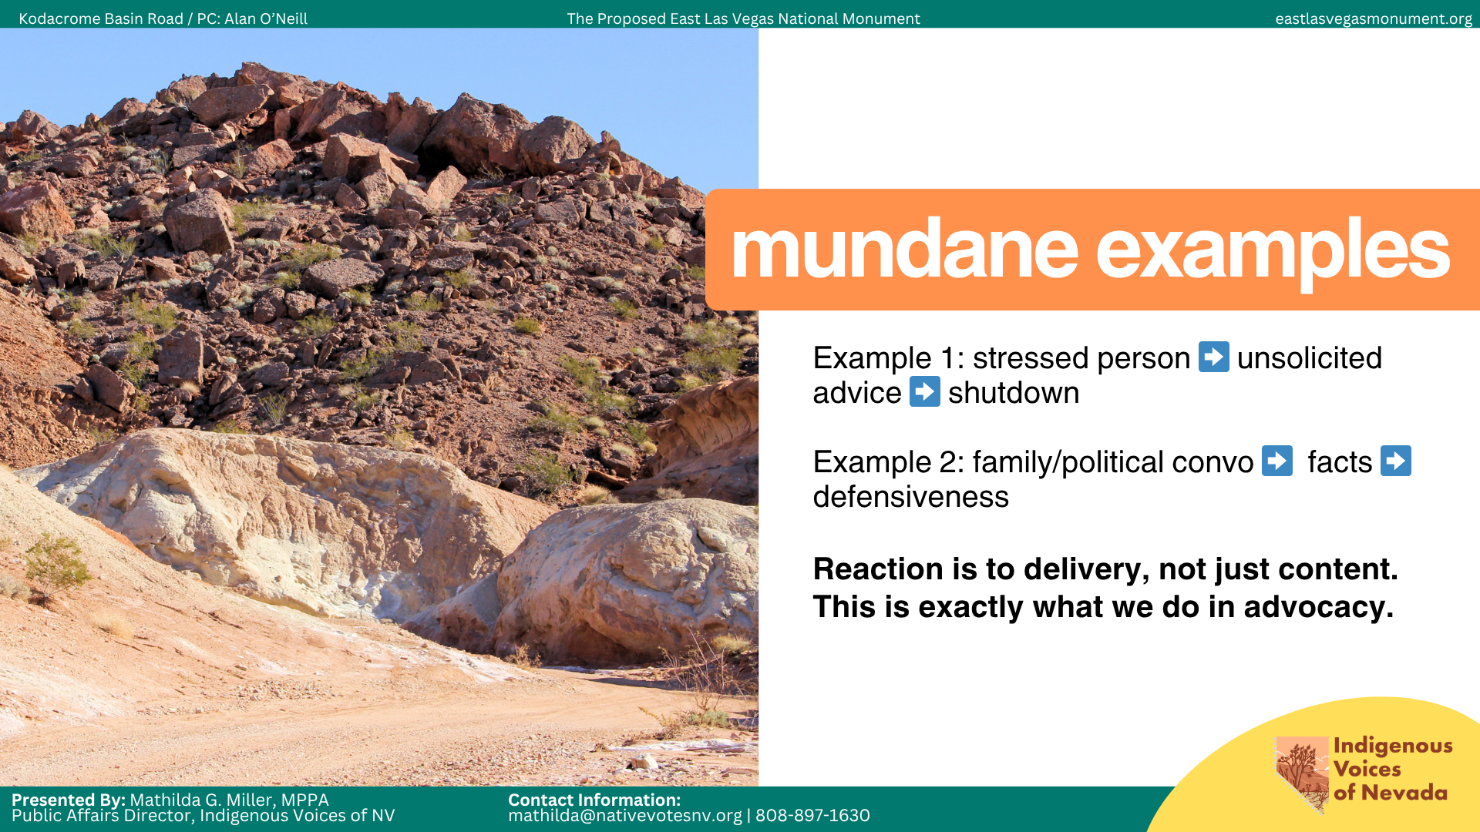
Notes:
So this is how it looks like irl because this isn’t just an advocacy problem, this is a human problem,
Think about the last time someone came to you stressed out. They’re overwhelmed, they’re probably venting, maybe a crash out or two. And instead of just listening, you jump in with “here’s what you should do,” “have you tried this,” or “you just need to….”
Technically, you’re right. But what happens?
They shut down, they stop listening because they feel dismissed even if it wasn’t your intent.
Not because your information was wrong but because your approach was.
Or think about explaining something to that one family member and I’m sure you can see them in your mind already.
You come in strong. You’ve got your facts lined up. And within 30 seconds, you can feel it. They cross their arms. They get defensive. They stop engaging.
But they’re not reacting to your facts. They’re reacting to how you made them feel.
And this is what we do in advocacy all the time. We lead with information, urgency, and we lead with being right. And then we’re confused when people don’t come with us. Now, let’s bring it into our work.
We say: “We need to protect public lands, we need to defend the Antiquities Act, and we need to stop harmful rollbacks.” That means something to us but to most people, it’s abstract, distant, and not connected to their day-to-day lives.
So we need to reframe it: This is about whether decisions about the land around your community are made by your or by someone who will never have to live with the consequences.
Now, it’s about control, fairness, and their life.
Instead of saying, “we need to defend national monuments.” Try: This is about whether places that hold history, culture, and identity (especially for Tribal communities), are protected or treated like they’re disposable the moment they become inconvenient.
Or even sharper: This is about whether the people who have lived in relationship with this land for generations get a say or whether those decisions get made in rooms far away from them.

Slide 8
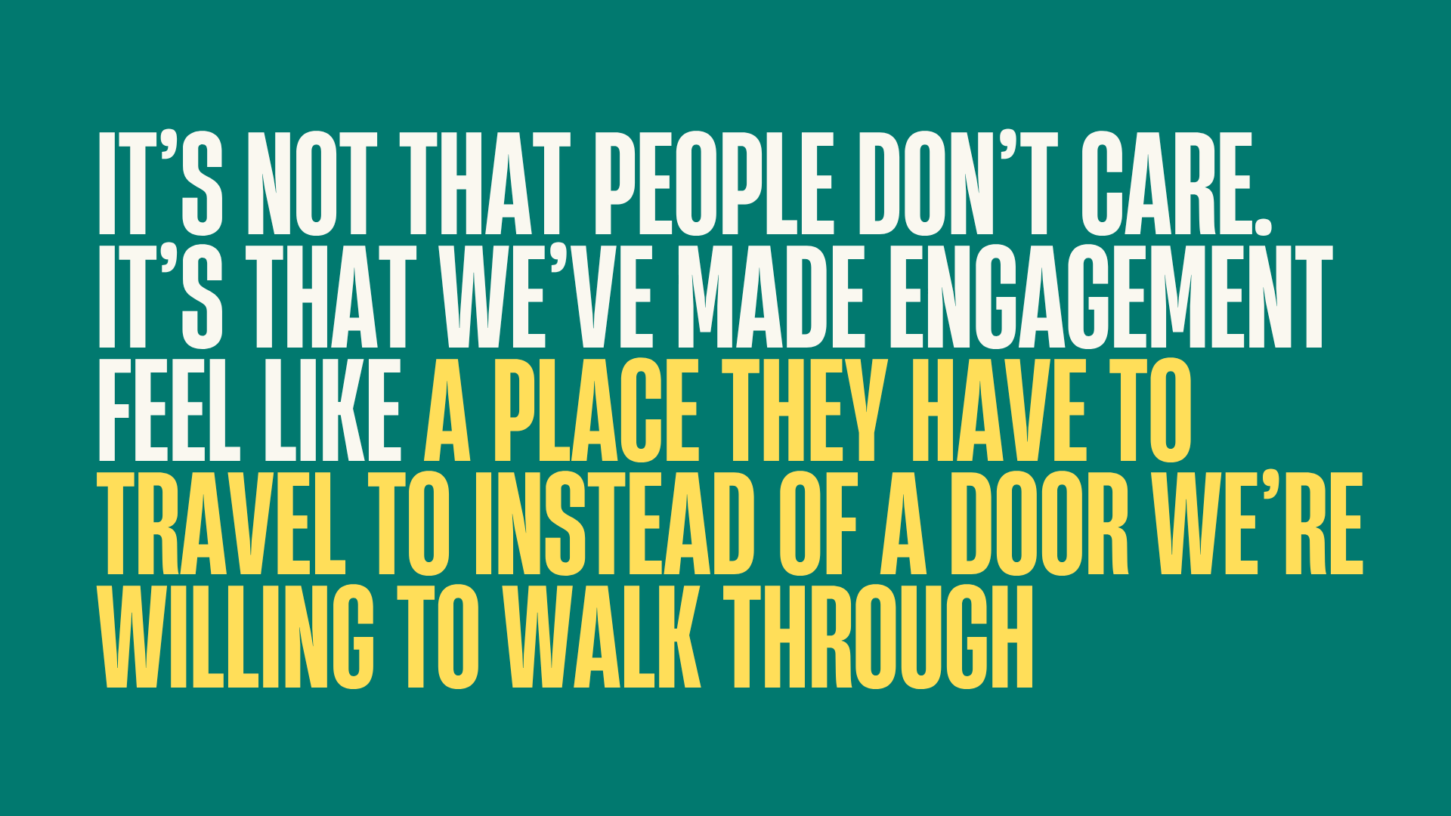
Notes:
This is the shift we have to make: we have to let go of the idea that there is one message that works for everyone. There isn’t and there isn’t just one door. There are many. And each of us in this room represents a different community with different lived experiences, priorities, and values. Which means what lands for one group might not land for another. And when we ignore that, we end up building messages that don’t fully reach anyone.
That’s the work, figuring out which door actually opens because you know your communities best. You know what they’re carting, what they care about, and you know what will make them pause.
Which means you know which door to walk through. And that’s exactly what we’re getting into next: how to choose the right door.

Slide 9
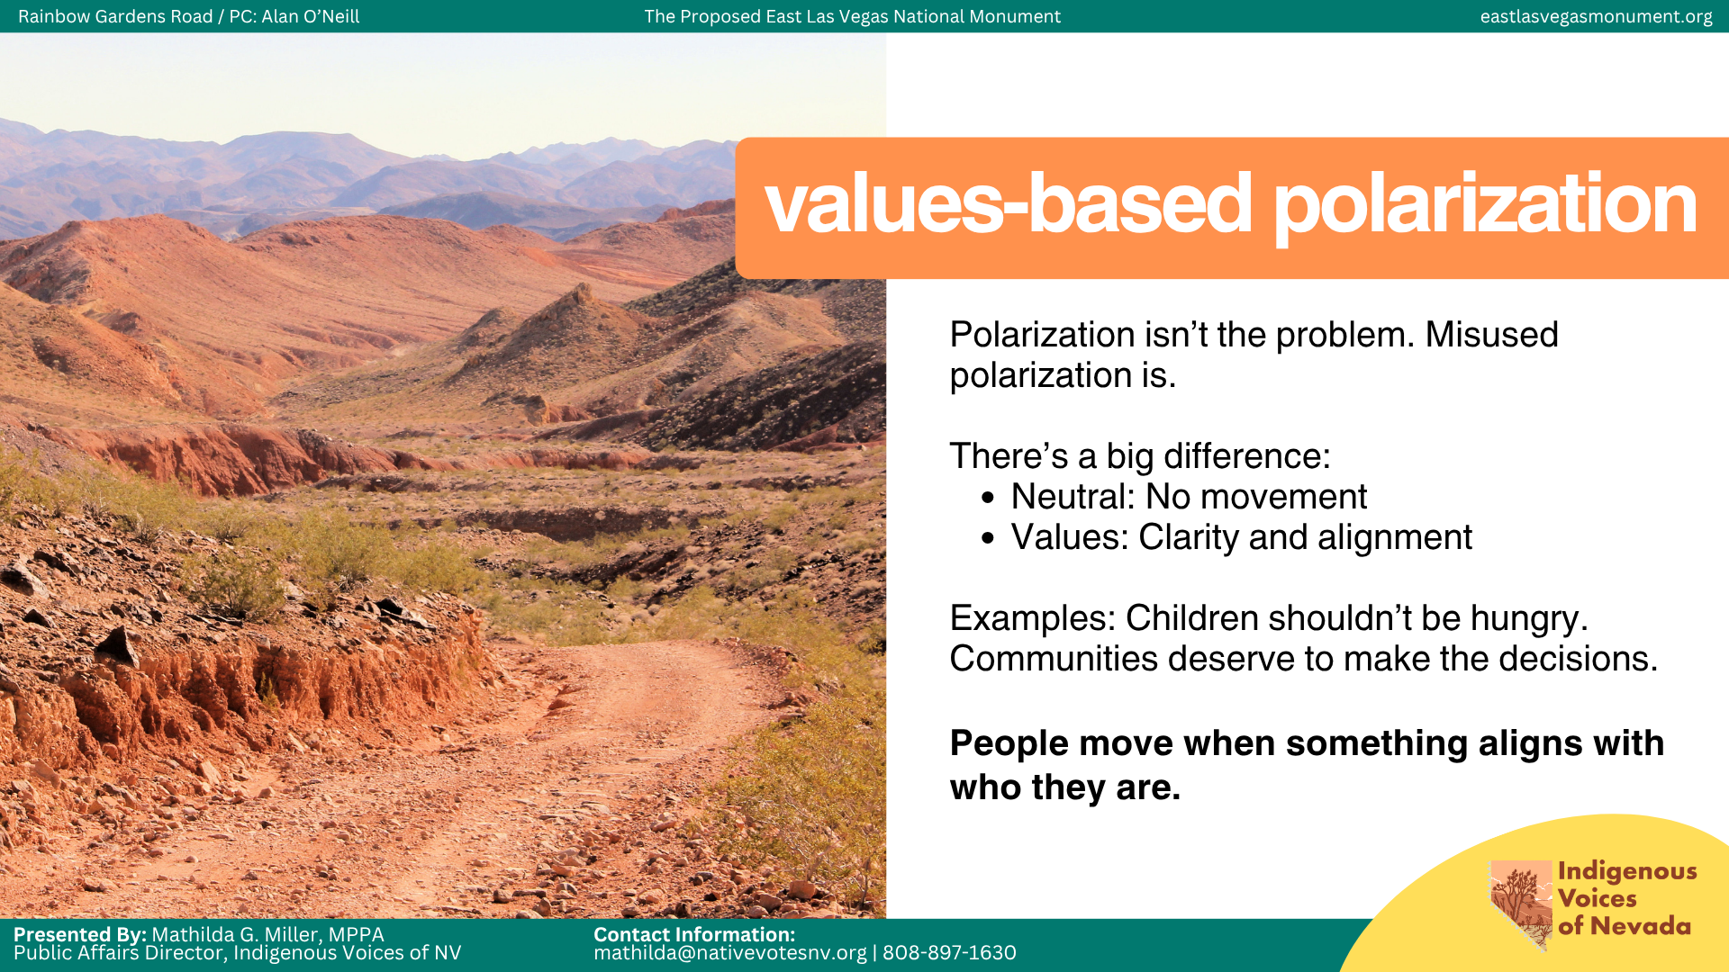
Notes:
So now we’re going to talk about something that makes people a little uncomfortable: polarization. And when I say polarization, I don’t mean division for the sake of conflict. I mean clarifying values in a way that helps people understand where they stand.
And I want to disarm this immediately, polarization is not the problem. Misused polarization is the problem.
Because whether we like it or not people don’t move because of more information. They move because something either aligns (or doesn’t align) with who they are.
We do this all the time in everyday life.
Should children be hungry at school?
Should communities have a say in what happens to the land around them?
Those are not neutral questions. Those are values-based and they make people choose.
Let me pause for a second, can anyone think of a polarizing question? It doesn’t have to be about our work, it can be about anything?
IF NO ONE SAYS ANYTHING: if you’re anything like me, you probably use these all the time, without even thinking about it. I’ll give you a few:
Is a hot dog a sandwich
Should your partner share their location with you
Should people have to pay for parking
Those are all polarizing questions because they make you pick a side.
And notice how quickly you had a reaction to at least one of those.
We can’t keep using neutral language in a world that isn’t neutral. Now here’s the part we don’t always say out loud. There are groups that have been very effective at moving people because they understand this. And whether we agree with them or not, we have to be honest about strategy
What made MAGA Republicans effective is that they used polarization.
They were clear about who they were, what they stood for, and what they were against. Unfortunately, that clarity moved a lot of people.
Now, on the other side, we often shy away from that. We keep things neutral, we try to keep things safe, and we try to not alienate anyone. But in doing that, we lose clarity.
For example, when we talk about public lands, we say things like: protect public spaces, defend the Antiquities Act. And again, that’s not wrong. But it doesn’t force a choice, create urgency, and it doesn’t move people who aren’t already with you.
Compare that to: Should decisions about the land around your community be made by you or by people who will never have to live with the consequences?
That’s polarization. It creates clarity and if people can’t see the choice, they won’t make one. The goal here isn’t to divide people for the sake of division. It’s to create a clear understand of: what’s at stake, who is impacted, and what side of that people are on?
Our responsibility here is to make the choice clear.

Slide 10
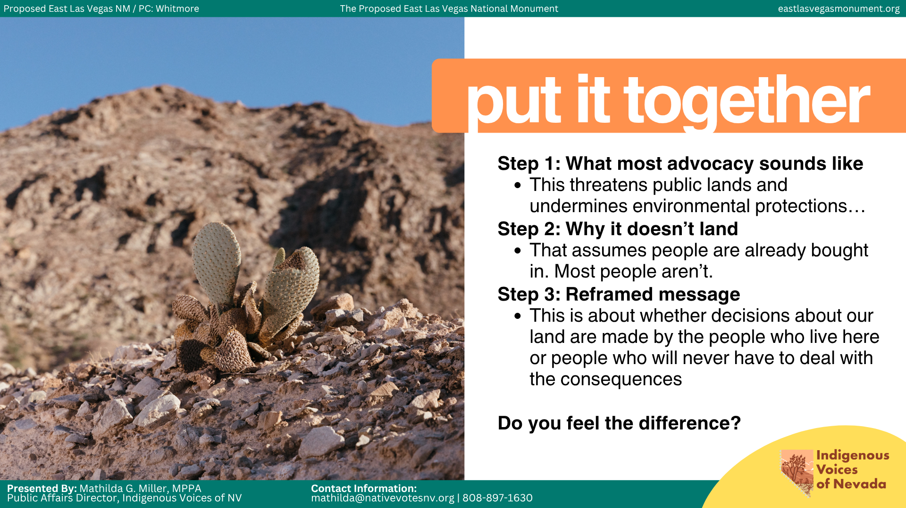
Notes:
Alright, so let’s put this together. This is what it looks like in practice. And I want you to think of this as a simple framework you can use in your own work.
Step one: what most advocacy sounds like.
“This threatens public lands and undermines environmental protections.” Or:“We need to defend the Antiquities Act.”
That’s how we usually talk about these issues.
Step two: why it doesn’t land.
That message assumes people are already bought in. It assumes they already care about public lands, policy, or the system itself. But most people are not there yet.
So when they hear that, it either feels abstract, it doesn’t feel relevant to their life, or they just move on.
Step three: the reframed message.
“This is about whether decisions about our land are made by the people who live here, or by people who will never have to deal with the consequences.”
Now pause for a second and notice how different that feels.
That’s not more information. That’s a different entry point.
Same issue. Different doorway in. It’s clearer. It’s more personal. And it forces a choice.
Here’s the shift we’re making:
We move from issue and policy language to values and lived experience.
Because if your message requires someone to already care, it’s not an entry point.
That’s trauma-informed communication and values-based polarization working together.
And this is something every single one of you can do.

Slide 11
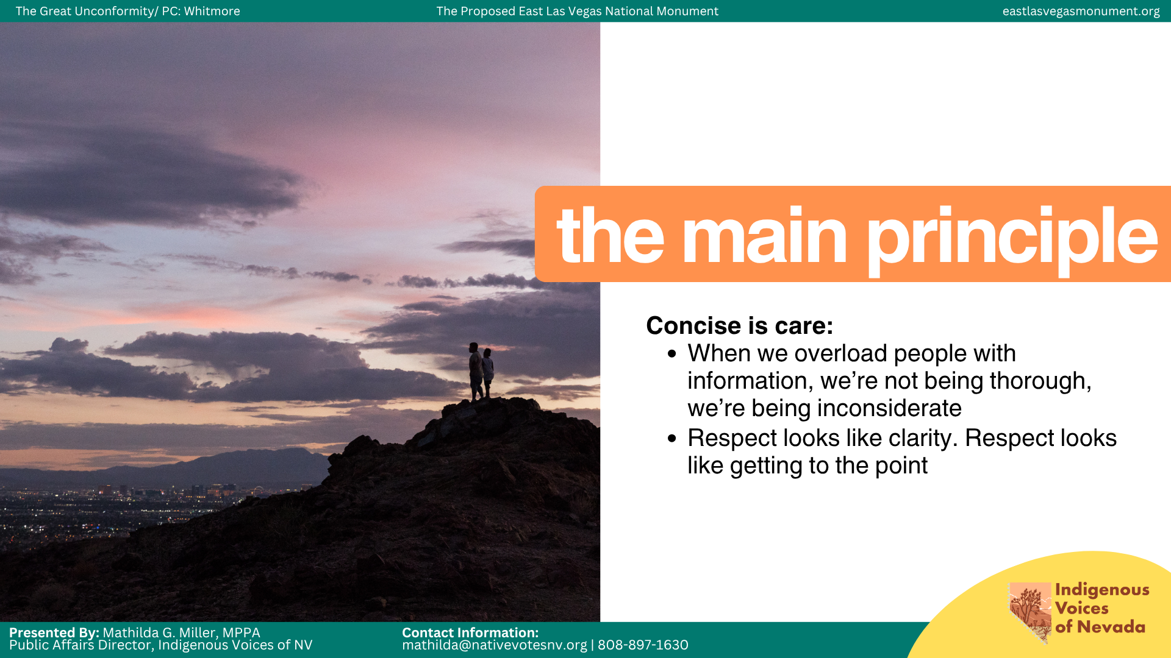
Notes:
Alright, so here’s the main principle I want you to leave with: Concise is care.
People are overwhelmed. Attention is limited. Capacity is real. People can only doomscroll for so long before everything starts blending together. And because of that, how we deliver information matters just as much as the information itself.
Most of the time, when we communicate, we’re trying to explain everything all at once. Every statistic, every detail, every piece of context. But when we do that, we don’t actually make people feel informed. We make people feel overwhelmed. And when people feel overwhelmed, they disengage.
So one of the ways I think about this is through what I call the Analyst version, the Auntie version, and the Child version.
The Analyst version is how you explain something to a legislator, policy person, or subject matter expert. It’s structured, logical, and evidence-based. This is usually the version advocacy spaces default to. And there’s a place for it. But it usually should not be the doorway in.
The Auntie version is how you explain something to your auntie at dinner. No jargon. Plain language. Real-life examples. This version makes people feel like they are allowed to participate in the conversation. And honestly, this is usually the version I start with because this is the version that actually pulls people in.
The Child version is how you explain something to a 10-year-old. Simple words. Simple logic. Clear story. Not because people are unintelligent, but because if you cannot explain something simply, you probably do not fully understand the core of what you’re trying to say.
And most of the time, when we’re talking to different groups of people, we already know how to shift our tone naturally. The problem is that advocacy spaces often reward the Analyst version, even when it’s the least effective entry point.
Because information alone does not empower people to participate.
Connection does.
People engage when they feel invited in, not lectured at.
That’s trauma-informed communication.
Not simplifying the issue, but making it easier for people to enter the conversation.

Slide 12
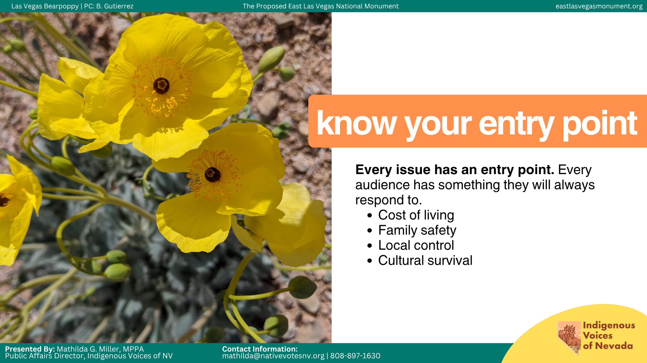
Notes:
Now that we’ve talked about different ways to communicate information, we also have to talk about entry points. Because every issue has one. And every audience has something they will respond to faster than anything else.
That’s what I mean when I say: know your entry point. Know your niche hook.
An entry point is the thing that makes someone care enough to keep listening. And most of the time, it’s not the policy itself.It’s the impact. It’s the value underneath it. It’s the thing that already exists in someone’s life before you ever enter the conversation.
For some people, the entry point is cost of living.
For others, it’s family safety.
For others, it’s local control.
The issue itself may stay exactly the same. The doorway in changes.
And all of us in this room work with different communities that already have specific interests, fears, priorities, and emotional anchors.
For us, as an Indigenous organization, we already know the things that will always get our community’s attention.
Land Back.
Protecting essential services, especially for elders and babies.
Protecting ancestral homelands.
We already know which words are going to make people stop scrolling, lean in, or feel something immediately. Whether we’re trying to mobilize, energize, protect, or activate our community, we already know the emotional anchors that matter most.
And that’s strategy. Because concise is care. And less is more.
We are not trying to explain everything all at once. We are building the bridge between the issue and the thing people already care about.
Because every extra layer of confusion is another barrier to participation.
And once people start leaning in, they naturally start asking more questions. They get curious. They want more information.
And by the time they get to the Analyst version, they’re already invested.
That works far better than overwhelming someone with every statistic, policy detail, and talking point all at once. Because when people feel overloaded, they disengage.
But when people feel emotionally connected, they participate.
And this is how you start owning the narrative and building power.

Slide 13
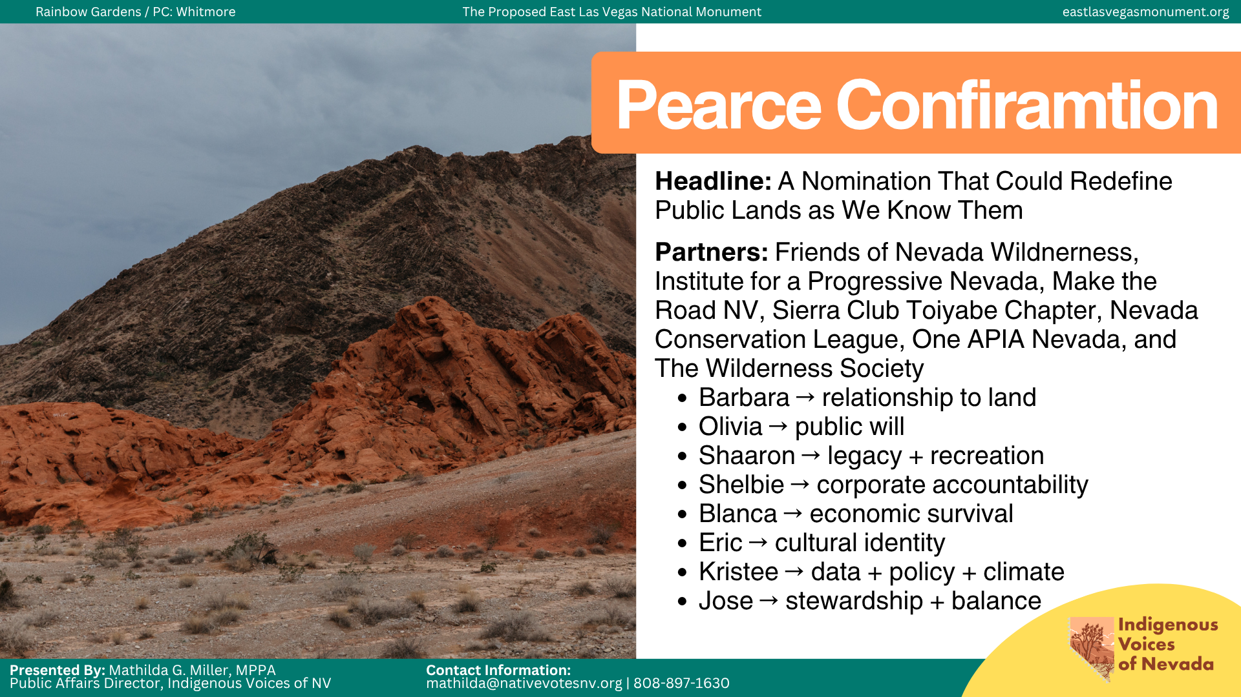
Notes:
In your packet, there’s a copy of a C3 statement we prepared following Steve Pearce’s confirmation to lead the Bureau of Land Management. And I wanted to include this because I think it’s one of the clearest examples of trauma-informed communication and values-based polarization working together in real time.
When we built this statement, I intentionally did not ask everyone to say the exact same thing. And that’s important. Because one of the biggest mistakes coalition spaces make is thinking alignment means repetition. It doesn’t. Alignment means telling the same story through different values, different messengers, and different emotional entry points.
So what I did was solicit quotes from organizations and leaders that I knew spoke to different audiences and different subject areas. And when I reached out to them, I gave them a baseline. I basically said: here’s the angle I think your voice is uniquely positioned to speak to. Not because I wanted to script them, but because I wanted each quote to shine in the area their communities already trusted them in.
So while we were all talking about the exact same issue, every single quote entered through a different doorway.
Barbara’s quote centered relationship to land, stewardship, and Indigenous worldview. Olivia’s focused on public will and the idea that public lands should remain public. Shaaron’s focused on legacy, recreation, and future generations. Shelbie’s focused on corporate power, privatization, and accountability. Blanca’s focused on economic survival, jobs, air quality, and water. Eric’s focused on cultural identity, belonging, and shared history. Kristee’s focused on policy stakes, economics, climate, and scale. Jose’s focused on stewardship, balance, and long-term responsibility.
Every quote told its own story. And together, they told the whole story.
And this is important because most coalition messaging tries to flatten everyone into the same voice. Everybody repeats the same talking points. Everybody sounds the same. Everybody says the same three lines. But that’s not how people actually connect to issues.
People connect through identity. Through values. Through lived experience. Through trust.
And when people can see themselves somewhere in the story, they are far more likely to engage with it.
That’s why this strategy works. Not because every quote said the same thing, but because every quote gave a different community a way to emotionally locate themselves inside the issue.
We were not repeating a message. We were translating it.
And this is where trauma-informed communication comes in. Different communities trust different messengers. Different communities carry different fears, histories, priorities, and emotional anchors. So instead of forcing everyone to enter through the same doorway, we created multiple entry points into the same issue.
That lowers barriers to participation. It makes people feel like there is a place for them in the conversation.
And this is also values-based polarization. Because every quote made a values-based choice about what mattered most: community control, stewardship, economic survival, public accountability, cultural identity, and future generations.
None of the quotes tried to sound neutral. They sounded clear. And that clarity allowed different audiences to emotionally locate themselves within the issue.
This approach does not just strengthen messaging. It strengthens coalition durability because people feel personally connected to the outcome.
That is why this strategy works better than trying to overload people with every single argument all at once. Because people do not build connection through information overload. They build connection through resonance.
And once people feel emotionally connected, they become curious. Once they become curious, they start asking questions. Once they start asking questions, they become invested. And that is how you start owning the narrative and building power.

Slide 14
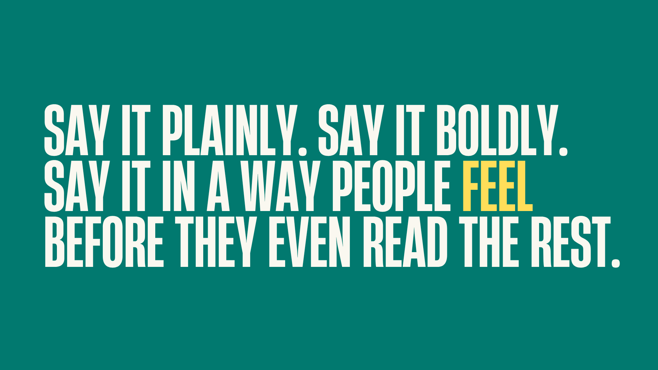
Notes:
Now that we’ve talked about frameworks and strategy, I want to talk about execution. Because all of this only works if people actually stop, pay attention, and feel something.
And that means we have to stop sounding like robots.
The example we just walked through was a statement, but this strategy works across practically every mode of communication: earned media, organic content, mail, speeches, field conversations, all of it.
And one of the biggest things I’ve learned is this:
Say it plainly. Say it boldly. Say it in a way people feel before they even finish reading the sentence.
Because people do not remember careful language. They remember language that makes them feel something.
Nobody has ever forwarded a statement because it sounded procedurally correct.
Our brains are wired to remember emotion, imagery, tension, and story far faster than institutional or policy language.
That’s why I’m a huge believer in what people would probably call “clickbait titles.” And I know “clickbait” sometimes has a bad reputation, but all I really mean is: make people curious enough to care.
For example:
“Stop trying to Utah our Nevada.”
“Some decisions don’t belong to Congressman Amodei.”
“Private Lands, Public Deals: Tribal Homelands Marked for Sale near Avi Kwa Ame and Gold Butte.”
“Trump Administration’s Push to Sell Public Lands Betrays American Values and Tribal Sovereignty.”
Those titles work because they immediately create tension, curiosity, or emotional reaction. People instantly understand that something is at stake.
And to be clear, this is not about misleading people. It’s about helping people immediately understand why something matters. And another huge part of this work is learning how to say the quiet part out loud.
This is usually the thing people are already thinking in their heads but either don’t have the language for, or don’t feel comfortable saying publicly yet.
For example, one line I used recently was: “If Teddy Roosevelt were here today, I have no doubt he’d be throwing down with these modern MAGA Republicans for trying to dismantle the very law he signed over a century ago to protect our most treasured landscapes.”
That line worked because it said the emotional part out loud.
People already felt the frustration. The line just gave language to it.
And I also want to say something about C3 versus C4 voice, because I think people sometimes get stuck there.
The way I think about it is: they’re sisters.
They share the same values, but they have very different personalities.
The C3 sister is more informational, polished, and professionally polite.
The C4 sister is off the walls.
But that does not mean the C3 sister has to sound lifeless.
You can absolutely stay within C3 boundaries while still using vivid, emotional, colorful language. You can still create tension. You can still use imagery. You can still say things plainly.
And honestly, when we hide behind overly careful language, we often make our work less accessible.
Because trauma-informed communication is not just about what we say.
It’s about whether people can emotionally recognize themselves in it.
That’s the real goal.
Not sounding smart.
Not sounding perfect.
Sounding human.

Slide 15
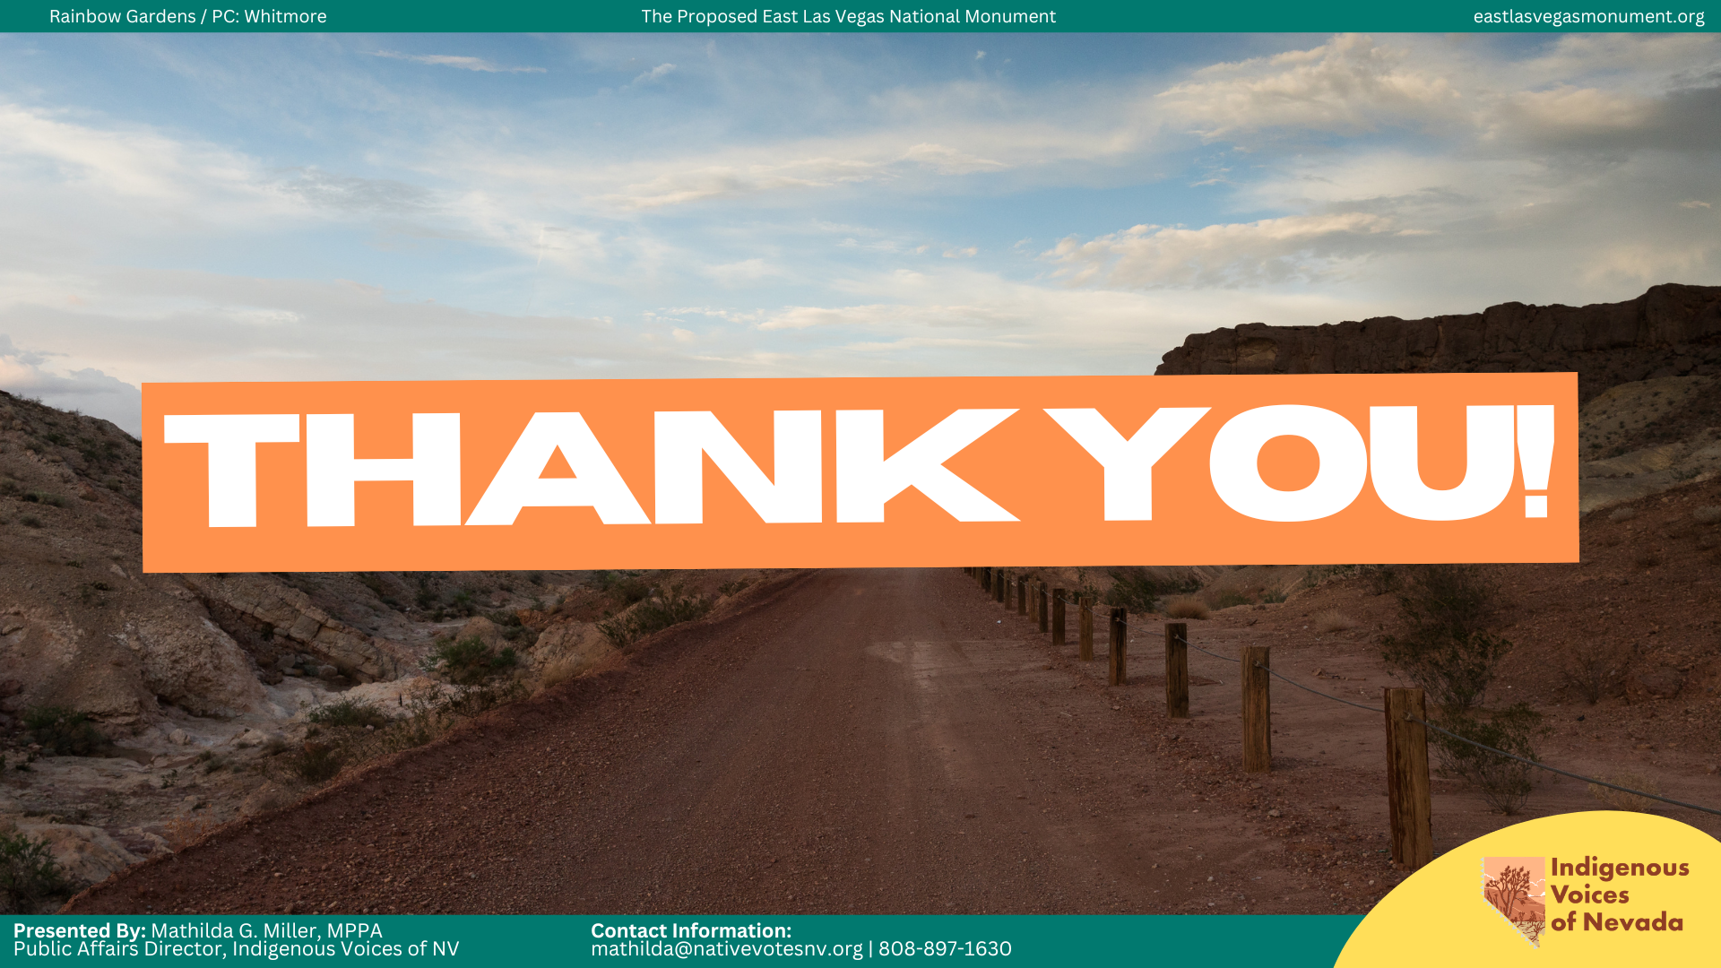
Notes:
If people are not responding to what we’re saying, it does not automatically mean they do not care. Most of the time, it means we have not made it possible for them to see themselves in it yet. And that’s the shift I really want us to leave with today. Because our job is not just to be right. Our job is to be understood. To be trusted. To be remembered. And to be impossible to ignore.
That means we stop treating communication like information transfer and start treating it like relationship-building. Like invitation. Like opening a door and making it possible for people to walk through it.
Because people do not move when they feel lectured at.
They move when they feel emotionally connected to what’s at stake.
That is trauma-informed communication.
That is values-based polarization.
That is narrative power.
And when we learn how to communicate in ways that are clear, emotionally grounded, human, and impossible to look away from, we stop playing defense.
We stop reacting to narratives built by other people.
We start shaping them ourselves.
And that is how movements grow.

