Slide 1

Fundraising For Today: Strategies That Build Resilience, Respect Capacity, And Result In More Revenue For Your Mission!
Brandy Bertram
For Conservation Lands Foundation, Friends Summit
May 12, 2026
Notes:
Description: Are you one of the many organizations being forced to reevaluate your fundraising strategy and explore new options in response to the seismic shifts in today’s funding landscape? Do you wish you had someone to help you sort out the best approach based on reality, not theory? Join Brandy Bertram, a 25+ year veteran of small-shop fundraising, as she shares critical insights and practical frameworks to move your fundraising forward, even if you’re fighting upstream.
Audience Takeaways: Participants will leave the session with the knowledge and tools they need to 1) understand and prioritize their prospects, 2) craft a compelling case for support, and 3) align their efforts to the critical actions that are most likely to result in success.

Slide 2
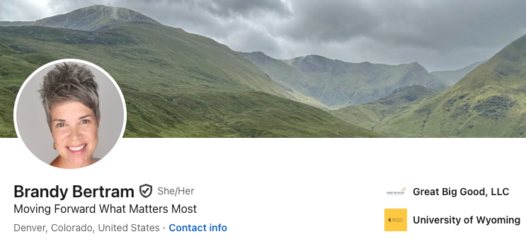

Slide 3
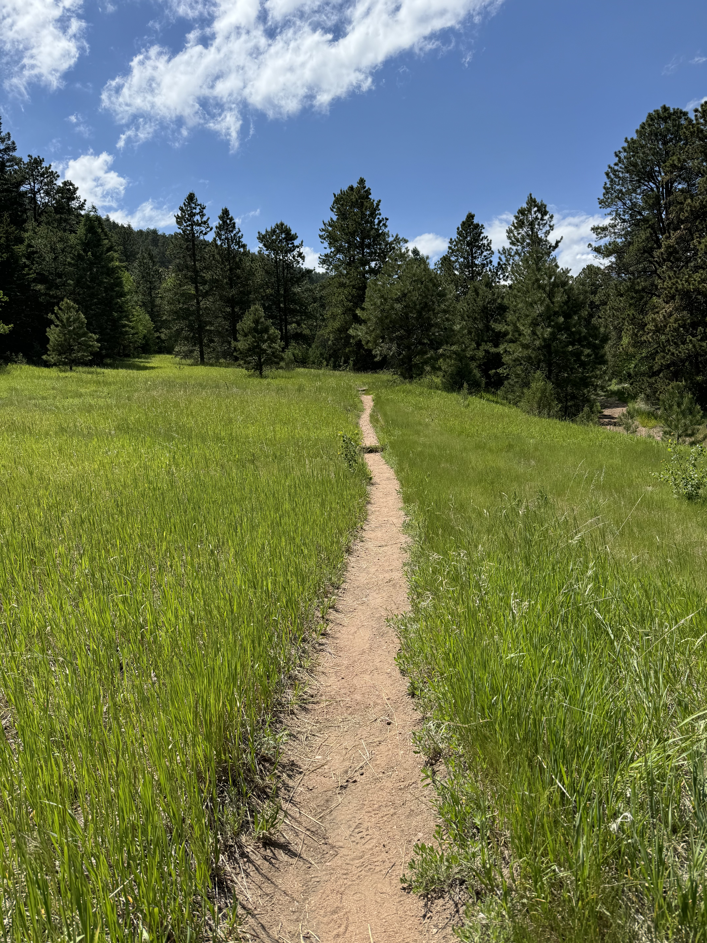
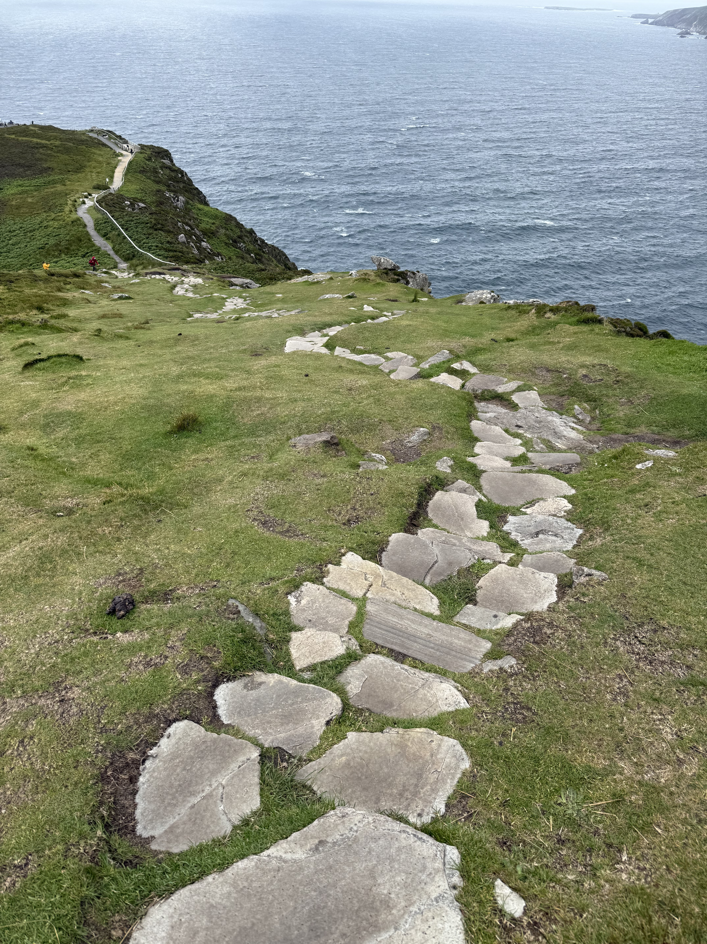
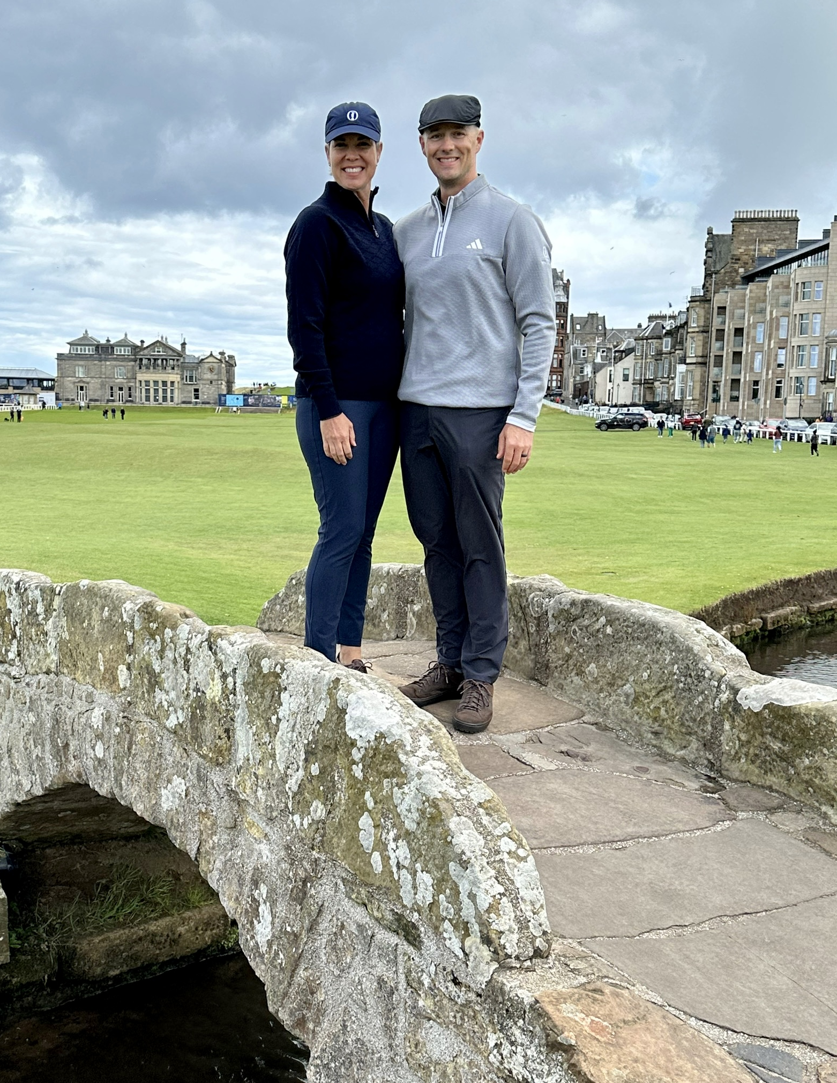
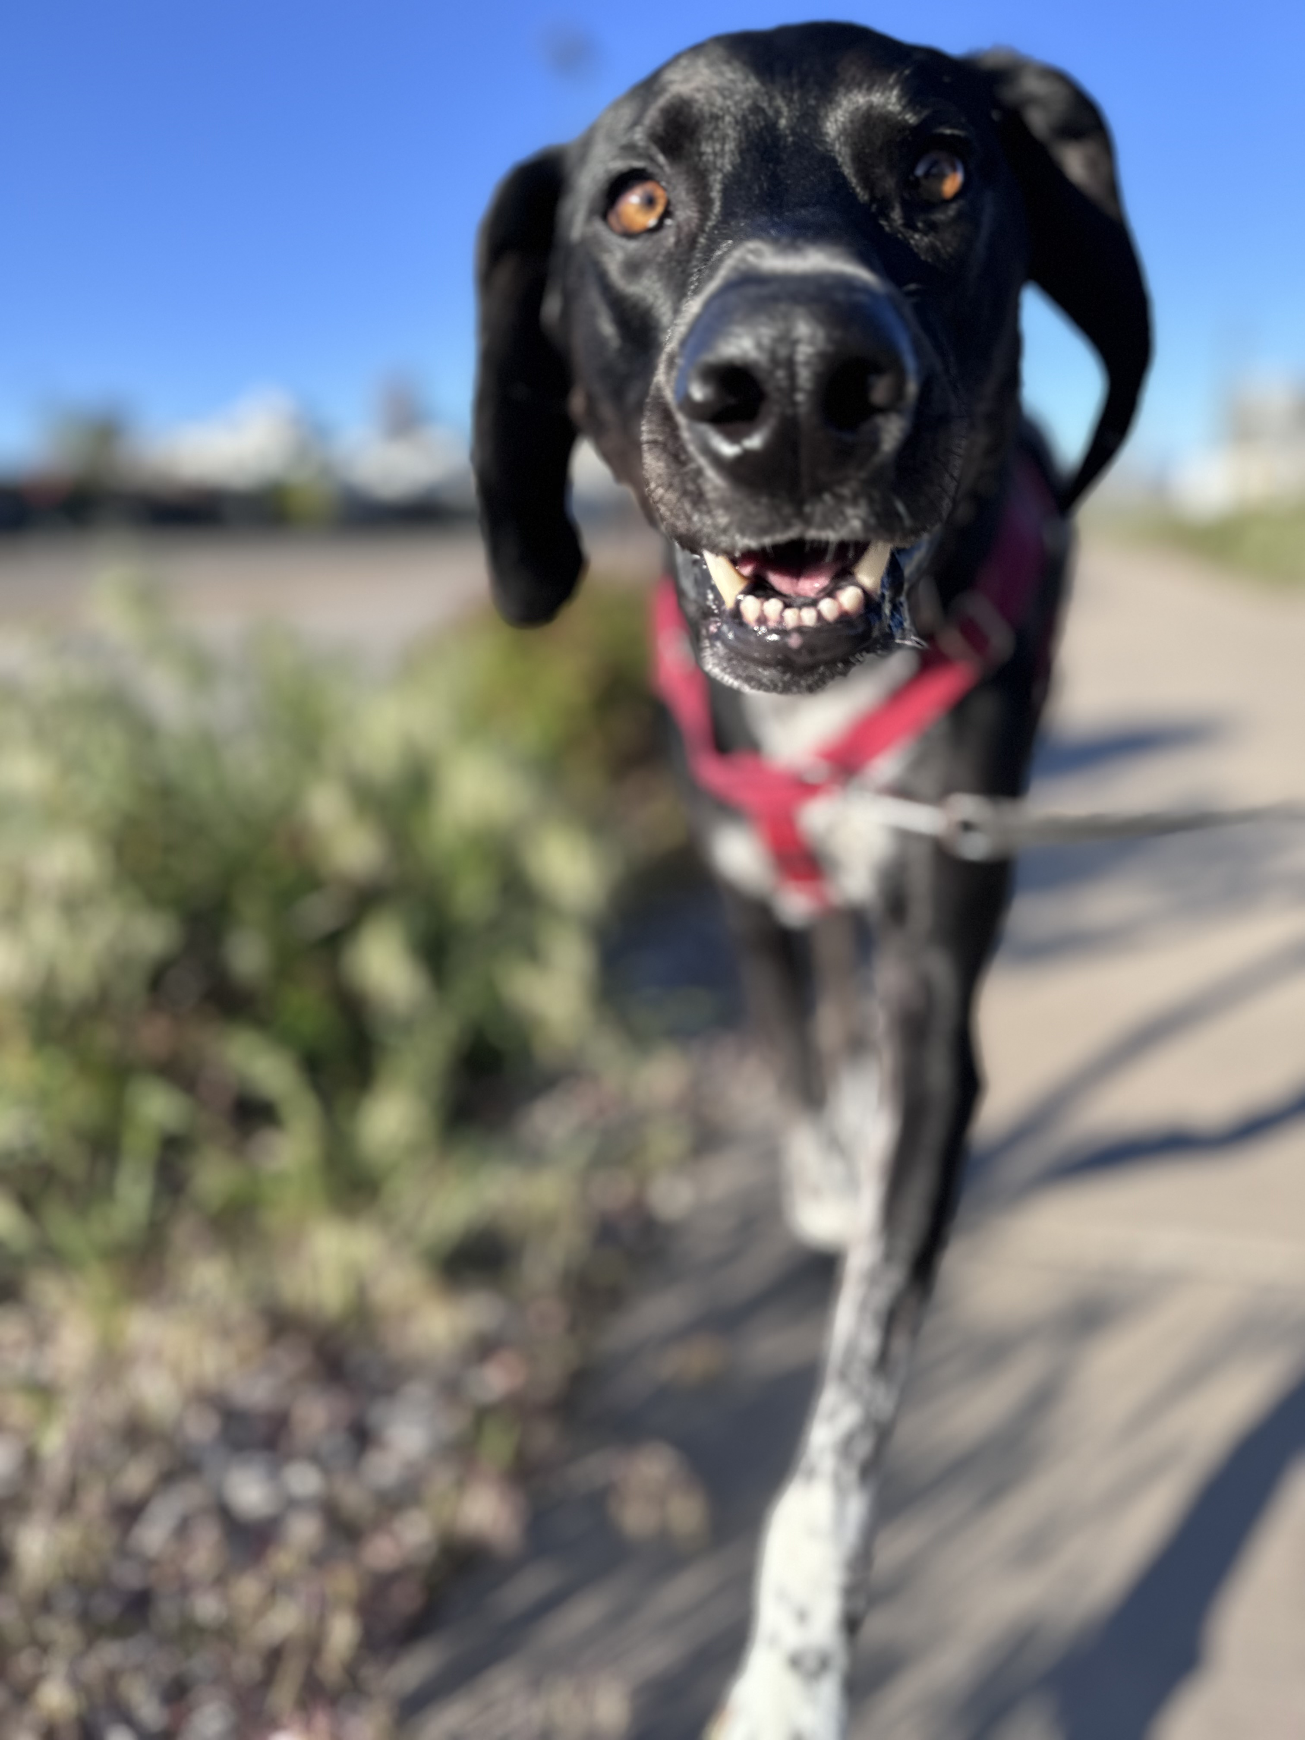

Slide 4
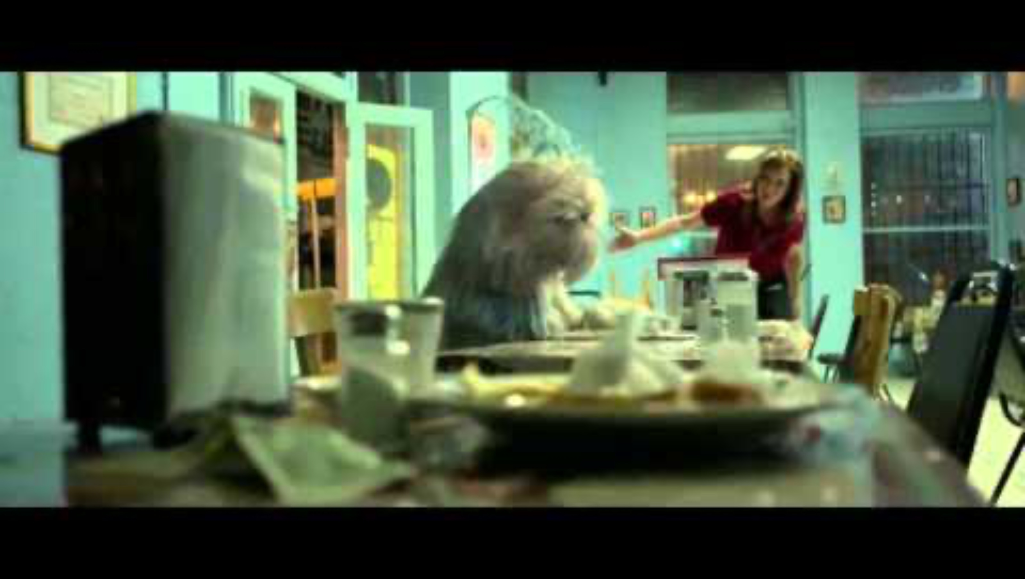
Notes:
Fundraising is scary. It comes into this world ugly and messy. Fundraising is frightening because it threatens what is known – and believed, by us and others about money, about wealth, and about cultural norms like what qualifies as polite conversation and other people’s business.
Yes, fundraising is scary, and messy, and, at times, fragile. But under the proper care, it becomes something beautiful.

Slide 5
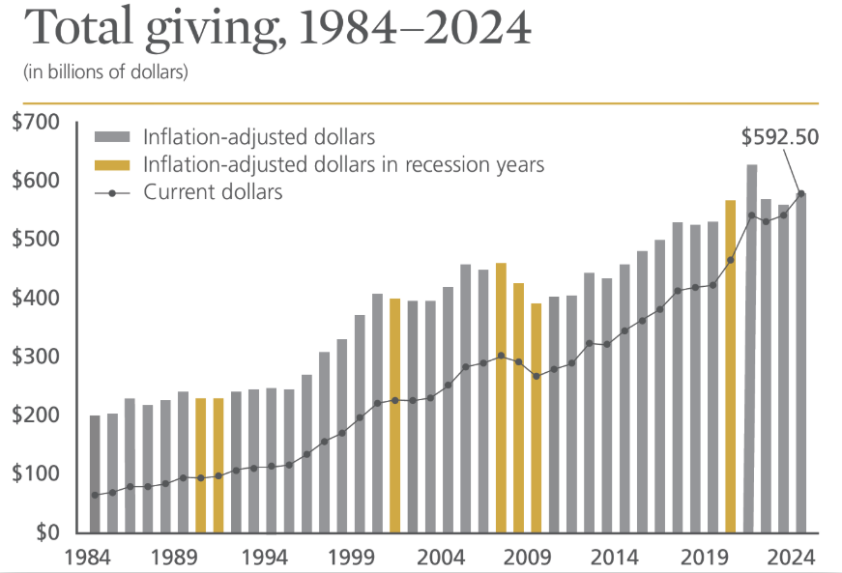

Slide 6
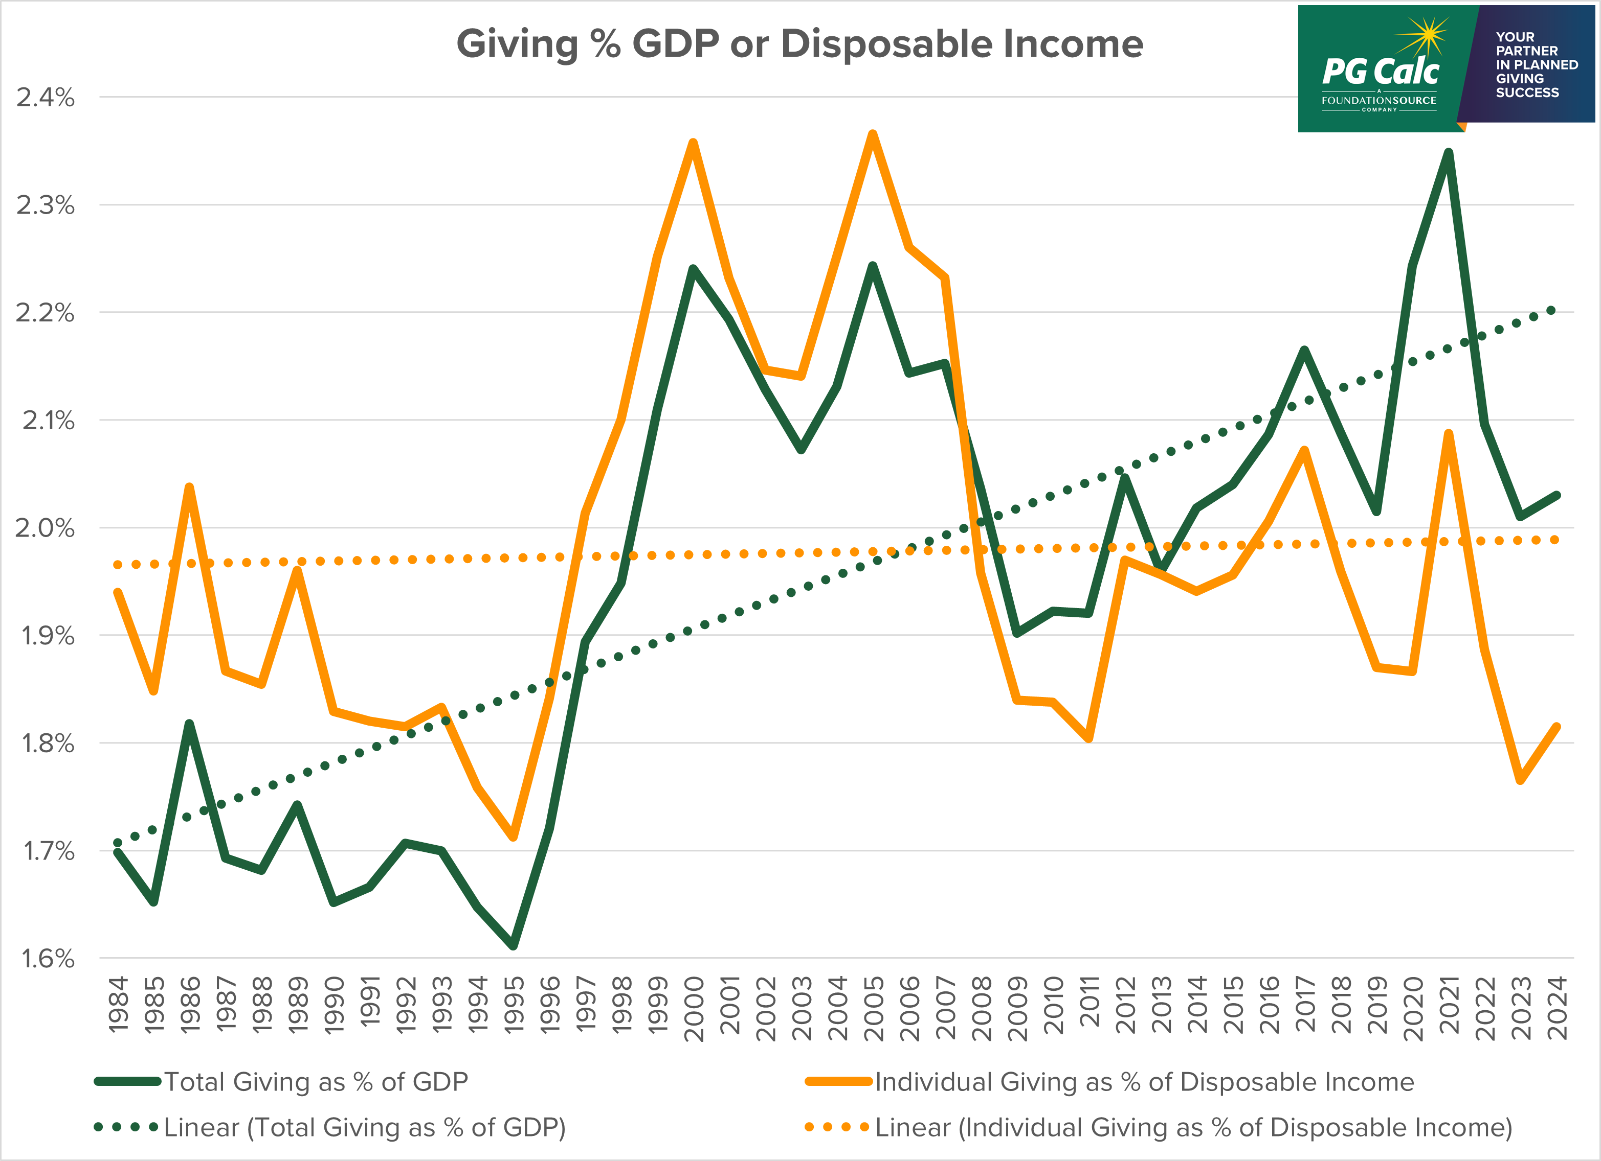

Slide 8
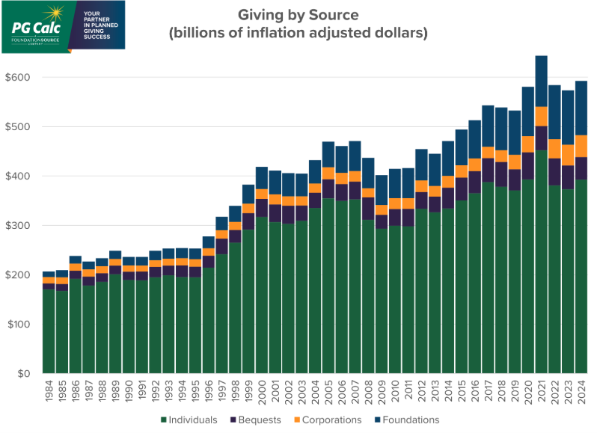

Slide 10

So, what does this mean for me?

Slide 11
Ten Critical Moves
Ready the Organization
Prepare your Archetypes
Lay the Foundation
Craft a Case for Support
Bolster Capacity
Prioritize your Prospects
Prep a Plan
Create Culture
Build your Networks
Calendar

Slide 12
Ready the Organization
Vision
Efficiency
Transparency
Impact
Integrity

Slide 13
Prepare the Archetypes
Why
What
How
When
Who

Slide 14
Lay the Foundation
Gift Acceptance & Partnership Policies
What
Whom
Conditions
Process

Slide 15
Craft the Case for Support
You
Us
Impact

Slide 16
Bolster Capacity
Staff
Volunteers (BoD!)
Vendors / Contractors

Slide 17
Prioritize Your Prospects
Affinity
Qualified Prospect
Ability
Access

Slide 18
Prepare a Plan
Cultivate
Brief
Steward
Engage
Qualify
Prioritize
Solicit

Slide 19
Create a Culture of Success
Goals
Behaviors
Metrics
Reflection
Celebration

Slide 20
Build a Network of Support
Square Squad
Follow
Community

Slide 21

Calendar a What Matters

Slide 22

Be Relentless
Center on the WHY
Focus on WHO and WHAT matters most
Keep a Growth Mindset
Ask for what you need
Keep going!

Slide 23
Brandy’s Keys to Fundraising through 2026
Clarity:
Of what matters most for you, your organization, and your donors.
Consistency
Repeating critical actions until plan becomes practice, and practice becomes habit.
Connection
Focusing on building authentic partnerships to achieve impact.

Slide 24

Questions?

Slide 25
Thank you!
Brandy@GreatBigGood.com

