Slide 1
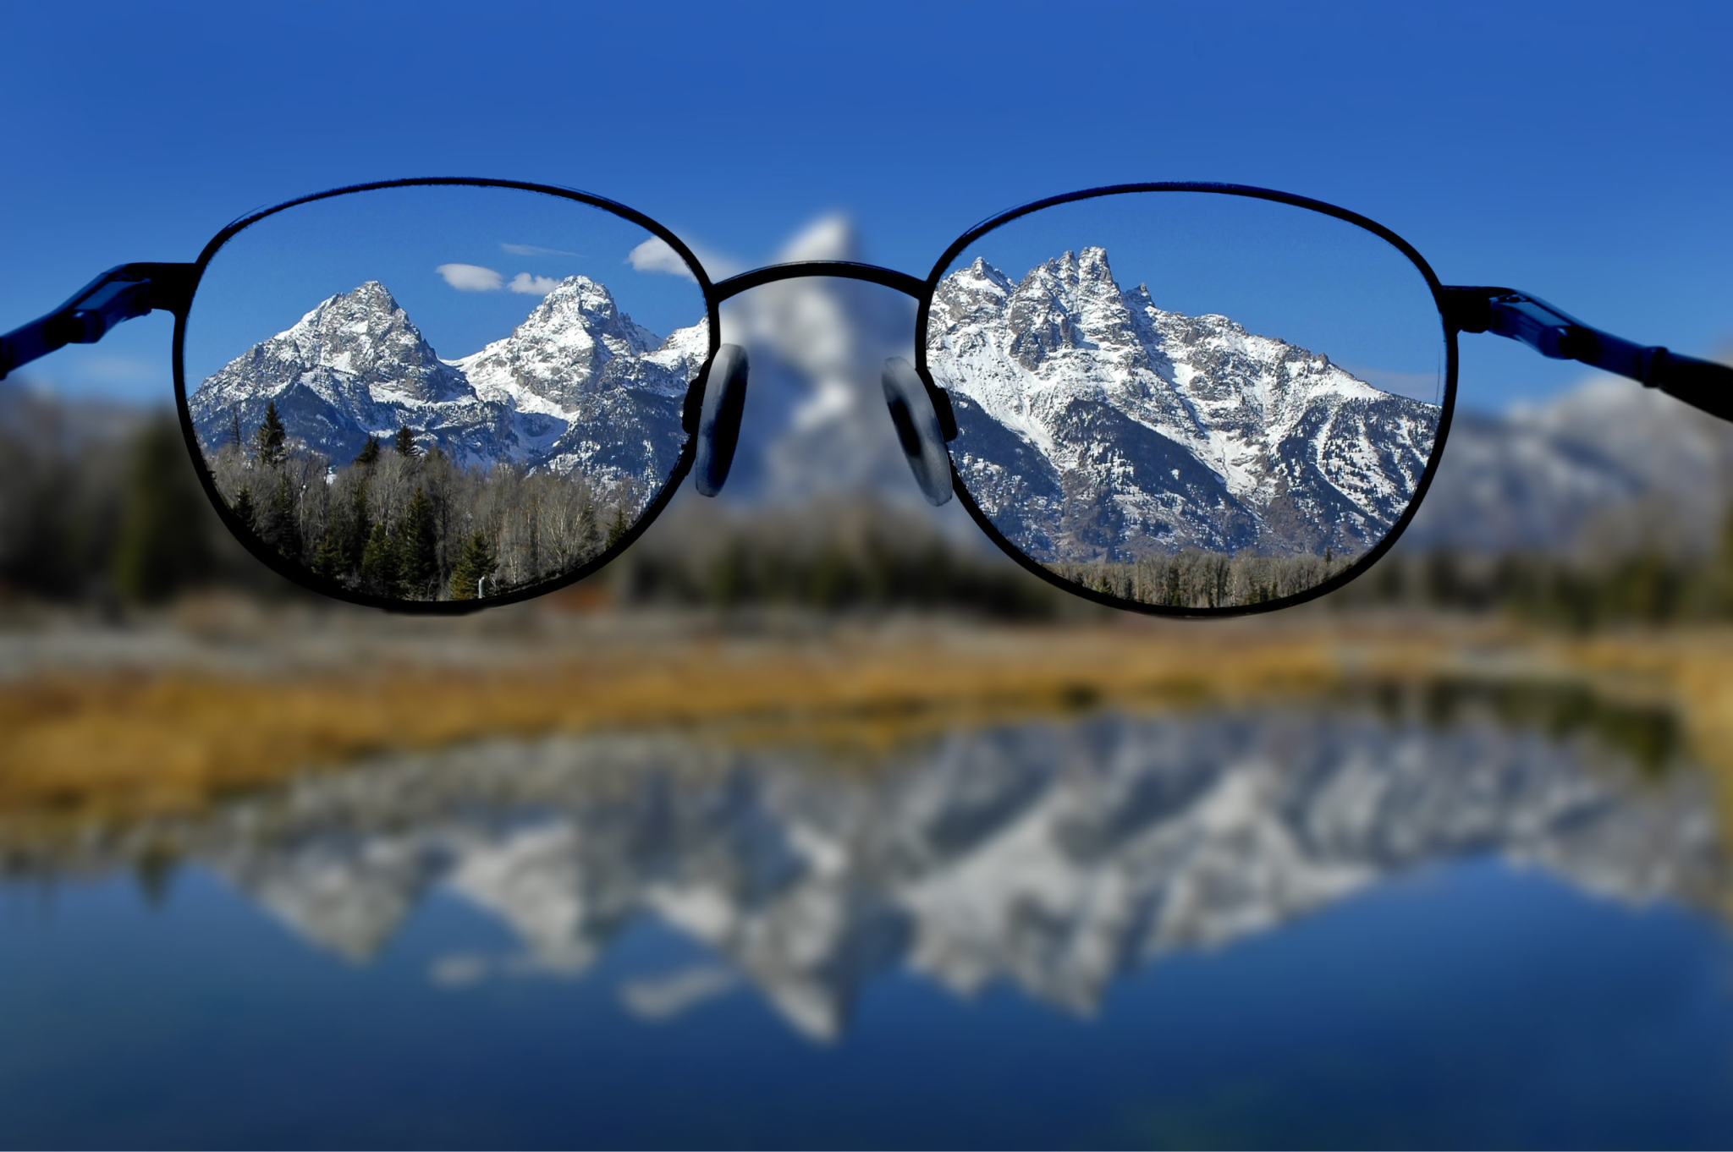

Envisioning the Future of the National Conservation Lands System Vision-to-Platform Session | FGN Summit | May 12, 2026
Pexels / ICON

Slide 2
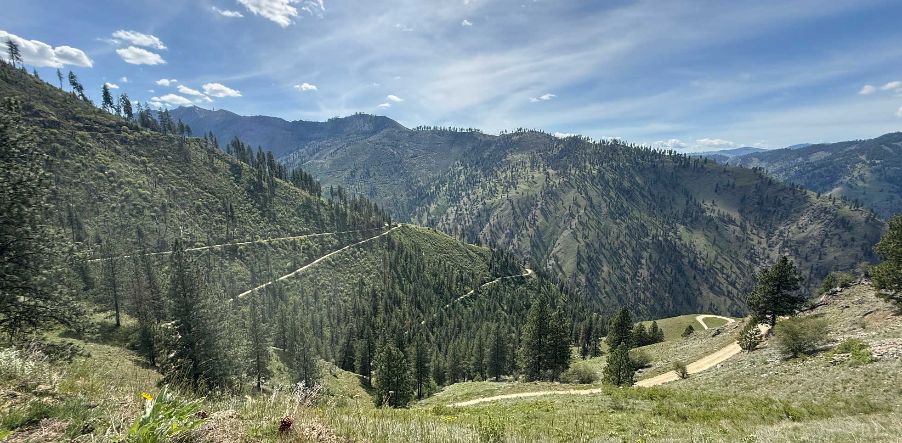
WHERE ARE WE?
25 Years Ago
1 Year Ago
1 Month Ago
TODAY!
Later this year
Near Sawtooth Wilderness Area | Idaho

Slide 3
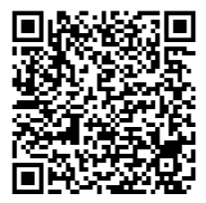
NCLS VISION THEMES
from the July 2025 NCLS Visioning Session
Community Engagement & the FGN
Permanence & Permanent Protections
Tribal Collaboration & Co-Management
Expanding the Tent / Diversifying the Coalition
Agency Capacity & Structural Challenges

Slide 4
GUIDING QUESTIONS
to structure your conversations
For each of the five topic areas…
What challenges are you facing that you hope future policies and/or elected officials will address?
What federal levers are essential (e.g., legislation, appropriations, executive action, agency direction) to advancing this portion of the National Conservation Lands vision in the next 2 to 6 years?
What would a candidate need to believe, understand, or commit to in order to be a genuine champion on this particular issue? If a candidate wins their race in 2028, what are our best hopes for them to act on during their first term?

Slide 5
VISIONING SESSION STRUCTURE
THREE guiding questions
FIVE vision themes
TEN (or so) of your friends and peers
FIFTEEN minutes at each theme

Slide 6
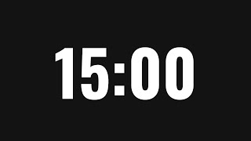
GUIDING QUESTIONS
to structure your conversations
For each of the five topic areas…
What challenges are you facing that you hope future policies and/or elected officials will address?
What federal levers are essential (e.g., legislation, appropriations, executive action, agency direction) to advancing this portion of the National Conservation Lands vision in the next 2 to 6 years?
What would a candidate need to believe, understand, or commit to in order to be a genuine champion on this particular issue? If a candidate wins their race in 2028, what are our best hopes for them to act on during their first term?

Slide 7
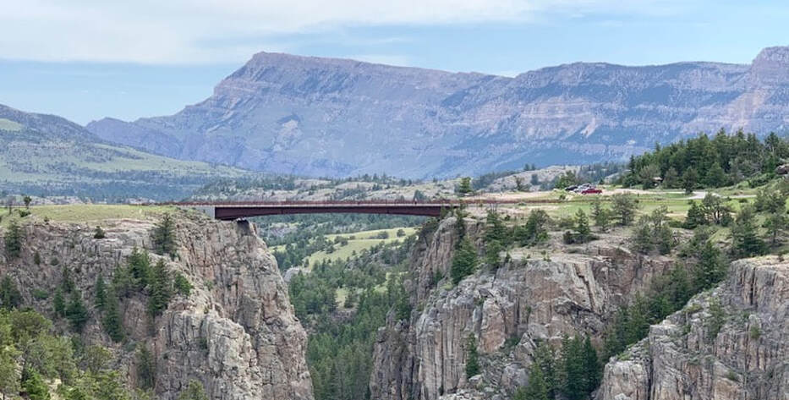
WHERE DO WE GO FROM HERE?
Sunlight Basin | Wyoming

Slide 8
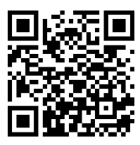
SURVEY FOR ADDITIONAL RESPONSES
to contribute to this conversation through June 5, 2026

Slide 9
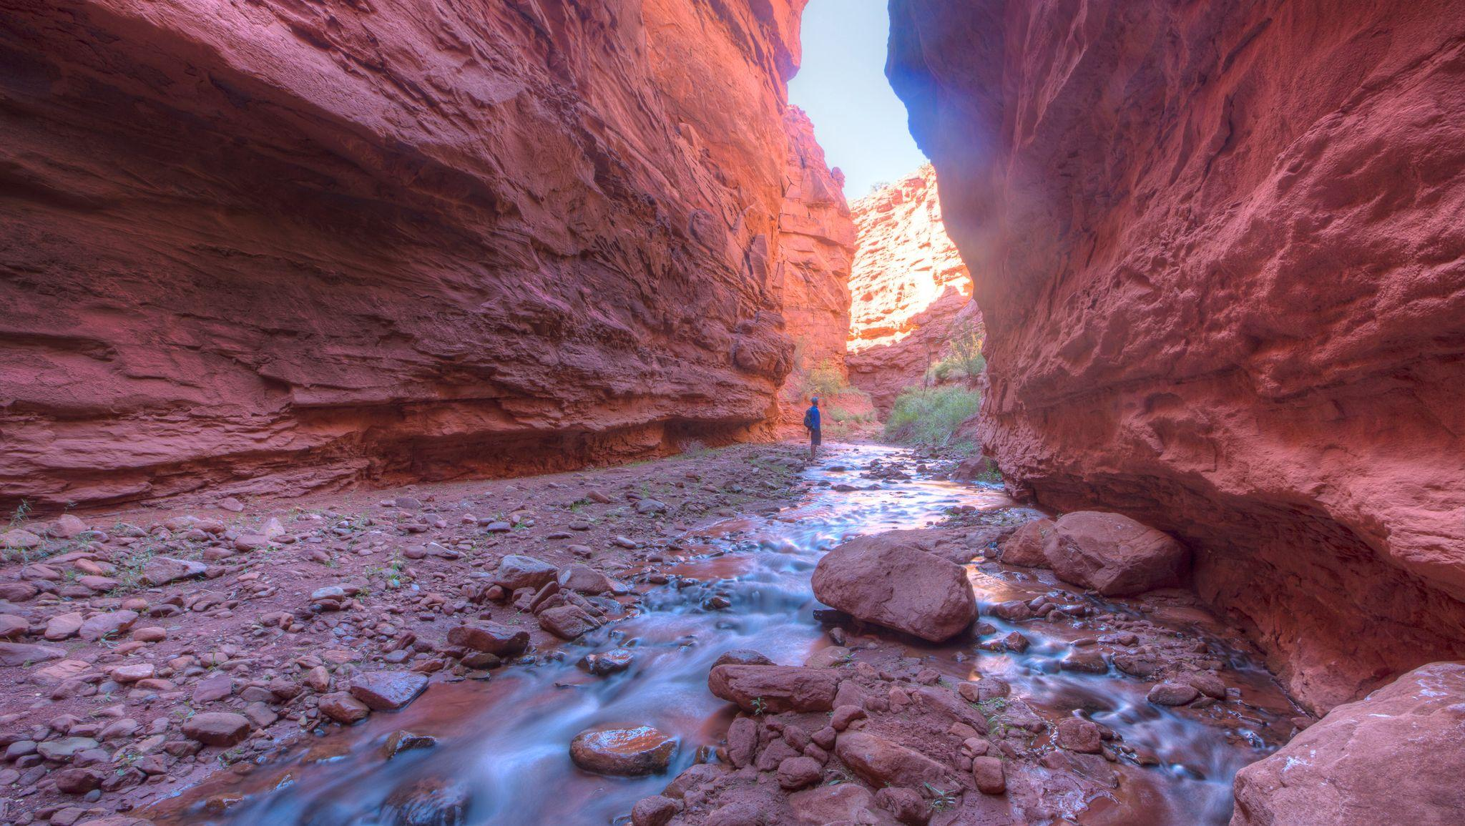
THANK YOU!
Professor Creek & Mary Jane Canyon | Utah

