Slide 1
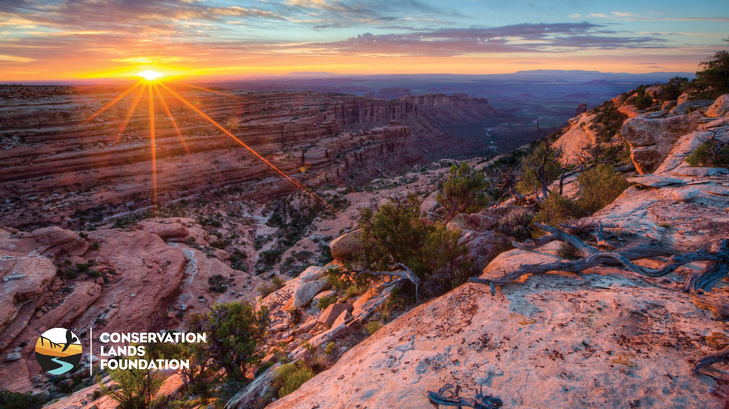
YOU are the Story
Friends Rendezvous 2019

Slide 2

Digital Toolkit & Resources
Tell your story:
Capture and share the impact of your work
Improve fundraising and recruitment efforts
Increase awareness of National Conservation Lands
So, how do we create engaging content that sparks action to protect our public lands?

Slide 3
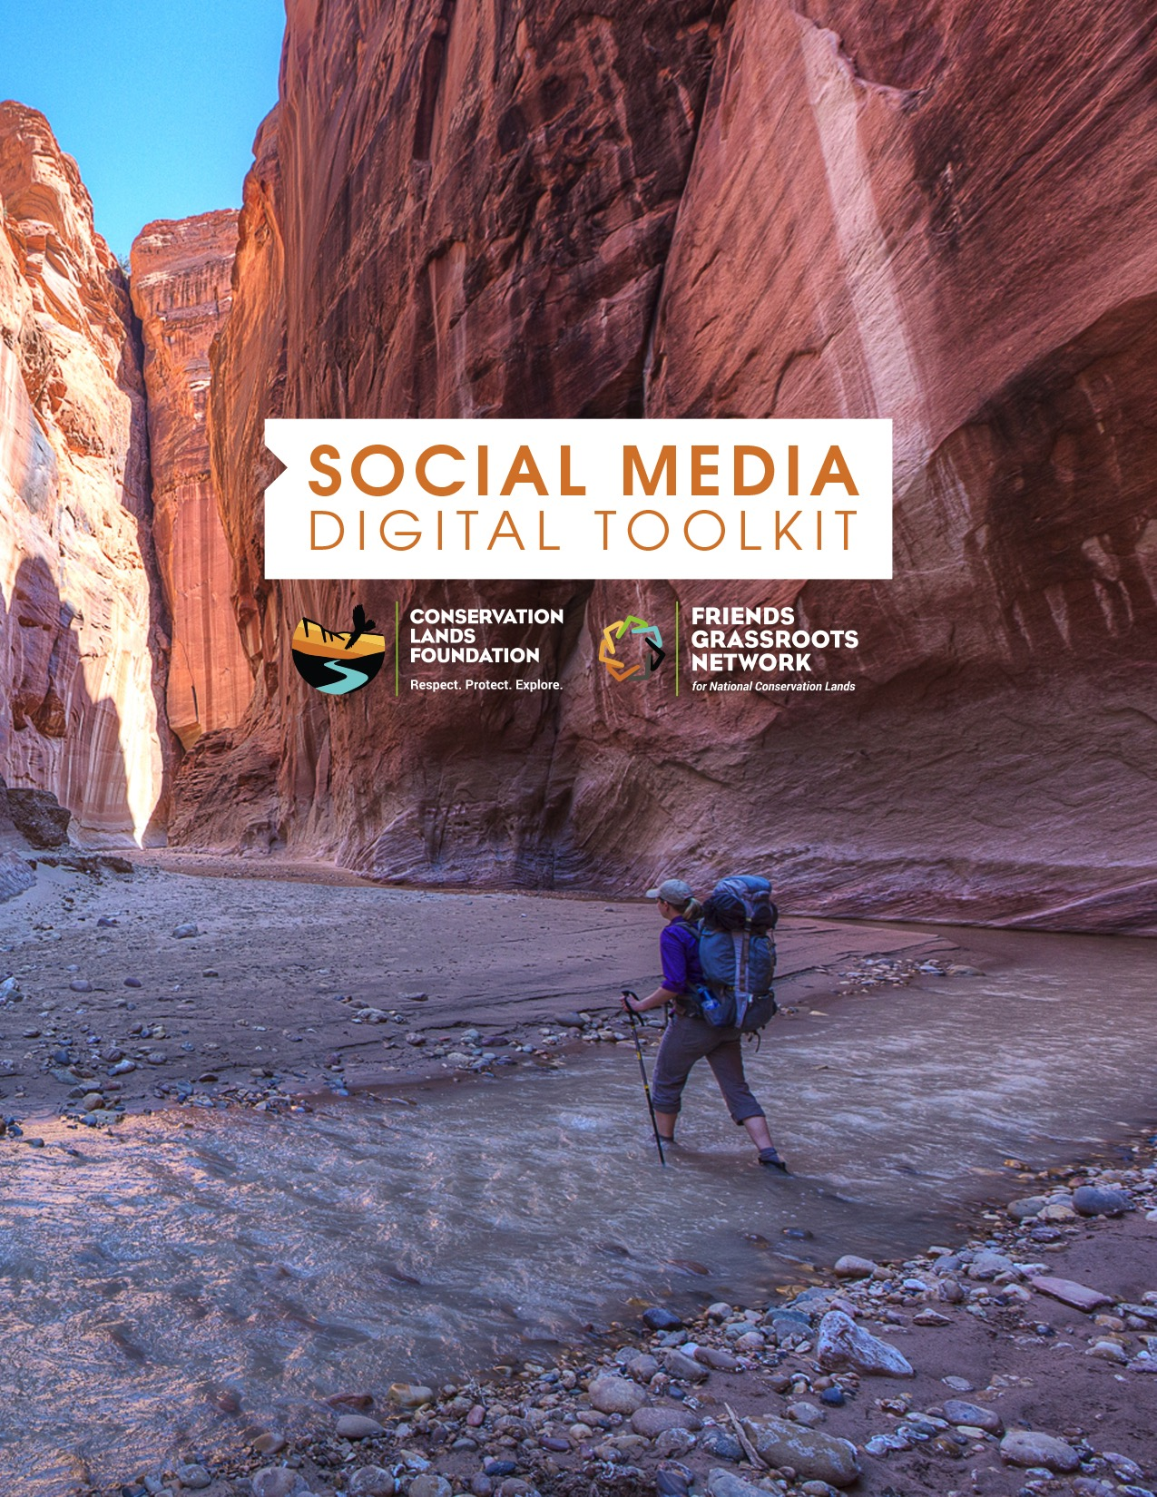
Social Media Digital Toolkit
  Tools and Templates:
  - Cross Platform Comparison Tool
  - Target Audience Worksheet
  - Social Media Strategy Worksheet
  - Editorial Calendar Planner
  - Content Builder
  - Hashtag & Key Influencers Lists

Slide 4
Create High Value, Campaign Content
Each FGN has a compelling story—a person, an initiative or an outcome—that can draw your audience in.
  Define target audiences for social media (specific)
  Set a few specific, measurable and attainable goals
  Prioritize content that drives actions and supports your organization’s overall objectives:
  Events, fundraising campaigns, evergreen topics, photos
  and videos from staff and volunteers

Slide 5
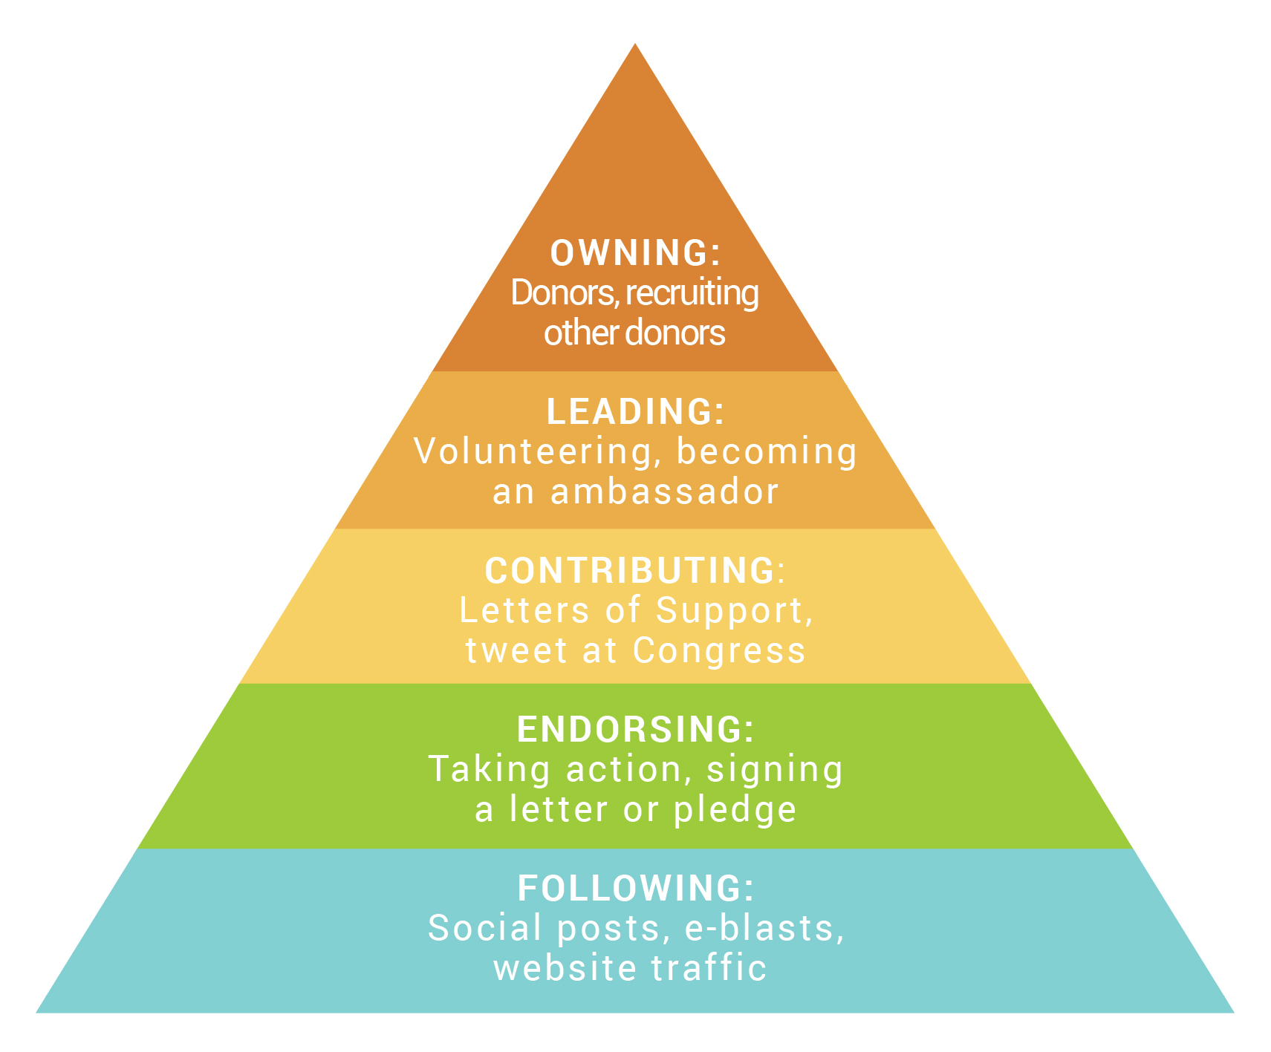
The Ladder of Engagement
Begins with a retweet, link-click or page view, and increases through various stages of commitment.

Slide 6
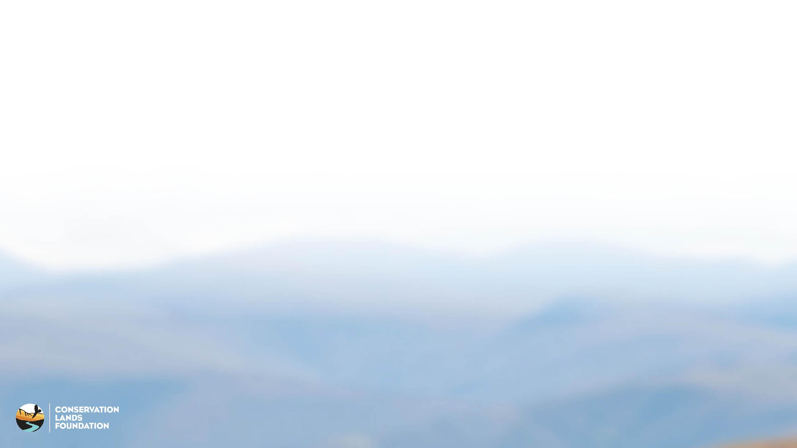
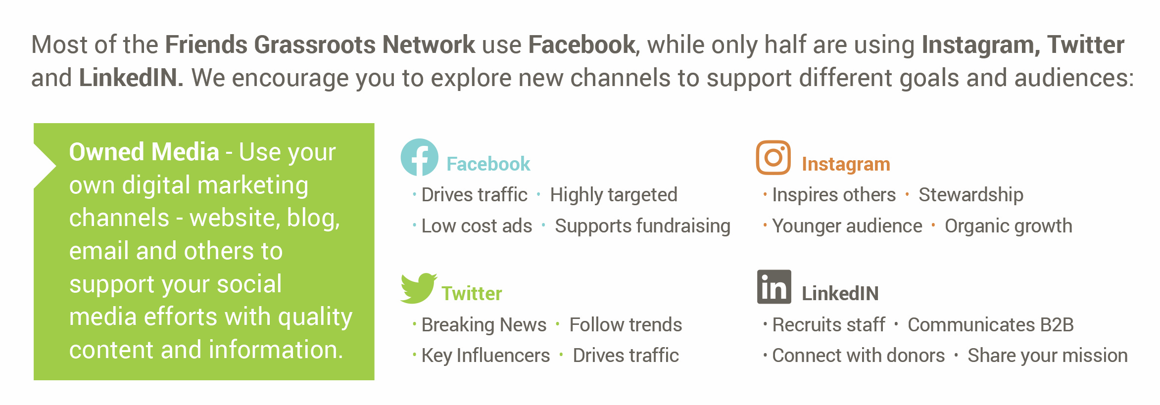
Tools & Best Practices

