Slide 1

Ignoring the Noise: Leveraging Legal Mandates to Protect and Grow Conservation Uses on Public Lands Nada Wolff Culver Natalie Landreth

Slide 2


Where we are – a lot has changed quickly
Executive orders, secretarial orders, guidance.
Energy dominance.
NEPA regulations repealed.
Threats to conservation regulations, designations, policies.

Slide 3


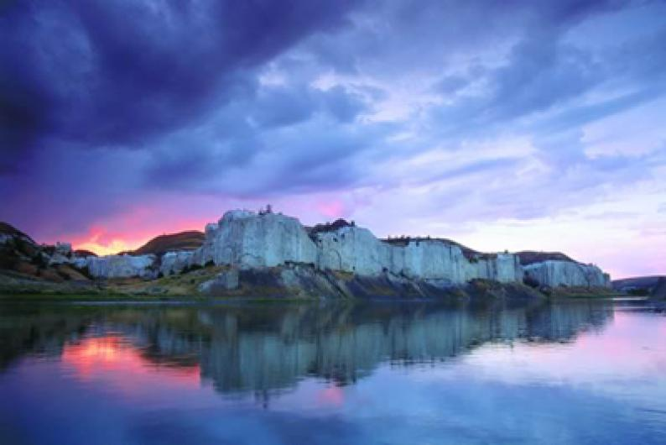


But keep in mind –
Plenty to fight for
Plenty to fight with

Slide 4
The state of NEPA
Major changes
CEQ implementing regs had existed for almost 50 years creating a very familiar process, and they have been revoked after D.C. Circuit ruling.
New regs are limited to: (1) emergency situations; (2) the use of categorical exclusions; (3) applicant prepared EISs/EAs; (4) cooperating/lead agencies.
Public input is only guaranteed for EISs and at scoping.
All other direction regarding NEPA processes will only be addressed in guidance documents, such as department handbooks and bureau guidance.
Supreme Court decision (Seven County Infrastructure Coalition case) changed the federal common law – finding the scope of NEPA review has become too broad and burdensome, so dialed back how much NEPA analysis will be required and emphasizing procedural nature.

Slide 5

With limited NEPA –what we can work with
The statute is still in place
Requires informed decision-making after taking into account environmental consequences, considering alternatives/mitigation, involving cooperating agencies.
Public participation/analysis
Agencies have discretion to provide more engagement/evaluation.
Looking at insight, complexity, community insight, efficiency ---- can be pushed.
Cooperating agencies have a seat at the table – federal/state/local/Tribal agencies.
Opportunities to cooperate and encourage.
Other statutes require public involvement in decision on management of public lands - FLPMA, oil & gas regulations, planning regulations
Can enforce these.

Slide 6

Energy emergency
Established in Executive Order 14156 (1/20/25) and continued for an additional year through 1/20/27, implemented by DOI for energy projects that have submitted plans of operations, applications for permits to drill, and other applications:
NEPA EISs 28 days/EAs 14 days.
NHPA consultation 7 days notice.
ESA expedited consultation.
However:
Projects have to fit these criteria.
And “project applicants must affirm in writing that they want their project covered.”
Other laws still apply.

Slide 7

Changes to laws, regs & the way they’re used
Reconciliation bill changed Mineral Leasing Act, oil & gas leasing.
Congressional Review Act use on plans and public land orders.
Regulations being rescinded or revised:
NPR-A.
Public Lands Rule.
Grazing.
Oil and gas.
Land use planning?
Travel planning?
Withdrawals being revoked/stopped:
Chaco.
Pecos.
Others?

Slide 8
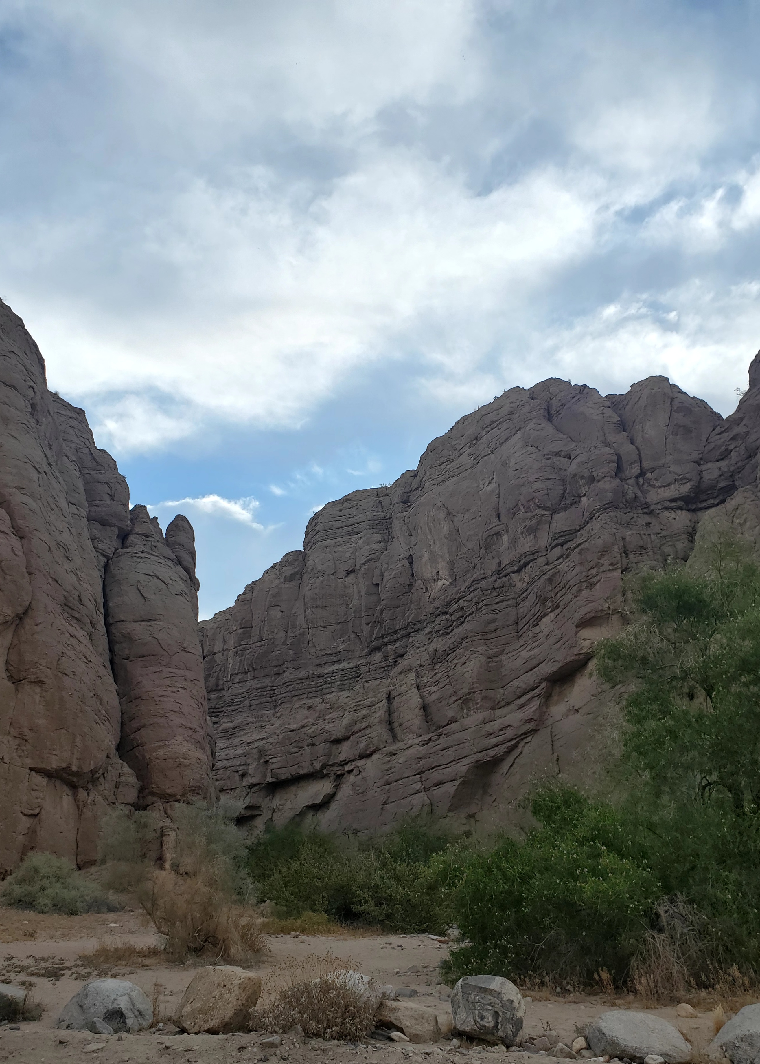
Other legal obligations
National Landscape Conservation System Act – created system of National Conservation Lands “in order to conserve, protect, and restore nationally significant landscapes that have outstanding cultural, ecological, and scientific values for the benefit of current and future generations.”
Defers to other governing acts such as Wilderness Act or Wild & Scenic Rivers Act.
Individual Monument Proclamations and other enabling legislation – for specific units identify those objects or other values/resources to prioritize
Guide all decisions and require some.
May be interim management guidance in place until plans are completed.

Slide 9

Other legal obligations
National Historic Preservation Act - Established to protect historic and cultural resources. Requires inventory, consultation and consideration of mitigation. Requires consultation with Tribes prior to action. Also provides for creation of Programmatic Agreements with broader set of parties that can govern action needed prior to approving permits or rights-of-way or other actions in broader areas.
Endangered Species Act - Enacted to prevent extinction and promote recovery of threatened and endangered fish, wildlife and plant species. Requires consultation and consideration of protection of listed species prior to any actions that could result in jeopardy of the species or harm their critical habitat; generally prohibits “take” of those species. The BLM is also supposed to take action to prevent actions that could make listing more likely of species identified as “special status species” (per manual).
Both of these tend to line up with ACECs, wilderness values, values of National Conservation Lands units.

Slide 10

Pushing back
Changes in agency position have to be justified.
Must be explained.
Repealing or revising regulations must show a reason that the previous regulation required changes.
Ending a mineral segregation must show withdrawal is no longer needed.
Participate.
Push for more robust opportunities, demand meaningful consultation, submit comments, build a record.
Increases the costs to operate – financial and social.
And, showing up is winning.
May affect the outcome and ensures you have standing to sue.

Slide 11

And adding to your campaign
Connections to the land and communities
Push for more robust opportunities, submit comments, build a record.
Engagement and visibility
Land use planning, oil & gas leasing, other authorizations.
Proposing alternatives, new designations or management approaches/areas.
Can be proactive in the interim, as well, using these same laws and authorities.
Ways to keep moving the conversation and the conservation forward…

Slide 12


Building blocks for conservation
MOUs for example – rooted in legal authority.
Relationships with the agency.
Opportunities for projects, land management.
Can be part of Tribal co-stewardship.
A few before Secretary Haaland’s initiative, hundreds signed during the last administration, still going forward.
Can be part of being a Friends group.
And work through different challenges.

Slide 13
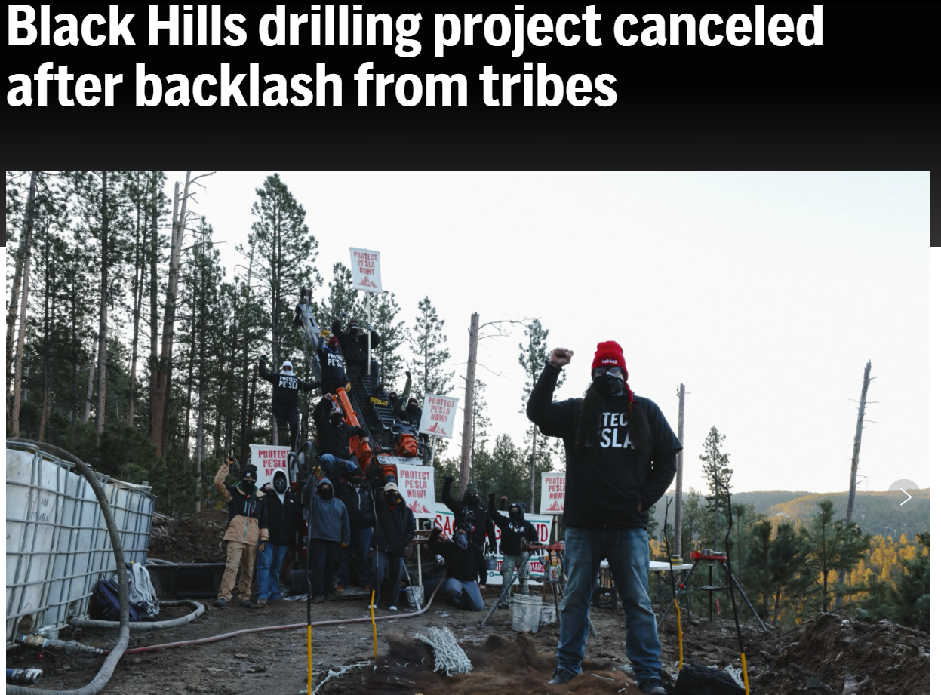
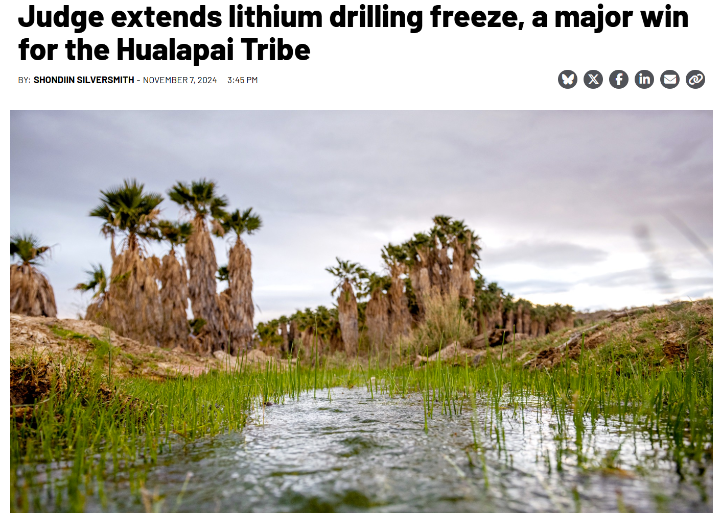
Or building blocks…
Winning with what we have – lawsuits + campaigns

Slide 14
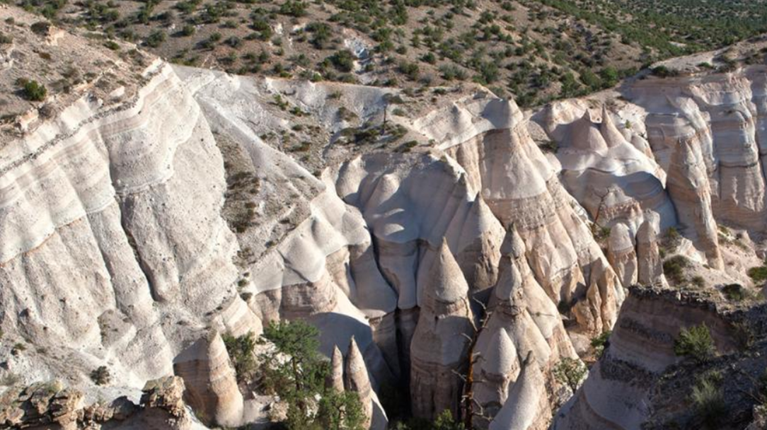
DISCUSSION
Contact us:
nada@tplalliance.org
natalie@tplalliance.org

