Slide 1



Holding the Line: Empowering Your Campaign through Legal Advocacy
Todd Tucci, Senior Attorney
Advocates for the West
CLF Friends Summit, May 2026
Monument Valley, UT

Slide 2

Hope in Hard Times: Strategic Legal Advocacy – A Roadmap for CLF’s Friends Grassroots Network
Using legal advocacy to protect landscapes and advance priority campaigns
When to litigate — and when not to
Real-world examples: Red Cliffs, Livestock Grazing & Greater Sage-Grouse
Greater sage-grouse

Slide 3
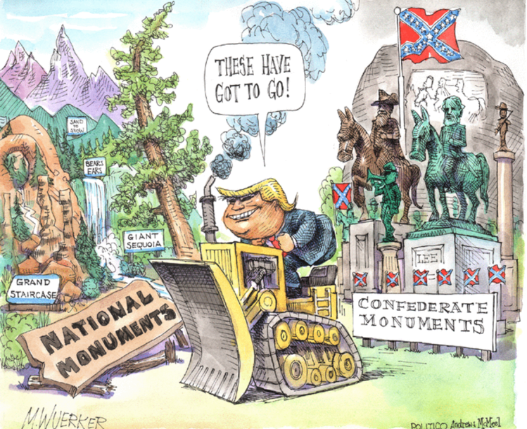
We are operating in a moment defined by ….
ACCELERATED AGENCY ACTION
INCREASED PRESSURE ON NATIONAL CONSERVATION LANDS
FEWER PROCEDURAL GUARDRAILS

Slide 4
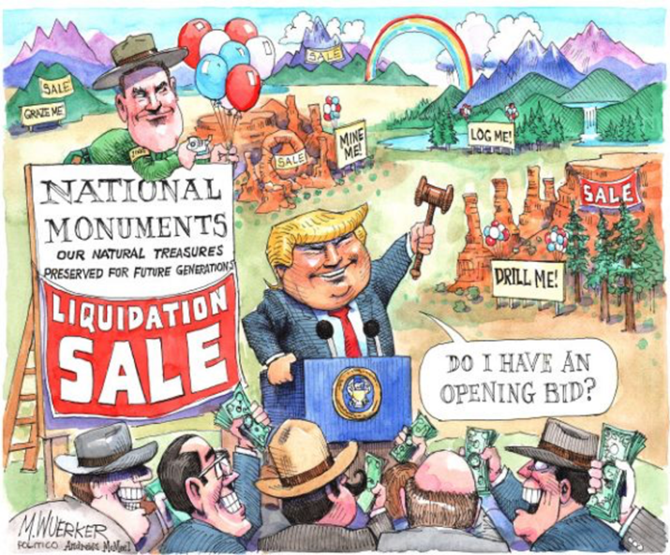
LEGAL ADVOCACY IS NO LONGER OPTIONAL — IT’S CORE TO EFFECTIVE CONSERVATION

Slide 5
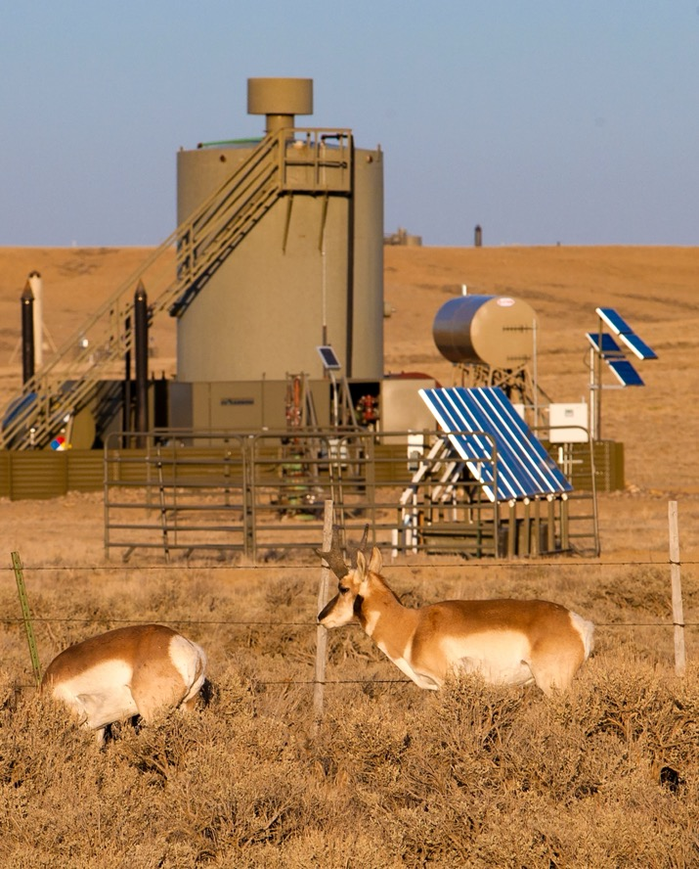
What is Advocacy?
Advocacy – An activity by an individual or group which aims to influence decisions within the political, economic, and social systems and institutions
Legislative
Administrative
Grassroots
Legal
ADVOCACY IS ONE TOOL IN A BROADER CAMPAIGN, NOT A STANDALONE SOLUTION
Converse County, WY

Slide 6
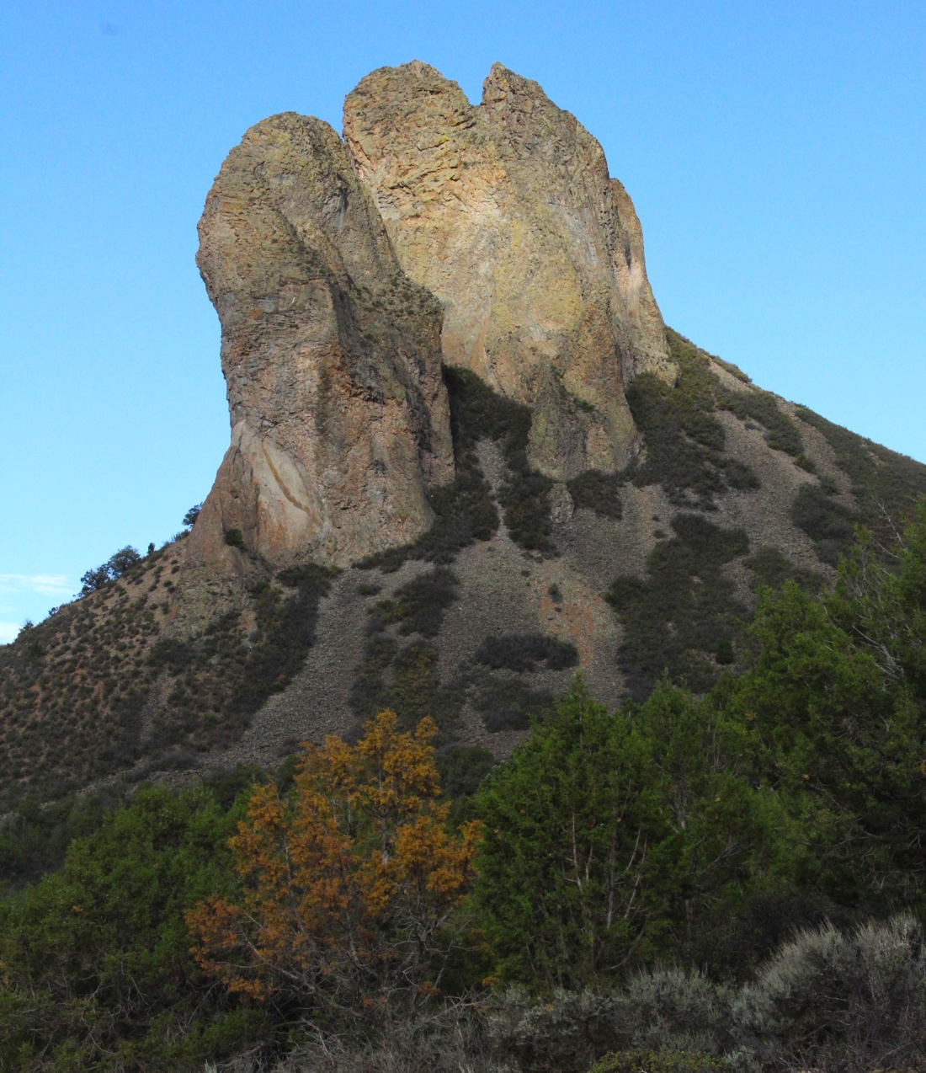
What is Legal Advocacy?
Legal Advocacy – Using state and federal legal tools, processes, and procedures to influence agency decisions
Public record requests
Engagement in agency decision-making
Administrative objections/appeals
Federal court litigation
RIGHT TOOL, RIGHT MOMENT
Needle Rock, Uncompahgre Field Office, CO

Slide 7
Putting Legal Tools to Work
Front-end ➡ influence decisions
Mid-stream ➡ objections/appeals
Back-end ➡ litigation
USE ALL THREE — INTENTIONALLY AND IN SEQUENCE
Sage-Grouse Planning
Red Cliffs
Front-end: advocacy in planning processes
Built record, shaped agency decision-making
Front-end: advocacy attempted
Back-end: litigation required when decision failed legal standards

Slide 8
Why Legal Advocacy Matters Now?
Heightened pressure on National Conservation Lands, public lands, and environmental safeguards
Faster agency action — often with fewer procedural guardrails
E.g., accelerated comment period, excessive use of exceptions
Litigation increasingly used to:
“Hold the line”
Enforce bedrock environmental laws
Examples
Compressed or accelerated NEPA timelines
Expanded use of categorical exclusions
Increased pressure on National Conservation Lands

Slide 9

When Should You Engage Legally?
Three threshold questions:
Consequential issue?
Clear legal hook?
Advances broader campaign strategy and conservation goals?
Chuckwalla National Monument, CA

Slide 10
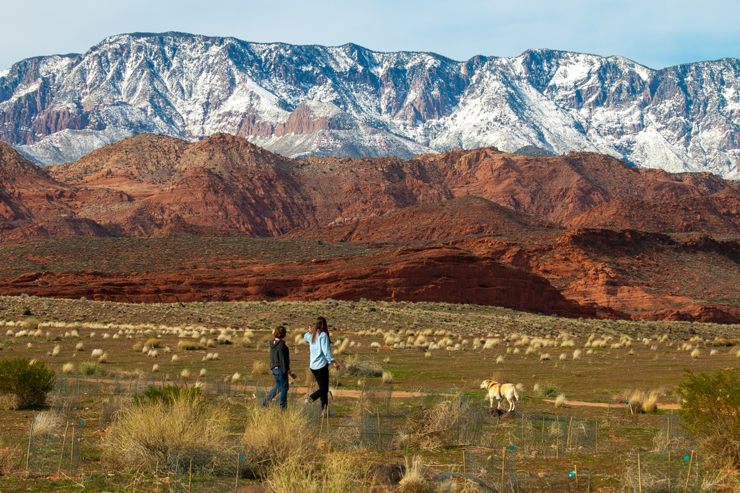
Legal Advocacy as Strategy (Not Reaction)
Avoid reactive litigation
Align legal work with campaign goals
WHEN AND WHETHER TO ENGAGE IN LEGAL ADVOCACY IS A STRATEGIC CHOICE
Red Cliffs National Conservation Area, UT/courtesy Conserve Southwest Utah

Slide 11
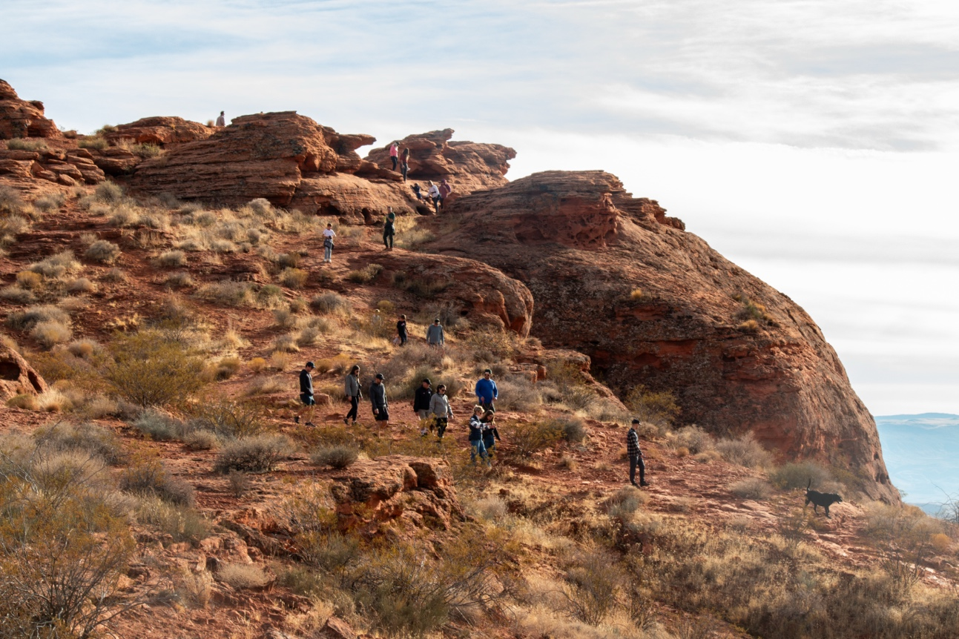
Understanding Risk
EVERY LEGAL DECISION INVOLVES TRADEOFFS — BE EXPLICIT ABOUT THEM
Types of risk:
Legal
Strategic
Resource
Reputational
SOMETIMES THE BIGGEST RISK IS NOT ACTING
Red Cliffs National Conservation Area, UT/courtesy Conserve Southwest Utah

Slide 12
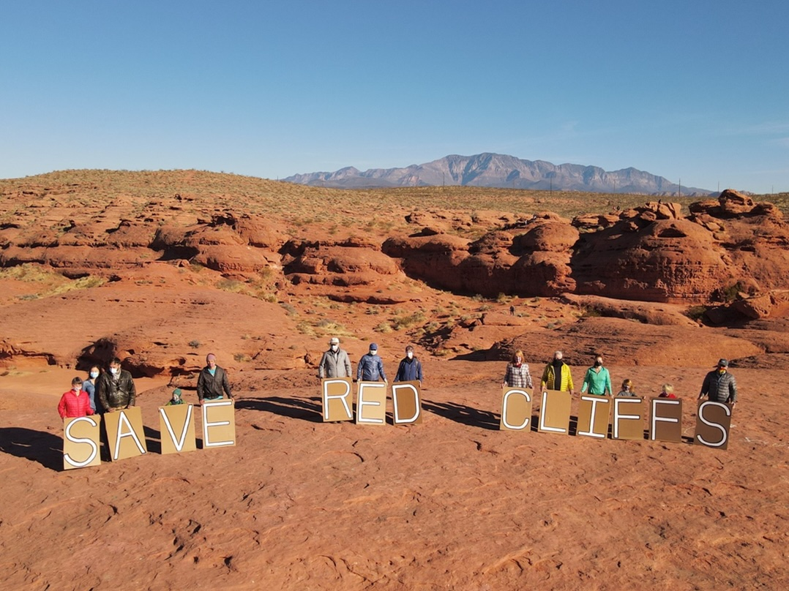
Organizational Readiness
Capacity
Partners
Resources
Decision clarity — who decides, how decisions are made, and how quickly
LEGAL ADVOCACY AND LITIGATION IS NOT JUST A LEGAL DECISION — IT’S AN ORGANIZATIONAL COMMITMENT
Red Cliffs National Conservation Area, UT/courtesy Conserve Southwest Utah

Slide 13
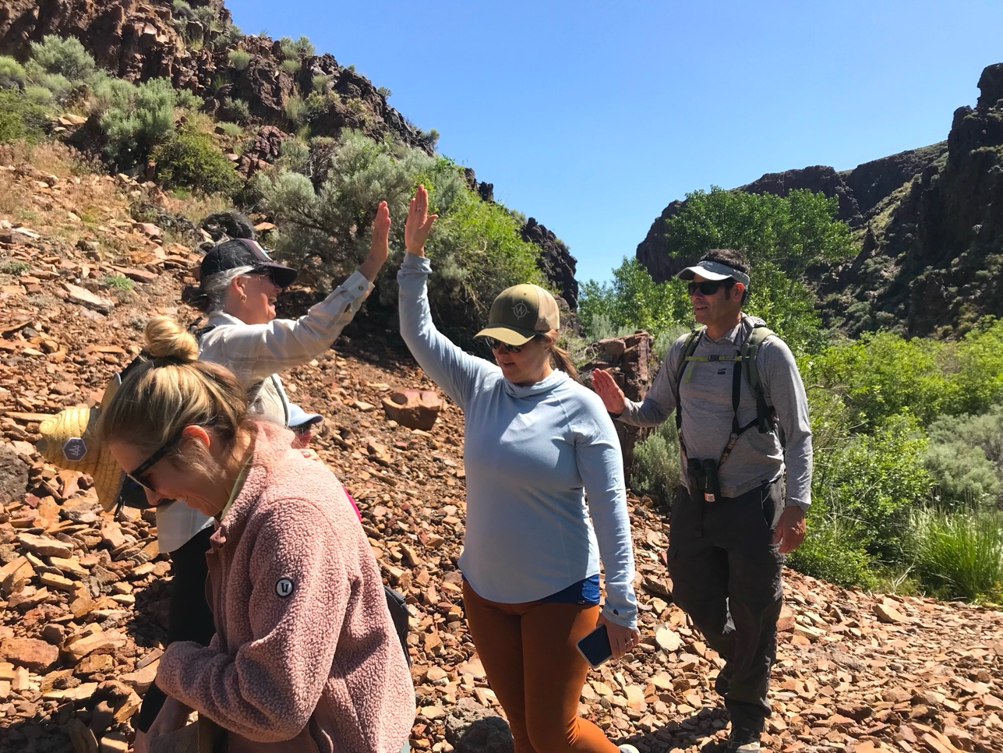
Practical Principles of Legal Advocacy
Pick your battles
Build strong partnerships
Be strategic about roles and sequencing
Engage early and stay engaged
Owyhee Canyonlands, ID

Slide 14

Building Effective Partnerships
Legal Partnership
Working with counsel
External counsel as strategic partners
Clear roles + communication
Coalition Partnerships
Alignment on goals
Alignment on risk tolerance
Alignment on strategy (litigation v. administrative advocacy v. other)
UPFRONT CLARITY AVOIDS LATER CONFLICTS

Slide 15
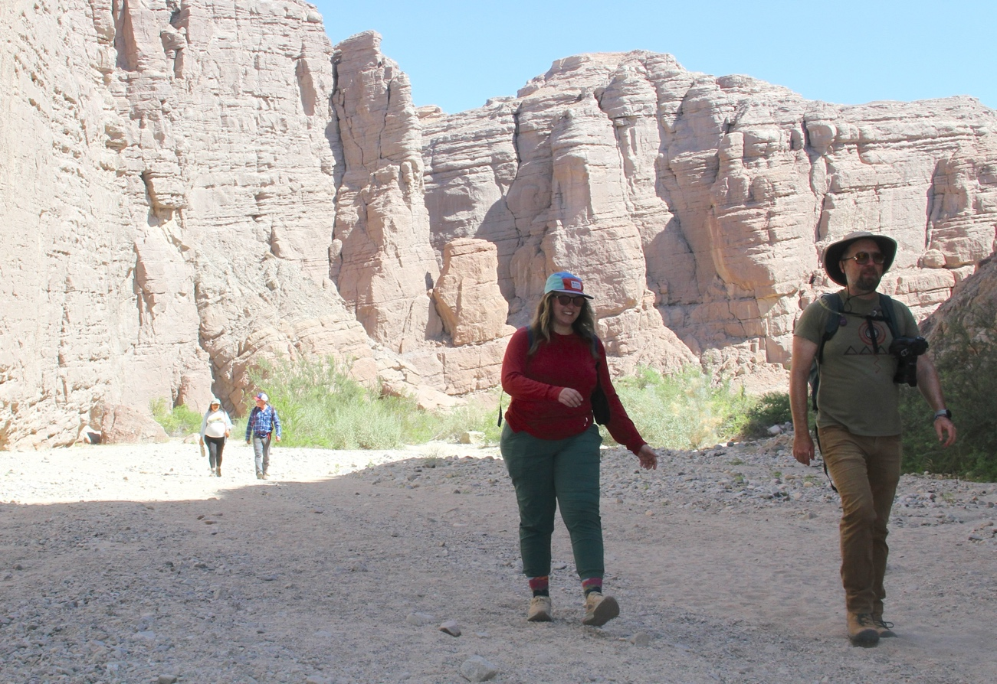
Integrating Legal into Campaigns
LEGAL ≠ SILOED
LEGAL STRATEGY SHOULD REINFORCE — NOT OPERATE SEPARATELY FROM — YOUR CAMPAIGN.
Chuckwalla National Monument, CA

Slide 16

Timing and Windows of Opportunity
Timing can determine success
Exhaustion
Raise your concerns with the agency first
Use available administrative processes
Preserve your claims for litigation
Develop the Administrative Record
Build your case from Day 1
YOU HAVE TO MAKE YOUR CASE TO THE AGENCY BEFORE YOU CAN MAKE IT TO A JUDGE
ENGAGE EARLY AND BE READY TO ESCALATE

Slide 17
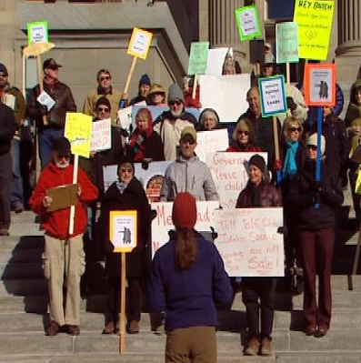
Common Pitfalls to Avoid
Defaulting to litigation
Misalignment with campaign goals
Underestimating capacity
Failing to engage early enough in the administrative process

Slide 18
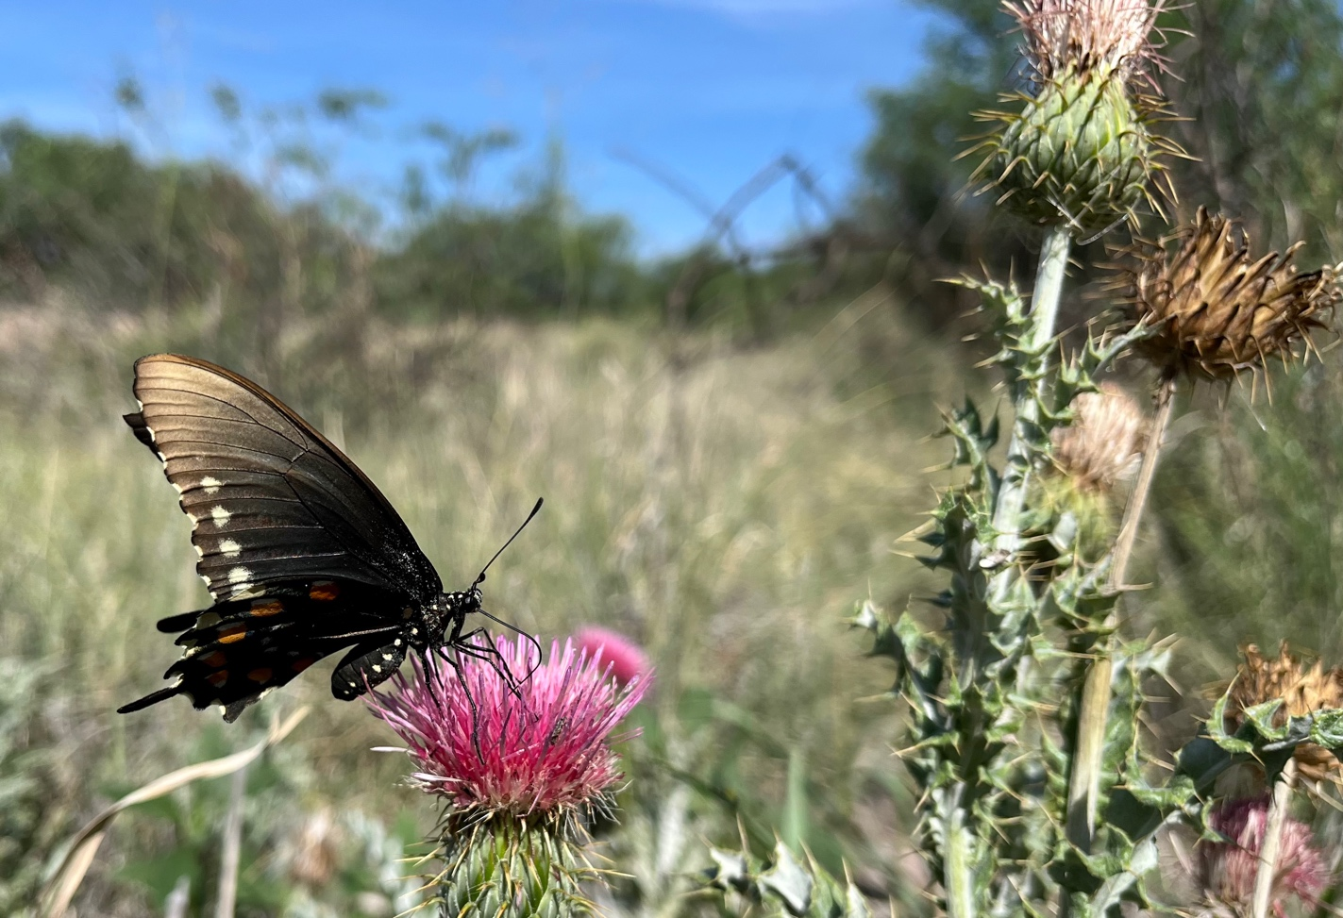
A Simple Decision Framework
Impact
Likelihood of success
Strategic fit
Capacity
BEFORE YOU LITIGATE, ASK
San Pedro Riparian National Conservation Area, AZ/credit Theresa Condos, BLM Arizona

Slide 19
Engaging in Legal Advocacy: Key Takeaways
Legal advocacy is a tool — not a goal
Be strategic about:
Timing
Risk
Organizational capacity
As noted earlier, legal advocacy is no longer optional. What I hope you’re taking away is — it’s also not automatic. It’s a strategic choice.
No cookie-cutter approach
Red Cliffs → Engage when litigation is necessary
Sage grouse → Engage with advocacy leading

Slide 20

WE ARE IN THIS TOGETHER
Advocates for the West and CLF are here to help you navigate the advocacy world
Advocacy Academy webinars can teach you the nuts and bolts of environmental law and advocacy
We can help you identify the most important threats to your landscapes and how to respond
Colorado Desert, CA

Slide 21

“Look: the state of the world is grim. It’s hopeless. You gotta face the facts, and go from there. But that doesn’t mean I lie around doing nothing. Rather, it inspires me to work harder for the things I love.”
Yvon Choinard
Canyon Rims Recreation Area, UT

Slide 22

QUESTIONS?
Todd Tucci, Senior Attorney
Advocates for the West
ttucci@advocateswest.org
Grand Staircase-Escalante National Monument, UT

