Slide 1
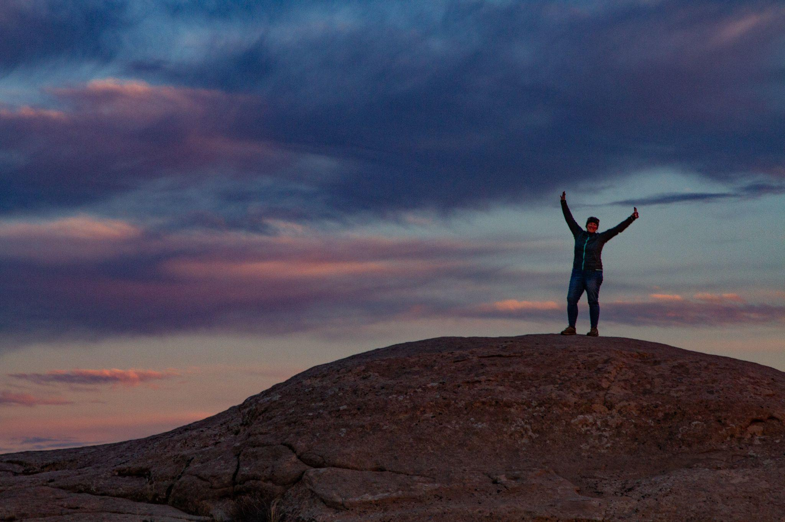
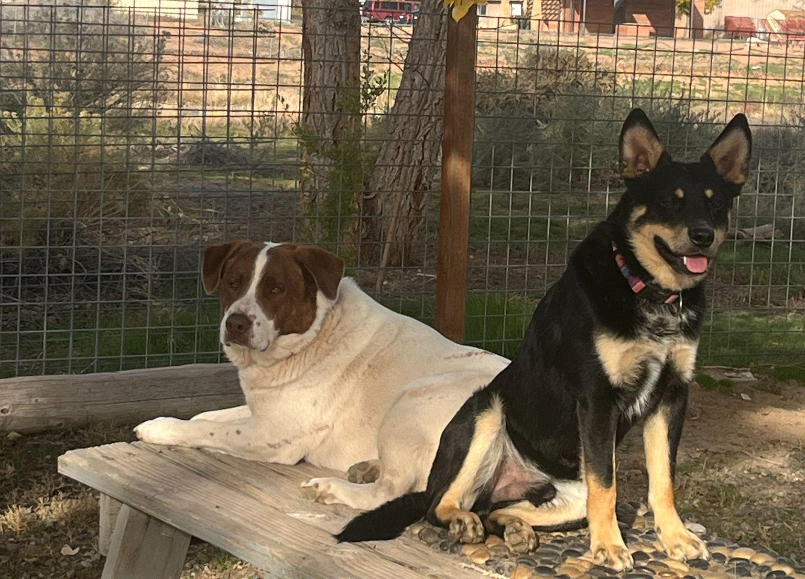
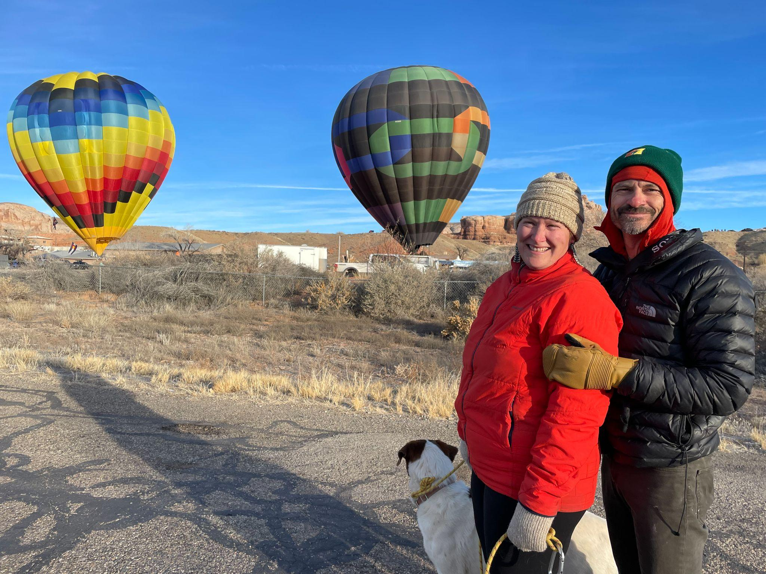
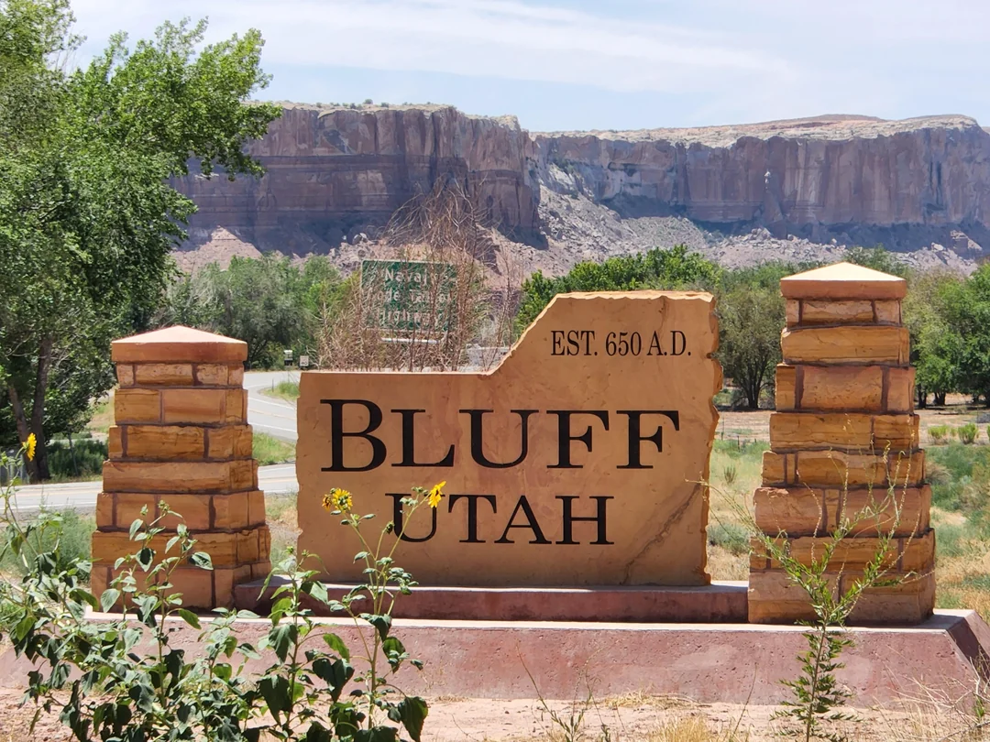

Slide 2



Bears Ears Partnership
Bears Ears Education Center
and
Visit with Respect

Slide 3
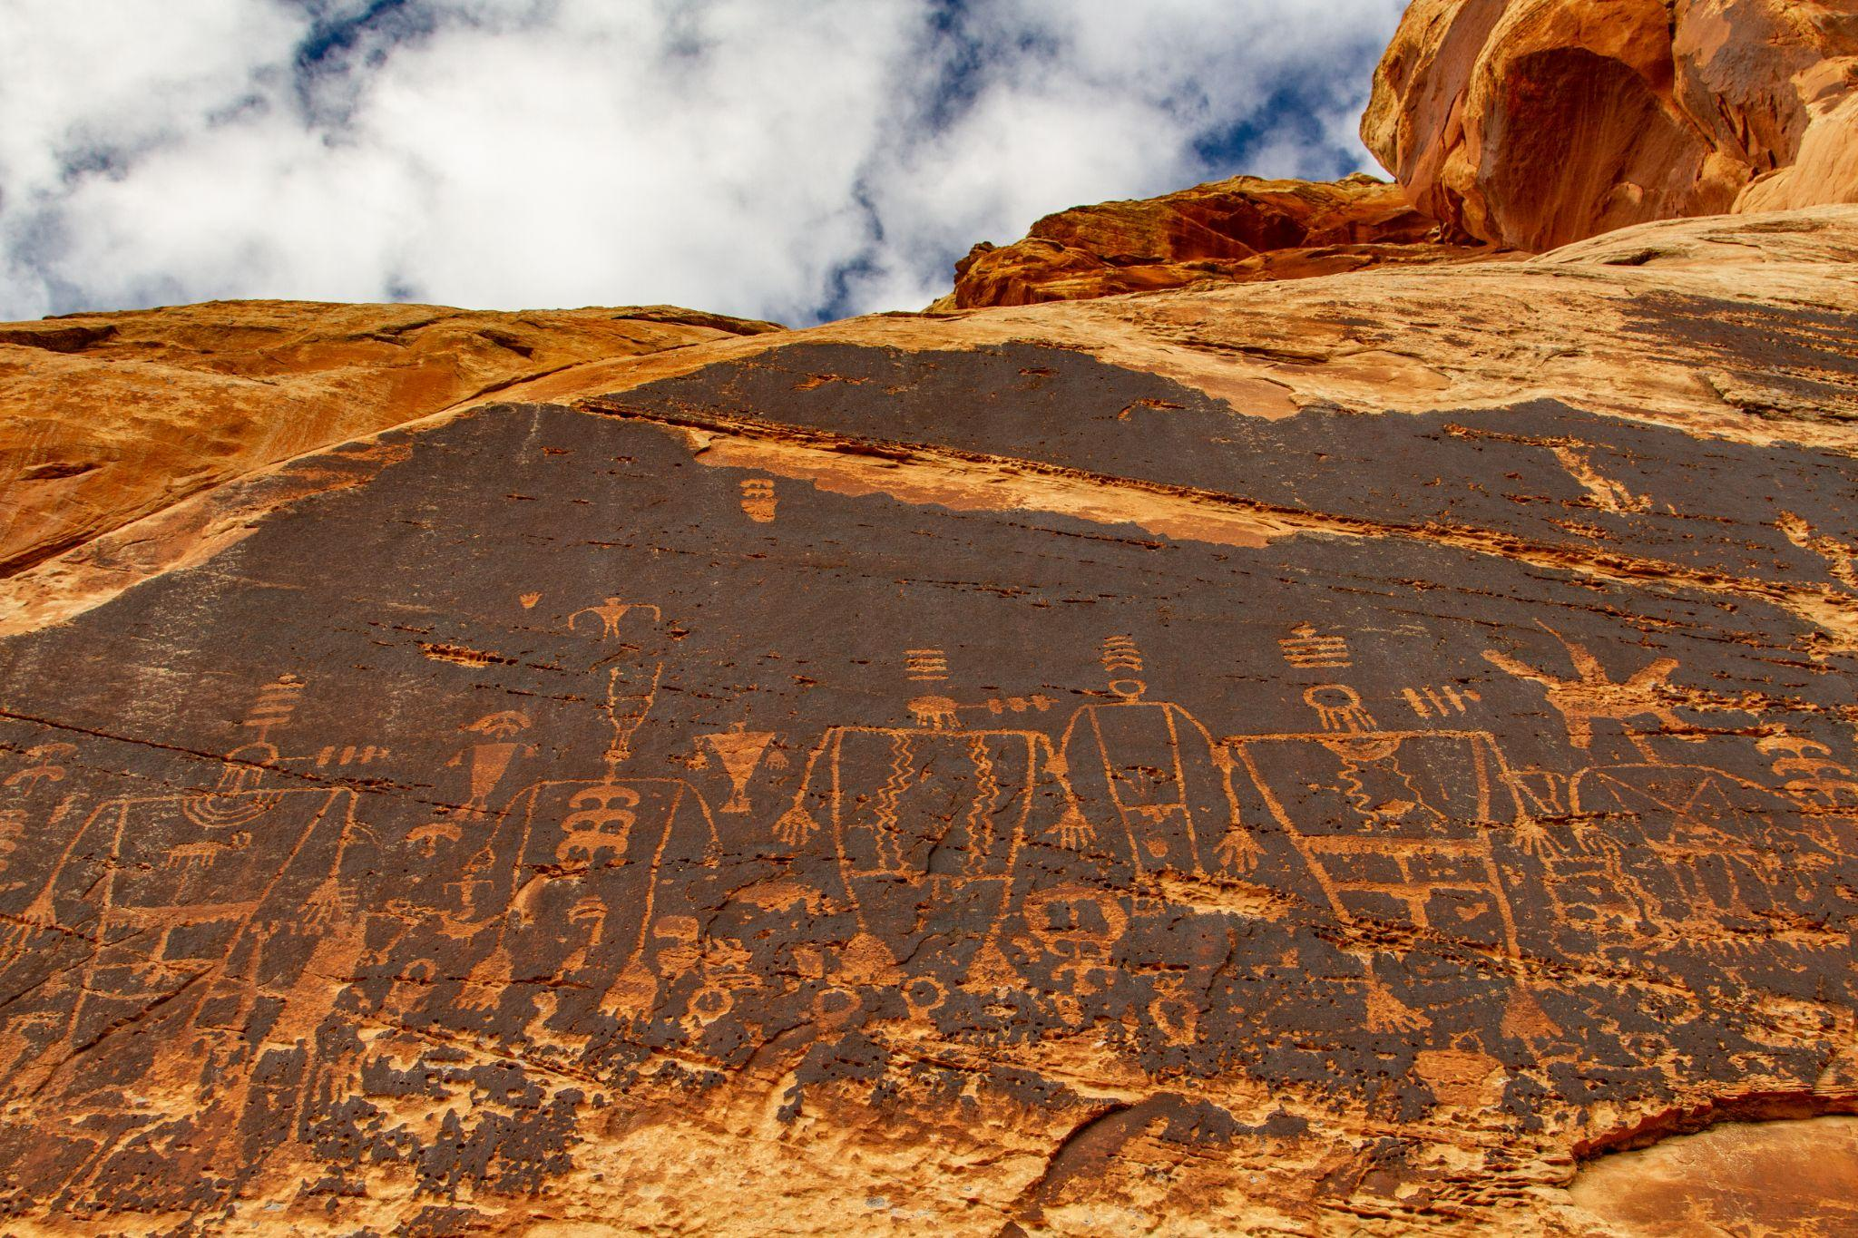
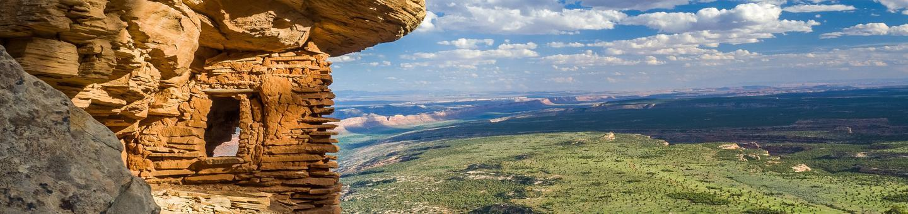
Bears Ears Partnership

Slide 4
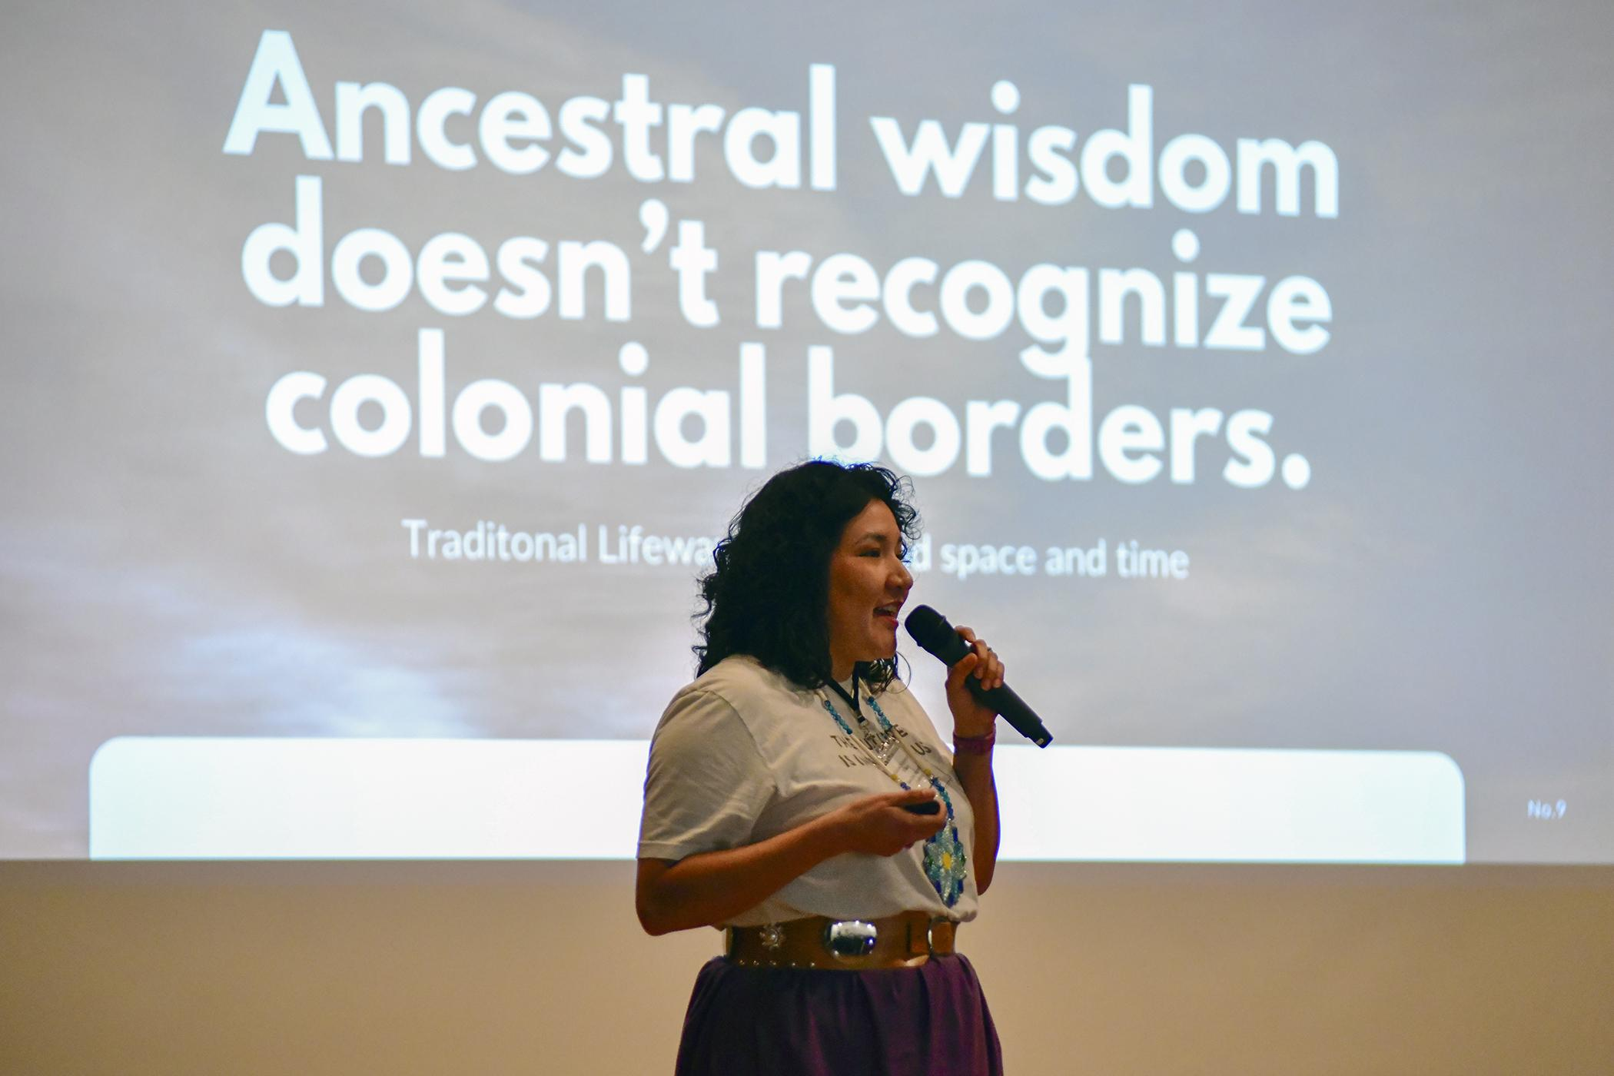
Partnerships
Charissa Miijessepe-Wilson BEITC
Notes:
ED of BEITC 2024 Keynote speaker at Celebrate Bears Ears Event in Bluff, Utah.

Slide 5
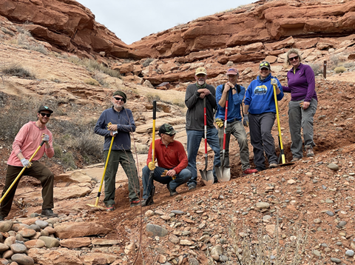
Volunteer Projects
Notes:
Erosion prevention and trail work at Sand Island

Slide 6
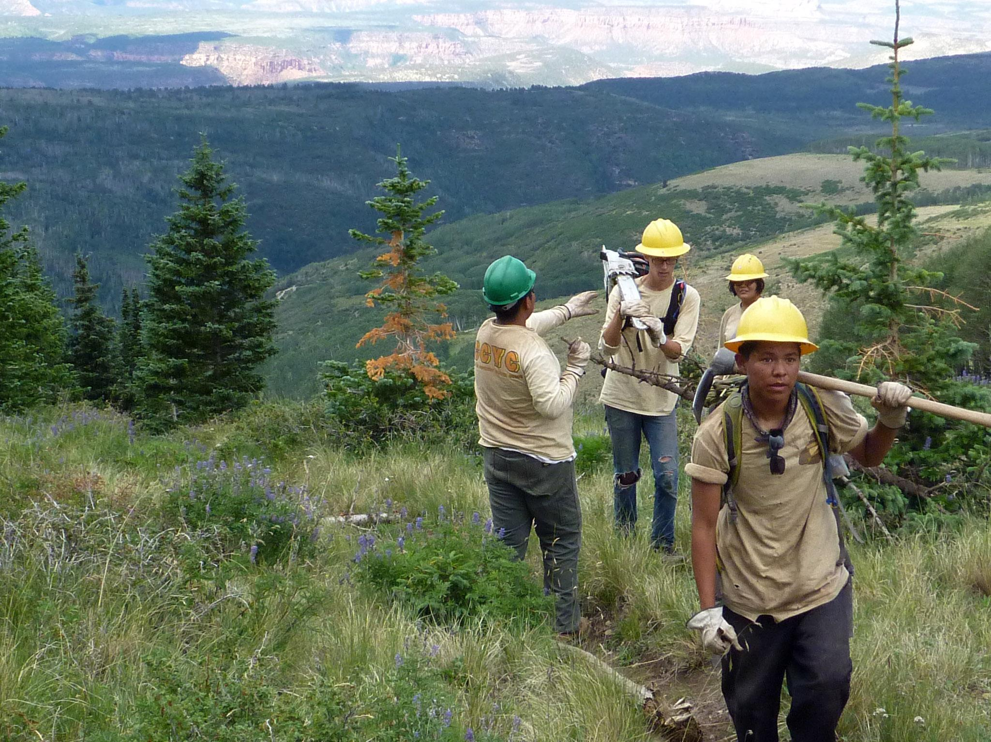
Conservation/ CCYC
Notes:
Newest addition to our team, several hitches each season doing various projects out deep in the Bears Ears Region

Slide 7
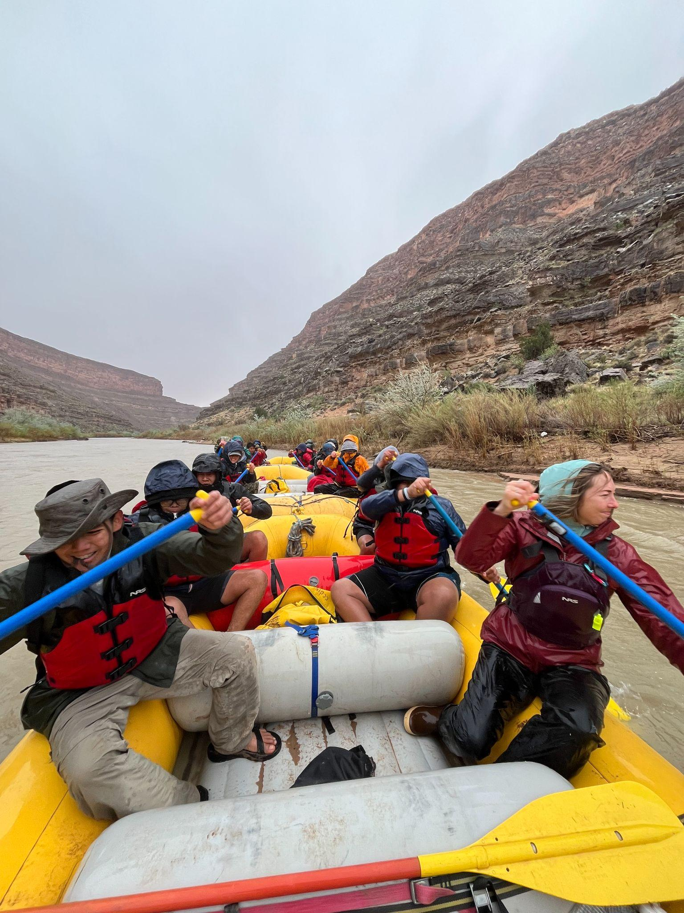
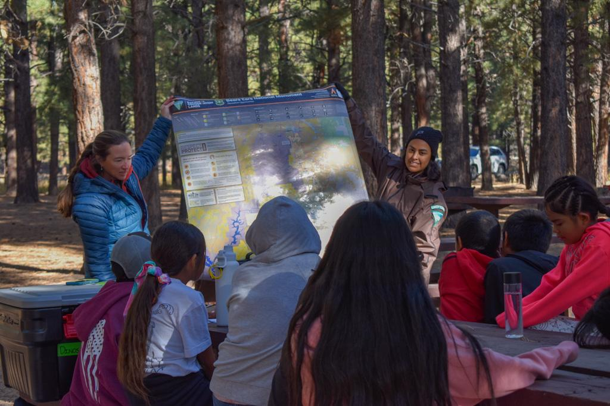
Educational Outreach
Notes:
4th grade student field trips to the Bears Ears

Slide 8
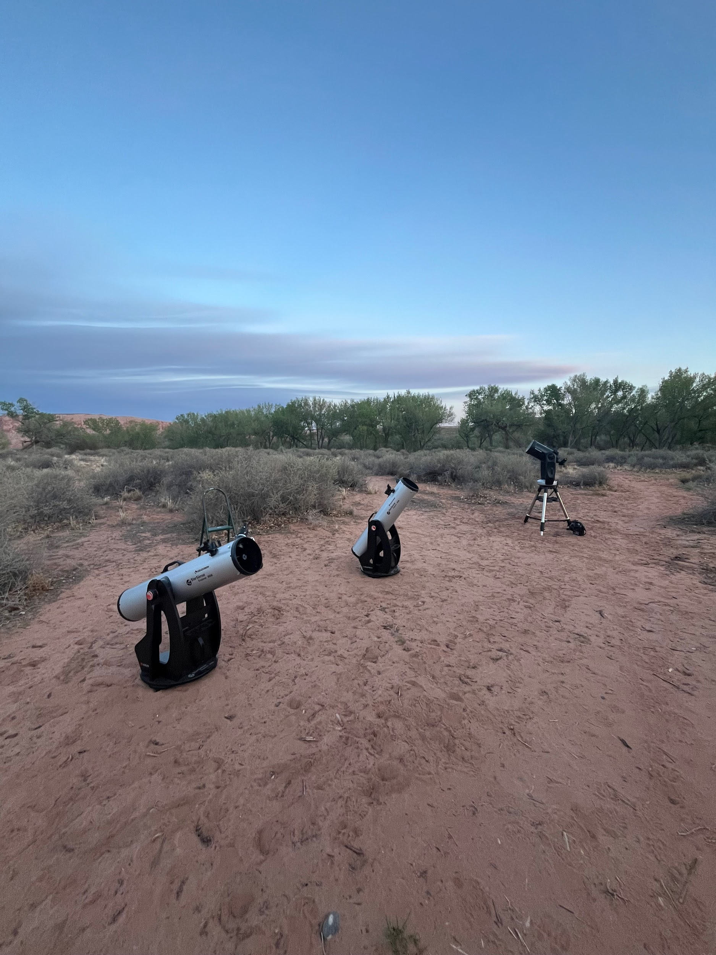
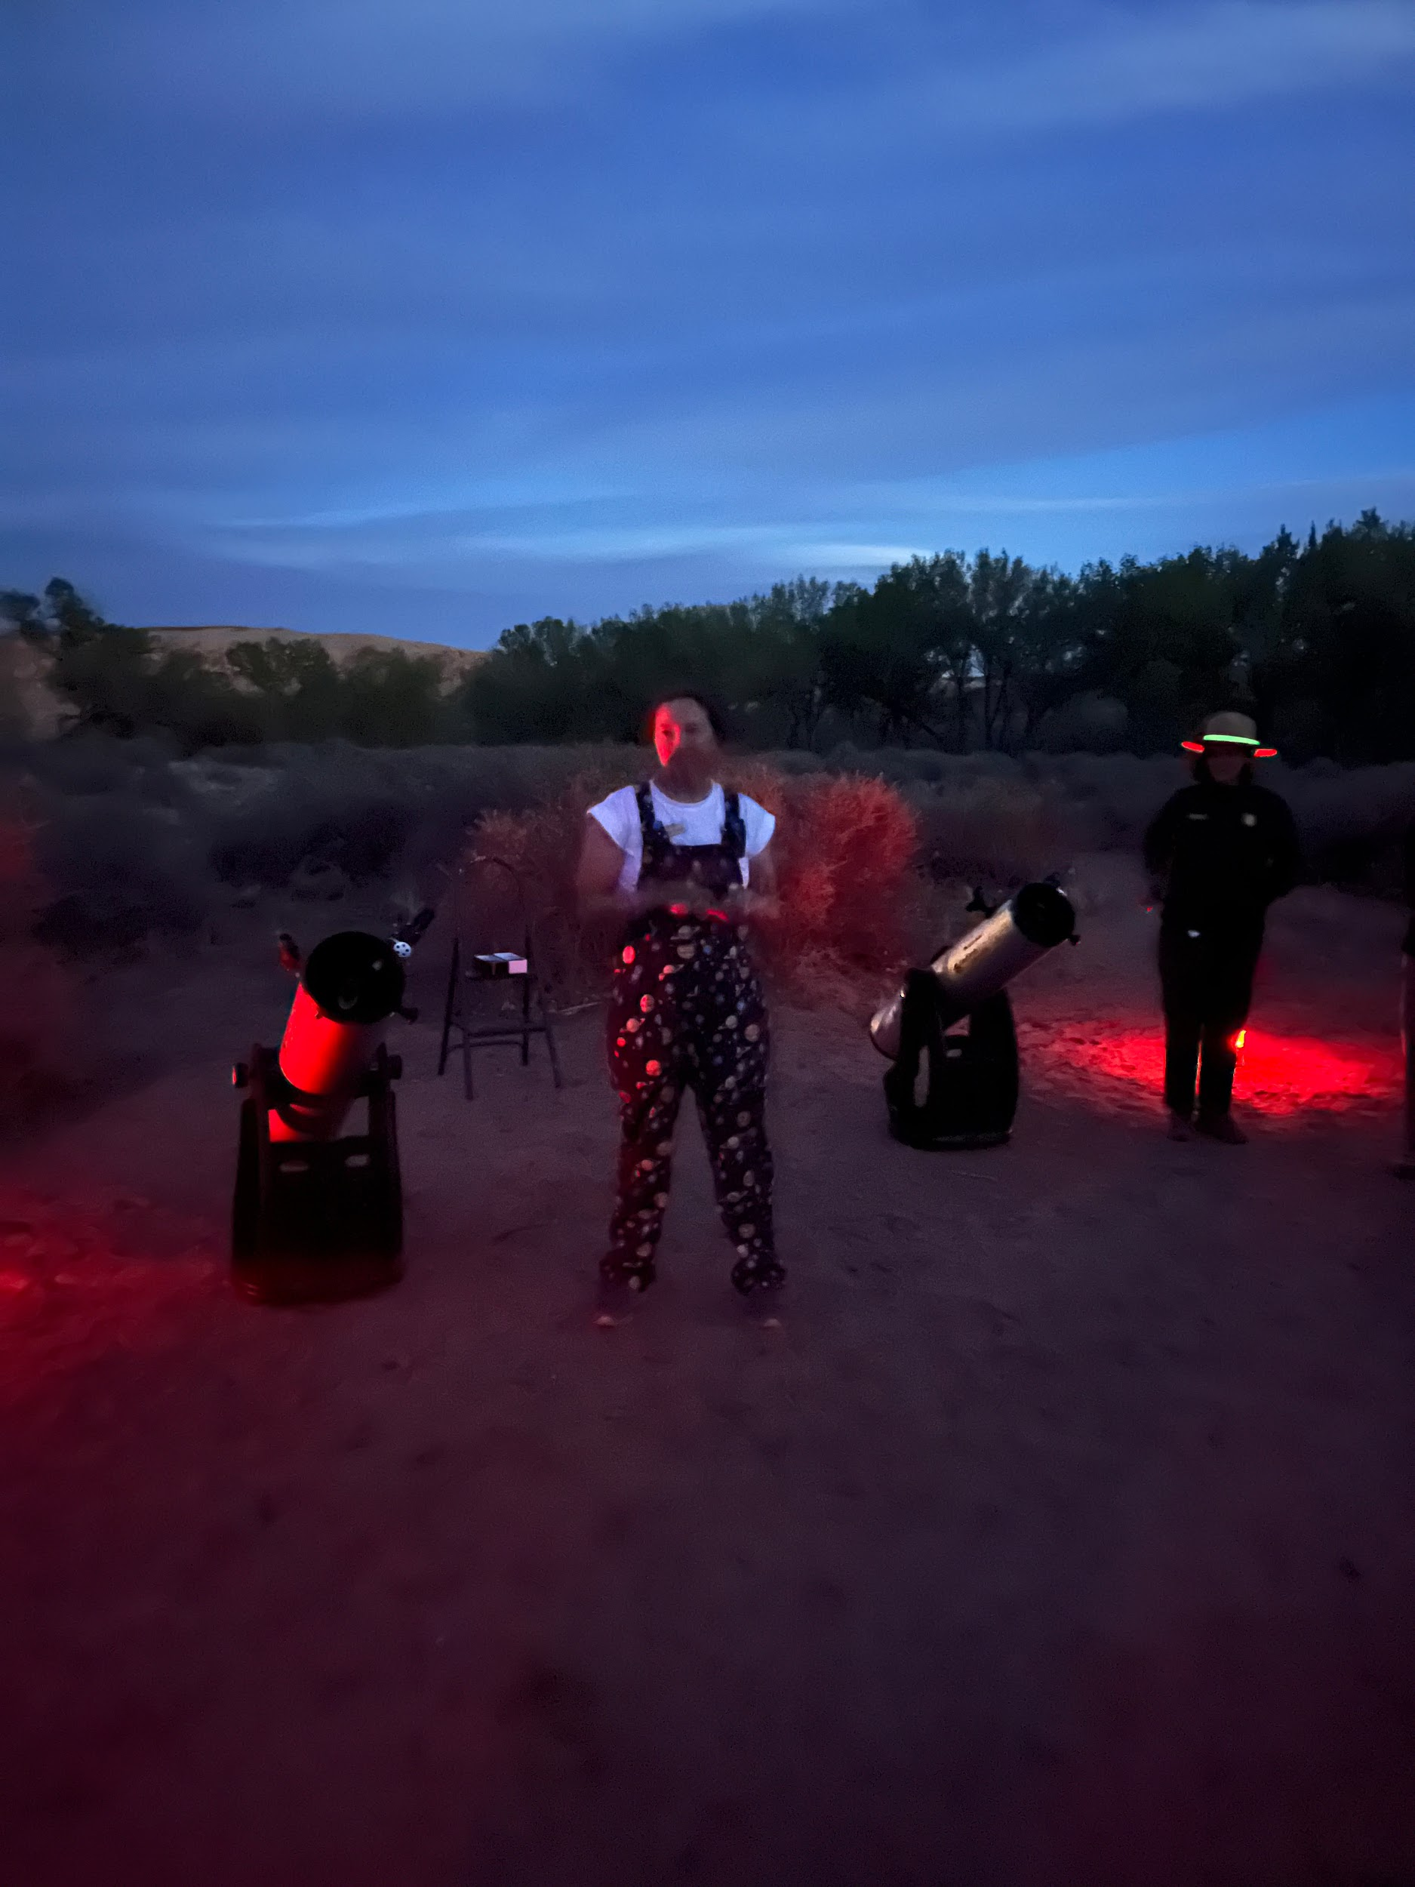
Dark Sky Viewing Parties and DS Ambassadors

Slide 9
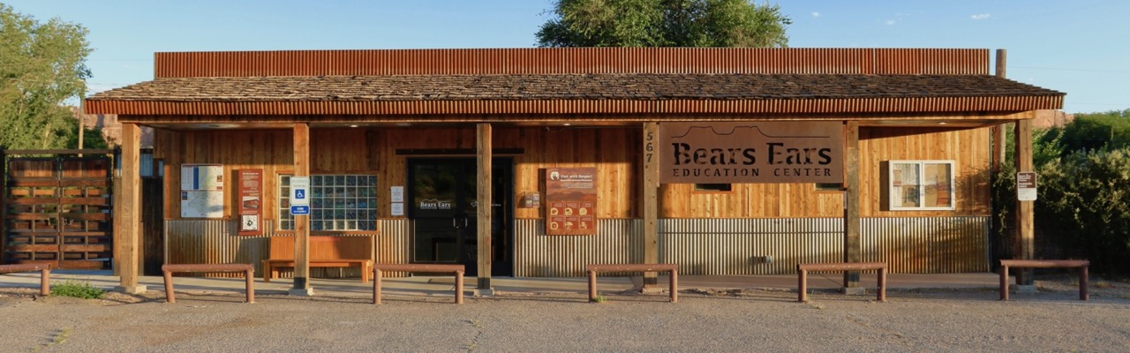
Bears Ears Education Center
Notes:
Public interface, Maps, Road conditions, and VWR talks/ Host larger and smaller groups on various topics that align with our mission and the BE landscape.

Slide 10
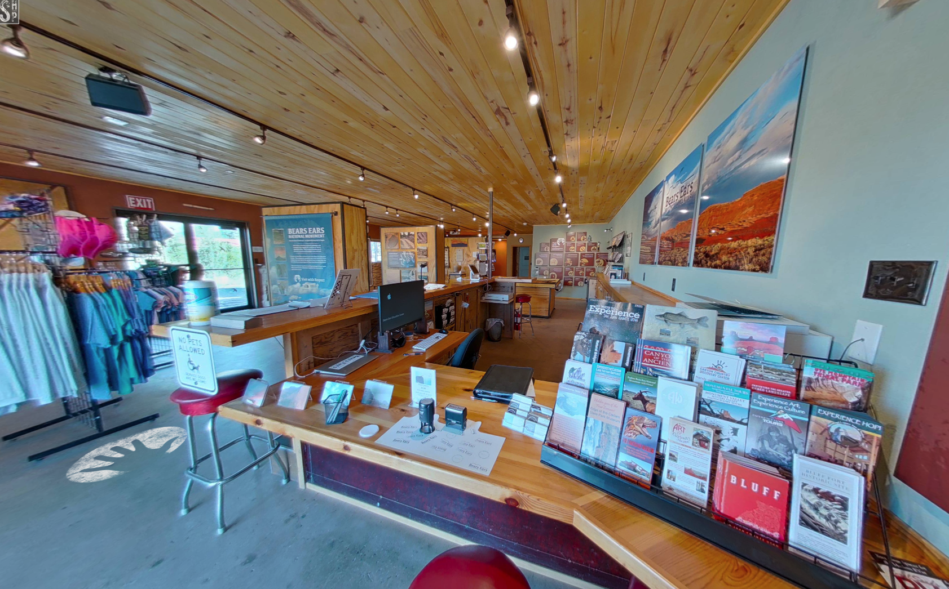
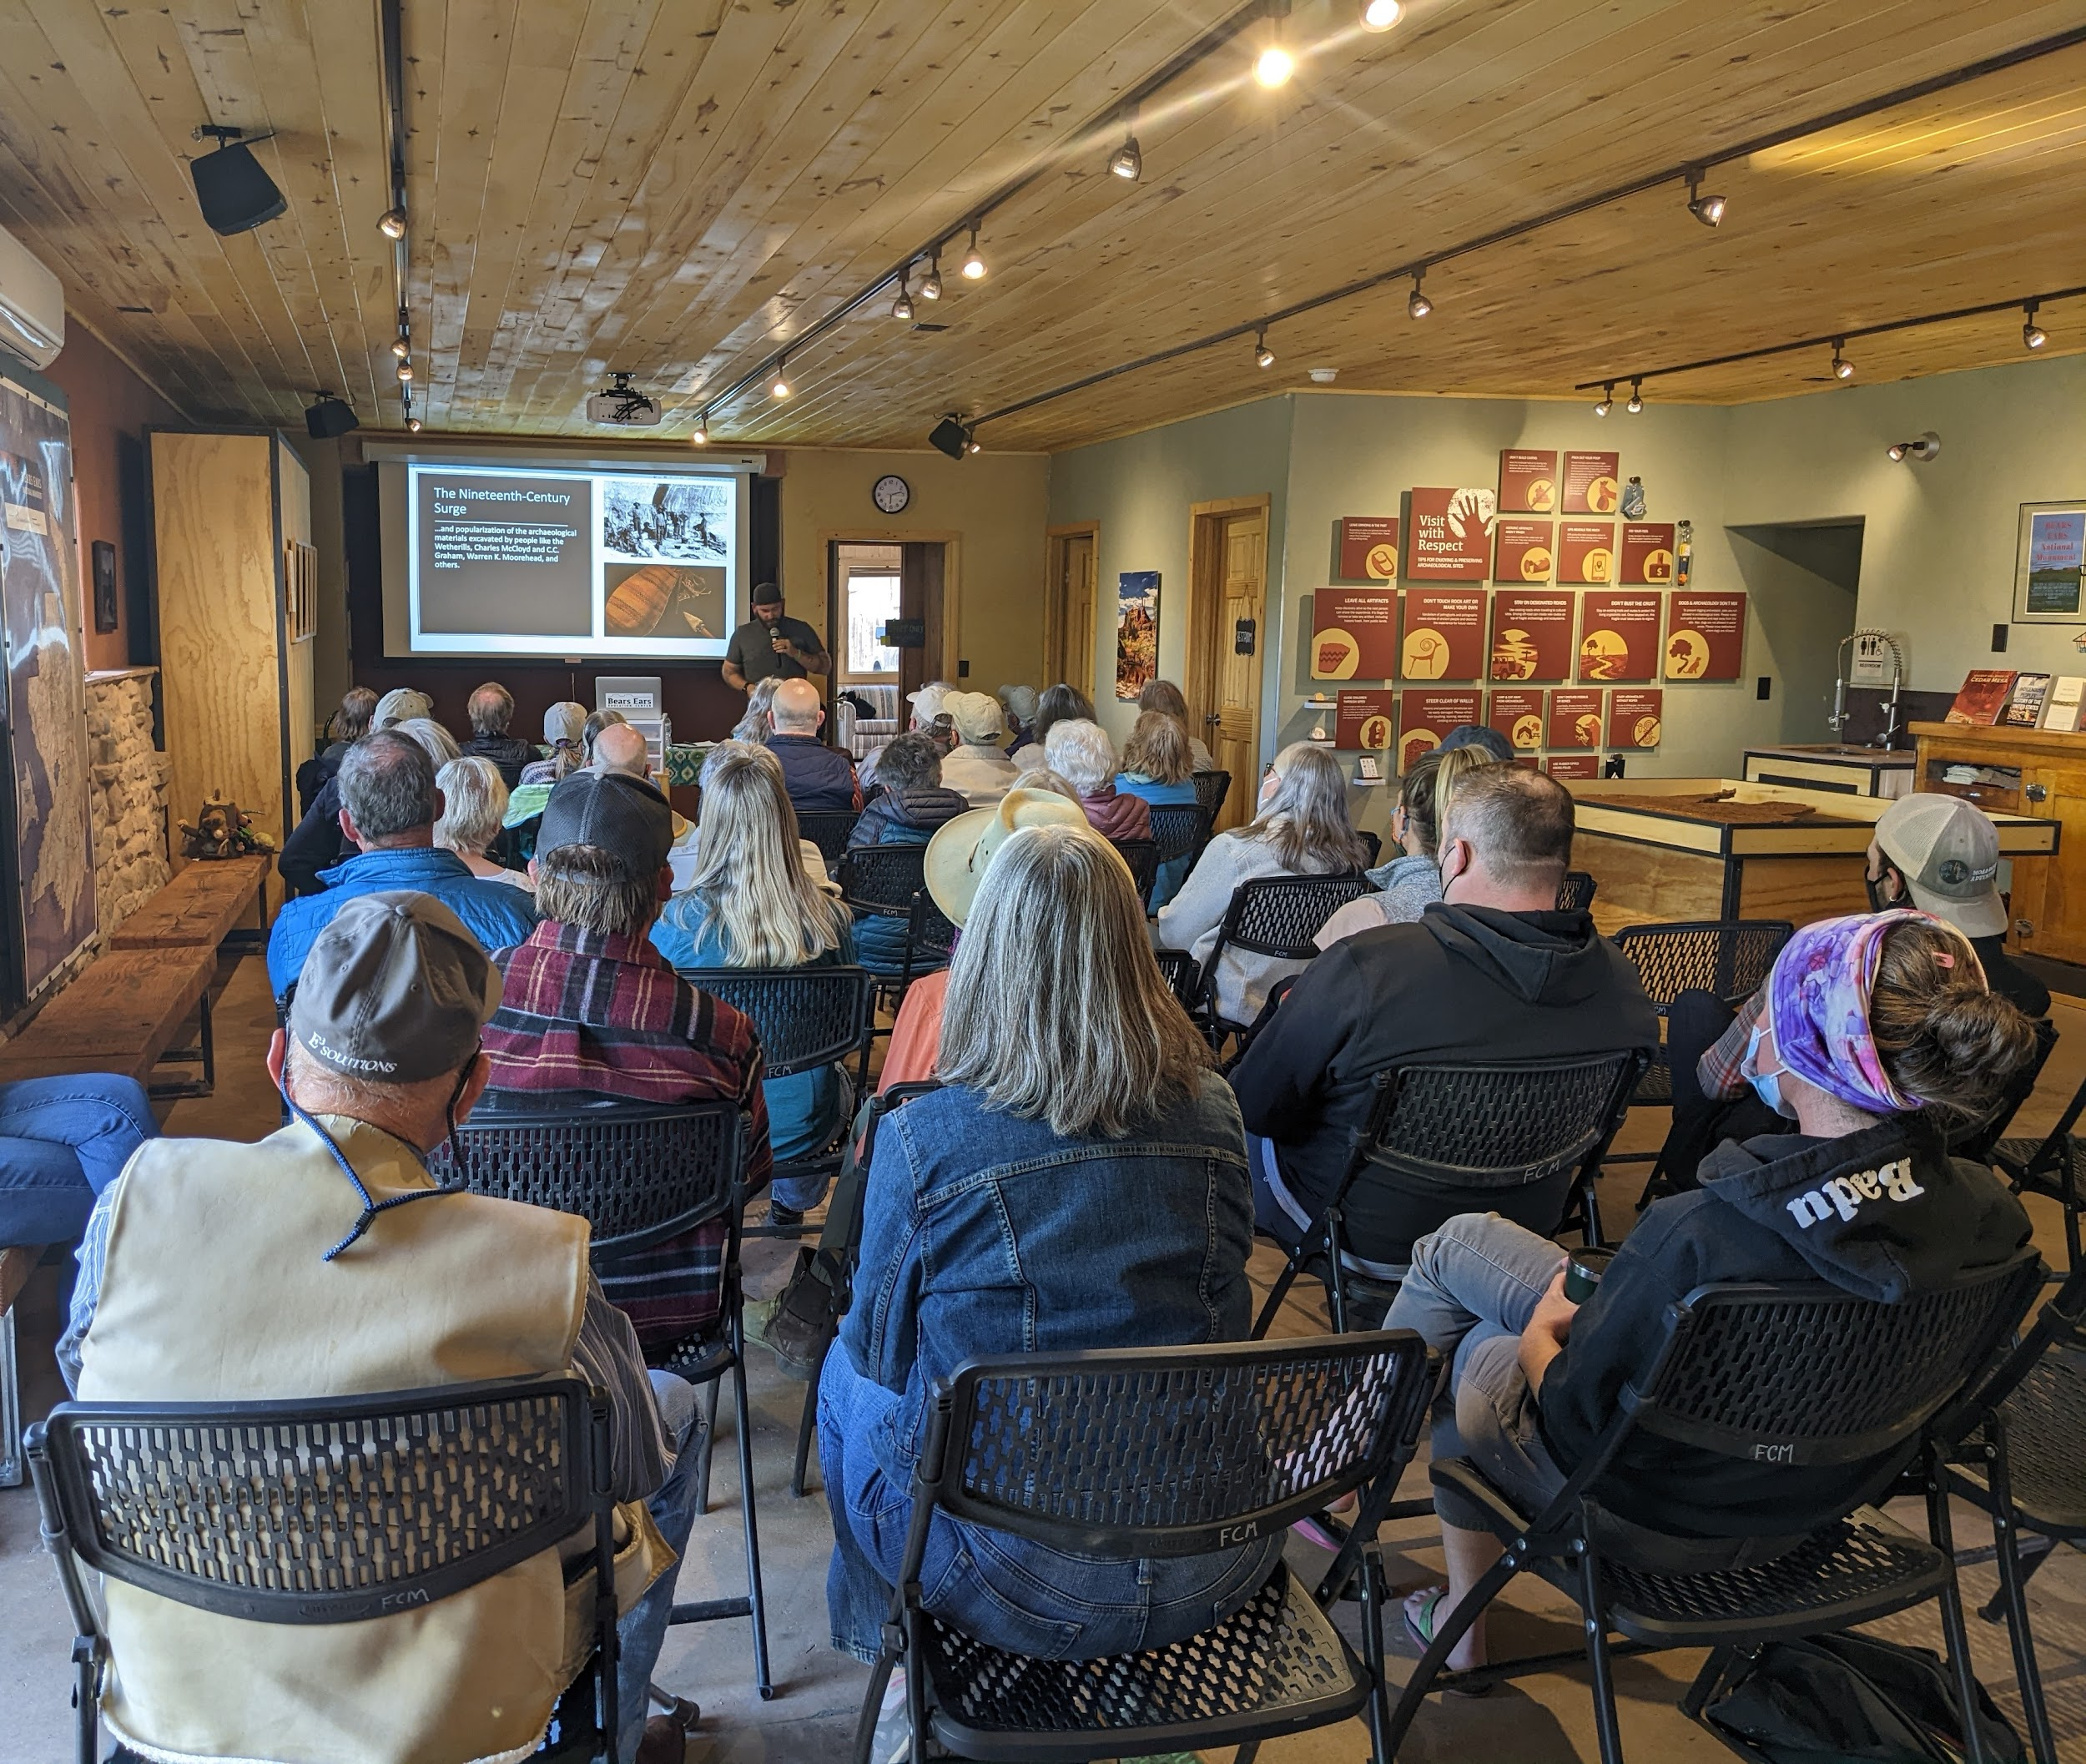
Visitor Information Talks and Lecutures

Slide 11
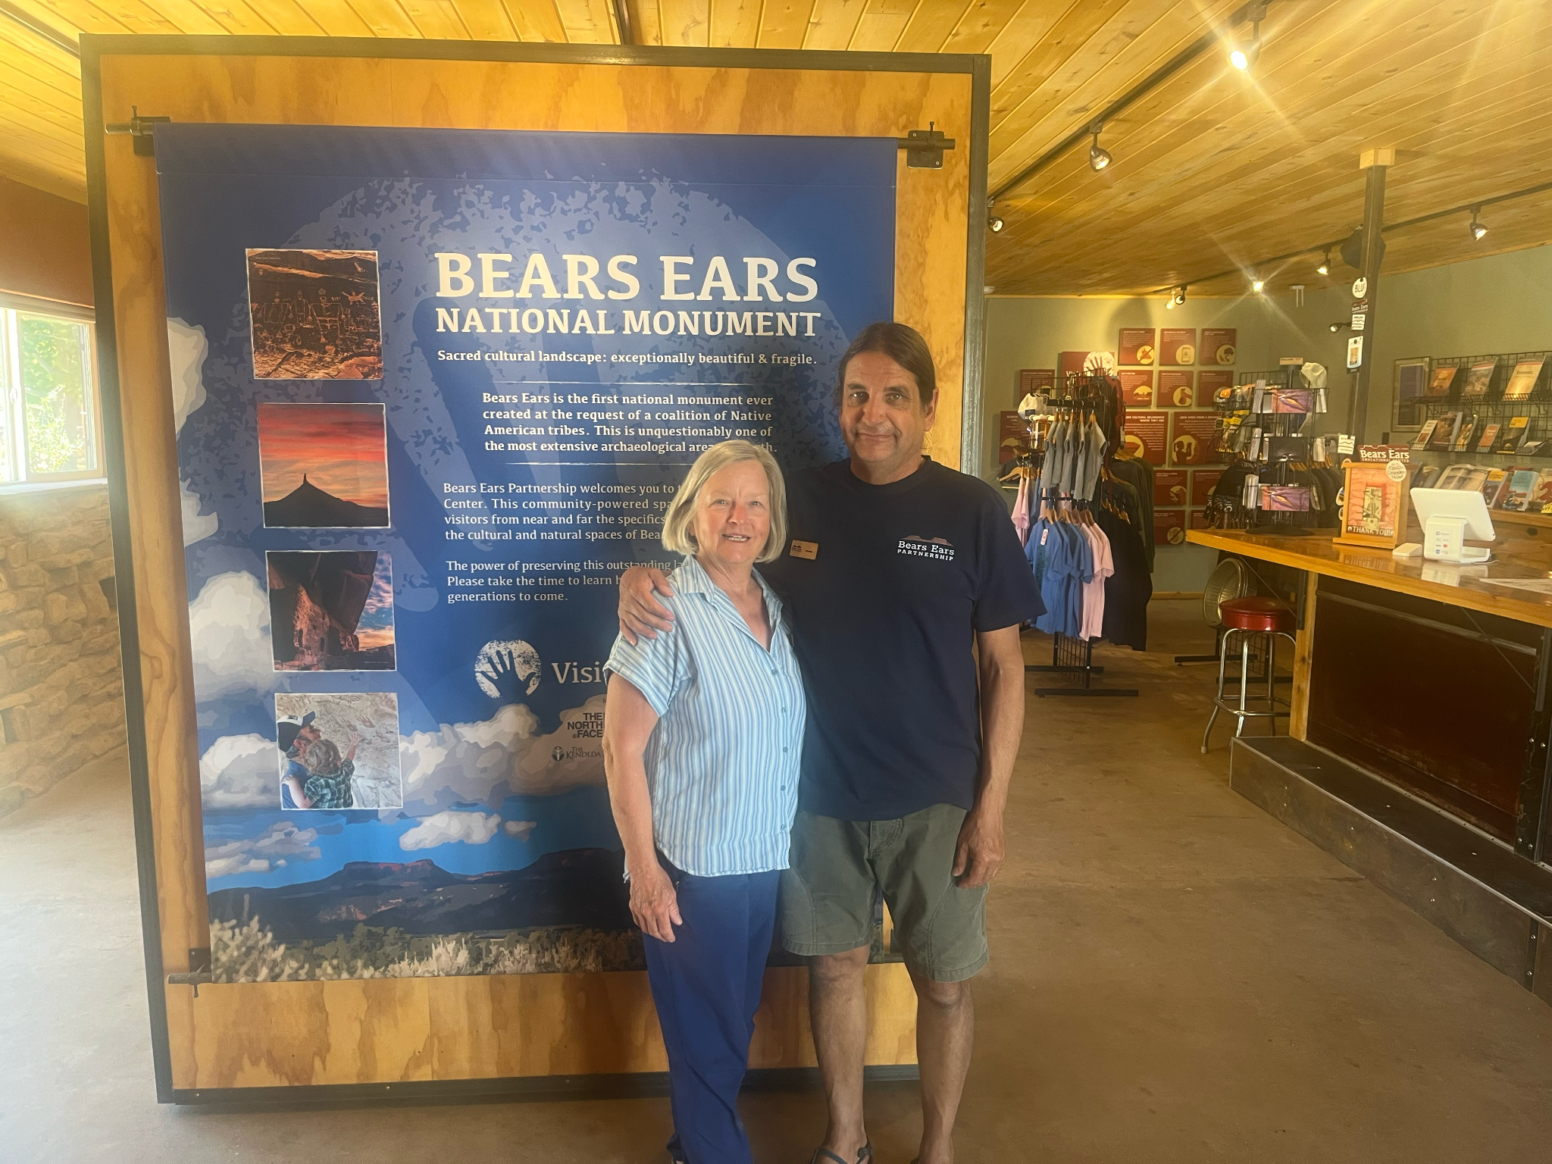
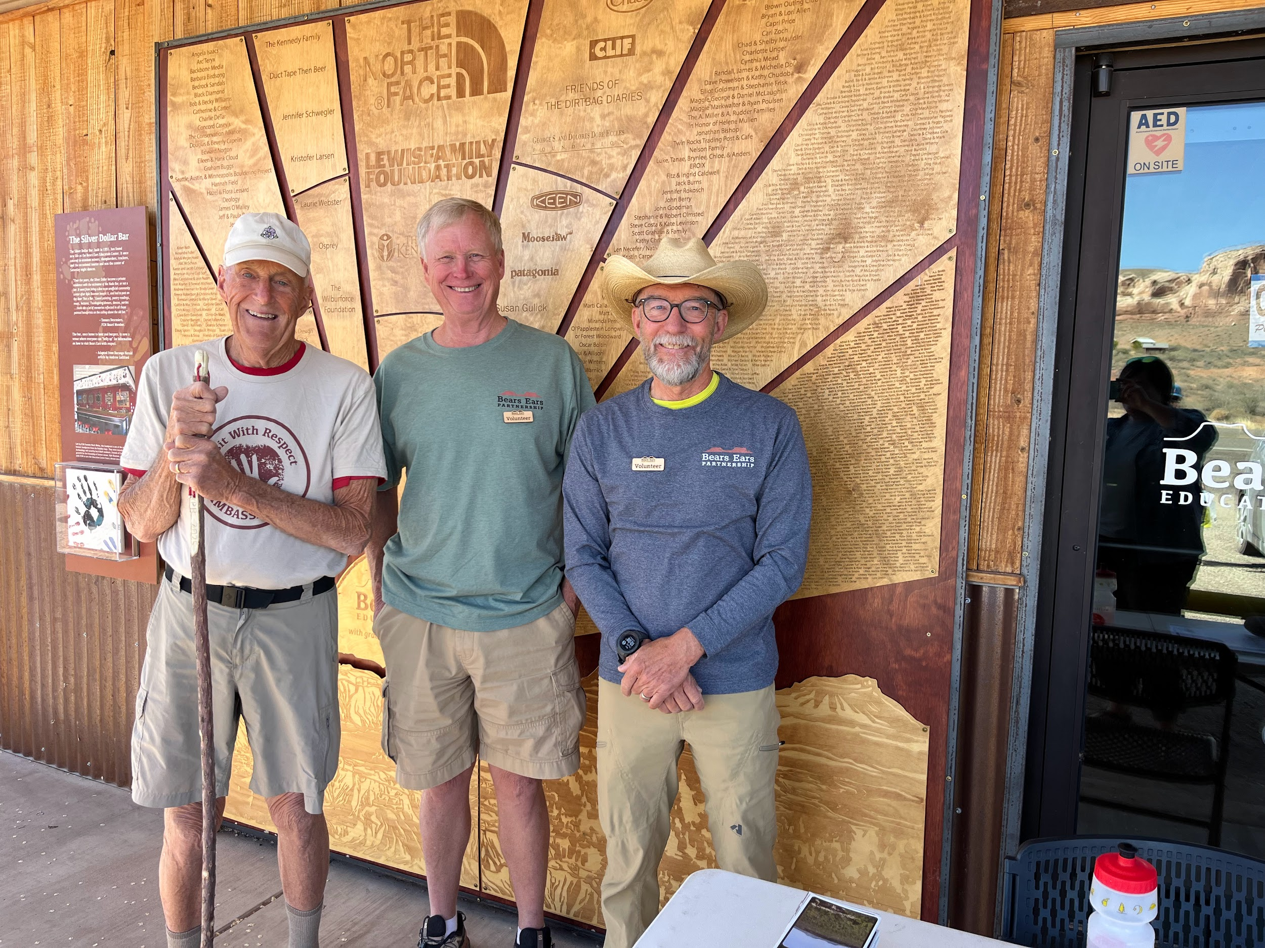
BEEC Hosts

Slide 12
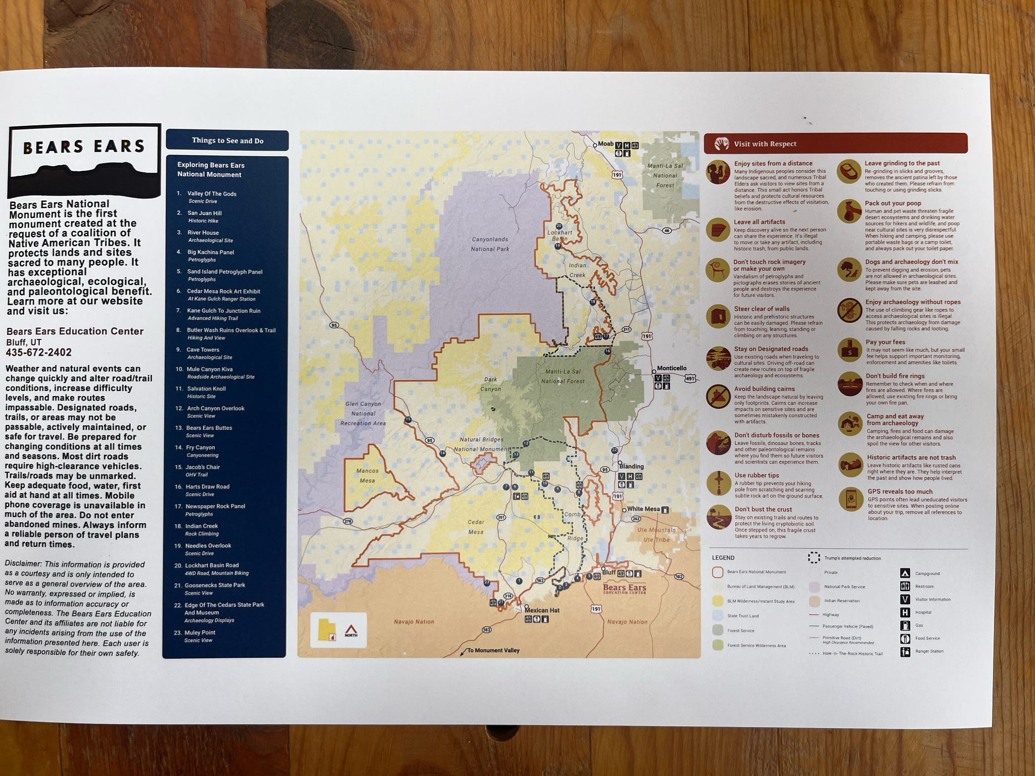
How Hosts gain an understanding of 1.3 million acres

Slide 13
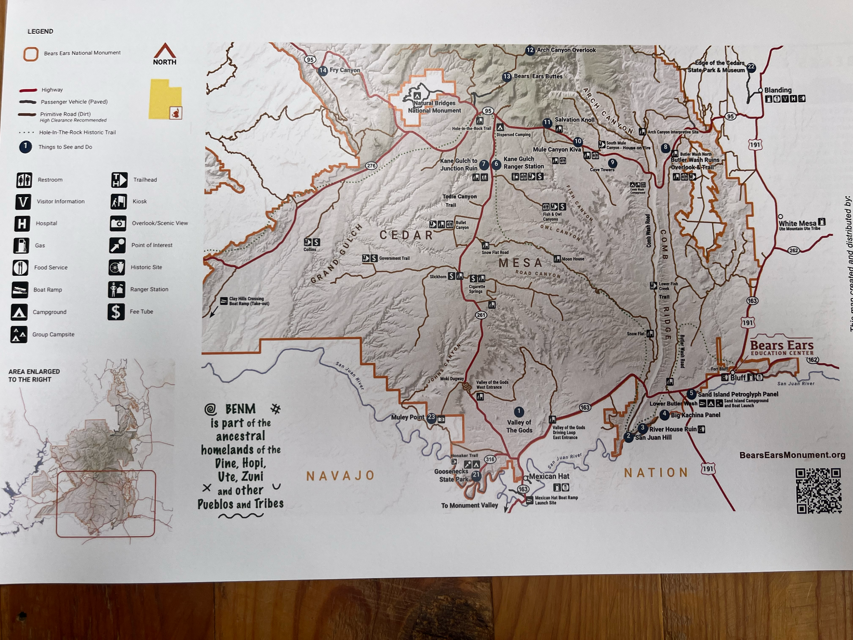
How BEEC Hosts interact with visitors to Bears Ears NM

Slide 14
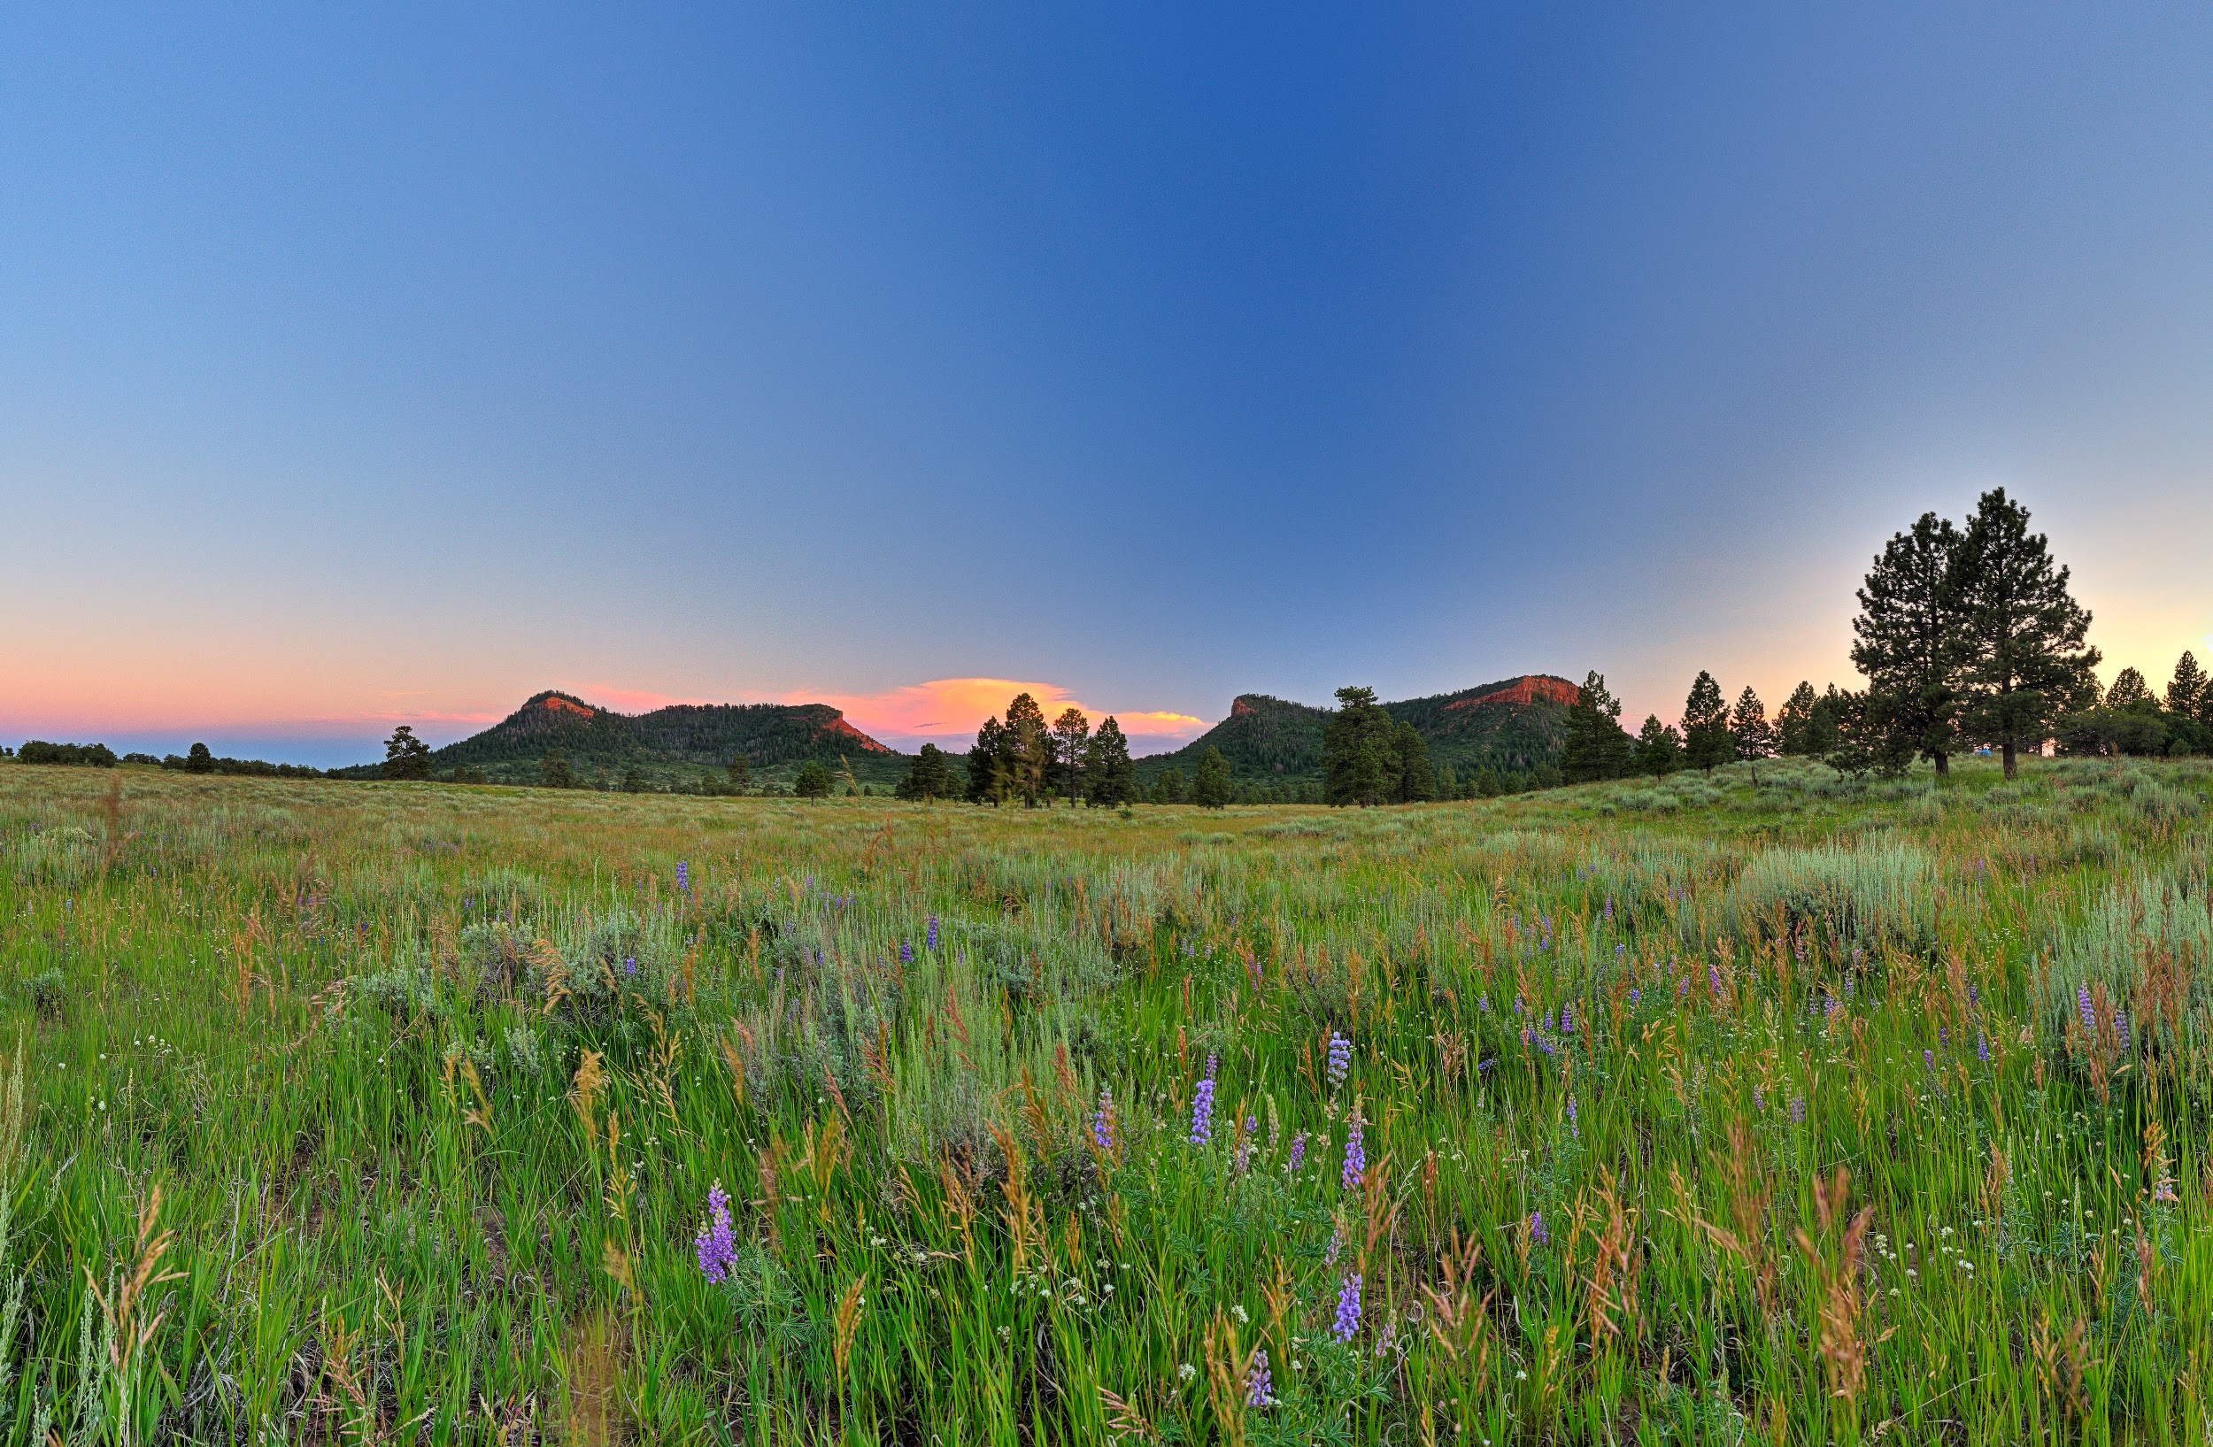
Basic evaluation questions for size up of visitors

Slide 15
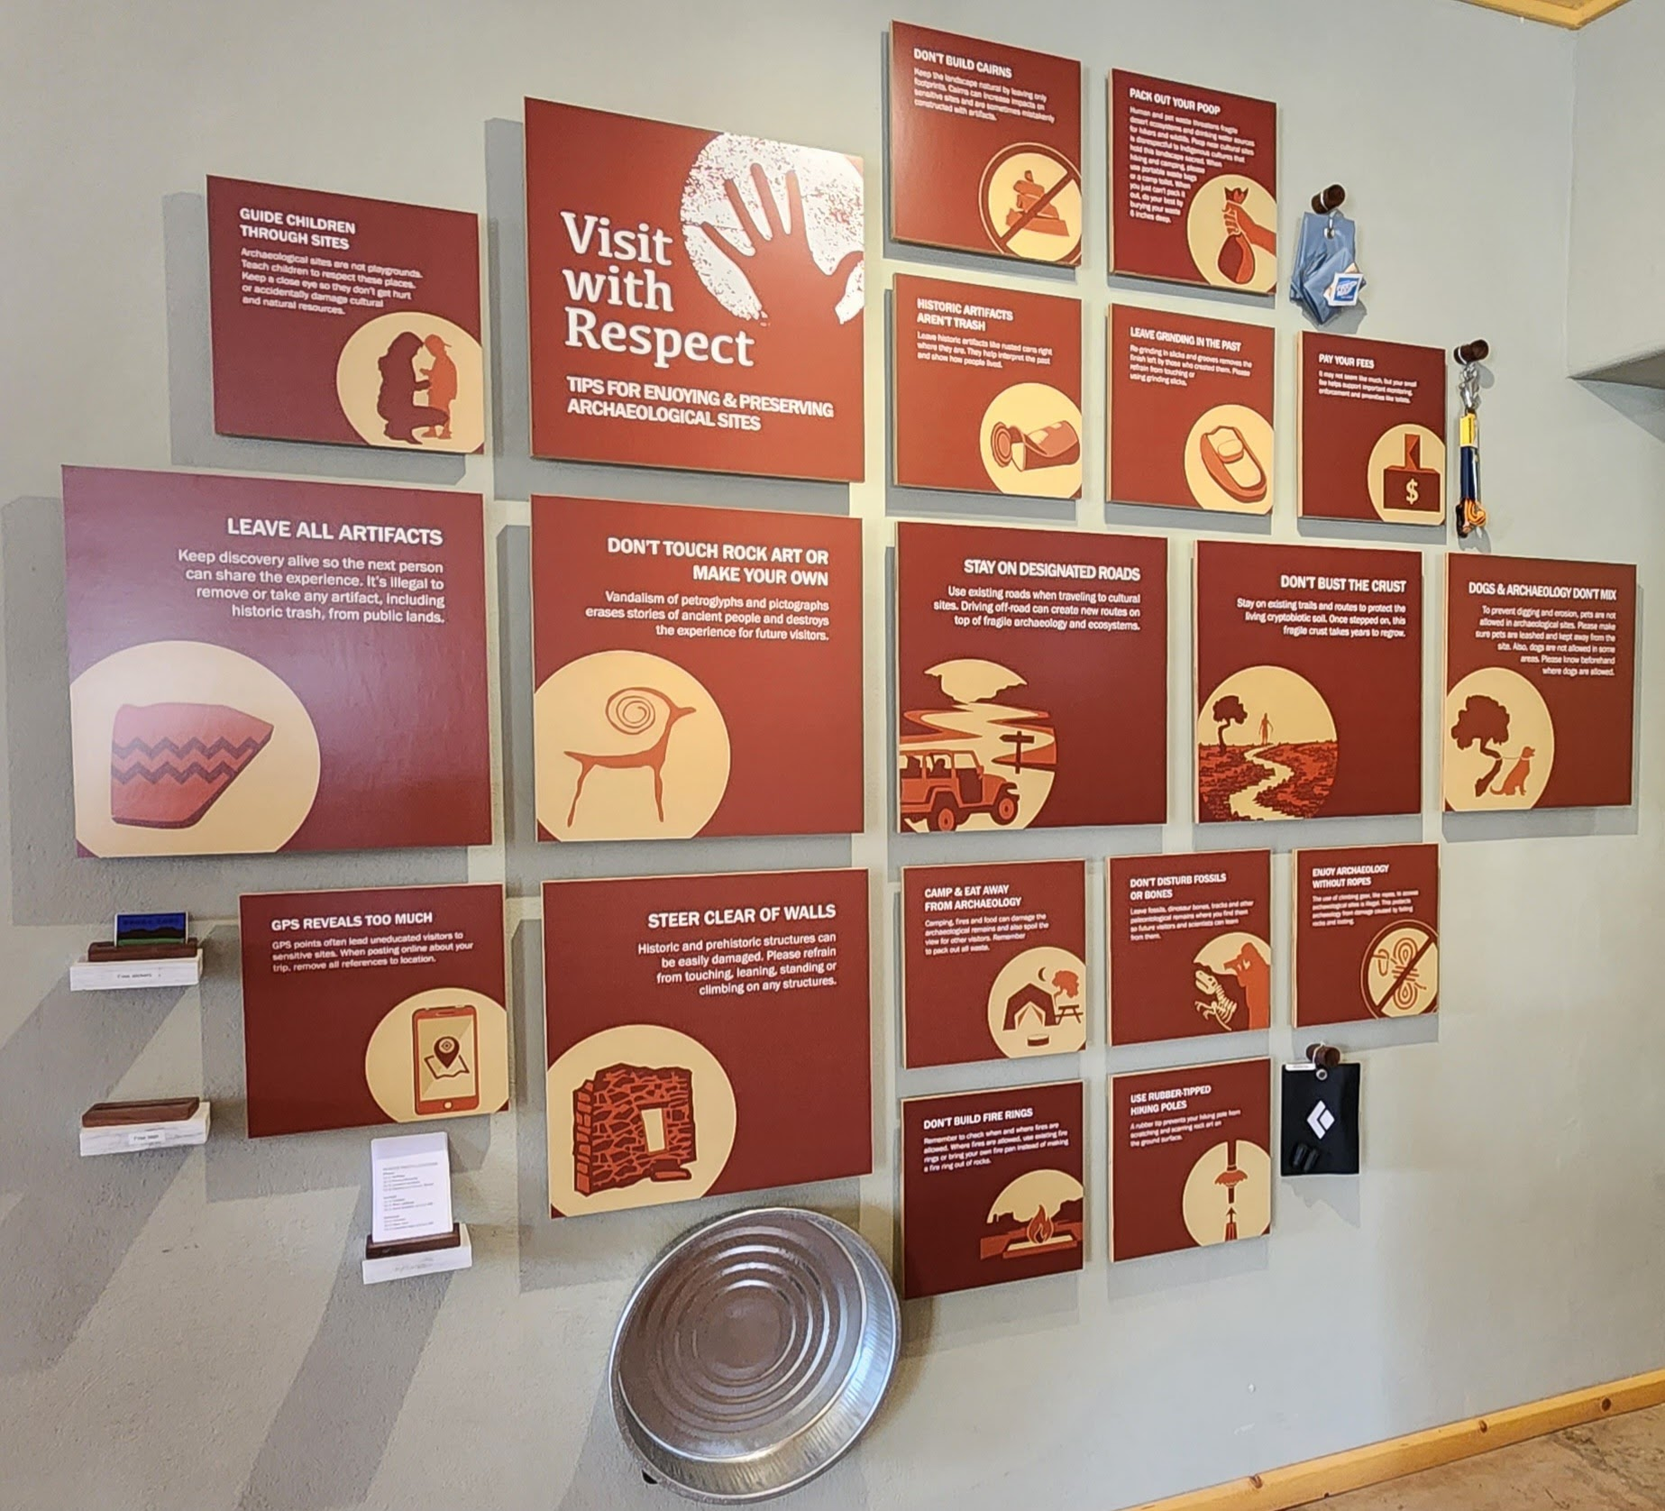
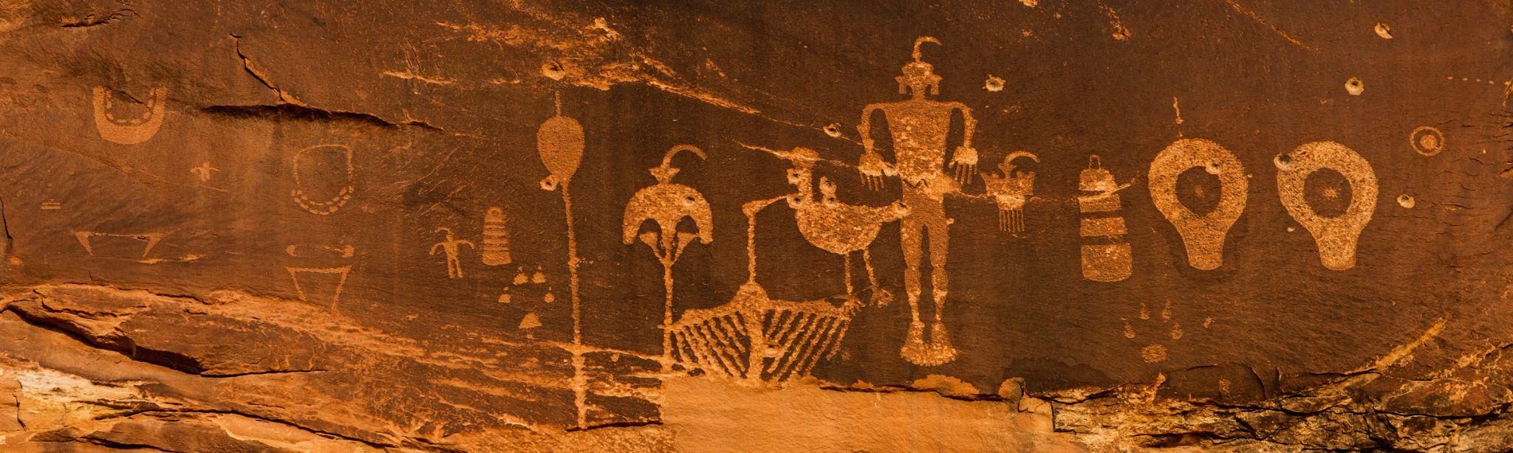
Visit With Respect
A campaign to educate visitors about responsible and respectful visitation within the Bears Ears landscape

Slide 16
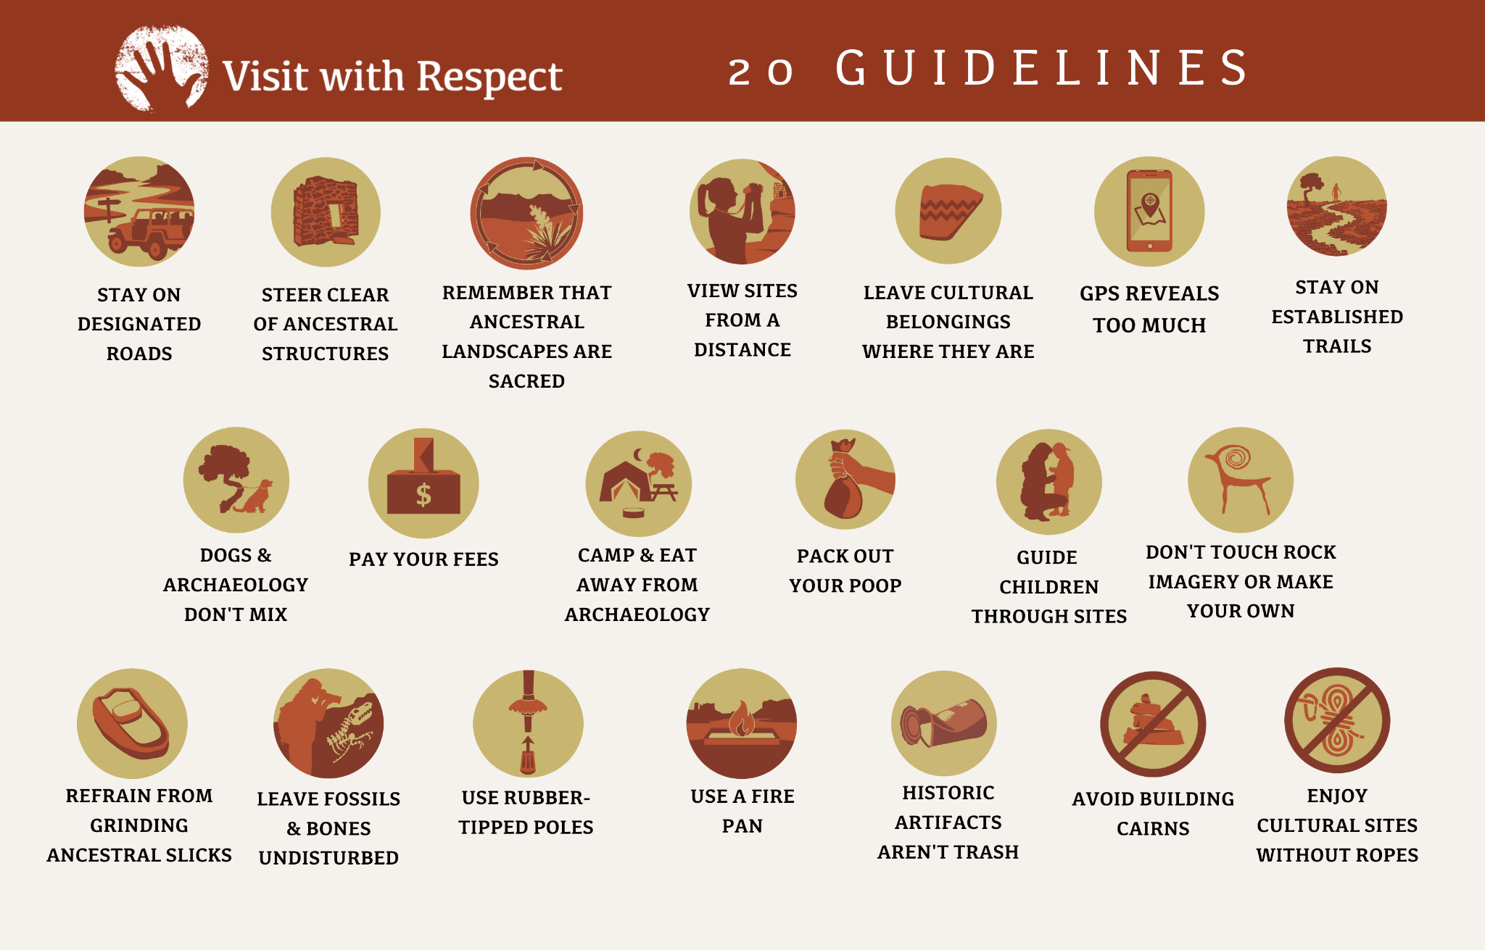

Slide 17
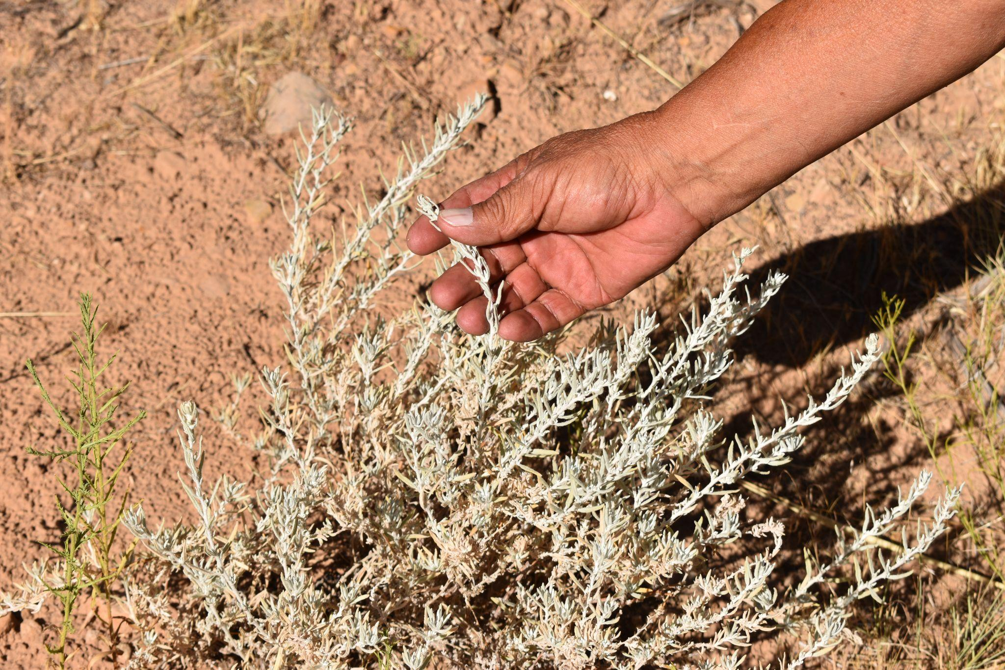
WHY is it important to Visit With Respect?

Slide 18
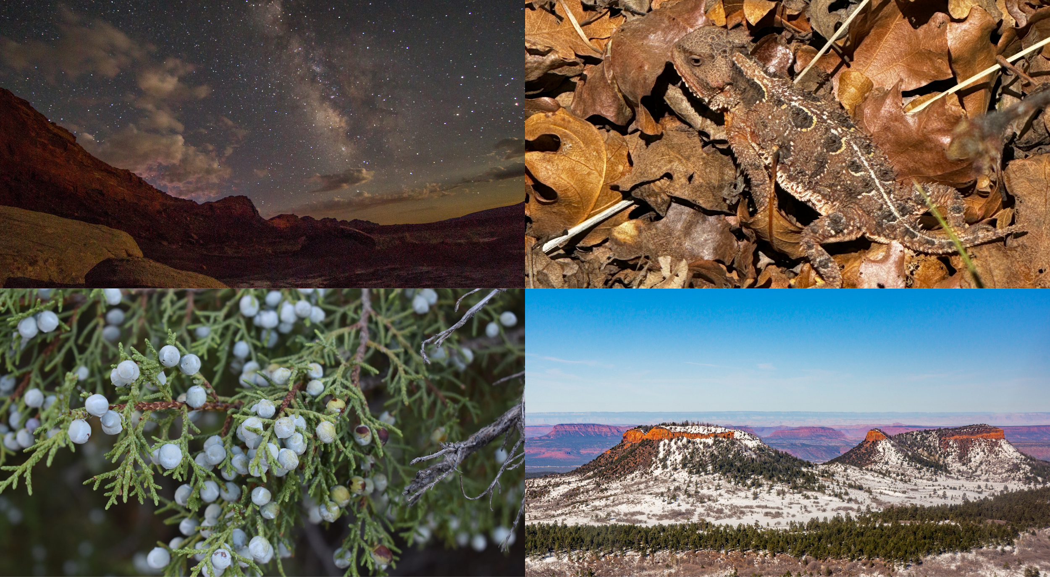

Slide 19


Slide 20


Slide 21


LEAVE CULTURAL BELONGINGS WHERE THEY ARE
GPS REVEALS TOO MUCH

Slide 22

Remember that Ancestral Landscapes are Sacred

Slide 23
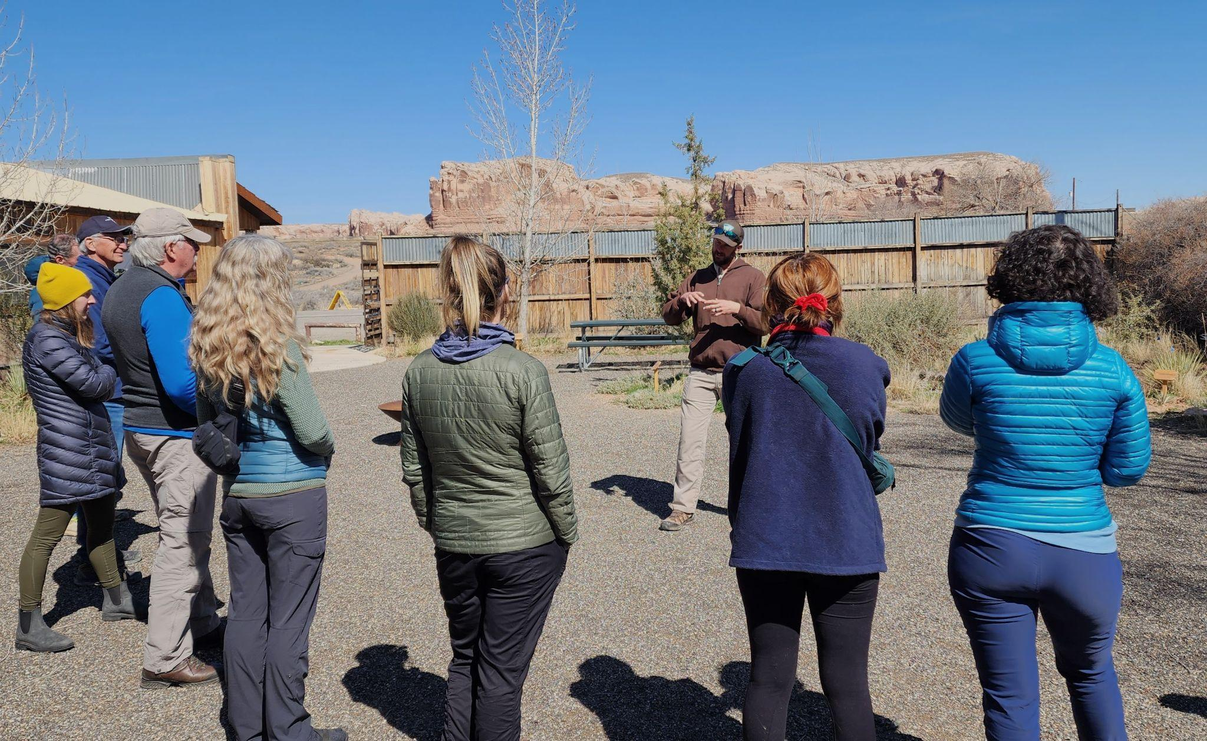
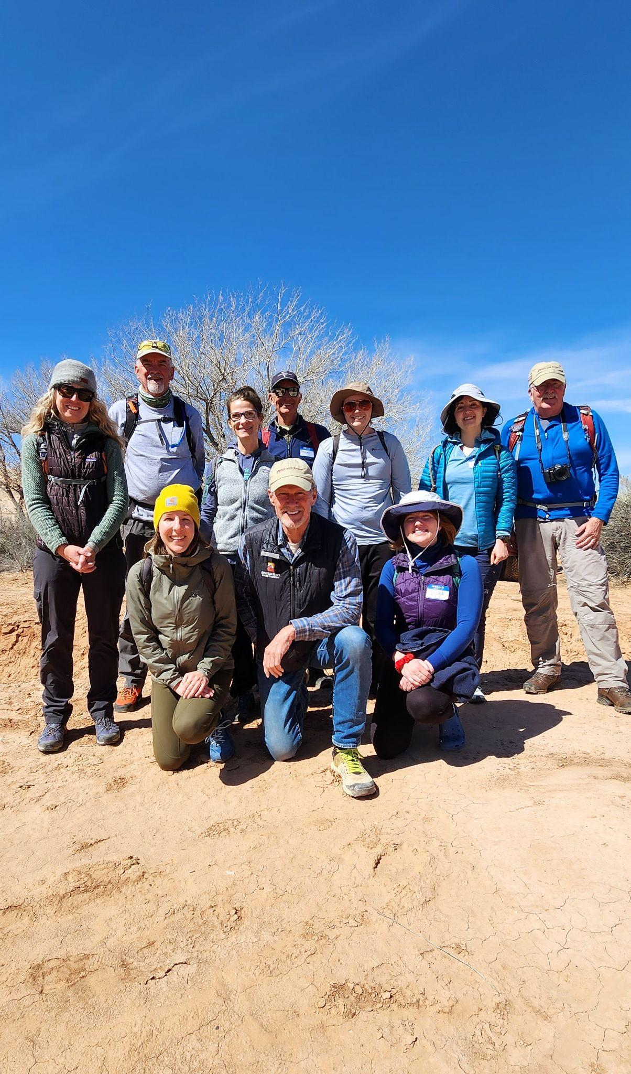
Visit With Respect Ambassadors
A volunteer-based program in which Ambassadors help monitor natural and cultural sites, document visitation patterns, and educate visitors about Visit With Respect principles

Slide 24
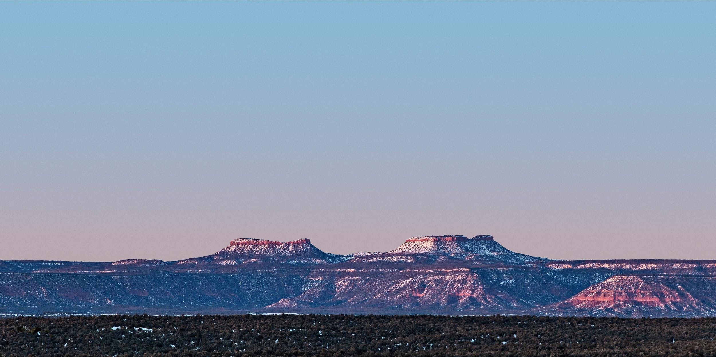
Questions?
To learn more go to bearsearspartnership.org

