Slide 1
How to Challenge a BLM Decision
Lizzy Potter
Advocates for the West, Inc.
Boise-Portland-D.C.

Slide 2
Purpose: Overview of key strategies, regulations, and processes that apply to challenging BLM decisions

Slide 3
Step One: Deciding Whether to Challenge a Decision
What type of decision is at issue?
Land use plan, implementation decision, or both?
How bad is the decision?
Procedural or legal flaws: e.g., 180° from draft w/ no analysis
Compelling facts re: agency bad-faith or on-the-ground harm
Small flaws can = big win (e.g., coal lease w/wrong signature)
Did you participate in planning process?
Generally must participate in comments or hearing
Must raise all issues directly or through someone else
Do you have standing?
Sometimes, but not always, participation is enough

Slide 4
Step Two: Determining How to Challenge a Decision
Challenges allow agency to take another look at a decision before it is final and subject to challenge in court
Review regulations, which include court-like procedures
E.g., Fulfill signature and representation requirements when practicing before DOI/BLM. 43 C.F.R. § 1.5
Attorney not mandatory; a full-time employee or officer can represent her corporation only. 43 C.F.R. § 1.3(b)(3)
Where possible, consult with attorneys early and often where key decisions are forthcoming

Slide 5
Step Three: Protesting a Decision
Land Use Plans (e.g., RMPs or Monument Plans)
43 C.F.R. § 1610.6-2: Protest procedures
Party must have participated in process and be adversely affected
May raise only issues submitted for the record during planning process unless issue arose after close of comment period on draft plan
30 day deadline to file protest in writing to BLM Director
Regulation specifies content requirements
Proposed final plan should explain specific procedures to protest
Director reviews in ~ 90 days, after which party may proceed to federal court if ripe

Slide 6
Step Three: Protesting a Decision
Implementation Level (e.g., oil & gas or grazing)
Not all decisions require protest/request for review, so check regulations for specific decisions like grazing, oil and gas, minerals, etc.
Some short deadlines – e.g., protests of grazing decisions must be filed w/in 15 days. 43 C.F.R. § 4160.2
Review typically by BLM state director or authorized officer
Protests may force an agency to change its mind – e.g., Canyon of the Ancients National Monument

Slide 7
Step Four: Filing an Administrative Appeal
Typical court-like procedures at IBLA/ALJ include:
Notice of Appeal w/ deciding BLM office, not board, 30 days after service or Fed. Reg. notice. 43 C.F.R. § 4.411
Raise or waive issues in Statement of Reasons w/in 30 days. 43 C.F.R. § 4.412
Service on solicitor, all parties named in decision, opposing parties. 43 C.F.R. § 4.413
Potential for hearing to present evidence and witnesses. 43 C.F.R. § 4.415
BLM/DOI governing regulations, including 43 C.F.R. Part 1; Part 4, Subparts A, B, E, are complex

Slide 8
Step Four: Filing an Administrative Appeal
Plenty of exceptions and unique processes
About a dozen different types of decisions have different processes to follow, such as:
43 C.F.R. § 4.470-480, 4160.3: grazing decisions
43 C.F.R. § 4.50-2 or 3120.1-3: oil and gas lease sales
43 C.F.R. § 3165: other oil and gas decisions (e.g., APD)
43 C.F.R. § 3809.800 et seq.: hard rock mining
Sometimes ALJ appeal required first (e.g., grazing)
Always double-check regulations to ID procedures and do not rely solely on secondary sources or websites, which may be outdated

Slide 9
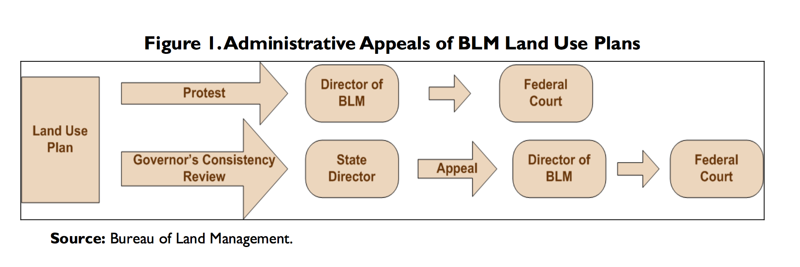
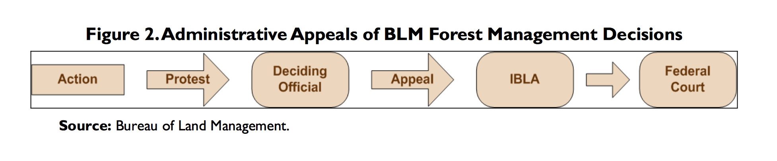
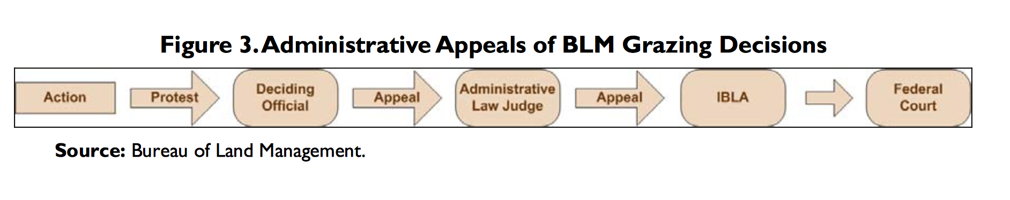

Slide 10
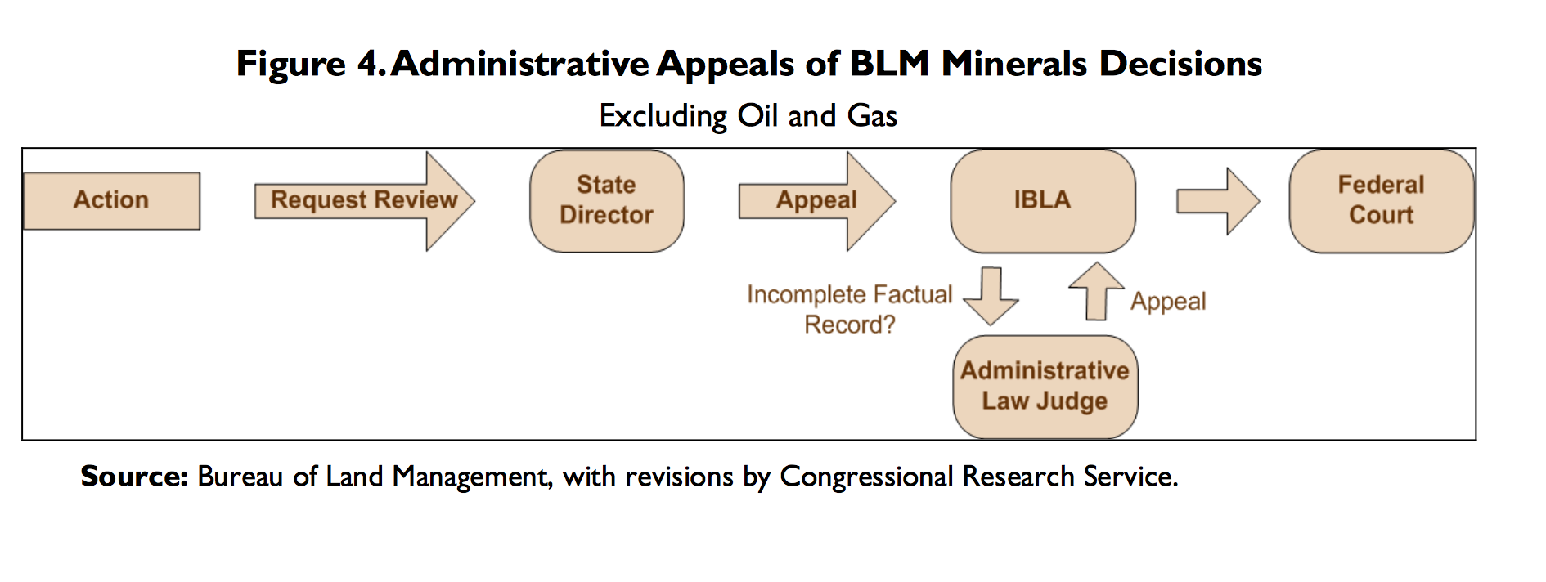
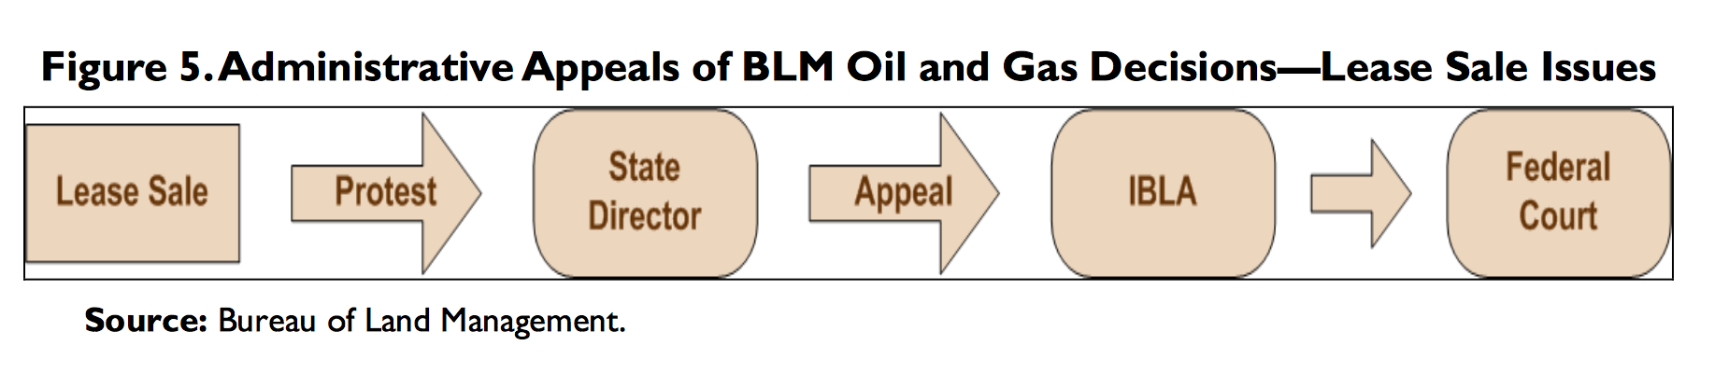

Slide 11
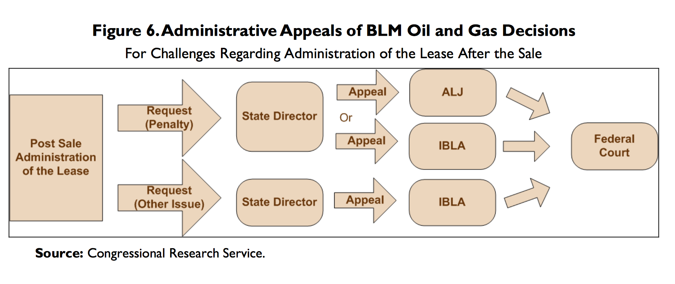
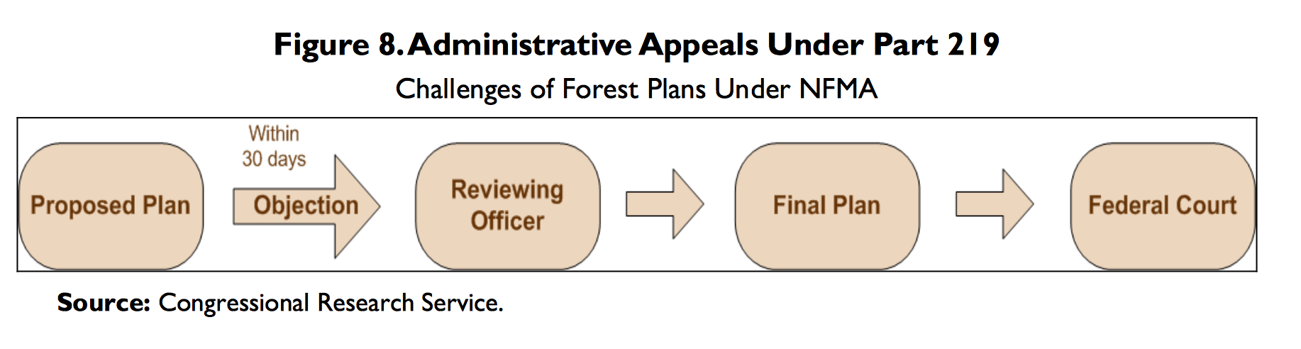

Slide 12
Step Five: When To File a Federal Lawsuit
Can file a Petition to Stay with IBLA to stop decision pending appeal; if denied, federal court generally an immediate option. 43 C.F.R. § 4.21(a)
E.g., IBLA granted stay of BENM ATV trail construction
Federal court generally an option to challenge final decisions via APA if party:
Exhausted administrative remedies &
Has standing based on concrete injuries from decision
Keep in mind venue, timing, and potential remedies
E.g., preliminary injunctions can be tough to stop projects pending litigation and appeals

Slide 13
Conclusion
Look closely at regulations and decision to ID what process is required to challenge decision
Assess organizational resources
Commenting, protesting, appealing, and suing can be time and resource intensive
Prioritize projects to challenge – e.g., questions of first impression, egregious facts, bundles of similar decisions, or decisions with potential for on-the-ground impact
Engage attorneys or experts early to help assess
Don’t wait until a final decision is issued to get involved or assess and notify agency of problems

Slide 14
Helpful Resources
Wilderness Society BLM Citizen’s Guide (2003)
Congressional Research Service Report on BLM Appeals (2013)
GPO.gov – Title 43 (Department of Interior), Subtitle A, Parts 1 & 4; Subtitle B
BLM Land Use Planning Handbook
DOI OHA IBLA Decision Web Search and Manual
Advocates for the West Advocacy Academy on How to Write Administrative Appeals: March 28

Slide 15
Questions?
Lizzy Potter
epotter@advocateswest.org
Todd Tucci
ttucci@advocateswest.org

