Slide 1
Sustain Your Spark:
Navigating Burnout in Grassroots Work
Colvin Hedgepeth
Senior Director of Client Services
Aperio Philanthropy
Notes:
So excited to be here with you today! You all are doing such important work, and I strongly believe that defending what matters starts with ensuring that we as individuals can prevent burnout and sustain our work for the long run to share the future of our lands.
I’m looking forward to sharing more about my own personal journey in navigating burnout and providing actionable tools to support you on your own journey.

Slide 2

Gentle Reminders
01 Let’s make this a safe space together. Stories stay in this room – share only lessons learned.
02 This is both an introspective and interactive session – meet yourself where you are today.
03 Hold space for different experiences. Burnout doesn't look the same for everyone in this room.
Burnout is a sensitive topic – here are some rules and reminders to keep in mind.

Slide 3
Pulse check
Notes:
I’d love to get a pulse from the group on your relationship to burnout.
Raise your hand if you’ve ever felt…
drained, overwhelmed, or depleted by the demands placed on you
disconnected from your work, the people you serve, or your mission
your work doesn’t make a difference, no matter how hard you try
Thank you all for bravely acknowledging and naming your feelings - which is an essential part of healing. I hate to break it to you, but all of those are symptoms of different types of burnout which we’ll dive more into now

Slide 4
Raise your hand if you’ve ever felt…
drained, overwhelmed, or depleted by the demands placed on you.
Notes:
I’d love to get a pulse from the group on your relationship to burnout.
Raise your hand if you’ve ever felt…
drained, overwhelmed, or depleted by the demands placed on you
disconnected from your work, the people you serve, or your mission
your work doesn’t make a difference, no matter how hard you try
Thank you all for bravely acknowledging and naming your feelings - which is an essential part of healing. I hate to break it to you, but all of those are symptoms of different types of burnout which we’ll dive more into now

Slide 5
Raise your hand if you’ve ever felt…
disconnected from your work, the people you serve, or your mission.
Notes:
I’d love to get a pulse from the group on your relationship to burnout.
Raise your hand if you’ve ever felt…
drained, overwhelmed, or depleted by the demands placed on you
disconnected from your work, the people you serve, or your mission
your work doesn’t make a difference, no matter how hard you try
Thank you all for bravely acknowledging and naming your feelings - which is an essential part of healing. I hate to break it to you, but all of those are symptoms of different types of burnout which we’ll dive more into now

Slide 6
Raise your hand if you’ve ever felt…
...like your work doesn’t make a difference, no matter how hard you try.
Notes:
I’d love to get a pulse from the group on your relationship to burnout.
Raise your hand if you’ve ever felt…
drained, overwhelmed, or depleted by the demands placed on you
disconnected from your work, the people you serve, or your mission
your work doesn’t make a difference, no matter how hard you try
Thank you all for bravely acknowledging and naming your feelings - which is an essential part of healing. I hate to break it to you, but all of those are symptoms of different types of burnout which we’ll dive more into now

Slide 7
Good & bad news…
you are not alone.
Notes:
I’d love to get a pulse from the group on your relationship to burnout.
Raise your hand if you’ve ever felt…
drained, overwhelmed, or depleted by the demands placed on you
disconnected from your work, the people you serve, or your mission
your work doesn’t make a difference, no matter how hard you try
Thank you all for bravely acknowledging and naming your feelings - which is an essential part of healing. I hate to break it to you, but all of those are symptoms of different types of burnout which we’ll dive more into now

Slide 8
On our lineup for this session!
Here are the topics we will be discussing:
Name and normalize burnout
Gain understanding on burnout
Identify values and energy drains
Explore boundaries
Apply learnings to grassroots activism
Walk away with ideas on how to sustain your spark

Slide 9
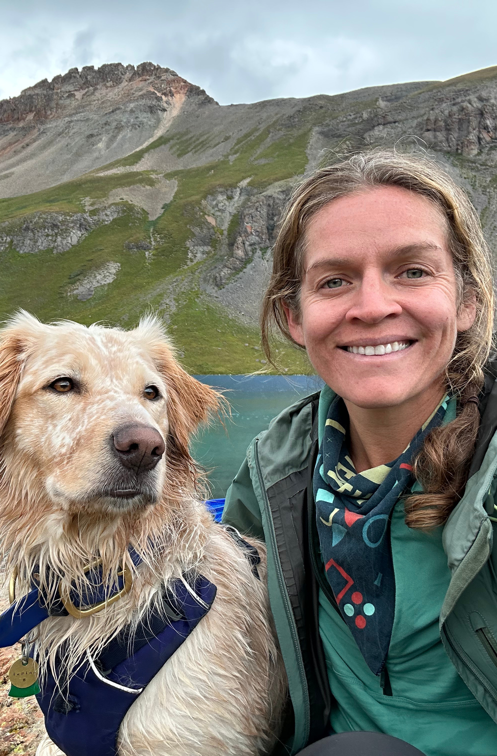
A little about me...
I’ve worked in the nonprofit sector for 15 years – from communications to events to finally fundraising, working with grassroots to international organizations.
And ... I’m wired to burn out.
Call it what you want – perfectionist, overachiever, control freak – I have a tendency to burn out. I’m passionate about sharing my learnings with other fundraisers and nonprofit folks to make this a more sustainable career.
Notes:
A little more on my story … I would say there are two common threads of my career journey so far. First is that I care deeply about making an impact, and the second is that I’m an over-achieving perfectionist that consistently brushes up against burnout. Every twist and turn on my path has been fueled by a desire to feel like I’m making an impact. I started in communications - and that felt way too far removed from on-the-ground work - then moved into events, where I could make an impact on someone’s experience on the day of an event, but that was about it - until I finally fell into fundraising and could tangibly feel that without my efforts, the work would not be possible. I shifted my focus from sports to outdoor education as I landed in fundraising, which was driven by my own personal passion for the outdoors as a space to support my mental health - which is why we’re sitting outside today! Now, as a fundraising consultant, most days I feel that I’m directly supporting a fundraiser in their work, and that feels pretty good.
I believe I’ve reached burnout at least three times in my decade in the professional world. The first time was absolutely the worst - what I consider to be my rock bottom - that I’d like to share a little bit about with you. At 25 years old, I thought I’d find my dream job working in events for the U.S. Olympic & Paralympic Committee down in Colorado Springs. I loved the emotional side of sports - the personal drive and sacrifice required to compete on the world’s biggest stage - and was consistently inspired by the underdog stories. Once I was entrenched in my role, I realized that working in sports - surprise surprise - was actually just all about winning and money. And working in events was actually a terrible fit for me - I’m a big-picture strategic thinker, so keeping on top of all of the minute details that events require made me lose my sanity. Suddenly I found myself checking my emails at all times of the night and weekends to make sure nothing fell through the cracks. I would fall into bed so tired, only for my heart to start racing, unable to lull myself into sleep. I started having severe gastro issues that I never did find a medical diagnosis for - eventually realizing that this was just how stress manifested in my body. The breaking point for me was three days before I was set to fly out to Rio de Janeiro to work the 2016 Games. I was doing last minute prep and packing at the office, and as I was looking at a spreadsheet on my computer, my vision went blurry. I couldn’t tell up from down or orient myself. My supervisor tried to help by guiding me to a private office, lying me down and turning off the lights… which did not in fact help as I felt like I was floating in midair. She drove me home and helped me to bed. The next day I woke up still dizzy and decided I need to see a doctor ASAP. They determined that I had stress-induced vertigo and encouraged more bed rest with medication. I spent another day in bed before I flew out to Rio. Throughout this period of what I now know was burnout, I felt like a shell of a human - I’d totally lost perspective, didn’t know who I was or what my purpose was. At that breaking point I realized - no job is worth sacrificing my health for. I completed my 6 weeks in Rio supporting Team USA, but I had mentally decided that I was done and something had to change. 6 months after Rio, I quit my job, moved back home to Virginia, and took over a year off to recover - which required therapy, lifestyle changes, and a whole lot of rewiring my brain to not feed into my over-achieving tendencies. I recognize the privilege in being able to take that time off - which is not always possible. I’ve since experienced burnout twice at a lower degrees, and did not have the ability to take time off. I was able to recognize the signs in my physical health and make changes - the first time I changed jobs, and most recently, I worked through burnout by maintaining my role.

Slide 10
Burnout is at historic levels
Nearly 90% of nonprofit leaders are concerned about burnout in their organizations
55% of U.S. workers report burnout
50% of nonprofits say burnout is impacting hiring and retention
43% of workers say the political climate is a major source of stress
Notes:
We all know that burnout is super prevalent in our nonprofit sector. I wholeheartedly believe that both our modern working world, and the culture of the nonprofit world, do not set us up for success and predisposes us to burnout. You’ve likely heard the statistics - zooming out first:
1. Over 50% of US workers are job searching - which is likely higher at this time - this is higher than during the Great Resignation in COVID
2. 95% of nonprofit leaders expressed concern about burnout - either in themselves or their team
3. And 18 months is the average turnover rate in fundraisers - which I’m sure there are a number of contributing factors to this, but I think it’s safe to say burnout is one of those, at least from my own personal experience and conversations with other fundraisers.
It’s easy to see how fundraisers so often end up in burnout. We have so much compassion and empathy for our missions and communities. We also have so much pressure on our shoulders to keep the doors open for a nonprofit. Each year, we work tirelessly to meet our fundraising goals, which is becoming increasingly challenging with the volatility of the current landscape. Our work is often thankless - and yet, we’re expected to come back year after year and raise more and more without support or resources.

Slide 11
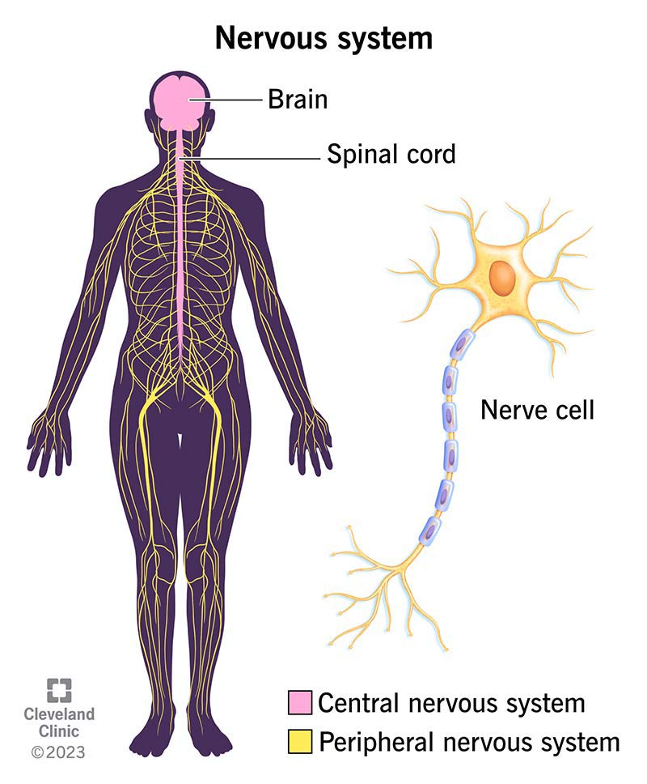
Understanding your nervous system
Notes:
We can't talk about burnout without talking about your nervous system. Your nervous system is your body’s command center. It’s made up of your brain, spinal cord and nerves. Your nervous system works by sending messages, or electrical signals, between your brain and all the other parts of your body. These signals tell you to breathe, move, speak and see, for example. Your nervous system keeps track of what’s going on inside and outside of your body and decides how to respond to any situation you’re in.
Central nervous system (CNS): Your brain and spinal cord make up your CNS. Your brain reads signals from your nerves to regulate how you think, move and feel.
Peripheral nervous system (PNS): Your PNS is made up of a network of nerves. The nerves branch out from your spinal cord. This system relays information from your brain and spinal cord to your organs, arms, legs, fingers and toes.

Slide 12
Stress cycle
01 Alarm phase Threat or stressor is perceived Stress hormones released Classic fight or flight response
02 Resistance phase Body stays in heightened state Marked by increased heart rate, alertness Costly if prolonged
03 Resolution phase Parasympathetic nervous system brings body back to baseline Physiological symptoms normalize
The full biological process in which the body responds to a perceived threat (stressor), activates stress-response systems, and then returns to baseline through recovery mechanisms.
Notes:
how your nervous system moves through the stress cycle is essential to understanding burnout.
Our nervous system is constantly assessing our surroundings for threats, and signals to our body how we need to respond.
these phase to the right are the stress cycle.
first we perceive a stressor, which often triggers fight or flight response
what's good about the fight or flight response is that it mobilizes you - so you can release that energy and move forward into resolution phase. this is the goal, that you complete the stress cycle when triggered.
If you don't though, your body might stay in resistance phase, which is not a good place to hang out for lot. prolonged periods at this heightened state are what leads to burnout.

Slide 13

What is Burnout?
Burnout is the result of chronic stress when the stress cycle is not completed.
Emotional exhaustion: feeling depleted, overwhelmed, and unable to give more
Depersonalization: feeling disconnected, cynical, numb, or detached from others and your work
Reduced sense of accomplishment: feeling ineffective, inadequate, or like nothing you do matters
Notes:
So what exactly IS burnout? it's the result of chronic stress when that cycle isn't completed - you're stuck in resistance phase.
In Burnout: The Secret to Unlocking the Stress Cycle by Emily and Amelia Nagoski, the authors highlight three key types of burnout that affect people differently but often overlap—especially in caregiving or mission-driven professions like fundraising and nonprofit work.
1. Emotional Exhaustion
This is the core experience of burnout—feeling drained, overwhelmed, or depleted by the demands placed on you.
Common in people who are “always on” or giving emotionally to others.
Signs include lack of motivation, irritability, or a feeling that you have “nothing left to give.”
2. Depersonalization (or Cynicism)
Often shows up as detachment or emotional numbness—feeling disconnected from your work, the people you serve, or your mission.
A defense mechanism to cope with chronic overwhelm.
Can look like sarcasm, reduced empathy, or feeling like your work doesn’t matter.
3. Reduced Sense of Accomplishment
A feeling of ineffectiveness or that your work doesn’t make a difference, no matter how hard you try.
You might still care deeply, but feel stuck, unproductive, or “not good enough.”
Often compounded by perfectionism or unclear goals/success metrics.
I care so deeply about nonprofit, mission and impact driven work - and I’m genuinely worried about the future of our sector. Nonprofits and grassroots groups can’t survive without the people behind them, and we can’t sustain this work as it currently is - so many are leaving the sector completely, including myself. I believe that supporting nonprofits and grassroots groups in navigating burnout and creating a new path forward is a way that I can make an impact on our sector. I’ve been building out a coaching framework based on my lived experiences and what has worked for me in the past, and I’m excited to share some of those exercises with you. I am absolutely not an expert and do encourage folks to get the professional help they need - I can’t recommend therapy enough if you are currently in burnout.

Slide 14

Movement burnout
Burnout caused not just by workload, but by sustained moral urgency + structural barriers to change.
Notes:
And there are nuances to burnout between grassroots groups and traditional nonprofits.
Grassroots / activist groups often experience:
1. unpaid or precarious labor
2. “always-on” crisis framing (e.g., climate, injustice)
3. weak HR / mental health infrastructure
4. internal conflict tied to values and identity
This can result in what's known as "movement burnout" - where it's not *just* your day-to-day job that's contributing to burnout, but the deeply emotional and personal fight for justice, and the systemic barriers you're working to dismantle.

Slide 15
What are ways you might complete the stress cycle?
Notes:
back to the stress cycle - curious if anyone has any ideas on what activities might help to complete the cycle, and break you out of that resistance phase?

Slide 16
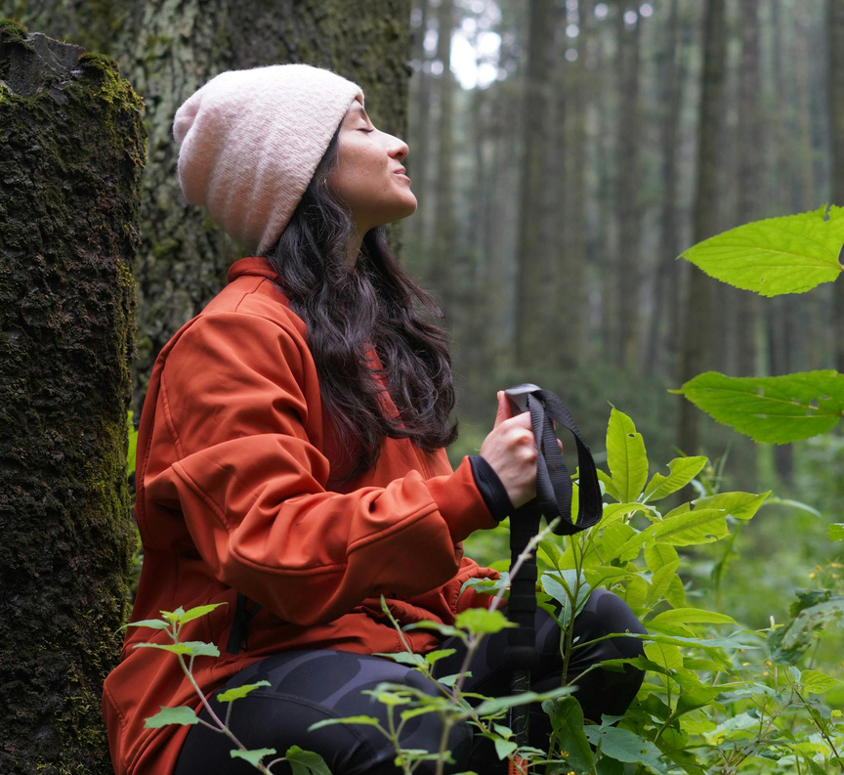
Completing the cycle
If your body doesn’t complete the cycle, you remain in a hyper-aware state which can exacerbate presence of additional stressors.
Positive coping mechanisms
Practice self-compassion
Exercise
Body scan
Call a friend or family member
Take a nap
Do a creative activity
Others?
Notes:
These are all great ideas.
If the stress cycle isn’t completed, it means that we are still experiencing that stress; we haven’t given ourselves the chance to recover from it or to tell ourselves that the danger is passed.
Thus, we are still living in that hyper-aware state that stress puts us through, which can lead to increased sensitivity to any additional stressors that we may encounter during this time. Which becomes a vicious cycle.
You likely already practicing some of these activities - the trick is being able to recognize "oh my body is triggered" and disrupt the cycle. I recommend that you find a go-to activity that you can easily do alone or in groups - such as the body scan, deep breathing, or mindful tapping.

Slide 17
“To be “well” is not to live in a state of perpetual safety and calm, but to move fluidly from a state of adversity, risk, adventure, or excitement, back to safety and calm, and out again. Stress is not bad for you; being stuck is bad for you.”
- Amelia & Emily Nagoski, Burnout
Notes:
I love this quote because when I started my journey of healing burnout the first time, I thought there was a distinct "before burnout" and "after burnout" and that because I'd moved through it I wouldn't necessarily dip back into it.
In learning more and understanding about the stress cycle - I now understand that we will always be presented with stressors. and the growth comes from recognizing the triggers and moving through the stress cycle more swiftly, rather than getting stuck in it.
One other anecdote I'll share related to the word adventure here. I don't know about you, but in my outdoor adventures, I love the challenge and uncertainty of how things will unfold. But in my day-to-day life, I'm more easily triggered. A big part of my journey has been around embracing that mindset of outdoor adventures and tolerance for unknowns in all areas of my life.

Slide 18
Exercise 1:
Values Discovery
Identify 5-7 values that are important to you
Focus on 1-2 that feel most alive or urgent to you right now
Reflect on your work – where do you feel most in alignment with those values? And where do you feel friction?

Slide 19
Sample values
Accountability
Achievement
Adaptability
Adventure
Altruism
Ambition
Authenticity
Balance
Beauty
Being the best
Belonging
Career
Caring
Collaboration
Commitment
Community
Compassion
Competence
Confidence
Connection
Contentment
Contribution
Cooperation
Courage
Creativity
Curiosity
Dignity
Diversity
Environment
Efficiency
Equality
Ethics
Excellence
Fairness
Faith
Family
Financial stability
Forgiveness
Freedom
Friendship
Fun
Future generations
Generosity
Giving back
Grace
Gratitude
Growth
Harmony
Health
Home
Honesty
Hope
Humility
Humor
Inclusion
Independence
Initiative
Integrity
Intuition
Job security
Joy
Justice
Kindness
Knowledge
Leadership
Learning
Legacy
Leisure
Love
Loyalty
Making a difference
Nature
Openness
Optimism
Order
Parenting
Patience
Patriotism
Peace
Perseverance
Personal fulfillment
Power
Pride
Recognition
Reliability
Resourcefulness
Respect
Responsibility
Risk-taking
Safety
Security
Self-discipline
Self-expression
Self-respect
Serenity
Service
Service
Simplicity
Spirituality
Sportsmanship
Stewardship
Success
Teamwork
Thrift
Time
Tradition
Travel
Trust
Truth
Understanding
Uniqueness
Usefulness
Vision
Vulnerability
Wealth
Well-being
Wholeheartedness
Wisdom
Write your own!
Credit> Brene Brown

Slide 20
Any surprises?

Slide 21

Exercise 2:
Energy Audit
Think about your typical workweek. List out your top 5–7 recurring tasks or meetings.
Mark each task as energizing, neutral, or draining
Reflect on which draining tasks could be reduced, reassigned, or restructured?
Check out Designing Your Life by Bill Burnett and Dave Evans for more exercises like this!

Slide 22
What patterns emerged from your energy audit?

Slide 23
Exercise 3:
Boundary setting
Look back at your values and energy audit: What is one boundary you want to set this week / month / year?
Who do you need to communicate that boundary to, and how?

Slide 24
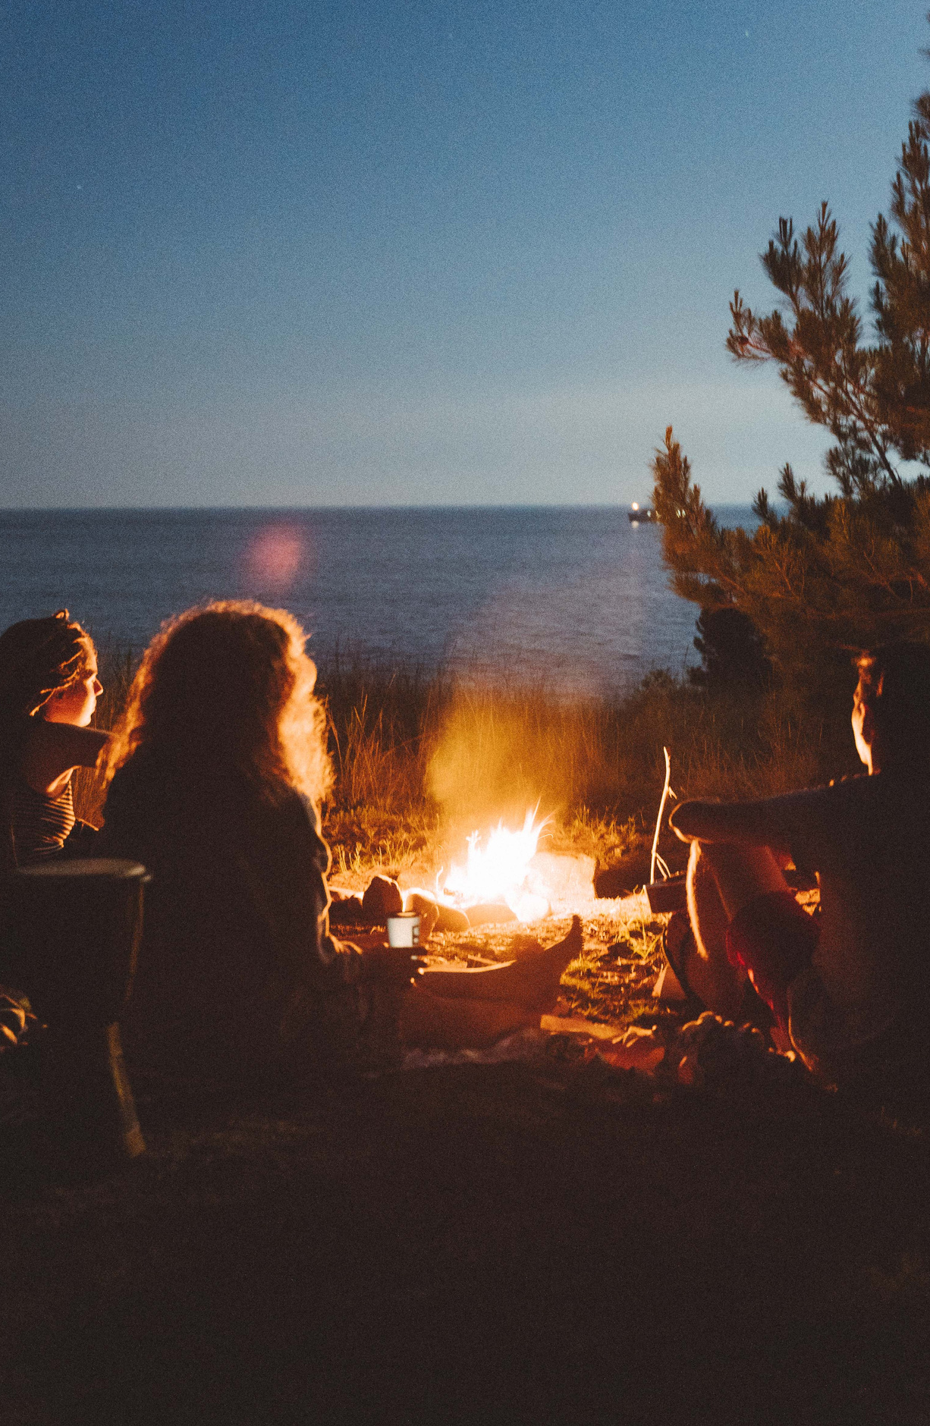
Any a-ha moments?

Slide 25
How do you sustain your spark in activism?
Find a clearing
Gather the tinder
Find a spark
Tend the flames
Notes:
As I thought about how to apply my burnout approach to activism, I really resonated with this Campfire Analogy for Building Sustainable Activism
from Karen Walrond's The Lightmaker's Manifesto. She says growing sustainable personal activism is similar to building a campfire, with four key elements: finding a clearing, tinder, a spark, and tending the flames.
1. Find a Clearing
The first step is finding a clearing — a safe place to build your fire. In practice, this means tossing away preconceived notions of what activism should look like and first defining how much time and space you actually have in your life to offer. It's about creating conditions that feel safe and sustainable before you begin. I think this is especially important in our current landscape - there are literally SO many fires in our world right now and no one person can possibly tend to ALL the flames. You have to get clear on what role you can play and the boundaries you need to sustain your spark for the long game.
2. Gather the Tinder
This step involves taking stock of the gifts and skills you bring to the table — what lights you up, what activities you enjoy most, the values you hold, and the things that keep you in your integrity. I'm hoping that the values and energy exercises we've completed might help illuminate your strengths and passions.
3. Find a Spark
This is about identifying the causes that make you angry, break your heart, or make you think something has to change. The spark is the intersection of your inner gifts and an outer need — the moment where your personal passions meet something worth fighting for. I imagine for most of us in this room - the environment is a common cause we are fighting for - but break that down further. Is it conservation, climate change, education, recreation that you're focused on? Across the country or in a specific region? for communities at large or a specific group.
4. Tend the Flames
Once your campfire is going, you have to tend to the flames....

Slide 26
Joy.
Rest.
Community.
Notes:
Joy makes it all worth fighting for. Rest is how you gather the energy to go back in and do the work. Community is how you remind yourself what you're fighting for. Tending the flames is about sustainability — making sure the fire doesn't burn out by nurturing yourself along the way.
The broader point of the analogy is that lightmaking — doing things that light you up and using them in service — means activism doesn't have to be 100% sacrificial. It can be something that brings meaning, purpose, and joy into your own life. And like a campfire, it's not about a dramatic single moment but about building something that can burn steadily over time.

Slide 27
01: Find your clearing What's my realistic capacity right now? What boundaries do I need to protect my energy?
02: Gather the tinder What skills, strengths, or ways of engaging actually energize me?
03: Find a spark What specific cause/issue sits at the intersection of my gifts and what the world needs?
04: Tend the flames What's ONE thing I'll protect (i.e. rest, community, joy etc.) to stay in this for the long game?
Build your campfire
Create a sustainable path ahead for your activism, or your community’s efforts.
Notes:
We're going to use the campfire analogy to help you get concrete — not just reflect, but leave with something actionable for yourself and something you can share with others in your network.

Slide 28
Focus on what you can control
 | Pick a lane - one primary activity you can commit to
 | Reduce information overload by picking a few key news sources
 | Take breaks when you need them
 | Reconnect with nature
 | Spend time in community

Slide 29
Recap
01 | 02 | 03
Values are your north star. | Energy = currency. Use yours wisely! | Boundaries turn awareness into action.
If you feel out of alignment, start with your values. Where you out of alignment and what small actions can you take to change that. | A majority of draining tasks will increase risk of burnout. The more energizing tasks that you can focus on, the greater chance you have to sustain your spark. | Set boundaries to take action toward the behaviors that will prevent and protect you from burnout.

Slide 30
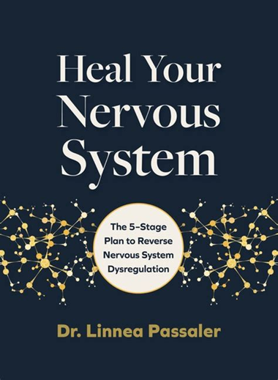
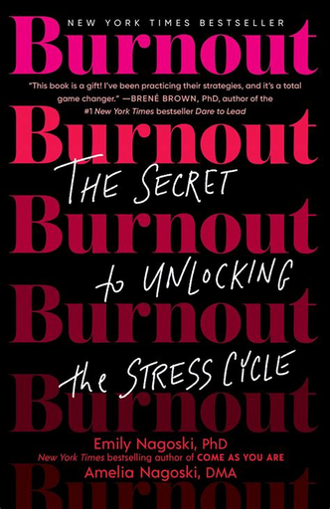
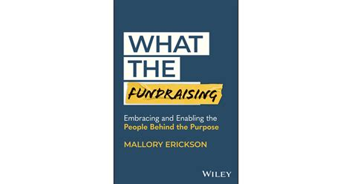

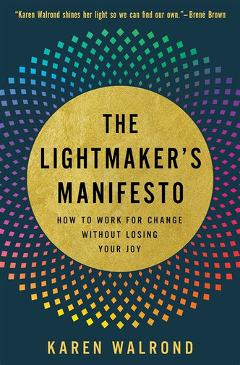
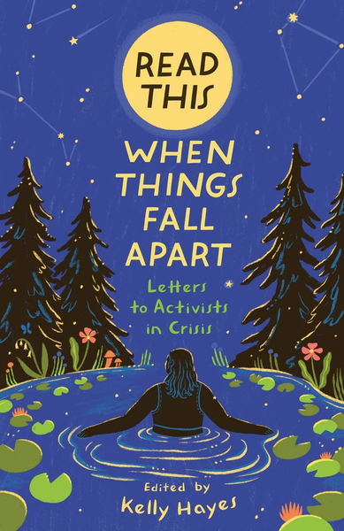
Resources
Notes:
Books / thought leaders that have either been helpful for me, or recommended by peers in the activist space.
Other recs:
Workshops
Retreats
Community groups
Courses - on emotional resilience in activist work

Slide 31
colvin@aperiophilanthropy.com
linkedin.com/colvworld
Thank you!
calendly.com/colvin-aperio/30min
I would absolutely LOVE to connect and provide support on your burnout journey.

Slide 32
Resource
Page
Use these icons and illustrations in your Canva Presentation. Happy designing!

