Slide 1

THE DAYLIGHT ON DARK DAYS
Encountering the Darkness of Discouragement
NYACS Teachers Conference 2023
Steve Harness, M.Div., Ph.D.

Slide 2

But of the times and the seasons, brethren, ye have no need that I write unto you. For yourselves know perfectly that the day of the Lord so cometh as a thief in the night.
For when they shall say, Peace and safety; then sudden destruction cometh upon them, as travail upon a woman with child; and they shall not escape. But ye, brethren, are not in darkness, that that day should overtake you as a thief.
1 Thessalonians 5:1–11
KJV 1900

Slide 3
Ye are all the children of light, and the children of the day: we are not of the night, nor of darkness. Therefore let us not sleep, as do others; but let us watch and be sober. For they that sleep sleep in the night; and they that be drunken are drunken in the night.
But let us, who are of the day, be sober, putting on the breastplate of faith and love; and for an helmet, the hope of salvation.
1 Thessalonians 5:1–11
KJV 1900

Slide 4
For God hath not appointed us to wrath, but to obtain salvation by our Lord Jesus Christ,
Who died for us, that, whether we wake or sleep, we should live together with him. Wherefore comfort yourselves together, and edify one another, even as also ye do.
1 Thessalonians 5:1–11
KJV 1900

Slide 5
καταλαμβάνω
katalambanō;
to lay hold of, seize:
Hebrew-Aramaic and Greek Dictionaries: Updated Edition

Slide 6
Jesus Overcomes
the Dark Days!

Slide 7
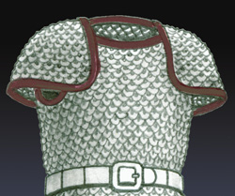

Slide 8
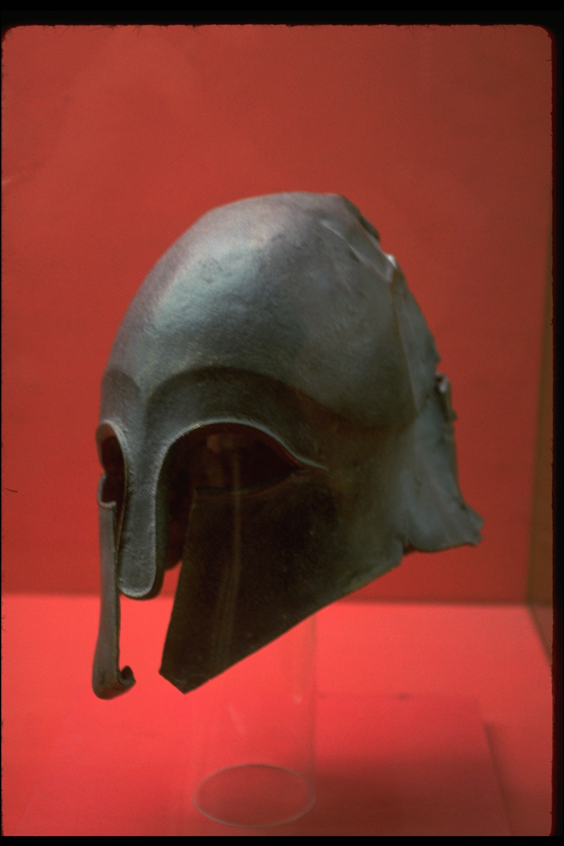

Slide 9
Jesus Overcomes
the Dark Days!

Slide 10
How can we know daily victory over the dark days?
Have FAITH in your HEART.
Have LOVE in your SOUL.
Have HOPE in your HEAD.

Slide 11
And above all these things put on charity, which is the bond of perfectness.
Colossians 3:14
KJV 1900

Slide 12
“We can’t plan for joy, or put a specific date and time on our calendars when we plan to savor it."
Today's Best Illustrations, Volumes 1-4

Slide 13
Joy overtakes us while we’re busy at something else.
Today's Best Illustrations, Volumes 1-4

Slide 14
How can we know daily victory over the dark days?
Have FAITH in your HEART.
Have LOVE in your SOUL.
Have HOPE in your HEAD.

Slide 15
But the fruit of the Spirit is love, joy, peace, longsuffering, gentleness, goodness, faith, Meekness, temperance: against such there is no law.
Galatians 5:22–23
KJV 1900

Slide 16
“Let Your love dissolve my hard heart. Let Your love raise me above myself. Let Your love reveal to me joy beyond imagination. Let my soul exhaust itself in singing the praises of Your love.Let me love You more than I love myself, and let me love myself only for Your sake. And let me see Your love shining in the hearts of all people, that I may love them as I love You. AMEN”
One person prayed…
6,000 Plus Illustrations for Communicating Biblical Truths

Slide 17
How can we know daily victory over the dark days?
Have FAITH in your HEART.
Have LOVE in your SOUL.
Have HOPE in your HEAD.

Slide 18
Hope is a confident, happy expectation.

Slide 19
And take the helmet of salvation, and the sword of the Spirit, which is the word of God: Praying always with all prayer and supplication in the Spirit, and watching thereunto with all perseverance and supplication for all saints;
Ephesians 6:17–18
KJV 1900

Slide 20
And to wait for his Son from heaven, whom he raised from the dead, even Jesus, which delivered us from the wrath to come.
1 Thessalonians 1:10
KJV 1900

Slide 21
“Positive thoughts create a happier reality.”
Dr. Dan Amen

Slide 22
How to assess your thinking. Dr Dan Amen.
1. It is True?
2. Is it Absolutely True?
3. How does the thought make you feel? Act? Outcome?
4. How would you feel if you were not having the thought? Act? Outcome?
5. Turn the thought around. What is the opposite of the thought?

Slide 23
Jesus Overcomes
the Dark Days!

