Slide 1


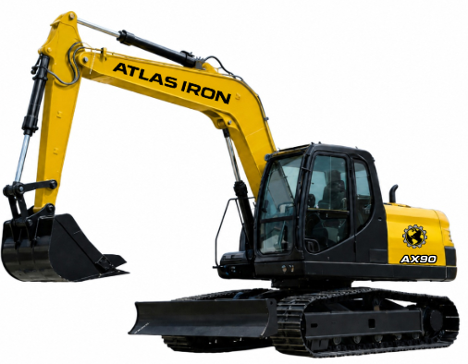


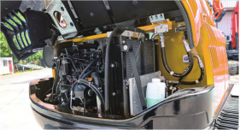
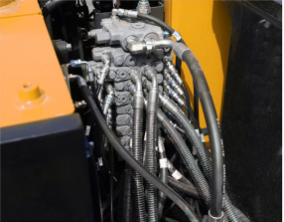
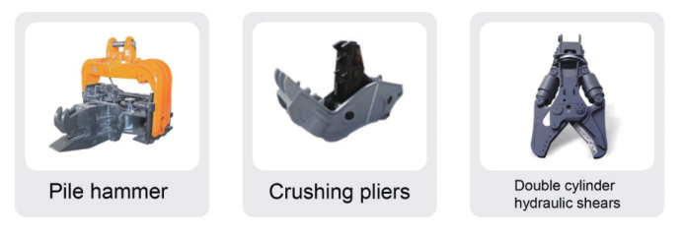
AX90
COMPACT EXCAVATOR
AX90
COMPACT EXCAVATOR
VERSATILE POWER. EASY SERVICE ACCESS.
3-YEAR / 3,000-HOUR LIMITED WARRANTY
A versatile 18,000 lb excavator designed to reduce maintenance time while expanding jobsite productivity.
82.6
POWER (HP)
18,000 LB
OPERATING WEIGHT
137.9 IN
MAX DIGGING DEPTH
12,814 LBF
BUCKET FORCE
PRODUCT HIGHLIGHTS
1
YANMAR 4TNV98L ENGINE
Four-cylinder diesel power supports efficient, reliable operation.
2
GROUND-LEVEL SERVICE
Accessible service points, gauges and filtration simplify routine upkeep.
3
ATTACHMENT READY
Hydraulic tools, buckets and grapples expand the machine's application range.
Notes:
[Sources]
- AX90 Brouchure.pdf (user-provided product imagery, product claims, and specifications).
- ATLAS IRON WHITE Hor_PNG 96 DPI.png (user-provided current logo).
- Globe_PNG 96 DPI.png (user-provided current logo).
[/Sources]

Slide 2
TECHNICAL SPECIFICATIONS
AX90
COMPACT EXCAVATOR
18,000 LB
OPERATING WEIGHT
137.9 IN
MAX DIGGING DEPTH
12,814
BUCKET FORCE (LBF)
ENGINE
Engine Brand / Model |  | Yanmar 4TNV98L
Rated / Maximum Power | hp | 60.3 / 82.6
Maximum Speed | rpm | 2,100
Displacement | gal | 0.88
Number of Cylinders |  | 4
WORKING RANGE
Maximum Digging Depth | in | 137.9
Maximum Digging Height | in | 250.9
Maximum Unloading Height | in | 207
Bucket Width | in | 23.6
Boom Length | in | 146.5
Stick Length | in | 65.8
OPERATING SPECIFICATIONS
Travel Speed Low / High | mph | 1.6 / 2.7
Tail Turning Radius | in | 70.9
Minimum Ground Clearance | in | 14.4
Theoretical Fuel Consumption | gph | 2.67
TRANSPORT DIMENSIONS
Transport Length | in | 242
Transport Width | in | 88.3
Transport Height | in | 104.8
DIGGING PERFORMANCE
Bucket Digging Force | lbf | 12,814
Arm Digging Force | lbf | 8,768
OPERATING WEIGHT
Operating Weight lb 18,000
DETAILS
DIMENSIONS & SUPPORT
Backfill Blade Width | in | 86.7
Cooling Method |  | Water cooled
Engine Oil Change Amount | gal | 1.8
Fuel Type |  | Diesel
Fuel Grade |  | 0/-10
Rate Set Pressure | psi | 3,263.3
Travel Hydraulic Motor |  | TM07
Travel Motor Displacement | in3 | 2.6
HYDRAULIC & DRIVE
Main Pump Type / Brand |  | HYTEK
Main Pump Maximum Flow | gpm | 44.9
Multi-Way Valve |  | 8-way hydraulic valve
Rated / Maximum Pressure | psi | 3,263.3 / 3,625.5
Travel Motor / Displacement |  | TM07 / 2.6 in3
Notes:
[Sources]
- AX90 Brouchure.pdf (user-provided technical specifications and product-detail imagery).
- ATLAS IRON WHITE Hor_PNG 96 DPI.png (user-provided current logo).
- Globe_PNG 96 DPI.png (user-provided current logo).
[/Sources]

