Slide 1


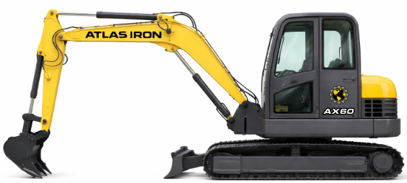


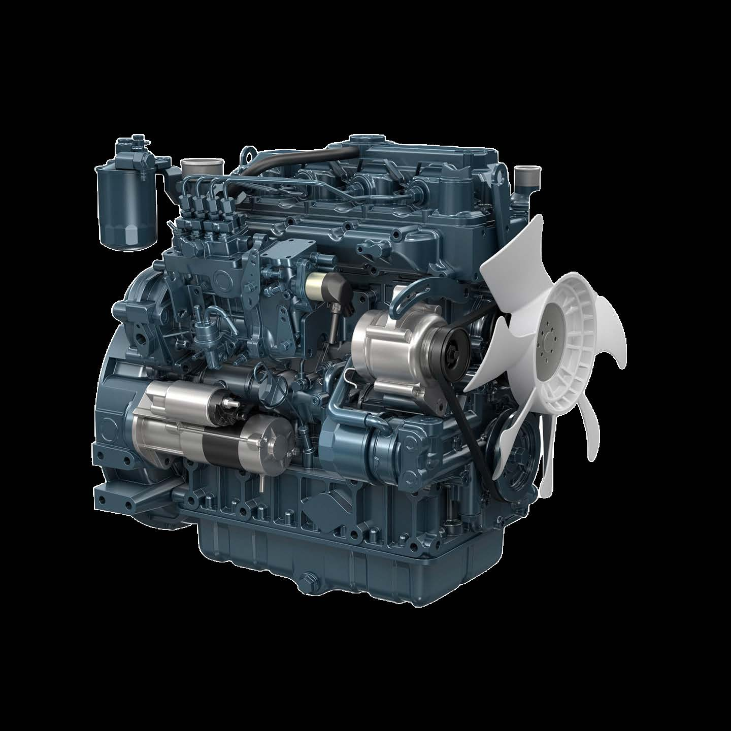
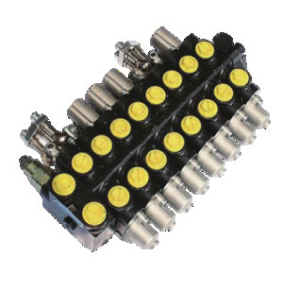
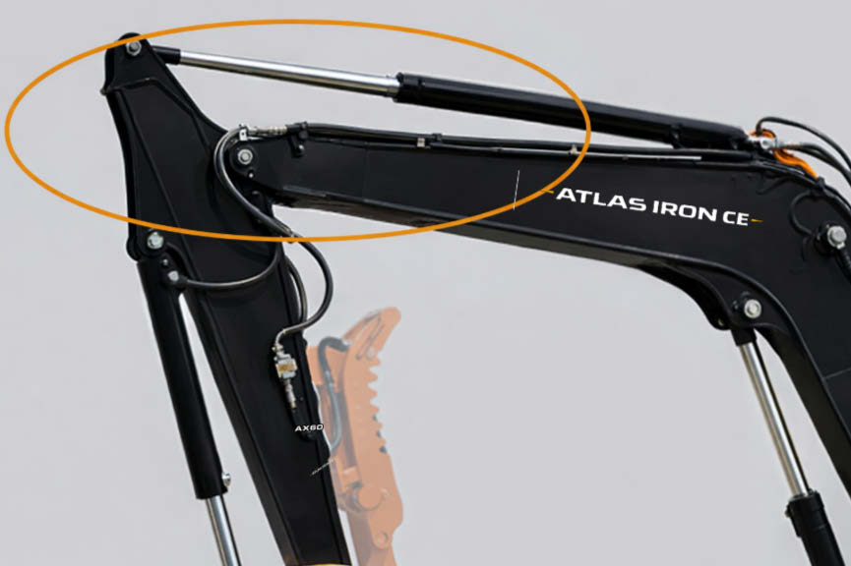
AX60
COMPACT EXCAVATOR
AX60
COMPACT EXCAVATOR
HEAVY-DUTY POWER. SMOOTH HYDRAULICS.
3-YEAR / 3,000-HOUR LIMITED WARRANTY
A 12,000 lb excavator built for smooth control, reinforced durability and productive attachment changes.
66 HP
RATED POWER
12,000 LB
OPERATING WEIGHT
149 IN
MAX DIGGING DEPTH
7,194 LBF
DIGGING FORCE
PRODUCT HIGHLIGHTS
1
KUBOTA V2607 ENGINE
Four-cylinder Tier 4 power delivers dependable, fuel-efficient performance.
2
LOAD-SENSING HYDRAULICS
Variable-piston pump and multi-way valve match flow to the workload.
3
REINFORCED BOOM SYSTEM
Thickened structures and integrated components improve high-load durability.
Notes:
[Sources]
- AX60 Brouchure.pdf (user-provided product imagery, product claims, and specifications).
- ATLAS IRON WHITE Hor_PNG 96 DPI.png (user-provided current logo).
- Globe_PNG 96 DPI.png (user-provided current logo).
[/Sources]

Slide 2
TECHNICAL SPECIFICATIONS
AX60
COMPACT EXCAVATOR
12,000 LB
OPERATING WEIGHT
149 IN
MAX DIGGING DEPTH
7,194
DIGGING FORCE (LBF)
ENGINE
Engine Brand / Model |  | Kubota V2607
Rated / Maximum Power | hp | 66 / 67
Maximum Speed | rpm | 2,700
Displacement | L | 2.6
Number of Cylinders |  | 4
WORKING RANGE
Maximum Digging Depth | in | 149
Maximum Digging Height | in | 228.7
Maximum Unloading Height | in | 160.6
Bucket Width | in | 23.6
Boom Length | in | 118.16
Stick Length | in | 63
OPERATING SPECIFICATIONS
Bucket Capacity | ft3 | 6.18
Travel Speed Low / High | mph | 1.5 / 2.4
Gradeability | % | 35
Ground Pressure | psi | 5.1
TRANSPORT DIMENSIONS
Transport Length | in | 230.3
Transport Width | in | 78.7
Transport Height | in | 101.6
DIGGING PERFORMANCE
Maximum Digging Force | lbf | 7,194
Maximum Digging Radius | in | 242.5
OPERATING WEIGHT
Operating Weight lb 12,000
DETAILS
DIMENSIONS & SUPPORT
Backfill Blade Width | in | 74
Cooling Method |  | Water cooled
Engine Oil Change Amount | gal | 1.4
Fuel Type |  | Diesel
Fuel Grade |  | 0/-10
Theoretical Fuel Consumption | L/h | 10.1
Travel Hydraulic Motor |  | TM07
Travel Motor Displacement | in3 | 2.64
HYDRAULIC & DRIVE
Main Pump Type / Model |  | Load-sensitive piston / 68
Main Pump Brand |  | HYTEK
Main Pump Maximum Flow | gpm | 35.9
Multi-Way Valve |  | 8-way hydraulic valve
Rated Set Pressure | psi | 3,263
Notes:
[Sources]
- AX60 Brouchure.pdf (user-provided technical specifications and product-detail imagery).
- ATLAS IRON WHITE Hor_PNG 96 DPI.png (user-provided current logo).
- Globe_PNG 96 DPI.png (user-provided current logo).
[/Sources]

