Slide 1


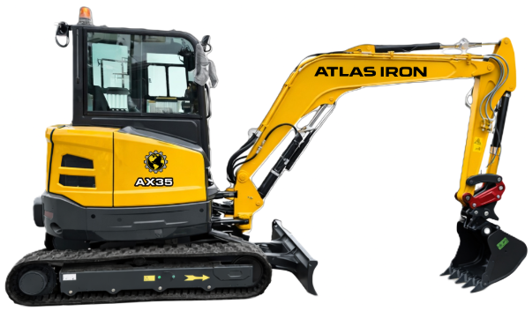


AX35
COMPACT EXCAVATOR
AX35
COMPACT EXCAVATOR
8,500-LB-CLASS LOAD-SENSING PERFORMANCE.
3-YEAR / 3,000-HOUR LIMITED WARRANTY
A compact excavator engineered for controlled digging, two-speed travel and versatile urban work.
24 HP
RATED POWER
8,553 LB
OPERATING WEIGHT
118 IN
MAX DIGGING DEPTH
6,834 LBF
BUCKET FORCE
PRODUCT HIGHLIGHTS
1
COMPACT FOOTPRINT
1,740 mm overall width and 860 mm tail swing radius support confined jobsites.
2
3.0 M DIG DEPTH
Working range includes 3,000 mm dig depth and 3,545 mm dump height.
3
LOAD-SENSING HYDRAULICS
96.8 L/min rated flow supports smooth, responsive implement control.
Notes:
[Sources]
- AX35 Brochure.pdf (user-provided product imagery, product claims, and specifications).
- ATLAS IRON WHITE Hor_PNG 96 DPI.png (user-provided current logo).
- Globe_PNG 96 DPI.png (user-provided current logo).
[/Sources]

Slide 2
TECHNICAL SPECIFICATIONS
AX35
COMPACT EXCAVATOR
8,553 LB
OPERATING WEIGHT
118 IN
MAX DIGGING DEPTH
6,834
BUCKET FORCE (LBF)
ENGINE
Engine Model |  | Kubota D1703
Engine Type |  | 3-cyl. direct injection
Rated Power | hp/rpm | 24 / 2,200
Displacement | L | 1.642
Emission Standard |  | Euro 5 / Tier 4 Final
WORKING RANGE
Maximum Digging Height | mm | 4,910
Maximum Dumping Height | mm | 3,545
Maximum Digging Depth | mm | 3,000
Maximum Vertical Depth | mm | 2,690
Maximum Digging Distance | mm | 5,500
Ground-Level Digging Distance | mm | 5,370
OPERATING SPECIFICATIONS
Bucket Capacity | m3 | 0.12
Travel Speed | km/h | 2.4 / 4.4
Gradeability | deg | 30
Ground Pressure | kPa | 32
TRANSPORT DIMENSIONS
Overall Length | mm | 4,880
Overall Width | mm | 1,740
Overall Cab Height | mm | 2,550
DIGGING PERFORMANCE
Bucket Digging Force | kN | 30.4
Arm Digging Force | kN | 18.2
OPERATING WEIGHT
Operating Weight lb 8,553
DETAILS
DIMENSIONS & SUPPORT
Tail Swing Radius | mm | 860
Minimum Ground Clearance | mm | 295
Track Length | mm | 2,155
Track Gauge | mm | 1,440
Shoe Width | mm | 300
Bucket Width | mm | 650
Blade Lift Height | mm | 400
Blade Cutting Depth | mm | 370
HYDRAULIC & DRIVE
Hydraulic System |  | Load-sensing
Rated Operating Flow | L/min | 96.8
Travel / Swing Motors |  | Plunger / plunger
Swing Speed | r/min | 0-9
Brake Type |  | Pressure release, mechanical
Notes:
[Sources]
- AX35 Brochure.pdf (user-provided technical specifications and product-detail imagery).
- ATLAS IRON WHITE Hor_PNG 96 DPI.png (user-provided current logo).
- Globe_PNG 96 DPI.png (user-provided current logo).
[/Sources]

