Slide 1


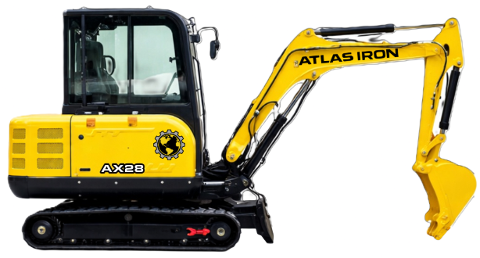


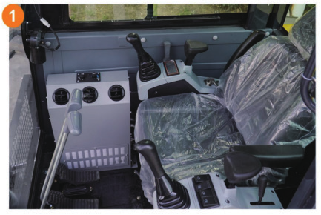
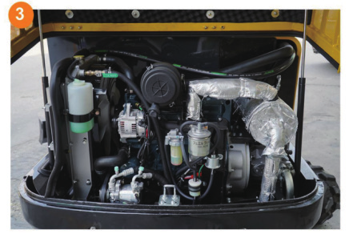
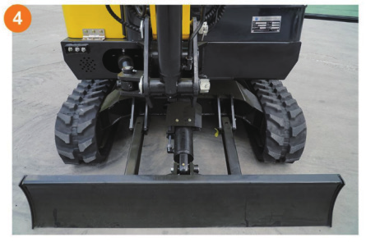
AX28
COMPACT EXCAVATOR
AX28
COMPACT EXCAVATOR
CAB COMFORT WITH EASY SERVICE ACCESS.
3-YEAR / 3,000-HOUR LIMITED WARRANTY
A 7,000 lb-class cab excavator with Kubota power, wide visibility and rental-ready durability.
24.4
POWER (HP)
5,683 LB
OPERATING WEIGHT
115 IN
MAX DIGGING DEPTH
10,582 LBF
DIGGING FORCE
PRODUCT HIGHLIGHTS
1
OPERATOR-FOCUSED CAB
Wide sightlines and available air conditioning support comfort and awareness.
2
FASTER SERVICE ACCESS
Air pre-filter and flip-up rear cover simplify inspection and maintenance.
3
DOUBLE-LAYER BLADE
Reinforced construction improves durability and helps reduce long-term wear.
Notes:
[Sources]
- AX28 Brouchure.pdf (user-provided product imagery, product claims, and specifications).
- ATLAS IRON WHITE Hor_PNG 96 DPI.png (user-provided current logo).
- Globe_PNG 96 DPI.png (user-provided current logo).
[/Sources]

Slide 2
TECHNICAL SPECIFICATIONS
AX28
COMPACT EXCAVATOR
5,683 LB
OPERATING WEIGHT
115 IN
MAX DIGGING DEPTH
10,582
DIGGING FORCE (LBF)
ENGINE
Engine Brand / Model |  | Kubota V1505
Rated / Maximum Power | hp | 24.4 / 29
Maximum Speed | rpm | 2,300
Displacement | gal | 0.39
Number of Cylinders |  | 4
WORKING RANGE
Maximum Digging Depth | in | 115
Maximum Digging Height | in | 146
Maximum Unloading Height | in | 105
Bucket Width | in | 15.7
Boom Length | in | 87.4
Stick Length | in | 63.7
OPERATING SPECIFICATIONS
Bucket Capacity | ft3 | 3.53
Travel Speed | mph | .99
Gradeability | % | 30
Ground Pressure | psi | 4.9
TRANSPORT DIMENSIONS
Transport Length | in | 137
Transport Width | in | 53
Transport Height | in | 92.7
DIGGING PERFORMANCE
Maximum Digging Force | lbf | 10,582
Maximum Digging Radius | in | 177
OPERATING WEIGHT
Operating Weight lb 5,683
DETAILS
DIMENSIONS & SUPPORT
Backfill Blade Width | in | 53.1
Cooling Method |  | Water + hydraulic shaft
Engine Oil Change Amount | gal | 1.05
Fuel Type |  | Diesel
Fuel Grade |  | 0/-10
Theoretical Fuel Consumption | gph | 0.40-0.48
Travel Hydraulic Motor |  | BWV-1000WCD
Travel Motor Displacement | in3 | 15
HYDRAULIC & DRIVE
Main Pump Type / Model |  | Gear Pump / TFA10VS
Main Pump Brand |  | TaiFeng
Main Pump Maximum Flow | gpm | 16.7
Multi-Way Valve |  | 8-control multi-way valve
Rated / Maximum Pressure | psi | 2,610 / 2,900
Notes:
[Sources]
- AX28 Brouchure.pdf (user-provided technical specifications and product-detail imagery).
- ATLAS IRON WHITE Hor_PNG 96 DPI.png (user-provided current logo).
- Globe_PNG 96 DPI.png (user-provided current logo).
[/Sources]

