Slide 1


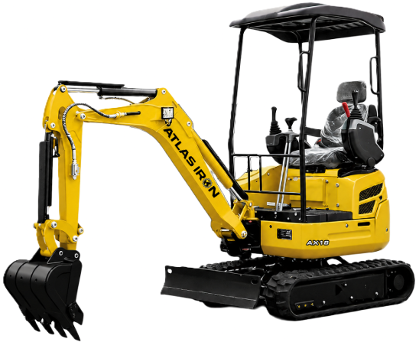


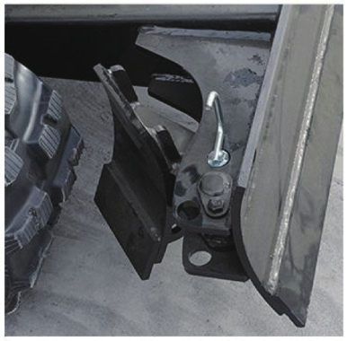
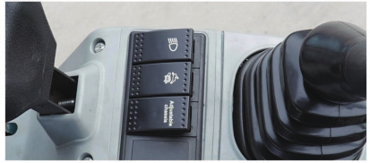
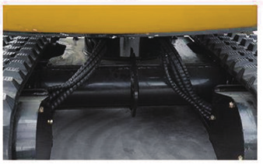
AX18
COMPACT EXCAVATOR
AX18
COMPACT EXCAVATOR
RETRACTABLE TRACKS FOR TIGHT-ACCESS WORK.
3-YEAR / 3,000-HOUR LIMITED WARRANTY
A 3,600 lb mini excavator with adjustable crawler width, 2,800 lbf digging force and dependable Kubota diesel power.
15.8
POWER (HP)
3,600 LB
OPERATING WEIGHT
95 IN
MAX DIGGING DEPTH
2,800 LBF
DIGGING FORCE
PRODUCT HIGHLIGHTS
1
VARIABLE BACKFILL BLADE
Pin-adjustable width matches the crawler stance for efficient grading coverage.
2
CENTRALIZED CONTROLS
Grouped key functions support smooth operation and quick switching.
3
DURABLE TRACK SUPPORT
Standard tensioning equipment improves rubber-track durability.
Notes:
[Sources]
- AX18 Brouchure(1).pdf (user-provided product imagery, product claims, and specifications).
- ATLAS IRON WHITE Hor_PNG 96 DPI.png (user-provided current logo).
- Globe_PNG 96 DPI.png (user-provided current logo).
[/Sources]

Slide 2
TECHNICAL SPECIFICATIONS
AX18
COMPACT EXCAVATOR
3,600 LB
OPERATING WEIGHT
95 IN
MAX DIGGING DEPTH
2,800
DIG FORCE (LBF)
ENGINE
Engine Brand / Model |  | Kubota D722
Maximum Horsepower | hp | 15.8
Maximum Speed | rpm | 2,300
Displacement | gal | 0.24
Number of Cylinders |  | 3
WORKING RANGE
Maximum Digging Depth | in | 95
Maximum Digging Height | in | 130
Maximum Unloading Height | in | 84
Track Extension Range | in | 39-51.2
Bucket Width | in | 15.7
Boom / Stick Length | in | 58 / 31.5
OPERATING SPECIFICATIONS
Bucket Capacity | ft3 | 1.59
Travel Speed Low / High | mph | .93 / 1.74
Gradeability | % | 30
Ground Pressure | psi | 4.4
TRANSPORT DIMENSIONS
Transport Length | in | 91
Transport Width | in | 39
Transport Height | in | 95
DIGGING PERFORMANCE
Maximum Digging Force | lbf | 2,800
Maximum Digging Radius | in | 150
OPERATING WEIGHT
Operating Weight lb 3,600
DETAILS
DIMENSIONS & SUPPORT
Backfill Blade Width | in | 47
Cooling Method |  | Water cooling
Engine Oil Change Amount | gal | 1
Fuel Type |  | Diesel
Fuel Grade |  | 0/-10
Theoretical Fuel Consumption | gph | 0.4-0.48
Travel Hydraulic Motor |  | Built-in LTM02PA
Travel Motor Displacement | in3 | 14.95
HYDRAULIC & DRIVE
Main Pump Type / Model |  | Variable piston / 18
Main Pump Brand |  | Taifeng Hydraulics
Main Pump Maximum Flow | gpm | 10.9
Multi-Way Valve |  | 9-way hydraulic control
Rated / Maximum Pressure | psi | 2,610 / 3,190
Notes:
[Sources]
- AX18 Brouchure(1).pdf (user-provided technical specifications and product-detail imagery).
- ATLAS IRON WHITE Hor_PNG 96 DPI.png (user-provided current logo).
- Globe_PNG 96 DPI.png (user-provided current logo).
[/Sources]

