Slide 1


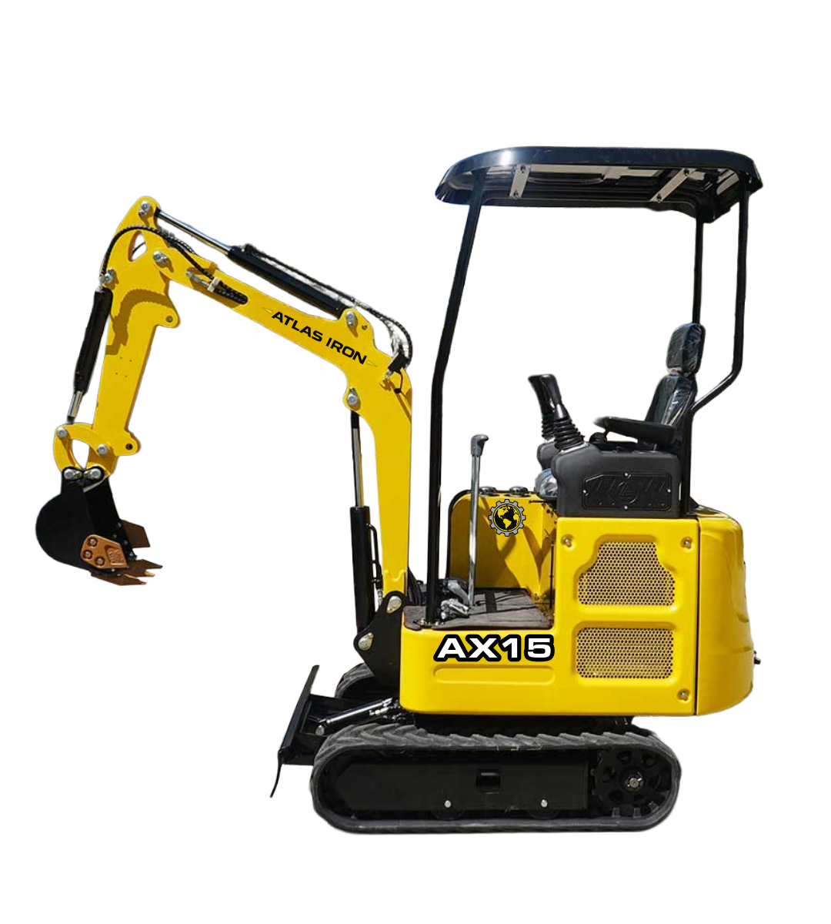
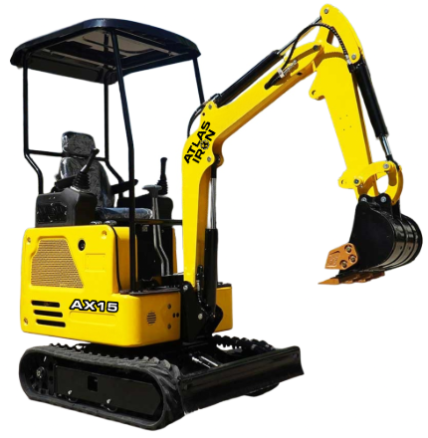


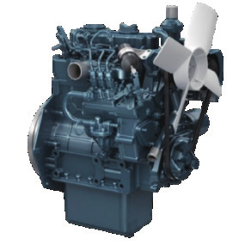
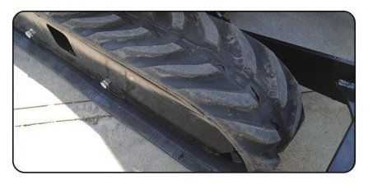
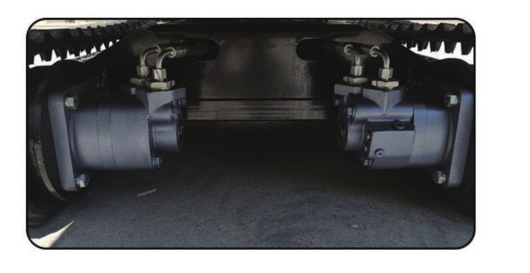
AX15
COMPACT EXCAVATOR
AX15
COMPACT EXCAVATOR
RETRACTABLE TRACKS WITH KUBOTA POWER.
3-YEAR / 3,000-HOUR LIMITED WARRANTY
A 3,000 lb excavator combining pilot control, track-width flexibility and durable undercarriage support.
13.7
POWER (HP)
3,000 LB
OPERATING WEIGHT
70 IN
MAX DIGGING DEPTH
2,338 LBF
DIGGING FORCE
PRODUCT HIGHLIGHTS
1
KUBOTA D722 ENGINE
Efficient, low-vibration diesel power supports dependable daily performance.
2
RETRACTABLE TRACKS
Adjustable track width improves access while supporting a stable working stance.
3
ENHANCED TRACK SUPPORT
Reinforced undercarriage support improves durability across demanding terrain.
Notes:
[Sources]
- AX15 Brouchure.pdf (user-provided product imagery, product claims, and specifications).
- ATLAS IRON WHITE Hor_PNG 96 DPI.png (user-provided current logo).
- Globe_PNG 96 DPI.png (user-provided current logo).
[/Sources]

Slide 2
TECHNICAL SPECIFICATIONS
AX15
COMPACT EXCAVATOR
3,000 LB
OPERATING WEIGHT
70 IN
MAX DIGGING DEPTH
2,338
DIGGING FORCE (LBF)
ENGINE
Engine Brand / Model |  | Kubota D722
Maximum Power | hp | 13.7
Maximum Speed | rpm | 2,500
Displacement | gal | 0.19
Number of Cylinders |  | 3
WORKING RANGE
Maximum Digging Depth | in | 70
Maximum Digging Height | in | 117
Maximum Unloading Height | in | 80
Bucket Width | in | 15.7
Boom Length | in | 58.1
Stick Length | in | 31.5
OPERATING SPECIFICATIONS
Bucket Capacity | ft3 | 1.4
Travel Speed | mph | .93
Gradeability | % | 30
Ground Pressure | psi | 4.6
TRANSPORT DIMENSIONS
Transport Length | in | 91
Transport Width | in | 37
Transport Height | in | 88.3
DIGGING PERFORMANCE
Maximum Digging Force | lbf | 2,338
Maximum Digging Radius | in | 127
OPERATING WEIGHT
Operating Weight lb 3,000
DETAILS
DIMENSIONS & SUPPORT
Backfill Blade Width | in | 41
Cooling Method |  | Water cooled
Engine Oil Change Amount | gal | 0.9
Fuel Type |  | Diesel
Fuel Grade |  | 0/-10
Theoretical Fuel Consumption | L/h | 1.1-1.5
Travel Hydraulic Motor |  | BM6-315
Travel Motor Displacement | in3 | 19.2
HYDRAULIC & DRIVE
Main Pump Type / Model |  | Gear Pump / 310
Main Pump Brand |  | TianJin Walking
Main Pump Maximum Flow | gpm | 6
Multi-Way Valve |  | 8-way pilot valve
Rated / Maximum Pressure | psi | 2,611 / 2,900
Notes:
[Sources]
- AX15 Brouchure.pdf (user-provided technical specifications and product-detail imagery).
- ATLAS IRON WHITE Hor_PNG 96 DPI.png (user-provided current logo).
- Globe_PNG 96 DPI.png (user-provided current logo).
[/Sources]

