Slide 1


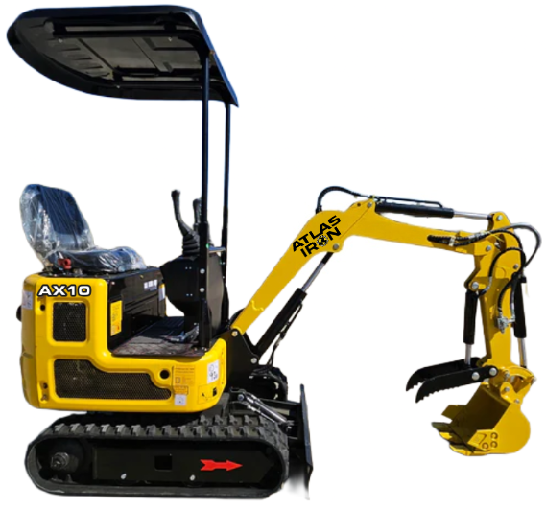
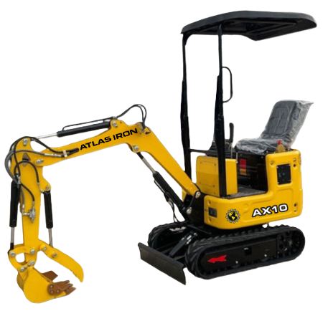


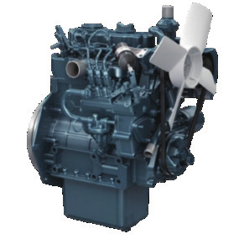
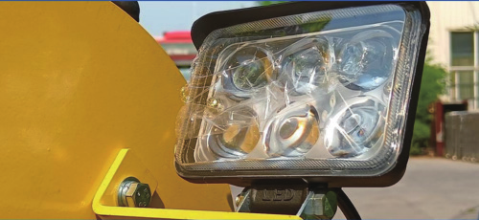
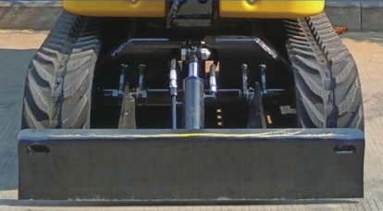
AX10
COMPACT EXCAVATOR
AX10
COMPACT EXCAVATOR
ULTRA-COMPACT POWER FOR TIGHT-ACCESS JOBSITES.
3-YEAR / 3,000-HOUR LIMITED WARRANTY
A 2,200 lb compact excavator designed for tight access, precise grading and dependable daily operation.
11 HP
RATED POWER
2,200 LB
OPERATING WEIGHT
72 IN
MAX DIGGING DEPTH
2,068 LBF
DIGGING FORCE
PRODUCT HIGHLIGHTS
1
KUBOTA D722 ENGINE
Three-cylinder, water-cooled diesel power with low noise and efficient operation.
2
LED WORK LIGHTS
High-intensity lighting improves visibility, safety and productivity in low-light work.
3
BACKFILL BLADE
Hydraulic control adds stability and precision for grading, leveling and backfilling.
Notes:
[Sources]
- AX10 Brouchure.pdf (user-provided product imagery, product claims, and specifications).
- ATLAS IRON WHITE Hor_PNG 96 DPI.png (user-provided current logo).
- Globe_PNG 96 DPI.png (user-provided current logo).
[/Sources]

Slide 2
TECHNICAL SPECIFICATIONS
AX10
COMPACT EXCAVATOR
2,200 LB
OPERATING WEIGHT
72 IN
MAX DIGGING DEPTH
2,068
DIGGING FORCE (LBF)
ENGINE
Engine Brand / Model |  | Kubota D722
Maximum Power | hp | 11
Maximum Speed | rpm | 2,500
Displacement | gal | 0.19
Number of Cylinders |  | 3
WORKING RANGE
Maximum Digging Depth | in | 72
Maximum Digging Height | in | 118
Maximum Unloading Height | in | 88
Bucket Width | in | 11.8
Boom Length | in | 58.1
Stick Length | in | 31.5
OPERATING SPECIFICATIONS
Bucket Capacity | ft3 | 0.49
Travel Speed | mph | .93
Gradeability | % | 30
Ground Pressure | psi | 3.7
TRANSPORT DIMENSIONS
Transport Length | in | 95
Transport Width | in | 35
Transport Height | in | 86
DIGGING PERFORMANCE
Maximum Digging Force | lbf | 2,068
Maximum Digging Radius | in | 127
OPERATING WEIGHT
Operating Weight lb 2,200
DETAILS
DIMENSIONS & SUPPORT
Backfill Blade Width | in | 35
Cooling Method |  | Water cooled
Engine Oil Change Amount | gal | 0.9
Fuel Type |  | Diesel
Fuel Grade |  | 0/-10
Theoretical Fuel Consumption | L/h | 1.1-1.5
Travel Hydraulic Motor |  | WDM-300
Travel Motor Displacement | in3 | 19.2
HYDRAULIC & DRIVE
Main Pump Type / Model |  | Gear Pump / 306
Main Pump Brand |  | TianJin Walking
Main Pump Maximum Flow | gpm | 4.76
Multi-Way Valve |  | 2+2+5 multi-way valve
Rated / Maximum Pressure | psi | 2,466 / 2,611
Notes:
[Sources]
- AX10 Brouchure.pdf (user-provided technical specifications and product-detail imagery).
- ATLAS IRON WHITE Hor_PNG 96 DPI.png (user-provided current logo).
- Globe_PNG 96 DPI.png (user-provided current logo).
[/Sources]

