Slide 1
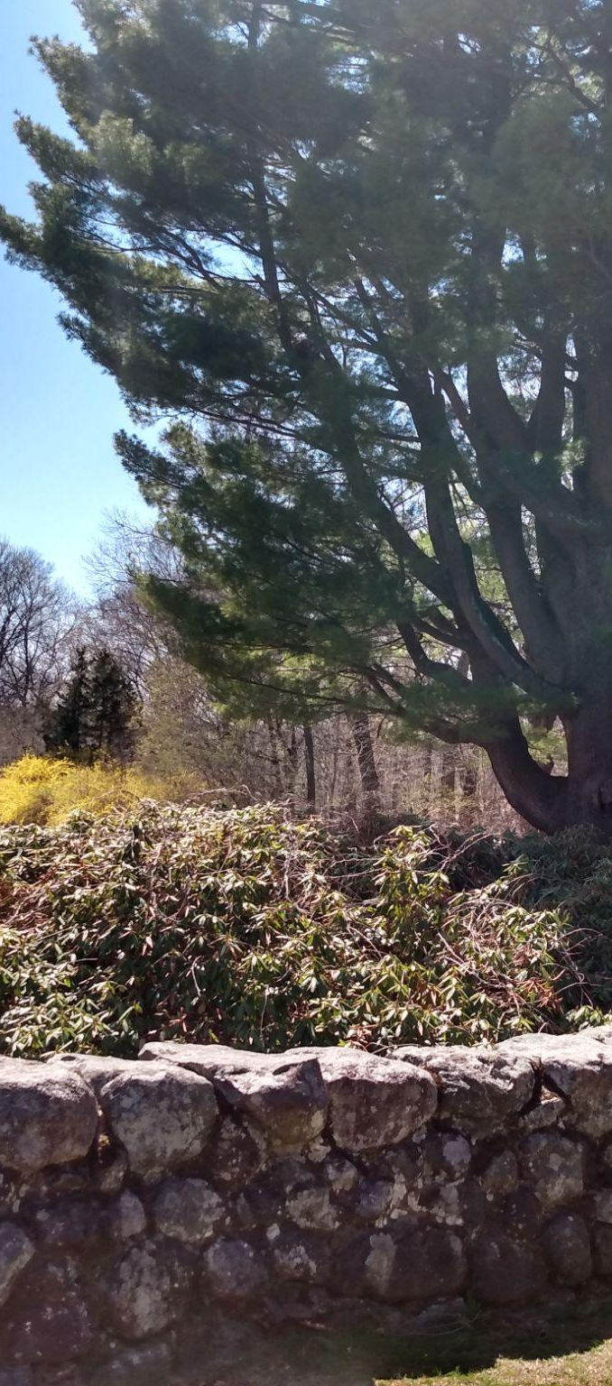
Building Climate Resilience via Collective Memory:
An Oral History of Flooding in Waltham, MA
Waltham Land Trust Annual Meeting
November 18, 2025
Photo Source: Waltham Land Trust
Notes:
Sara

Slide 2
Contents
Introduction
Emergent Themes
Project Motivations
Website
Study Methods
Q&A/Feedback
01
04
02
05
03
06
Notes:
Sara

Slide 3
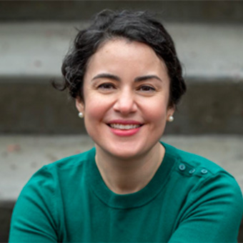
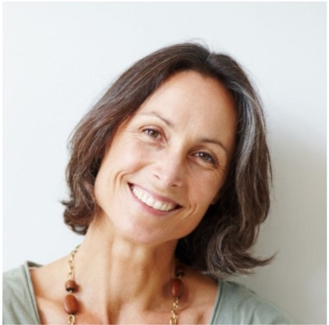
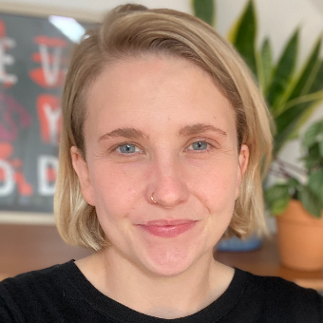
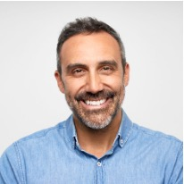
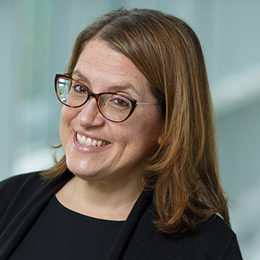


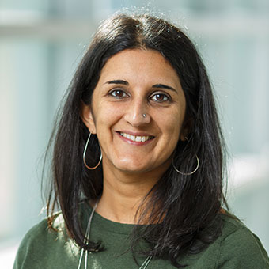
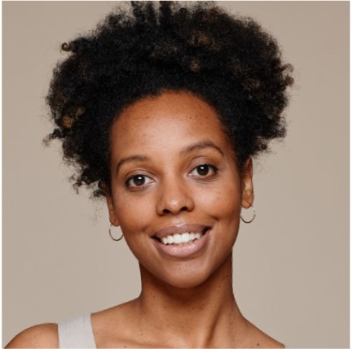
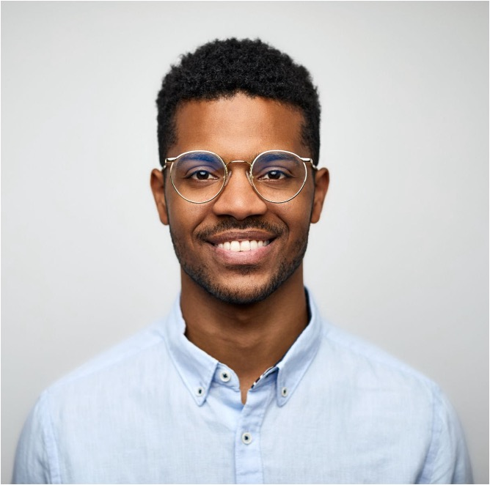
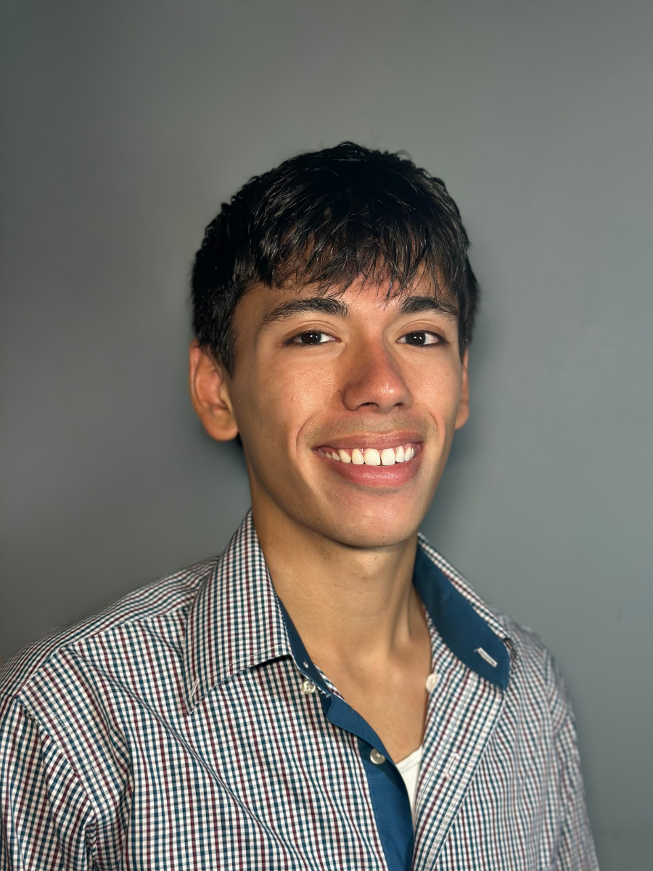
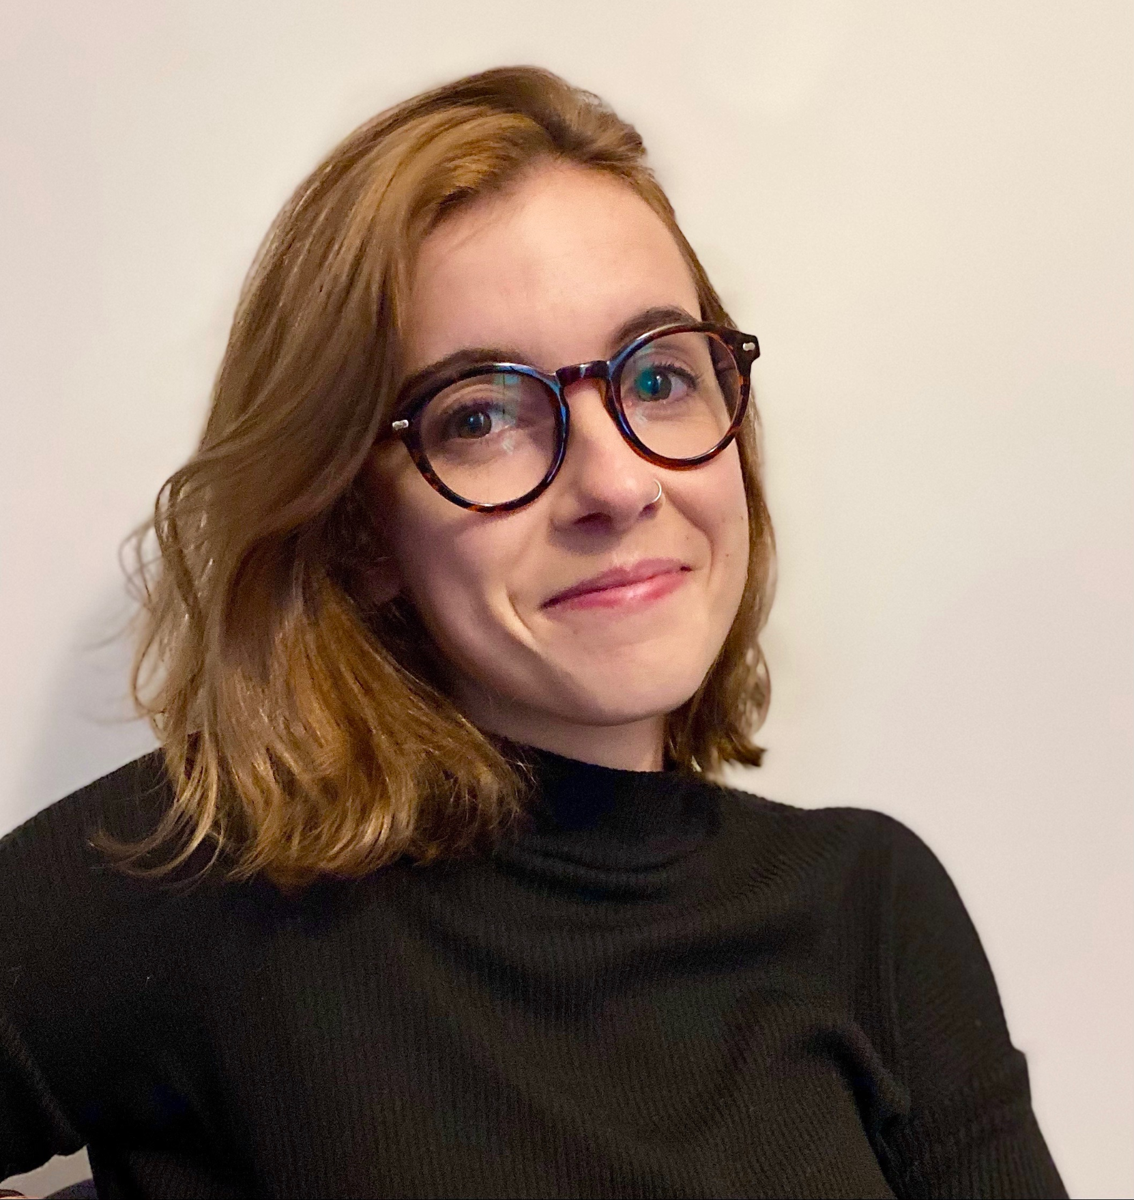
Meet the team
Sarah Mayorga
Rachel McKane
Professor of Sociology
Assistant Professor of Sociology
Sara Shostak
Ulka Anjaria
Professor of Sociology and Health Science and Social Policy
Director of Mandel Center for Humanities
Danielle Jacques
Justin Koizumi
Graduate Research Assistant
Undergraduate Research Assistant
Notes:
All Team

Slide 4
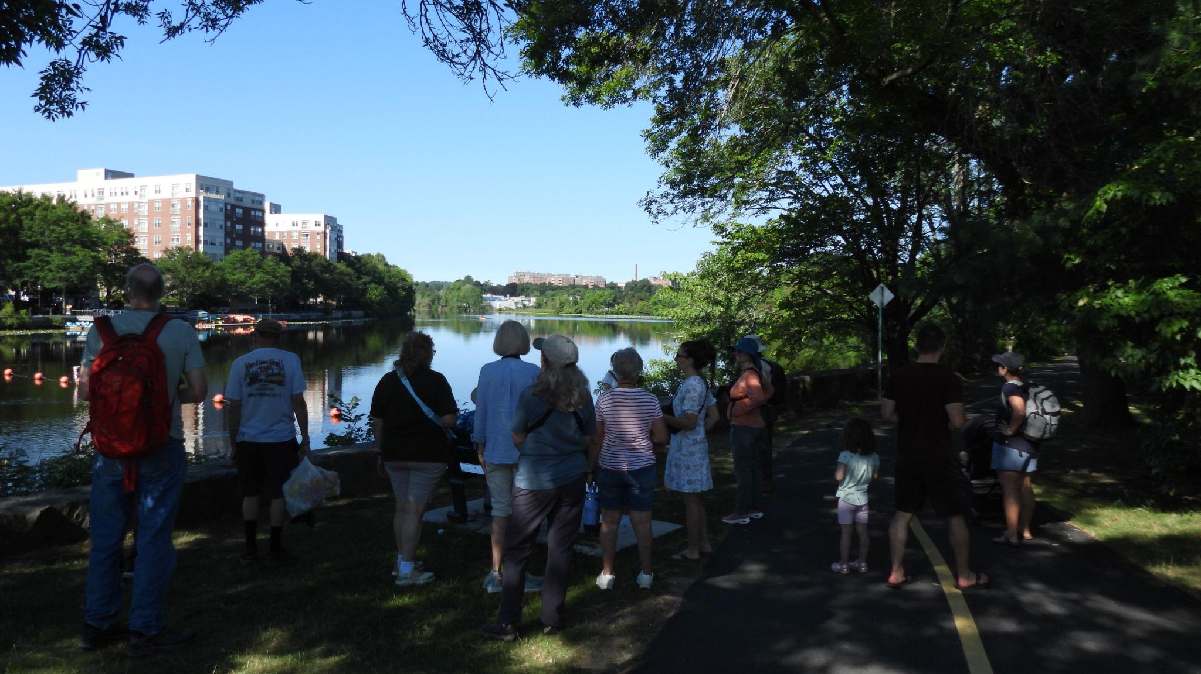
The overarching goal of this project is to contribute to a more resilient, just, and equitable future for all residents of Waltham.
Photo source: Waltham Land Trust (Summer Morning Bird Walk)
Notes:
Sarah

Slide 5
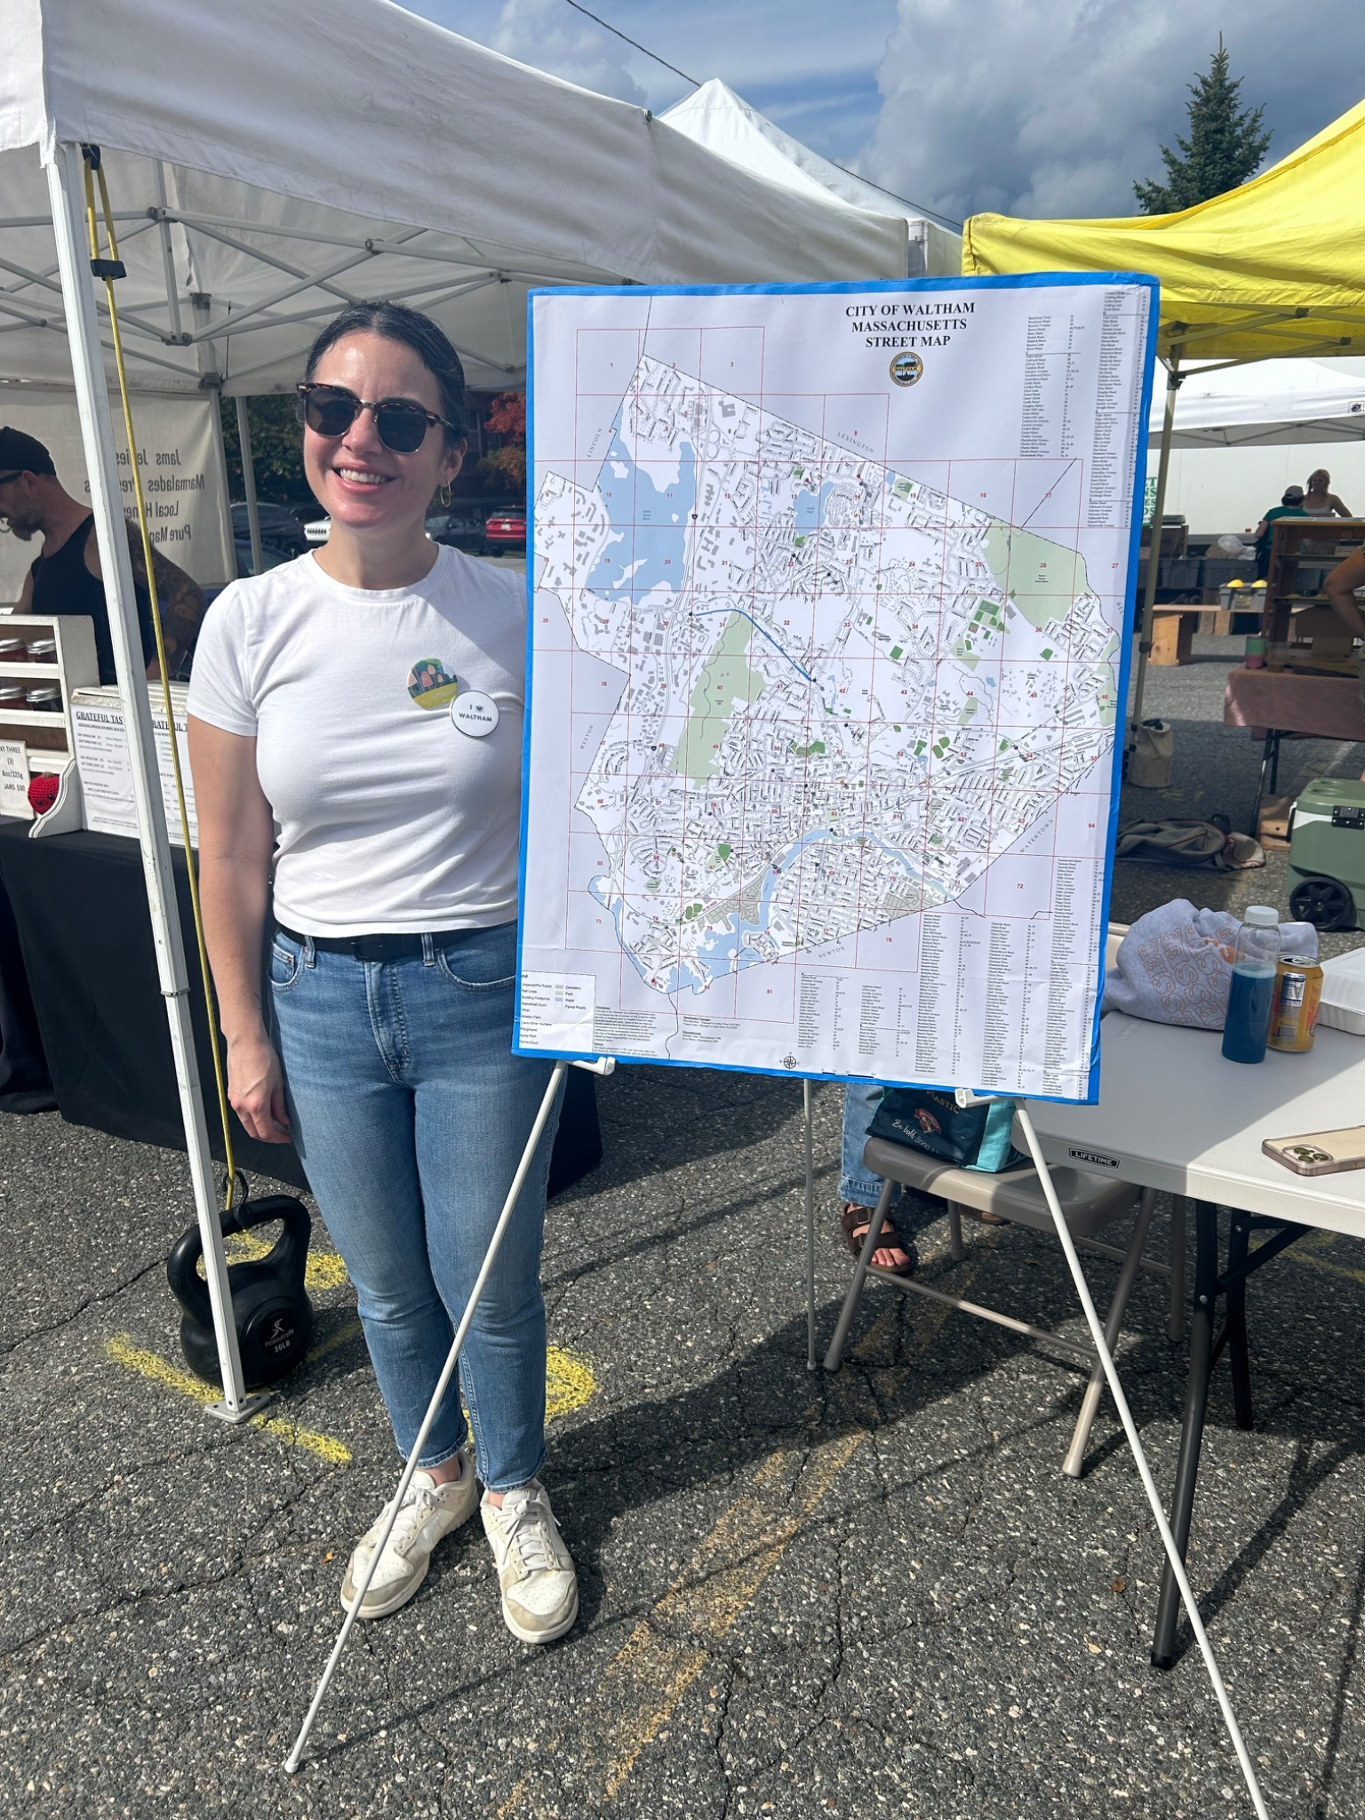
Research Methods
Oral history interviews
  (n=28, and still recruiting! )
Participatory mapping
Photo and video archive
Notes:
Sara

Slide 6
Emergent Themes
01
02
04
05
Flood Stories
Development
03
Infrastructure
Environmental Activism
Mitigation Efforts
Notes:
Danielle

Slide 7
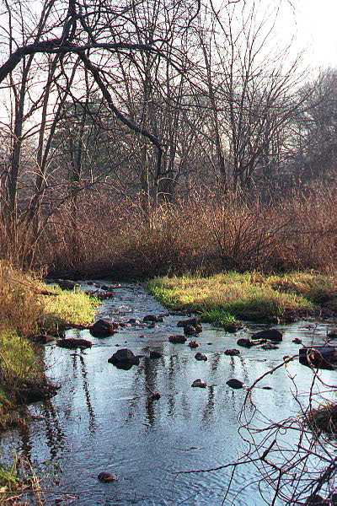
Flood Stories
Marie: When we were in kindergarten… there was such a torrent coming down Trapelo Road that the police actually had to carry the smallest children across the street so that we wouldn't get sort of carried away in the torrent.
Bonnie: We would stand in the kitchen window of the office and look outside at the beaver swimming in the parking lot.
Beaver Brook Reservation
Source: Waltham-Community.com

Slide 8
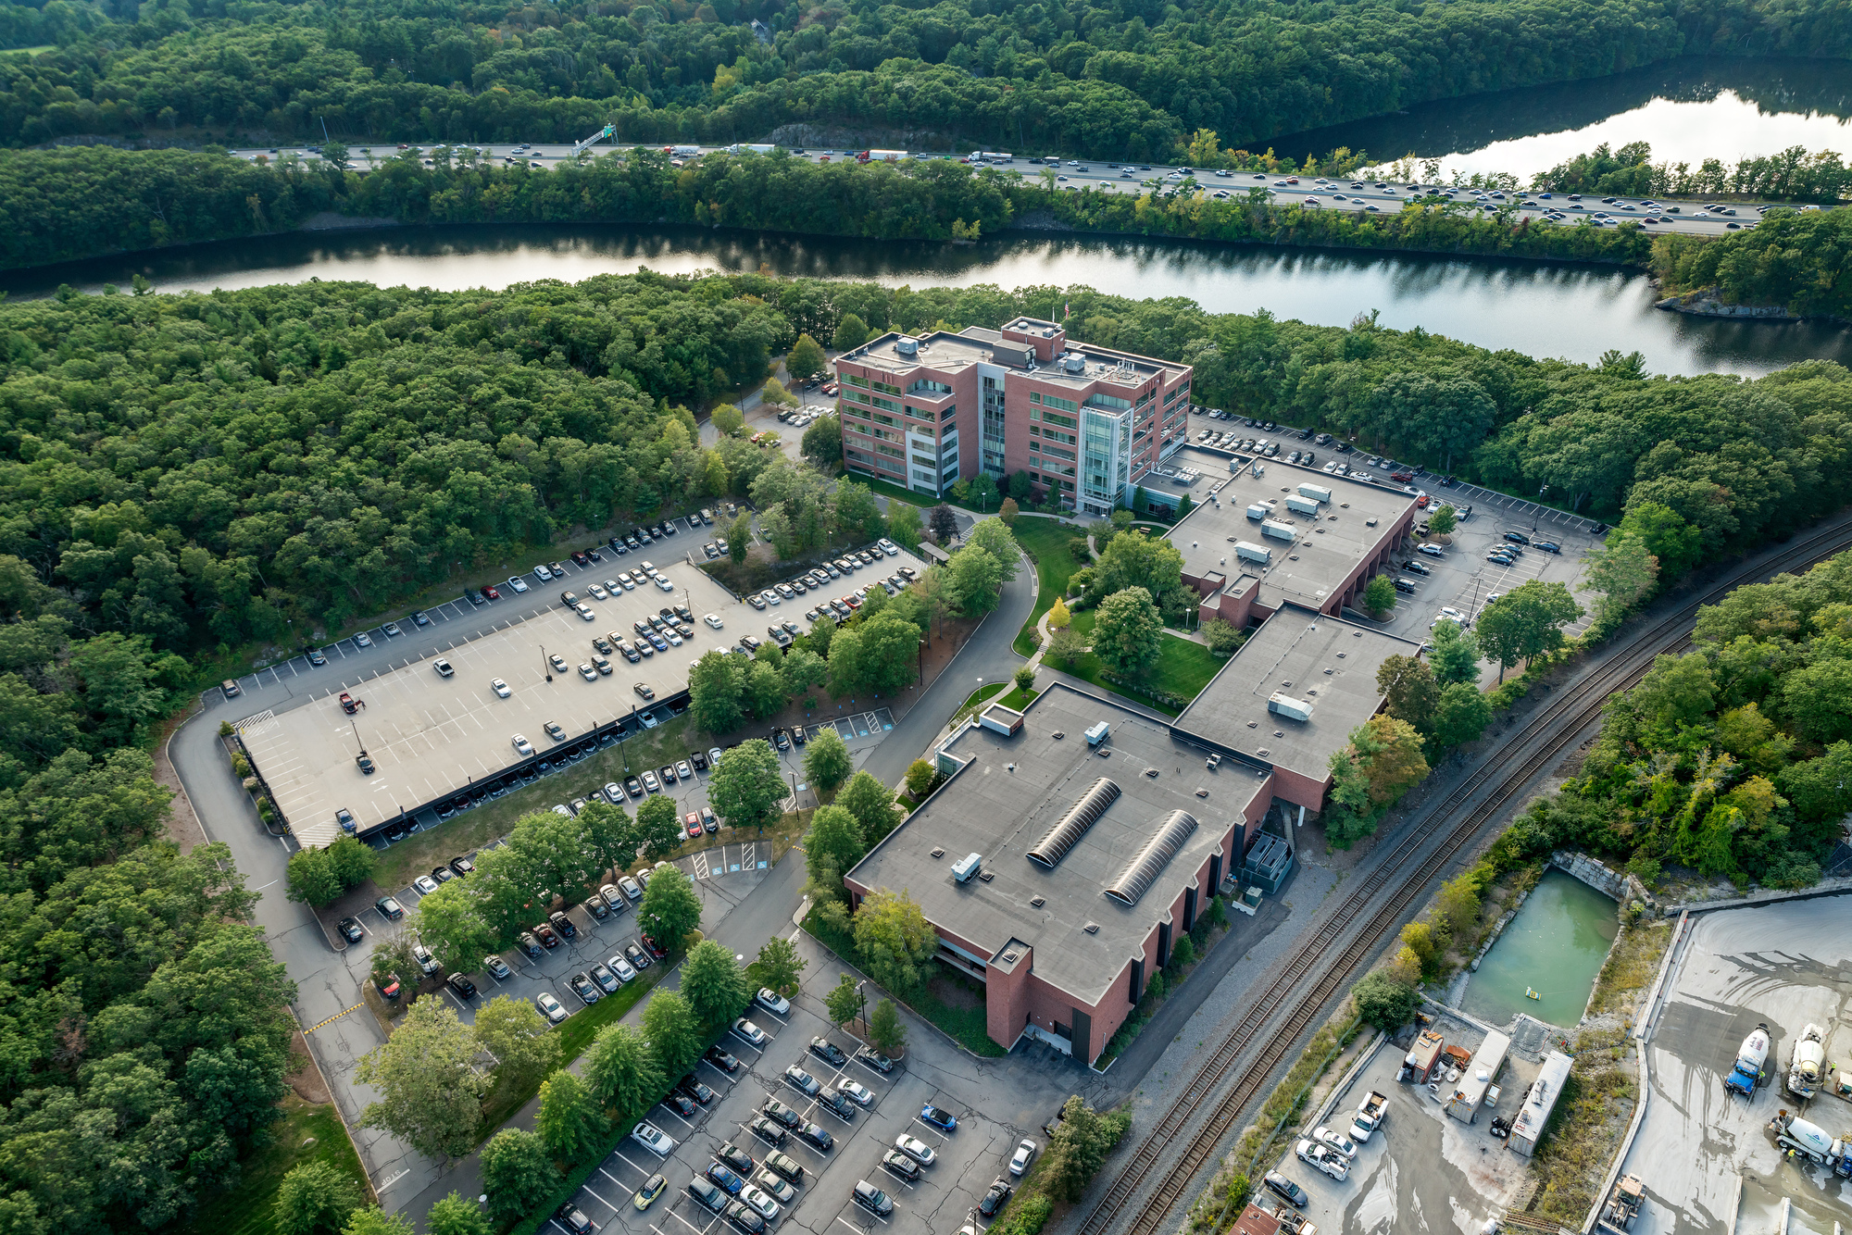
Development
Bill: Well, certainly the Industrial Revolution was a big part in Waltham because of the Charles River and the Falls, and a lot of the industries were based right along the river at some point… Of course, it took a while to clean it up because they had a lot of chemicals there.
Mike: When you build on wetland areas, you're going to kind of get what you get. There's no arguing with Mother Nature about that.
Stony Brook Office Park
Source: NMRK.com

Slide 9
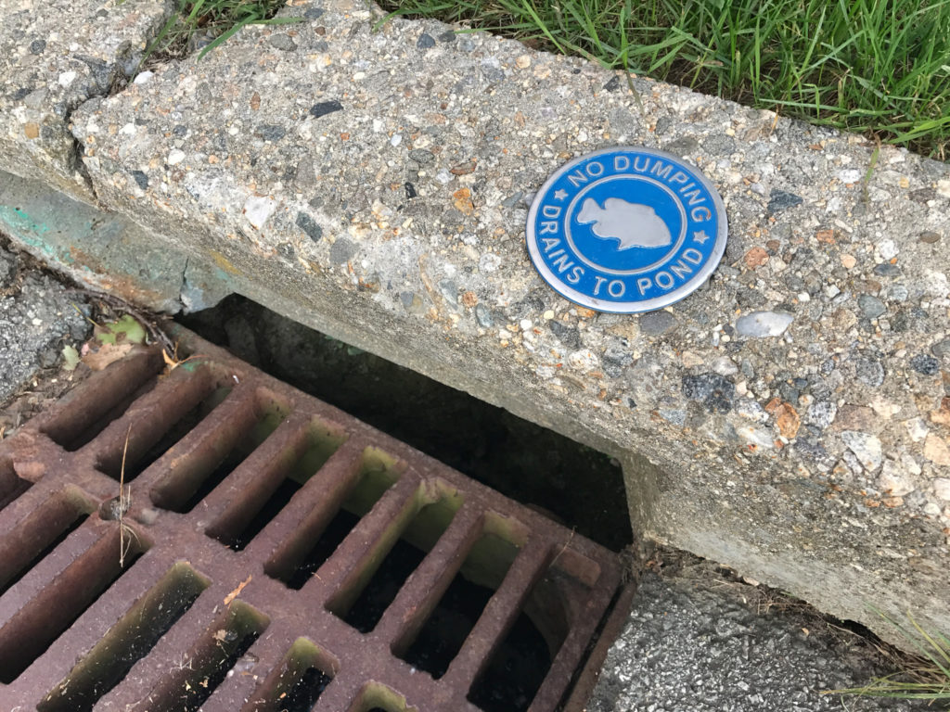
Infrastructure
Charlene: It's been going on for, I want to say the whole 20 years. I don't know if those sewer drains have ever been fully maintenanced. They'll clear the top of it, but I don't know if they're actually properly maintaining them enough to keep it from flooding.
Drain near Hardy Pond
Source: WalthamLandTrust.org

Slide 10
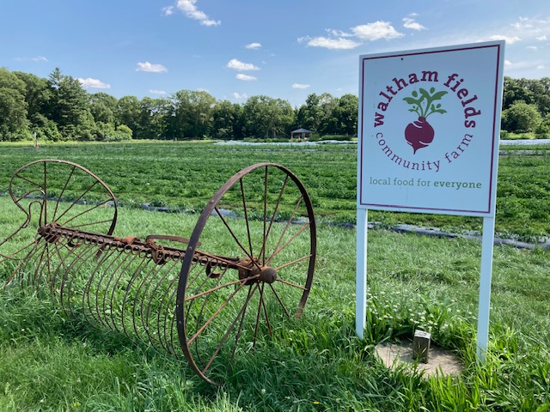
Flood Mitigation
Mike: We've got grading issues where we could bring in the use of swales and rain gardens and just ways of protecting the water so it just doesn't flood. And we've, so that's what we're talking about, that continued stewardship.
Kam: It requires a lot of planning. Planning in a way that then can anticipate and be ready for it, but also can mitigate some of that through other ways.
Waltham Fields Community Farm
Source: WalthamTimes.org

Slide 11
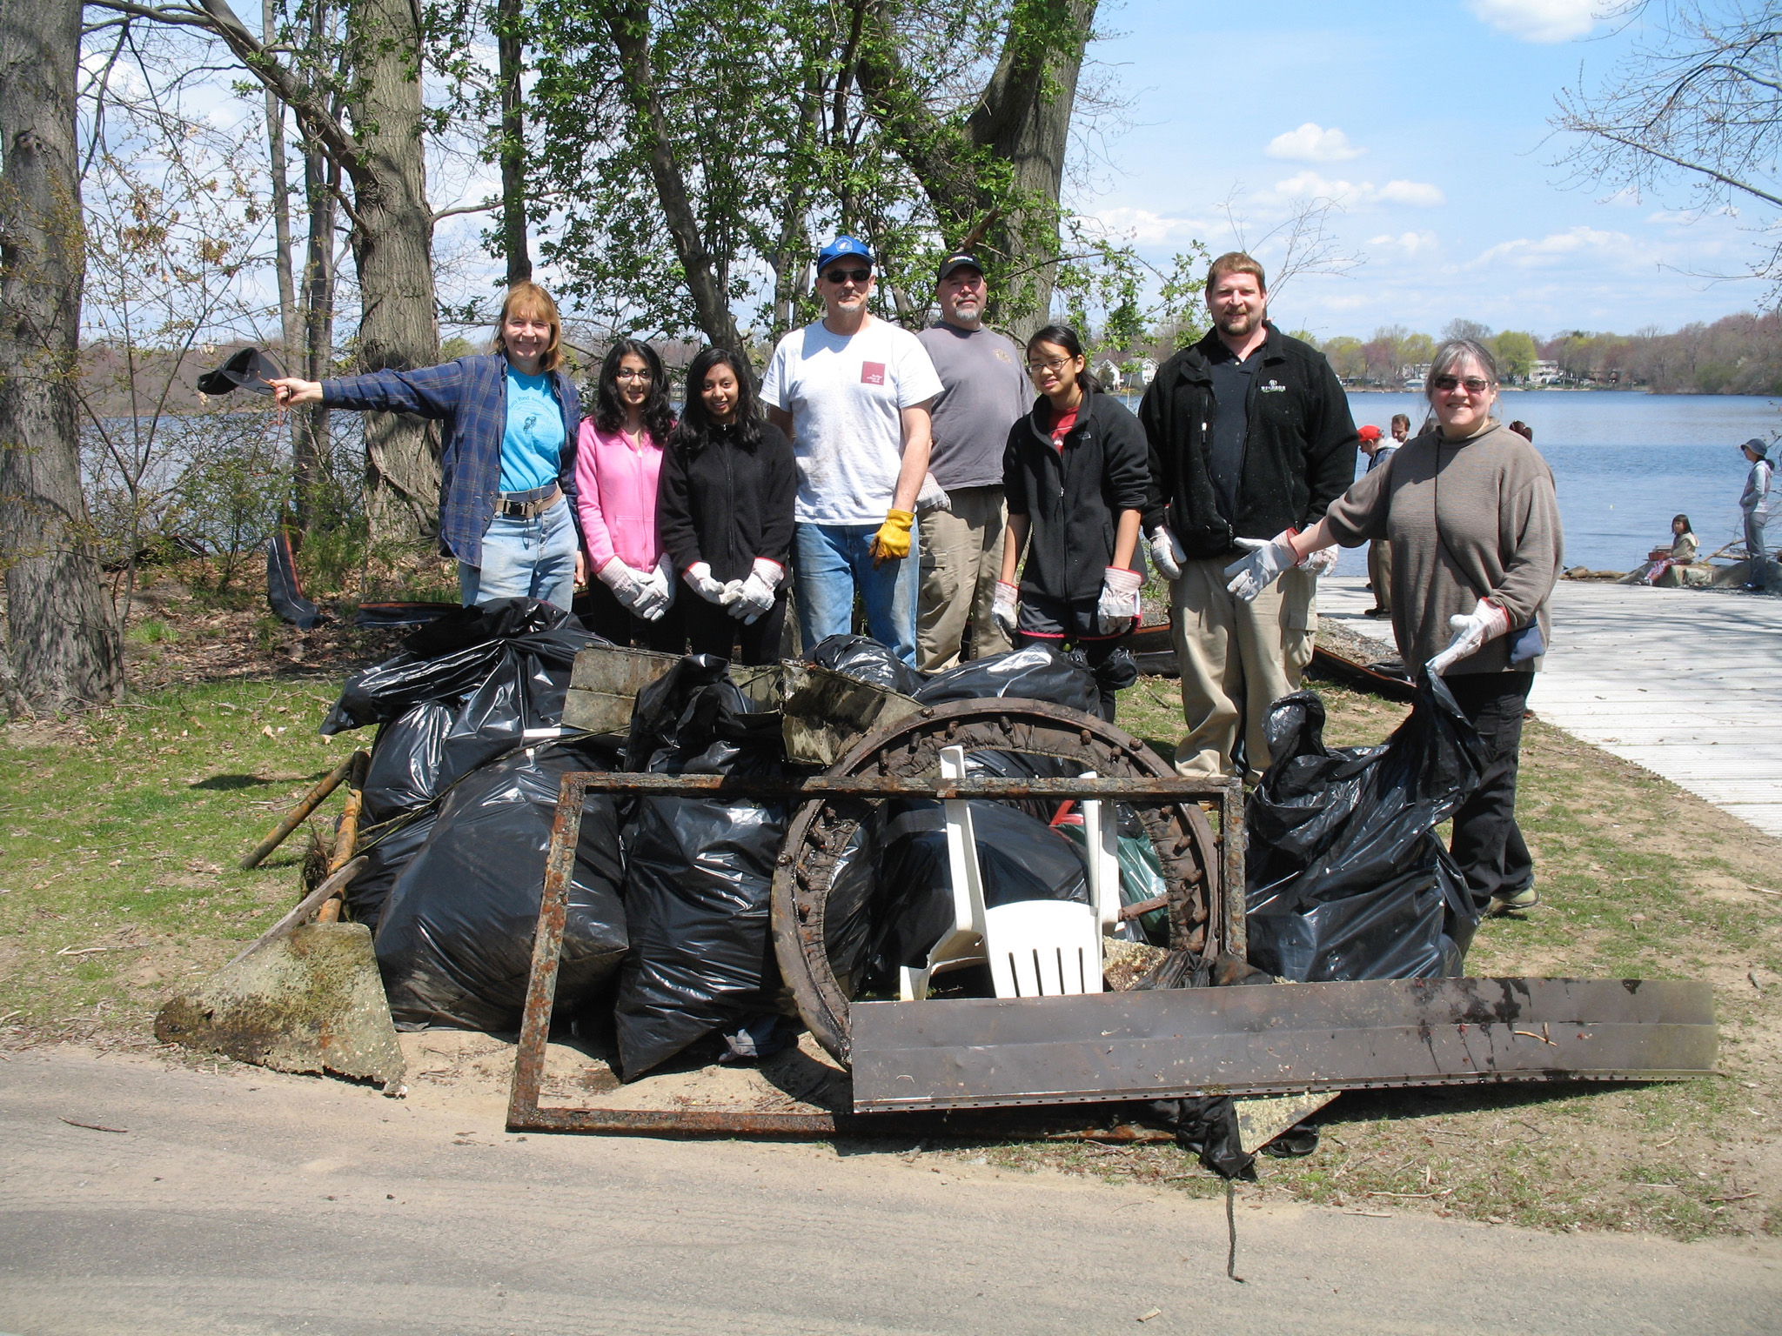
Environmental Activism
Marie: When we walk around the open space there, they say, “you're so lucky to live near such great conservation land.” And I said, “Well, luck had nothing to do with it. We fought tooth a nail to save that land.”
Marc: The Land Trust added a level of clout, partly because the founders were involved in a variety of successful parts of the city, including city employees like the recycling director. The Hardy Pond Association got its clout from our success at driving the dredging project forward… just out of the strength of people's’ will to get it done.
Stewardship at Hardy Pond
Source: WalthamLandTrust.org

Slide 12
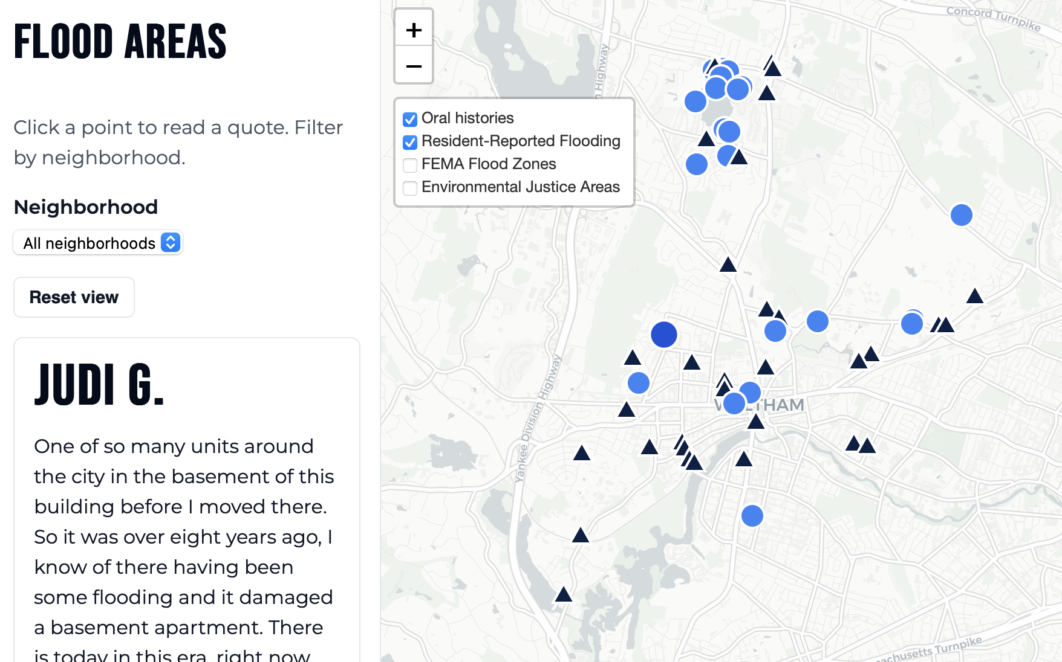
Public Archive and Mapping Project
Maps residents’ flood stories and lived experiences across Waltham
Uses local knowledge with narrative context to supplement official flood data
Notes:
Rachel

Slide 13
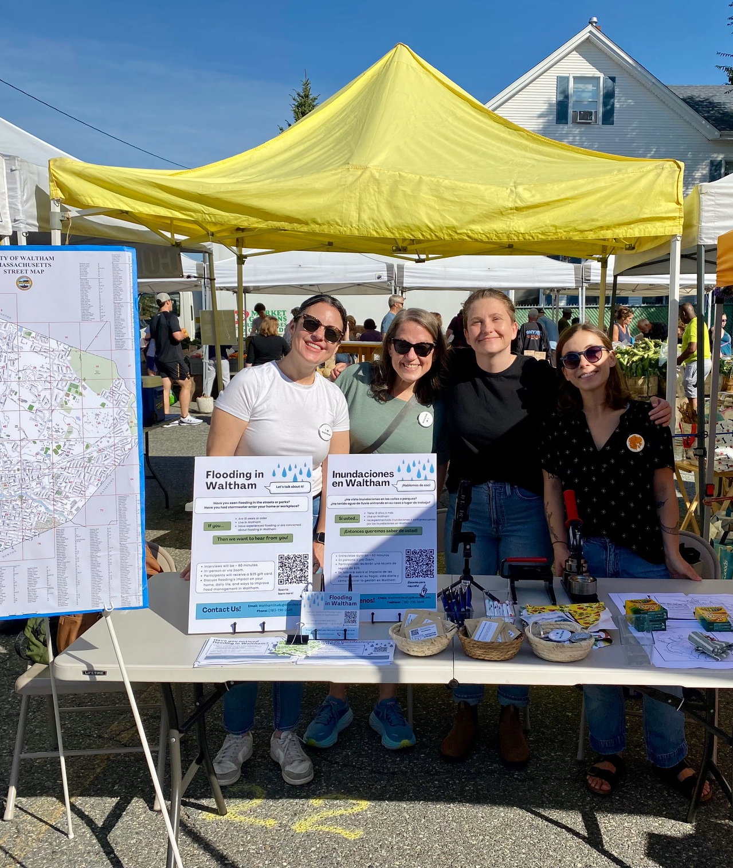

Thank you!
Contact us via email at: walthamstudy@brandeis.edu
Notes:
Rachel

