Slide 1
WALTHAM LAND TRUST
2025 Annual Meeting
Our 26th Anniversary
November 18, 2025

Slide 2
Welcome!
Dr. Nadene Stein, President of the Board

Slide 3
Annual Meeting Agenda
Welcome & Opening Comments Dr. Nadene Stein
Highlights of the Past Year Sonja Wadman
Inge Uhlir Environmentalist of the Year Sonja Wadman
“Building Climate Resilience via Collective Memory” Waltham Climate Study Team, Brandeis University
Mass Central Rail Trail Update Sonja Wadman
Financial Status of the WLT Marc Rudnick
Business Meeting: Vote on Returning and New Directors Nadene Stein
Q&A Various members
Conversations and ice cream

Slide 4
2025 Highlights
Sonja Wadman, Executive Director

Slide 5

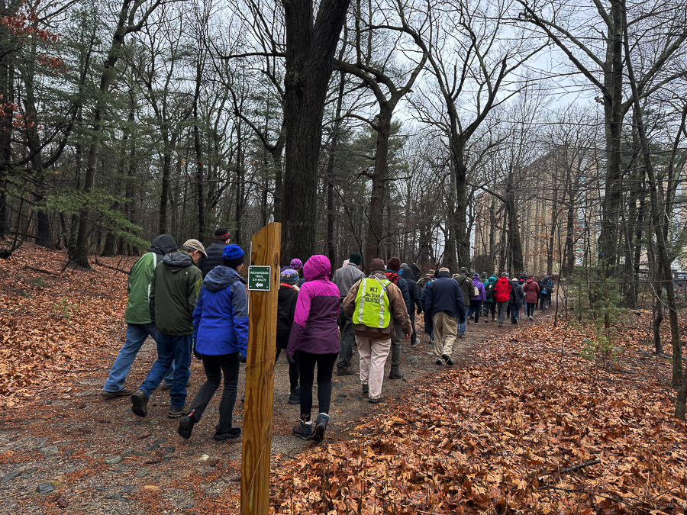

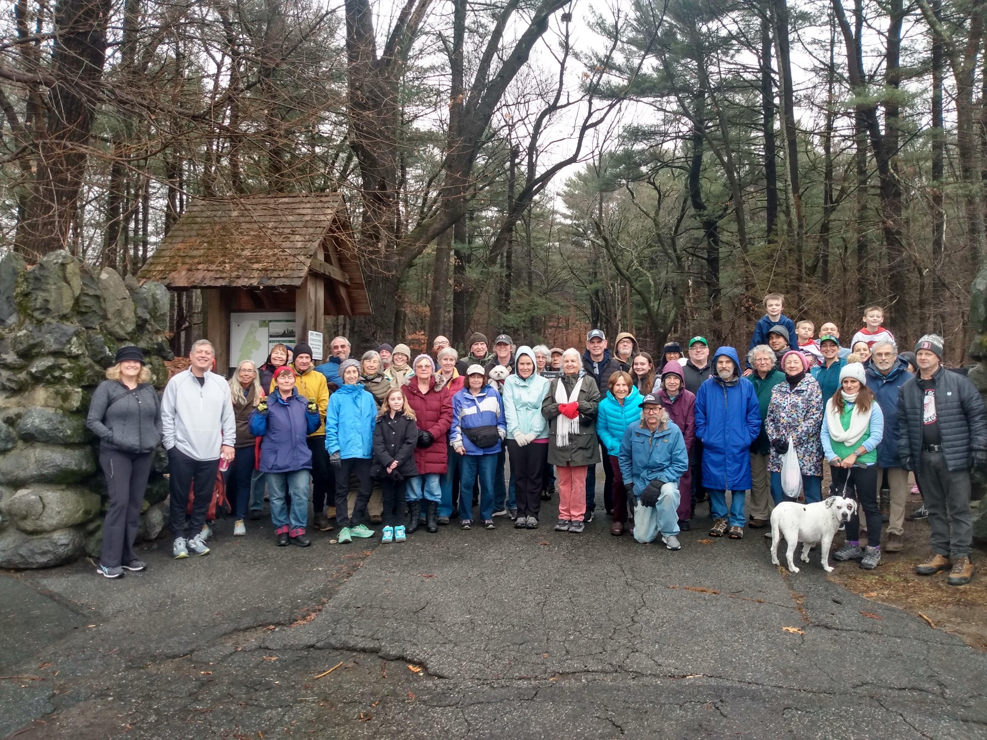



New Year’s Day Hikes at Prospect Hill Park

Slide 6
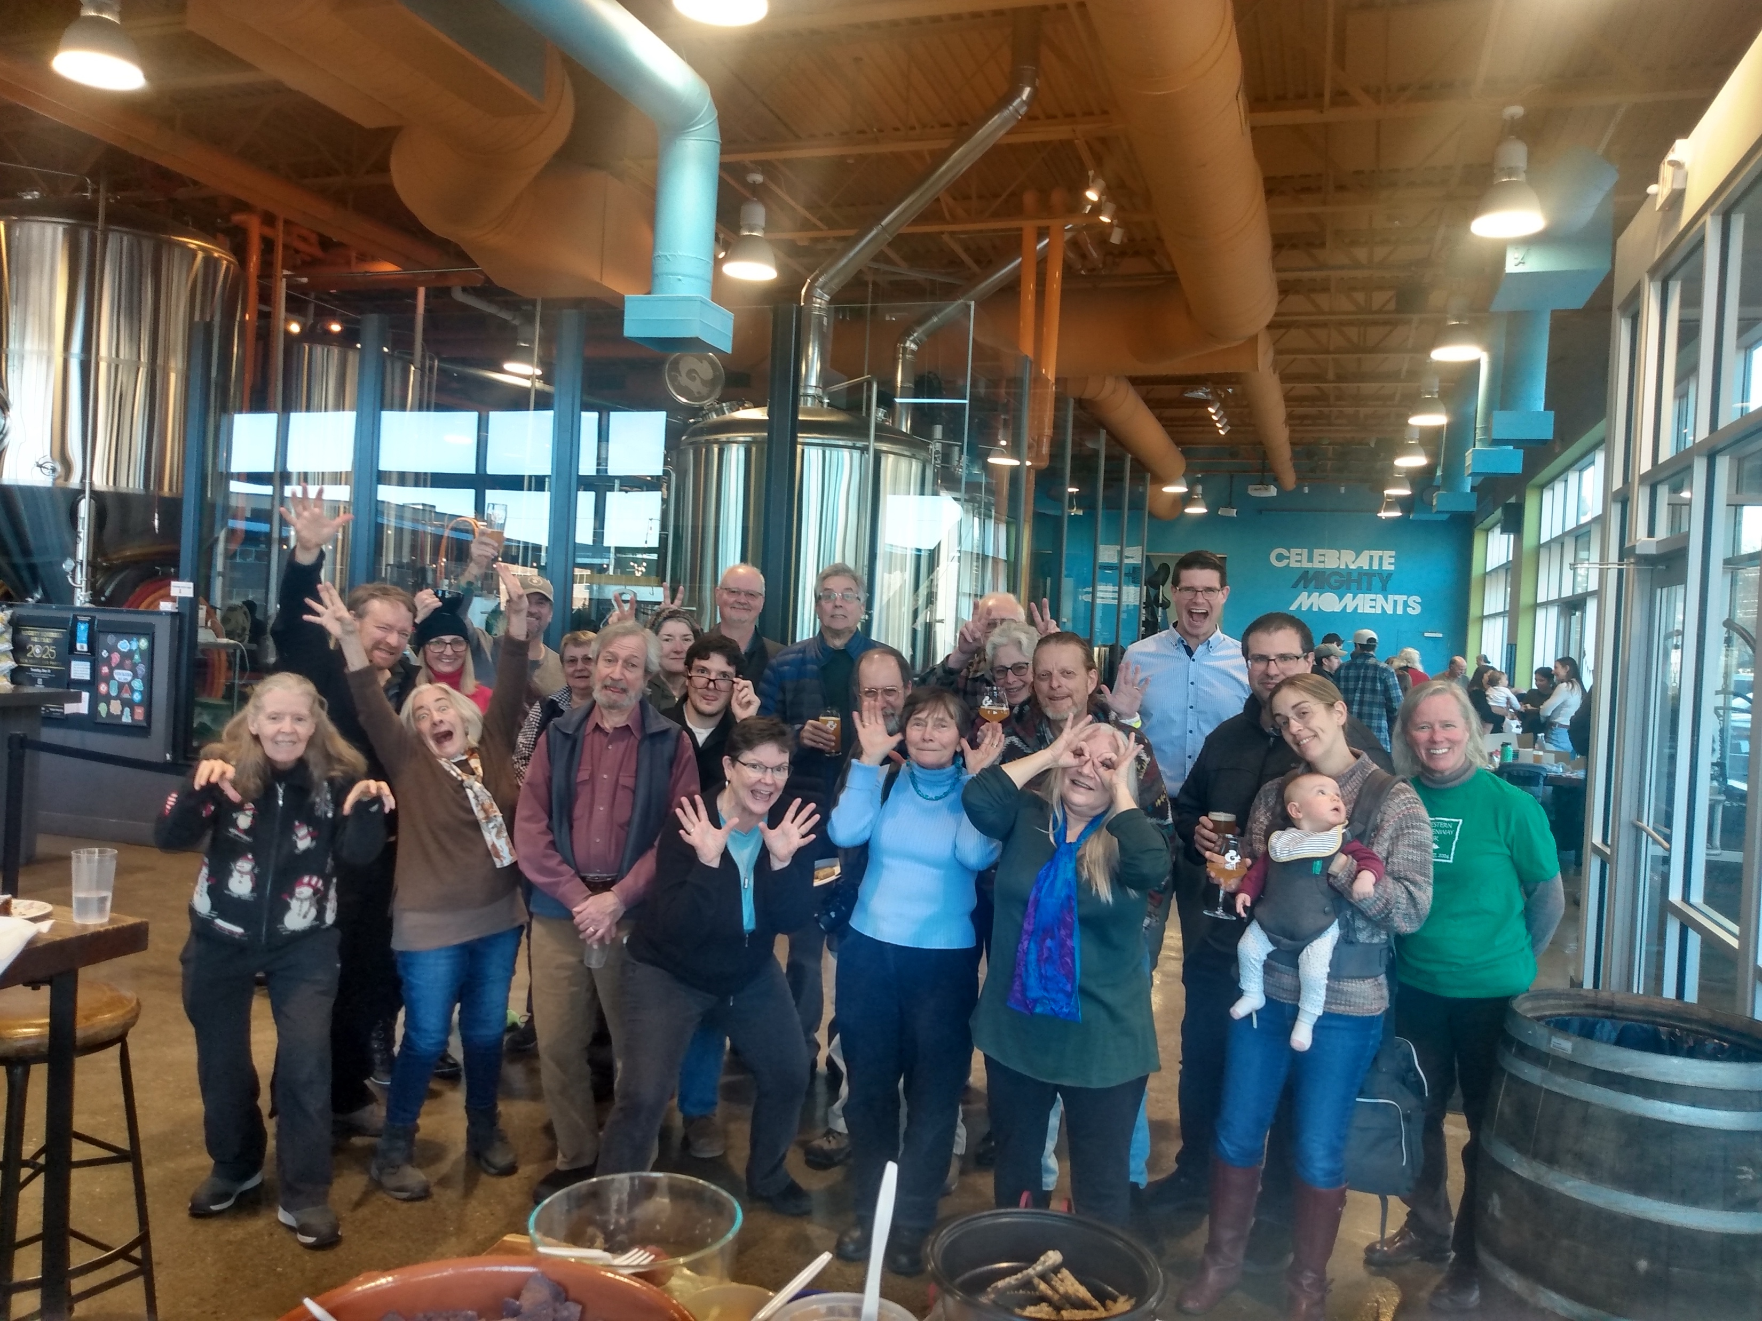
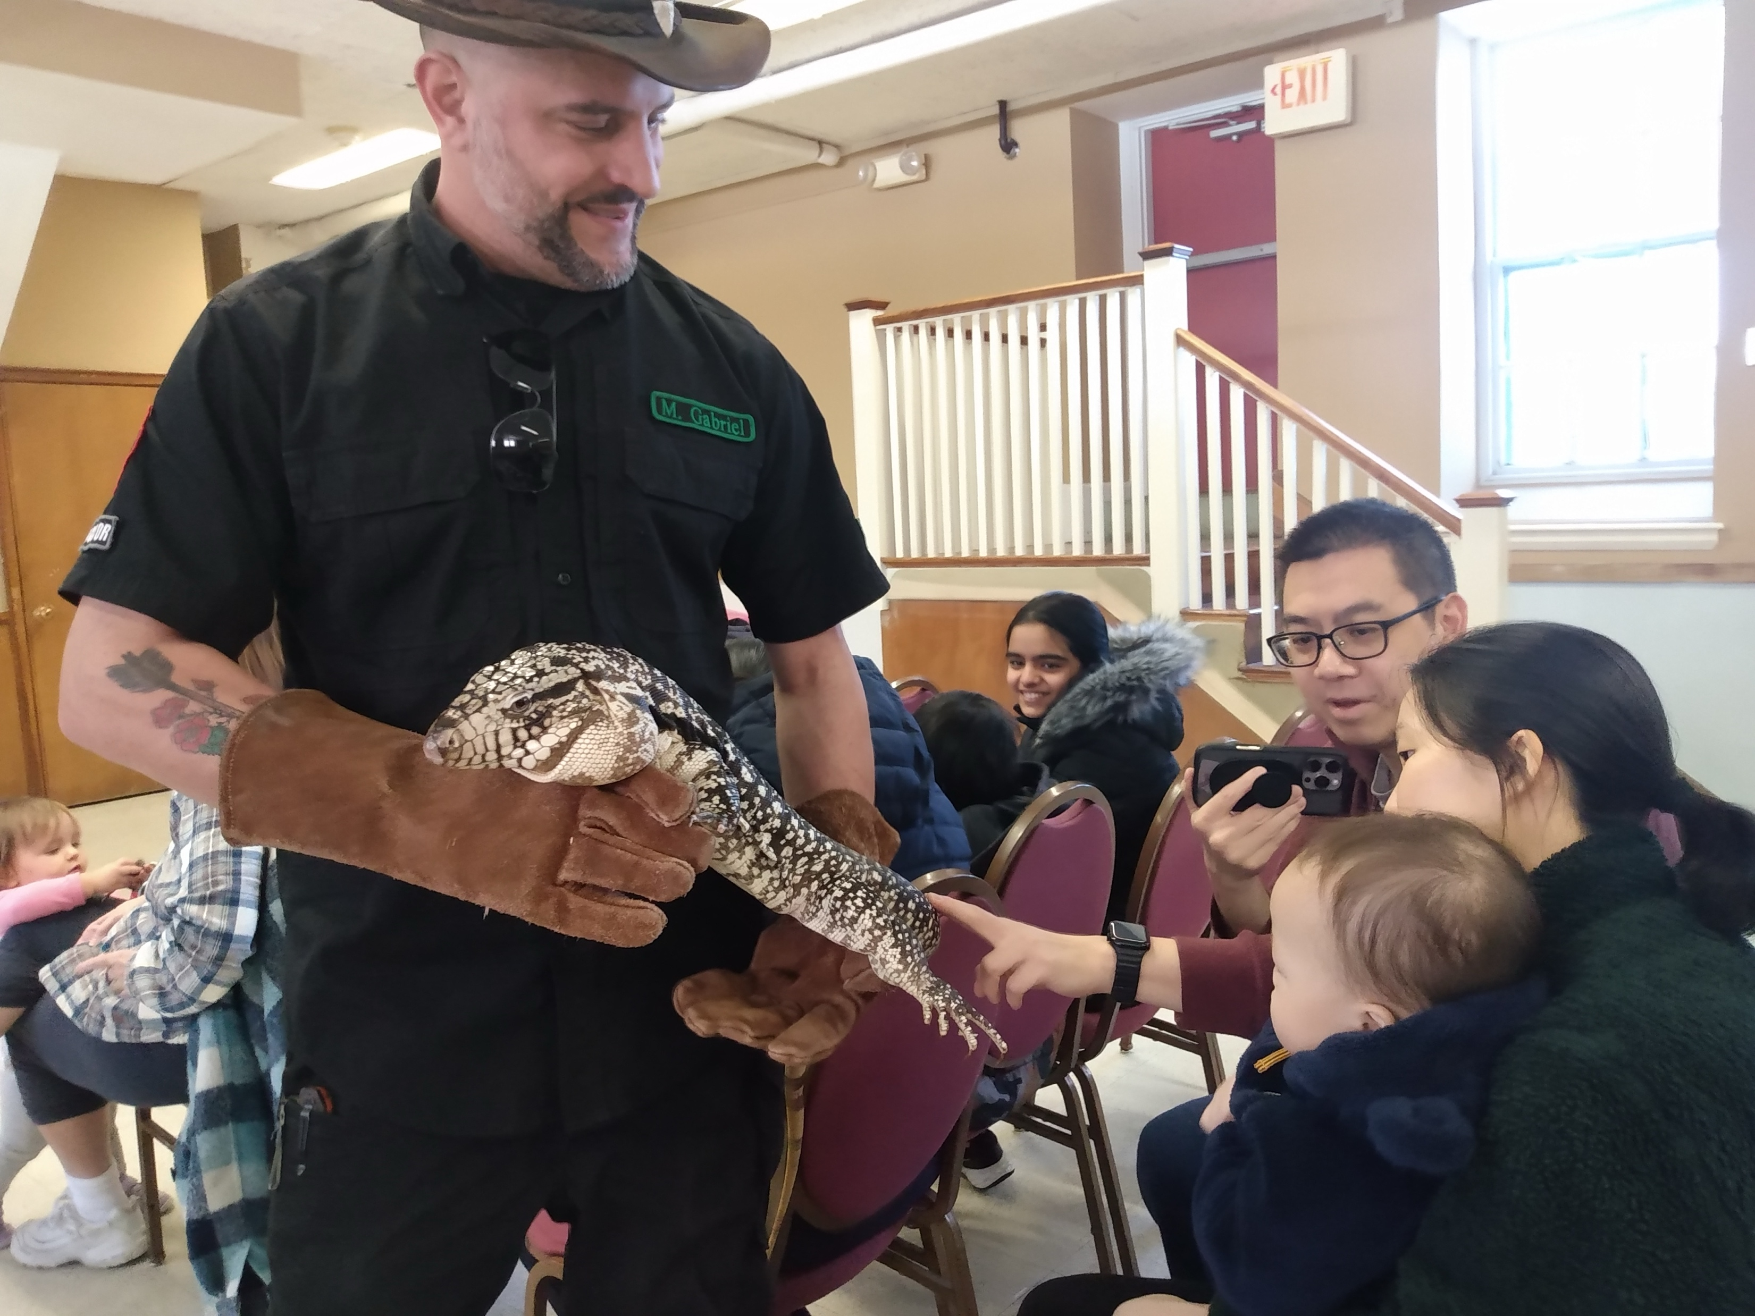
Stewards’ Appreciation Party at Mighty Squirrel in January Kids’ Animals program in February

Slide 7
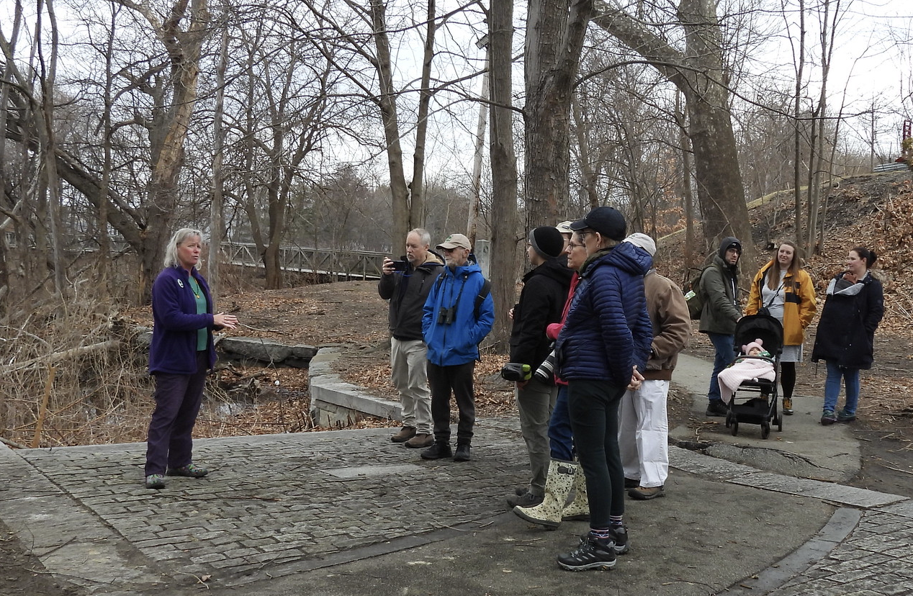
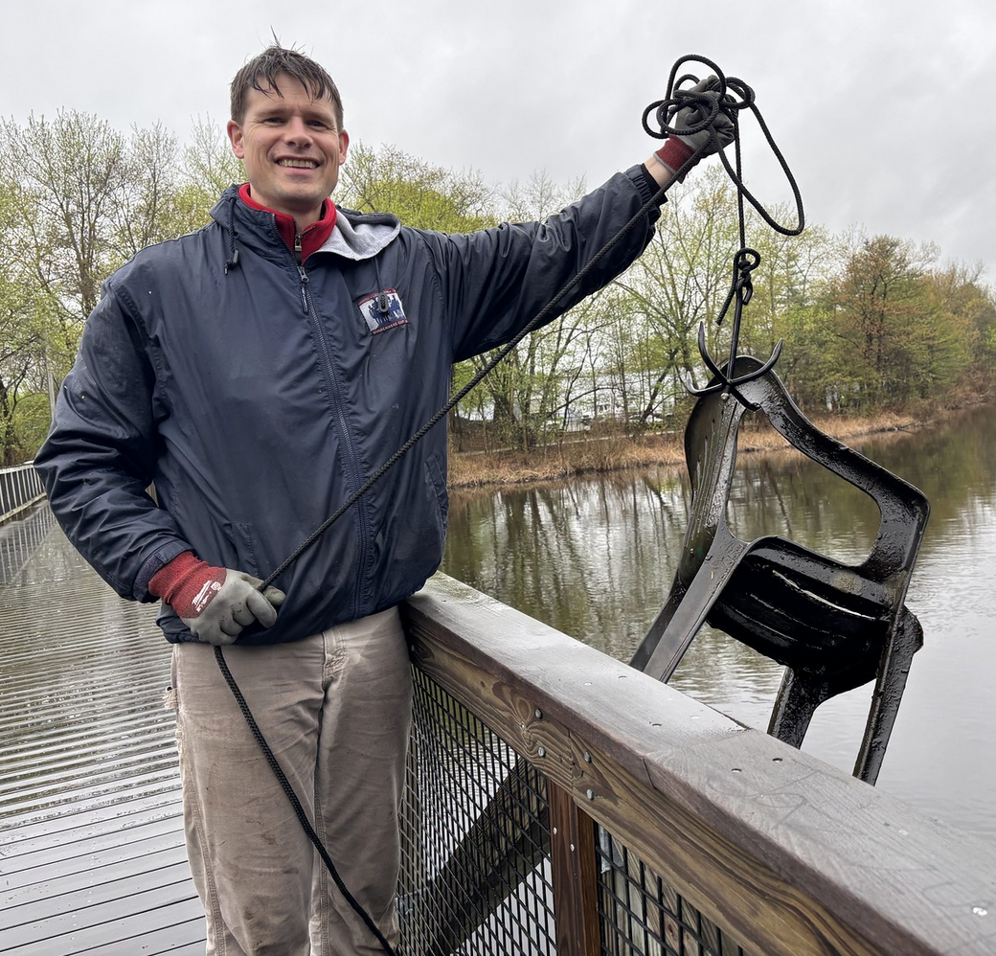
Finally, our Duck Walk, in March! Earth Day Charles River Cleanup

Slide 8
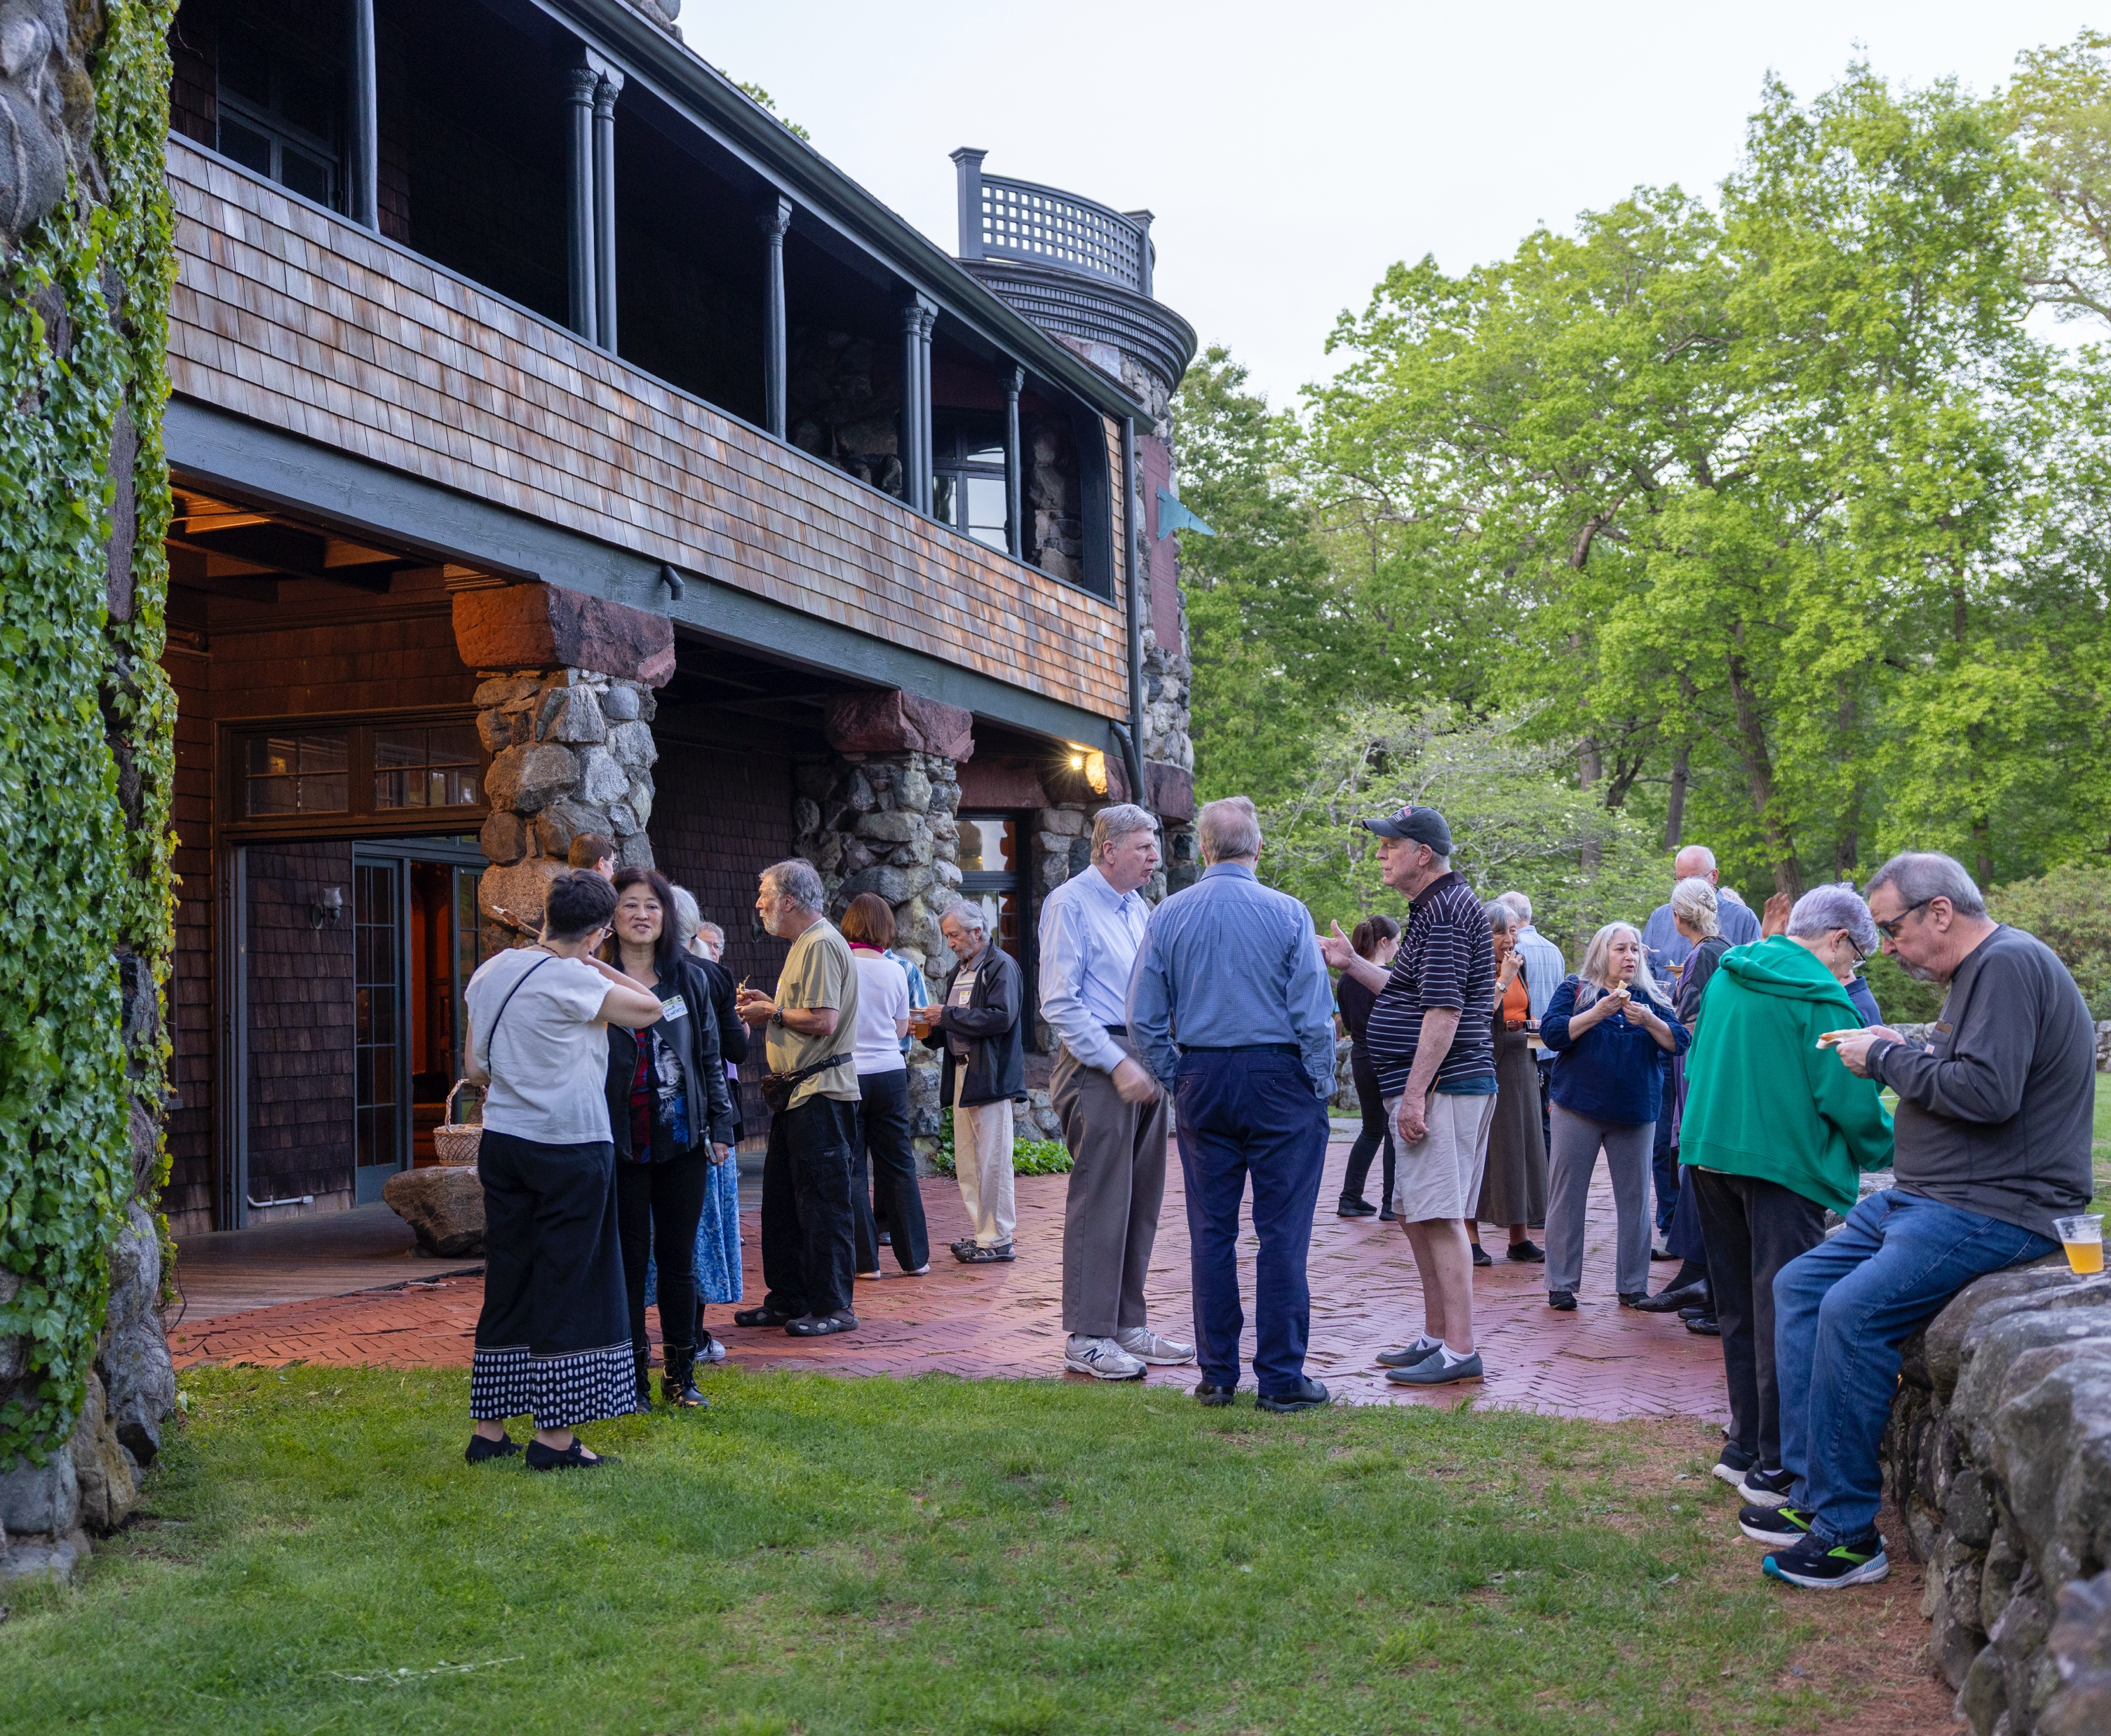
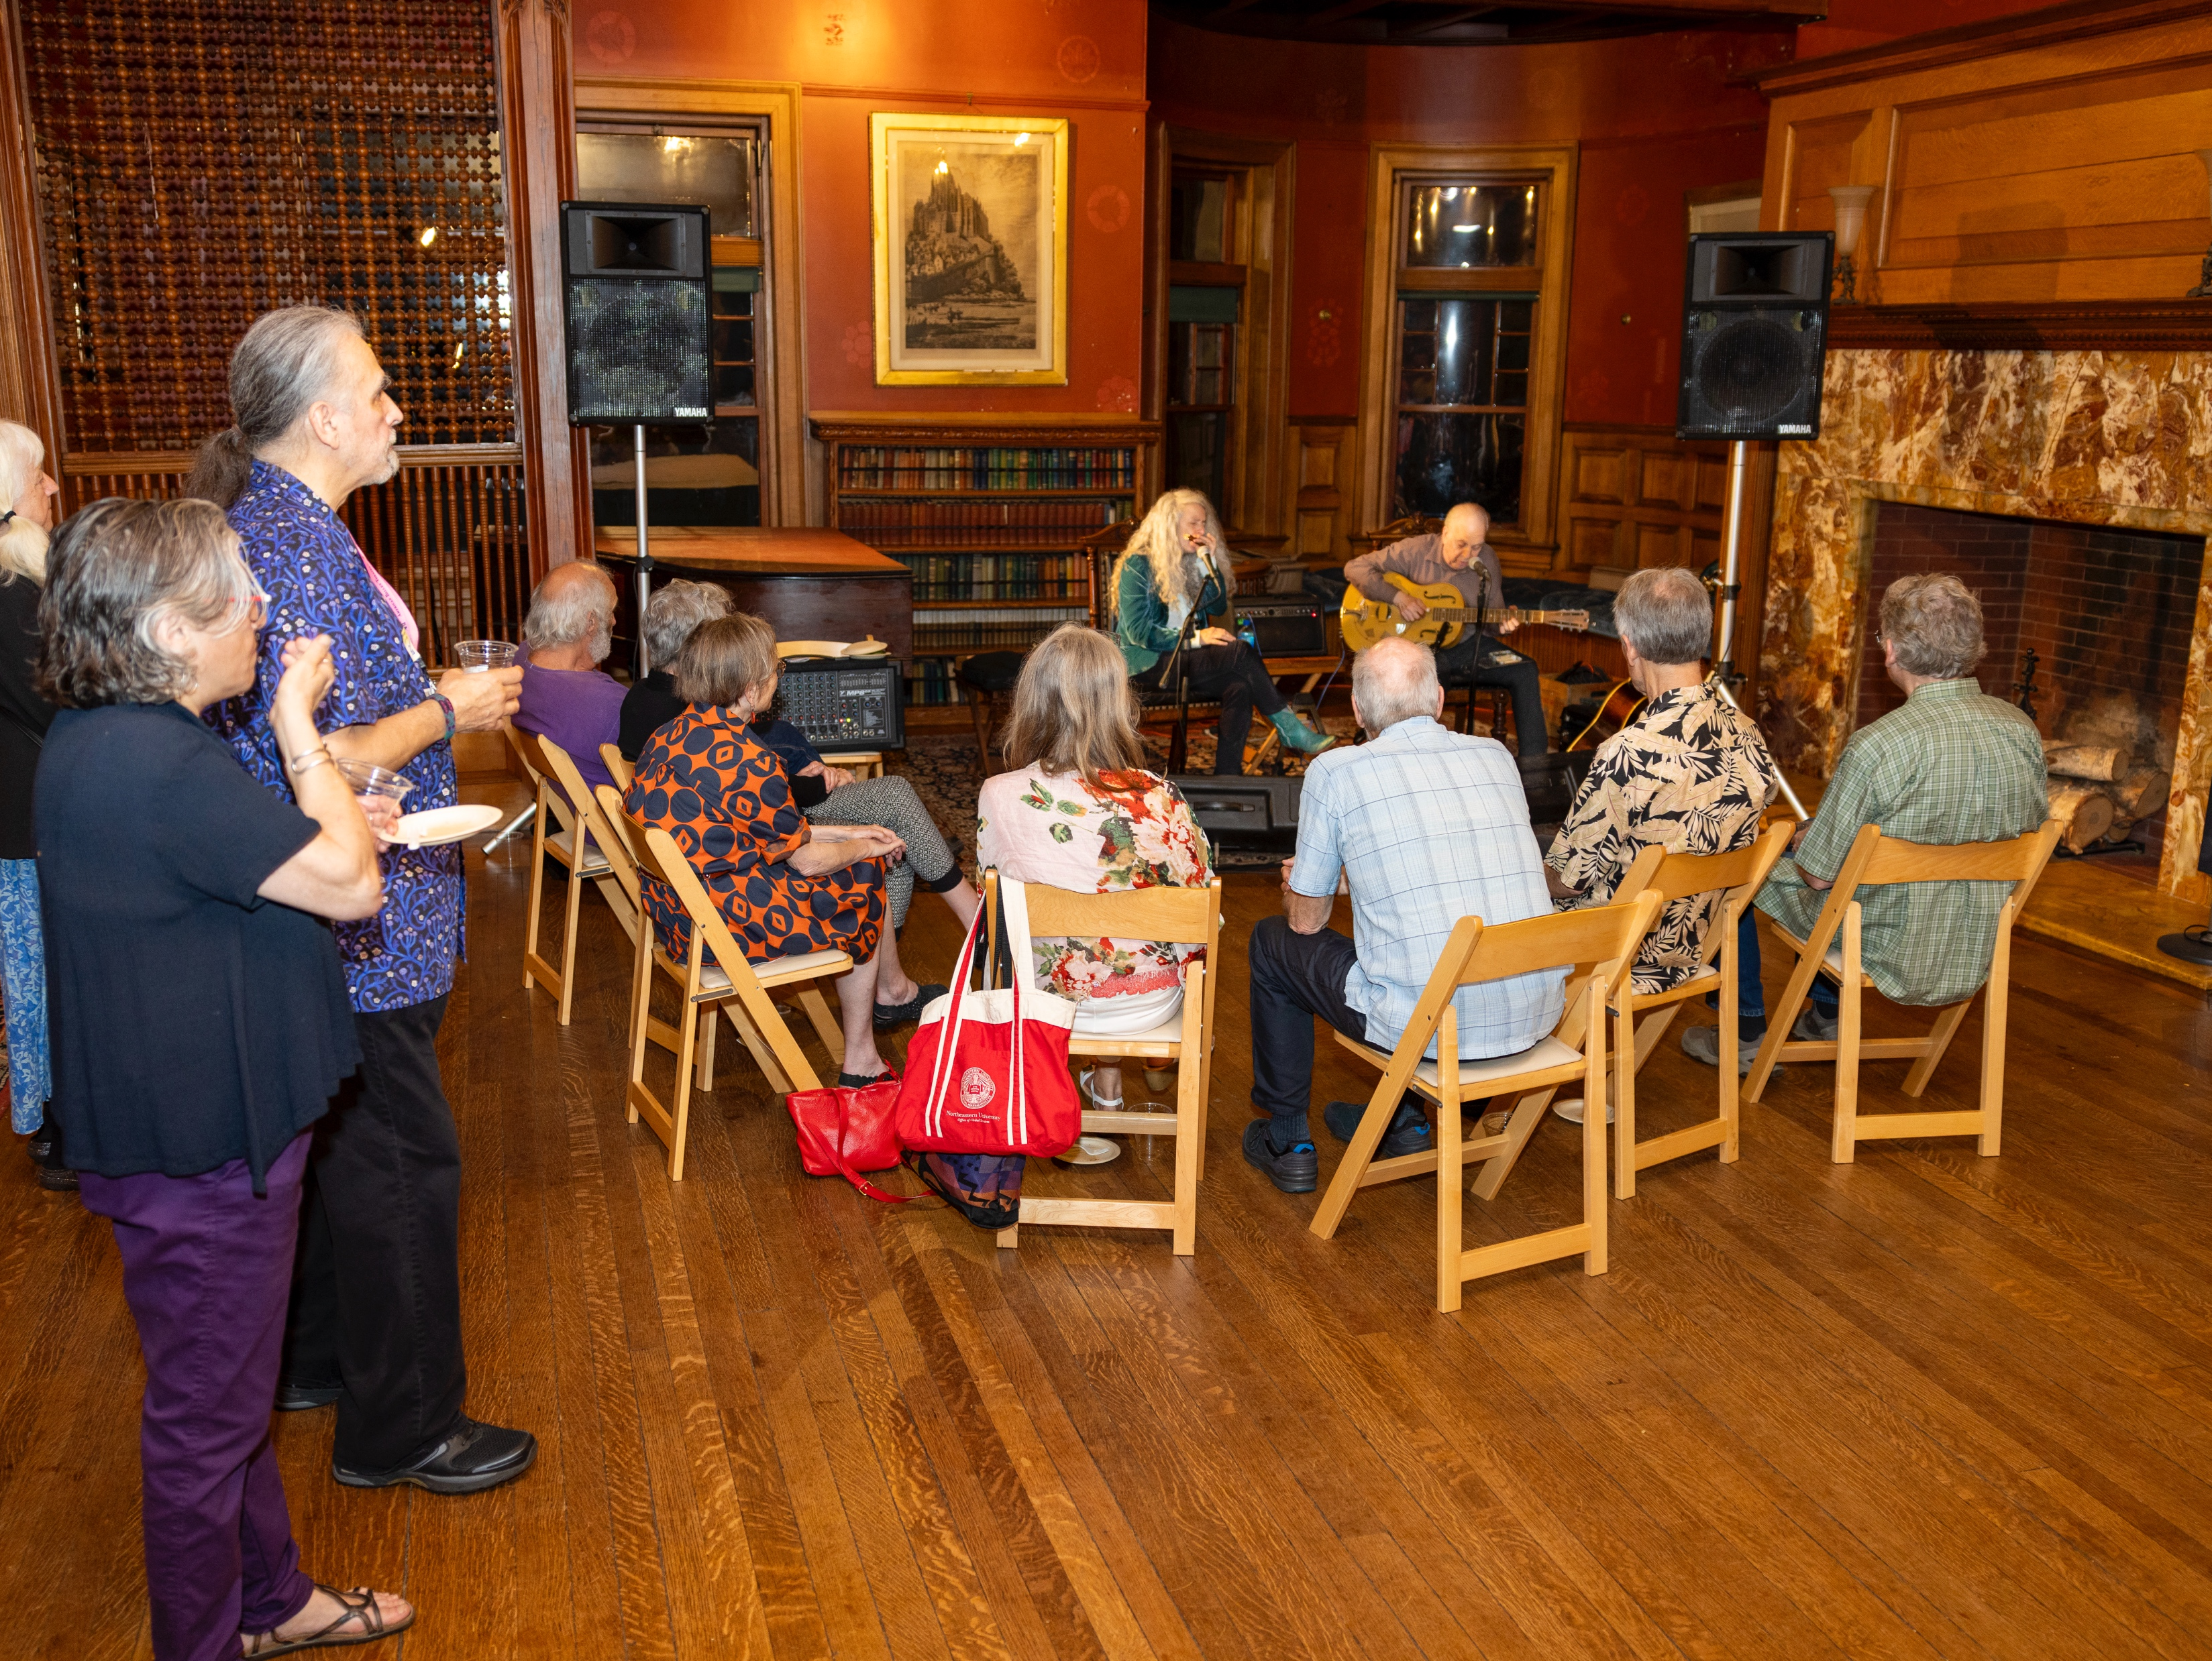
Green Space Blues Jam at Paine Estate in May

Slide 9
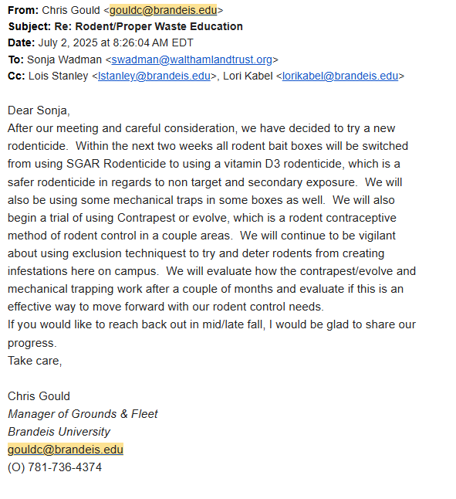
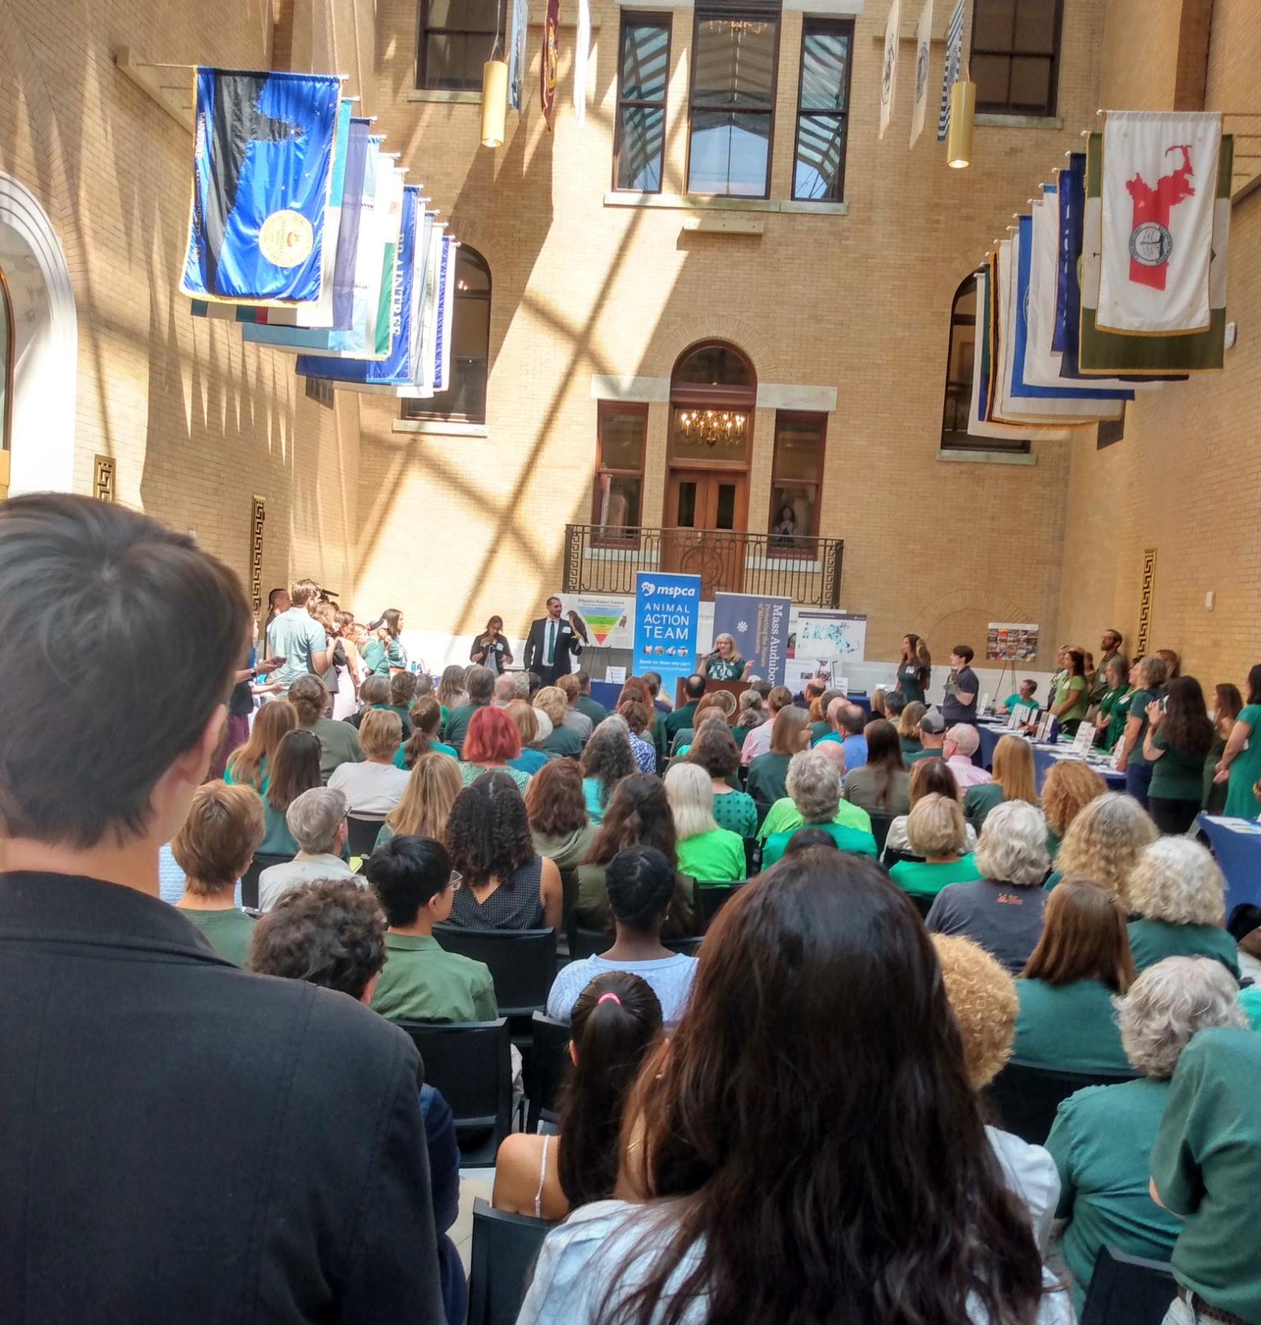
Email from Brandeis re: Ending Rodenticide Use and Lobby Day at MA State House in July

Slide 10
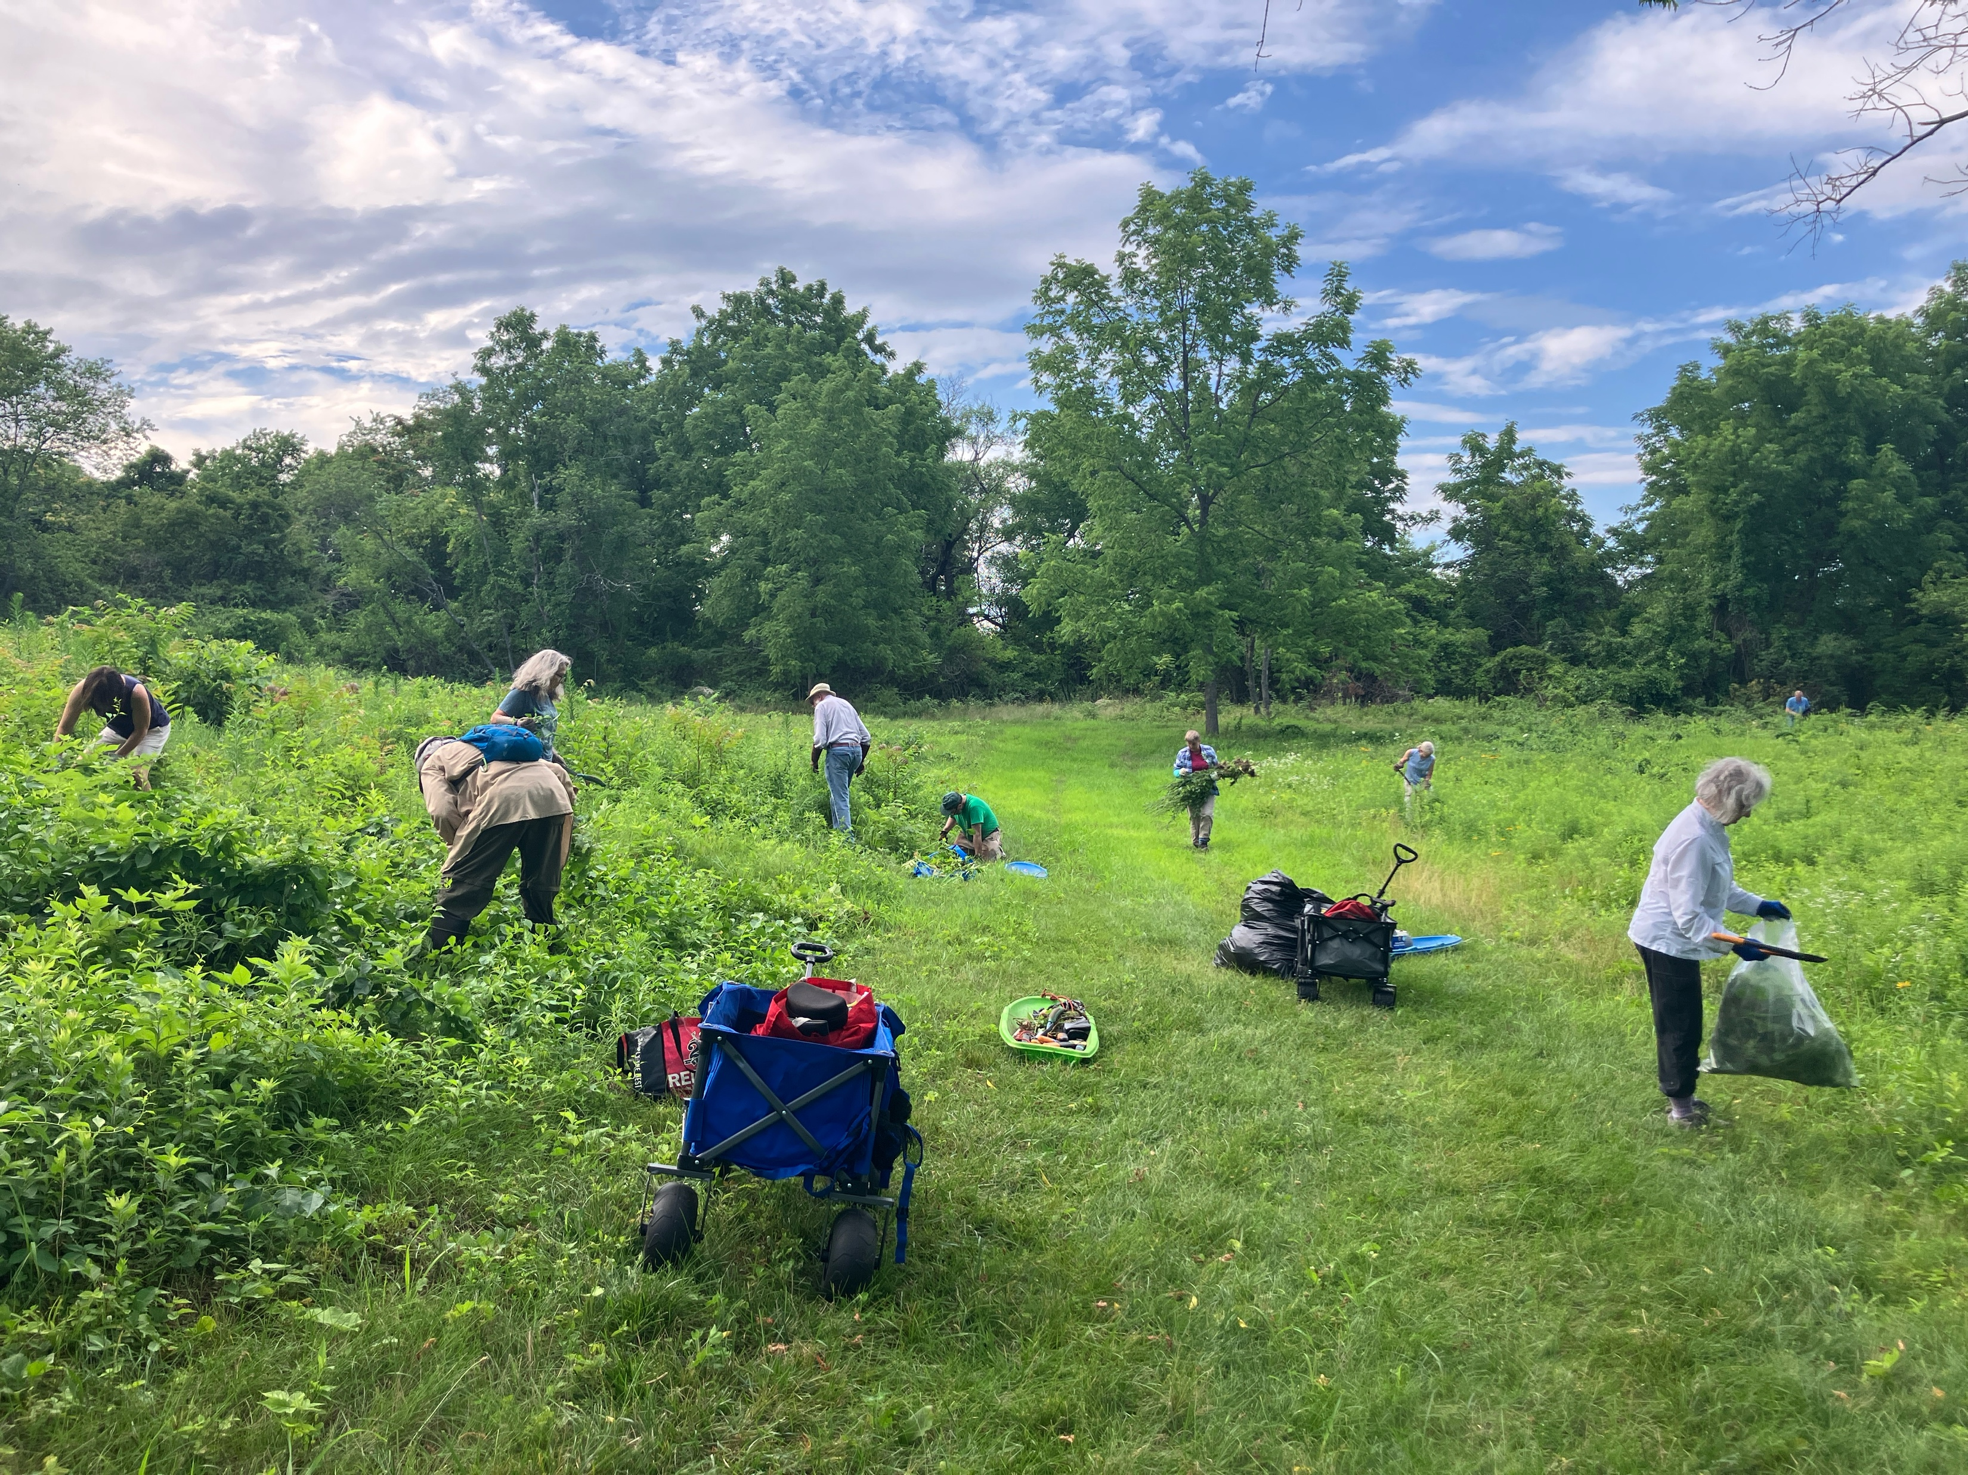
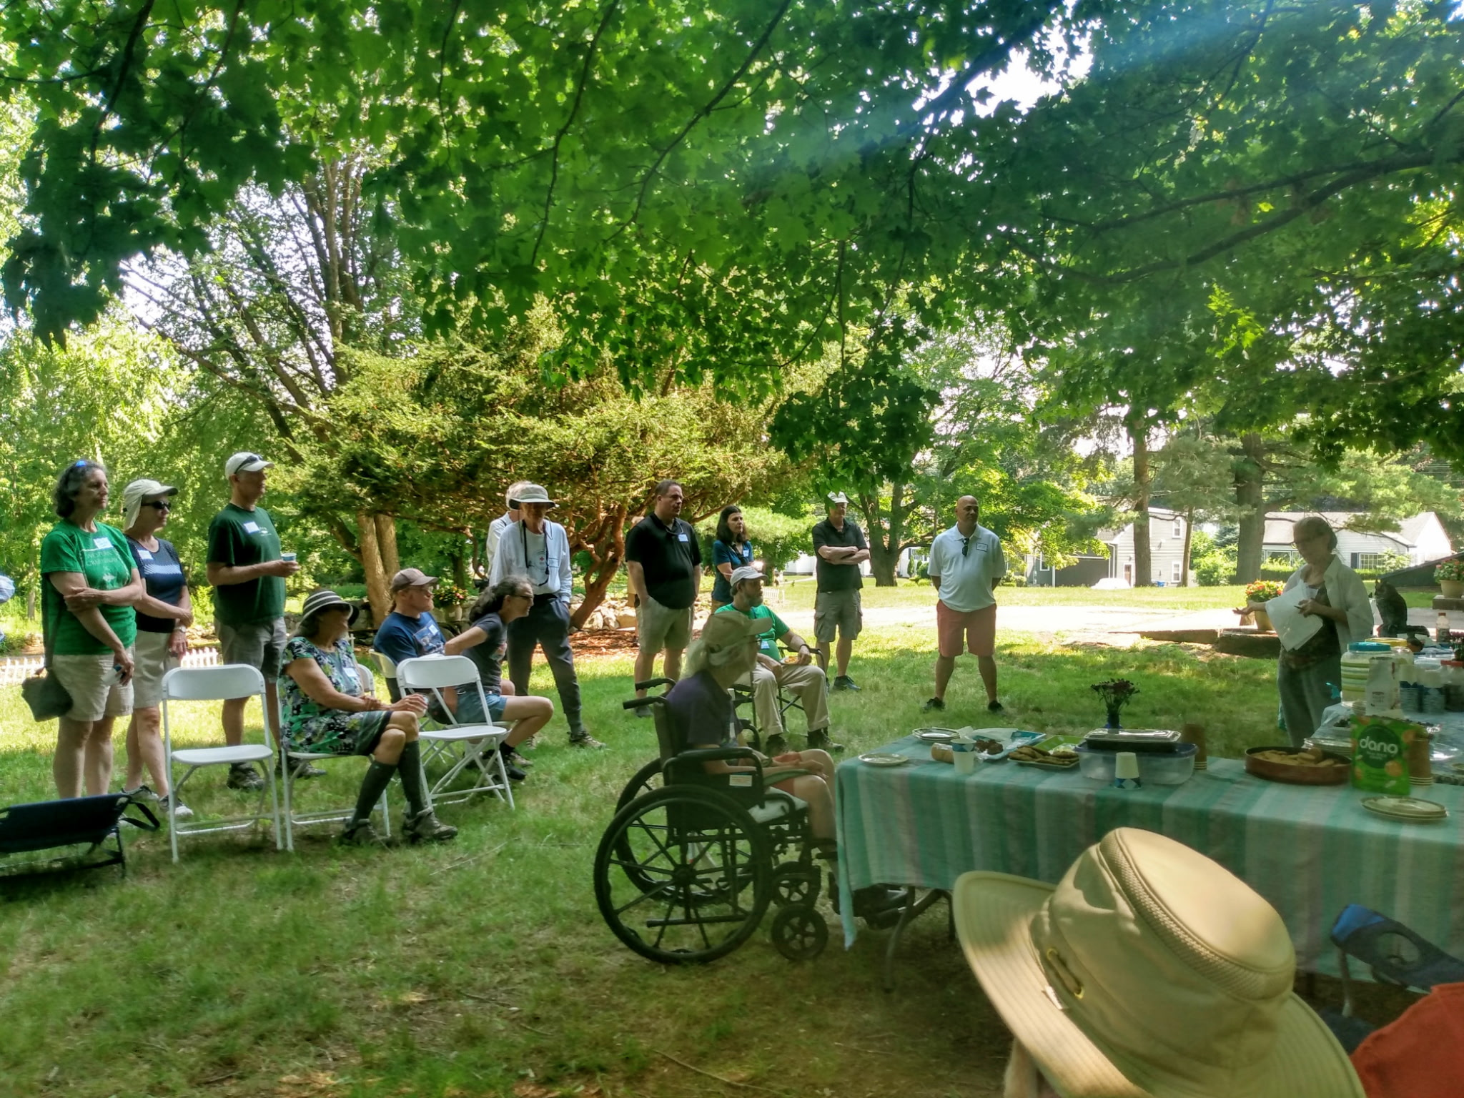
Wellington Fields Work Parties and Lemonade Social in July

Slide 11
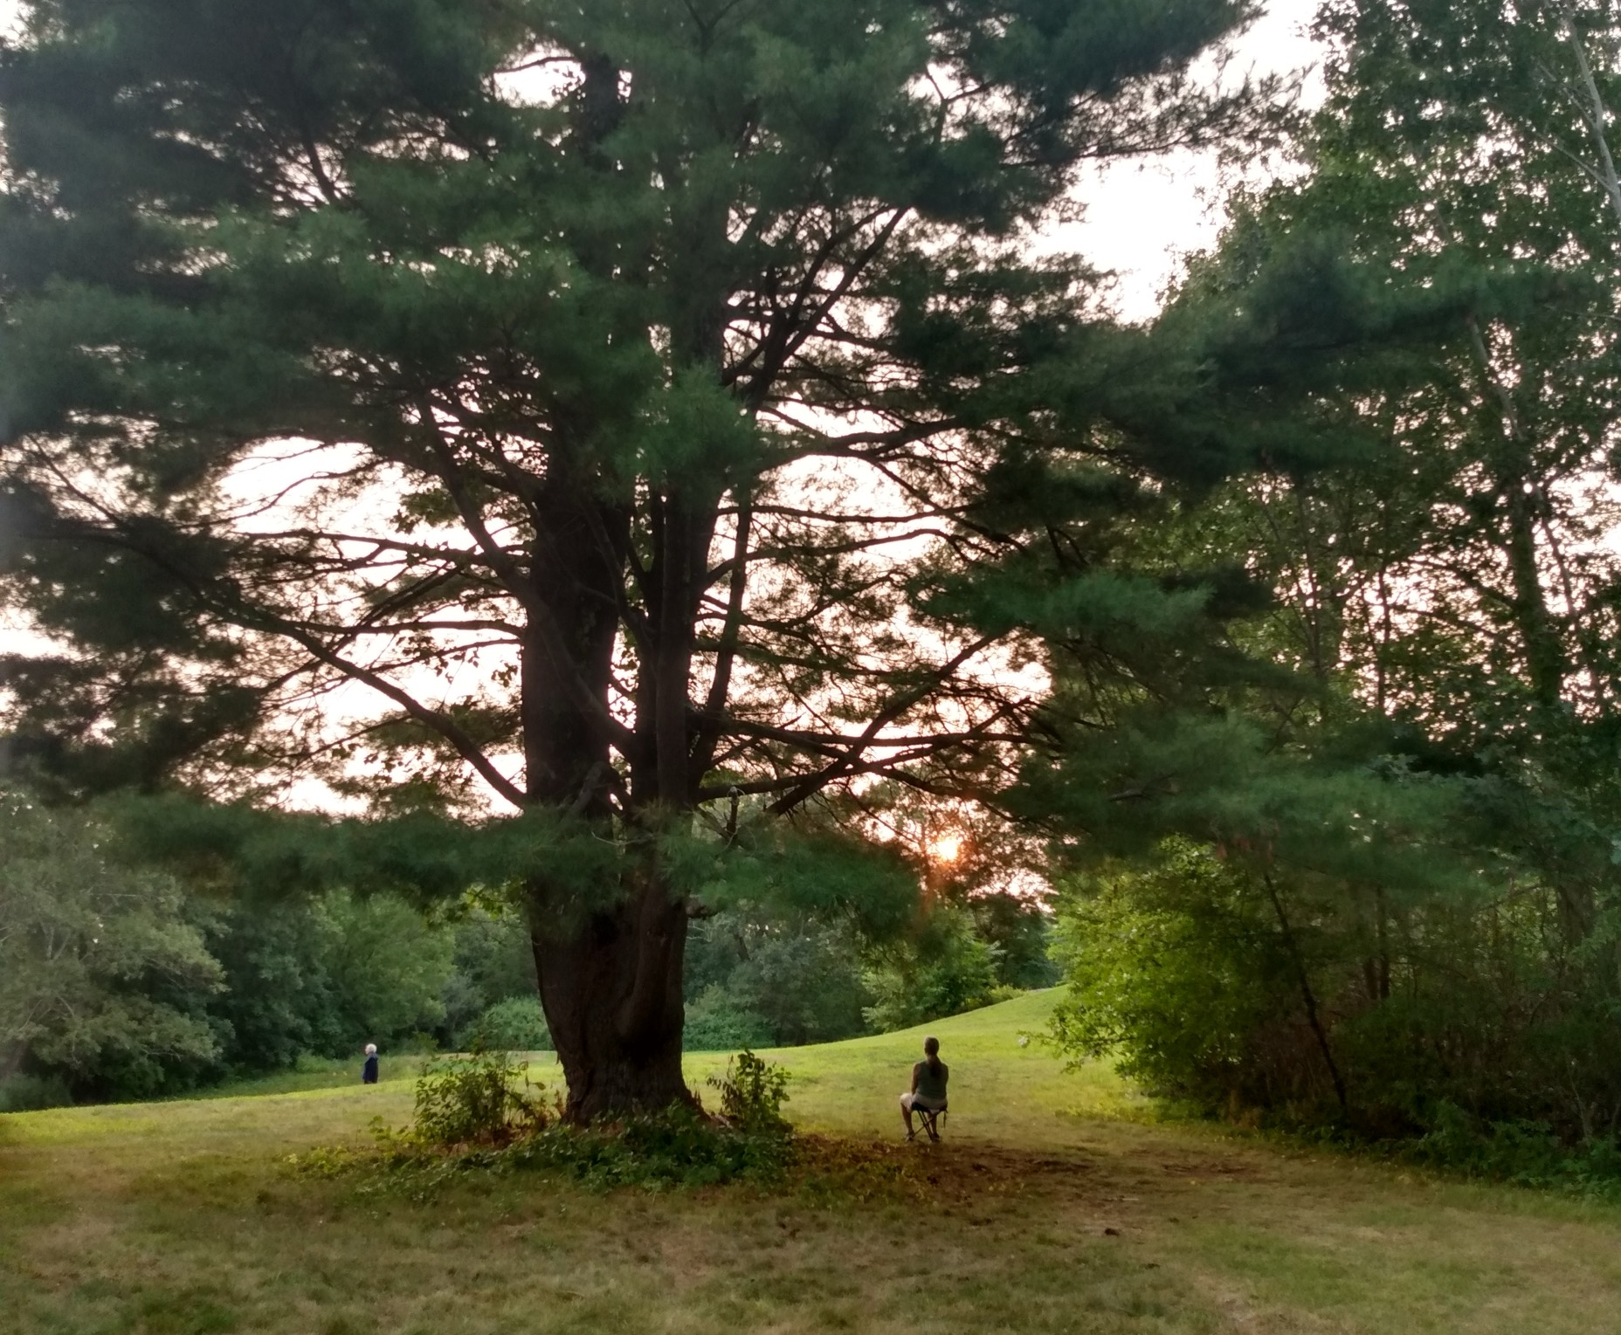
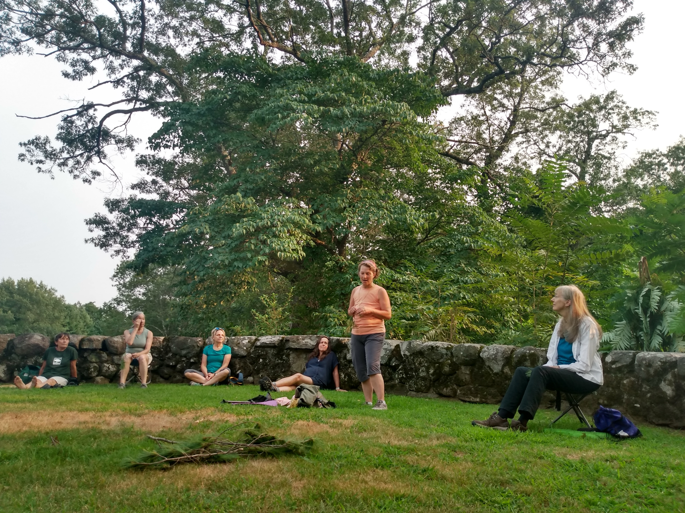
Forest Bathing at Paine Estate in August

Slide 12
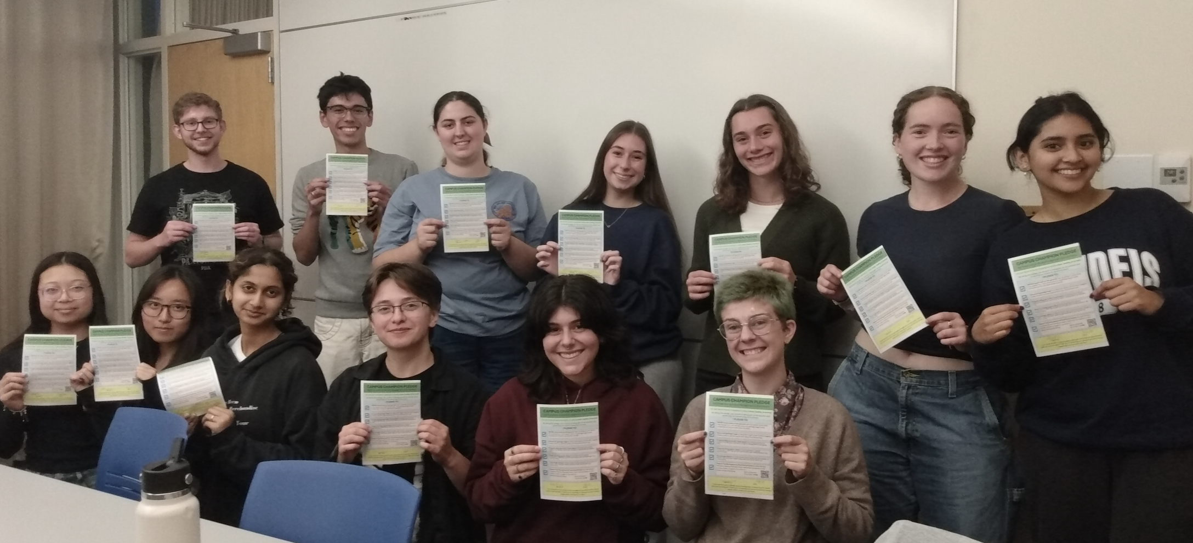
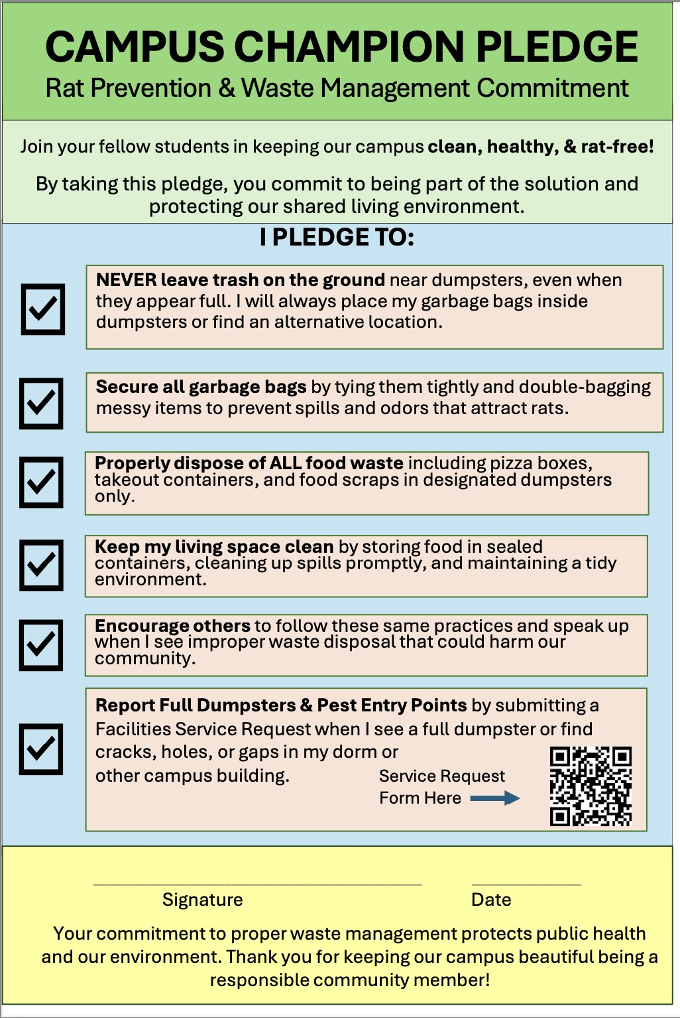
Brandeis Students Take Pledge re: Trash Disposal and Rodent Control in September

Slide 13
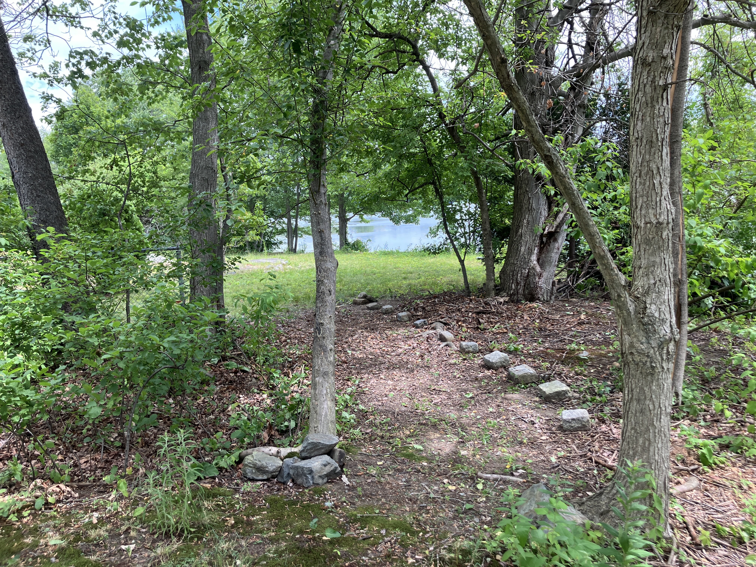
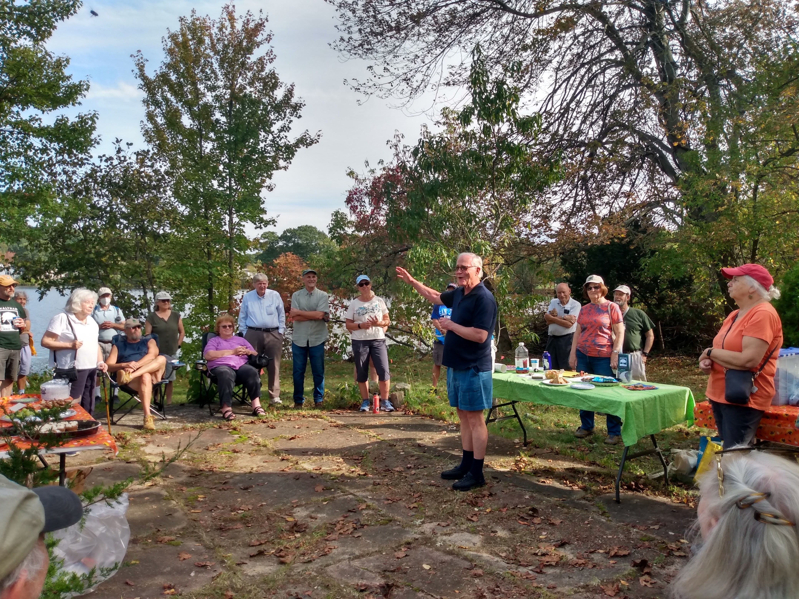
Lakeview Preserve Party at Hardy in late September

Slide 14
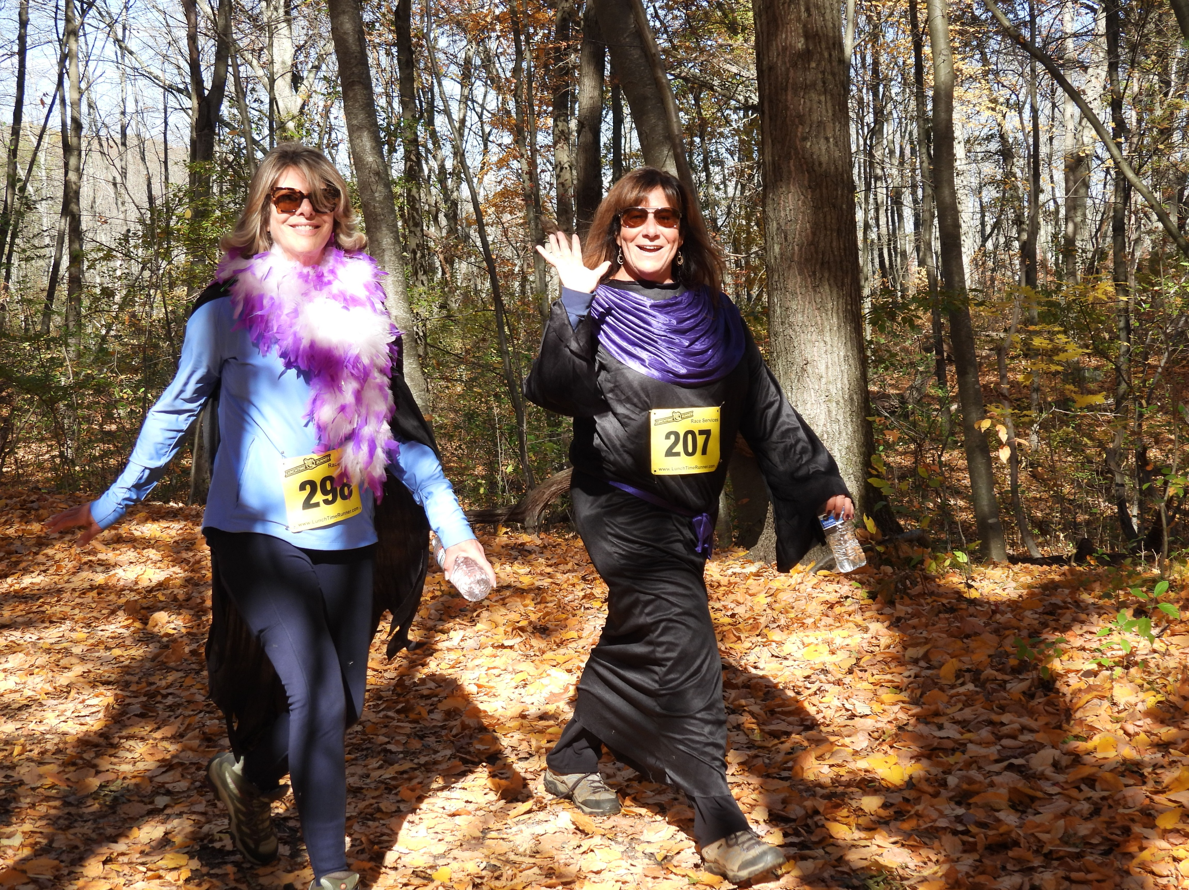
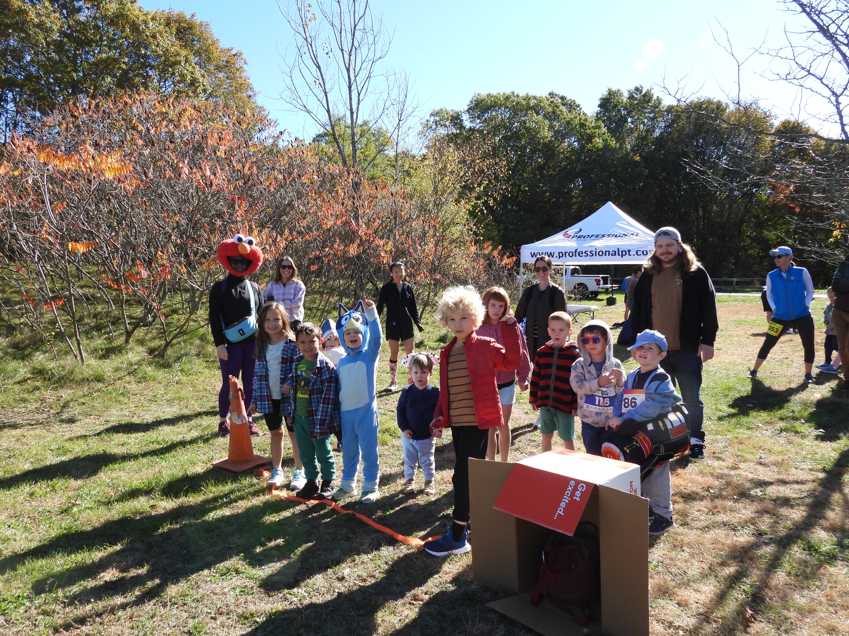
Western Greenway 5K Trail Run/Walk & Kids’ Monster Dash in October

Slide 15
Inge Uhlir Environmentalist of the Year
Sonja Wadman, Executive Director

Slide 16
History of this Award
Named for Inge Uhlir, a founding director, in 2011 to recognize her retirement from the Board. Sadly, Inge passed in April 2024
Not necessarily ‘Volunteer of the Year’ or a WLT member
Recent previous recipients include:
Stewards: Emily Szczypek, Betty MacKenzie, Bob Primak, Naoe Suzuki
Advocates: Dee Kricker
City officials: George Darcy
Others: Ann Clifford

Slide 17
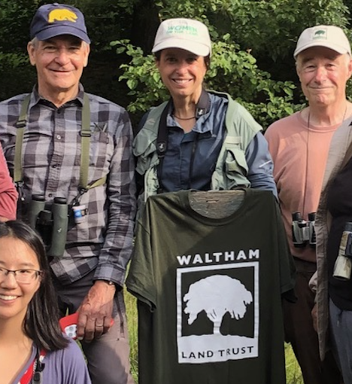
And This Year’s Environmentalist of the Year Is…Michele Grzenda!
Michele and husband Josh joined WLT in 2023
Currently Conservation Director for Town of Lincoln, worked for Sudbury Valley Trustees and Mass Audubon
Offered to lead bird Zooms and walks—Yes, please!
”Getting to Know Your Feathered Friends” Zoom in May 2024, followed by walks in Sear’s Land in Weston and BBN. Additional walks happened in 2025.

Slide 18
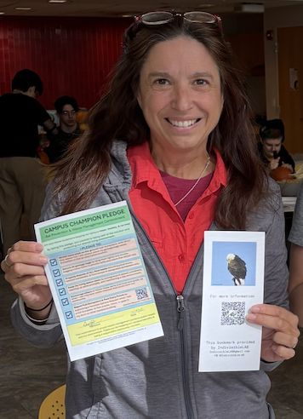
More about Michele
Organized Zooms re: dangers of rodenticide for fellow municipal employees, Conservation Commissioners
Started researching/emailing officials about Waltham’s rodenticide use in Fall, 2024
Joined Save Waltham Wildlife Steering Committee December 2024
We quickly realized she was a LEADER!!!!
Organizes our files, runs SWW meetings and public Zooms, helps guide our plan of attack
Was a major part of SWW Lobby Day team
Developed the Brandeis Campus Champion Pledge, other materials that would become model Tool Kit promoted by Mass Audubon

Slide 19
“Building Climate Resilience through Collective Memory”
Waltham climate study team, Brandeis university

Slide 20
MCRT Update
Sonja Wadman, Executive director for Laurel Carpenter, WLT Lead Steward and
Rail trail advisory committee member

Slide 21
FY 25 Financial Results
Marc Rudnick, WLT Treasurer

Slide 22
Waltham Land Trust FY25 Financials

Slide 26
Additional Financial Information
In FY25, the Land Trust received a $75,000 grant from Senator Barrett which was used to purchase property on Hardy Pond.
We also received a $69,000 donation from an anonymous donor. A portion of these funds were used for land acquisition/improvements, with the majority held as restricted funds for future land acquisition/improvements. Restricted funds are not available to pay payroll, rent, or other operating expenses.
These two donations were recorded as a capital contributions, but without offsetting expenses. This resulted in an extraordinary profit of $142,423.
The balance sheet has increased by almost $139,892 and is primarily on the balance sheet as additional property holdings and increased restricted funds.

Slide 27

Now, for a commercial break…
Please remember the Waltham Land Trust
on Giving Tuesday, December 2.
We also appreciate your contributions
on any other day of the year, too!

Slide 28
Business Meeting
Nadene Stein, WLT President

Slide 29
Departing Board Member
Barabara Jacobs, a board member since 2019, has decided not to run for a third term.
Thank you to Barbara for all her work on the board, including being the very successful chair of the Development Committee, dealing with the contractors on the Lyman Estate trail project, leading many walks, being a member of the Program Committee, and so much more.
Happy Travels, Barbara and Ted!

Slide 30
And the Nominees are…
New Board Nominees:
Tom Benavides
Barbara Marriott
Meghan Sullivan
Returning Board Members:
John Dieckmann
Anna Richardson
Mark Sivers

Slide 31
Now to Vote…
If you are a MEMBER of the Land Trust, please vote:
Please raise your hand to record if you accept the slate of John Dieckmann, Anna Richardson, Mark Sivers, Tom Benavides, Barbara Marriott, and Meghan Sullivan, for three-year terms.

Slide 32
Q&A
Sonja Wadman and Board Members

Slide 33
Join us for some special treats
Toscanini’s Ice cream
Complements of Sally Wetzler and Marc Rudnick (and Toscanini’s)

Slide 34

Thanks for coming!

