Slide 1
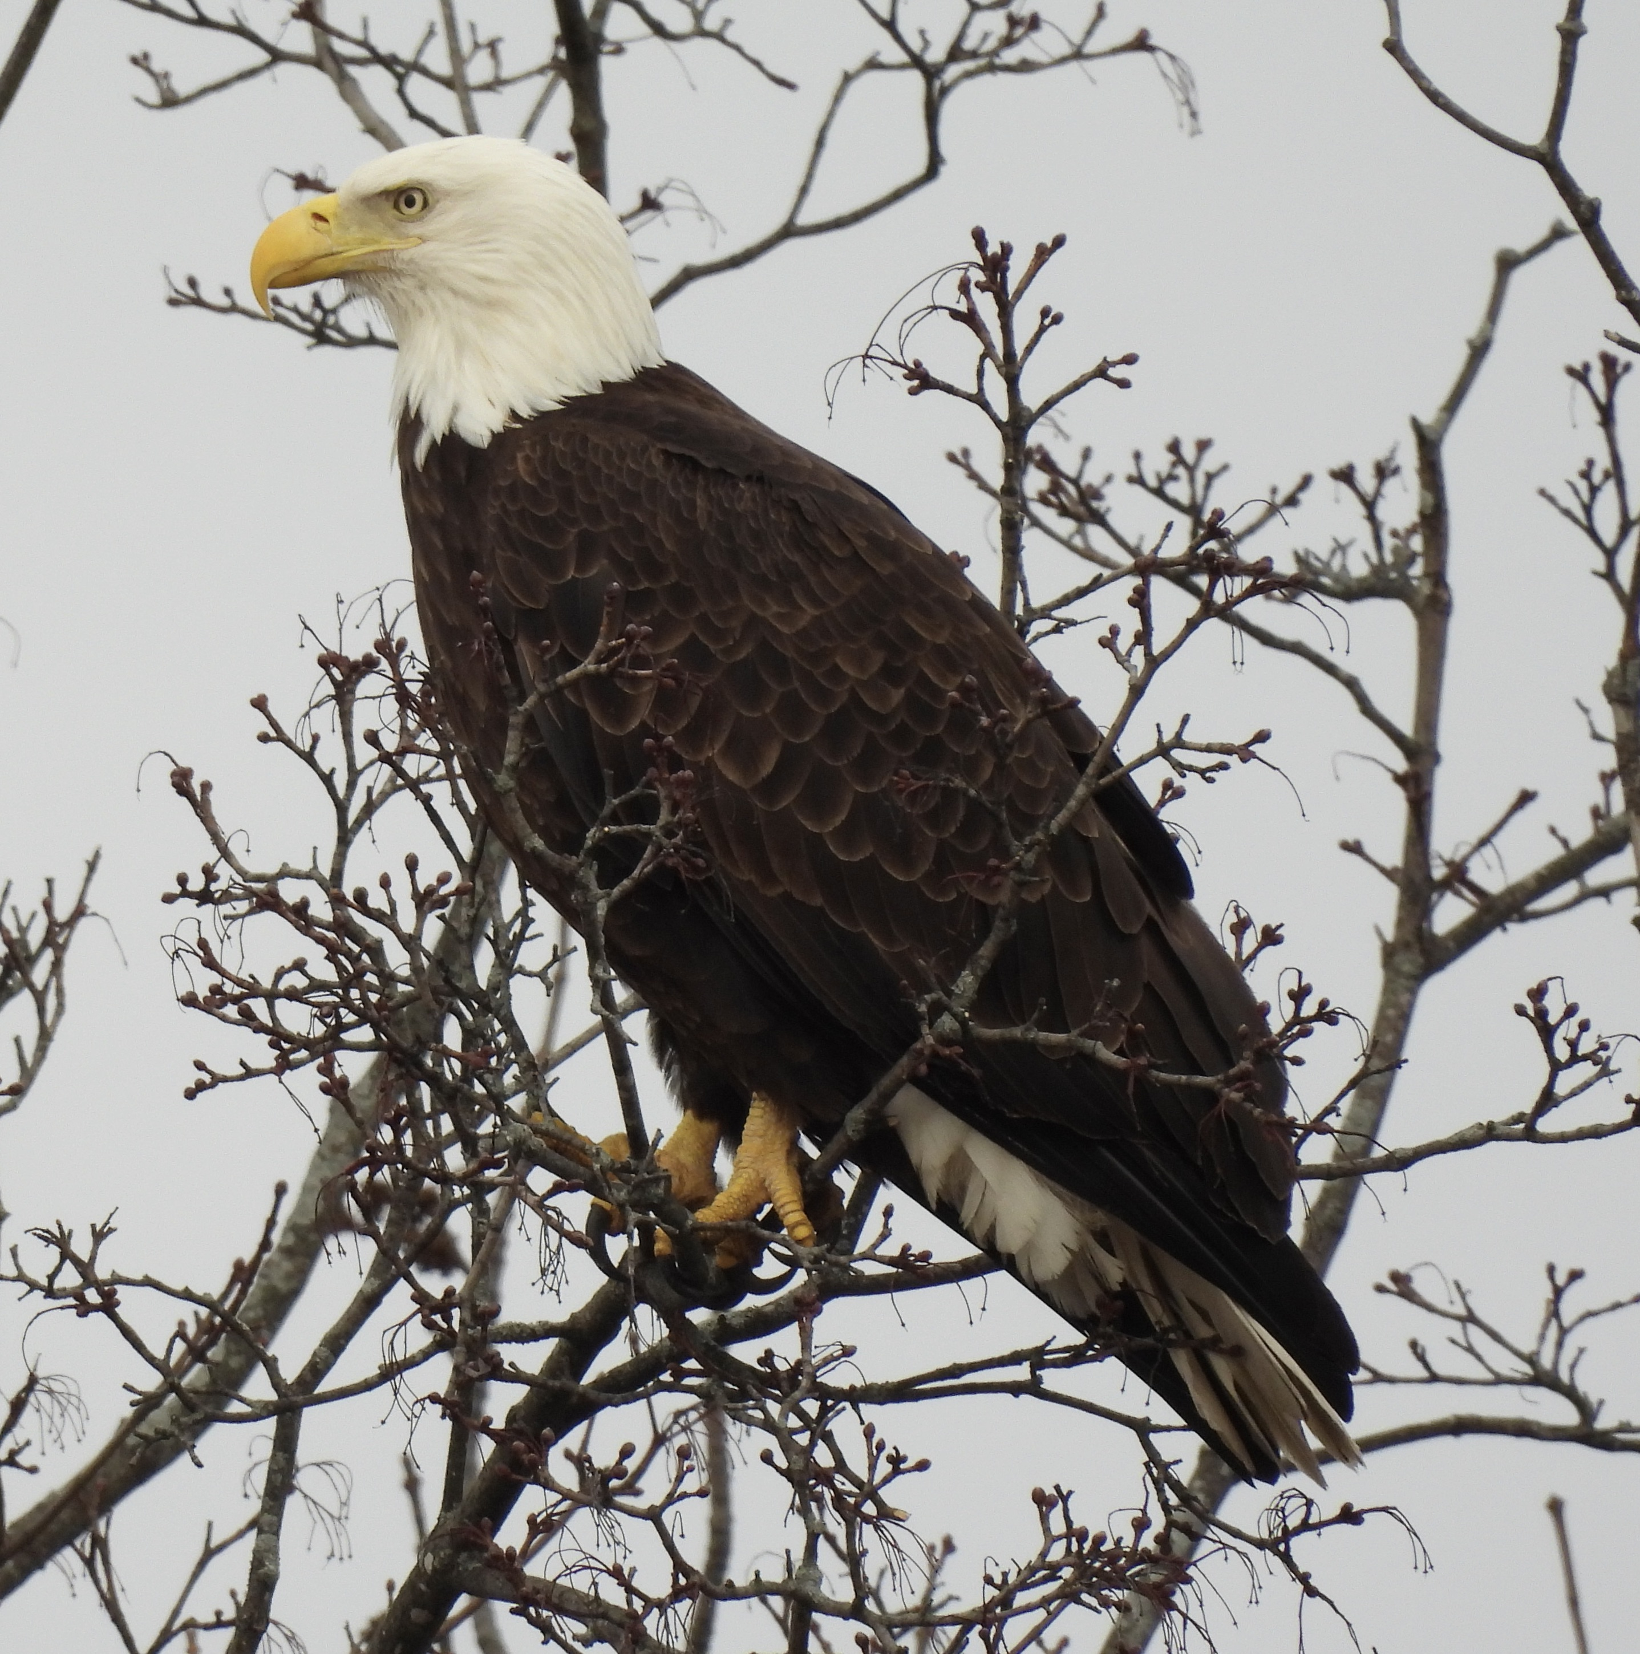
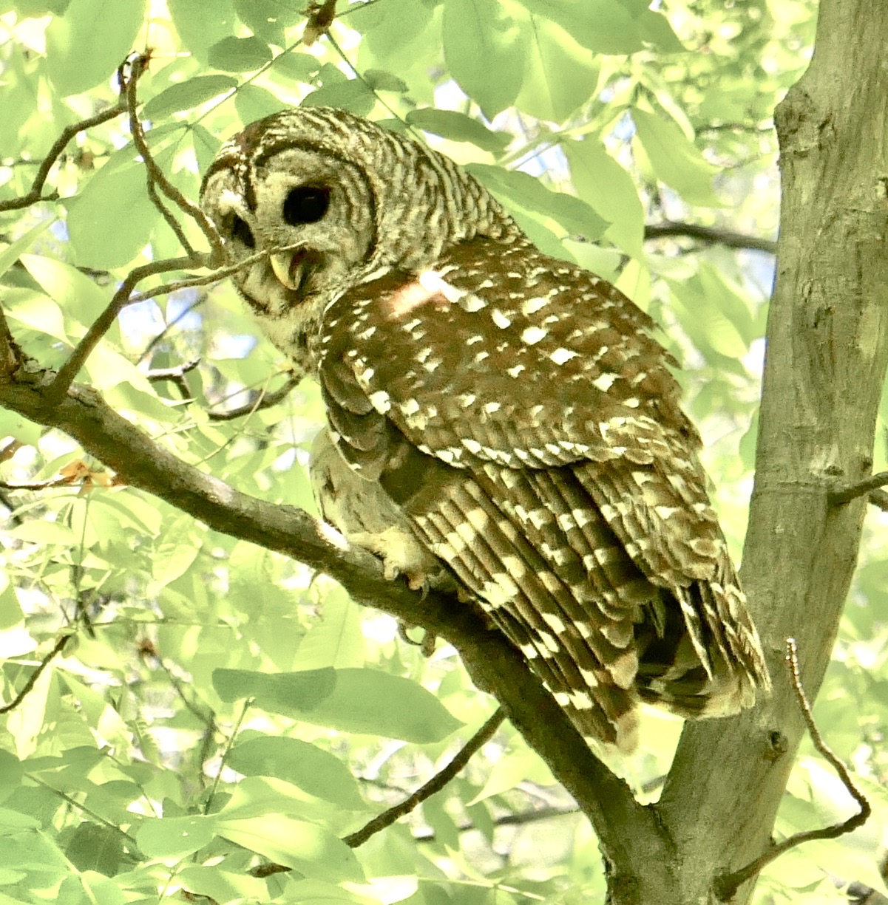
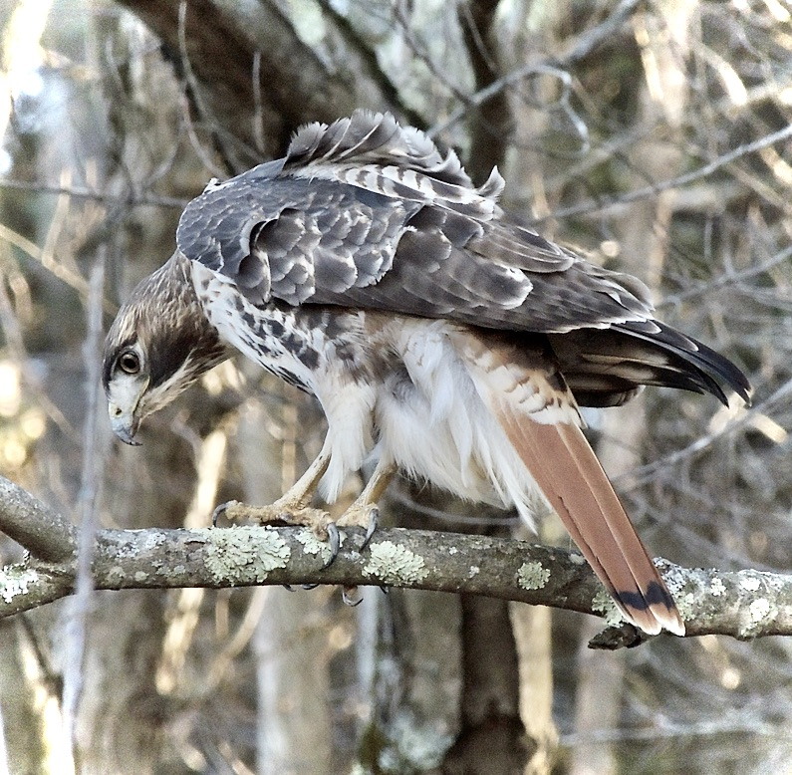
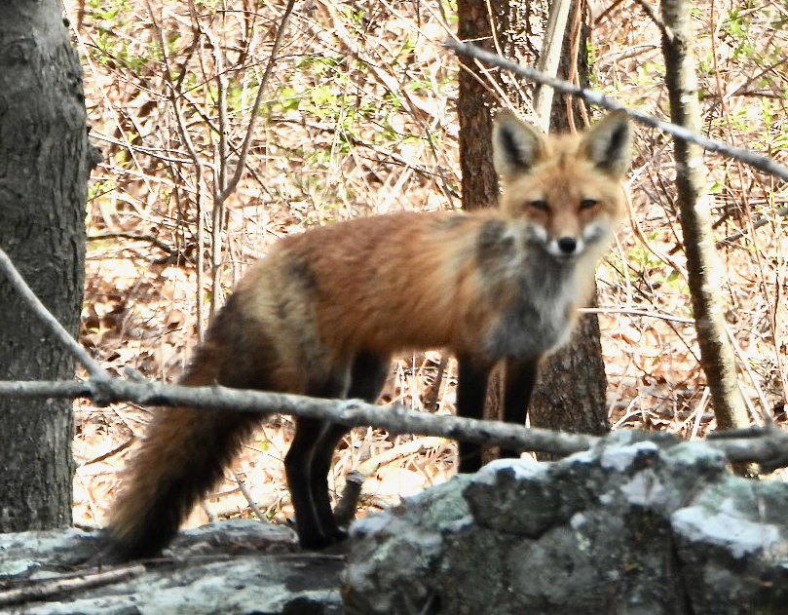
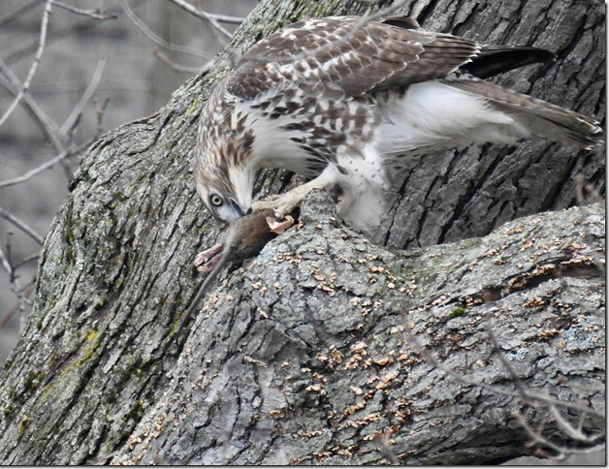

Save Waltham Wildlife
Photo: Linda Graetz
Photos by Emily Szczypek

Slide 2
SWW Mission
To save Waltham Wildlife by reducing the need for, and eventually ending, the use of SGAR rodenticides in the City of Waltham.
We work to achieve this goal through education, advocacy and promoting alternative methods of effective rodent control.

Slide 3
Second Generation Anti-coagulant Rodenticides - SGARs
ARE KILLING BIRDS OF PREY AT AN ALARMING RATE.
Recent documented deaths include 3 Bald Eagles who once lived and nested in Waltham, and a female
Red-Tailed Hawk found at Gore Place that succumbed on March 29, 2024.
In 2020 Tufts Wildlife Clinic reported that 100% of Red-tailed Hawks they studied had been exposed to SGARs.
HOW YOU CAN HELP
REPORT any lethargic or injured hawk, owl, or other wildlife that you see.
Contact a wildlife rehabilitator: https://www.mass.gov/info-details/find-a-wildlife-rehabilitator
or call Cape Ann Wildlife: 1-978-325-2501 http://www.caw2.org/
It’s important that you stay with the bird until someone comes to pick it up. If for some reason you feel you can’t do this, photograph the bird, make note of its location and call someone who can stay with it until help arrives.
ALSO REPORT:
Any dead rat/rodent on city property (conservation land, sidewalk, street, parking lot, around a public building). Immediately contact Public Works at 781-314-3855 for its removal. Photograph and make note of location.
• Note and record any animal (wild bird, mammal, or pet) consuming or feeding on a dead rat or mouse.
Report your wildlife sightings. Start using iNaturalist! Submit photos (for owls you can also submit audio) and report your Waltham wildlife sightings. As far as we know, no bird or wildlife survey has ever been done in Waltham. So how can we know what has disappeared? For example, we do know that Barred, Great Horned, even Screech Owls have been seen and/or heard in Prospect Hill Park. But are they still there? We need documentation.

