Slide 1
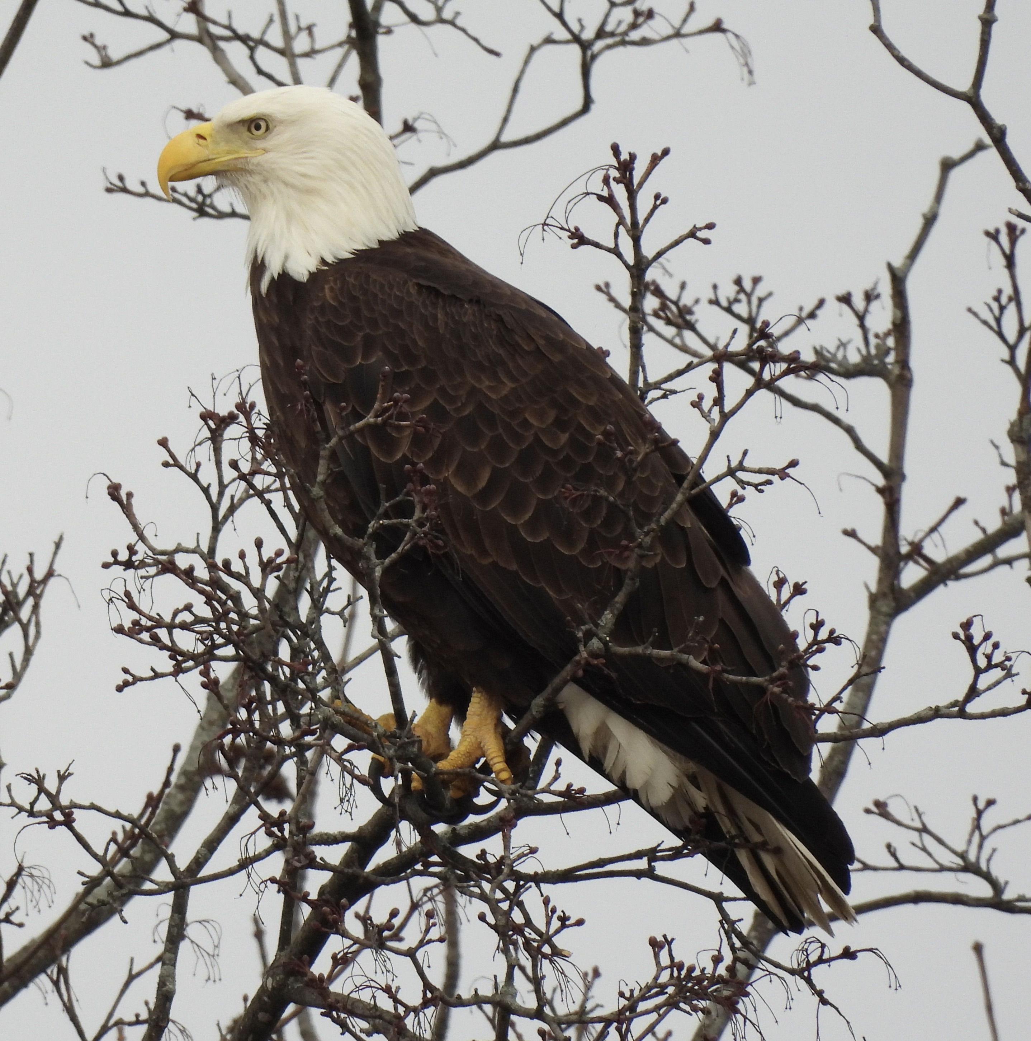
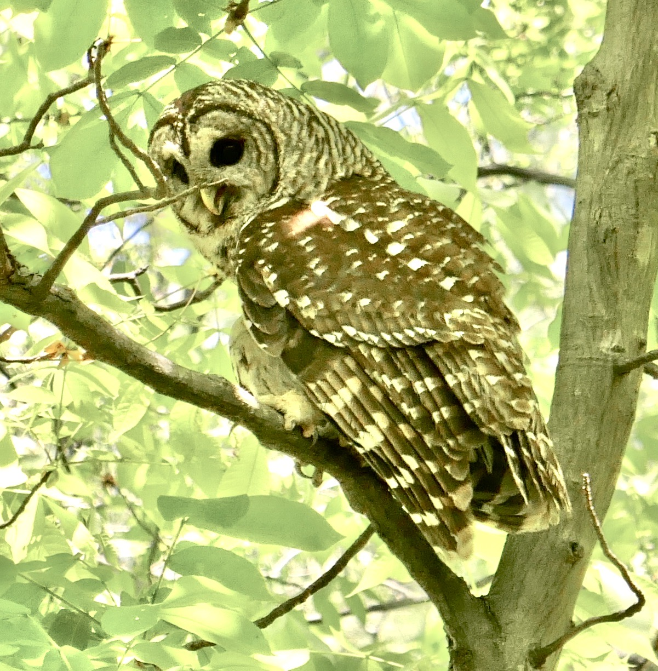
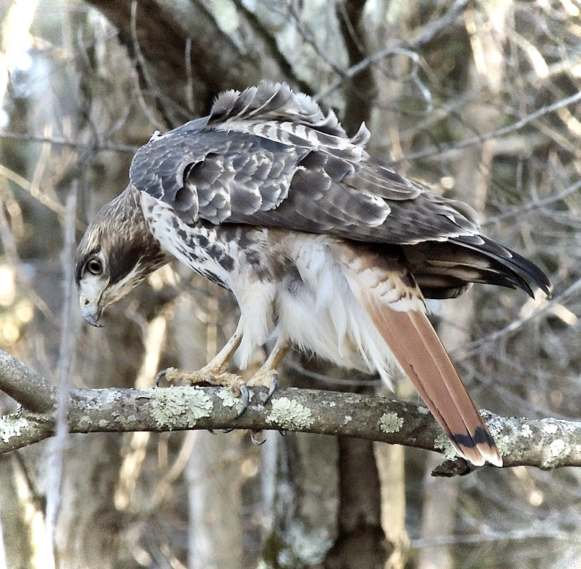
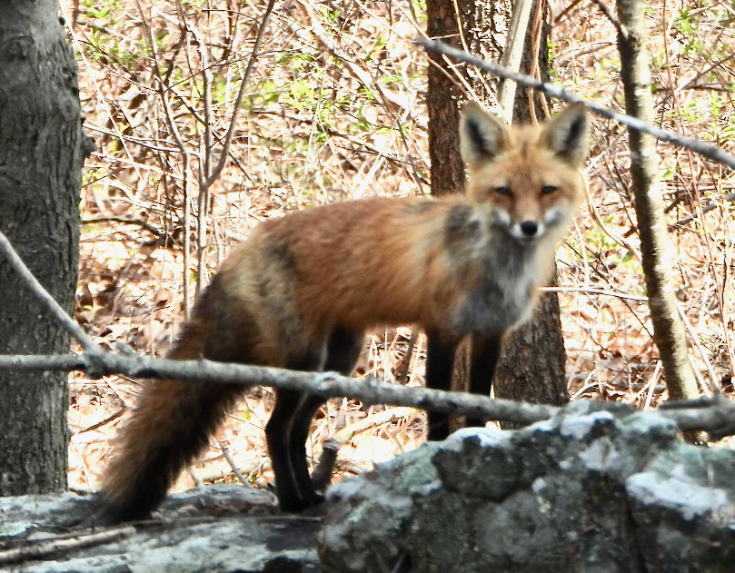
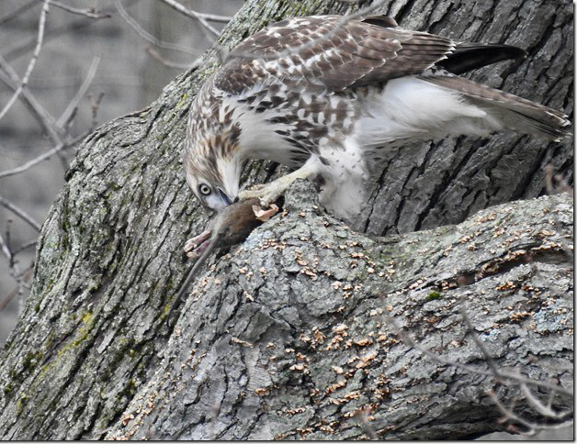

Save Waltham Wildlife
Photo: Linda Graetz
Photos by Emily Szczypek

Slide 2
SWW Mission
To save Waltham Wildlife by reducing the need for, and eventually ending, the use of SGAR rodenticides in the City of Waltham.
We work to achieve this goal through education, advocacy and promoting alternative methods of effective rodent control.

Slide 3
The Problem
Rodent populations are growing all over the country
Many property owners are hiring pest control companies
Some believe cheapest and easiest solution is anticoagulant rodenticides (sometimes call ARs or SGARs) in black bait boxes or fake rocks
Poison slows down rodent who eats it, making it easy prey, and/or kills the rodent
Affects natural predators and outdoor pets who consume rodents, often slowly killing them by causing them to bleed out when injured
There are alternatives! Seal entrances, remove food sources, use snap or electronic traps, inject CO2 into burrows, last resort is RatX (nontoxic)

Slide 4
Second Generation Anti-coagulant Rodenticides - SGARs
ARE KILLING BIRDS OF PREY AT AN ALARMING RATE.
Documented deaths include three Bald Eagles who once lived/nested in Waltham, many Red-tailed Hawks.
In 2020 Tufts Wildlife Clinic reported that 100% of Red-tailed Hawks they studied had been exposed to SGARs.
HOW YOU CAN HELP
Join Save Waltham Wildlife to get on its e-list: savewalthamwildlife@gmail.com
REPORT any lethargic or injured hawk, owl, or other wildlife that you see.
Contact a wildlife rehabilitator: https://www.mass.gov/info-details/find-a-wildlife-rehabilitator
or call Cape Ann Wildlife: 1-978-325-2501 http://www.caw2.org/
It’s important that you stay with the bird until someone comes to pick it up. If for some reason you feel you can’t do this, photograph the bird, make note of its location, and call someone who can stay with it until help arrives.
ALSO REPORT:
Any dead rodent/animal on city property (conservation land, sidewalk, street, parking lot, around a public building): immediately contact Public Works at 781-314-3855 for its removal. Photograph and make note of location.
Dead raptor: contact Cape Ann Wildlife: 1-978-325-2501 http://www.caw2.org/
Note and record any animal (wild bird, mammal, or pet) consuming or feeding on a dead rat or mouse.
Report your wildlife sightings. Start using iNaturalist! Submit photos (for owls you can also submit audio) and report your Waltham wildlife sightings. We need documentation!

