Slide 1
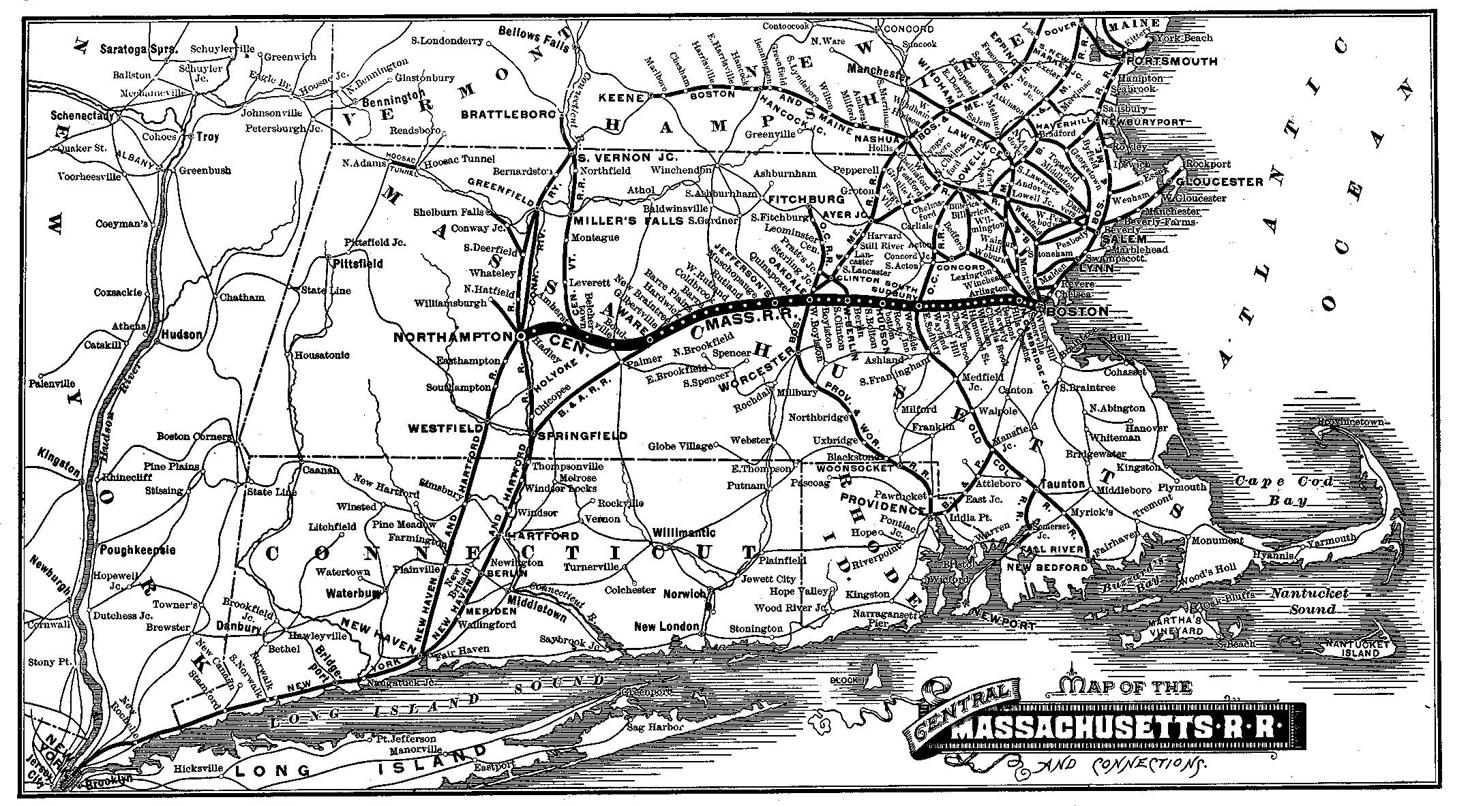

MASS CENTRAL RAIL TRAIL Update and Status 2025 Waltham Land Trust Annual Meeting

Slide 2
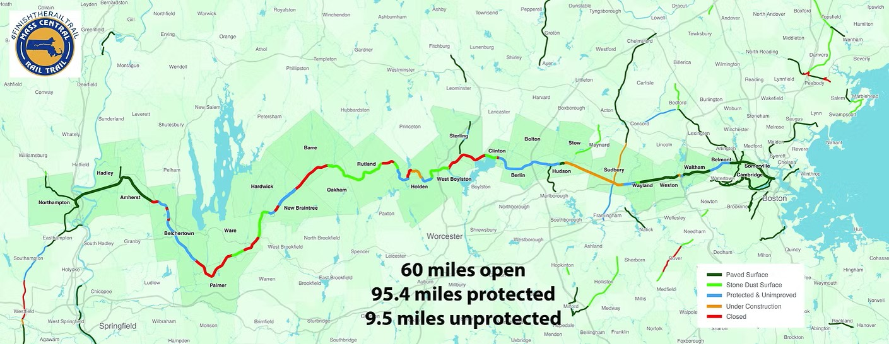
MCRT Across the State

Slide 3
MCRT Wayside (DCR)
Waltham 3 miles (2.5 complete)
Weston 3 miles (complete)
Wayland 3 miles (complete)
Sudbury 4.6 miles (~4 complete)
Hudson 7 miles (~complete)
Berlin 2.3 miles (not started)

Slide 4
Waltham Status
Core segment open: Linden St to 1265 Main
Linden Street ramp now open!
Jones Road now open!
Provides access to trail in Weston and Wayland
Gaps remain
Linden Street Bridge—projected end of 2025
I-95 bridge/MassDOT project: in design
Notes:
I-95 bridge expected to cost $80 million!

Slide 5
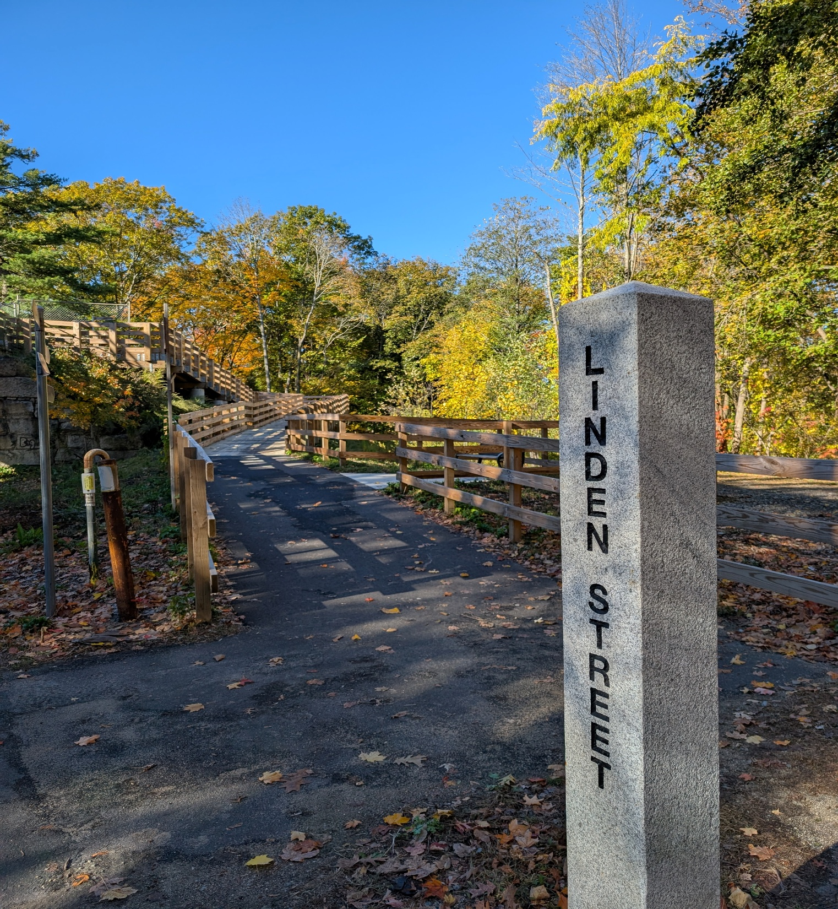
2025 Highlights Linden St. ramp open

Slide 6
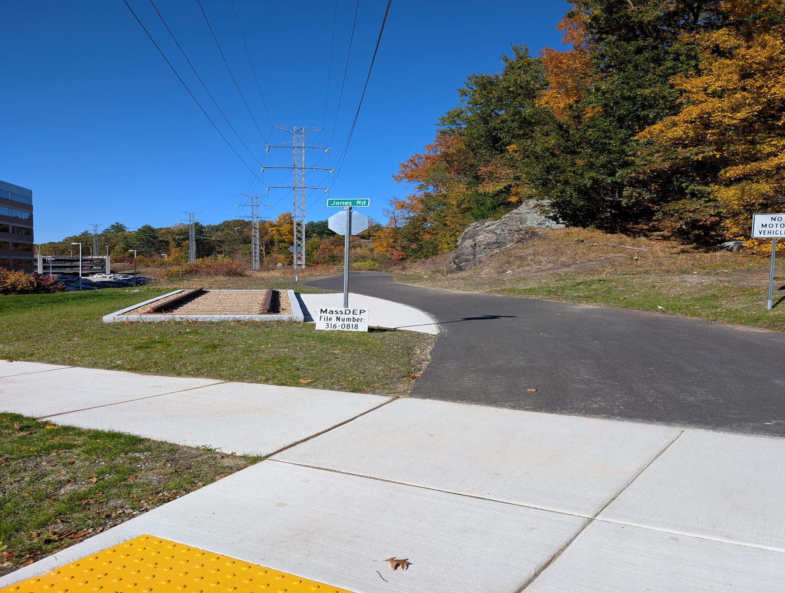
2025 Highlights
Jones Road
now open

Slide 7
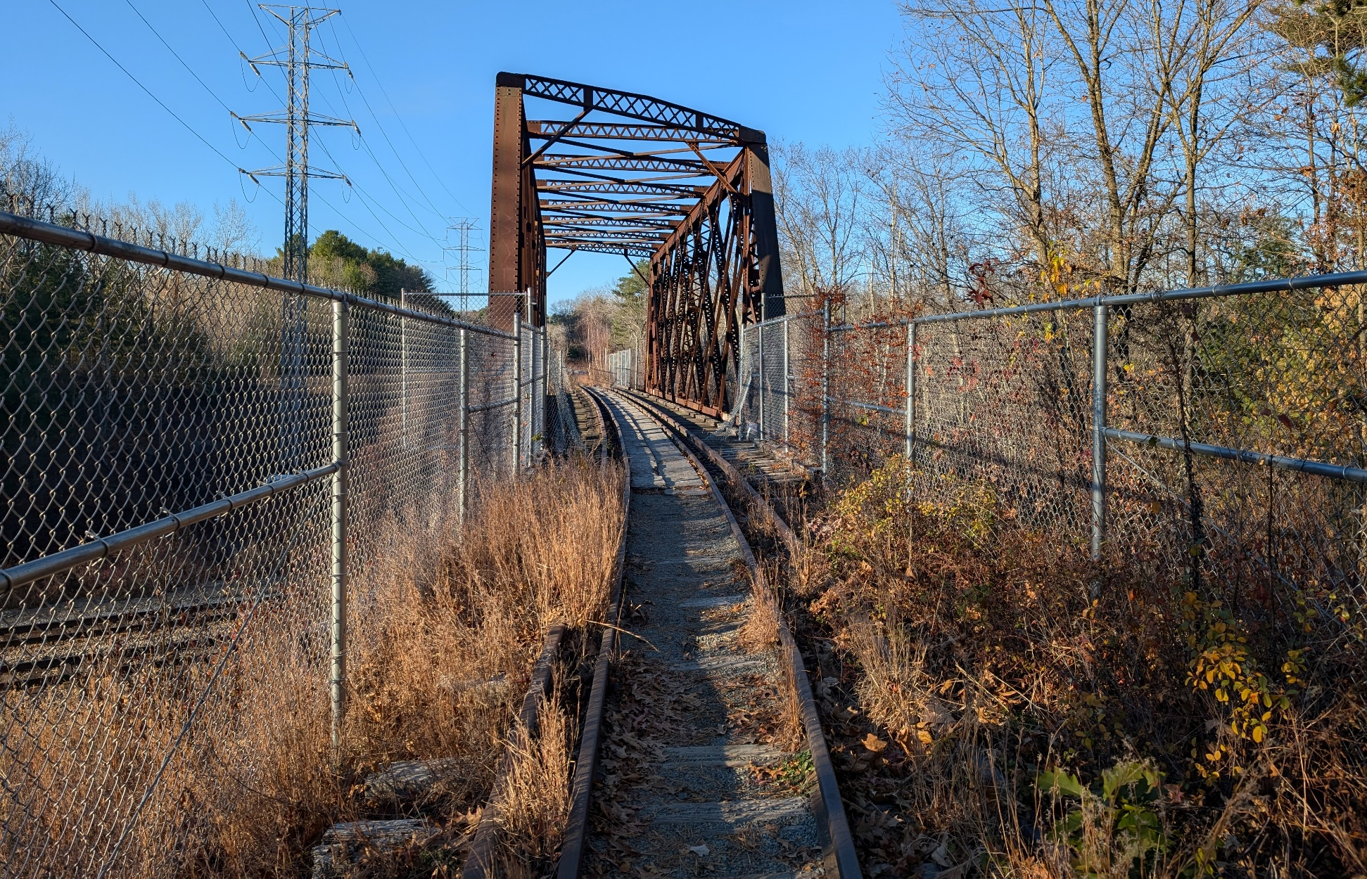
Waltham - Weston connection in 2024

Slide 8
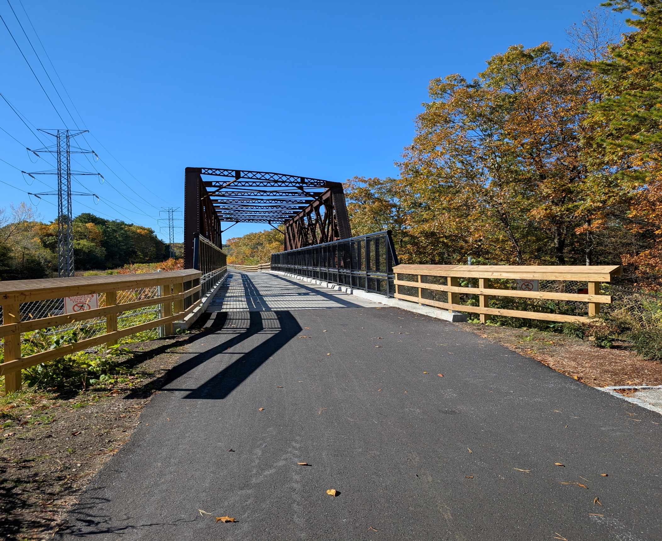
Waltham – Weston bridge 2025

Slide 9
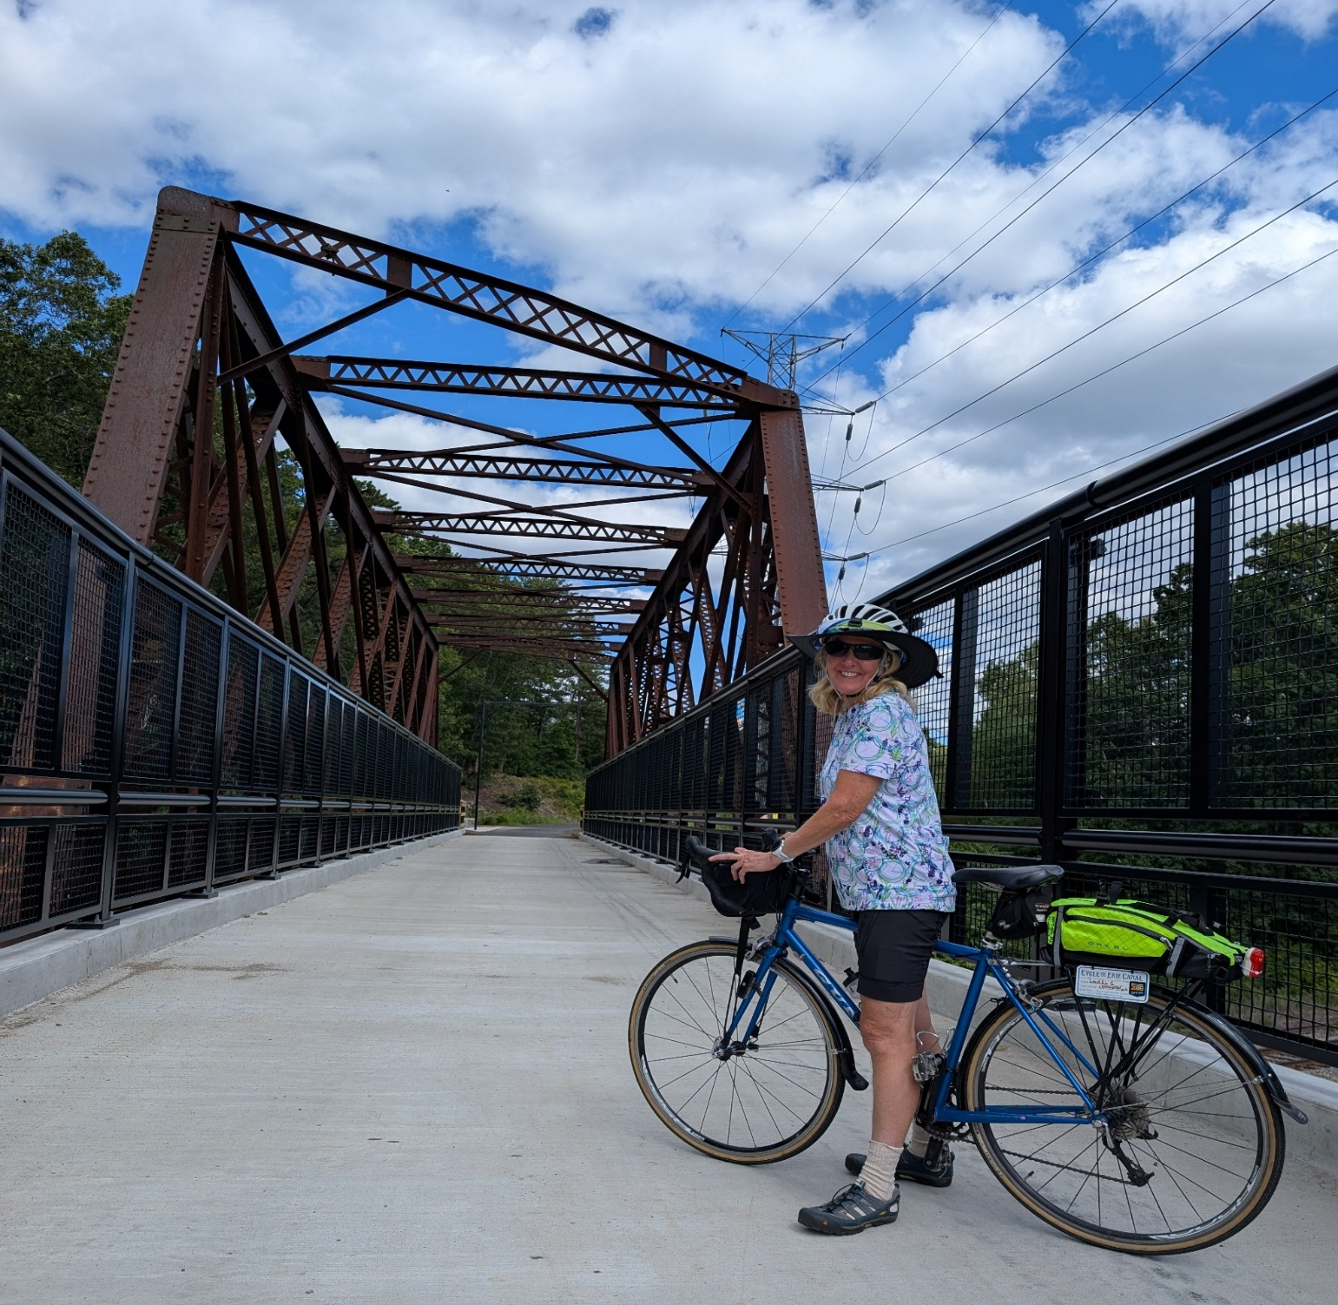
Waltham – Weston bridge 2025

Slide 10
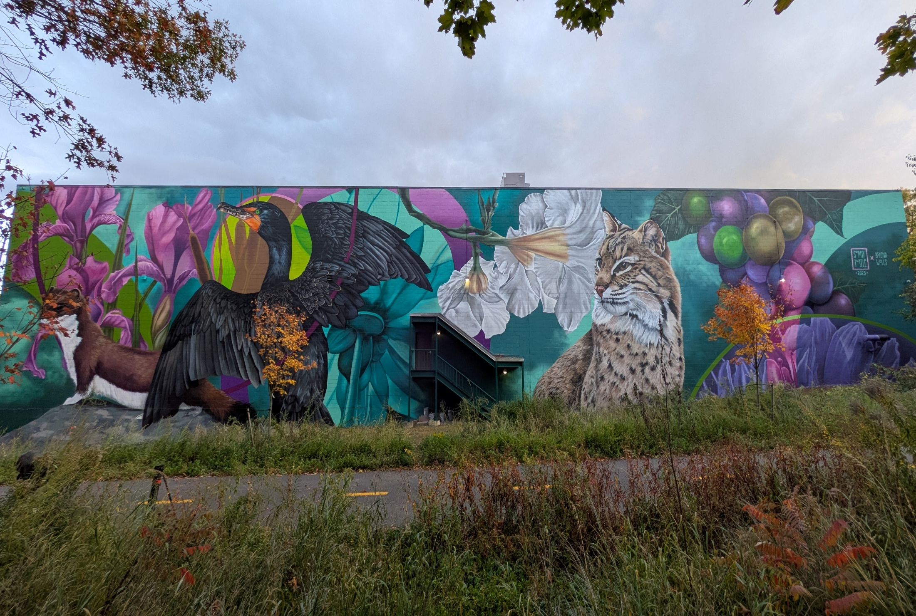
2025 Highlights: Public Art
Mural by Sophy Tuttle on DCF building
Notes:
Near 1265 Main Street

Slide 11
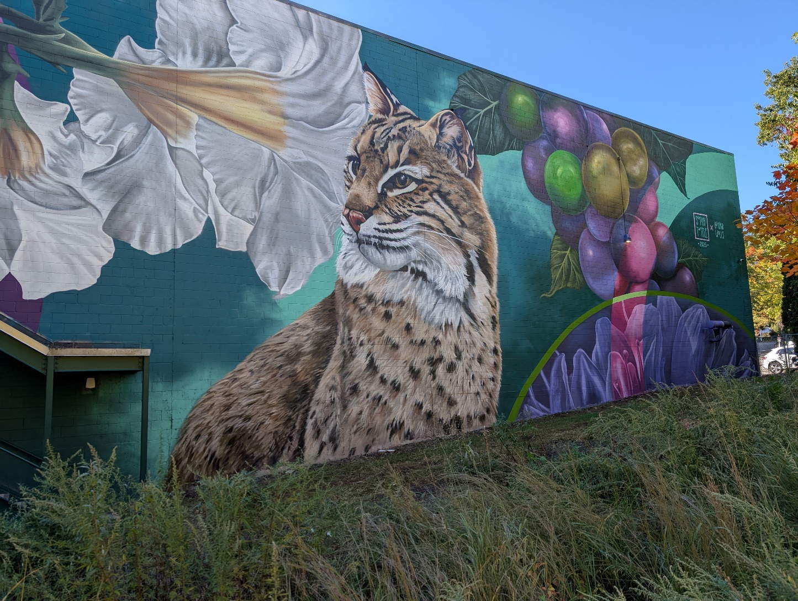

Slide 12
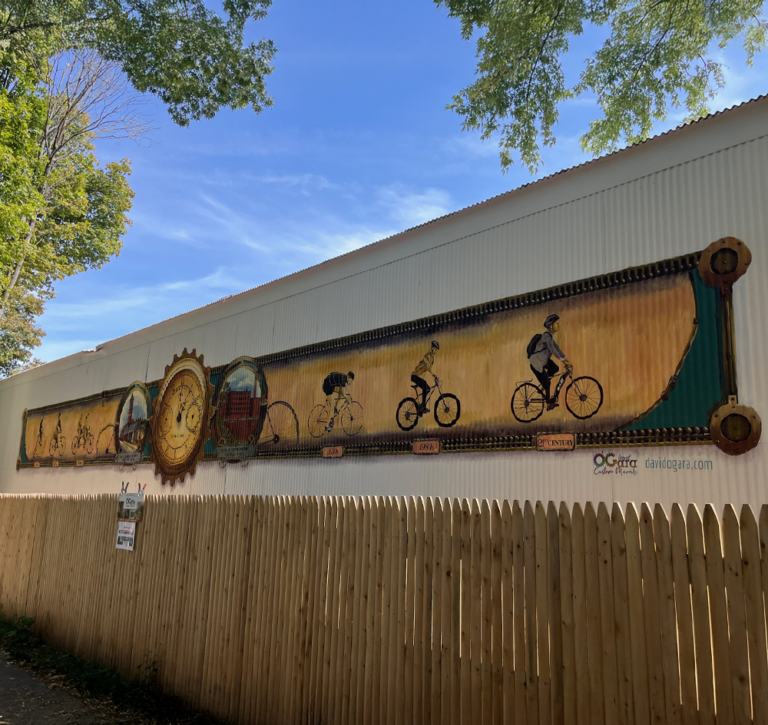
Trail features Waltham’s history & present
Notes:
Between Bacon and Hammond St, owned by Gloria and Peter Ryan

Slide 13
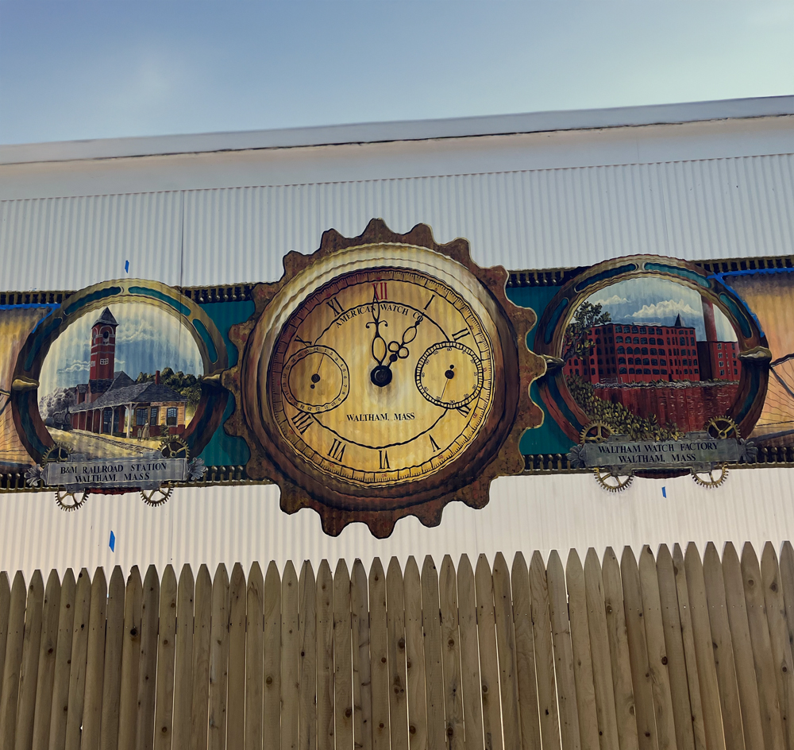
Detail of David O’Gara mural

Slide 14
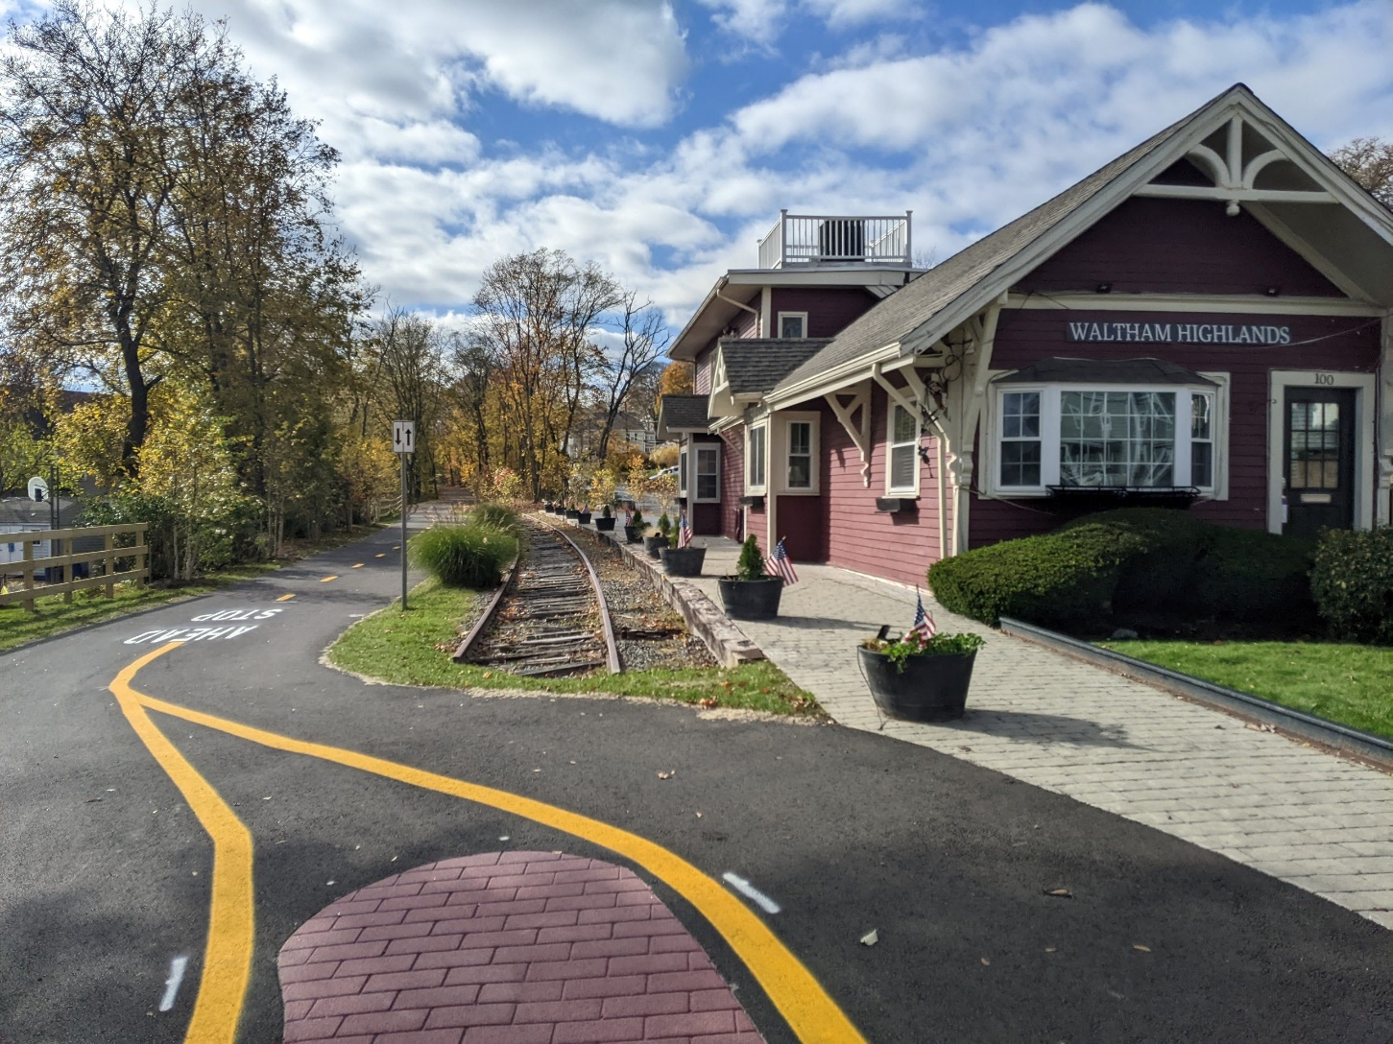
Highlands Station
Notes:
At Hammond St.

Slide 15
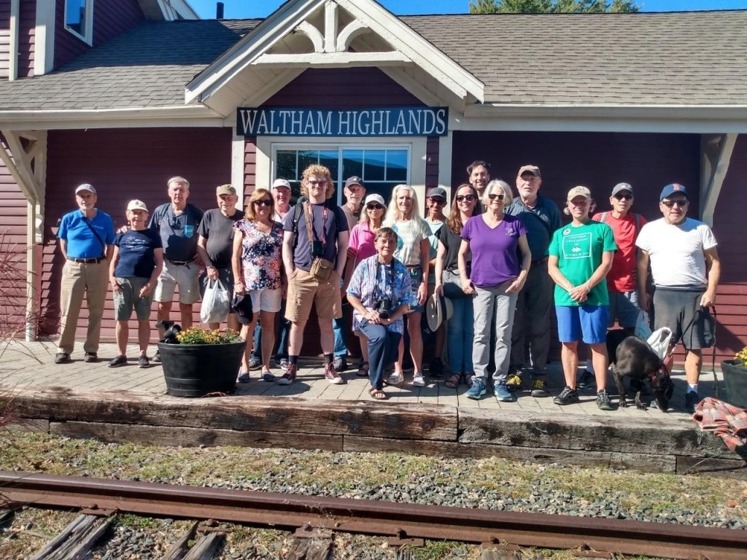
October 5, 2025 WLT/CRMII walk
Notes:
Led by Rick Kfoury, president of the Boston & Maine Railroad Historical Society,

Slide 16
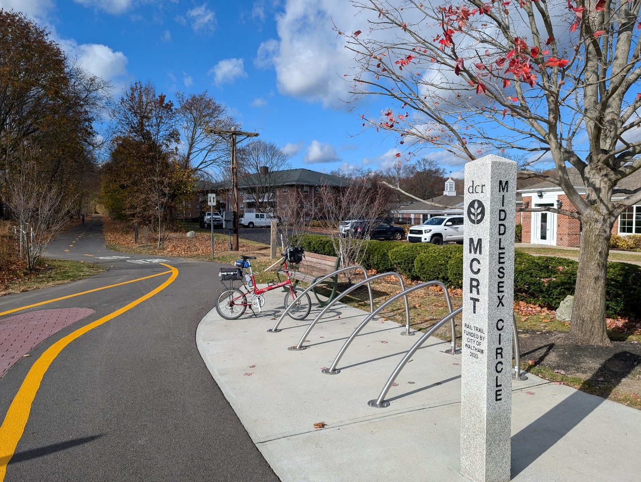
Community spaces

Slide 17
Linear park & connections
Busy trail counter at Lexington Street: walkers, strollers, wheelchairs, etc
Access to schools: Plympton, Fitzgerald, McDevitt and Bentley
Access to open spaces: Field Station, Lyman Estate, Prospect Hill Park, Berry Park, Charles River path
Access to trails in Weston & beyond

Slide 18
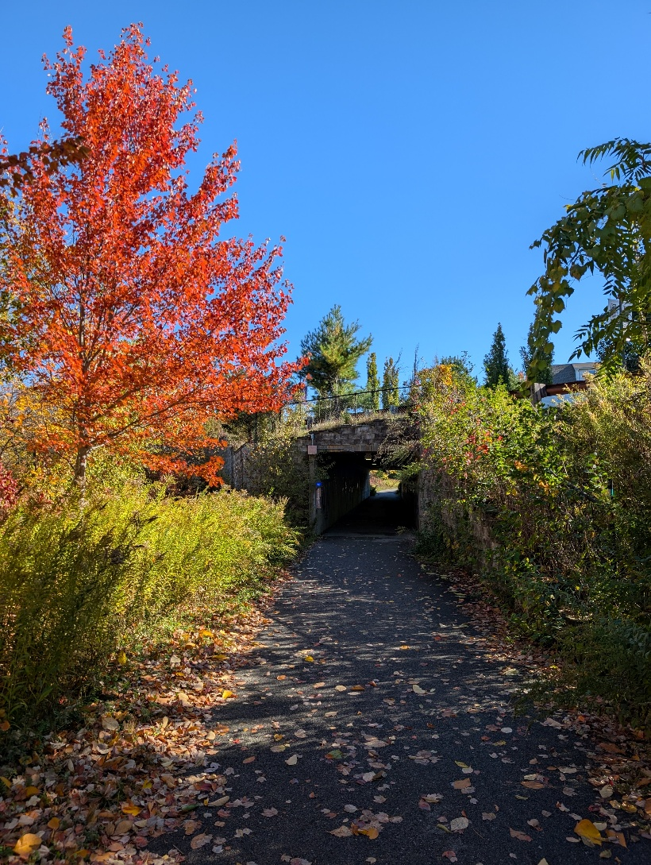
Fall color 2025

Slide 19
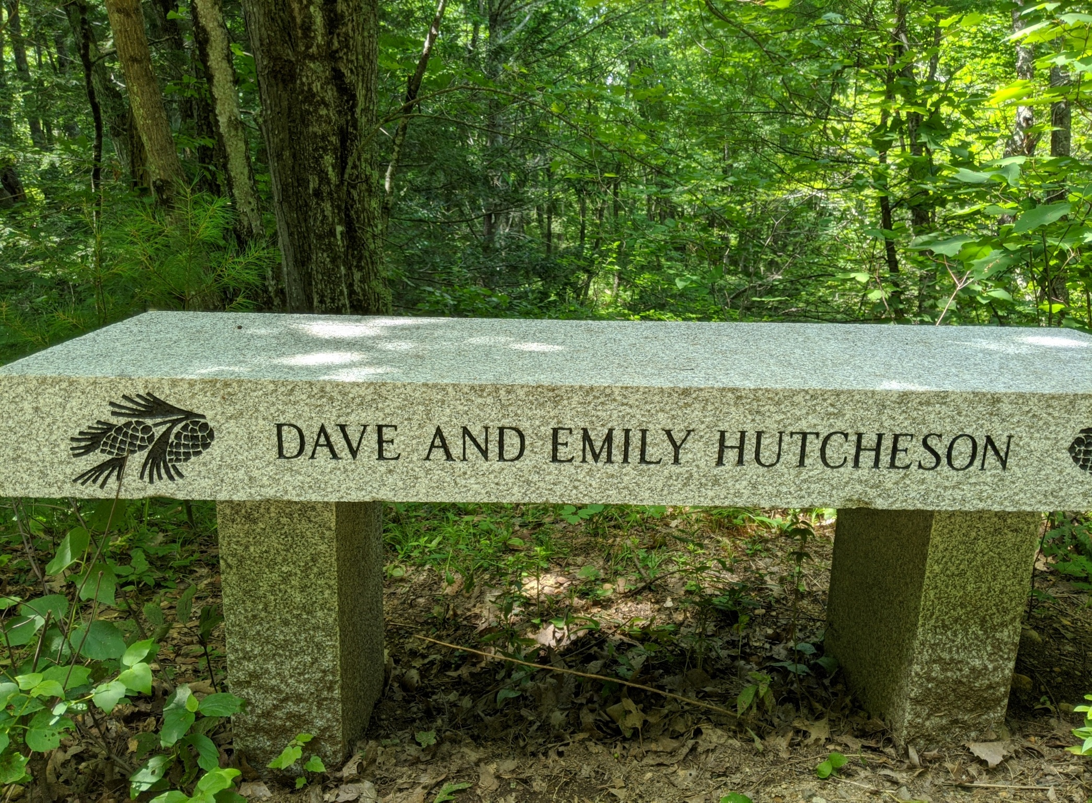
Thank you to all MCRT trail stewards
through the years

