Slide 1
Invasive Plants
Adam Green
Park Ranger
City Of Waltham, MA

Slide 2
Overview
Native vs Invasive vs Non-native
What are Invasive plants?
Invasive plant ID
Control methods

Slide 3
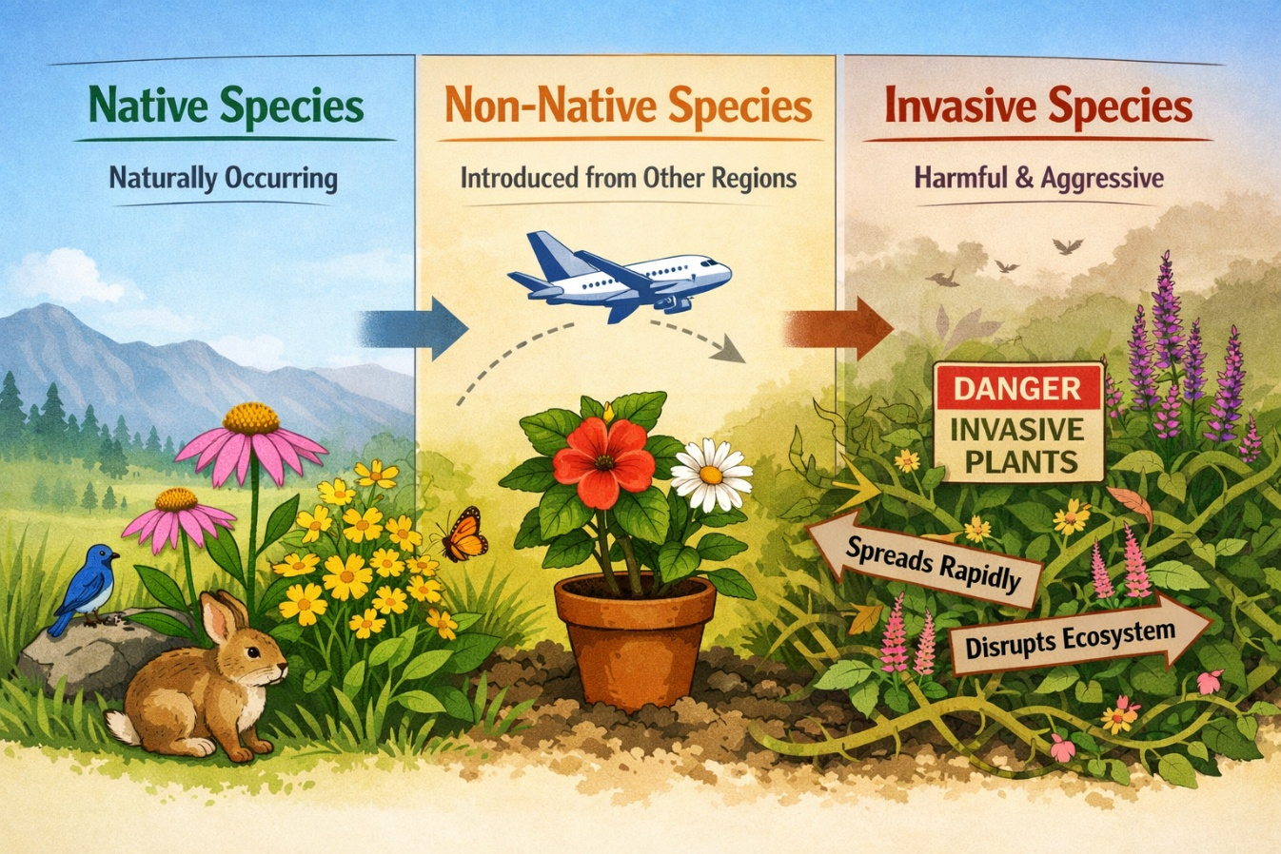
Native vs non-native vs invasive
More than 2,200 plants have been documented in Massachusetts.
725 of them are non-natives that are considered naturalized (established).
72 plant species have been categorized by the Massachusetts Invasive Plant Advisory Group (MIPAG) as "Invasive," "Likely Invasive," or "Potentially Invasive."
Nearly all of these invasive species have been banned for importation, propagation and sale in Massachusetts by the MA Department of Agricultural Resources.

Slide 4
What are Invasive plants?
Invasive species are non-native plants that disrupt native plant ecosystems.
They do real damage to the ecosystem where they have been introduced.
They establish away from the diseases and predators that helped to keep them in check in their home environments.
They are so aggressive that they quickly out-compete native species and significantly alter ecosystem relationships.
Their dominance reduces biodiversity—threatening or eliminating local plant and animal species.
Often, they spread extensively enough to form “monocultures,” areas where they literally are the only plant growing.

Slide 5
Invasive Plant ID
It is important to properly ID plants prior to working on them.
Different species require different management techniques.
Improper ID can lead to mismanagement during treatment and/or removal , this can cause more harm.

Slide 6
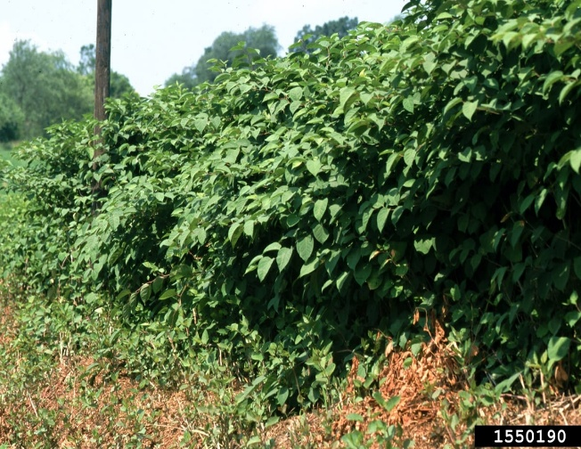
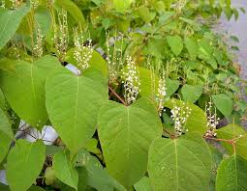
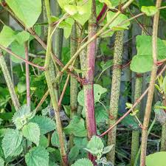
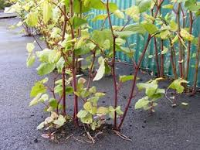
Japanese knotweed
Japanese knotweed is native to eastern Asia.
It was introduced to North America in the late 19th century as an ornamental plant and, crucially, for erosion control along roadways, rivers, and embankments.
While initially prized for its fast growth and deep, dense root systems that can stabilize soil, it soon escaped cultivation to become one of the most destructive invasive species.
It can grow in a wide range of habitats including riparian areas, wetlands, roadsides, ditches, and fence lines.
It forms dense thickets of bamboo-like vegetation that aggressively outcompetes native plants and negatively impacts wetland and riparian areas.
This invasive plant has hollow, smooth, purple to green colored stems.
Knotweed can grow to over 10 feet in height.
Growth rates are generally 3 to 4 inches per day during the summer.

Slide 7
Japanese knotweed control
The primary objective in controlling Japanese knotweed is eliminating the rhizome system. Rhizomes are creeping underground stems that give rise to new shoots and roots.
There are two phases of knotweed management: initial control and maintenance. The control phase for knotweed takes at least two seasons and consists of either two applications of herbicide or a cutting with a follow up of herbicide.
Late season application of herbicide in the control phase is especially effective because this is when the foliage is sending sugars produced through photosynthesis to the roots and rhizomes.
Cutting alone is not as effective; sites must be visited multiple times during the growing season over many years.
Cutting prior to an herbicide application can be very helpful. Cut in June and wait at least eight weeks after cutting to treat the resprouting plants with herbicide.

Slide 8
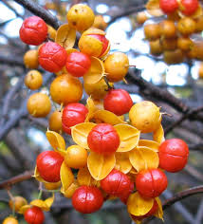
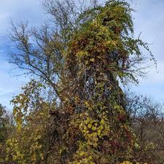
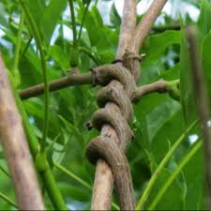
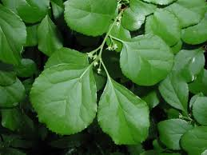
Asiatic bittersweet
Introduced to the United States in the 1860s from East Asia.
Chokes out desirable native plants by smothering them with its dense foliage and strangling stems and trunks.
In some areas, it forms nearly continuous blankets along entire stretches of woodlands.
Single vines can reach 60 feet in length, though it will only grow as high as the vegetation it is climbing.
As a perennial vine, it puts on yearly growth and can reach diameters of over 10 inches.

Slide 9
Asiatic bittersweet control
Attacking the root system is the only way to kill the vine,.
However freeing surrounding trees and other vegetation from the weight of the aerial stems by cutting them at ground level is typically the first step in controlling the vine.
Cut as low to the ground as you can, then make another cut as high up the tree as you can.
The most practical method to injure the root system of is to treat the regrowth following cutting with a foliar herbicide application.

Slide 10
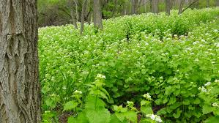
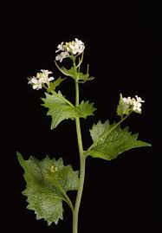
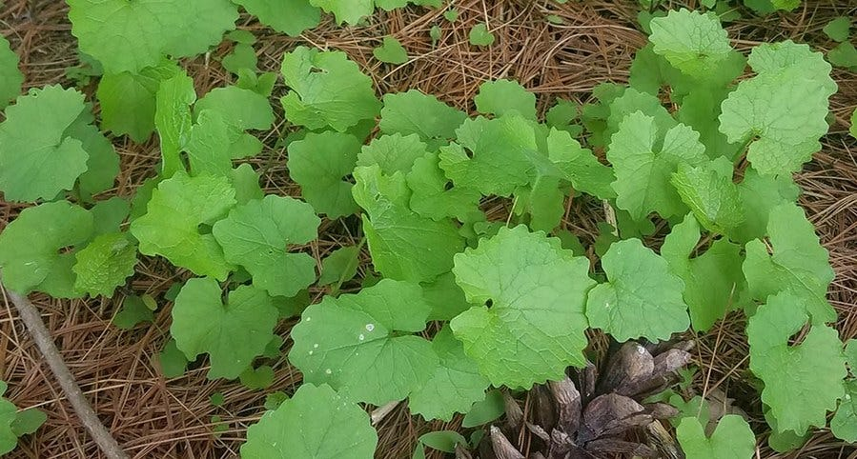
Garlic Mustard
An herbaceous member of the mustard family (Brassicaceae) brought over by early European settlers.
First documented in New York in 1868, it was used as a source of food and medicine.
This plant's biennial life cycle consists of a ground-level, or "basal," year and a reproductive, or "bolt," year.
Garlic mustard's vigorous reproduction has enabled it to spread from coast to coast, where it blankets habitats.
Is allelopathic, releasing chemicals (specifically glucosinolates and flavonoids like sinigrin) into the soil—to inhibit the growth of native plants and beneficial mycorrhizal fungi.
A prolific seeder it forms dense monocultures, leaving little room for native plants.

Slide 11
Garlic Mustard Control
Garlic mustard has a taproot, and unlike some invasive herbaceous perennials, it does not regenerate from root fragments.
This is one of the few invasive plant species that can be controlled manually by pulling.
Manual operations that completely remove shoot tissue will prevent regrowth.
Ideally, plants should be pulled before flowers
It is best practice to bag and remove pulled plants from the site, as even early pulling treatments probably include some plants that have, or will develop, viable seed.

Slide 12
Questions?
My contact information
Adam Green
Park Ranger
Waltham Recreation
314 Totten Pond Rd
Waltham, MA 02453
Office Phone: 781-314-3452

