Slide 1
Waltham Land Trust’s Stewardship Training
April 18, 2026

Slide 2
WLT’s Mission
The Waltham Land Trust’s mission is to create a legacy of land conservation in Waltham by promoting, protecting, restoring, and acquiring open space.
We envision growth in public appreciation of natural resources, preservation and restoration of native habitat, and increased biodiversity to foster a healthier environment.

Slide 3
Waltham Land Trust’s People
Founded in 1999 by neighborhood associations (HPA, PHAG, Beaver Brook, Island), community activists, environmentalists, and “just plain folks“
Currently 15 Board Directors, 8 Advisors
Executive Director, 30 hours/week. Tech & Development Manager, ~10 hours/week
6 committees of board members, ED, others
440 paying members receive The Journal
3000 supporters receive upcoming event e-blasts
400 trained volunteer stewards--including you!

Slide 4
WLT’s Funding
Membership dues (individuals and businesses) and individual contributions
Major special events -- Green Space Blues Jam May 15 band, snacks, drinks, auction. WG5K in October.
Grants from local foundations, family foundations, the Commonwealth
Fundraisers: Wed. 4/29 Jake n JOES, group table @ 6 p.m. (WLT gets 20% when you tell them to “flag your check” in person or pick ”fundraiser” online)

Slide 5
WLT’s Volunteer Stewards
  Regularly monitor section of trail
  On your own or with others
  Complete Reporting Form online every time
  Remove trash (we provide bags & gloves)
  Can remove invasive plants once trained
  Plant natives, mainly during group activities
  Ideally recruit new stewards while working!

Slide 6
WLT’s Stewardship Projects
Western Greenway Trail
  Stewards established 2012
  In Waltham, from Metropolitan Parkway west to Lot 1, south to Beaver Street (map on next slide)
  Easements “owned” by WLT
  Waltham Police, Fire, and Public Works help out
  Online Reporting Form goes to Sonja
    No “official” receives report if problem

Slide 8
WLT’s Stewardship Projects
Prospect Hill Park
  Stewards est. 2014
  Owned by City of Waltham
  Work closely with Ranger, Recreation Dept., Rec. Board
  Online Reporting form goes to Sonja & Ranger Adam
Charles River paths (incl. Woerd Woods by Watch Factory)
  Stewards est. 2014
  Owned by MA Dept. Conservation & Recreation (DCR)
  Online Reporting Form goes to Sonja
    DCR (Erica) receives if problem needs addressing

Slide 9
WLT’s Stewardship Projects
Mass Central Rail Trail (MCRT)
  Stewards est. 2015
  Owned by MBTA, leased by DCR
  Online Reporting Form goes to Sonja
    DCR (Erica) receives if problem needs addressing
Beaver Brook North and Historic reservations
  Stewards est. 2015
  Owned by DCR
  Online Reporting Form goes to Sonja
    DCR (Chris) receives if problem

Slide 10
WLT’s Stewardship Projects
  Hardy Pond wetlands, shoreline, Smith Point, and Lakeview Avenue properties
    Stewards est. 2017
    Hardy Pond itself, wetlands and shorelines owned by public
    Lazazzero and Graverson parks owned by City of Waltham, Recreation Dept.
    Smith Point and Lakeview Preserve owned by WLT
    Online Reporting Form goes to Sonja
      No “official” receives report if problem

Slide 11
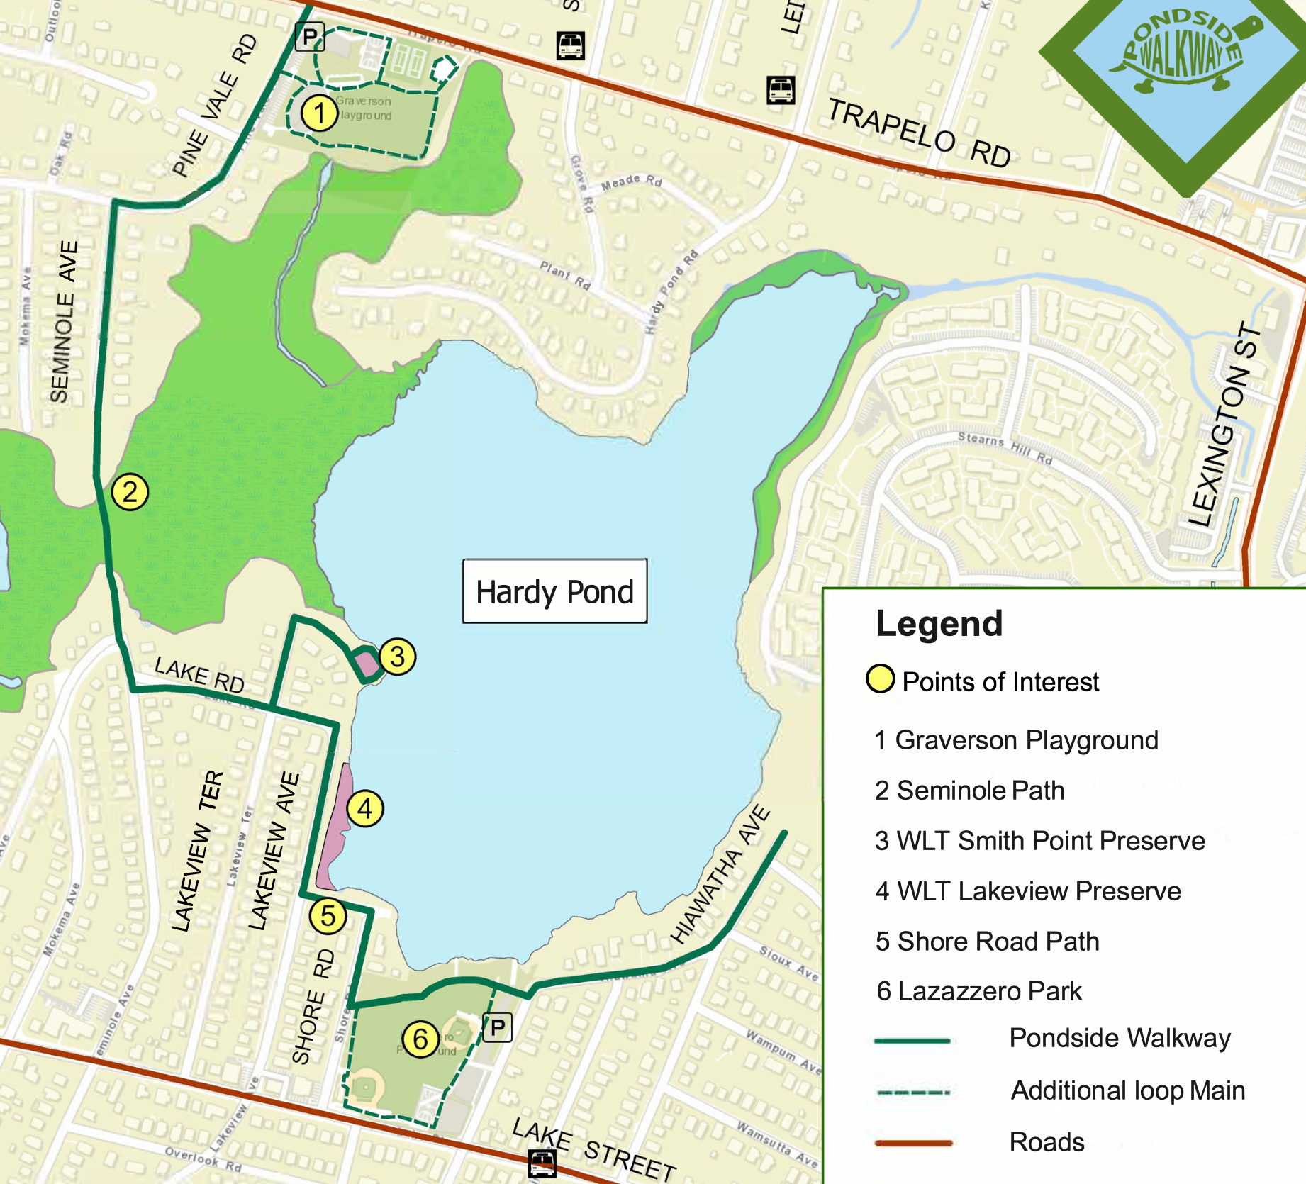

Slide 12
WLT’s Stewardship Projects
  Wellington Fields
    Located at 775 Trapelo Road next to historic house
    Stewards est. 2021
    Owned by City of Waltham
    Work closely with Ranger, Recreation Dept., Rec. Board
    Lots of corporate/group volunteer work sessions
    Online Reporting Form goes to Sonja
      No “official” receives report if problem

Slide 13
Becoming an Official
WLT Steward
All must complete WLT interest form!
Once WLT gets form, added to the stewards e-list:
  mainly used by me to remind folks of activities
  stewards use it to organize small cleanups, ask ?s
  sometimes can be lots of emails
  ”digest” option link at bottom of each email
Meet at office for supplies and orientation if can’t make annual training

Slide 14
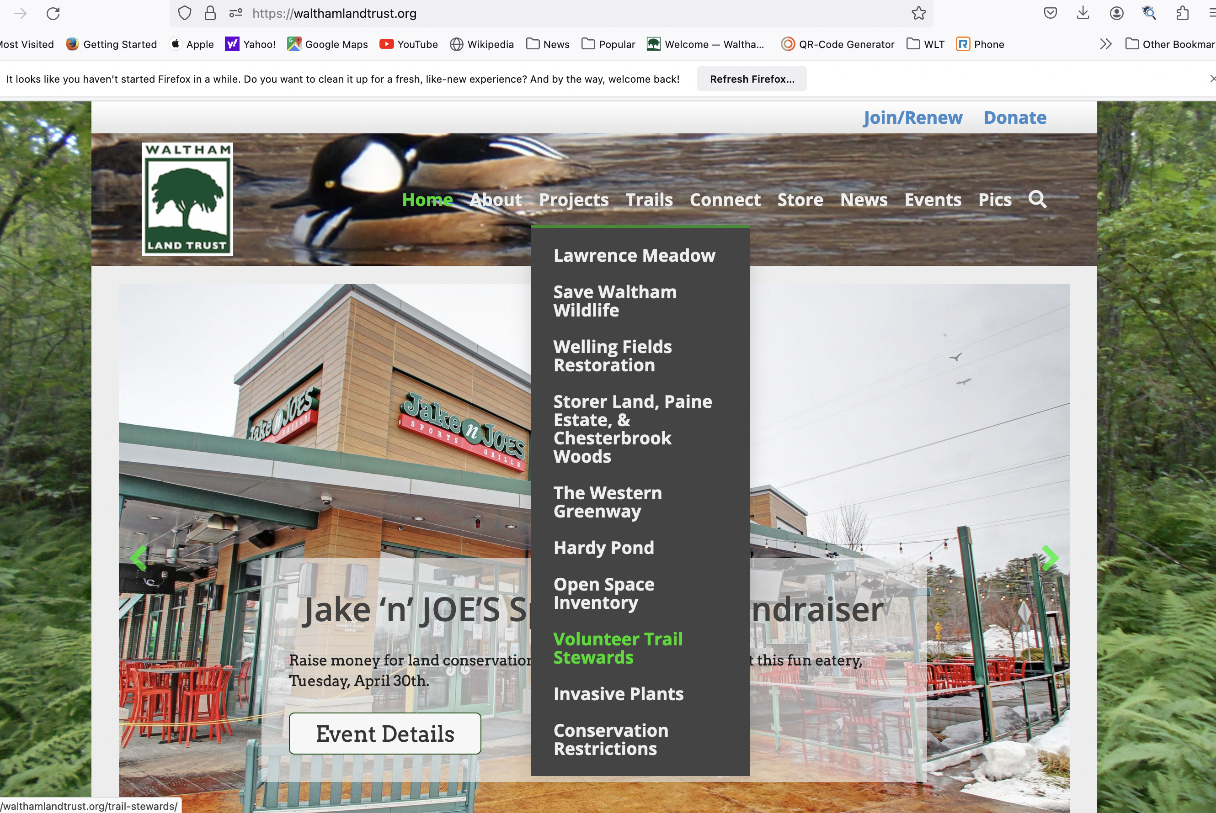
Trail Steward Resources @walthamlandtrust.org
  Projects → Trail Stewards → program description, form

Slide 15
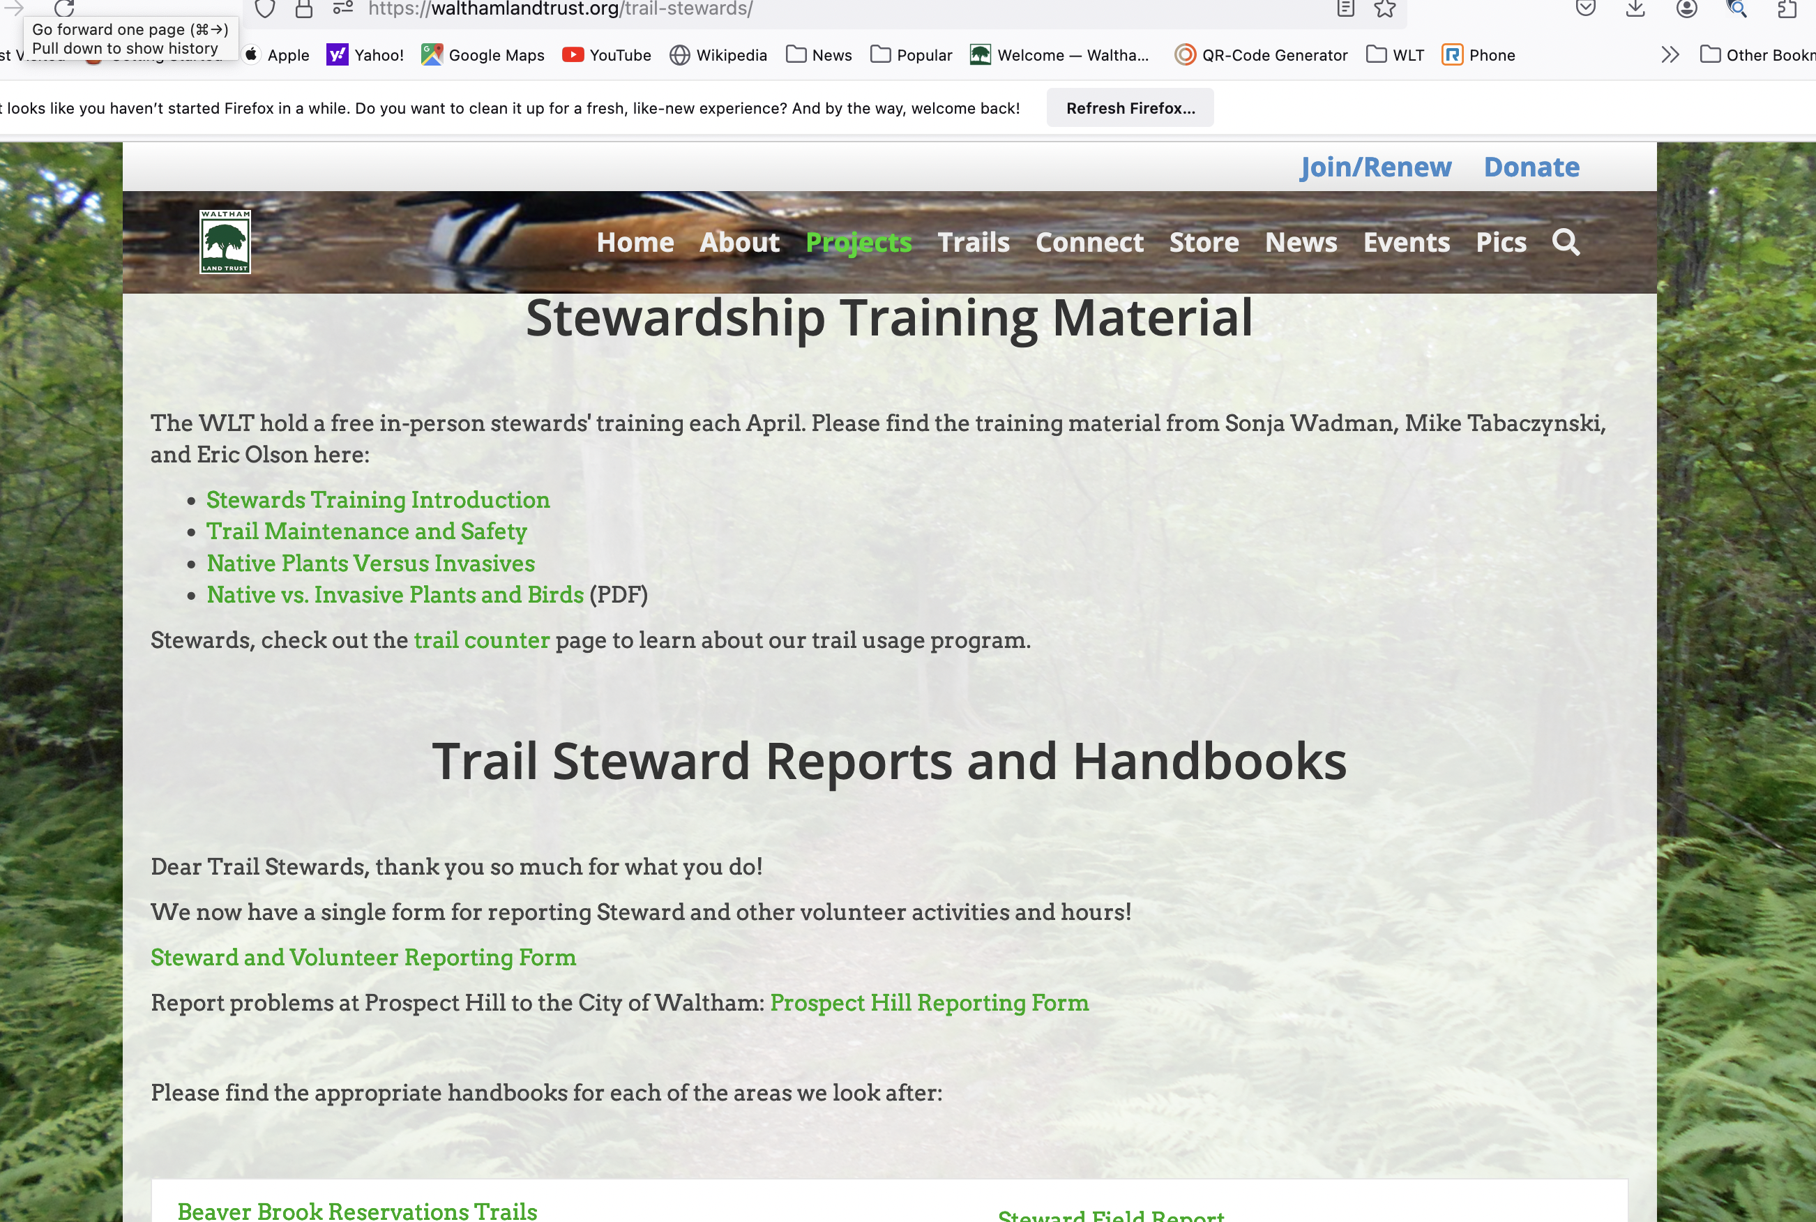
Trail Steward Resources @walthamlandtrust.org
Notes:
Top part of page describes program, where we steward
Links to training materials

Slide 16
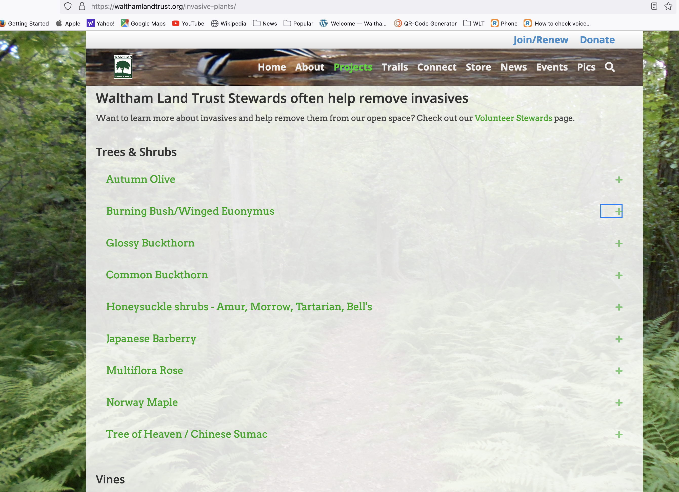
https://walthamlandtrust.org/invasive-plants/

Slide 17
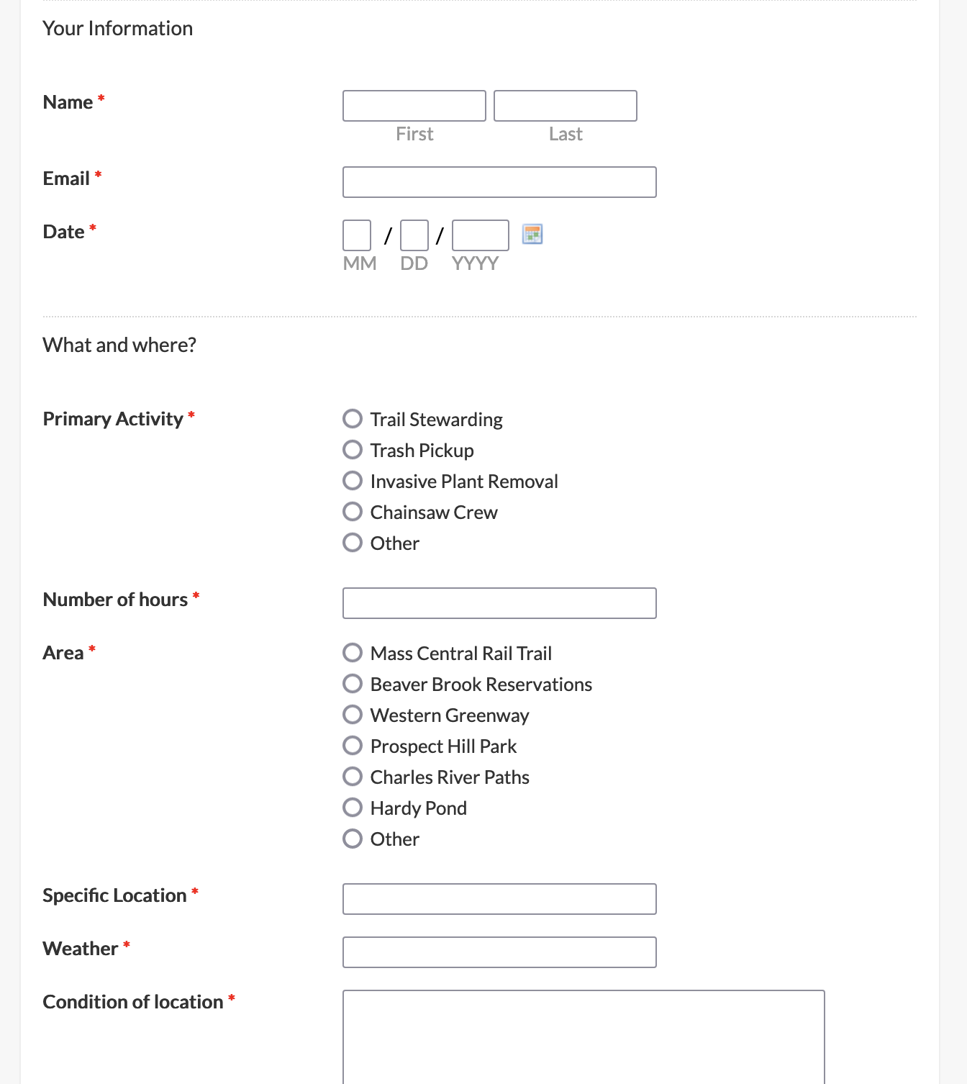
Online Reporting Form

Slide 18
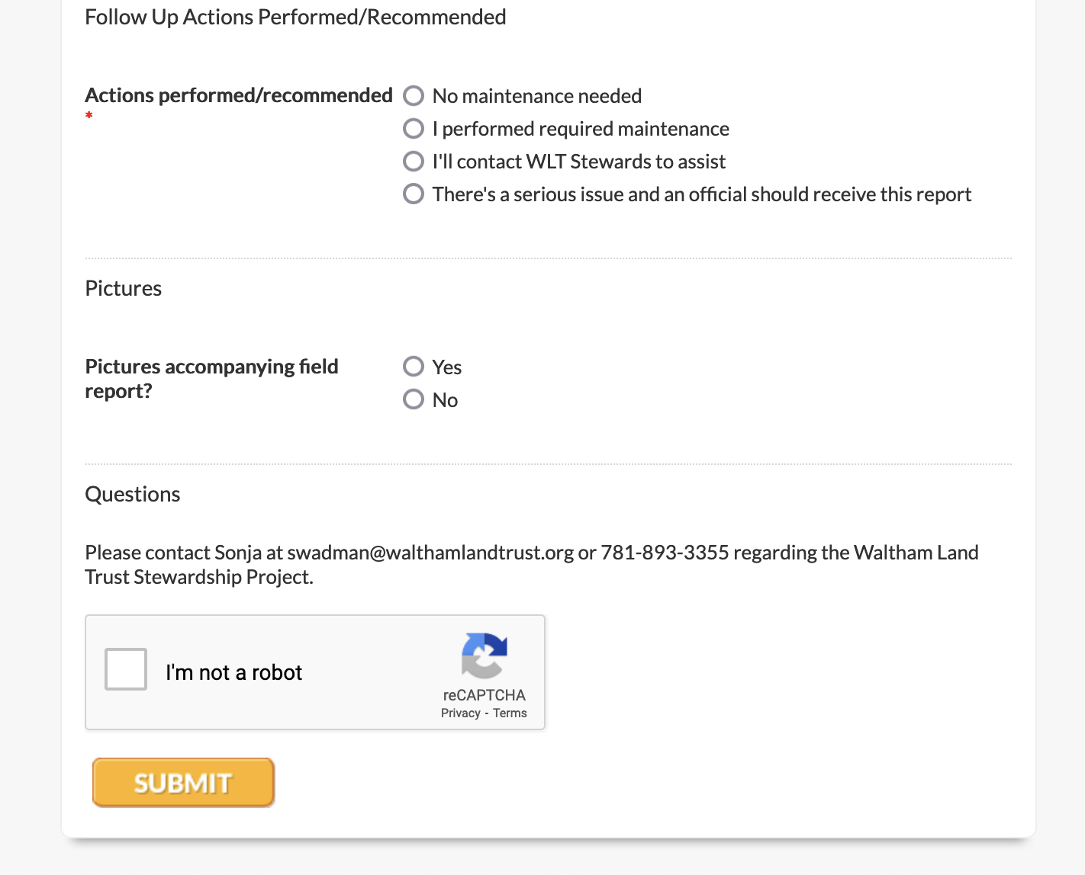
Online Reporting Form

Slide 19
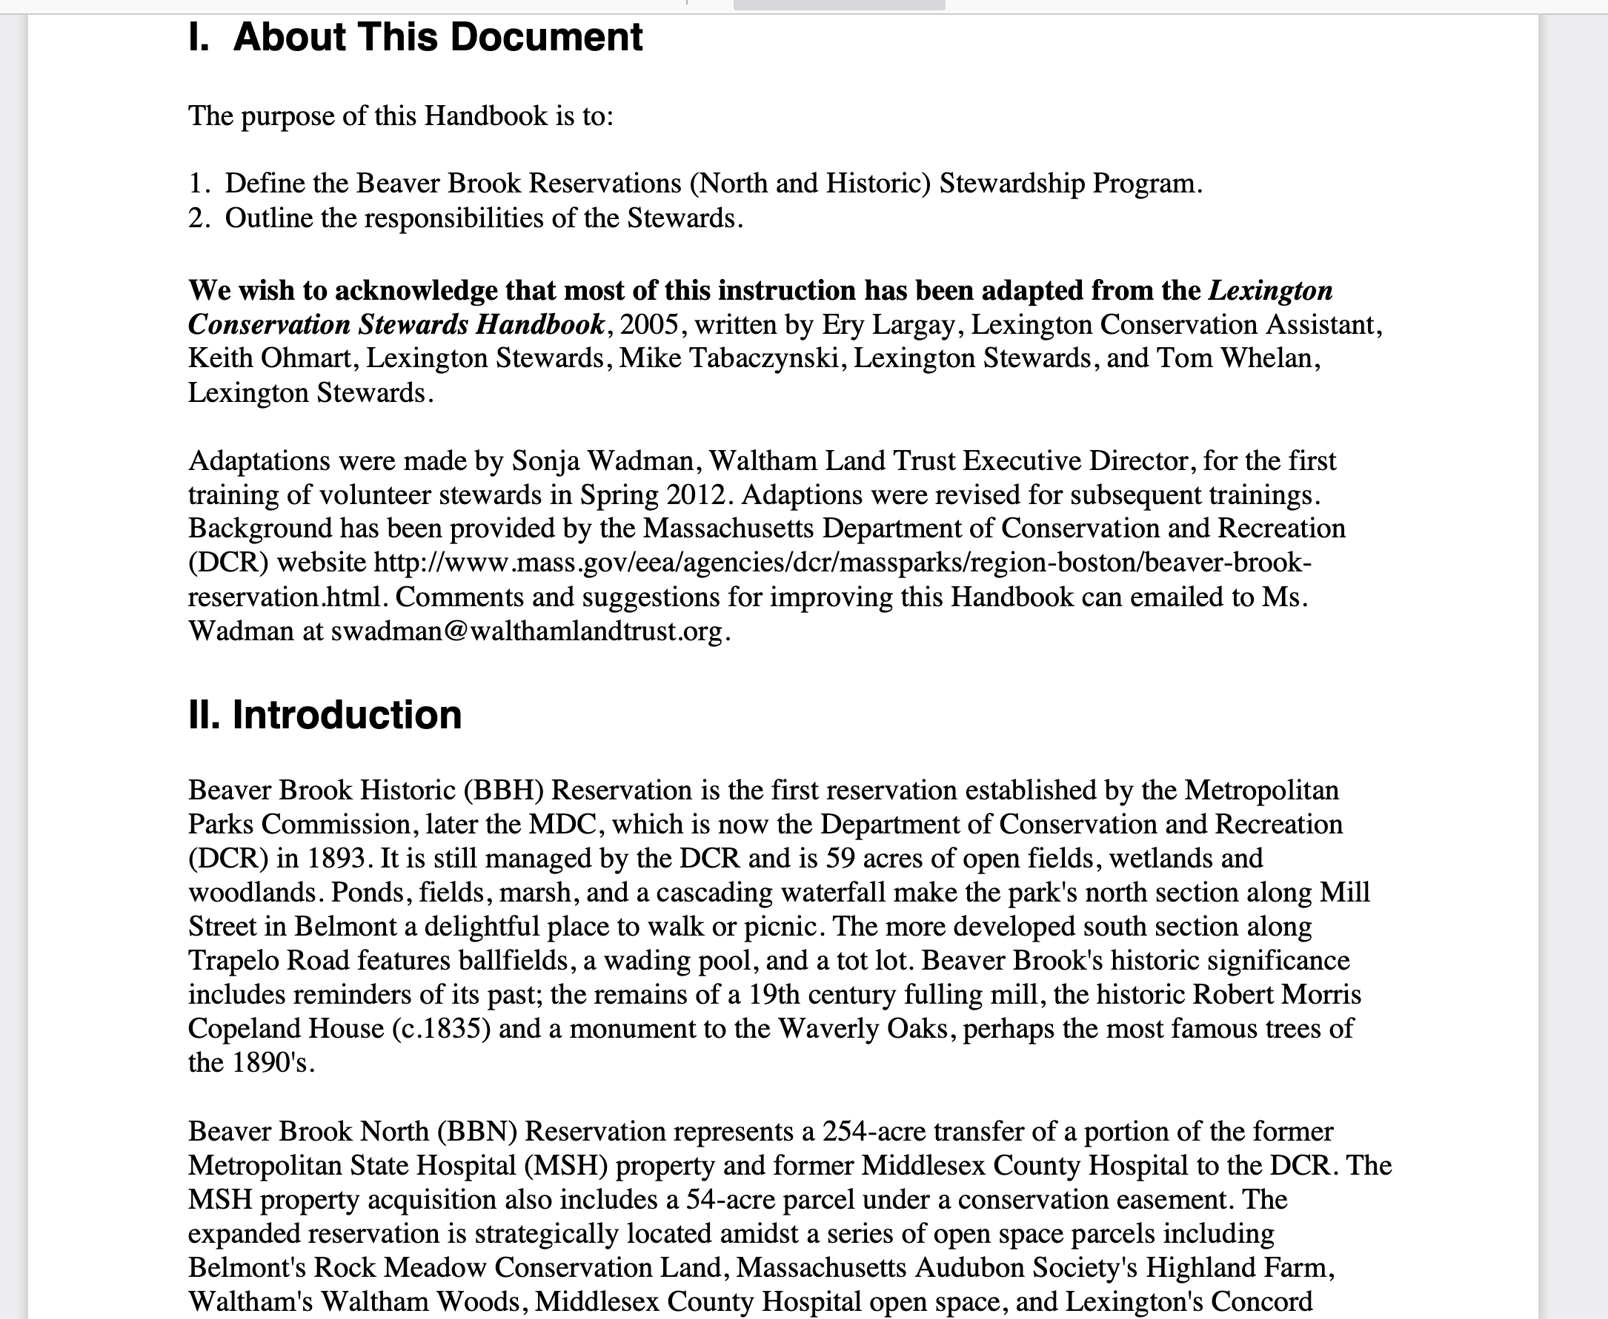
Stewardship Handbooks
Notes:
Different for each location (owner, contacts), PHP looks different bc City
Contain description of location (owner, history), WLT, stewardship program, Basic Do’s and Don’ts, what to bring & take note of, dealing w/HazMats, meeting people, invasives, trimming, owner/emergency contacts.

Slide 20
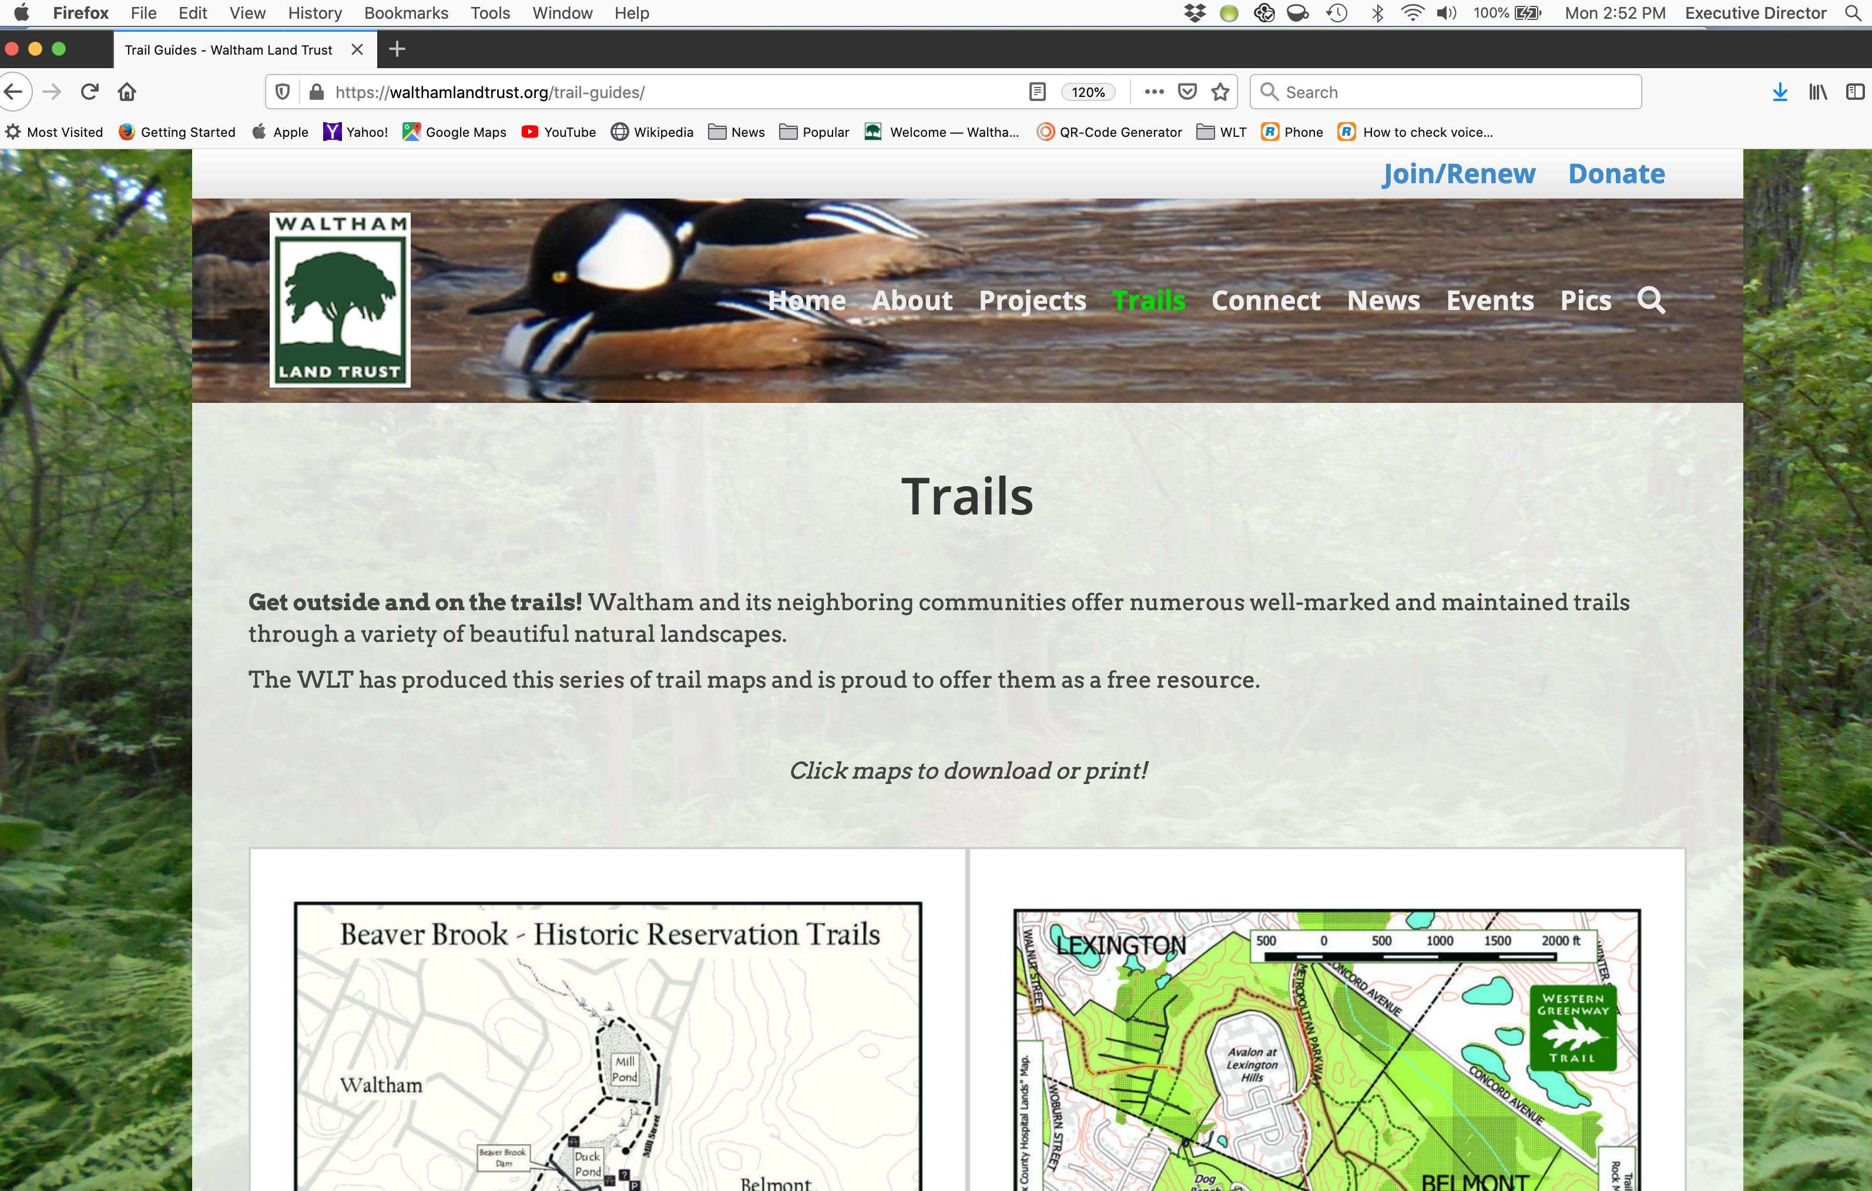
Trail Guides & Maps @walthamlandtrust.org
Trails→ Choose the proper locale

Slide 21
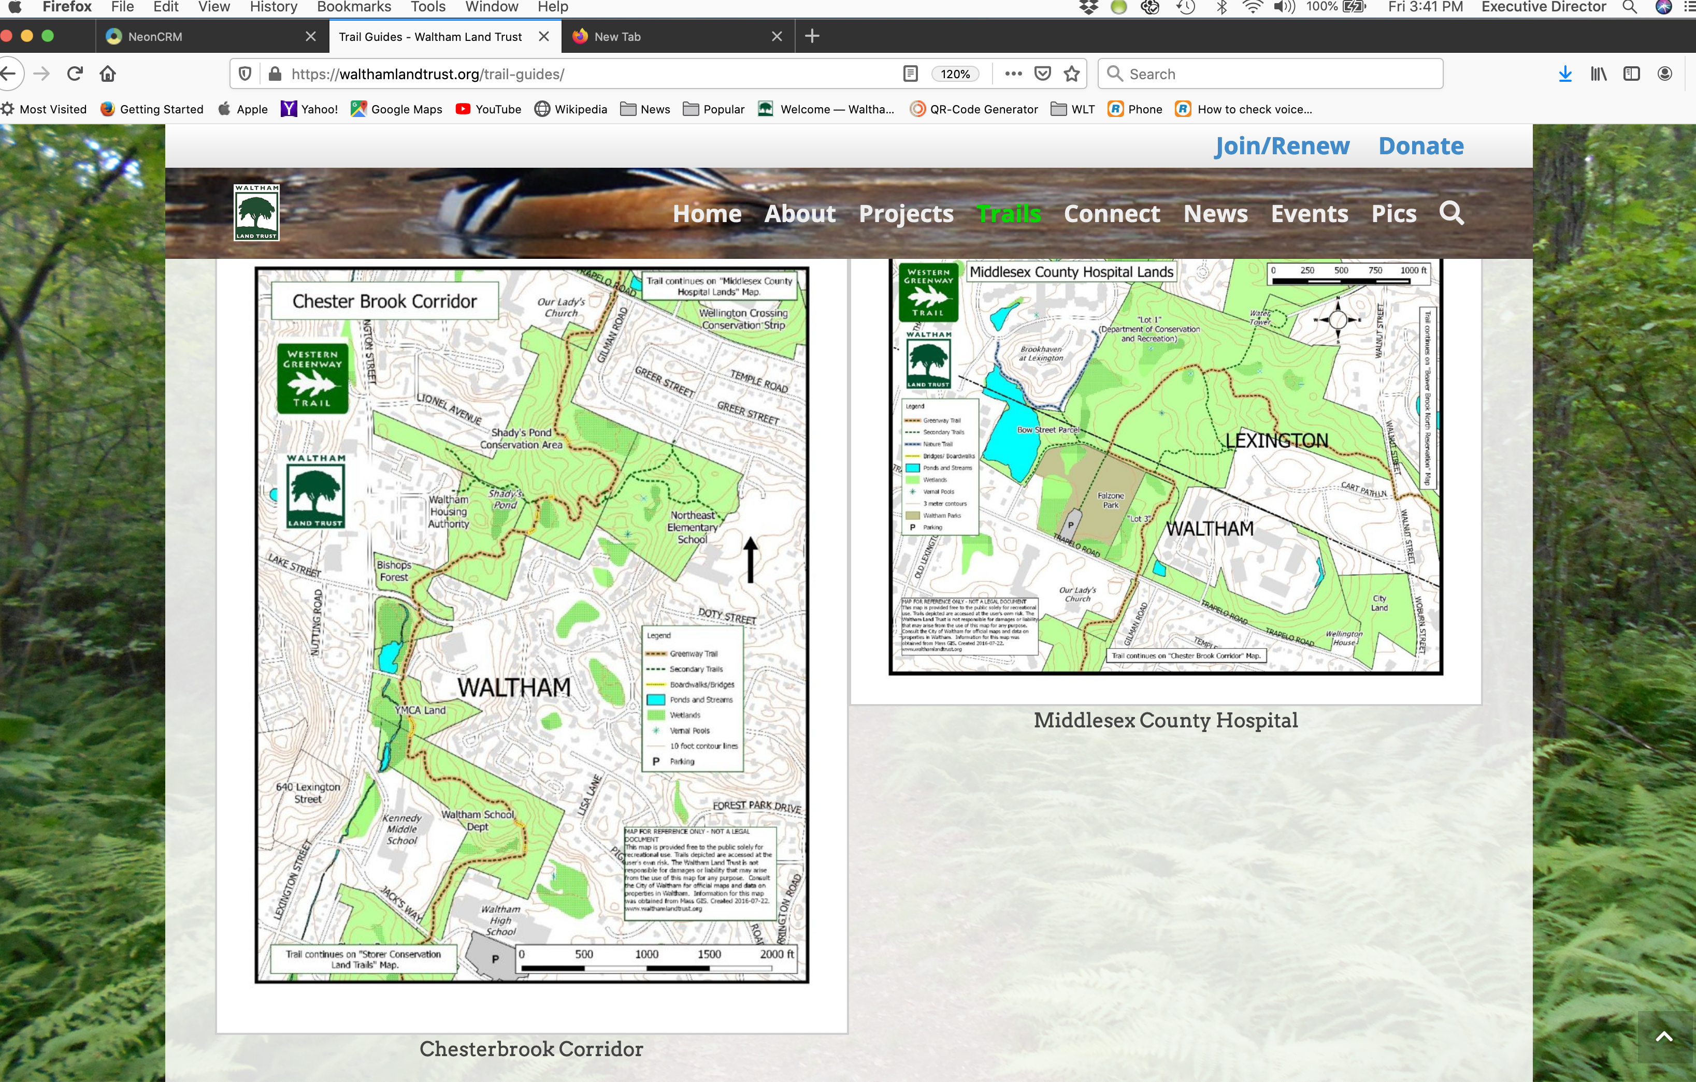
More Trail Guides

Slide 22
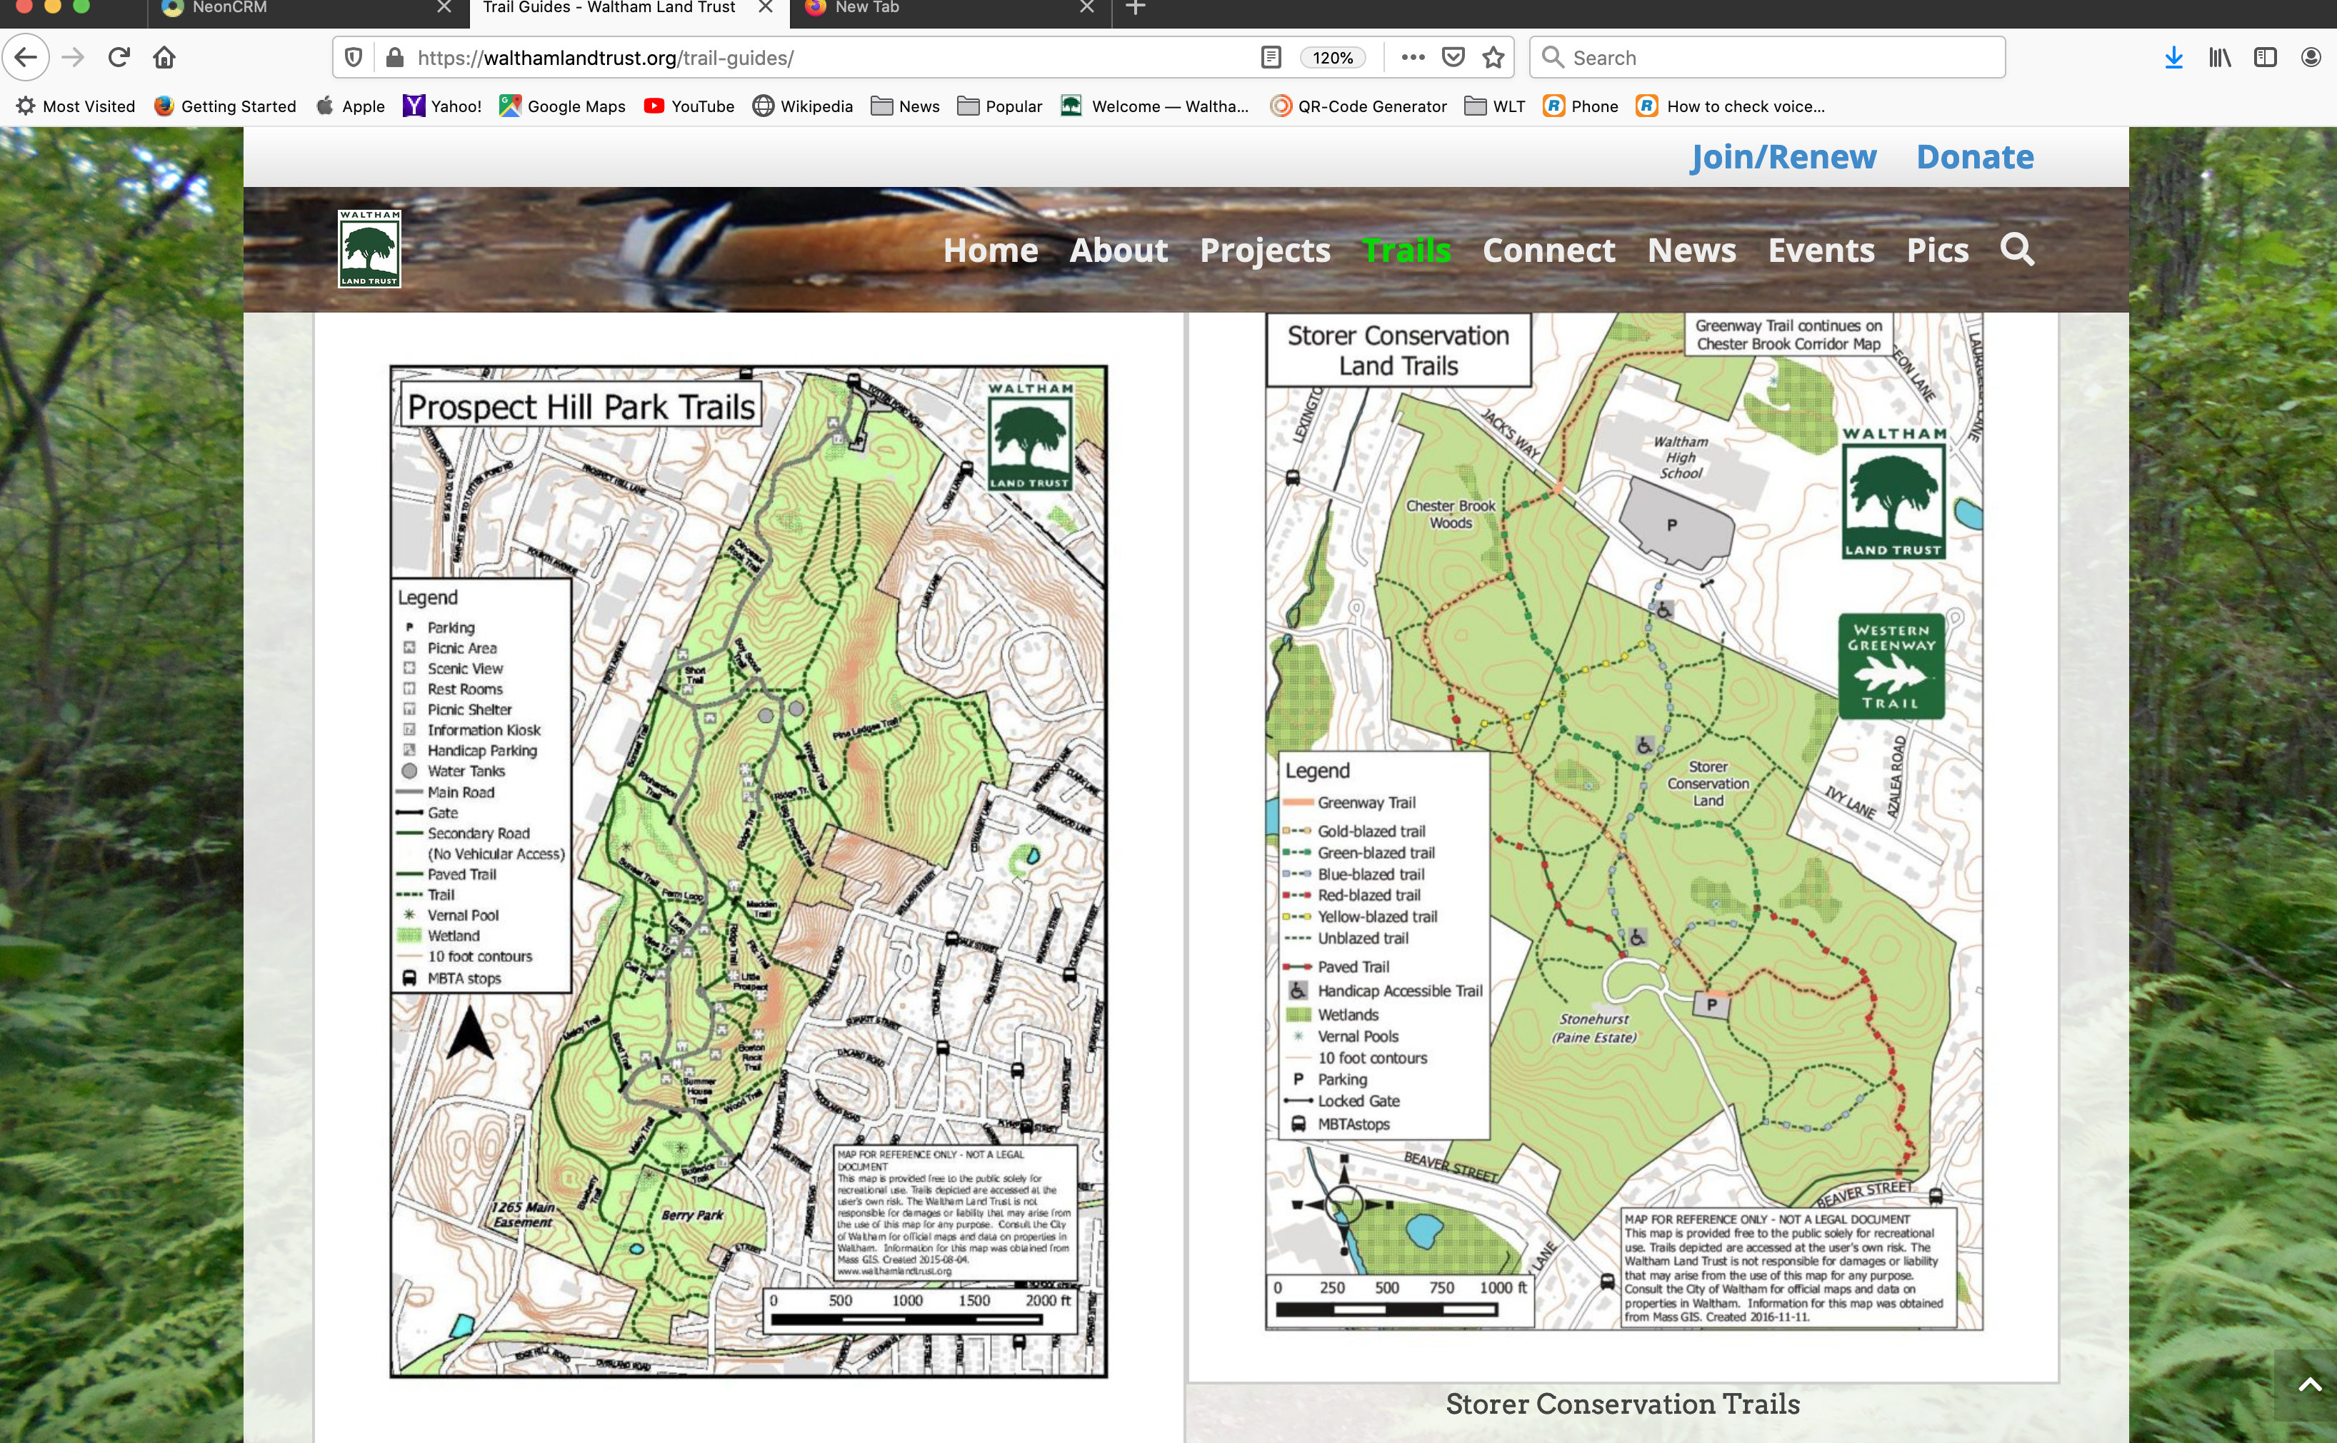
More Trail Guides

Slide 23
Upcoming Group Events
Charles River Earth Day Cleanup Sat. April 25, 10-noon, park/meet @ Shaw’s, 130 River St. ATTENDANCE HIGHLY DESIRED
Friends of PHP kickoff event Sun April 19, 10-noon
We encourage stewards to self-organize small events on your own (with WLT support/supplies)
Active stewards will organize work parties
  Hardy Pond area and Wellington (Betty MacKenzie)
  Along Charles River (Emily S. & Jeremy P.)
  MCRT, Chester Brook Corridor, and Lyman (Charlie)

Slide 24
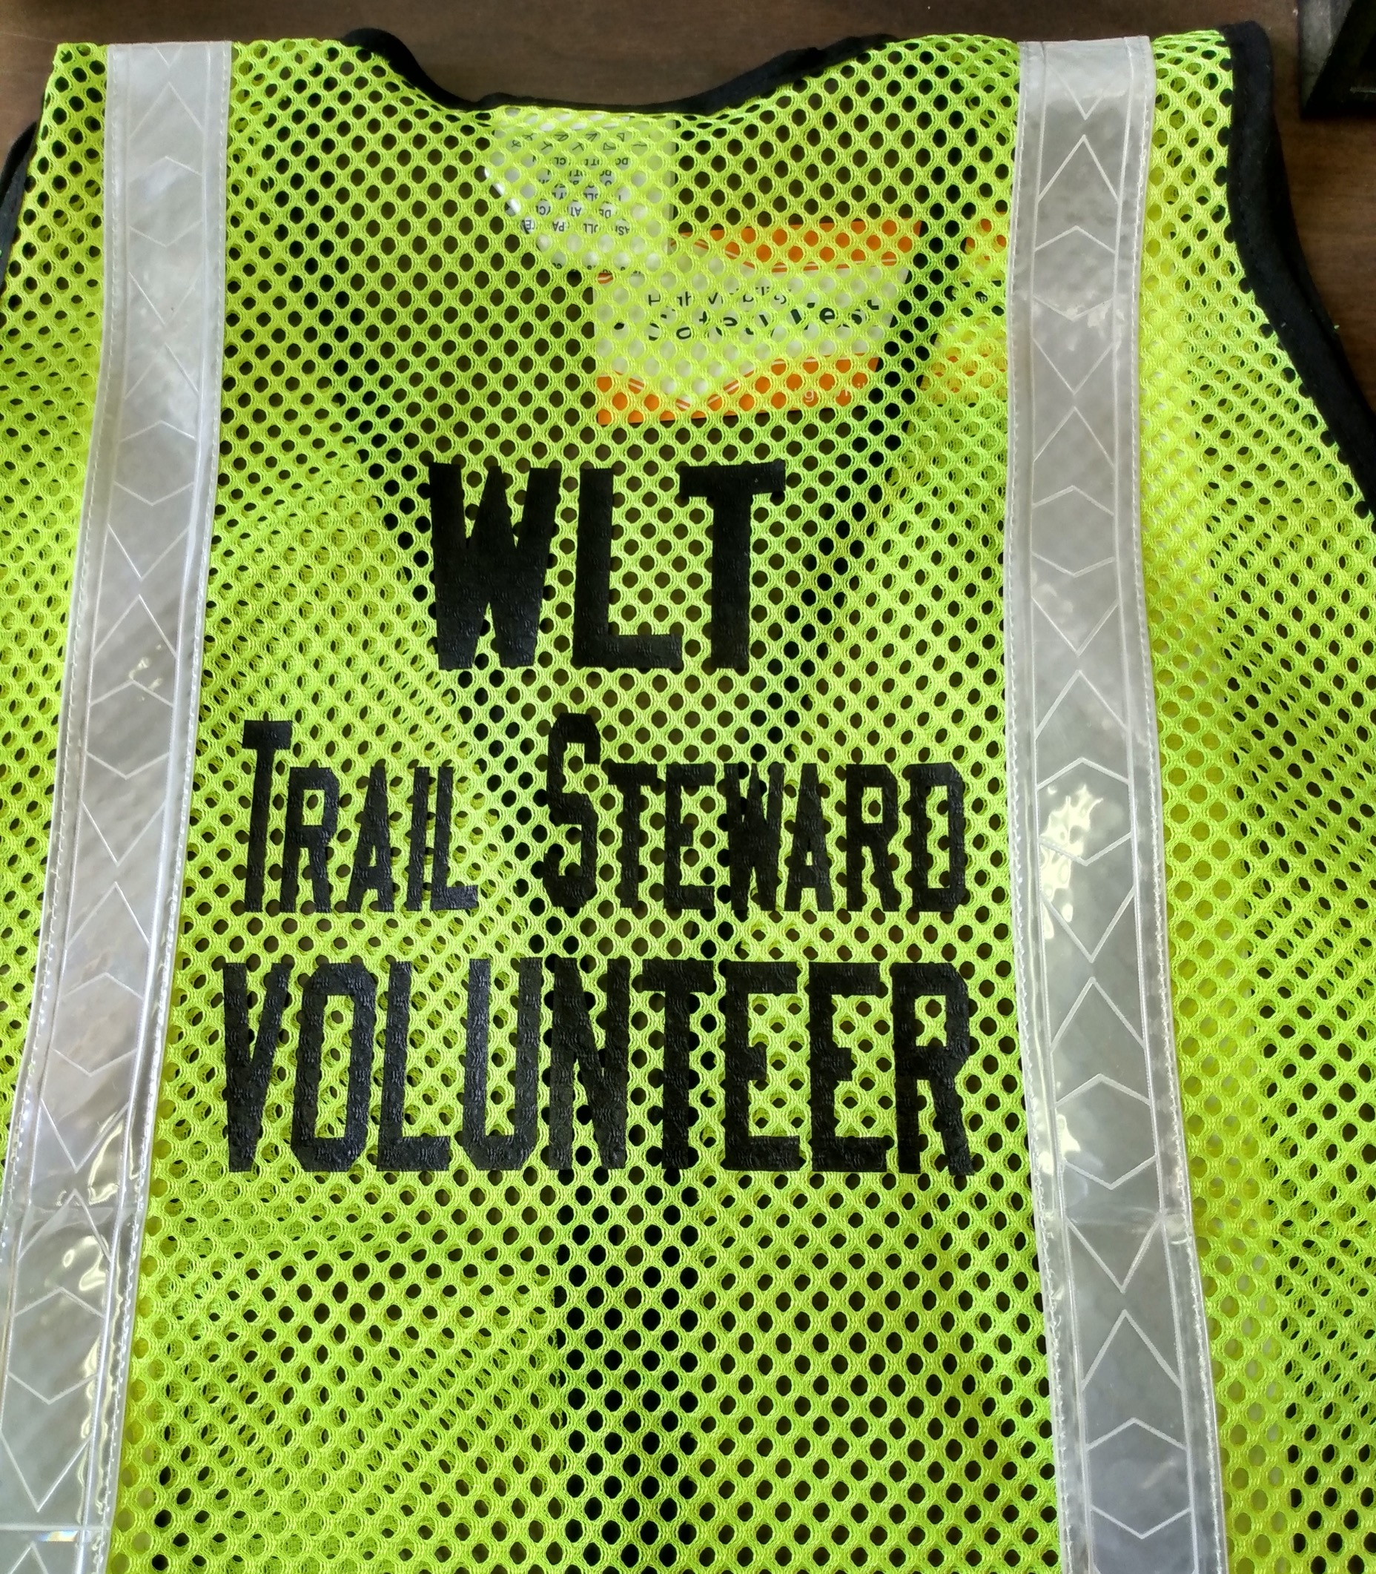
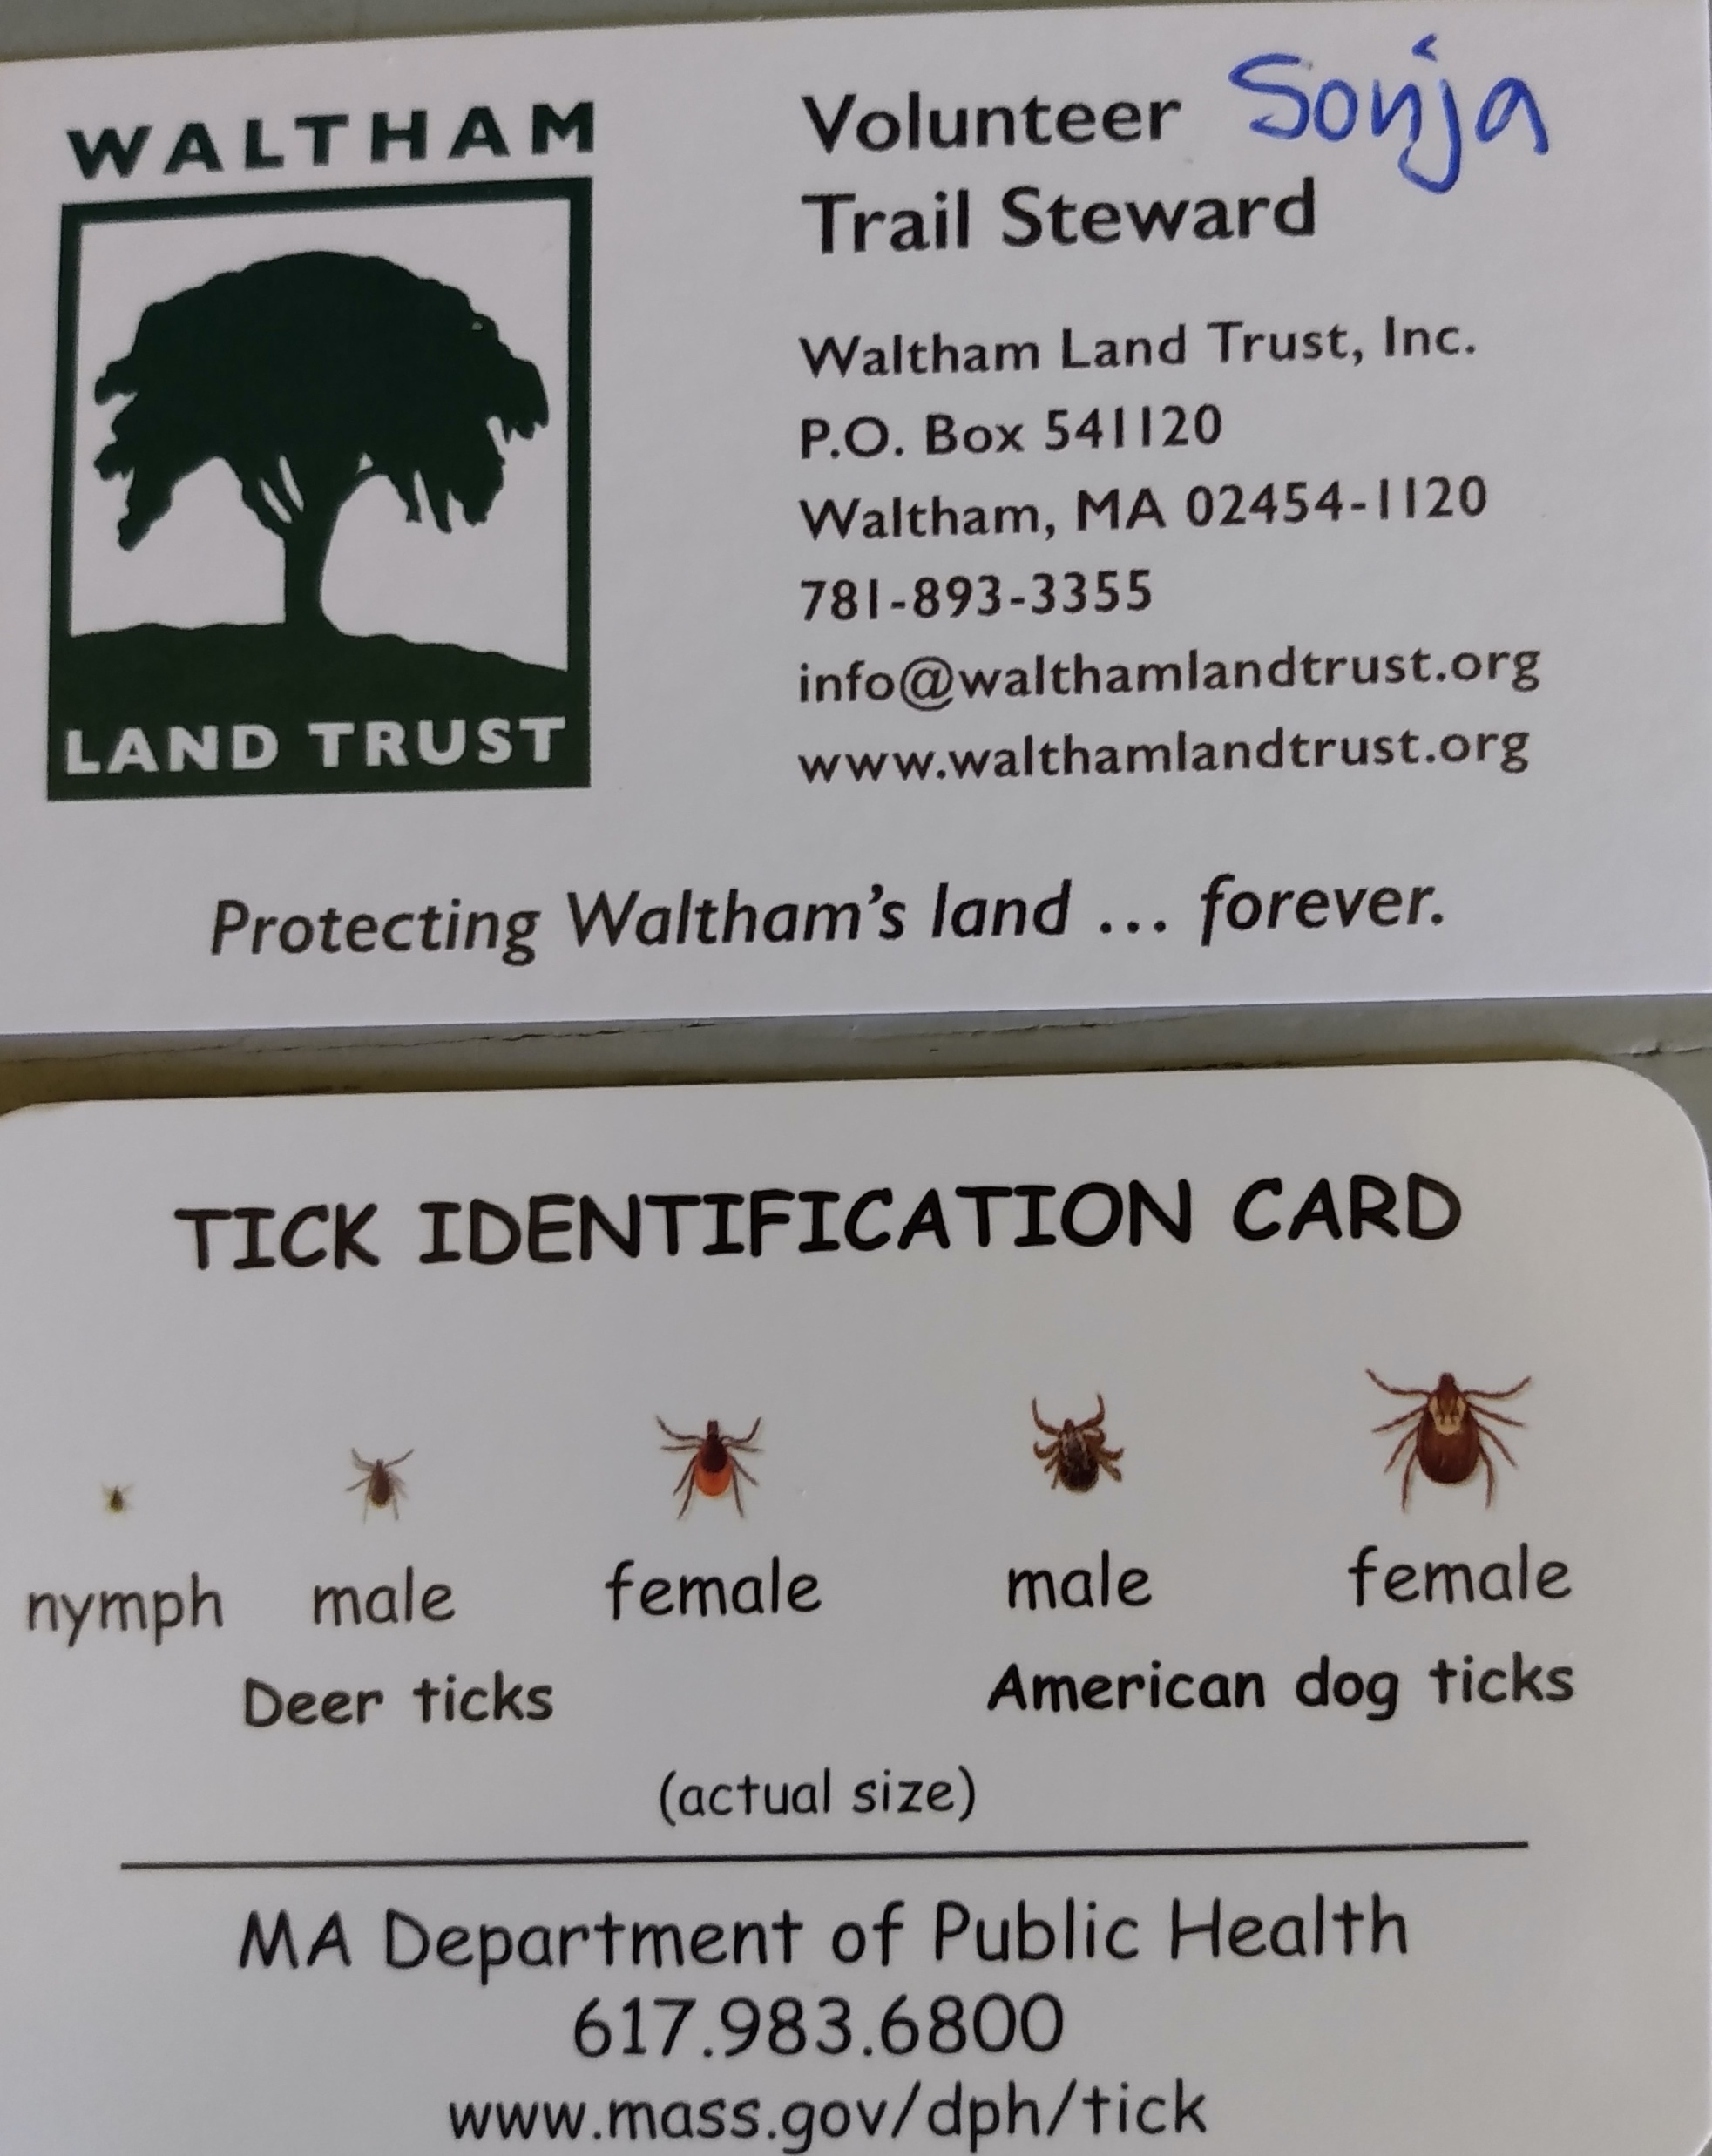
Stewardship Supplies

Slide 25
Supplies & Meetings
Trash bags, gloves, WLT Steward business cards, Band-Aids, poison ivy wipes, WLT safety vest
Hand tools: small loppers, a few Nifty grabbers
Monthly (optional) Stewards meeting
  Second Wednesday, 6:30 - 7:30 pm
  Virtually via Zoom
Email Sonja (swadman@walthamlandtrust.org) or call office (781-893-3355) to schedule appointment
THANK YOU FOR HELPING OUR TRAILS!

