Slide 1
Tax Planning Playbook 2025/2026

Slide 2

HELLO!
I am Billy Amberg
What is Bloomwood….
What is tax planning….

Slide 3
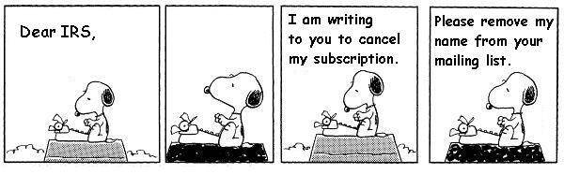
If this doesn’t work, you’ll have to settle for tax planning.

Slide 4
How to plan in a nutshell.
Get the client organized
Clean books required
Discuss goals that evolve over time
Everyone has the same first goal. Don’t outlive your money.
Craft a plan to reach those goals that evolves over time
Tax planning can help, but it is not the goal.
Easy

Slide 5
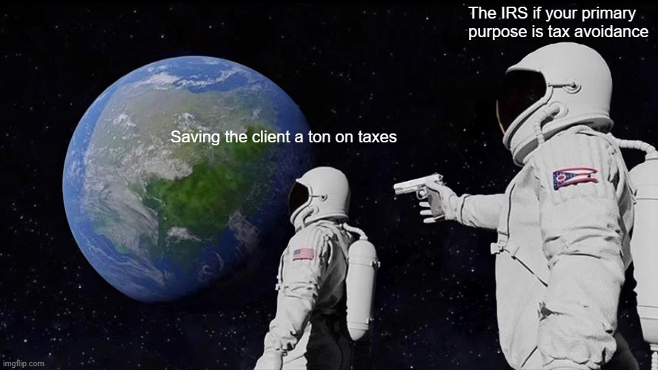
How to plan in a nutshell.
Easy

Slide 6
Broadly Applicable Concepts - Easy
Tax Bracket Management & Arbitrage
Direct giving does not burn unified credit (Estate Tax Exemption)
Don’t start the client with an irrevocable trust if possible
Clients will pay some tax. Sometimes it is best to just pay and not get fancy.
No acronyms or jargon with clients, please!
If the goal is to put the client to sleep, please proceed.
Easy

Slide 7
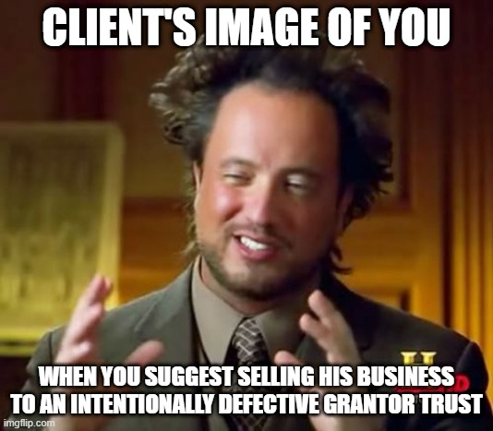
Broadly Applicable Concepts - Easy
Easy

Slide 8
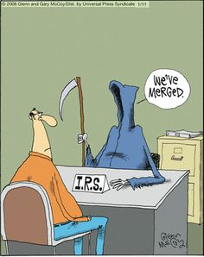
Death and…No Taxes?
Death is a powerful, but final, tool. Why sell?
Always keep the basis step up in mind!
Both death and taxes are certain. For most people, the
IRS cuts you a break when you die.
Easy
Gains

Slide 9
Basic Investment Account Tactics
Investment Portfolio Line of Credit
Harvesting Gains/Losses
Giving Appreciated Assets
Roth Conversions - Legacy/Standard
Beneficiary Election (charitable, eligible designated, low bracket)
Asset Location
Easy

Slide 10
Investment Portfolio Line of Credit
Competitive rates should be 3.5% - 5.2% interest only
More assets = lower rate
UHNW can typically negotiate even lower rate
It’s all about arbitrage and optionality
LoC proceeds are not taxable income
How do you think Bezos paid for his yacht?
Use OPM to pay tax
Easy

Slide 11

Investment Portfolio Line of Credit
Easy

Slide 12
Harvesting Gains/Losses
Take the opportunities in front of you
Direct Indexing vs. ETFs
Depends on goals
Ossification
What happens when everything has a gain? How do you rebalance on a tax neutral basis?
Easy
Gains

Slide 13
Giving Appreciated Assets
Never give cash if you have liquid, appreciated assets held in taxable accounts!
Charitable Swap
Give appreciated stock, use cash to buy back the position at higher basis
Use of Donor Advised Funds
Commit to giving and get deduction now, but decide where it goes later.
Beware the 80% rule and AGI limitations
Easy
Gains

Slide 14
Roth Conversions
Standard
When all you have is the difference between current and future tax brackets
Special Considerations
Carryforward losses
NOLs are your best friend
Legacy Roth Conversion
Massive compounding of wealth
Easy
Gains
Income
Owner

Slide 15
Beneficiary Elections
Take advantage of charitable intent
Name charitable orgs as benes on Traditional retirement accounts
Take advantage of basis step up at death for taxable benes (individuals etc)
Eligible Designated Beneficiaries
Check to see who among eligible benes can take advantage of stretching payments over lifetime vs. 10 yr. rule
Interactive Example - Designate the beneficiary
Client has $1MM in IRA, $1MM in taxable, $1MM of death benefit. Currently has three benes on each account ⅓ each (his church, his wife, and his son). What is wrong with this?
Easy
Income

Slide 16
Asset Location
Place tax inefficient assets in tax free or tax deferred accounts.
Taxable income producing assets
Place tax efficient assets in normal, taxable accounts.
Tax free income and buy/hold appreciation assets
Interactive Example - Where should we move the assets? How?
$1MM bonds, $1MM private credit in taxable account
$1MM growth stocks, $1MM munis in IRA
Easy
Gains
Income

Slide 17
Broadly Applicable Concepts
Life insurance is a wonderful tool and an extremely tax efficient vehicle
Tax free growth, cash value , death benefit proceeds
Flexible irrevocable trusts
Dictatorial control via power of appointment, etc.
Income shifting
Tax bracket arbitrage among family, etc.
Value of deferral (Installment Sales)
Basic time value of money
Moderate

Slide 18
529 Plans: More features than you think…
Super Funding
Contribute $95,000 (single) or $190,000 (married) in a single year per kid, grandkid.
Five-year accelerated gifting.
Convert to Roth IRA
Leftover balances can be converted into a Roth IRA for the beneficiary.
OR…
A Dynasty 529 Plan
State Tax Benefits
Combine with Super Funding to get big deductions on state tax.
Very useful in states like CA, NY.
Moderate
Gains
Income

Slide 19
Stock Based Compensation
Incentive Stock Options (ISOs)
No ordinary income tax on exercise
Qualified vs. disqualified sale
Beware AMT!
Non Qualified Stock Options (NQSOs)
FMV/strike spread on exercise taxed as ordinary income + payroll + SALT
At exercise…
ST/LT gains clock starts, FMV is your basis for future sale
What happens to options in an all stock acquisition?
Almost always better than cash acquisition
Highly dependent on the option agreement and deal terms
Typically assumed or converted to options of the acquirer
Moderate
Gains
Income
Owner
Exec

Slide 20
Section 351 Exchange
Gain deferral mechanism
Transfer appreciated property into co.
Must receive enough stock in co. in exchange to own at least 80%
Relatively straightforward with appreciated liquid assets
Specialized 351 ETF providers
Moderate
Gains
Exec

Slide 21
Corporate Election/Entity Type
C-Corp
OBBBA QSBS improvements a big factor
Double taxation can be beneficial
S-Corp
It’s mostly about how you pay yourself
Moderate
Gains
Income
Owner

Slide 22
Retirement Accounts
Charitable Gift Annuity for RMD
Use of immediate annuities inside IRAs for tax bracket management
Super stretch out retirement plan
Funding a DB plan
Self directed IRAs
Investment flexibility
SALT cap increase
Moderate

Slide 23
Cash Balance/Defined Benefit Plans
Defined Contribution vs. Defined Benefit
10-20% More expensive than 401(k), SEP, SIMPLE
Higher employer contribution requirements.
Can be combined with a 401(k)
$24,500 + $8,000 vs. $200,000+ contribution limit
Solo/split versions available
Moderate
Income
Owner

Slide 24
Qualified Small Business Stock
Tax free sale of company stock acquired from a qualifying business. Greater of:
$15MM per taxpayer, can get more taxpayers with spouse/trust stacking
10x aggregate adjusted basis
C-Corp stock only
If you convert to a C-Corp, tax free sale of stock only applies to gain post-conversion
Hold 3, 4, 5 years, get 50%, 75%, 100% gain exclusion
Attestation letter can be useful
Moderate
Gains
Owner

Slide 25
Qualified Opportunity Zone Funds
New Rules (Invest on or after 1/1/2027)
QOZFs
Defer gain recognition until five year anniversary of investment date
10% step up if held 5 years
Gain on fund investment excluded if held 10 years
Qualified Rural Opportunity Funds (QROFs)
30% step up if held 5 years
100% tax free growth if held 10-30 years
Moderate
Gains
Owner

Slide 26
Paying Your Kids
Excellent wealth and discipline builder
Roth IRA, use PRE-TAX dollars for spending money
Standard deduction
Don’t get cute…..pay the kids a realistic W-2 wage
Moderate
Income
Owner

Slide 27
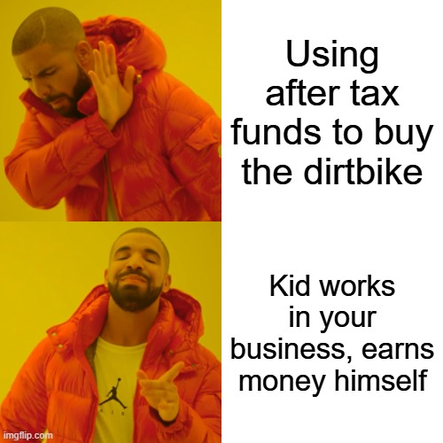
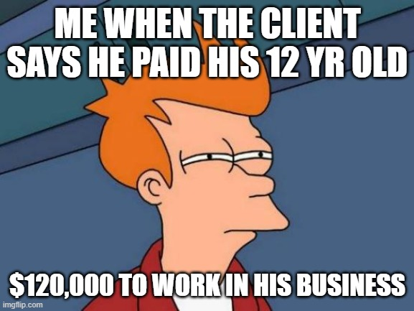
Paying Your Kids
Moderate
Income
Owner

Slide 28
Oil & Gas
Drill baby drill (for intangible drilling costs and ordinary income offsets)
Up to 80% deductions in year one
10-15% of investment amount in deductions in next years
Income received highly tax efficient due to depletion
Great as part of a balanced portfolio
Beware if 40% of deductions exceed AMT income
Plenty of conservative, already producing fields to invest in
Moderate
Income

Slide 29
Insurance Strategies
Estate equalization
Preventing WWIII
Estate tax payment
Estate/trust audit insurance
Income replacement
Survivors joint universal life
Bypasses GSST
Moderate
Estate

Slide 30
Gifting Retirement Account Contributions
Annual gift exclusion
$19,000 per individual
$38,000 for couple
Gift appreciated stock - tax bracket arbitrage
Massive long term wealth builder
Built in guardrails
Moderate
Gains
Income
Estate

Slide 31
ESOPs
Become a tax favored organization
Employees must receive a piece of the co.
Great exit option
No 3rd party buyer
Can be sold again
Levered vs. unlevered
Start considering if co. is $10MM+ revenue, $1MM+ profit
ESOP co. performs better than non-ESOP co. peers
Moderate
Gains
Income
Owner

Slide 32
Quantitative Hedge Funds
Account “layers”
Long only = 2 layers (positive return and loss harvesting)
Long/short = 4 layers
2x, 3x leverage = 8, 12 layers
Result?
Approx. 80% of invested amount comes back as losses
7-10% absolute return even with the losses
Low correlation to public markets
Invest early in a calendar year or invest more later
Moderate
Gains
Income
Owner
Exec
UHNW

Slide 33
Augusta Rule
Primary Residence Rental for Tax Free Income
14 days or less
Can rent to a third party….or…..
Can rent to your business…..under the right circumstances
Don’t get cute….
Comps
Pictures
Meeting minutes
Pay for ACTUAL use
Moderate
Income
Owner
UHNW

Slide 34
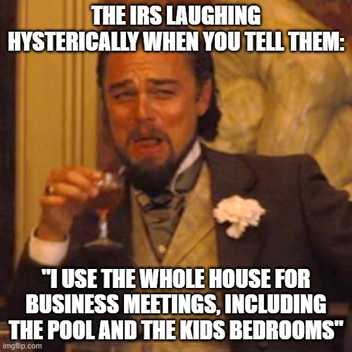
Augusta Rule
Moderate
Income
Owner
UHNW

Slide 35
Tax Credit Arbitrage
Offset $1 of tax payment w/ $0.85-0.90
State tax for people
State and federal tax for C-Corps
Watch out! Tax typically owed on application of credit to offset tax bill…so not quite as straightforward as $1 minus $0.85-0.95
Moderate
Income

Slide 36

1031s, DSTs, 721s, and Variations
1031 Exchange
Same scenario, but differs after
Close on sale. Two clocks start.
45 days - ID a property.
180 days - Buy the property.
$0 tax paid.
You ARE NOT done with the IRS.
Potential “have your cake and eat it too” with financing.
Estate planning benefit.
DST
A different kind of 1031 Exchange, but……
More flexible and liquid.
Way less hassle than a traditional 1031 Exchange.
Invest in a diversified fund rather than a single property.
Variations
721 “Upreit”
DST - Zero Coupon/Income
DST - Immediate 70-80% cash out/refi
DST - Separately Managed Account ($10MM minimum)
DST - TIC 30-50% cash out/refi
Moderate
Gains

Slide 37
Broadly Applicable Concepts
“Flipping” a trust
More flexibility in execution, easier pill for client to swallow
7520 rate, annuity vs. unitrust
Big factor in attractiveness of many strategies
Trust state location
SD, DE, WY, NV
Incomplete gifts
Zeroing out
Expert

Slide 38
Selling to Intentionally Defective Grantor Trusts
Typically for larger estates that have used up some gift exemption already
Installment sale with promissory note replaces appreciating asset
“Freeze” the value
Appreciation over applicable rate goes to benes outside your estate
Zero capital gains
Careful planning required
Seed gift, debt terms, basis step up at death, GST planning
Expert
Gains
Income
Estate
Owner
UHNW

Slide 39
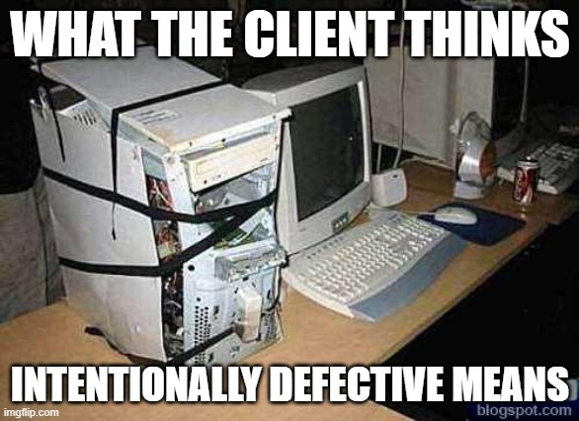
Selling to Intentionally Defective Grantor Trusts
Expert
Gains
Income
Estate
Owner
UHNW

Slide 40
Grantor Retained Annuity Trusts (Rolling, ZO)
Wealth transfer mechanism
Heads you win, tails you tie
Appreciation over applicable rate goes to benes outside your estate
Zeroed Out GRAT (ZOGRAT)
Wealth transfer with no use of exemption
Rolling GRATs
If grantor dies during the term, assets included in estate
Continuous funding of new GRATs (Always Be Funding meme)
Expert
Estate
Owner
Exec
UHNW

Slide 41
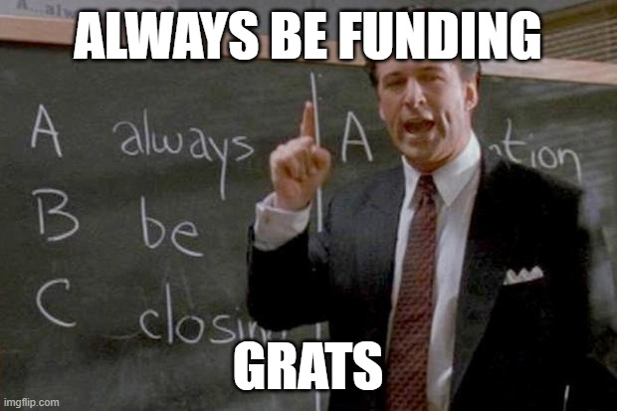
Grantor Retained Annuity Trusts (Rolling, ZO)
Expert
Estate
Owner
Exec
UHNW

Slide 42
Charitable Lead Trusts
Wealth transfer mechanism
Charitable income bene, non-charitable remainder benes
Account growth over charitable obligations goes to remaindermen estate tax free
NOT a tax favored vehicle like CRT
Almost never a good idea to set up a CLUT.
Beware Unrelated Business Taxable Income (UBTI)
Expert
Income
Estate
Owner
Exec
UHNW

Slide 43
Charitable Remainder Trusts + NI, NIM
Capital gains reduction tool, great for estate planning too!
Non-charitable income benes, charitable remainder benes
Inherently tax favored vehicle
Typically better lifetime cash flow outcome than just paying the tax
Tiered income system
Flexibility and potentially more attractive with smart use of NI, NIM, and Flip provisions
Beware Unrelated Business Taxable Income (UBTI)
EXTREMELY punitive in a CRT
Expert
Gains
Income
Estate
Owner
Exec
UHNW

Slide 44
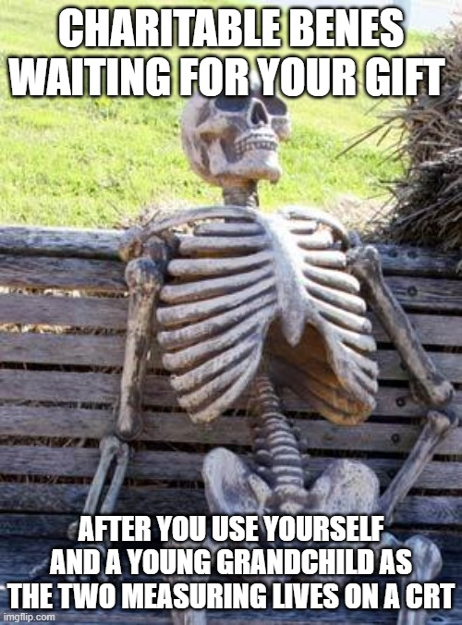
Charitable Remainder Trusts + NI, NIM
Expert
Gains
Income
Estate
Owner
Exec
UHNW

Slide 45
Charitable Remainder Trust Home Split Sale
First $500,000 of gain on primary residence uses spousal deduction
Drop the rest into a CRT
Can be useful if home sale proceeds not needed for next home purchase
Expert
Gains
Income
Estate

Slide 46
Private and Public Exits
Can come down to the wire, requires frequent check ins, re-underwriting
Hard to get great outcome without knowing easy to expert level tax planning cold
When a deal is going on, you typically have to work deal hours
Expert
Gains
Income
Owner
Exec

Slide 47
Re-Domiciling: Big benefit, big moves required
State (CA, NY, FL, TX, TN) vs. Country (Cayman Islands, etc.)
ACTUALLY move your life to the new place
6 Months & 1 day with a condo doesn’t cut it.
Low tax jurisdictions
Cayman Islands, Bahamas, Monaco, Saint Kitts and Nevis, UAE
Expert
Gains
Income
Estate
Owner
Exec
UHNW

Slide 48
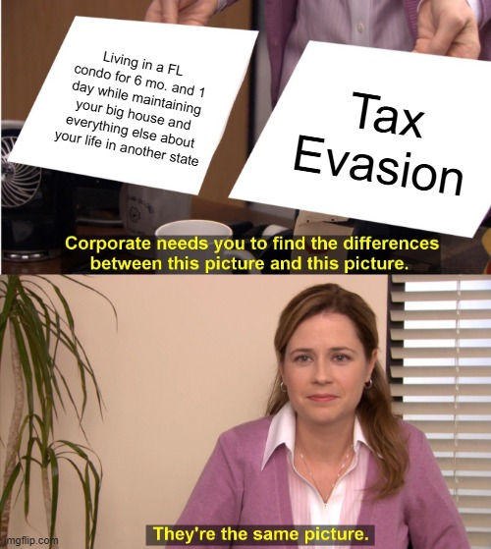
Re-Domiciling: Big benefit, big moves required
Expert
Gains
Income
Estate
Owner
Exec
UHNW

Slide 49
Insurance - CRTs and PPLI
Use life insurance to replace the C interest in a CRT
Private Placement Life Insurance
Typically the only way to get $10MM+ death benefit
Wider investment selection
Potential to mitigate capital gains tax on closely held or publicly traded assets
Almost always use an ILIT
Expert
Gains
Estate
UHNW

Slide 50
Installment Sale - 2 Yr. Basis Boost
Sell to a complex trust for the benefit of your children for a promissory note
Wait two years
Trust sells at stepped up basis
Original seller gets benefit of deferral
Could do second disposition immediately in the 80s, partially blocked by IRC 453(e)
IRC 453(e) only applies if the date of the second disposition is sooner than two years from the date of the first disposition.
Expert
Gains
Income
Owner

Slide 51
Family Limited Partnerships
Income shifting
Have lower tax bracket family members own portions of the company
Freeze/Squeeze
Can be used to reduce the value of an asset and/or freeze the value
Careful planning required
Expert
Income
Estate
Owner
UHNW

Slide 52
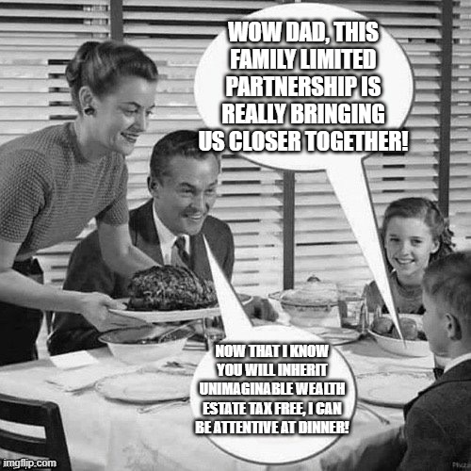
Family Limited Partnerships
Expert
Income
Estate
Owner
UHNW

Slide 53
Dynasty Trusts
If something never dies, it never pays estate tax
Avoid passing down a taxable estate from generation to generation
Trust tax rates are steep!
Make sure distributions are going to benes for them to pay the tax
Trust state location matters
Expert
Estate
UHNW

Slide 54
Goodwill - It’s not just for old clothes.
Articl
C-Corp asset sales happen, unfortunately
Avoid double taxation on a part of the sale
Appraise goodwill
Hold it in LLC subsidiary
Martin Ice Cream case
Expert
Gains
Owner

Slide 55
One Day ESOP
Become an ESOP-owned company, then immediately sell
Trade off capital gains rate for 10% holding period excise tax (3 yrs)
Beware economic substance, step transaction, etc.
Exotic
Gains
Income
Owner

Slide 56
Structured Warrants
Can eliminate, not just defer capital gains tax.
Costs about $1MM to execute
Explanation is beyond the scope or time limit of this presentation.
Talk to me after if you want to know more.
Exotic
Gains
Owner

Slide 57
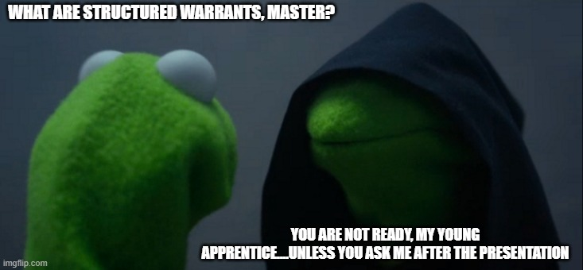
Structured Warrants
Exotic
Gains
Owner

Slide 58
New Types of Syndicated Investing Schemes
OBBBA brings lots of attractive benefits…..of course there will be abuse
Keep the spirit of the law in mind
Tax benefits aside….still has to be a good investment
Exotic

Slide 59
If this has been thought provoking or valuable to you, don’t keep us a secret!

Slide 60

THANKS!
Any questions?
404.854.4067
billy@bloomwoodcapital.com
Youtube | Apple | Spotify | Web & Blog

Slide 61
Other Important Concepts
Switzerland, Malta, Singapore, UAE, Freeports, and tax favored jurisdictions
Installment sale variations (FLP interest sale to heirs, then 754 election; 3rd party/monetized S. Crowe; Unrelated 3rd party)
Doctrines (Assignment of income; Economic substance; Step transaction)
Insurance (Captives; Viatical; Perpetual Family Foundation; Family Bank Trust)
Retirement Accounts (CRT as beneficiary; One 60 day rollover per year; Guaranteed family retirement plan)
Trusts (Creditor protection/Spendthrift; Portability; SCINs; Decanting; BDITs; Inter Vivos CLAT; DAPTs; SALT trust stacking; SLATs; NING/DING/WING
Other (Trump accounts; Short against the box; Married sep. vs. joint for NIIT; Empowerment zones; Donating inheritance rights; Cost segregation; C to S election before exit; 338(h)(10); 1045 gain rollover; Form 7203

Slide 62
Grouping Business Activities
Passive vs. Active
Turning passive to active by grouping
Income
Owner

Slide 63
Tax Credit Awareness
Surprisingly few CPAs, even ones at big firms, review client eligibility for tax credits….don’t be surprised if you are missing something.
Common Credits: R&D, Wage Credit for Active Service, Work Opportunity, Retirement Plan Startup, Employer Provided Childcare, Low Income Housing, FMLA, New Markets, Energy Investment, Rehabilitation, Subnormal Inventory, Qualifying Student Loan Debt, Dependent Care Expense
Income
Owner

Slide 64
Peter Thiel (Paypal) Roth IRA
Best for new ventures with high conviction of success.
Self-directed Roth IRA.
No self-dealing.
Gains
Income
Estate

Slide 65
Non Qual Tax Deferred Annuities
Earnings and appreciation tax deferred
Consider if maxed out retirement account possibilities
If ok with not being able to touch funds, should be better than a standard taxable brokerage account (after tax goes in, investment returns taxed vs. after tax goes in, investment returns tax deferred)
With careful planning, can own inside a trust to have appreciation and any death benefit (if hybrid annuity) accrue outside the estate.
Gains
Income

Slide 66
Trust as IRA Beneficiary
Normal Will and Trust vs. Adding a Trust specifically for IRA
Income shifting benefits
Tax benefits
Control benefits
Income

Slide 67
Section 125 Champ Plan
Provide employees with more categories of expenses to be funded with PRE-TAX dollars.
Health insurance premiums
Dental and vision coverage
Accident and disability coverage
Adoption assistance
Dependent care assistance
Term life coverage
Other categories depending on industry

Slide 68
QSST Trust as S Corp Shareholder
Shift income from high tax bracket individual to low tax bracket individual beneficiary of Qualified Subchapter S Trust.
Avoids payroll tax.
A variation on paying your kids for work. This doesn’t require the payee to work.
Beware the Kiddie Tax.
Income
Owner

Slide 69
Crummey Provision
Give an amount under the annual exclusion each year.
Amount applies to EACH beneficiary.
Can add up substantially for gifting privately held assets with savvy reduction of value due to marketability, etc.
Commonly used with ILITs to pay premiums with using up any gift exclusion
Estate

Slide 70
Tax Bracket Management & Arbitrage
Strategic
Can we predict the future bracket?
Take action today to capitalize!
Tactical
What can we do given the tax bracket our client is in today?
Most of what follows is considered “tax bracket management & arbitrage”
Easy

Slide 71
Intra-Family Loans
Arbitrage
Preferential terms relative to bank
Not a gift
More control vs. outright gift
Moderate
Estate

