Slide 1
Model Name：MIC-D1305
13.3” Dual-Display Portable Side-Mount Kit
Revision History
Date | Revision | Page | Content | By
2026/7/30 | 0.1 | All | First Draft | Eisley Yao
2026/7/31 | 0.2 | 3, 8 | Additional Optional Interfaces | Eisley Yao
2026/8/6 | 0.3 | All | Updated Specification | Eisley Yao
2026/8/18 | 0.4 | All | Updated Brightness and I/O | Eisley Yao
Rev. 0.4

Slide 2
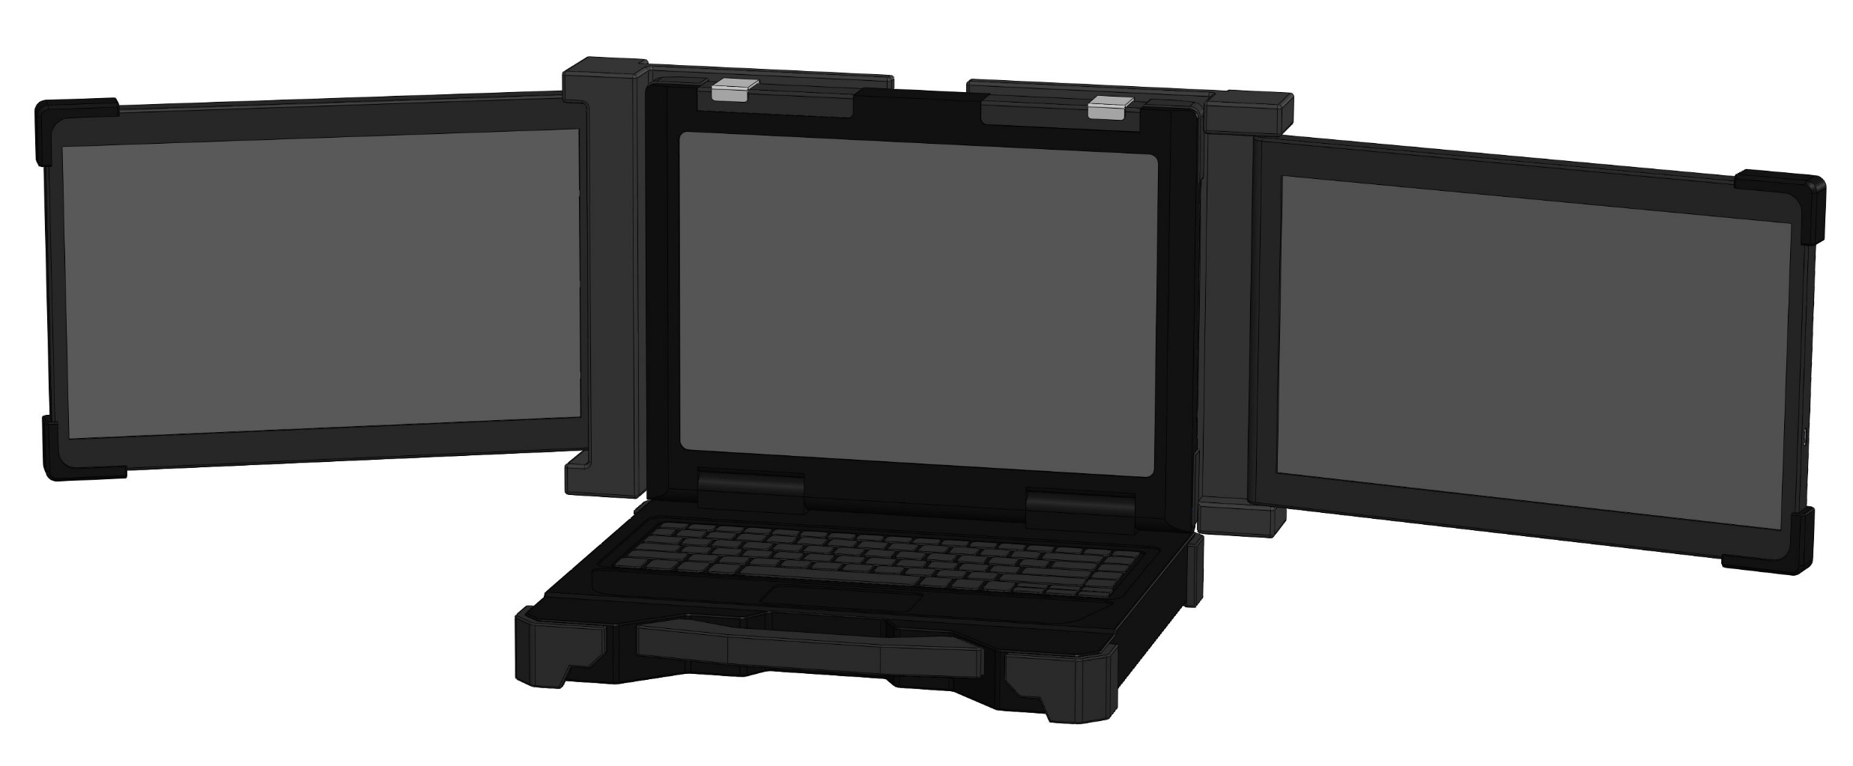
MIC-D1305
13.3” Dual-Display Portable Side-Mount Kit
Features
Dual 13.3” Full HD Rugged Displays
300 nits High Brightness for Sunlight Readable
Side-mount Configuration and Simple Installation
Flexible Rotation Screen
Stretchable Back Panel
IP65 Front Panel
EMI Mesh, Optical Bonding
Design to meet MIL-STD-810
9-36V DC Input
Appearance
*Image for reference only. Final product may vary slightly from the image shown.
Rev. 0.4

Slide 3
MIC-D1305
13.3” Dual-Display Portable Side-Mount Kit
Specification
LCD Panel
LCD Size | 2x 13.3” inch
Backlight | LED
Resolution | 1920 x 1080 Full HD
Pixel Pitch | 0.153 (H) mm x 0.153 (V) mm
View Angle | 178°/178° (H/V)
Brightness | 300 nits (after bonding)
Contrast Ratio | 1000:1
Aspect Ratio | 16:9
LED Life time | 50,000 hrs
Optical Bonding | Full optical bonding with OCR
EMI Mesh | Integrated EMI shielding mesh
Cover Glass | 6H hardness cover glass
Others
Interface | 1x USB-C 3.2 supports video input and power delivery 1x HDMI 2.0 Input 1x DC IN
Rotation | 210° for Dual Display
Power | 9-36VDC, <25W (Both Displays)
Dimension (Fold) | Approx. 354 x 236.07 x 54 mm
Dimension (Open) | Approx. 950.08 x 236.07 x 54 mm
Weight (Dual Display Kit) | Approx. 3.5 kg
Mounting | Vehicle/ Desk Mount
Rev. 0.4

Slide 4
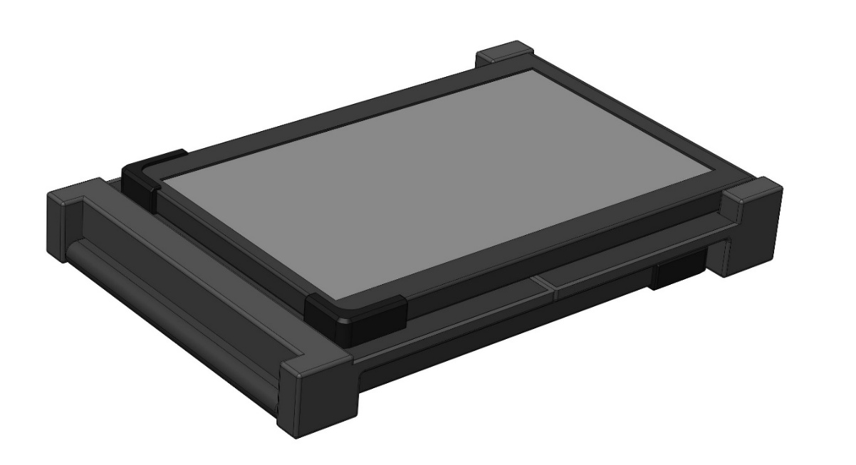
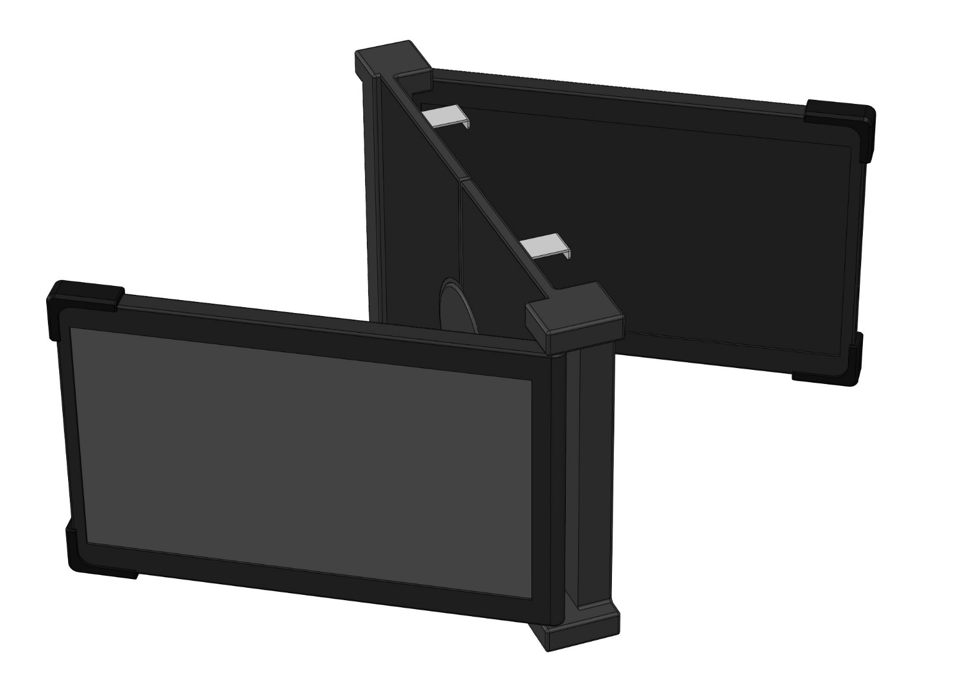
MIC-D1305
13.3” Dual-Display Portable Side-Mount Kit
Installation and Storage
Protective Storage Design
Raised rugged edges on all four sides help protect the display panels from impact and collision during storage and transportation.
Dual-Screen Expansion with 210° Rotation
Dual side screens can be fully expanded, with each side supporting up to 210° rotation for flexible viewing angles.
Rev. 0.4

Slide 5
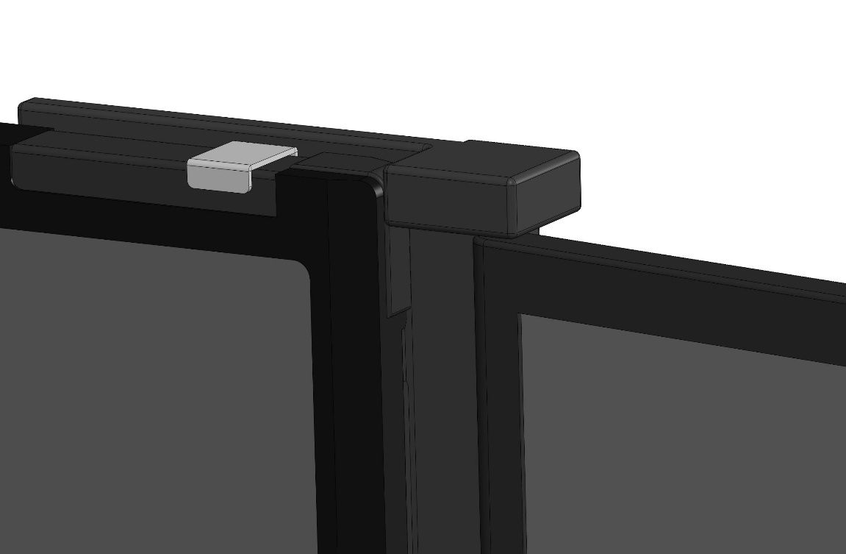
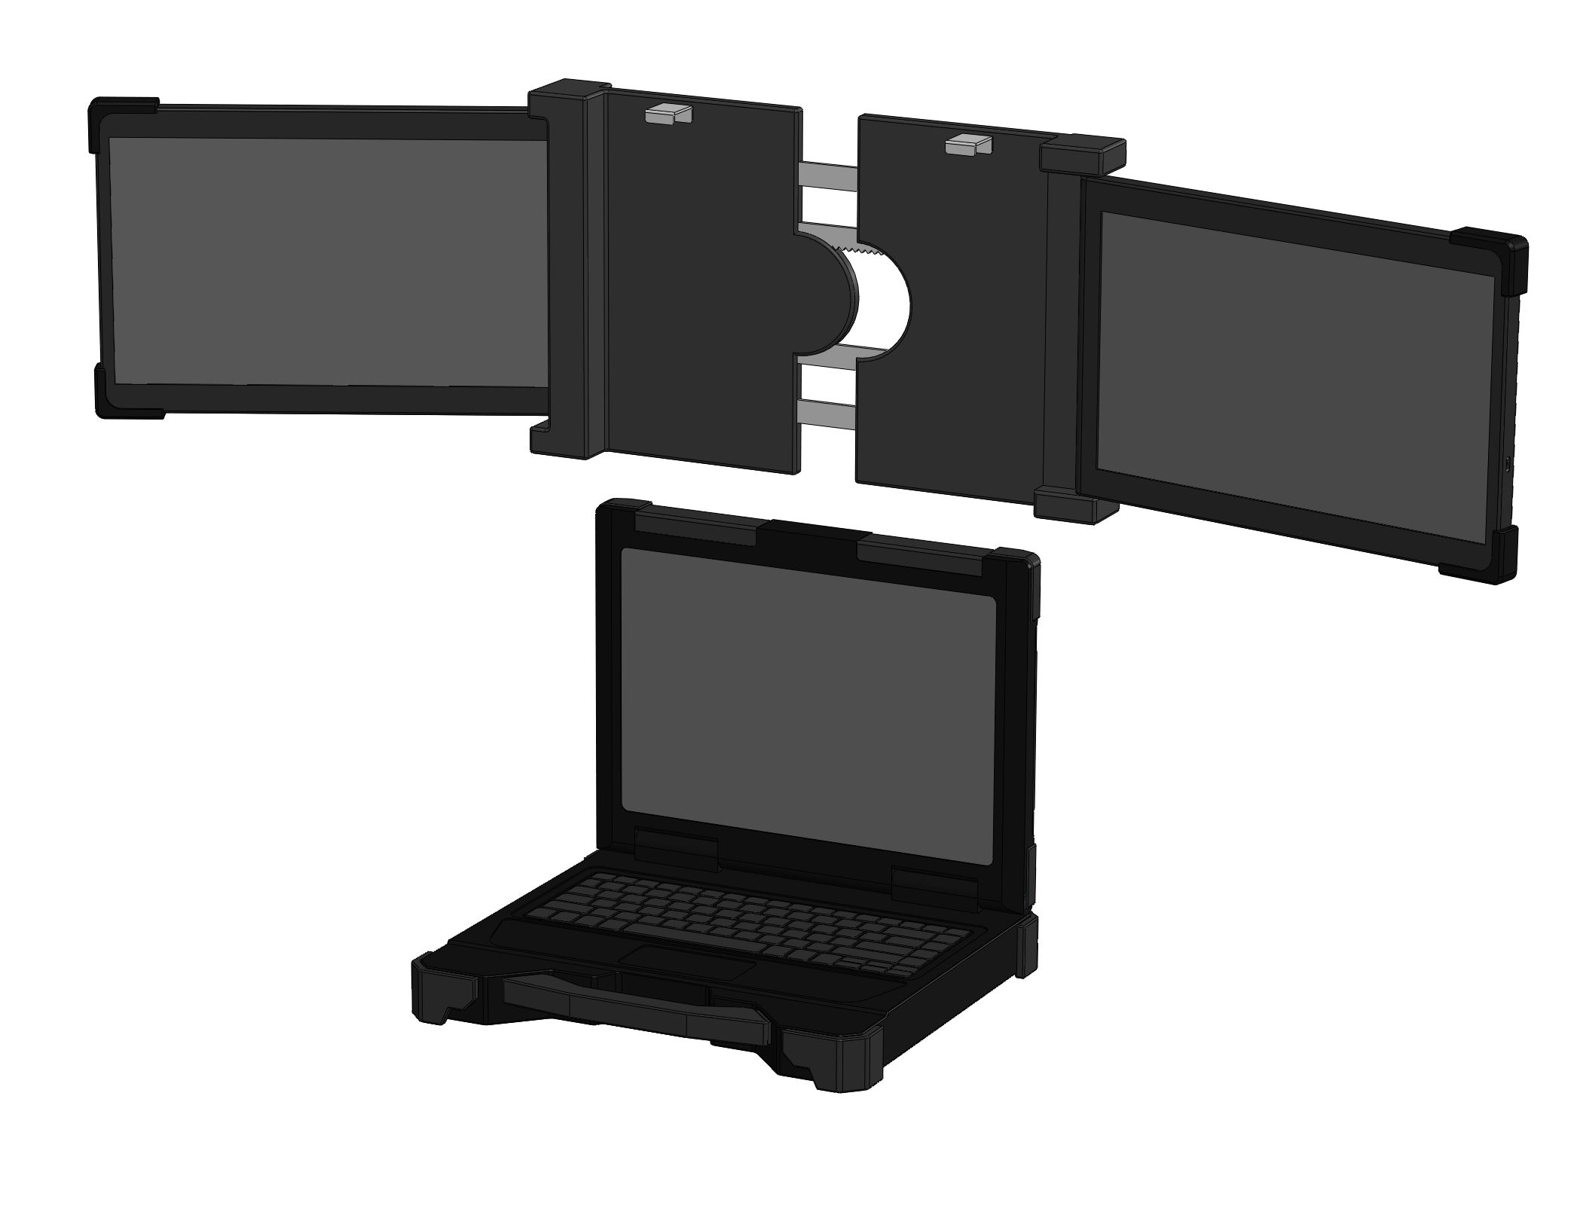
MIC-D1305
13.3” Dual-Display Portable Side-Mount Kit
Installation and Storage
Secure Clip Design
Reinforced snap-fit clips ensure the external screens are firmly attached to the laptop, preventing movement or slipping during use.
Stretchable Back Panel
The stretchable back panel allows smooth extension and retraction for easy storage, while ensuring a secure and stable fit with the laptop screen.
Rev. 0.4

Slide 6
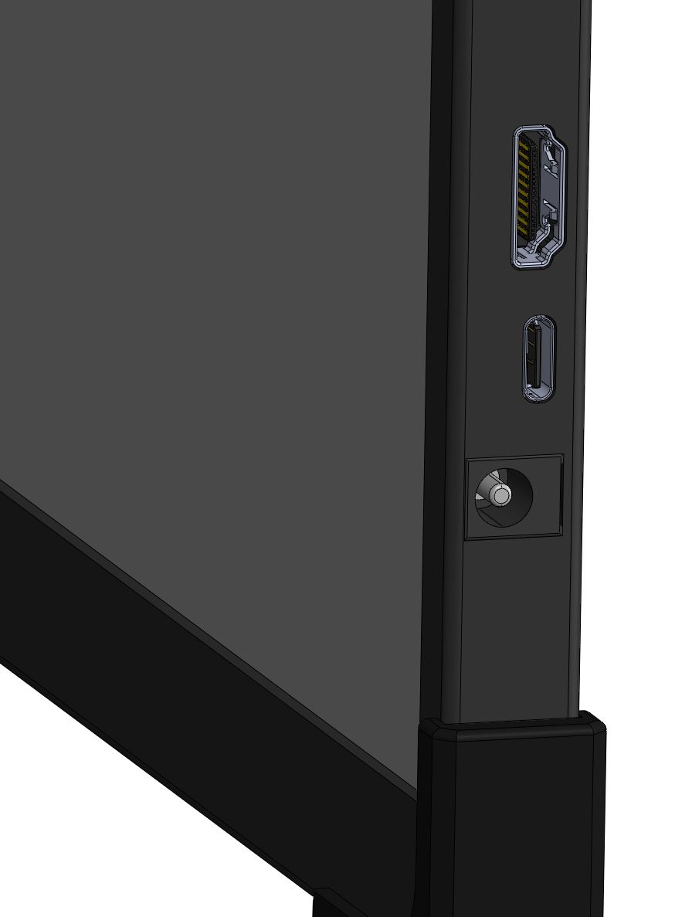
MIC-D1305
13.3” Dual-Display Portable Side-Mount Kit
I/O Interface
HDMI 2.0
Supports HDMI video input
USB-C 3.2
Supports video input and power delivery
DC IN
DC power input
Rev. 0.4

Slide 7
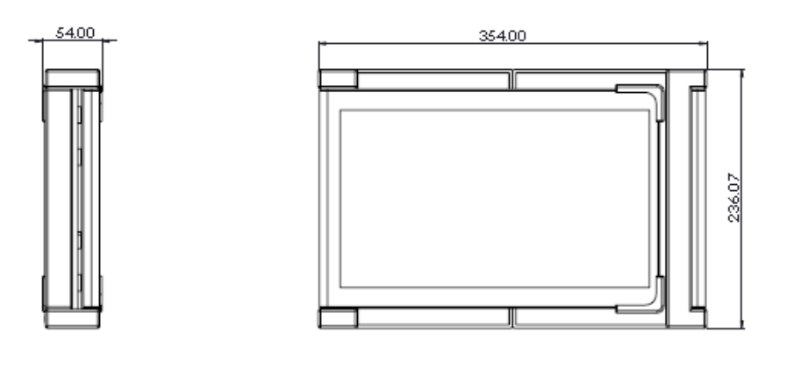
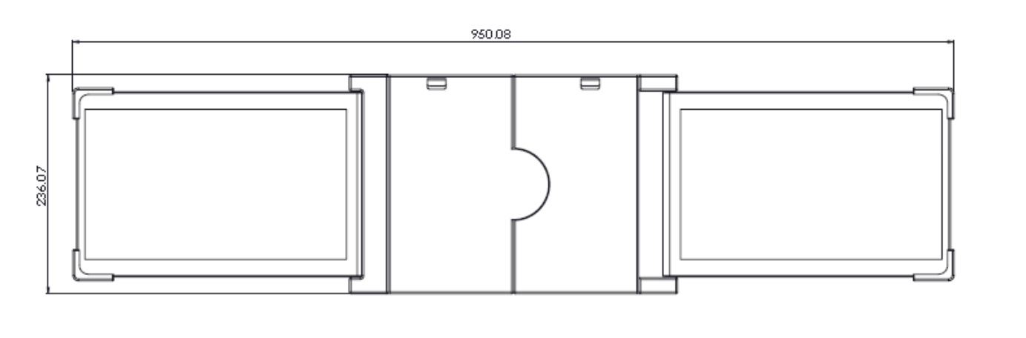
MIC-D1305
13.3” Dual-Display Portable Side-Mount Kit
Dimension
Rev. 0.4

Slide 8
MIC-D1305
13.3” Dual-Display Portable Side-Mount Kit
Environment Compliance
Operating Temp. | -20°C to 60°C
Storage Temp. | -30°C to 70°C
Humidity | Ta≦40°C, 90%RH, non-condensing
IP Rating | IP65 Front Panel
Shock & Vibration | Design to meet MIL-STD-810
Environmental performance may vary according to the integration method or final integration scenario.
Rev. 0.4

Slide 9
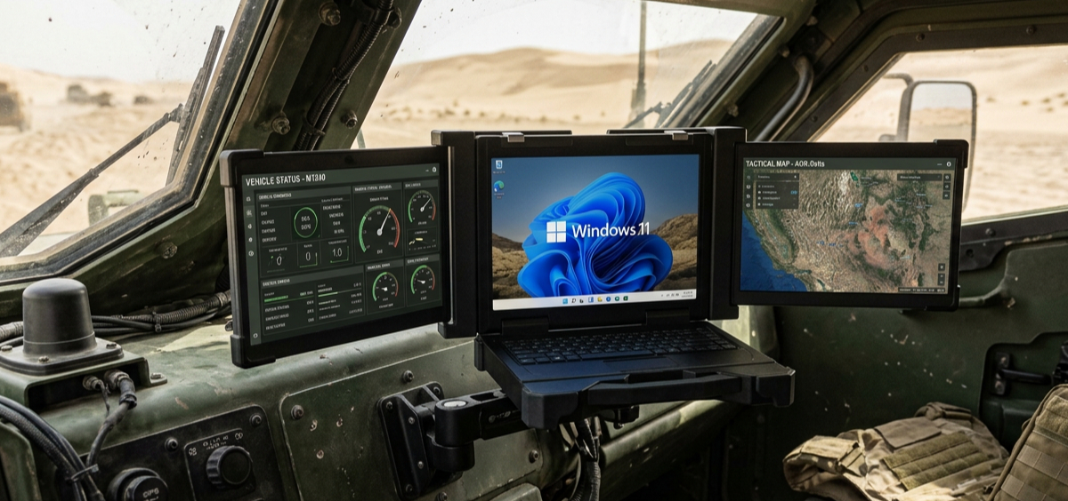
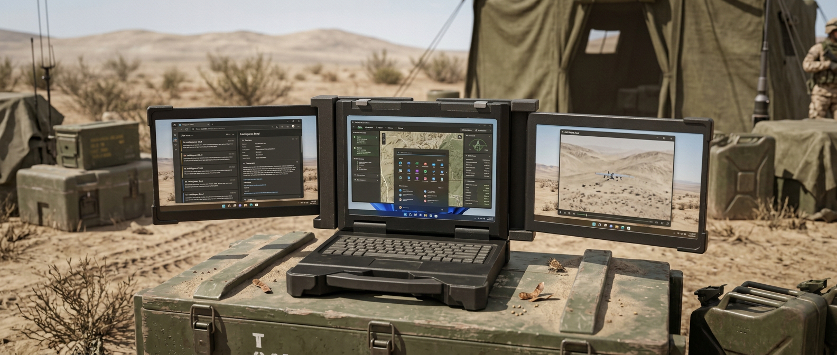
MIC-D1305
13.3” Dual-Display Portable Side-Mount Kit
Multi-Scenario Applications
Vehicle Command Center
Portable Command Center
Rev. 0.4

Slide 10
MIC-D1305
13.3” Dual-Display Portable Side-Mount Kit
Deliverables
1 | 13.3” Dual-Display Portable Side-Mount Kit
2 | Accessories: 1x USB-C Cable, 1M + 1x HDMI Cable, 1M + 1x Power Cable, 1M
Ordering Information
Model Name | Description | Unit
MIC-D1305 | 13.3” Dual-Display Portable Side-Mount Kit | 1
Disclaimer
This datasheet is for informational purposes only and does not constitute professional advice, a contractual obligation, or a guarantee of any kind. While efforts have been made to ensure accuracy, ACT POWER TAIWAN makes no representations or warranties, express or implied, regarding its completeness or reliability. ACT POWER TAIWAN reserves the right to update, modify, or withdraw this document at any time without prior notice. Users should verify the suitability of the product for their specific application through independent testing and validation.
ACT POWER TAIWAN shall not be liable for any direct, indirect, or consequential damages arising from the use of this document. This document is governed by the laws of Taiwan, and any disputes shall be subject to the exclusive jurisdiction of the Taiwan courts.
Rev. 0.4

